Slide 1





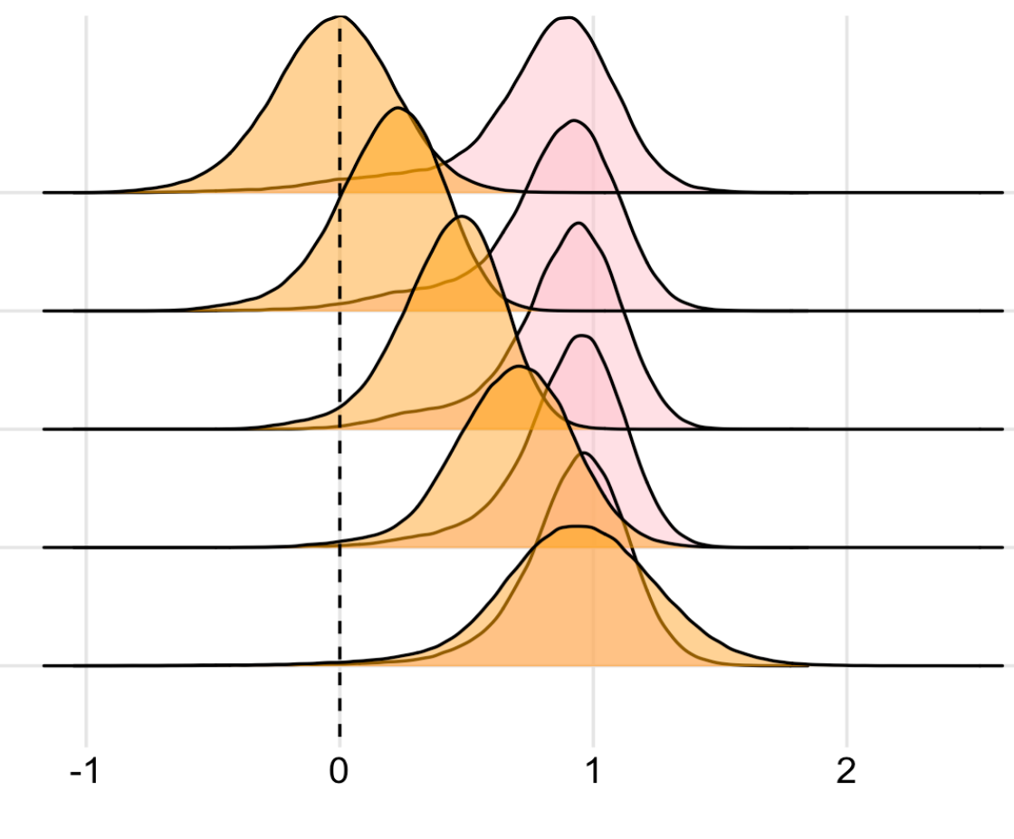

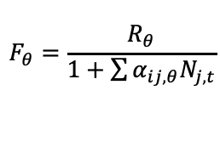

A
B
Goal 1: Promote persistence of native
α_{ii}
α_{ij}
Goal 2: Hinder persistence of exotic
x
x
s
g
F
Soil Phosphorus
C
1. Population model
2. Invasion model
$$F_{θ}=\frac{R_{θ}}{1+\sum{α_{ij,θ}N_{j,t}}}$$
$$N_{t+1}=gF_{θ}N_{t}+s(1−g)N_{t}$$
D
coexistence
3. $LDGR$=$ln\left(\frac{N_{t+1}}{N_{t}}\right)$
Competitor’s present
Abiotic factor
Competitor’s absent
Low density growth rate

