Slide 1
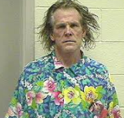
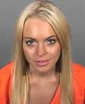



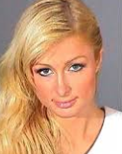



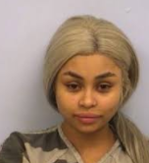
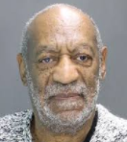

CELEBRITY GOSSIP By: Lauren Shareshian

Slide 2
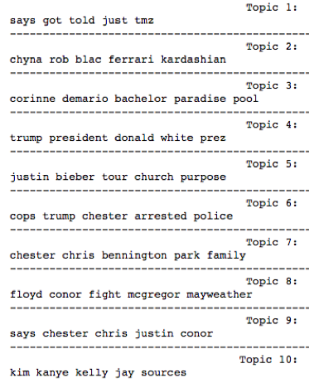
Objective 1:
Find the hottest summer gossip topics from 1500 TMZ articles

Slide 3
Objective 2: Recommendations If you like this article…
“Usher isn't letting his herpes scandal get in the way of his music career ... because we've learned he's in the studio right now with Jermaine Dupri. Usher is in an L.A. studio recording for a new album, produced by Jermaine. We're told Usher literally hasn't missed a beat in the wake of multiple lawsuits alleging he exposed sexual partners to herpes.It's interesting ... Usher headlined at the Cincinnati Music Festival alongside Mary J. Blige last month, 5 days after a woman filed a $20 million lawsuit against him, claiming her exposed her to the STD.”

Slide 4
…then you might like these articles…
Article | Similarity Score
USHER ACCUSER DAYS BEFORE CONFERENCE...'I NEED MONEY' | 0.984
USHER LAWSUIT PLAINTIFFS CLAIM VAGINAL, ORAL SEX EXPOSED THEM TO HERPES | 0.984
USHER LAWSUIT ACCUSER SAYS HE NEVER MENTIONED HERPES | 0.980
USHER - I DIDN'T SLEEP WITH THAT CHICK – SHE’S NOT MY TYPE | 0.977
USHER - ACCUSER NOW WANTS $20MI TESTED POSITIVE FOR STI | 0.973
USHER – WIFE DOESN’T BUY STD LAWSUIT CLAIMS | 0.972

Slide 5
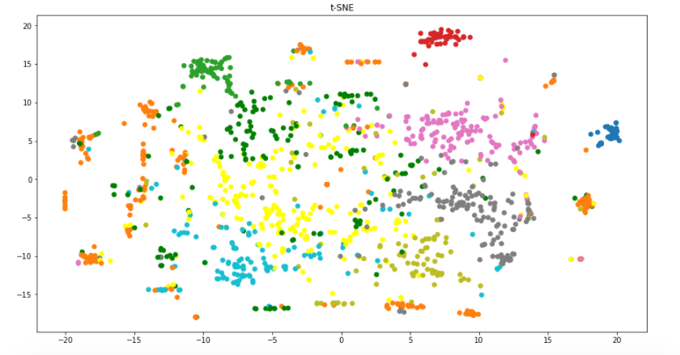
Objective 3: Visualize relative closeness of topics
Using TFIDF + LSA
+ Normalization
+manifold.TSNE
Colors according to 10
K Means Clusters

Slide 6
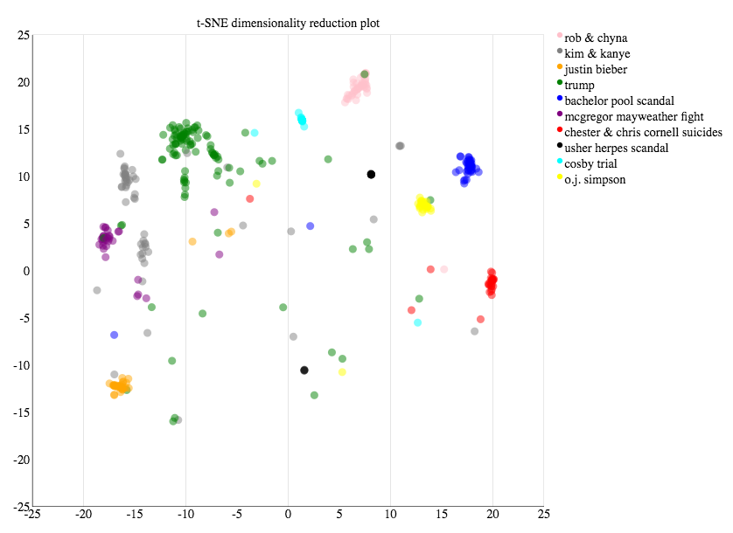
Use D3 to visualize a few topics:

Slide 7
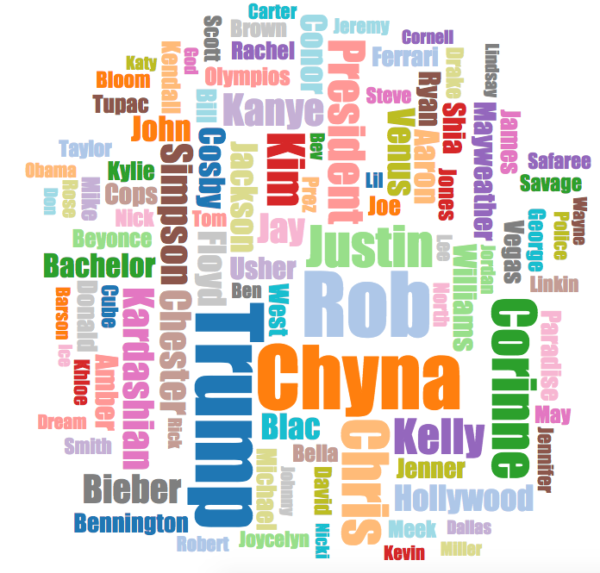
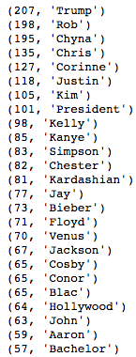
Objective 4: Visualize most common names with D3 AND the old fashioned way

Slide 8
Objective 5: Sentiment Analysis Out of the top 50 celebrity twitter accounts: who is the most positive? Who is the most negative?

Slide 9

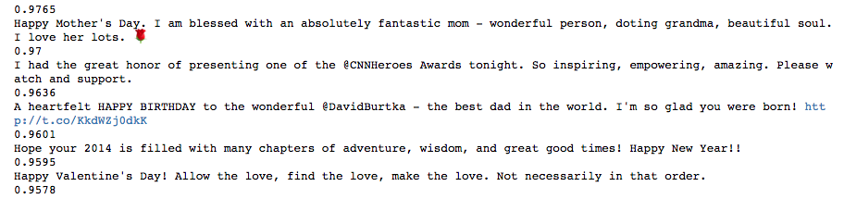
Neil Patrick Harris!
Average sentiment score: 0.4254

Slide 10
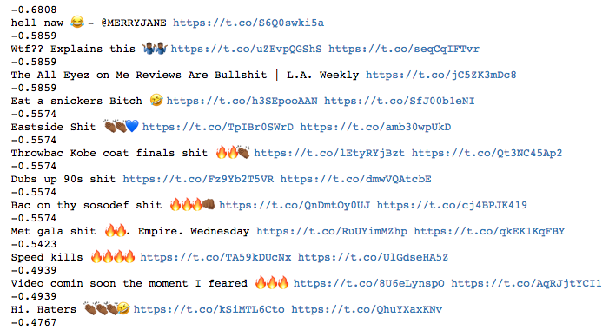
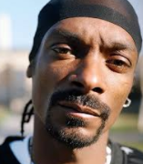
Who was the most negative? Snoop Dogg!
Av: 0.06

Slide 11
Tools
First used Selenium and Beautiful Soup for TMZ articles
Curl was better though because too many pics/advertisements on TMZ slowing Selenium down
Sk-learn pipe = [TfidfVectorizer + TruncatedSVD(50) + Normalizer()] for topic selection
Gensim for similar recommendations – VSM LSI + cosine similarity
Twitter API + NLTK SentimentAnalyzer for sentiment analysis
D3 for word cloud and t-SNE plot

