Slide 1
Detecting Colleges With High Debt-to-Earnings Ratios By: Lauren Shareshian

Slide 2





How many US colleges are there?
Pulled all 6,740 US colleges listed as “in operation” from the government API.
43% of schools on list are for-profit

Slide 3
Metric: Schools earning a failing score on DTE analysis
2,042 school programs were listed on the Dept. of Ed’s debt-to-earnings ratio list
“Generally, in order to be eligible for funding under the Higher Education Act Title IV student assistance programs, an educational program must lead to a degree at a non-profit or public institution or it must prepare students for ‘gainful employment in a recognized occupation’. ”
“Debt-to-earnings rates are calculated for each program as a measure of the ability of program completers to reasonably repay the educational debt incurred for their attendance in the program. "

Slide 4
Debt-to-earning data
School | Program | Score
Harvard University | DRAMA AND DRAMATICS/THEATRE ARTS, GENERAL | FAIL
Johns Hopkins University | MUSIC PERFORMANCE | FAIL
Everest College | MEDICAL ADMINISTRATIVE/MEDICAL SECRETARY. | ZONE
Everest College | MEDICAL/CLINICAL ASSISTANT. | ZONE
Everest College | MASSAGE THERAPY/THERAPEUTIC MASSAGE. | ZONE
Everest College | SECURITIES SERVICES ADMINISTRATION/MANAGEMENT. | FAIL
Everest College | DENTAL ASSISTING/ASSISTANT. | PASS
University of Washington | ??? | ???
2,042 school program majors were listed
9% of programs on list had failing status
66% of schools on list were for-profit
97% of the schools with a failing status were for-profit

Slide 5
Which features are significant for predicting failing Debt-to-Earnings status?
(p-value, feature)
(0.0, 'avg_family_income'),
(0.0, 'number_of_branches'),
(0.0, 'faculty_salary'),
(0.0, 'instructional_expenditure_per_fte'),
(0.0, 'loan_principal'),
(0.0, 'pell_grant_debt'),
(0.0, 'size'),
(0.0, 'tuition_revenue_per_fte'),
(3.97e-130, 'for_profit'),
(3.32e-43, 'age_entry'),
(5.66e-27, 'religious_status'),
(1.30e-15, 'percent_dependent'),
(8.20e-15, 'federal_loan_rate'),
(3.15e-14, '5_year_declining_balance'),
(4.23e-09, 'percent_black'),
(7.11, ’percent_dependent_low_income'),
(0.0002, '7_yr_repayment_completion'),
(0.0003, 'percent_pell_grant'),
(0.0004, 'most_common_degree'),
(0.002, 'percent_fafsa_loan'),
(0.006, 'percent_students_with_any_loans'),
(0.007, 'first_generation'),
(0.017, 'online_only'),
(0.022, 'retention')
*Used sklearn.feature_selection.SelectKBest to
select p-values less than 0.05

Slide 6
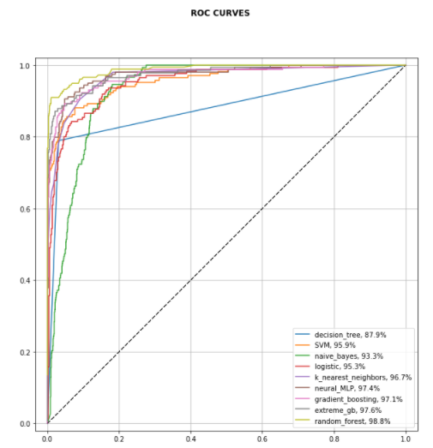
Predicting failing Debt-to-earning status
XGBoost:
ROC AUC: 0.978
Test Accuracy: 0.968
Precision: 0.923
Recall: 0.792

Slide 7

What percentage of schools under investigation are for-profit?
43% of schools were for-profit
97% of the schools under investigation were for-profit

Slide 8
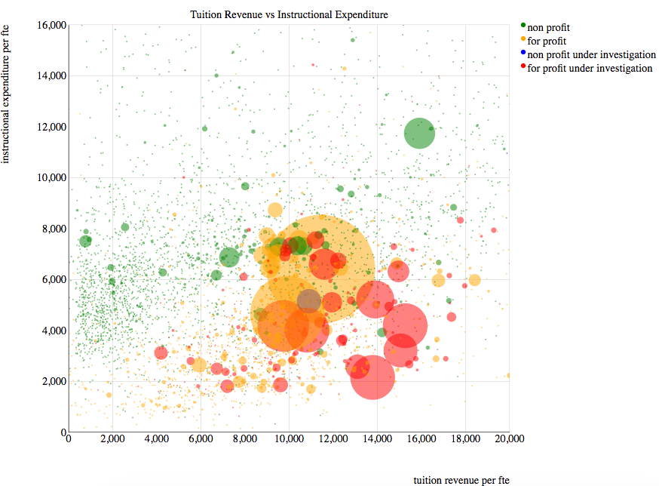
What makes for-profits different?

Slide 9
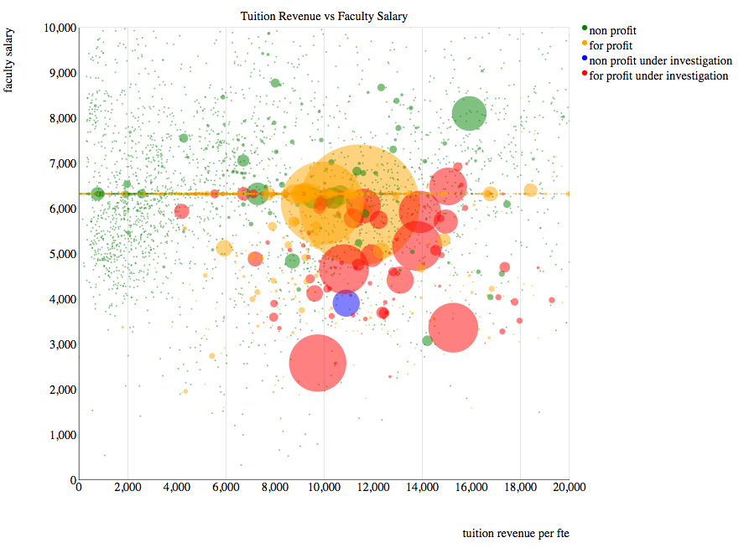
What makes for-profits different?

Slide 10
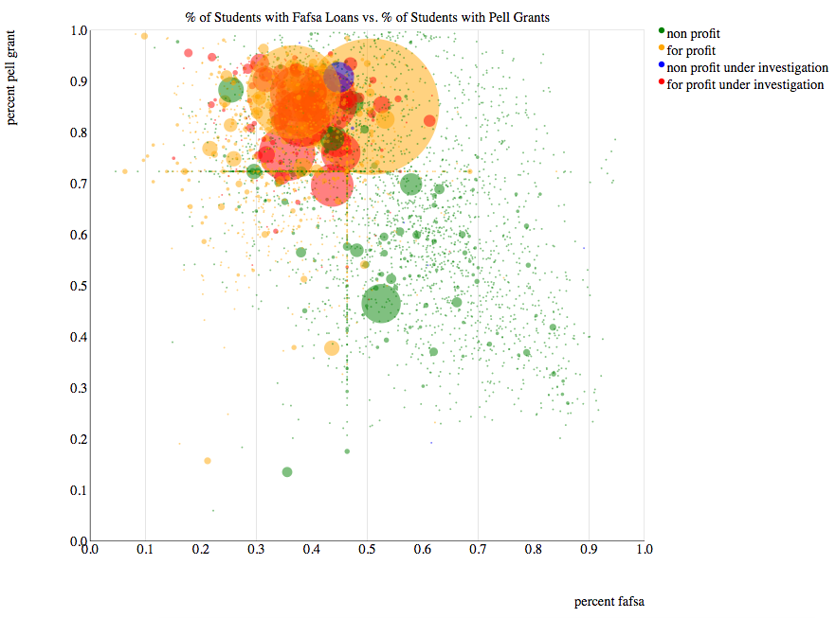
What makes for-profit colleges different?

Slide 11
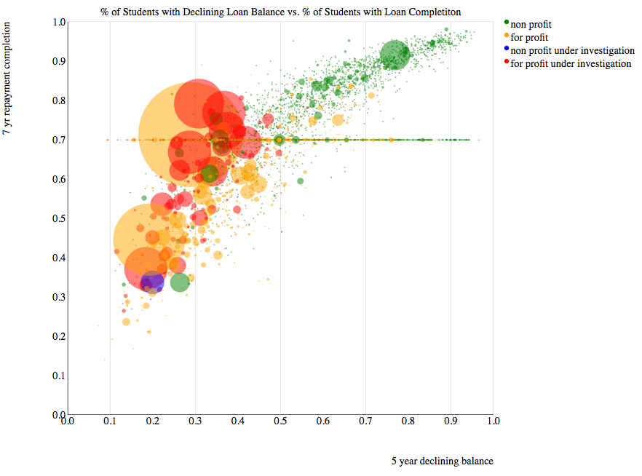
What makes for-profit colleges different?

Slide 12
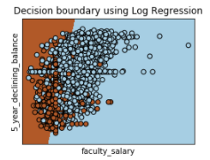
Predicting For-Profit Status using Four Features
How much I have to pay (tuition revenue per fte)
How much the school invests in me (instructional expenditure per fte)
How quickly I will be able to pay back my loan (5 year declining balance)
Faculty salary
Estimator | Test ROC AUC | Test Accuracy | Precision | Recall
Logistic | 0.983 | 0.959 | 0.943 | 0.962
Extreme Gradient Boosting | 0.999 | 0.988 | 0.984 | 0.989

Slide 13
Summary
Using gradient boosting, we have a model that detects 79% of schools receiving failing debt-to-earning scores
Of the schools that our model predicts to be failing, we are correct 93% of the time.
The Department of Education may want to impose more regulation on for-profit schools, as they account for 97% of the failing schools.

Slide 14
References
https://www.ed.gov/news/press-releases/education-department-releases-final-debt-earnings-rates-gainful-employment-programs
https://studentaid.ed.gov/sa/about/data-center/school/hcm
https://studentaid.ed.gov/sa/about/data-center/school/ge
https://collegescorecard.ed.gov/data/

