Slide 1
Project prinstat
Robin Boudry, Maarten Rahier, Tom Schipper, Laurens Van Paemel

Slide 2
Data cleaning
No missing data
No duplicates
Suspicious values
1 observation removed
Non-adherence to treatment
80 % cut-off¹
29 observations removed
Selection bias
¹ Valgimigli, M., Garcia Garcia, H., Vrijens, B., Vranckx, P., McFadden, E. P., Costa, F., . . . Tijssen, J. G. P. (2018). Standardized classification and framework for reporting, interpreting, and analysing medication non-adherence in cardiovascular clinical trials: a consensus report from the Non-adherence Academic Research Consortium (NARC). European heart journal.
Notes:
Suspicious value: DBP measure of 66
Non-adherence:
Removal assumed to remove more bias than introduced

Slide 3
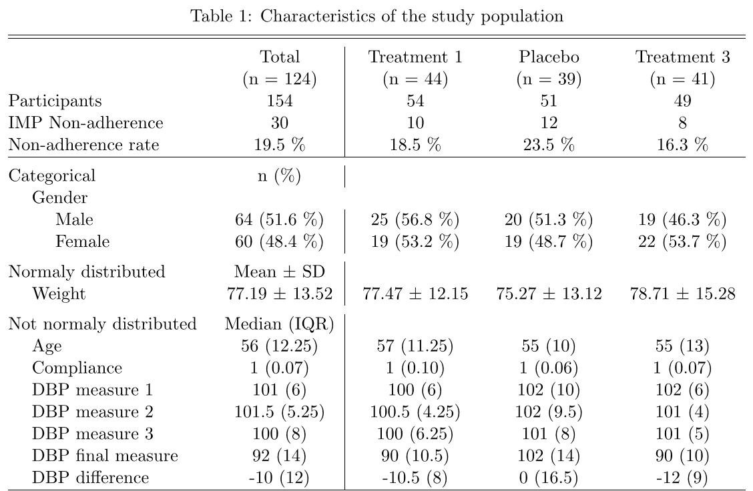
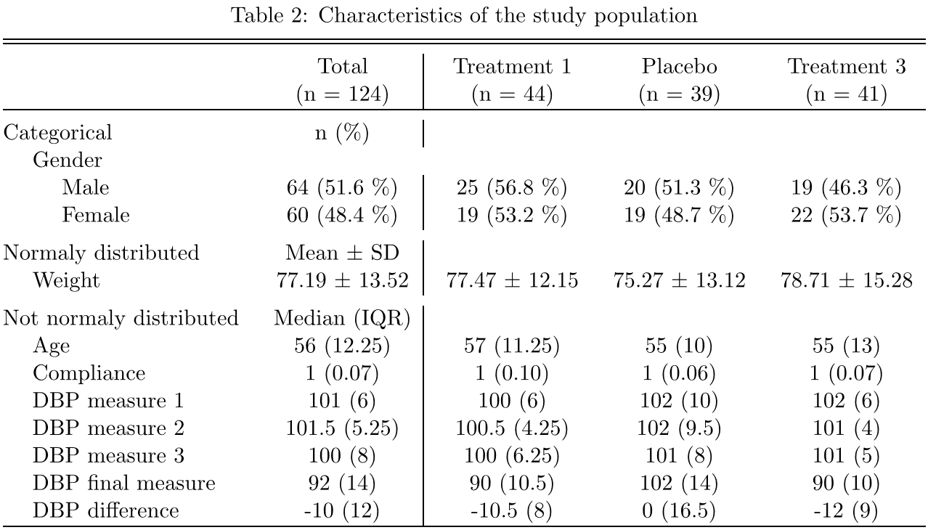
Characteristics of the study population
Stage 2 hypertension
Gender neutral
Weight neutral
Advanced age
Except for gender, comparable groups
Notes:
Intro slide: beginnen met uitleg methodologie – rest slides gaat hierop verder.
Question 1 and 2
IMP: investigational medical product

Slide 4
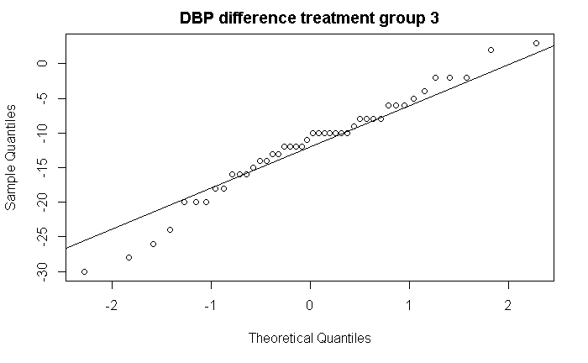

Testing assumptions
Comparable groups
Normality
Independence
Outliers
Homogenity of variances
Sample size
~
~
Notes:
Comparable groups: yes, except for gender there’s a bigger gap.
Normality: DBP difference is normally distributed. DBP measure aren’t (except the final one – which cannot be trusted due to the discrepancy with other DBP measures). Age isn’t normally distributed, weight is.
Independence: the observations do not depend on one another
Outliers: yes, for DBP3 and for DBP difference in treatment group 3 and the placebo group. For the final DBP measure there’s an outlier in the 3rd treatment group.
Sample size: sufficiently large, however rather small when split by gender

Slide 5
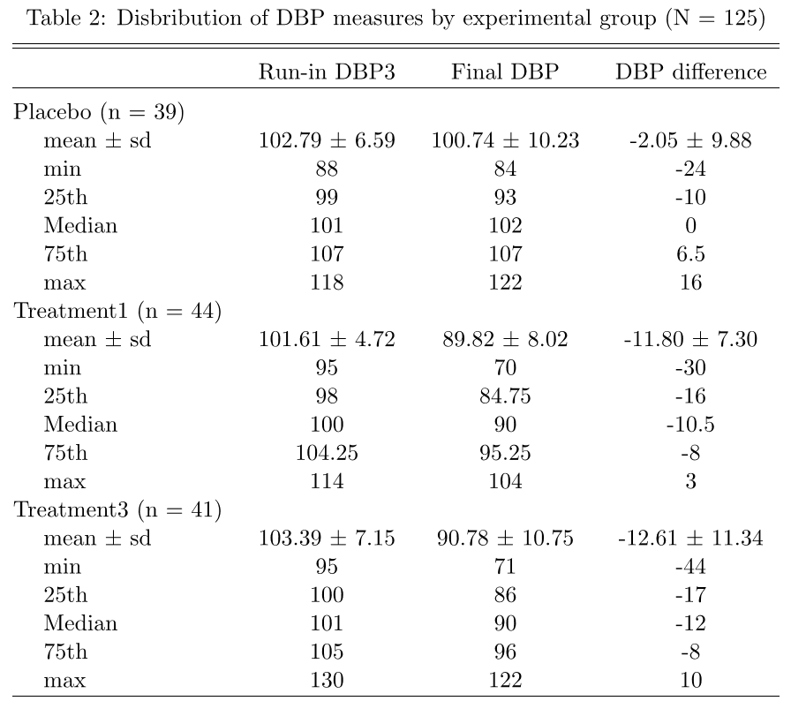
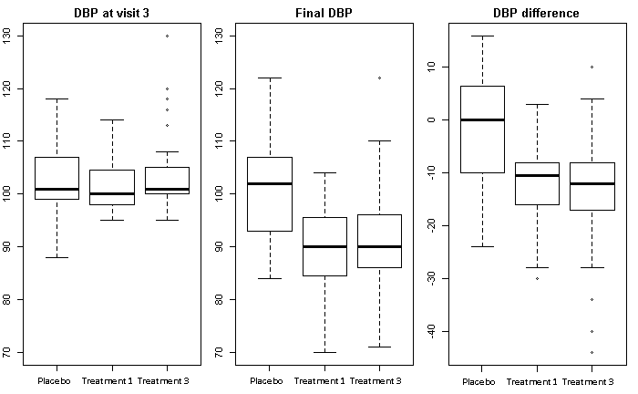
Descriptive analysis
Notes:
Question 4
Voor de drie variabelen zijn er geen missings

Slide 6
Formal analysis
Parametric:
Two-sample T-test
Variances are comparable
CI: 6.6 to ∞
P-value: 1.5 x 10-5
H₀ (μ_{t} = μ_{p}) rejected
Preferred test under normal distribution
Non-parametric:
Mann-Whitney U test
CI: 6.0 to ∞
P-value: 2.4 x 10-5
H₀ (μ_{t} = μ_{p}) rejected
Notes:
Question 4
Voor de drie variabelen zijn er geen missings

Slide 7
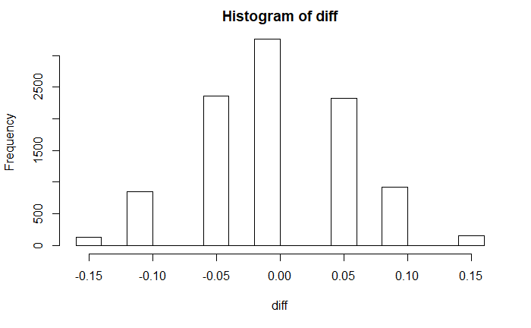
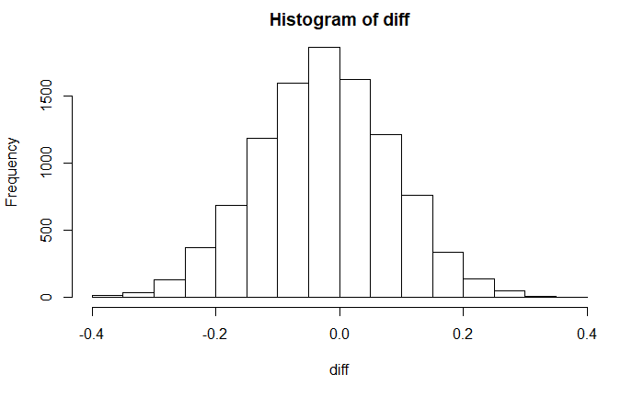

Binary comparison
Binary indicator of whether (dbp5-dbp3)<10mmHg between the 2 treatment arms.
Only 2 proportions observed
Normal distribution not to be assumed
Create own distribution: assign all the observed values randomly to 2 even groups. Simulate 10 000 times
In total only 6 ‘0’s for both groups
Scarce distribution
Observed proportional difference in 0 distribution only 1.49% likely
Caveat: test of (dbp5-dbp3)< -10mmHg
30 0’s
Observed diff 0,001% likely
Notes:
Vraag 4, korte beschrijving hoe te werk gegaan, wat het geobserveerd verschil is en hoe likely in een 0-distributie.

Slide 8
Evolution in the placebo group
Blood pressure decreased, but only mildly
Is the decrease significant?
One-sample T-test to test the significance
H₀: μ_{placebo} = 0
CI: -5.3 to 1.2
P-value: 0.20
H₀ cannot be rejected

Slide 9
blood pressure decrease by gender
Two-way ANOVA of blood pressure evolution
Factor 1: treatment
Factor 2: gender
Difference dependent on gender = significant interaction
Interaction term
H₀: no interaction
P-value: 0.09
H₀ cannot be rejected

Slide 10
Power analysis
Simulation of the ANOVA test
Four random samples (genders x treatments)
From normal distribution with the true variance
But adapted mean to create a difference of 4 mmHg
P-value of the interaction term calculated for 10 000 samples
13% of the P-values < 0.05
Power: 13%

