Slide 1
Data Projections and coordinate systems
WEEK 3 LECTURE SLIDES

Slide 2
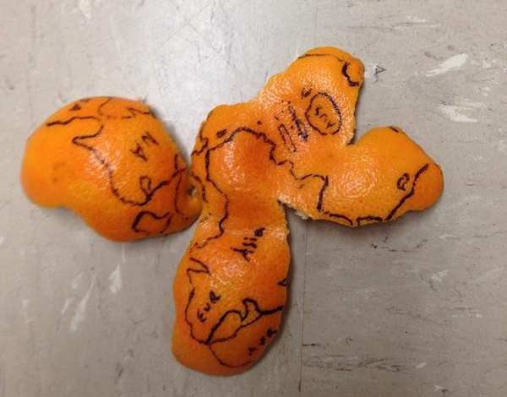
Outline
What are projections and why do we need them?
What is geocoding?
Lab #3
Notes:
Image credit: Craig Callahan (Twitter)

Slide 3
From the 3d to the 2d
Maps are models of the Earth’s surface and are meant to represent the 3D surface via a 2D medium
To as accurately as possible represent the 3D in the 2D, we must make a series of assumptions and conduct some calculations.
Think of it like peeling and orange. You can’t lay the peel flat once it’s off the fruit – it will stretch, distort, and tear into pieces (more on this in a few slides…)
On the next series of slides I will explain how we can take our 3D world and effectively model it with a 2D representation….

Slide 4
Real world (3D geoid)
A geoid is an imperfect approximation of the shape of the earth
Spheroid approximation (geographic coordinate system)
The imperfect shape is modelled to a spheroid or reference ellipsoid shape that is governed by a datum, which are different mathematical reference surfaces. Many kinds exist, but two popular ones are WGS 1984 and NAD1983
Projection of the spheroid onto a flat surface (projected coordinate system)
Various projections exist, and the focus point of each projection will change the perspective of the map you’re creating.

Slide 5
Issues that complicate mapping
Some issues arise when we try to represent the Earth’s 3D surface in a 2D map:
Distortion – the orange peel example here. Check out the distortion example on the next slide for a visual on area/shape distortion in maps
Earth’s irregular shape (which we already estimate with a geoid via geodesy) is always changing as natural processes constantly change Earth’s surface
Measurement error, both human and machine
These issues and more work together to continuously evolve our estimates of positions through time.
E.g: If you mapped the trails surrounding all slopes on Mt. St. Helen’s prior to 1980, you would need to reevaluate those maps post eruption because the literal shape of Earth’s surface changed in that event.

Slide 6
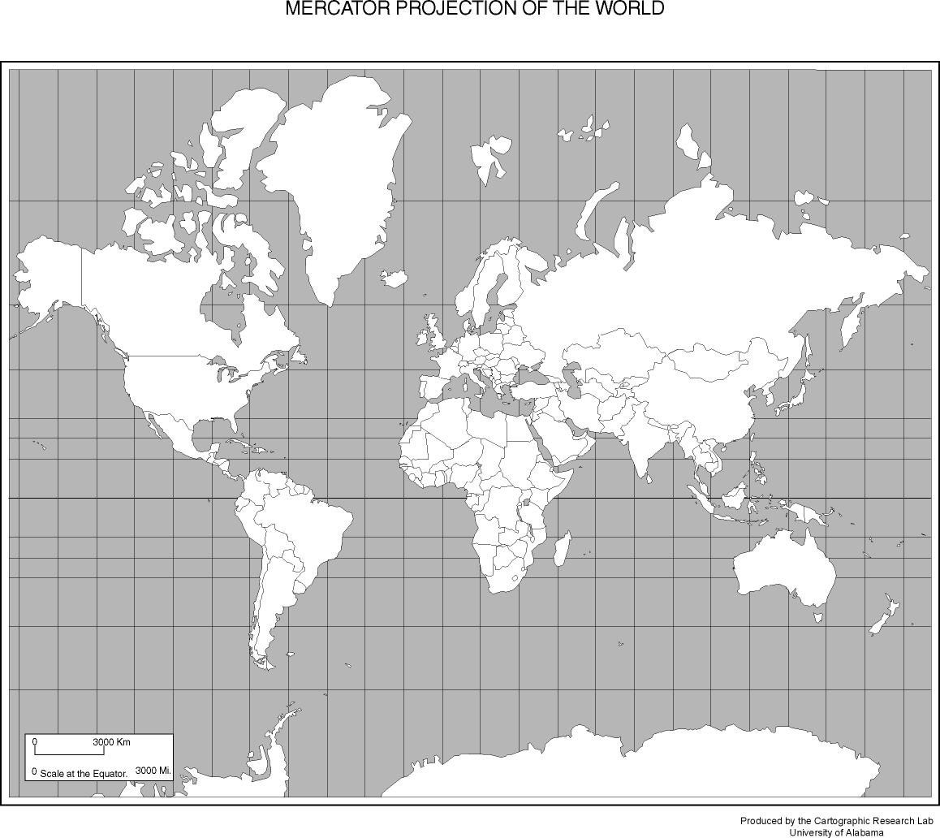
Distortion in Maps
A
This is a classic “Mercator” projection system.
However, it hides a serious distortion…
In “real life,” Greenland (A) and Mexico (B) are approximately the same area!! But look how much larger Greenland looks on this map!! Things farther away from the Equator on this particular projection are more distorted.
B

Slide 7
Geographic coordinate systems
Once a spheroid or reference ellipsoid has been chosen for the approximation of Earth’s shape, we can orient the poles and situate the zero degree latitude line (the equator)
But what governs the spheroid or reference ellipsoid shapes? The datums, which are the reference surfaces that geodesy has produced for us through time, and there are many of them.

Slide 8
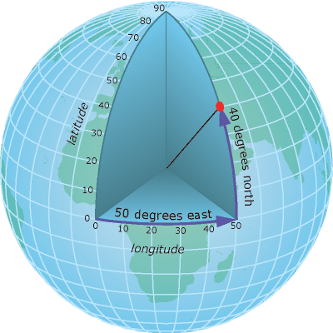
Geographic coordinate system
Think of it all like this…
A geoid is the best representation of Earth’s true shape
We model the geoid via a spheroid/ellipsoid, whose shape and orientation is governed by a datum (and we’ve created many datums over the years all with their own strengths and weaknesses based on the context of your project).
The datum rules that create the shape and orientation to form the spheroid all work together to form what we know as the geographic coordinate system
Note: GCSs are not the same as regular coordinate systems, sometimes called Cartesian planes, specifically geographic coordinates form on a curved surface (e.g. ellipsoid)
Notice the orientation of the lines, the location of the equator, and the obliquity of the shape in the figure to the right. All of that is a geographic coordinate system, and it aims to best represent the earth and model Earth’s surface.
Notes:
Figure: ArcGIS online

Slide 9
projections
If a datum tells us where a series of points are on a curved ellipsoid surface, the next step in our GIS analysis is to get those points onto a flat surface by a final step know as a projection
Note: Lab #3 requires you to project geocoded address data from a geographic coordinate system (spheroid, curved surface) to a projected system. Specifically the Universal Transverse Mercator (UTM) projection in Zone 11N. You can Google “UTM Zones” and maps will come up with the zones listed – I always have to look these up when I’m projecting data. ☺

Slide 10
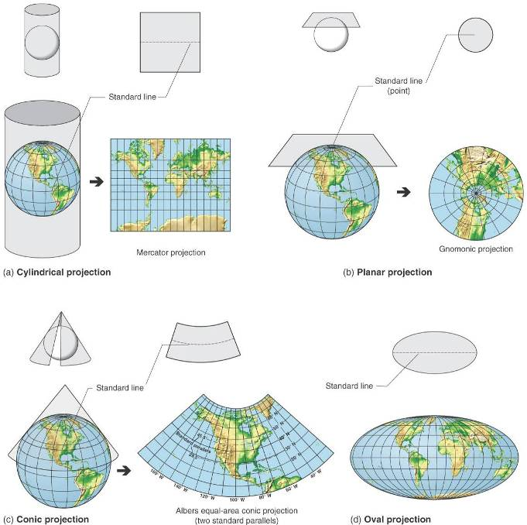
projections
Map projection – the transformation of coordinate locations from the Earth’s curved surface onto flat maps
Notes:
Image: Geosystems, Chp. 1, Christopherson

Slide 11
projections
Hundreds of various projections of different styles (i.e. planar, conic, cylindrical) and more are produced all the time
However, only a select few projections are commonly used, and these projections have modifications based on specific regions (e.g. UTM Zone 11N)
Two really common projections are the Lambert Conformal Conic (more info on this projection here: https://desktop.arcgis.com/en/arcmap/10.3/guide-books/map-projections/lambert-conformal-conic.htm) and the Universal Transverse Mercator (link here: https://desktop.arcgis.com/en/arcmap/10.3/guide-books/map-projections/universal-transverse-mercator.htm)
Note: Another good website for UTMs and topo maps is via the USGS here: https://www.usgs.gov/faqs/how-are-utm-coordinates-measured-usgs-topographic-maps?qt-news_science_products=0#qt-news_science_products)

Slide 12
Lab #3
Be sure you make a “Lab3” folder in your “GEOS323” master folder BEFORE you download the Lab 3 data from Canvas or open ArcGIS Pro.
Skills/tools we will cover in Lab 3:
Utilizing the attribute table (continued from Lab 2)
Displaying X/Y data from tabular datasets
Geocoding addresses to a lat/lon coordinate system
Projecting data layers
Intro to the Analysis toolset – the Buffer tool

