Slide 1
Intro to gis for environmental sciences
WEEK 2 LECTURE SLIDES

Slide 2
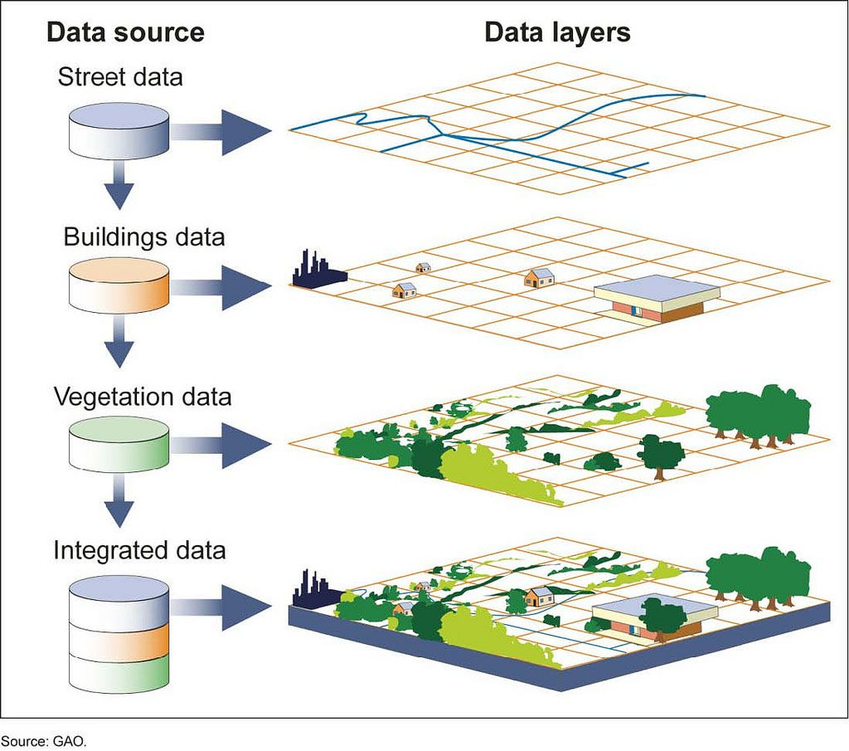
Outline
Data Types
Vector
Raster
Begin Lab #2
Example Practical Exam

Slide 3
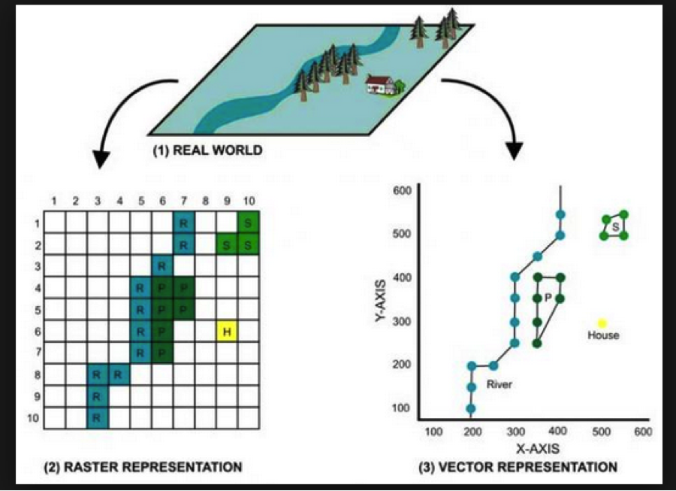
DATA TYPES
Spatial data come in all shapes and sizes and can represent all kinds of scales on Earth
Did you know your phone pictures have geospatial data attached to them?
Ever get an email from a store with a special offer (e.g. $2 off your next Starbucks purchase) when you’re near that store?
What do temperature data look like across space?
These questions and spatial relationships can all be visualized and analyzed with GIS data
The two primary data types are VECTOR and RASTER data.

Slide 4
vector
Vector data are called shapefiles to indicate the shapes of points, lines, and polygons
Vector data is best suited for discrete data
Shapefiles are viewed in ArcGIS Pro as .shp files and they hold a variety of data for each shape, including
Georeference information or where the shapefile is located in actual geographic space
Projection information (will be data-dependent)
Feature variables
Point shapefile of major US cities would have information like, population, demographics, economic stats like median income, etc.
Check out the example point shapefile in the next slide!

Slide 5
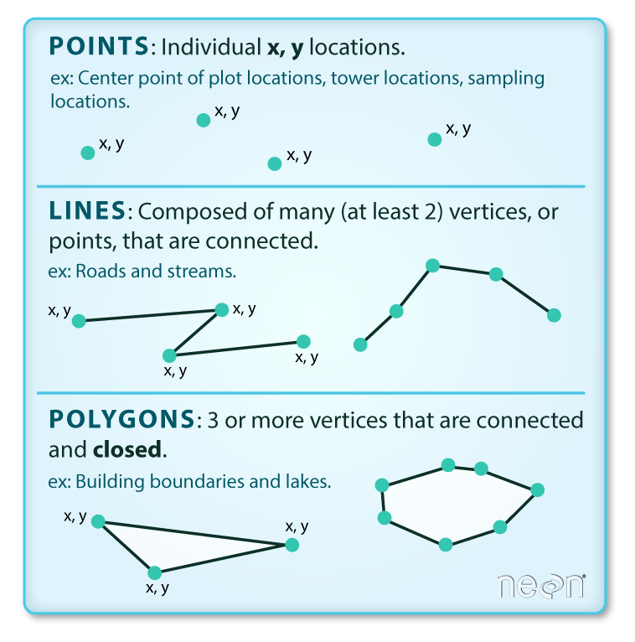
VECTOR
Vector Data features include:
Points
GPS locations of stop signs in a neighborhood
Trees in a forest sampling site
Major cities in the US
Lines (and polylines)
River courses through a landscape
Migration routes of birds
Polygons
County boundary lines in a state
Wetland areas in Eastern Washington
Areas of high biodiversity in a coastal marsh

Slide 6
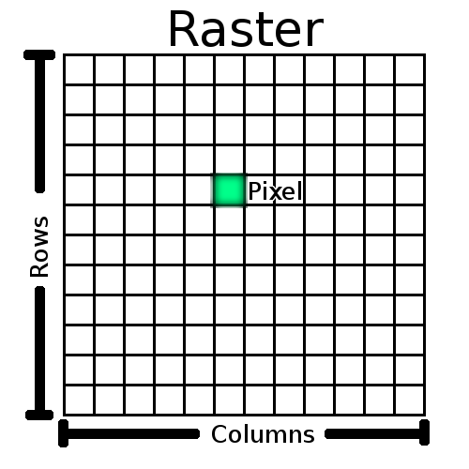
raster
Raster data files are commonly referred to as grids or gridfiles and they include data that can be displayed cellularly
Raster grids are best suited for continuous data, such as temperature or elevation
Each cell or pixel in the grid forms a network, with the center of the cell representing the spatial location and occupation of space by things on Earth or in reality
Raster grids come in different cellular resolutions
For example, a 10 m elevation model has cells in the grid that represent 10 m x 10 m cells on Earth’s surface
The higher the resolution of raster grid, the more definition you will see on your map

Slide 7
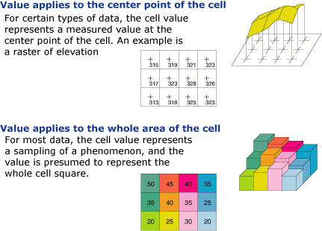
RASTER
Geographic properties of raster data typically include the following:
Coordinate system – same as vector, it’s always good to have your data layers in your GIS projected in the coordinate system most appropriate for that location
Cell size or resolution
The larger area on Earth’s surface that each cell represents, the more homogenization you will see in your data
More accurate results (usually) can be found with higher resolution raster layers, but only to a point
Higher resolution (smaller cell size) of your raster layers will almost undoubtedly increase your processing time (more cells = more math the computer must do)

Slide 8
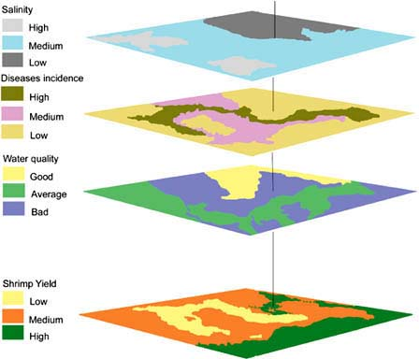
RASTER
Raster grids become powerful when geocomputations come into play, not necessarily only as single layers.
A series of grids ”stacked” on top of each other for a given area provides the ability to perform grid-based analysis for any number of layers, potentially providing a wealth of secondary information about an area
For example:
A landcover grid + a slope gradient grid + a precipitation grid = basic landslide risk grid
The landcover data provide information on vegetation, the slope gradient data provide slope steepness, and the precipitation data provide a wetness factor. Areas of low vegetative cover, steep slopes, and high rain are at highest risk for landslides. This secondary information on landslide risk is only clear once the other three data layers are .
Figure to the right shows the same principle, but with Shrimp Yield in the ocean – notice, how the yield is low where it is co-located with high disease incidence, for example.

Slide 9
DATA TYPES
A quick note about data types and data used in a GIS….
Regardless of which type of GIS data you’re working with, you MUST be sure the projection system for both the workspace in ArcGIS Pro and your data match.
You must also be sure all your data layers in your GIS (some GIS models have dozens of layers!) are all in the same projection system too.
Data you acquire from other sources may not be projected in the correct coordinate system, so always be sure to check!

Slide 10
Lab #2
Be sure you make a “Lab2” folder in your “GEOS323” master folder BEFORE you download the Lab 2 data from Canvas or open ArcGIS Pro.
Skills/tools we will cover in Lab 2:
Accessing Living Atlas datasets
Reading and storing metadata
Recognizing and changing spatial references for data layers and map frames
Utilizing the attribute table
Sorting
Select by Attributes
Visualizing statistics
Adding and populating fields
Calculating geometry

Slide 11
Example practical exam
Open up your Lab #2 .aprx file and add the data from the Practice2 folder on Canvas – this is a point shapefile and should overlap perfectly with the tornado path polylines from Lab 2.
Add in the state and county polygon shapefiles from the Living Atlas data portal
Subset the data layers to Washington State
Answer the following geostats questions for WA only:
What is the total number of tornadoes to have occurred since 1950?
What is the longest tornado path length to have occurred since 2000?
Build a histogram of mag field for the point data layer for tornadoes since 2000 – what is the highest mag value for that subset?
Which county or counties had the highest frequency of tornadoes for the entire dataset?
Provide answers for each of the above questions in a word document and submit to the assignment dropbox on Canvas.

