Slide 1
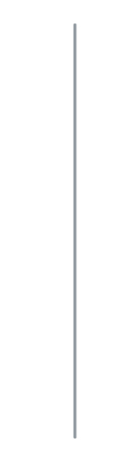

Keeping It Consistent: ASSESSING MEASUREMENT REPRODUCIBILITY OF A NOVEL ANISOTROPIC PHANTOM FOR HIGHER ORDER DIFFUSION TENSOR MRI SEQUENCES
By: Lauren Stephens

Slide 2
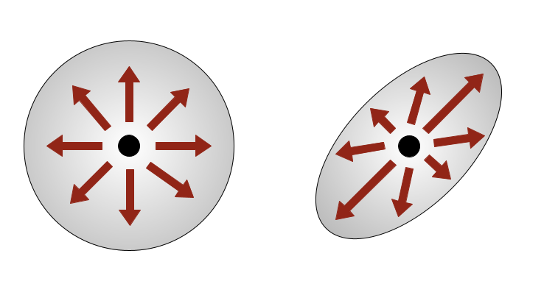
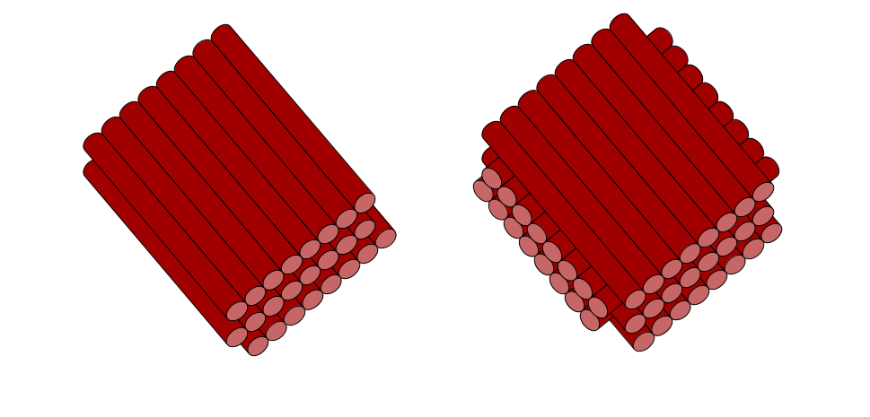
Introduction
Diffusion magnetic resonance imaging (dMRI) measures the diffusion of water molecules in biological tissues
dMRI is highly susceptible to issues with standardization and reproducibility
Crossing-fibre problem
33-90% of white matter voxels contain multiple fibre populations
There is a need for a robust quality assurance (QA) tool made specifically for diffusion data
Isotropic diffusion
Anisotropic diffusion
Linear coherent fibres
Crossing fibres

Slide 3
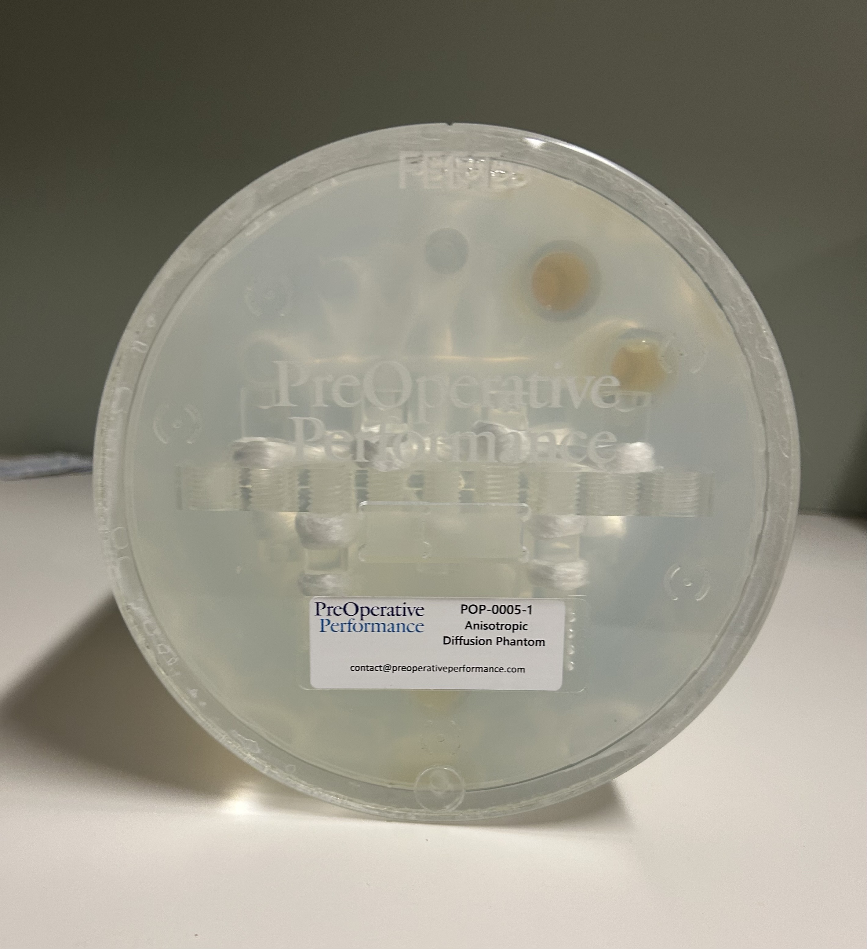
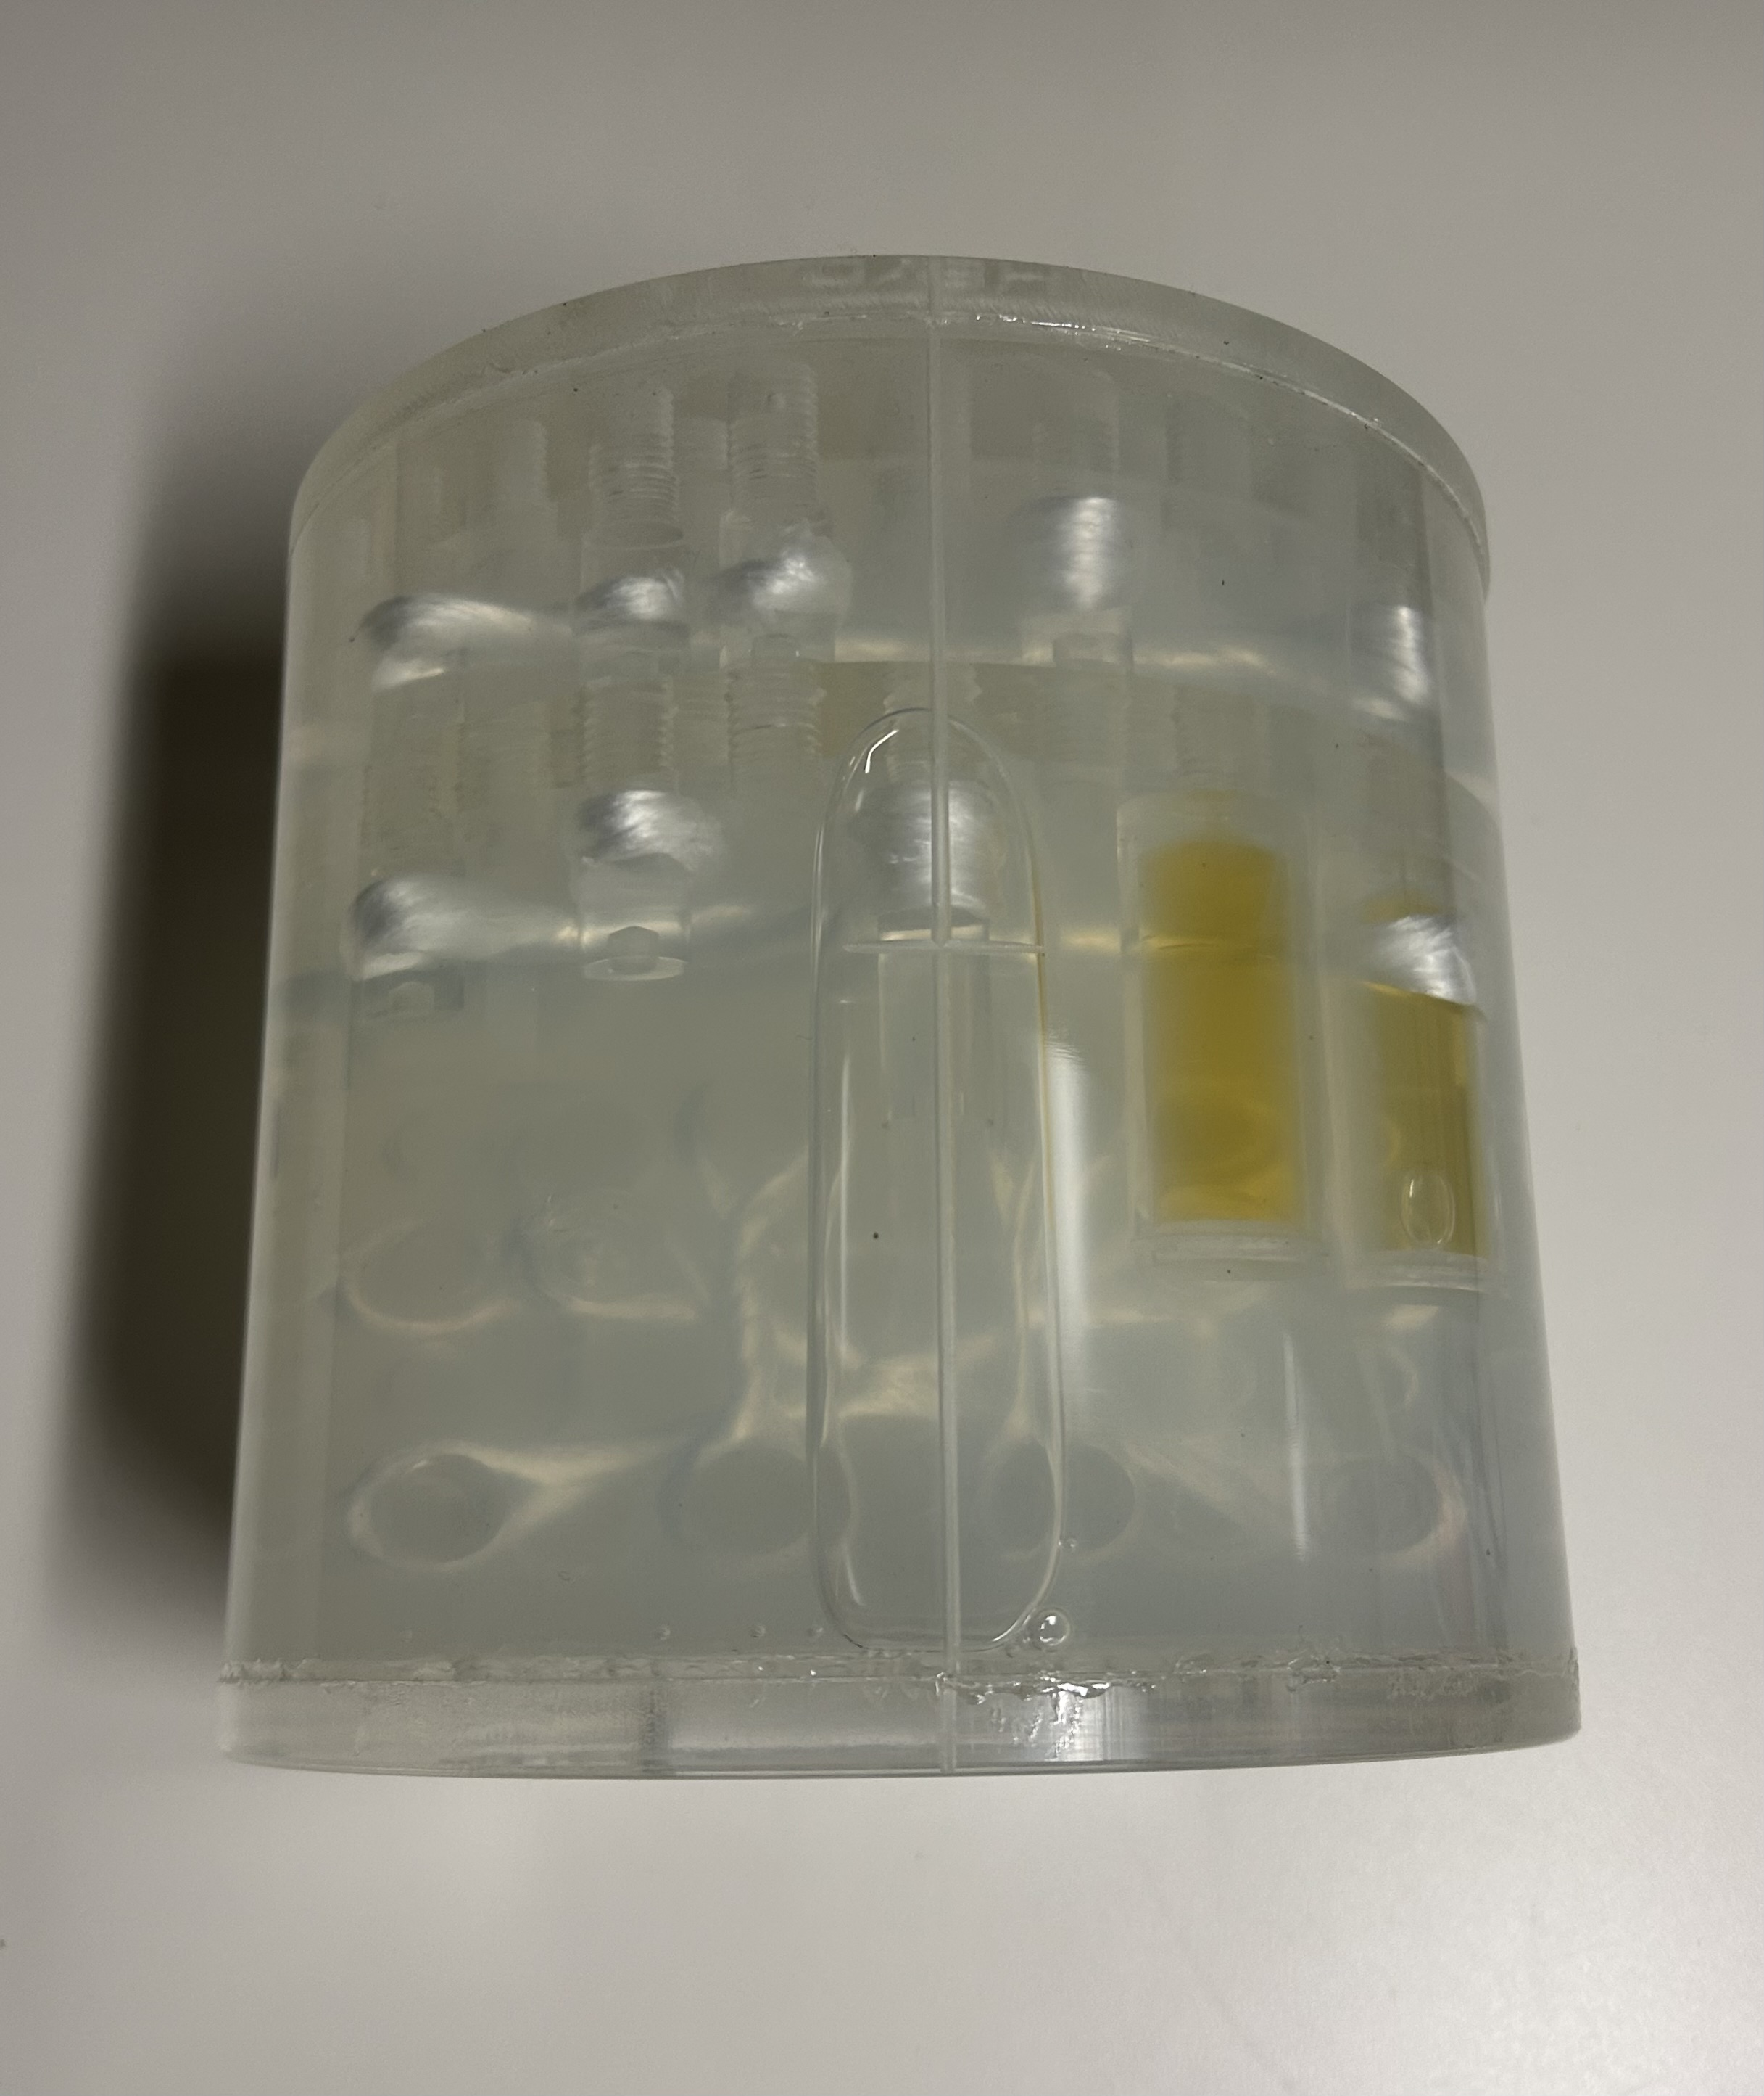
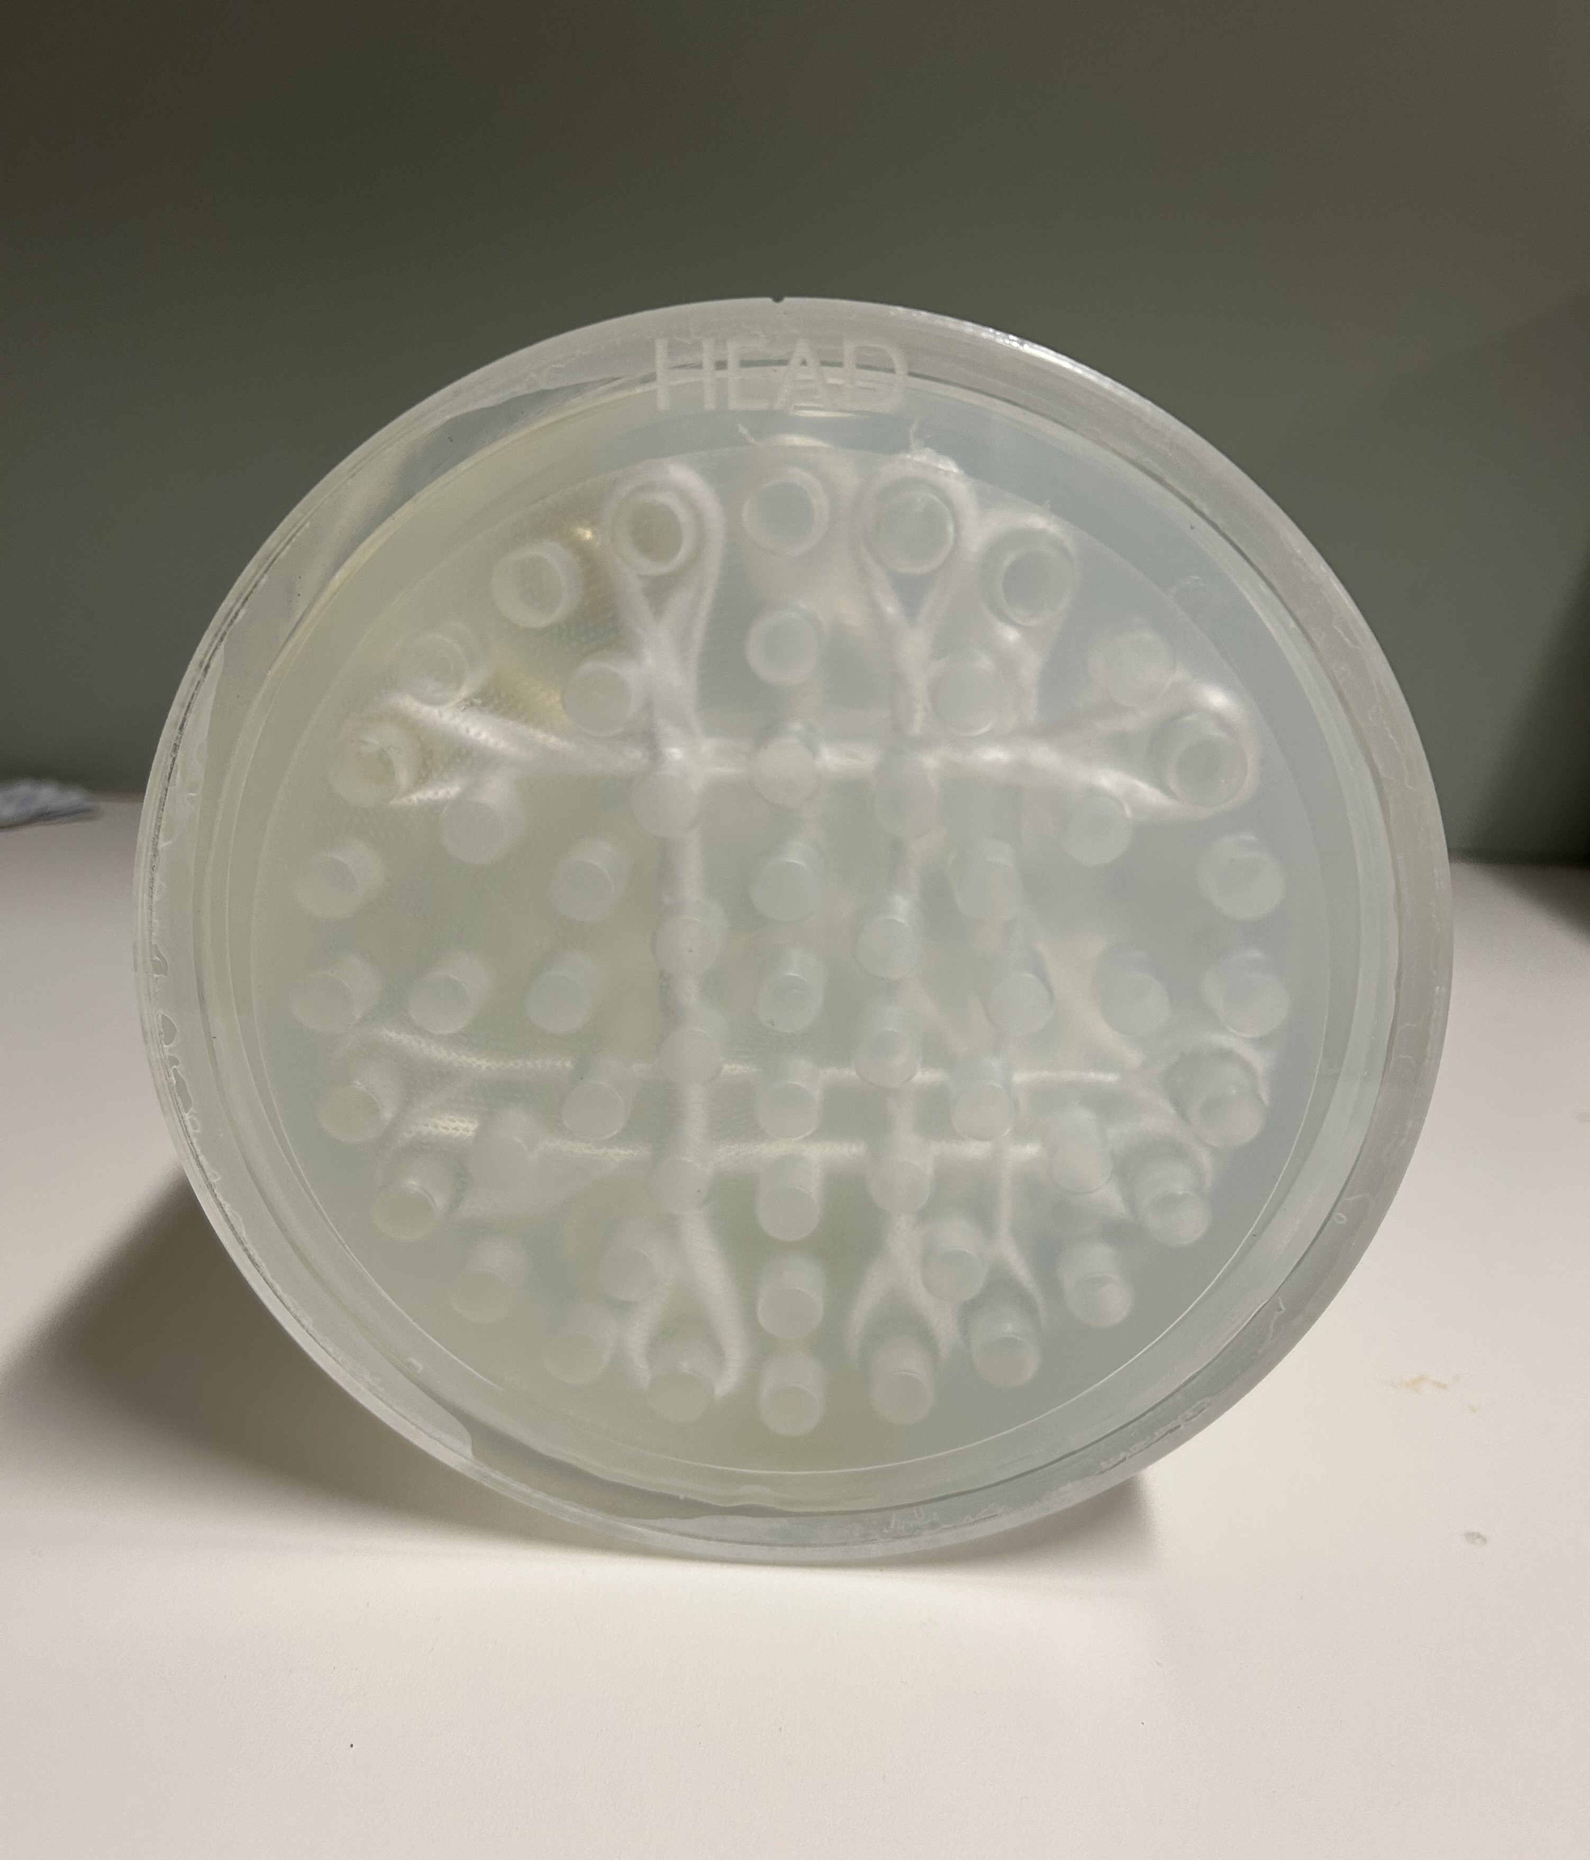
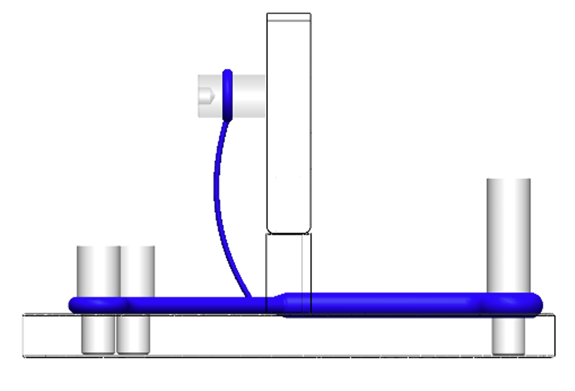
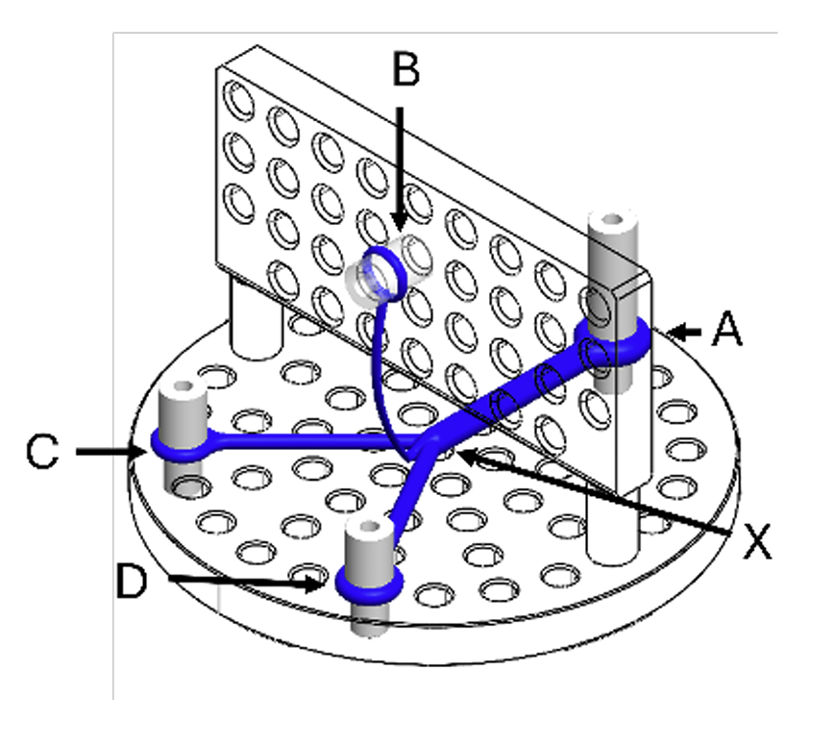
Introduction
PreOperative Performance (Toronto, ON) have developed a novel anisotropic phantom for QA of diffusion data
Mimics the structure of white matter
Includes anisotropic fibre bundles with complex crossing and branching structures
Previous work has been done to validate the phantom for rank-2 tensor metrics across multiple scanner vendors [3]

Slide 4
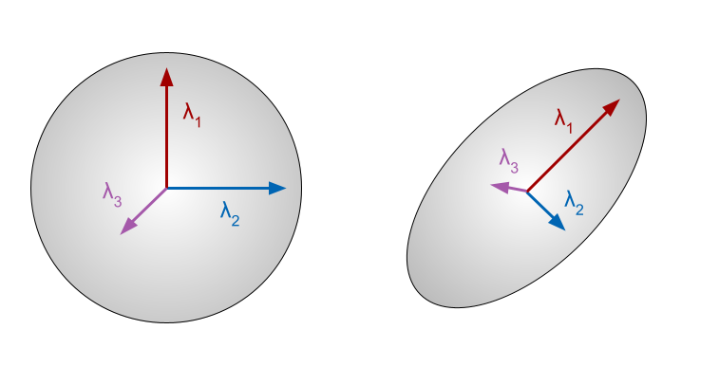
Background
Diffusion Tensor Imaging (DTI)
Rank-2 tensor representation
Assumes Gaussian distribution and single fibre direction
Diffusion Kurtosis Imaging (DKI)
Rank-4 tensor representation
Assumes non-Gaussian distribution
Constrained Spherical Deconvolution (CSD)
Spherical convolution with a single-fibre response function
Allows multiple fibre directions
Isotropic diffusion
Anisotropic diffusion

Slide 5
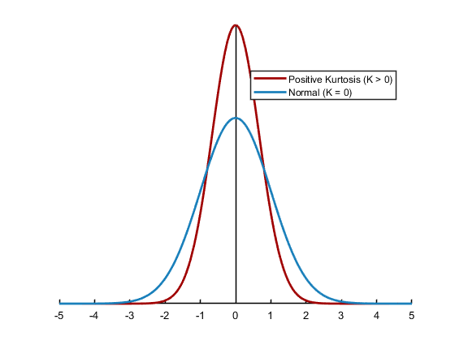
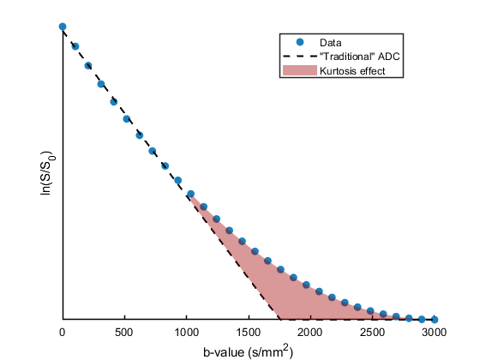
Background
Diffusion Tensor Imaging (DTI)
Rank-2 tensor representation
Assumes Gaussian distribution and single fibre direction
Diffusion Kurtosis Imaging (DKI)
Rank-4 tensor representation
Assumes non-Gaussian distribution
Constrained Spherical Deconvolution (CSD)
Spherical convolution with a single-fibre response function
Allows multiple fibre directions
Positive Kurtosis (K > 0)
Normal (K = 0)
Data
“Traditional ADC”
Kurtosis effect

Slide 6
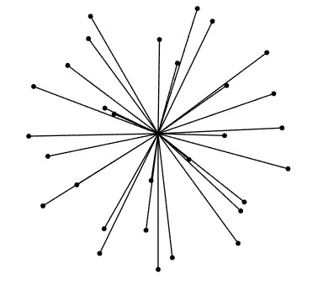
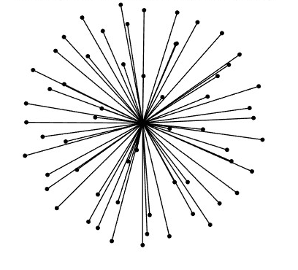
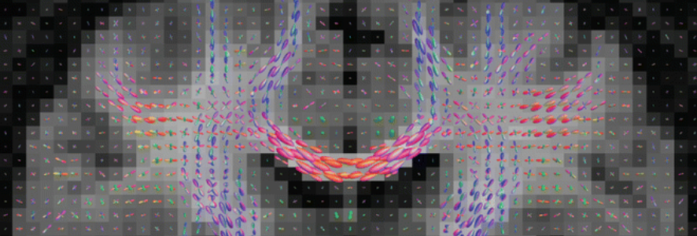
Background
Diffusion Tensor Imaging (DTI)
Rank-2 tensor representation
Assumes Gaussian distribution and single fibre direction
Diffusion Kurtosis Imaging (DKI)
Rank-4 tensor representation
Assumes non-Gaussian distribution
Constrained Spherical Deconvolution (CSD)
Spherical convolution with a single-fibre response function
Allows multiple fibre directions
Traditional DTI imaging
High Angular Resolution Diffusion Imaging (HARDI)

Slide 7
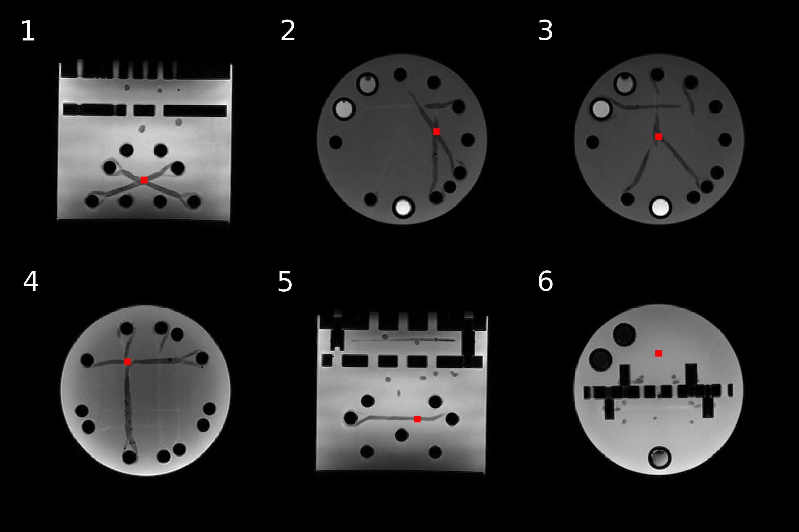
Methods
Phantom was imaged across 11 independent trials, with complete removal and repositioning between each scan
30 direction DTI scan
60 direction HARDI scan
90 direction HARDI scan
30 direction DKI scan
DiPy Python library was used to model the data and generate scalar metric maps
Metric maps were coregistered and voxelwise data was extracted from 6 ROIs with a variety of fibre geometry
Mean, standard deviation (SD), coefficient of variation (CoV) and intraclass correlation coefficient (ICC) were calculated from the ROI data

Slide 8
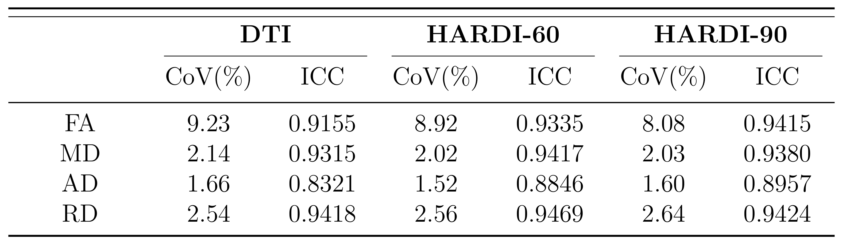
Results: DTI
Overall, high reproducibility (CoVs < 10%, ICC around 0.9)
Trend shows CoV decreased and ICC increased when using HARDI acquisitions, showing advantages to using more gradient directions

Slide 9
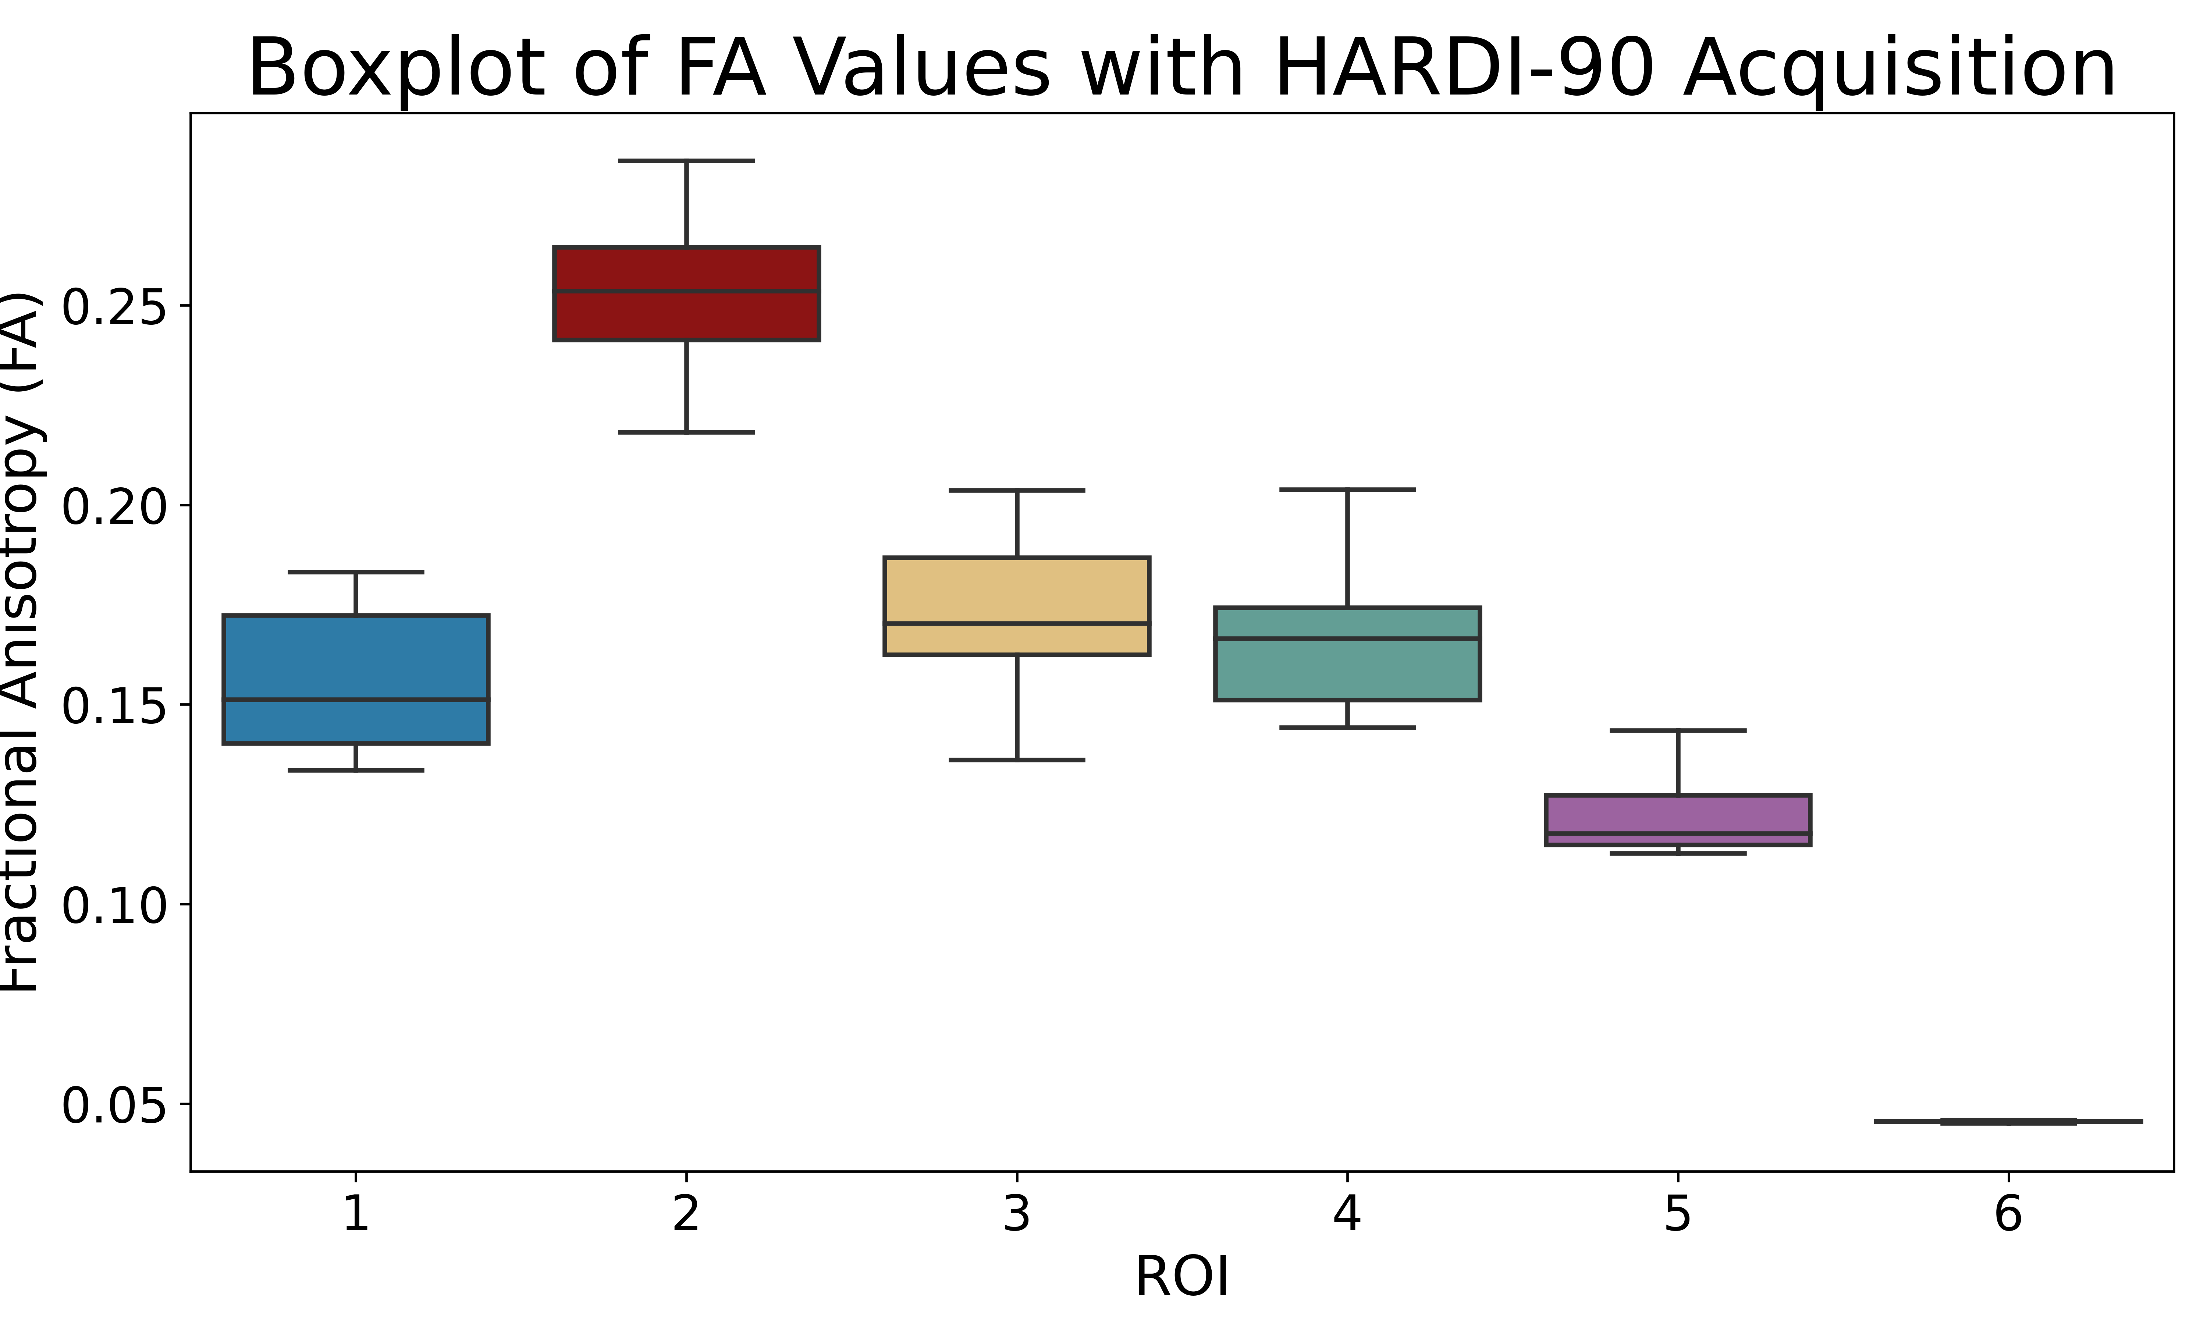
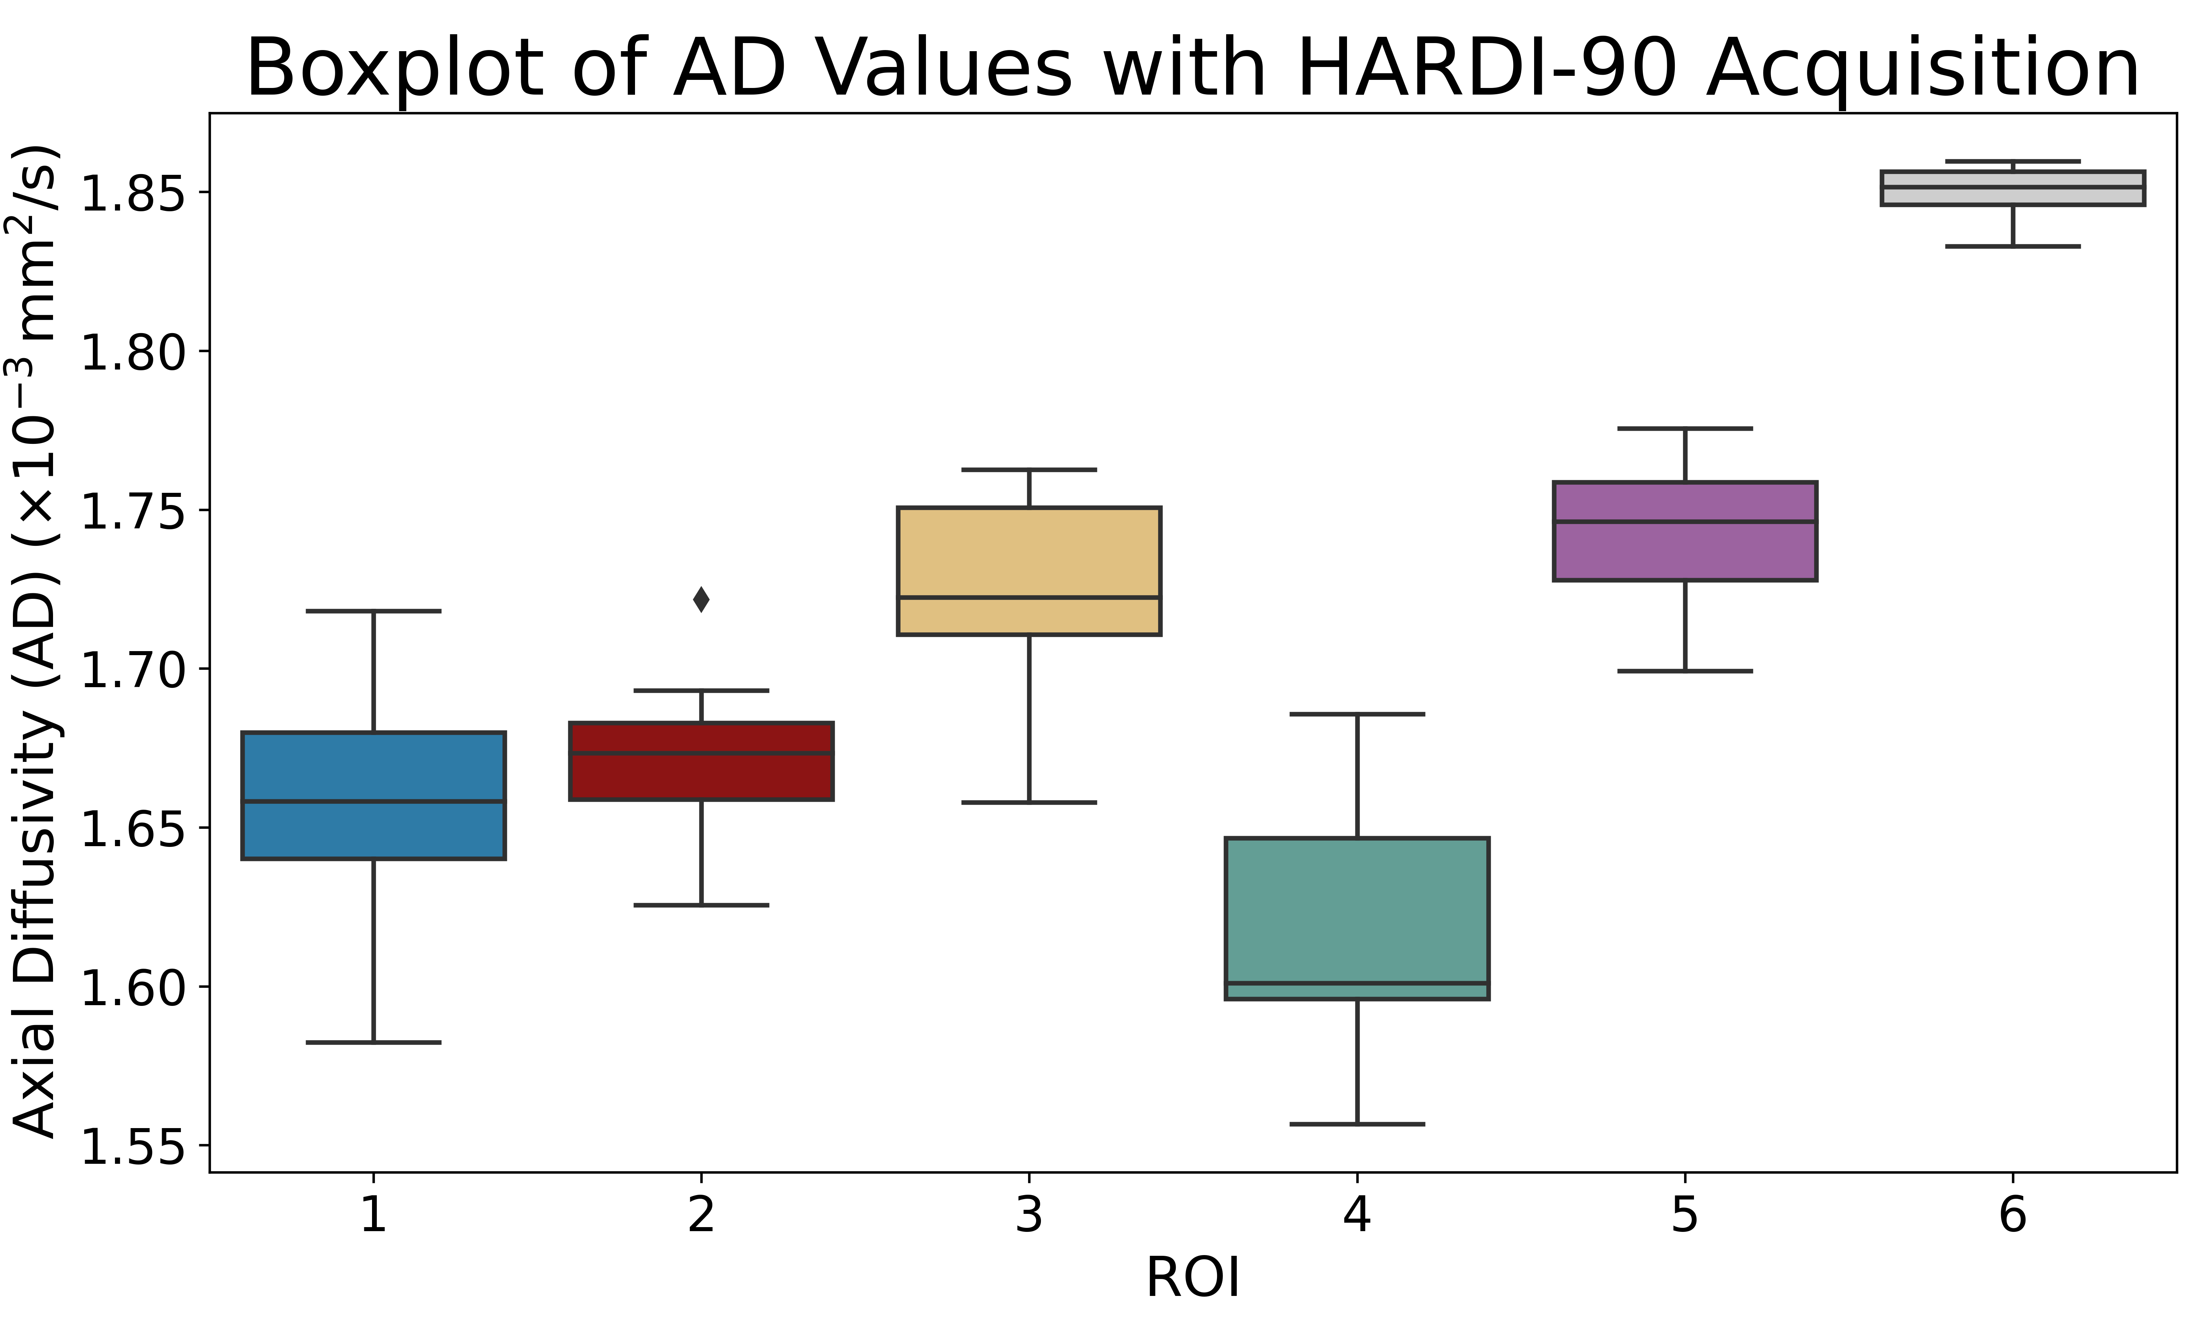
Results: DTI
ROI 2 has the highest FA → could be a result of narrow 30˚ intersection
ROI 4 has the lowest AD → could be 45˚ intersection causing supressed diffusion along the principal axis
ROI 5 has the smallest CoV → simple linear fibre aligns well with model assumptions

Slide 10
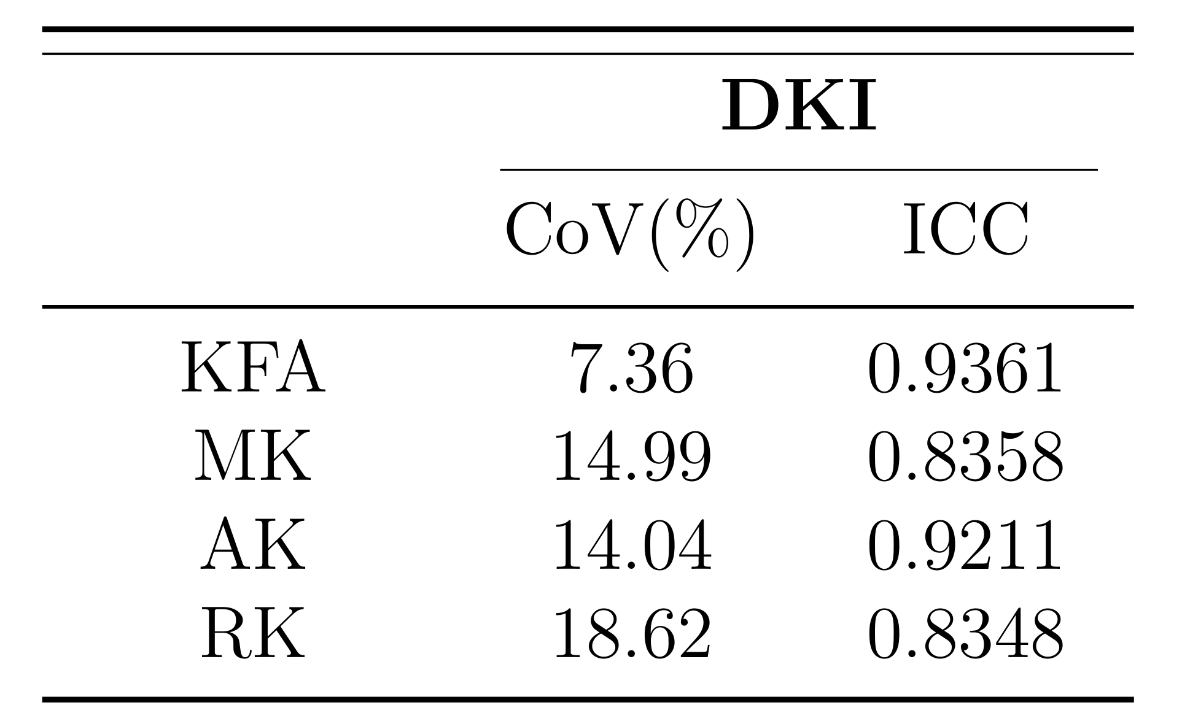
Results: DKI
Higher variability across DKI metrics, especially MK, AK, and RK
KFA remained stable, with CoV <10% and strong ICC
Despite higher CoV, ICC values suggest good scan-to-scan repeatability

Slide 11
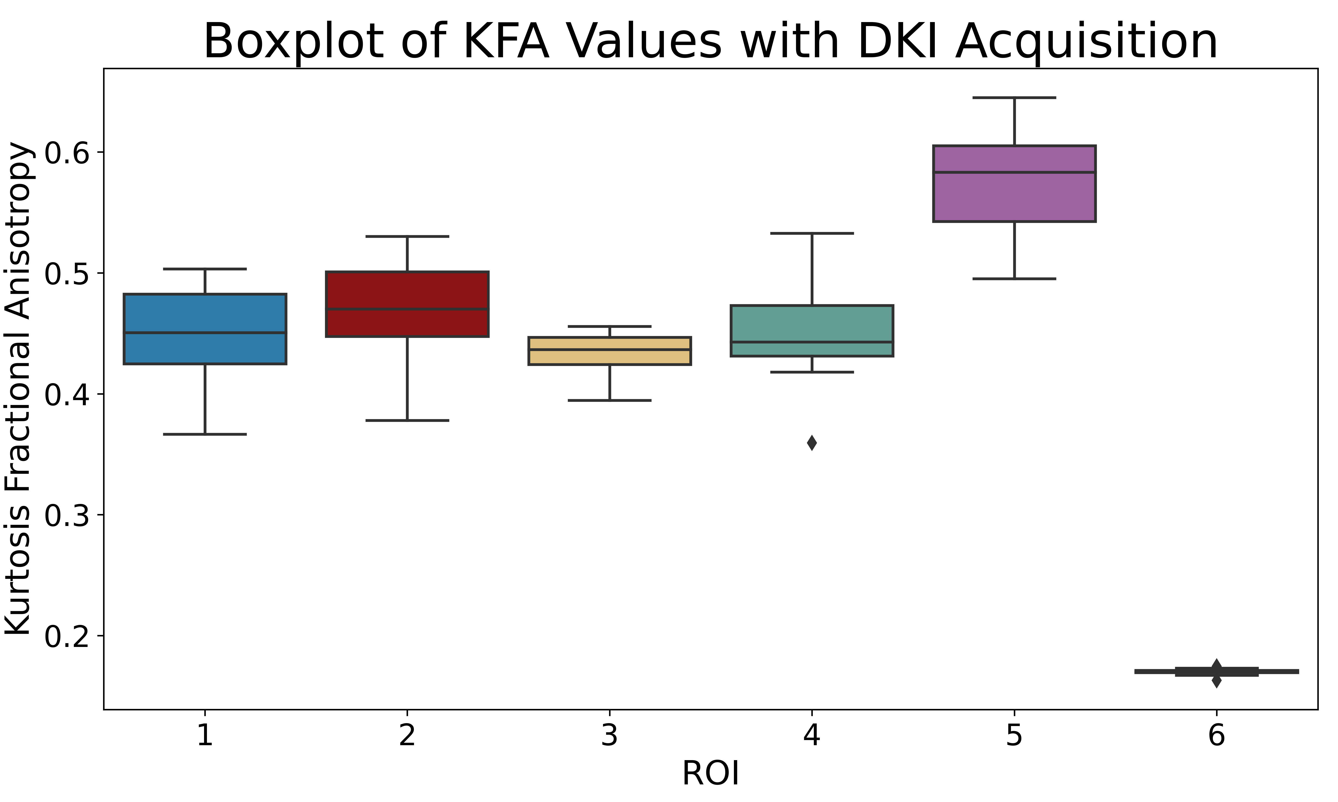
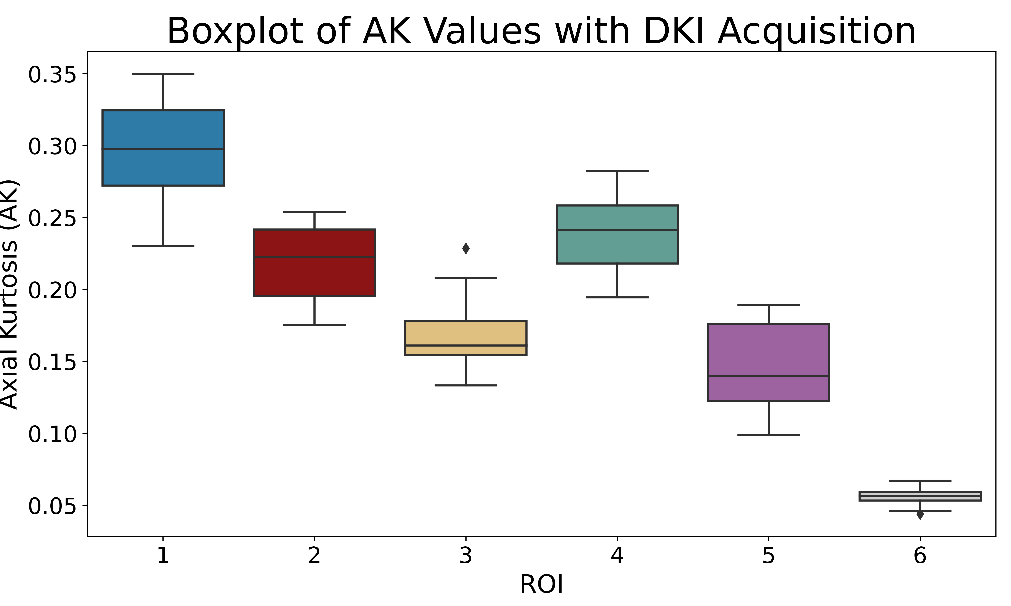
Results: DKI
Unexpectedly, the simple linear geometry (ROI 5) had the highest CoVs
Very low kurtosis in the isotropic region, indicating that a Gaussian distribution assumption holds well
No obvious trends with fibre geometry and kurtosis metrics, meaning the relationship between fibre structure and kurtosis is more nuanced

Slide 12
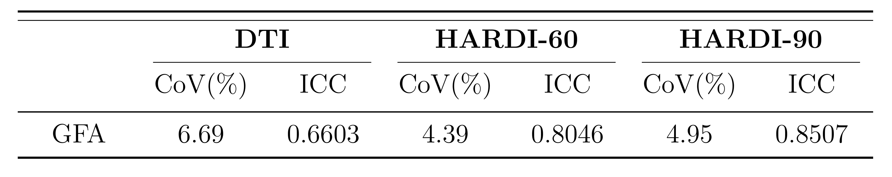
Results: CSD
GFA reproducibility improved with higher angular resolution
ICC increased from 0.66 to 0.85
CoV stayed relatively low across protocols

Slide 13
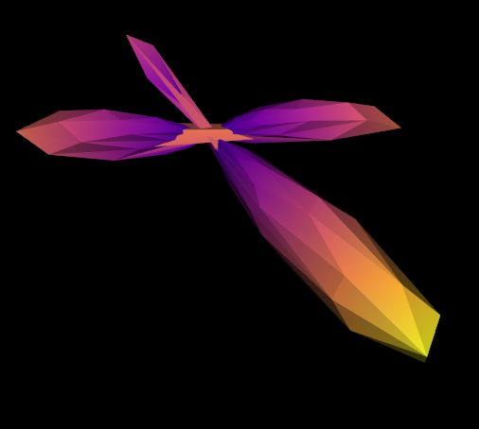
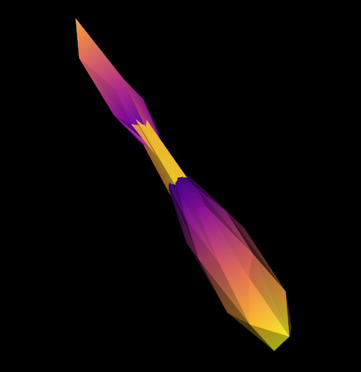
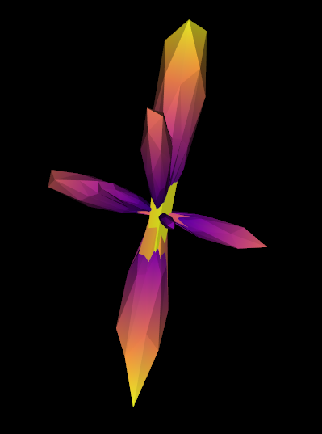
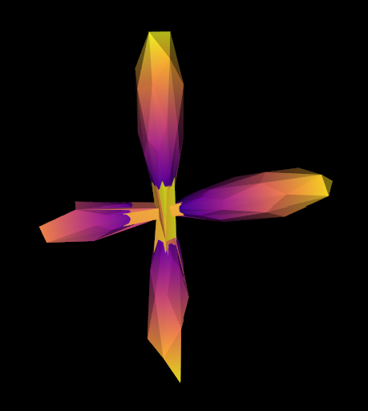
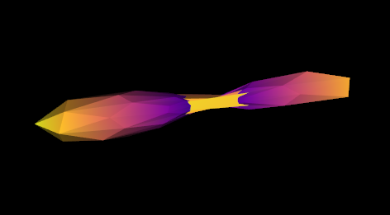
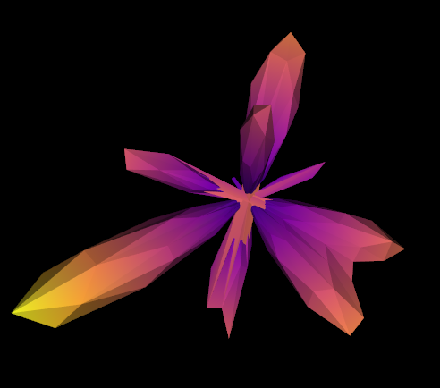
Results: CSD
ROI 1
ROI 2
ROI 3
ROI 4
ROI 5
ROI 6

Slide 14
Discussion
These results highlight that model reproducibility and scalar metric variance is fundamentally linked to fibre geometry
Future repeatability studies should aim to include complex fibre geometry in their analysis
Diffusion kurtosis metrics suffer from high variability
This may be due to high b-value acquisitions involving more signal loss and lower SNR
CSD is able to differentiate crossing and branching fibres in the phantom
30˚ fibre not resolved → could potentially increase number of gradient directions, b-value, or increase l_{max}
PreOperative Performance phantom is a reliable and effective tool for both traditional DTI and higher order diffusion tensor MRI sequences

Slide 15
Thank you!

Slide 16
Thank you!

Slide 17
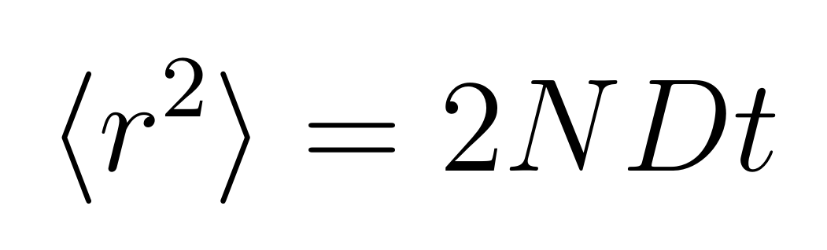
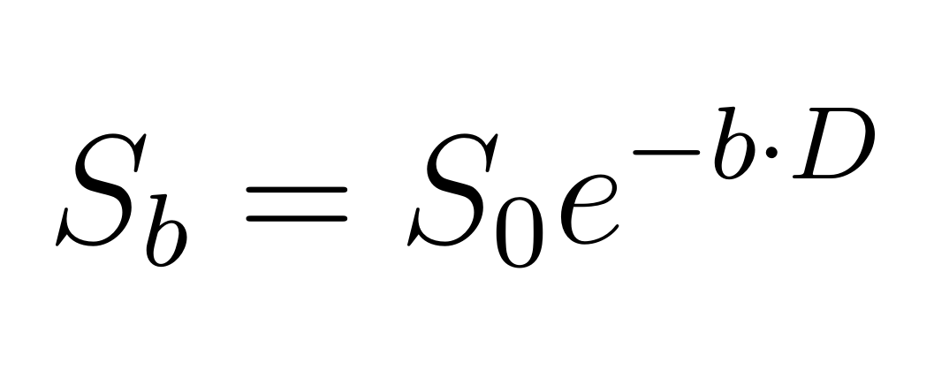
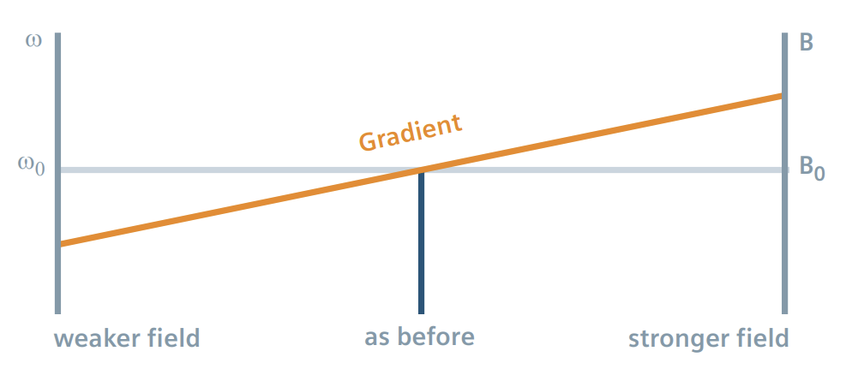
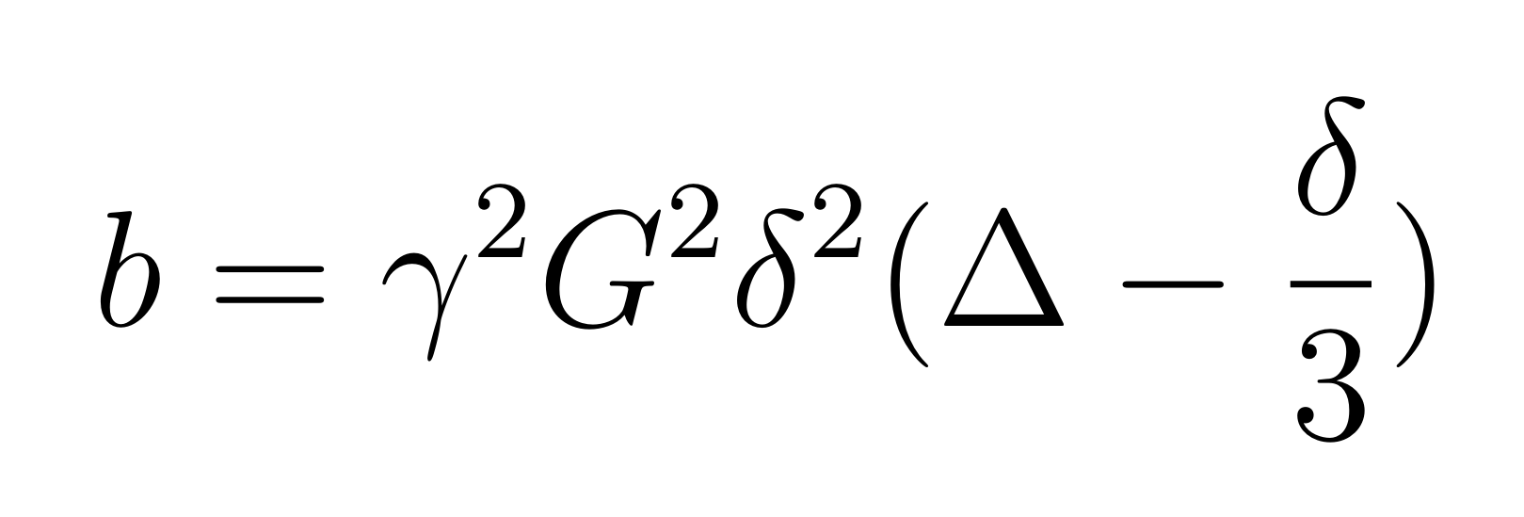
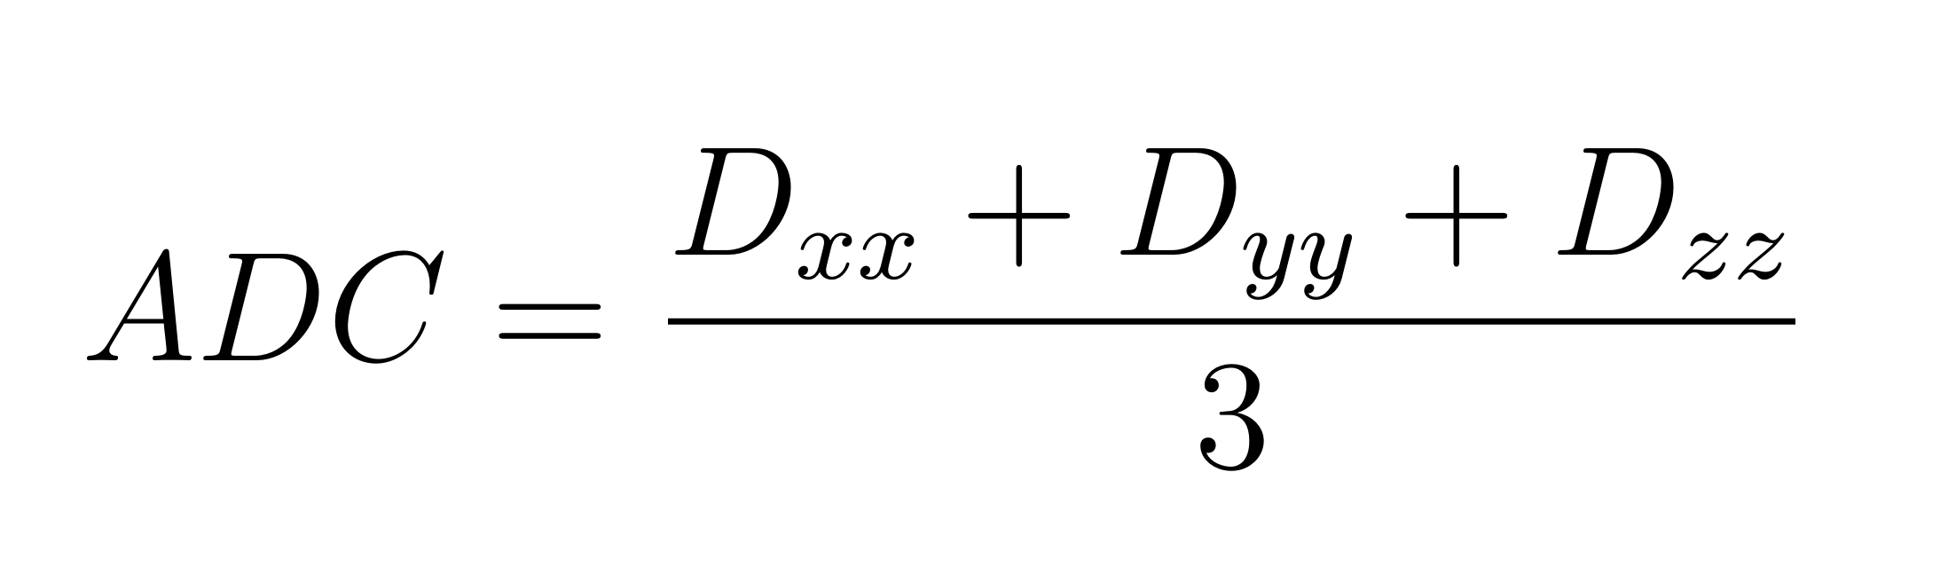
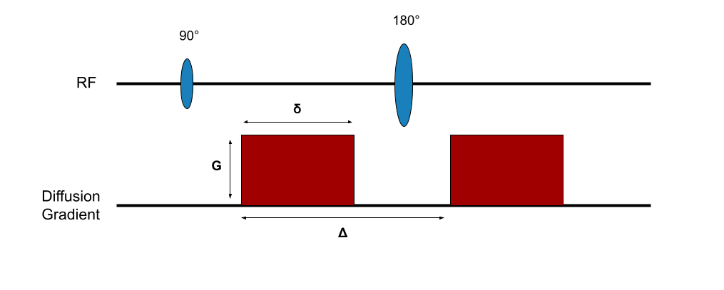
DWI
x
slope = D or ADC
ln (signal)
x
b (s/mm²)

Slide 18
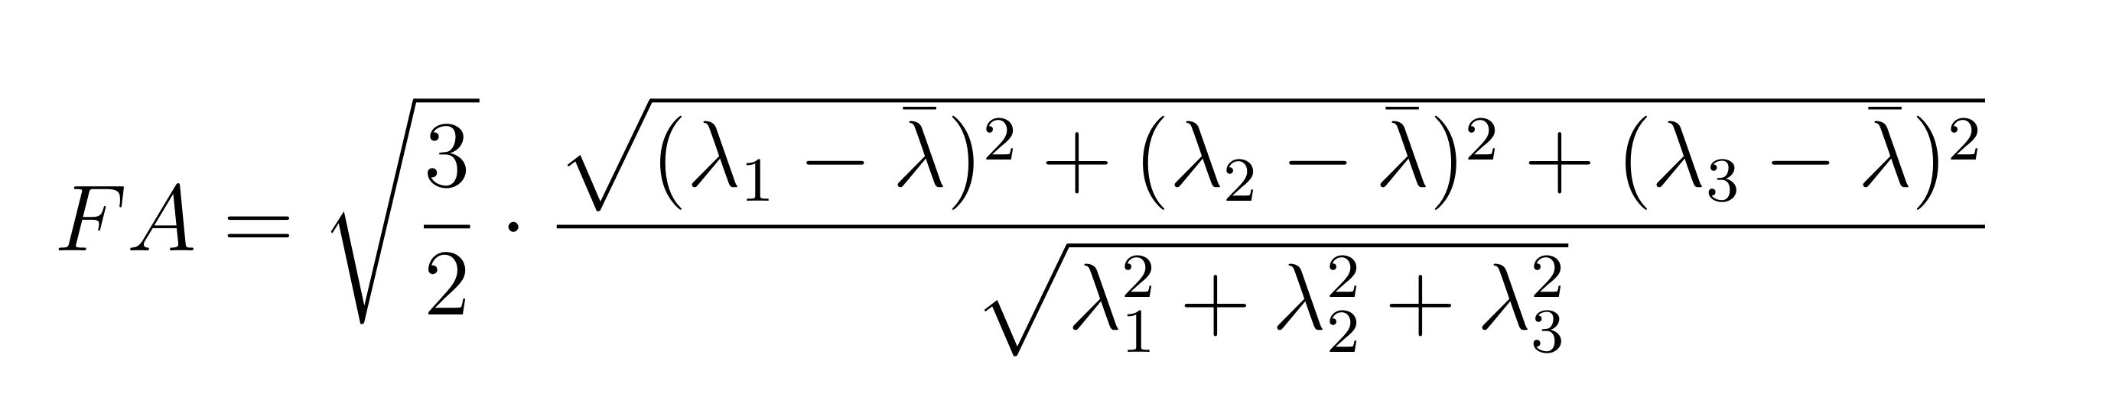
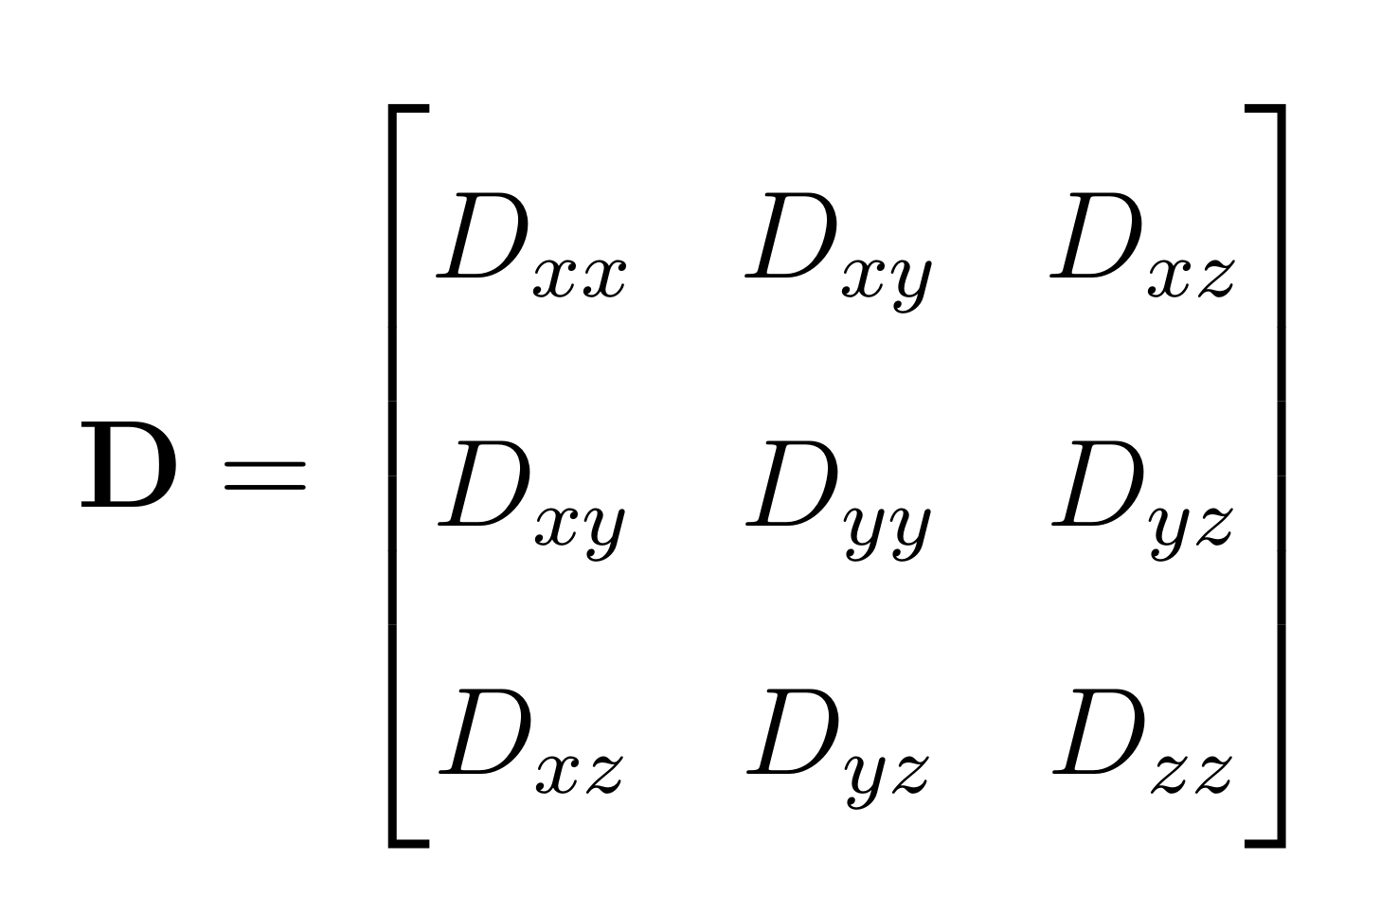
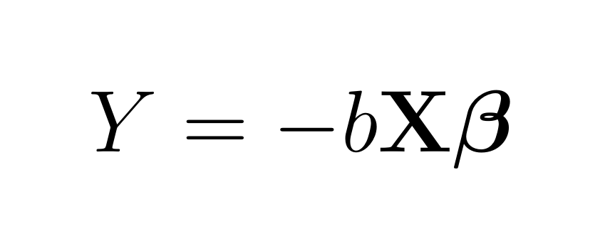
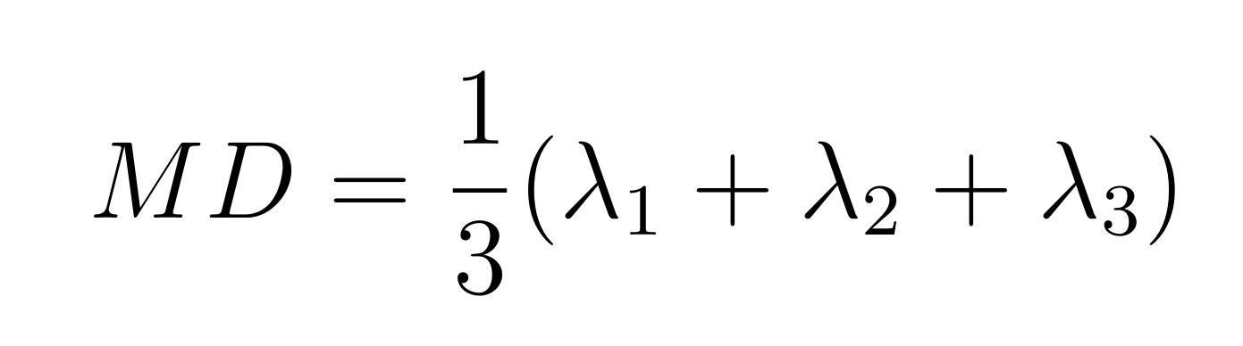
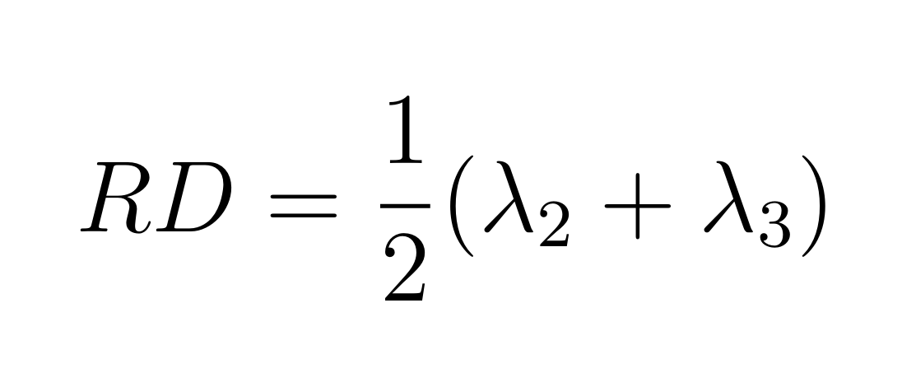
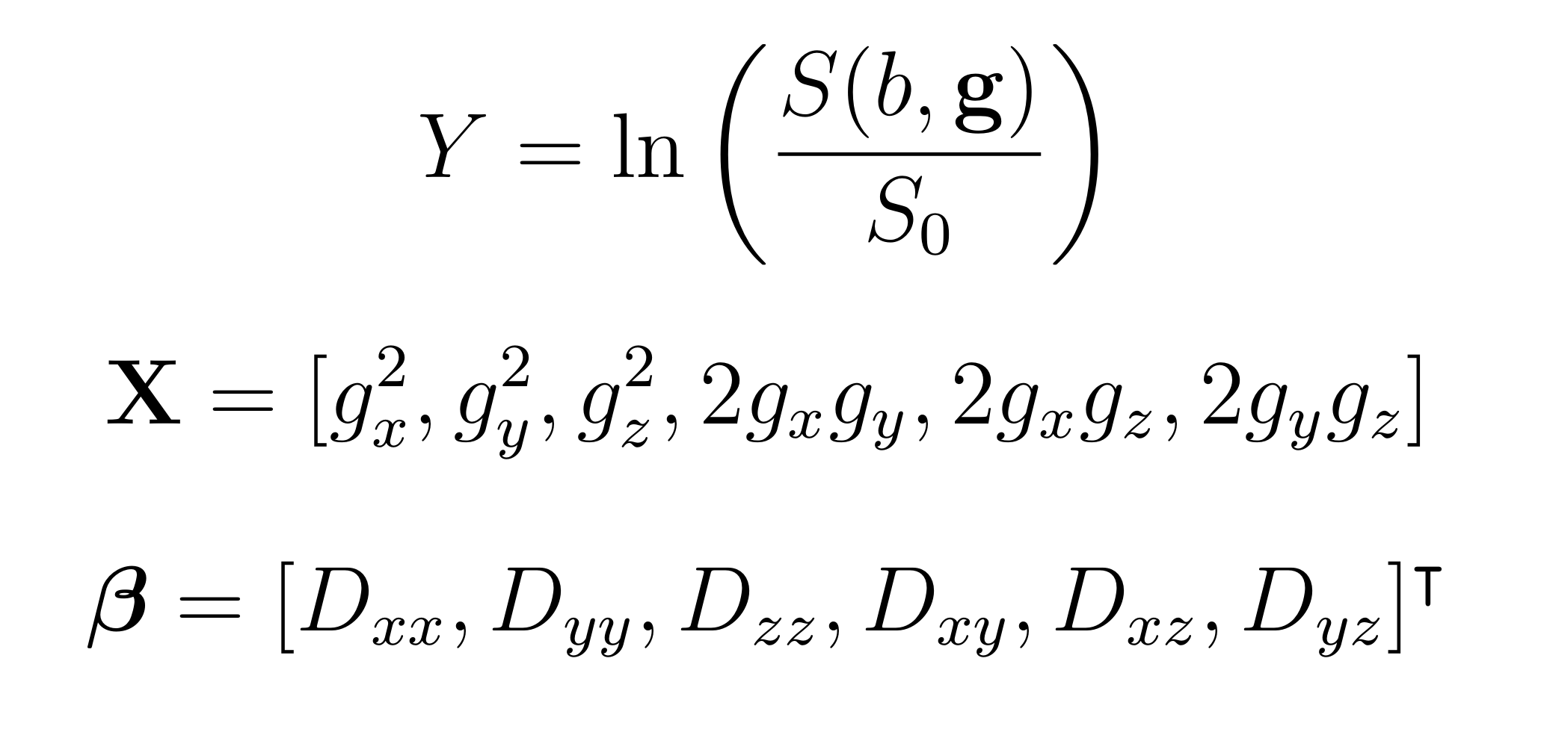
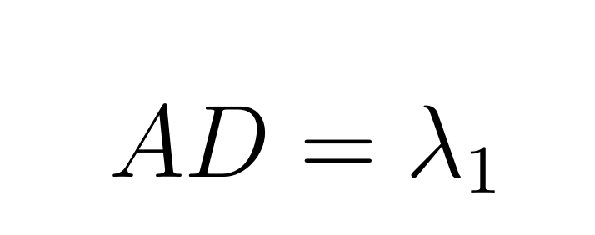
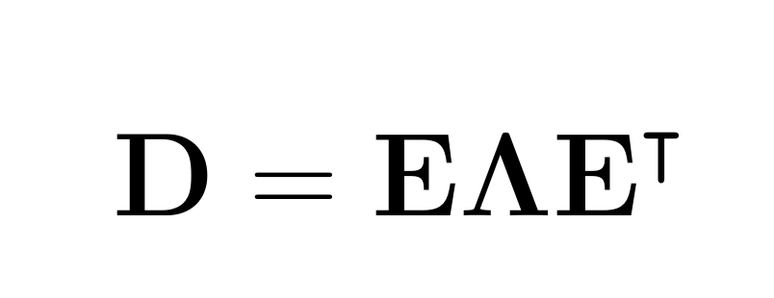
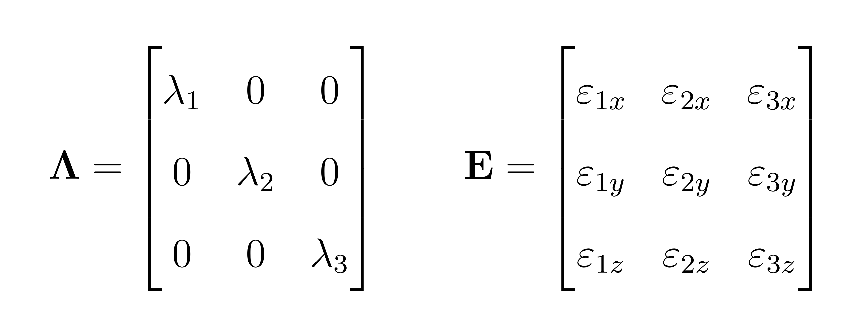
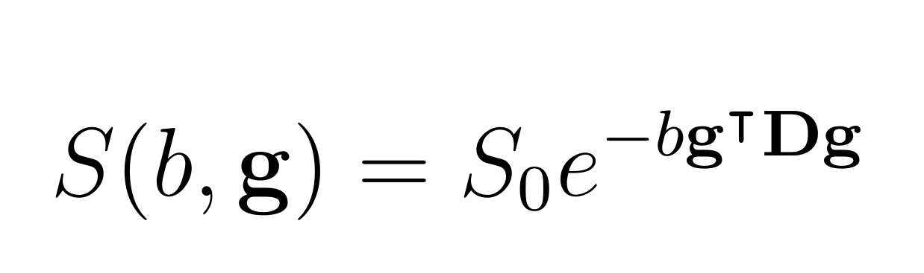
DTI

Slide 19
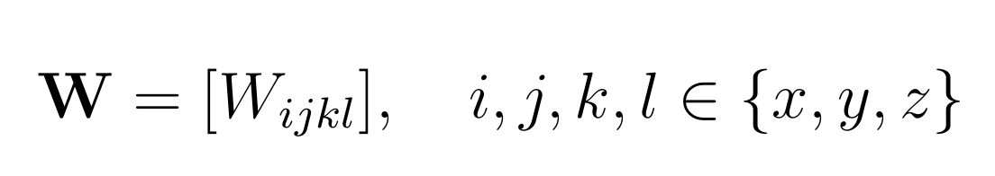
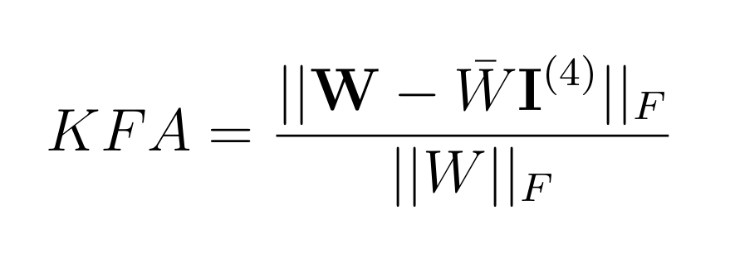
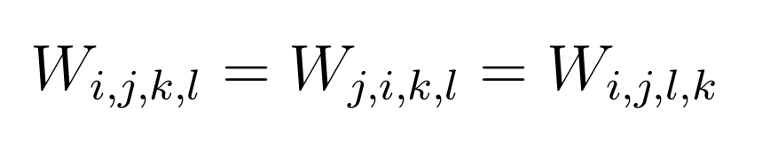
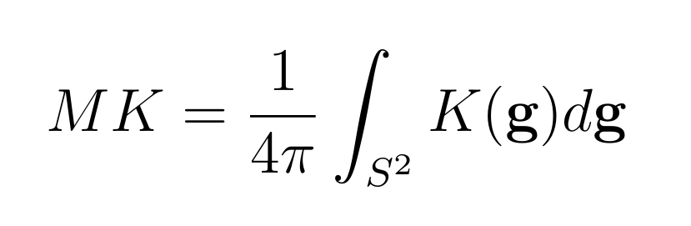
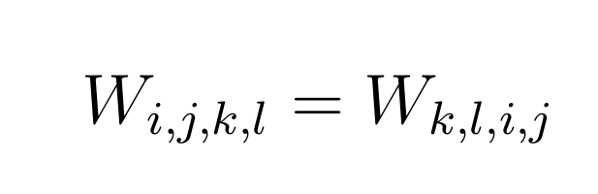
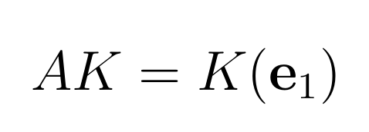




DKI

Slide 20











CSD

Slide 21


CSD

Slide 22
Scanner Parameters
Scan | Directions | B-values | TR/TE (ms) | Flip angle | Voxel size | Slices | Scan Time
T1w FSPGR | – | – | 7.94/3.07 | 12˚ | 1.0 iso | 168 | 4:37
PROPELLER DWI | 3 | 0, 1000 | 11000/58.15 | 110˚ | 2.5 iso | 66 | 4:57
DTI | 30 | 0, 1000 | 7000/58.1 | 90˚ | 2.5 iso | 66 | 4:05
HARDI-60 | 60 | 0, 1300 | 7000/61.6 | 90˚ | 2.5 iso | 66 | 7:35
HARDI-90 | 90 | 0, 1300 | 7000/61.6 | 90˚ | 2.5 iso | 66 | 11:05
DKI | 30 | 0, 250-3000 | 8000/75.1 | 90˚ | 2.5 iso | 66 | 32:40

Slide 23

Figures From Thesis 1
Figure 2.1
Figure 2.2
Figure 2.3
Figure 2.4

Slide 24


Figures From Thesis 2
Figure 2.5
Figure 4.1
Figure 4.2

Slide 25





Figures From Thesis 3
Figure 4.3
Figure 4.4
Figure 5.7
Figure 5.10
Figure 5.8
Figure 5.9

Slide 26






Figures From Thesis 4
Figure 5.1
Figure 5.2
Figure 5.3
Figure 5.4
Figure 5.5
Figure 5.6

Slide 27





Figures From Thesis 5
Figure B.1
Figure B.2

Slide 28





Figures From Thesis 6
Figure B.3
Figure B.4

Slide 29





Figures From Thesis 7
Figure B.5
Figure B.6

Slide 30


Tables from Thesis

