Slide 1

Allocation Run Process Flow and 2022 EMEA Early Allocation Set Up Review
July the 23rd & 24th, 2025
Nathalie Alves, SAP SD-MM external Consultant

Slide 2
Introduction on ARun and Early Allocation
Allocation Run is mandatory on AFS materials sales orders and is a prerequisite to delivery creation and billing.
Delivery can only be created once the stock is received at the warehouse, but stock can be reserved on Future Receipts before the goods arrive using Early Allocation.
Within the Sales and Distribution process, Allocation Run ensures the best possible assignment of stock to the open customers requirements based on specific rules, specially in case of stock shortage. Those rules are configured in ARun types that are the basis of any Allocation Run execution and determine its result.
Periodic ARun jobs are executed on requirements based either on Physical stock only, or on both Physical Stock and Future Receipts, using the assigned “Allocation Set”.
We will thereafter detail all the Allocation Run process flow steps and review the EMEA Early allocation set up.
Sales Order
Procurement Process
Allocation Run
Delivery
Invoice
ATP check
- Internal
- External
- Physical stock
- Future receipts
Automatic Allocation Run

Slide 3
Summary
Introduction
Allocation Run Process Flow
Requirements Selection
Requirements Filter
Stock Selection
Requirements Sorting
Stock Sorting
Stock/Requirements Allocation Rules
Release Rules
ARun Jobs
Deallocation Rules
Reporting: SAP & BI
Other future enhancements
Open questions
Appendix

Slide 4
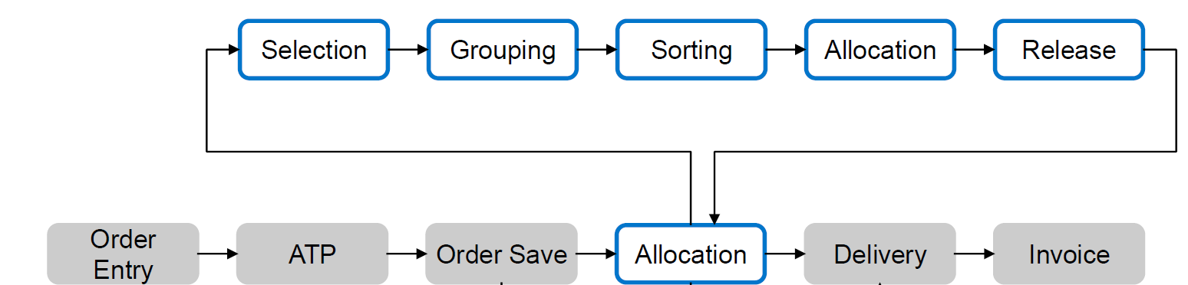

Allocation Run Process Flow
Requirements Selection
Global selection: order types
Customized Allocation sets
Rules for stock selection
Stock on-hand
Stock segments
Future stocks (Purchase Orders, Inbound deliveries...)
Temporary grouping during runtime
according to fields used in sales orders
(not supported by Parallel ARun)
Sorting of requirements according to fields used in sales orders
Sorting of stocks
according to stock specific criteria
Allocation logic
FIFO (based on requirements sorting)
SPREAD (equal stock distribution btw groups)
(not supported by Parallel ARun)
Allocation rule
Reference dates
Fields check
Dynamic stock validity
Release Rule
Fulfillment Percentage driven checks on allocated qty at different levels in order (header, item…)
Flexible release rule determination
ARun rejection check
Checks
Global Filter within Req. Selection
according to fields used in sales orders (i.e. Cancel date)
Automatic
ARun
ARun Optimizer
Requirements
Stocks
Early Allocation

Slide 5
Allocation Run Process Flow
Automatic Allocation Run is executed on “Rush Orders” when they are saved and only on Physical stock:
Automatic Allocation Run is executed on “Consignment Issue and Return Orders” when they are saved and only on Customer stock:
Future Receipts are not relevant for those Automatic Allocation Runs.
Sales order type | Description
ZEEC | E-commerce
ZICR | Inter Com Rush Order
ZRO | Rush order
ZWTY | Warranty Replacement
Sales order type | Description
ZKA | Wholesale Pick-up
ZKE | Wholesale Inv Issue

Slide 6
Requirements Selection
Requirements Selection
Global selection: order types
Customized Allocation sets
Rules for stock selection
Stock on-hand
Stock segments
Future stocks (Purchase Orders, Inbound deliveries...)
Temporary grouping during runtime
according to fields used in sales orders
(not supported by Parallel ARun)
Sorting of requirements according to fields used in sales orders
Sorting of stocks
according to stock specific criteria
Allocation logic
FIFO (based on requirements sorting)
SPREAD (equal stock distribution btw groups)
(not supported by Parallel ARun)
Allocation rule
Reference dates
Fields check
Dynamic stock validity
Release Rule
Fulfillment Percentage driven checks on allocated qty at different levels in order (header, item…)
Flexible release rule determination
ARun rejection check
Checks
Global Filter within Req. Selection
according to fields used in sales orders (i.e. Cancel date)
Automatic
ARun
ARun Optimizer
Requirements
Stocks
Early Allocation

Slide 7
Requirements Selection
Global requirements selection is done according to the origin of the requirements records.
Allocation Run can then only access to Sales Orders and Contracts.
Credit/Debit notes and Returns are automatically excluded from the Allocation Run.
MTO/PTO sales orders can be excluded from the Allocation Run.
BOARDRIDERS’ allocation only runs on Sales Orders and Contracts.

Slide 8
Requirements Customized Selection
Each Allocation Run can have its own requirements selection criteria. We then create Allocation sets accordingly which will run separately.
EMEA Common selection criteria:
Sales Order criteria: Sales Organization = 2*
Header Delivery block: Exclusion of 01 to 30, 33, 34 or 40.
Item Season indicator: Exclusion of “future seasons” range
(i.e. 213 exclusion of range 214 to 999.)
Season indicators starting with a letter are not excluded.
Stock criteria: Storage Location= 2000
Note: Season indicator defines when customers priority level should be reviewed, Season dates being determined based on a Buying Calendar (which is Global) and thereafter Customers delivery windows.

Slide 9
Requirements Customized Selection
EMEA Specific selection criteria according to Business Channel and process flow:
Requirements Delivery horizon: Corresponding to the largest full season delivery window (= 365 days)
Customer criteria: CGP 1 to filter Business Channels (i.e. G10=Retail, G55=Marketplace,..)
CGP 2 to filter Customer group within CGP 1 (G10 Retail/G30 Outlets)
Sold-to list for Priority sets when no Customer criterion available
Material criteria: List of relevant plants:
Material number: only used for special needs such as exclusion.
Plant | Name 1
2001 | FMS
2002 | KATOEN
2003 | SUNSHINE
2004 | STACI BELGIUM
2005 | STOCK 153
2007 | ELBPACK
2051 | FMS EC
2052 | KATOEN EC
2053 | SUNSHINE EC
2054 | STACI BELGIUM EC
2055 | STOCK 153 EC
2057 | ELBPACK EC

Slide 10
Requirements Customized Selection
EMEA Specific selection criteria according to Business Channel and process flow:
Sales Order Header criteria: List of relevant Sales Order types:
Excluding the Rush Order types, Consignment Issue or Return orders.
List of Order Reasons:
Including or Excluding values
Sales order type | Description
ZCQ | Quantity Contract
ZFOC | Free of Charge
ZIC | Inter Company Sales
ZICQ | Qty Contract RTL
ZKB | Wholesale Fill-up
ZKBR | Wholesale FUp ref
ZPOP | QS POP
ZSAM | Sample Order
ZSO | Standard order
ZTRA | Transfer Order

Slide 11
Requirements Filter
Requirements Selection
Global selection: order types
Customized Allocation sets
Rules for stock selection
Stock on-hand
Stock segments
Future stocks (Purchase Orders, Inbound deliveries...)
Temporary grouping during runtime
according to fields used in sales orders
(not supported by Parallel ARun)
Sorting of requirements according to fields used in sales orders
Sorting of stocks
according to stock specific criteria
Allocation logic
FIFO (based on requirements sorting)
SPREAD (equal stock distribution btw groups)
(not supported by Parallel ARun)
Allocation rule
Reference dates
Fields check
Dynamic stock validity
Release Rule
Fulfillment Percentage driven checks on allocated qty at different levels in order (header, item…)
Flexible release rule determination
ARun rejection check
Checks
Global Filter within Req. Selection
according to fields used in sales orders (i.e. Cancel date)
Automatic
ARun
ARun Optimizer
Requirements
Stocks
Early Allocation

Slide 12
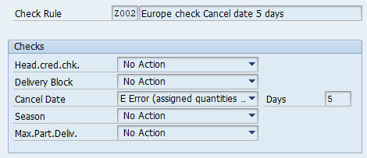
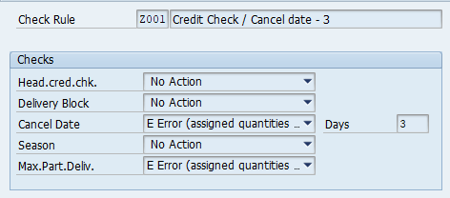
Requirements Filter
The selected orders will then have a check on the following criteria. If it fails, then they are excluded from the Allocation Run:
EMEA US
EMEA - Sales Order Header/Item Cancel date:
If the Cancel date is <= (ARun date + 5 working days), the sales order is not allocated, or allocation is not updated.

Slide 13
Stock Selection
Requirements Selection
Global selection: order types
Customized Allocation sets
Rules for stock selection
Stock on-hand
Stock segments
Future stocks (Purchase Orders, Inbound deliveries...)
Temporary grouping during runtime
according to fields used in sales orders
(not supported by Parallel ARun)
Sorting of requirements according to fields used in sales orders
Sorting of stocks
according to stock specific criteria
Allocation logic
FIFO (based on requirements sorting)
SPREAD (equal stock distribution btw groups)
(not supported by Parallel ARun)
Allocation rule
Reference dates
Fields check
Dynamic stock validity
Release Rule
Fulfillment Percentage driven checks on allocated qty at different levels in order (header, item…)
Flexible release rule determination
ARun rejection check
Checks
Global Filter within Req. Selection
according to fields used in sales orders (i.e. Cancel date)
Automatic
ARun
ARun Optimizer
Requirements
Stocks
Early Allocation

Slide 14
Stock Selection
  “Regular Allocation Run” considers current available physical stock :
  Batch Stock
  Customer Consignment Stock -> selected only for Consignment process flows.
  MTO/PTO Stock -> only used through X-Dock and Drop Ship dedicated Z t-code

Slide 15
Stock Selection
  “Early Allocation Run” (also called “Allocation Run on Future Receipts”) considers the following stocks types:
Current Physical Stock:
  Batch Stock
And
Future Receipts:
  Purchase Orders (including STO for the requirements of the STO receiving plant)
  Shipping Notifications
  Production Orders are not taken into account in the ARun execution at BOARDRIDERS but only external procurements.
  Purchase Requisitions and Planned Orders are not relevant for the Early Allocation Run but for the ARun Preview only.

Slide 16
Requirements Sorting
Requirements Selection
Global selection: order types
Customized Allocation sets
Rules for stock selection
Stock on-hand
Stock segments
Future stocks (Purchase Orders, Inbound deliveries...)
Temporary grouping during runtime
according to fields used in sales orders
(not supported by Parallel ARun)
Sorting of requirements according to fields used in sales orders
Sorting of stocks
according to stock specific criteria
Allocation logic
FIFO (based on requirements sorting)
SPREAD (equal stock distribution btw groups)
(not supported by Parallel ARun)
Allocation rule
Reference dates
Fields check
Dynamic stock validity
Release Rule
Fulfillment Percentage driven checks on allocated qty at different levels in order (header, item…)
Flexible release rule determination
ARun rejection check
Checks
Global Filter within Req. Selection
according to fields used in sales orders (i.e. Cancel date)
Automatic
ARun
ARun Optimizer
Requirements
Stocks
Early Allocation

Slide 17
Requirements Sorting
For EMEA, allocatable Requirements (excluding Samples Orders) will be sorted with the following priorities within individual allocation set:
Customer Group 1 (applies to Wholesale allocation sets only)
Delivery Priority indicator (Ascending sorting)
Sales Orders Creation Date (Ascending sorting)
Sales Orders number (Ascending sorting)
Steps 3 & 4 were implemented so the contracts were not allocated last.
Cust Gp | Description | Cust Gp 1 | Description | Alloc Prio New (Asc.)
03 | Ecommerce | G55 | Homesite | 1
03 | Ecommerce | G50 | Marketplace | 2
01 | Wholesale | G15 | Key Account | 3
01 | Wholesale | G01 | Large Account | 4
01 | Wholesale | G02 | Franchise | 5
01 | Wholesale | G05 | Small Account | 6
01 | Wholesale | G20 | Distributor | 7
01 | Wholesale | G40 | B2B | 8
01 | Wholesale | G25 | Promo | 9
01 | Wholesale | G45 | Licensee | 10
01 | Wholesale | G30 | Internal | 11
02 | Retail | G10 | Retail | 12
01 | Wholesale | G35 | Clearance | 13

Slide 18
Stock Sorting
Requirements Selection
Global selection: order types
Customized Allocation sets
Rules for stock selection
Stock on-hand
Stock segments
Future stocks (Purchase Orders, Inbound deliveries...)
Temporary grouping during runtime
according to fields used in sales orders
(not supported by Parallel ARun)
Sorting of requirements according to fields used in sales orders
Sorting of stocks
according to stock specific criteria
Allocation logic
FIFO (based on requirements sorting)
SPREAD (equal stock distribution btw groups)
(not supported by Parallel ARun)
Allocation rule
Reference dates
Fields check
Dynamic stock validity
Release Rule
Fulfillment Percentage driven checks on allocated qty at different levels in order (header, item…)
Flexible release rule determination
ARun rejection check
Checks
Global Filter within Req. Selection
according to fields used in sales orders (i.e. Cancel date)
Automatic
ARun
ARun Optimizer
Requirements
Stocks
Early Allocation

Slide 19
Stock Sorting
Using the Early Allocation, EMEA allocatable stock is sorted with the following priorities:
Batch Stock (C)
Shipping Notifications (L)
Purchase Orders (B)

Slide 20
Stock/Requirements Allocation Rules
Requirements Selection
Global selection: order types
Customized Allocation sets
Rules for stock selection
Stock on-hand
Stock segments
Future stocks (Purchase Orders, Inbound deliveries...)
Temporary grouping during runtime
according to fields used in sales orders
(not supported by Parallel ARun)
Sorting of requirements according to fields used in sales orders
Sorting of stocks
according to stock specific criteria
Allocation logic
FIFO (based on requirements sorting)
SPREAD (equal stock distribution btw groups)
(not supported by Parallel ARun)
Allocation rule
Reference dates
Fields check
Dynamic stock validity
Release Rule
Fulfillment Percentage driven checks on allocated qty at different levels in order (header, item…)
Flexible release rule determination
ARun rejection check
Checks
Global Filter within Req. Selection
according to fields used in sales orders (i.e. Cancel date)
Automatic
ARun
ARun Optimizer
Requirements
Stocks
Early Allocation

Slide 21
Stock/Requirements Allocation Rules
Allocation rule defines how selected stock are assigned to selected requirements.
Fixed assignments will then be done based on:
Requirements and Stock Schedule Line Reference Dates
Requirements Date = Material Availability Date (= RDD – 3 days)
or Confirmed Delivery Date (according to Process flow)
Stock Date = Goods Receipt Date (= PO Delivery date + GR processing time), GR = 5 days in EMEA
Item Storage Location Logic
Storage Location strictly matches between Stock and Requirements when available in the Sales orders.
-> Automatic fill-in implemented of Storage Location 2000 in all Sales Orders and 2015 in Returns orders for EMEA.
Schedule Line Stock Category Logic
Stock Category matches the Requirement Category as maintained in the Coverage Strategy.

Slide 22
Stock/Requirements Allocation Rules
Stock priorization = Validity Horizon of allocation per stock type following priority
Physical Stock Prioritization:
This determines the point in time (days) when physical stock can be allocated. Based on this, the system calculates a horizon within which the Schedule Line confirmed date (= MAD) must lie to allow physical stock to be allocated.
Batch stock allocation horizon starts from ARun execution Date.
Future Stock Prioritization:
An allocation window is defined for a stock element. If the requirement date is within the window, then this stock can be allocated.
ASN and PO allocation horizons are calculated « backwards » and « forwards » starting from the Sales Order Schedule Line MAD
ASN and PO reference date for the allocation horizon is the Goods Receipt Date = PO Delivery date + GR processing time, also called as ASN/PO MAD.

Slide 23
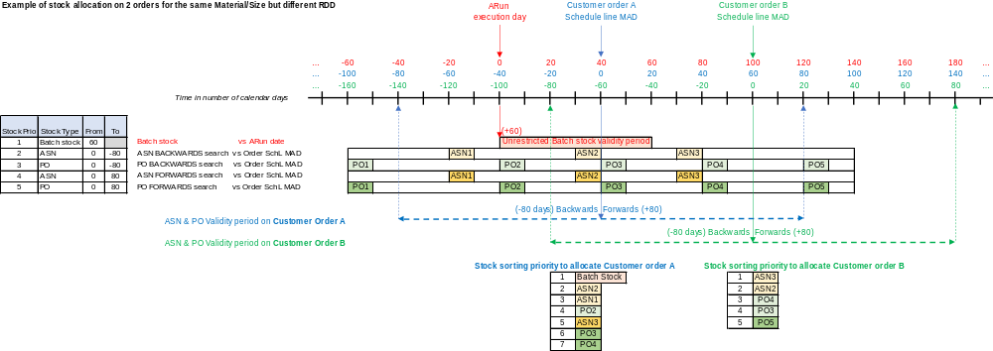
Stock/Requirements Allocation Rules

Slide 24
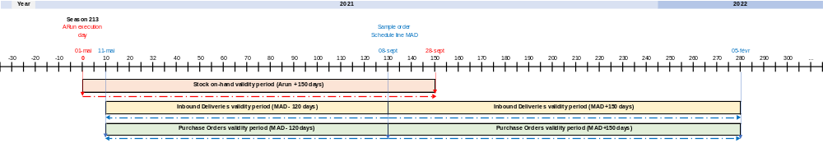
Stock/Requirements Allocation Rules
  EMEA Samples Orders Horizon:
Horizons are defined according to seasons’ delivery dates – see Appendix for details
Prio. Of Stock | Stock Type | From | To
1 | C Batches | 150
2 | L Confirmations | 120- | 150
3 | B Purchase Orders | 120- | 150

Slide 25
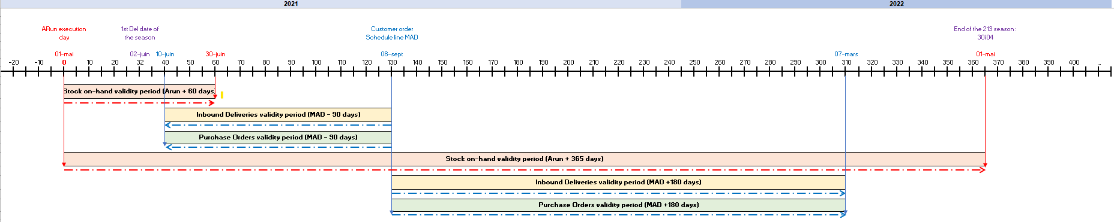
Stock/Requirements Allocation Rules
“Late” Future receipts : delivered max 180 days after customer MAD
Prioritize “Shipped PO (ASN)” VS “PO WIP”. ASN dates & quantities are less about to be adjusted
Searching for documents delivered after MAD, accepting late deliveries, and giving visibility on it (SO, Customer, PO)
Searching for documents in “forwards” mode to limit gap between customer MAD & effective delivery
Assigning through 90 days late will provide detailed analysis on late (SO, Customer, Channel, PO, Airfreight) with a risk of changes in those 90 days (Asia Hub, XDK…) that will need to be adjusted if massive
Current Supply / Demand analysis is set to +/-14 days
Prio. Of Stock | Stock Type | From | To
1 | C Batches | 60
2 | L Confirmations | 0 | 90-
3 | B Purchase Orders | 0 | 90-
4 | C Batches | 365
5 | L Confirmations | 0 | 180
6 | B Purchase Orders | 0 | 180
  EMEA Customers/Bulk Orders:
Horizons are defined according to seasons’ delivery dates – see Appendix for details
Stock on-hand : max to +60 days as 1st allocation priority vs customer MAD
“On-time” Future receipts : delivered max 90 days before customer MAD
Prioritize “Shipped PO (ASN)” VS “PO WIP”. ASN dates & quantities are less about to be adjusted
Searching for documents delivered prior to MAD to maximize “on-time” customer delivery, with a risk of immobilizing inventory (once received in DC) for 60 days (+ 30 days compared to on-hand strategy)
Searching for documents in “backwards” mode to limit stock immobilization once received in DC
Stock on-hand : max to +365 days
Catch all exceptions and reserve existing inventory before late goods receipts.

Slide 26
Release Rules
Requirements Selection
Global selection: order types
Customized Allocation sets
Rules for stock selection
Stock on-hand
Stock segments
Future stocks (Purchase Orders, Inbound deliveries...)
Temporary grouping during runtime
according to fields used in sales orders
(not supported by Parallel ARun)
Sorting of requirements according to fields used in sales orders
Sorting of stocks
according to stock specific criteria
Allocation logic
FIFO (based on requirements sorting)
SPREAD (equal stock distribution btw groups)
(not supported by Parallel ARun)
Allocation rule
Reference dates
Fields check
Dynamic stock validity
Release Rule
Fulfillment Percentage driven checks on allocated qty at different levels in order (header, item…)
Flexible release rule determination
ARun rejection check
Checks
Global Filter within Req. Selection
according to fields used in sales orders (i.e. Cancel date)
Automatic
ARun
ARun Optimizer
Requirements
Stocks
Early Allocation

Slide 27
Release Rules: General settings
Requirements are allocated according to fill-up release rules where schedule lines can be reserved on Batch stock even if the final release check fails until it succeeds. Allocation Run will update the MRP status from R to F on Batch stock according to release rule and eventual new goods receipts.
All reserved requirements are not automatically deallocated and reallocated but analyzed in additional allocation runs for updates based on the existing reservation.
As long as quantities are allocated Reserved on a Shipping Notification or a PO, the next Allocation Runs will keep the same allocated ASN/PO.
Quantities allocated ‘F’ are not reallocated by the next allocation Runs. They are pending for delivery creation which is a different step.
Final action depends on release rule, but system is set up in a way that no blocking event drops any Reserved quantities during ARun.

Slide 28
Release Rules: General settings
If contract is allocated « R »:
  the call-off order will get the contract allocation « R » and can be then updated to « F » if stock is available or Future Receipts are received.
  And if the call-off order quantity is rejected, deleted or reduced, the quantity goes back to the Contract with the initial allocation.
If contract is not yet allocated:
  the call-off order can be allocated by the next ARun execution, not the Contract anymore.
  And if the call-off order quantity is rejected, deleted or reduced, the quantity goes back to the Contract without the call-off allocation. The allocation is lost.

Slide 29
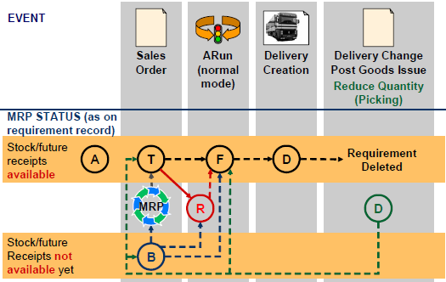
Release Rules: MRP Status update
ARun will chose the supply that covers the best the requirements according to business and customer rules (grouping, sorting and check rules), and stock selection and sorting, before releasing the delivery.
Future Receipts can then be Reserved.
MRP main status:
A : Freely available stock (Batch and/or Future receipts)
B : Blocked requirements (no supply can cover the req., neither on-hand stock, nor Future Receipts)
T : Temporarily assigned (some on-hand stock or Future Receipts supply covers the req. on a FIFO basis).
This supply was either created through MRP run or direct purchase documents creation.
R : Reserved (Allocation Run was executed and reserved on-hand stock or Future Receipts stock on req.
until release checks succeed to deliver the order)
F : Fixed (Allocation Run was executed and fixed on-hand stock on req. which can now be delivered)
D : Delivered (Delivery was create on Fixed orders)

Slide 30
Release Rules: Backorders Rejection
Open quantities are dropped by ARun only when using specific ARun Types as per Business needs:
  ZE - EU Rush orders Backorders
  is used for Wholesale AMZ, EDI, ZRO « Replenishment Rush orders », and E-Commerce Marketplace replenishment orders by dropping all open quantities regardless allocation status. This rejection is proposed by ARun and applied after delivery creation by mass update (vs ARun rejection check). This way only open quantities not under delivery are dropped.
  ZD - EU Unallocated Rush orders
  is used in order to drop only open unallocated quantities. It is manually applied in Inventory Management team Sales Orders.

Slide 31
ARun Jobs
ARun Parallel Execution:
Night Allocation jobs use the Parallel ARun execution program for better performances.
It works by material, by task, and then by levels above the Item.
Some restrictions exist with Parallel ARuns :
Grouping and SPREAD allocation logic is not possible,
dynamic credit check are not possible,
value-added services cannot be handled when they require additional physical VAS materials,
stats not available like Batch allocation.

Slide 32
ARun Jobs
ARun Logs have been activated for all regions. No region limitation can be done on those logs.
Existing ARun Logs Refresh job has also been updated with logs deletion delays due to high database volumes:
Job name | Periodicity /Day | PST Time | PST Day | CET Time | CET Day
100_GL_D_SD_ARUN_REFRESH_LOGS | 1 | 20:30:00 | D | 05:30:00 | D+1
New No. | Program name/command | Parameters | User | New Date Attribute update proposal
1 | ZZYDTT65 | IT_HELPDESK | BATCHUSER | -
2 | /AFS/ARUN_LOGFILE_REORG | DAILY_PROT | BATCHUSER | <= Current date -21 days
3 | /AFS/ARUN_LOGFILE_REORG | DAILY_PROI | BATCHUSER | <= Current date -14 days
4 | /AFS/ARUN_LOGFILE_REORG | DAILY_STAT | BATCHUSER | <= Current date -21 days
5 | /AFS/ARUN_LOGFILE_REORG | DAILY_SORT | BATCHUSER | <= Current date -21 days
6 | /AFS/ARUN_LOGFILE_REORG | DAILY_RFC | BATCHUSER | <= Current date -14 days
7 | J_4ALOGR | J_3ABDBS | BATCHUSER | <= Current date -30 days
8 | J_4ALOGR | J_3ABDBS_M | BATCHUSER | <= Current date -30 days
9 | J_4ALOGR | J_3ABDSI | BATCHUSER | <= Current date -30 days
10 | J_4ALOGR | J_3ABSSI | BATCHUSER | <= Current date -30 days
11 | J_4ALOGR | MCHB | BATCHUSER | <= Current date -30 days
12 | ZZYDTT65 | REL_JOB | BATCHUSER | -

Slide 33
ARun Jobs
Final EMEA 221/222 ARun Jobs list :
Each Job has 1 or more allocation runs, and other steps like ATP checks, rejections, Delivery blocks updates, Delivery creation, GI… according to the process flows.
All of them are executed within a specific sequence.
Seq. | Job name | Periodicity /Day | PST Time | PST Day | CET Time | CET Day
6 | 100_EU_X_SD_ALLOC_EDI_AMZ | 3 | 04:00:00 | D | 13:00:00 | D
1 | 100_EU_D_SD_ZKE_PRE_INVOICING | 1 | 10:00:00 | D | 19:00:00 | D
2 | 100_EU_X_SD_ALLOC_EDI_AMZ | 3 | 11:00:00 | D | 20:00:00 | D
3 | 100_EU_D_SD_ALLOC_SAMPLES | 1 | 12:15:00 | D | 21:15:00 | D
4 | 100_EU_D_SD_ALLOC | 1 | 15:45:00 | D | 00:45:00 | D+1
5 | 100_EU_X_SD_ALLOC_EDI_AMZ | 3 | 23:00:00 | D | 08:00:00 | D+1

Slide 34
ARun Jobs
EMEA Consignment Issue ARun Job:
Consignment Issue orders (ZKE) do not need manual, or period Allocation Run since they are automatically allocated at creation/saving.
This job is only for Consignment Issue orders which could not be « completely » allocated when they were created (release rule at Header = 100%), and allocation needs to be run back again after stock correction, in order to invoice them and post GI.
Jobs Seq | Job name | New Step N° | Step description | Program name/command | Parameters | Allocation Set | Alloc. Set Job Description
1 | 100_EU_D_SD_ZKE_PRE_INVOICING | 1 | ATP Check | /AFS/RVMDCD | EU ZKE ATP
1 | 100_EU_D_SD_ZKE_PRE_INVOICING | 2 | ARUN | /AFS/ARUN_PARALLEL | EU_ZKE | 100000540 | EU_ZKE
1 | 100_EU_D_SD_ZKE_PRE_INVOICING | 3 | Invoicing | RVV50R10C | EU ZKE
1 | 100_EU_D_SD_ZKE_PRE_INVOICING | 4 | GI | WS_MONITOR_OUTB_DEL_GDSI | EU_PGI_ZKE

Slide 35
ARun Jobs
EMEA AMAZON ARun Job:
This job is only for a limited selection of AMAZON accounts, and for immediate replenishment orders.
AMAZON replenishment orders are supposed to be created under requirement category « 1 OPT », the AMAZON bulk orders need to be allocated, and stock transferred to « 1 OPT » before replenishment orders are allocated.
This job also cleans obsolete backorders and short picks; updates delivery blocks and creates deliveries.
Jobs Seq | Job name | New Step N° | Step description | Program name/command | Parameters | Allocation Set | Alloc. Set Job Description
2 | 100_EU_X_SD_ALLOC_EDI_AMZ | 1 | BO Rejections | /AFS/RVMDCD | AMZ_OBSOLETE
2 | 100_EU_X_SD_ALLOC_EDI_AMZ | 2 | BO Rejections | /AFS/RVMDCD | AMZ_OBSOLETE2
2 | 100_EU_X_SD_ALLOC_EDI_AMZ | 3 | BO Rejections | /AFS/RVMDCD | AMZ_OBSOLETE3
2 | 100_EU_X_SD_ALLOC_EDI_AMZ | 4 | Short Picking Rejections | /AFS/RVMDCD | ZSO_AMZ_SHP
2 | 100_EU_X_SD_ALLOC_EDI_AMZ | 5 | Wait | ZDT_PROCESSING_WAIT | WAIT_10_MIN
2 | 100_EU_X_SD_ALLOC_EDI_AMZ | 6 | ATP Check | /AFS/RVMDCD | EU_AMZ_ATP
2 | 100_EU_X_SD_ALLOC_EDI_AMZ | 7 | Wait | ZDT_PROCESSING_WAIT | WAIT_10_MIN
2 | 100_EU_X_SD_ALLOC_EDI_AMZ | 8 | ARun | /AFS/ARun_PARALLEL | EU_AMAZON | 100000542 | EU_AMAZON_REPL RUSH ORDERS
2 | 100_EU_X_SD_ALLOC_EDI_AMZ | 9 | Wait | ZDT_PROCESSING_WAIT | WAIT_10_MIN
2 | 100_EU_X_SD_ALLOC_EDI_AMZ | 10 | Delivery creation | ZSD_SO_DUE_FOR_DELIVERY_R01 | EU_AMZ_EDI
2 | 100_EU_X_SD_ALLOC_EDI_AMZ | 11 | Wait | ZDT_PROCESSING_WAIT | WAIT_10_MIN
2 | 100_EU_X_SD_ALLOC_EDI_AMZ | 12 | BO Rejections | /AFS/RVMDCD | ZSO_017_AMZ
2 | 100_EU_X_SD_ALLOC_EDI_AMZ | 13 | BO Rejections | /AFS/RVMDCD | AMZ_OUTOFSTOCK
2 | 100_EU_X_SD_ALLOC_EDI_AMZ | 14 | Del Block change | /AFS/RVMDCD | AMZ_DB 37=>60
2 | 100_EU_X_SD_ALLOC_EDI_AMZ | 15 | Wait | ZDT_PROCESSING_WAIT | WAIT_10_MIN
2 | 100_EU_X_SD_ALLOC_EDI_AMZ | 16 | P&H_Del Block change | ZSD_PACK_HOLD_DELV_NEW_E01 | AMZ_DB_37_60

Slide 36
ARun Jobs
EMEA SAMPLES ARun Job:
This job is only for Samples Orders.
It uses specific allocation rules such as specific allocation Horizon against Batch stock and Future Receipts stock.
There are multiple allocation sets : 3 for Early Samples sets, and 3 for Regular Samples sets.
Each group of samples sets has 3 accounts priority groups : Prio 1, Prio 2 and the remaining accounts.
Deliveries are created manually by Logistics.
Jobs Seq | Job name | New Step N° | Step description | Program name/command | Parameters | Allocation Set | Alloc. Set Job Description
3 | 100_EU_D_SD_ALLOC_SAMPLES | 1 | ARUN | /AFS/ARUN_PARALLEL | EU_ZSAM_1_224 | 100000543 | EU_SAMPLES_1_224
3 | 100_EU_D_SD_ALLOC_SAMPLES | 2 | ARUN | /AFS/ARUN_PARALLEL | EU_ZSAM_2_224 | 100000544 | EU_SAMPLES_2_224
3 | 100_EU_D_SD_ALLOC_SAMPLES | 3 | ARUN | /AFS/ARUN_PARALLEL | EU_ZSAM_3_224 | 100000545 | EU_SAMPLES_3_224
3 | 100_EU_D_SD_ALLOC_SAMPLES | 4 | ARUN | /AFS/ARUN_PARALLEL | EU_ZSAM_1_009 | 100000546 | EU_SAMPLES_1_009
3 | 100_EU_D_SD_ALLOC_SAMPLES | 5 | ARUN | /AFS/ARUN_PARALLEL | EU_ZSAM_2_009 | 100000547 | EU_SAMPLES_2_009
3 | 100_EU_D_SD_ALLOC_SAMPLES | 6 | ARUN | /AFS/ARUN_PARALLEL | EU_ZSAM_3_009 | 100000548 | EU_SAMPLES_3_009

Slide 37
ARun Jobs
EMEA Regular ARun Job:
This job combines the allocation of the different Distribution Channels of the company according to allocation priorities between them:
It also includes Channels Bulks (stock transferts orders and contracts), deliveries, goods issue posting, backorders and short picks rejections, ATP checks and delivery blocks updates. All those steps are organized in a specific sequence.
Alloc Prio# | Distribution Channel/Dept. | 221/222 Allocation Process Flow/Accounts involved
1 | E-Commerce | E-Commerce Bulk
2 | E-Commerce | Marketplace accounts
3 | E-Commerce & Mkgt | E-Commerce Influencers & Photoshoot
4 | Retail | Retail Implementation Bulk
5 | Retail | Retail Stores Implementation Orders (except Outlets)
6 | Wholesale | Alaia Bay Account
7 | Wholesale | Prio 1
8 | Wholesale | EDI Replenishment Rush Orders
9 | Wholesale | Russian Distributor (Santocha)
10 | Wholesale | ZRO Replenishment Rush Orders
11 | Wholesale | Amazon Bulk
12 | Wholesale | Remaining accounts/orders
13 | Retail | Retail Replenishment Bulks
14 | Retail | Retail Stores Replenishment Orders (except Outlets)
15 | Inventory Management | Outlets accounts only
16 | Inventory Management | Clearance accounts only
17 | Inventory Management | Any sales order containing Order Reason 008

Slide 38
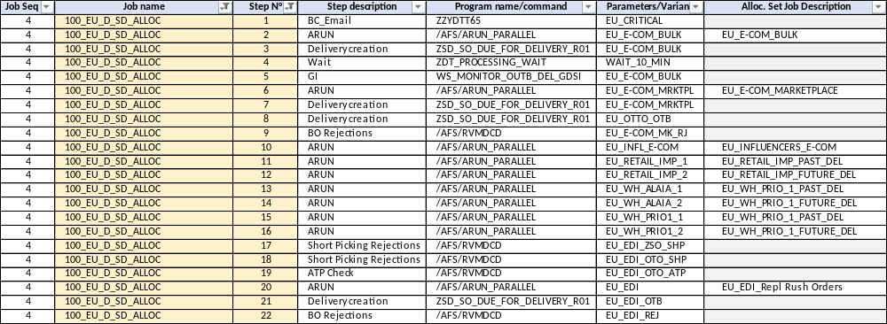
ARun Jobs
Job steps:

Slide 39
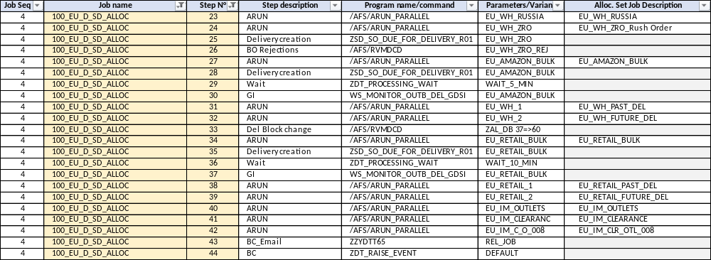
ARun Jobs
Next steps:

Slide 40
Deallocation Rules
As changes and cancellations can occur in the following documents:
Customer sales order
Purchase order
Shipping notification
GR/GI movements
, the system will automatically deallocate existing requirements or stock.
In addition to the SAP standard automatic deallocation process, we have implemented Requirements and Stock deallocation rules including stock deallocation windows and Sales Order safety window.
According to the deliveries/receipts’ windows, the type of changes and the source of those changes, either the quantities are not always deallocated, or they are deallocated following sorting rules.
Only existing reservation is either kept or dropped but never replaced by other assignments !

Slide 41
Deallocation Rules : resulting from Sales Order changes
Standard automatic deallocation
Whenever a change is made to a:
  Material,
  Size,
  Plant or
  Item category (i.e. X-dock and Drop-ship PO Explosion)
Or the deletion of a material or a schedule line is done in a Sales Order, the corresponding assignments will be completely deallocated.
Customizable automatic deallocation
Stock deallocation rules and sorting are assigned to Sales Order type/Sales Org./Dist. Channel/Division.
Same rules are applied to all Sales areas of the same Sales Order type.
We have maintained 2 deallocation rules for :
Customer Orders
Samples Orders
Consignment Issue and Consignment Return Orders do not need stock deallocation sorting rule and will use the basic deallocation rule on item deletion and quantity changes.

Slide 42
Deallocation Rules : resulting from Sales Order changes
Deallocation rules
  Requested Delivery Date
When changing a Schedule Line Sales Order requested delivery date, or the Item RDD, Stock/Requirements assignments deallocation will be based on:
New Requirements Date at Schedule Line = New « Material Availability Date » = New RDD – 3 days
And the stock validity period:
Batch stock validity period = Number of days that should not be exceeded between the SchLine ”new” MAD and “initial” MAD
  -> Anytime the “new” MAD it in the past compared to the “initial” MAD there is no deallocation.
Stock validity period (Inbound Del. or PO) = From/To number of days added to the SchLine “new” MAD
  -> if the « Goods Receipt Date » (Delivery date + GR processing time = Delivery date + 5 working days) still meets this interval then the allocation remains, otherwise it is deallocated.
You will get the following warning in the order :

Slide 43
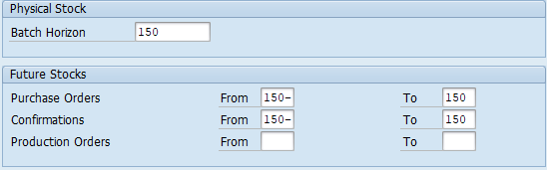

Deallocation Rules : resulting from Sales Order changes
Stock Deallocation windows are defined according to Stock allocation Windows.
We consider a “Safety window” where changes in the Sales orders do not deallocate Stock on Hand or Future Stock. (= Nbr of days between initial SchL RDD and last updated RDD of the same SchL)
Stock types assignment horizon validity for Samples Orders RDD change:
With these horizons, the sales order RDD
can be delayed up to max 30 day
without deallocation.
Stock types assignment horizon validity for Customer Orders RDD change:
With these horizons, the sales order RDD
can be delayed up to max 60 days
without deallocation.

Slide 44
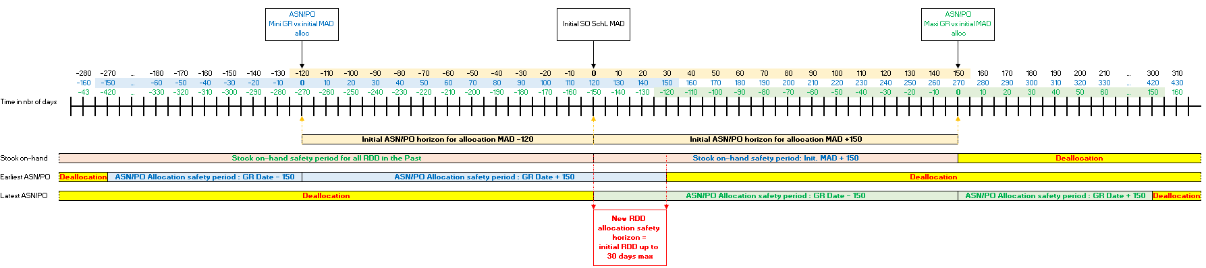
Deallocation Rules : resulting from Sales Order changes
Samples orders :

Slide 45
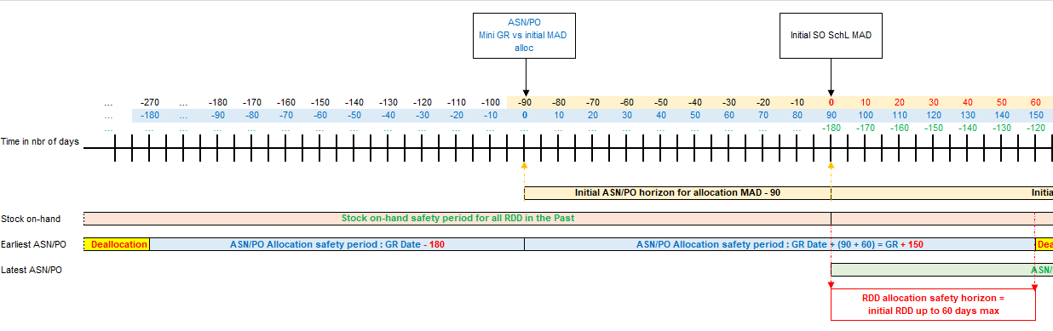
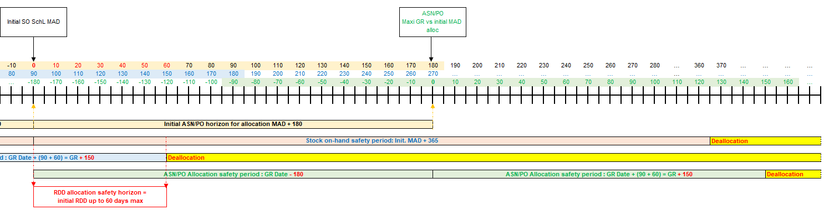
Deallocation Rules : resulting from Sales Order changes
Customer orders :

Slide 46

Deallocation Rules : resulting from Sales Order changes
  Fields change
When changing the following fields, the assignments will be deallocated:
Storage Location
Requirement Category (other than authorized by coverage strategy)
  Quantity change
In case of a quantity change with no other change in the sales order:
Quantity Decrease:
  existing allocation is dropped on the reduced quantity; you will get a warning message:
  and kept as is on the remaining quantity.
Quantity Increase:
  allocation is kept for the existing quantity,
  the increased quantity either goes to Temporary assigned if open supply exists before it is reserved during next ARun, or goes to Blocked requirements if no supply is available until new supply can cover it.

Slide 47
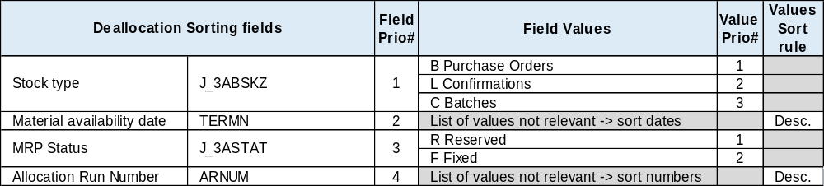
Deallocation Rules : resulting from Sales Order changes
Stock deallocation sorting Rule
i.e. Initial sales order SKU qty is 100, you decrease it to 60, then 40 ea are deallocated. Those 40 ea were initially assigned to several stock types, within those Batch stock but also several PO/IBD documents.
You need then to define how the system sorts assigned Stock when performing deallocations by selecting the sort check fields, giving them a priority, and by detailing their values when it is relevant and sorting those.
The following stock deallocation sorting rule has been applied to all sales order types for SO Changes :
For i.e. Rush orders will only consider Batch stock for deallocation since no other stock type can be initially allocated on those orders. But the other criteria are still valid.

Slide 48
Deallocation Rules : resulting from PO & IBD changes
Standard automatic deallocation
Whenever a change is made to a:
  Material,
  Size
Or the deletion of a material or a schedule line is done in a Purchase Order or Inbound Delivery, the corresponding assignments will be completely deallocated.
Customizable automatic deallocation
Requirements deallocation rules and sorting are assigned to Plant.
All allocable plants are assigned with the same Requirements deallocation rule when PO or IBD are changed.

Slide 49
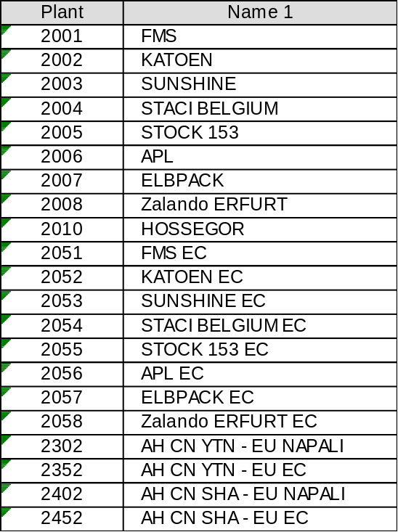
Deallocation Rules : resulting from PO & IBD changes
EMEA Allocatable/Deallocable Plants:

Slide 50
Deallocation Rules : resulting from PO & IBD changes
Deallocation rule
  Schedule Line Delivery Date
When changing a Schedule Line PO/IBD delivery date, Stock/Requirements assignments deallocation will be based on:
New PO Goods Receipt Date at Schedule Line = Delivery date + GR processing time = Delivery date + 5 working days
And the stock validity period vs the assigned requirements:
Stock validity period (Inbound Del. or PO) = From/To number of days added to the Req. SchLine MAD
  -> if the new « Goods Receipt Date » still meets this interval then the allocation remains, otherwise it is deallocated.

Slide 51
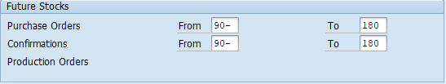
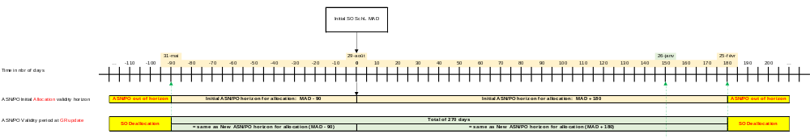
Deallocation Rules : resulting from PO & IBD changes
Stock types assignment horizon validity at PO/IBD Delivery date change:

Slide 52
Deallocation Rules : resulting from PO & IBD changes
  Fields change
When changing the following fields, the assignments will be deallocated:
Storage Location
Stock Category (other than authorized by coverage strategy)
Delivery Complete Indicator
  Quantity change on PO
Quantity Decrease:
  existing allocation is dropped on the reduced quantity only,
  kept as is on the remaining quantity.
Quantity Increase:
  allocation is kept for the existing quantity,
  the increased quantity either goes to Temporary assigned if open requirements exist before it is reserved during next Arun, or goes to Available Stock if no requirement is open until requirements are created.

Slide 53
Deallocation Rules : resulting from PO & IBD changes
  Quantity change on IBD
Quantity Decrease:
  reduced quantity allocation is not restored to the PO,
  existing allocation is dropped on the reduced quantity only,
  kept as is on the remaining quantity.
Quantity Increase:
  allocation is kept for the existing quantity,
  the increased quantity either goes to Temporary assigned if open requirements exist before it is reserved during next Arun, or goes to Available Stock if no requirement is open until requirements are created.

Slide 54
Deallocation Rules : resulting from PO & IBD changes
Requirements deallocation sorting Rule
i.e. Initial PO SKU qty is 400, you decrease it to 250, then 150 ea are deallocated. Those 150 ea were initially assigned to several Requirements.
You need then to define how the system sorts assigned Requirements when performing deallocations by selecting the sort check fields, giving them a priority, and by detailing their values when it is relevant and sorting those.
The following requirements deallocation sorting rule has been applied to all allocable plants for PO/IBD changes:
The purchase order can only be processed when the locked sales order is unlocked. If the quantity is reduced and a sales order cannot be locked, the next sales order will be deallocated.
Deallocation Sorting fields | Field Prio# | Field Values | Value Prio# | Values Sort rule
Customer group 1 | 1 | - Customers w/o CGP1 | 14 | Desc.
 |  | G35 - Clearance | 13
 |  | G30 - Internal | 12
 |  | G45 - Licensee | 11
 |  | G25 - Promo | 10
 |  | G40 - B2B | 9
 |  | G20 - Distributor | 8
 |  | G05 - Small Account | 7
 |  | G02 - Franchise | 6
 |  | G01 - Large Account | 5
 |  | G15 - Key Account | 4
 |  | G10 - Retail | 3
 |  | G50 - Marketplace | 2
 |  | G55 - Homesite | 1
Delivery priority | 2 | List of values not relevant -> sort numbers | (1 to 7) | Desc.
Material availability date | 3 | List of values not relevant -> sort dates |  | Desc.
Allocation Run Number | 4 | List of values not relevant -> sort numbers |  | Desc.

Slide 55
Deallocation Rules : resulting from Goods Receipt changes
Standard automatic deallocation
There are no standard automatic deallocation.
IBD Putaway = delivery quantity, which means the IBD is changed in case of partial delivery or different material receipt, not the GR itself and you have to refer to IBD changes.
Unplanned GR movements have no impact on allocated quantities since they add new stock.
Customizable automatic deallocation
Requirements deallocation rules and sorting are assigned to Plant.
All allocable plants are assigned with the same Requirements deallocation rule at GR movements.

Slide 56
Deallocation Rules : resulting from Goods Receipt changes
Deallocation rule
  Actual late GR Date
We did not implement deallocation at GR posting change date. When IBD final GR is late, Stock/Requirements assignments validity will not be checked back again. There will be no deallocation. Reservation R are converted into F at next Arun.
  Fields change
When changing the following fields during GR (MIGO), the assignments will be deallocated:
Storage Location
Stock Category (other than authorized by coverage strategy)
Delivery Complete Indicator

Slide 57
Deallocation Rules : resulting from Goods Receipt changes
Requirements deallocation sorting Rule
i.e. You change the storage location during IBD GR via MIGO. All allocated skus will be deallocated from requirements.
You need then to define how the system sorts assigned Requirements when performing deallocations by selecting the sort check fields, giving them a priority, and by detailing their values when it is relevant and sorting those.
The following requirements deallocation sorting rule has been applied to all allocable plants for GR :
-> Same sorting rule than PO/IBD changes
Deallocation Sorting fields | Field Prio# | Field Values | Value Prio# | Values Sort rule
Customer group 1 | 1 | - Customers w/o CGP1 | 14 | Desc.
 |  | G35 - Clearance | 13
 |  | G30 - Internal | 12
 |  | G45 - Licensee | 11
 |  | G25 - Promo | 10
 |  | G40 - B2B | 9
 |  | G20 - Distributor | 8
 |  | G05 - Small Account | 7
 |  | G02 - Franchise | 6
 |  | G01 - Large Account | 5
 |  | G15 - Key Account | 4
 |  | G10 - Retail | 3
 |  | G50 - Marketplace | 2
 |  | G55 - Homesite | 1
Delivery priority | 2 | List of values not relevant -> sort numbers | (1 to 7) | Desc.
Material availability date | 3 | List of values not relevant -> sort dates |  | Desc.
Allocation Run Number | 4 | List of values not relevant -> sort numbers |  | Desc.

Slide 58
Deallocation Rules : resulting from Goods Receipt changes
Standard automatic deallocation
There are no standard automatic deallocation.
Customizable automatic deallocation
Requirements deallocation rule and sorting are assigned to Plant only for ‘normal’ GI movement types.
All allocable plants are assigned with the same Requirements deallocation rule at GI movements.
Unplanned GI movements can have an impact on allocated quantities since they reduce on-hand stock.

Slide 59
Deallocation Rules : resulting from Goods Issue changes
Deallocation rule
  Quantity changes at ‘normal’ GI posting
For 'normal' movement types, such as 601 (goods issue for deliveries) or 102 (GR reversal), the system automatically carries out deallocation if there are allocated quantities and the quantity is changed during goods issue posting.
  ‘Unplanned’ GI posting
Unplanned GI movements can have an impact on allocated quantities since they reduce on-hand stock but it was not activated for any unplanned GI movements at the moment.
At this moment, those GI posting can deallocate the sales orders automatically when GI is processed via MIGO only. Idocs processing will be adjusted in a near future.

Slide 60
Deallocation Rules : resulting from Goods Issue changes
Requirements deallocation sorting Rule
i.e. You post an unplanned goods issue for 20 ea. Or make a GR reversal of 500 ea. Those reduced quantities were initially assigned to several Requirements.
You need then to define how the system sorts assigned Requirements when performing deallocations by selecting the sort check fields, giving them a priority, and by detailing their values when it is relevant and sorting those.
The following requirements deallocation sorting rule has been applied to all allocable plants for PO/IBD changes:
Deallocation Sorting fields | Field Prio# | Field Values | Value Prio# | Values Sort rule
Customer group 1 | 1 | - Customers w/o CGP1 | 14 | Desc.
 |  | G35 - Clearance | 13
 |  | G30 - Internal | 12
 |  | G45 - Licensee | 11
 |  | G25 - Promo | 10
 |  | G40 - B2B | 9
 |  | G20 - Distributor | 8
 |  | G05 - Small Account | 7
 |  | G02 - Franchise | 6
 |  | G01 - Large Account | 5
 |  | G15 - Key Account | 4
 |  | G10 - Retail | 3
 |  | G50 - Marketplace | 2
 |  | G55 - Homesite | 1
Delivery priority | 2 | List of values not relevant -> sort numbers | (1 to 7) | Desc.
Material availability date | 3 | List of values not relevant -> sort dates |  | Desc.
MRP Status | 4 | R Reserved | 1 | Asc.
 |  | F Fixed | 2
Allocation Run Number | 5 | List of values not relevant -> sort numbers |  | Desc.

Slide 61
Deallocation Rules : Mass-deallocation/Reallocation
When open PO quantities are closed using DCI, when items are deleted, or when PO is split for delivery/vendor split, PO assigned requirements deallocation sorting rule will be applied. Only the reduced quantities of the initial PO are deallocated.
Then the mass-deallocation strategy will depend on the Buys calendar:
  If the Buys are still ongoing and will cover all the requirements needed at RDD:
    -> no action is needed. The requirements will be allocated in the next Allocation Runs.
  If the Buys are finished or if they are still ongoing but you know you will not cover all the needs:
    and if deallocation comes from late Buys, deallocated requirements will be reallocated at next Arun on other remaining open supplies or assigned as uncovered. If you need to save some orders by manually deallocating others and few requirements/quantities were affected:
    -> You would use the Arun Optimizer (Deallocation/Reallocation under same customers group)
    and if the deallocation comes from deleted early/mid-season Buys, those PO changes may have disorganized the requirements allocation and you need to re-organize it:
    -> in this case mass-deallocation can be done based on the PO deleted materials list.

Slide 62
Deallocation Rules : Mass-deallocation/Reallocation
Hub / Cross-Dock / Drop Ship PO Explosion Run:
  When existing PO is changed, it deallocates the assigned Sales orders, but those Sales orders are also changed and newly allocated to the new POs using the same specific settings no other free requirement use (special stocks, item catg).
    -> no action needed
  Hub / Cross-Dock / Drop Ship PO Explosion Reversal:
  When a reversal of those PO explosion processes is done, the assigned requirements are deallocated, except those from the initial PO for the last confirmed quantities in regular PO. All the other requirements need a new Allocation Run but the next night run includes also other new requirements so they might loose their previous assignment.
    -> new allocation would use the requirements priority criteria so if some initially allocated orders are not allocated anymore it is because they are not a priority vs new requirements. If you want to do some adjustments you can use he Optimizer (Dealloc/realloc orders from customers of same group).
    PO GR Dates changes :
    If same PO material GR date is delayed several times, it can delay the assigned Sales orders delivery to much. In that case you could decide to deallocate the SO/Material within your Distribution Channel to reallocate them a night.

Slide 63
Reporting : SAP
SAP Sales Report ZSD_R53 : “New fields” were added :
  Net Order Qty = Order qty – Rejected Qty
  Net Order Value = Corresponding Net value
  Future Receipts Qty = Quantities allocated on Future Receipts
  Future Receipts Value = Corresponding Net value
  Latest MAD date = Latest Goods Receipts Date of the SchL / Item / Order.
-> enhancement to be done on Contract to add Latest MAD Date (done?)
SAP Sales Report ZSD_R04
-> Adjustments required in order to separate “Allocated” quantities on On-hand stock and “Allocated” quantities on Future Receipts. (Done ?)
SAP Sales Report ZSD_E88 Sold-to Accnts ARUN Fields Mass Updt
-> New report to mass-update the sold-to accounts ARun sensitive fields
SAP Sales Report ZSD_E89 SO & Ctrct ARUN flds Mass Update
-> New report to align the Sales Orders data according to the sold-to updated master data

Slide 64
Reporting : BI
BI Sales Report EUR088
-> Adjustments were done order to separate Reserved quantities on On-hand stock and Reserved quantities on Future Receipts.
BI Supply Report R096
-> No adjustment needed. Buckets are correctly populated.

Slide 65
Other future enhancements: Miscellanious
Limitation of additional allocation sets creation and reduction of existing sets maintenance:
  Use new ARun specific Customer Group criterion to define whether the customer orders should:
  Run into the AMZ allocation job, but also in other jobs like Orders changes or OTB creation;
  Run into the EDI allocation job, but also in other jobs like Orders changes or OTB creation;
  Run into the Samples allocation job;
  Run into the WH top priority set (do we need 1 or 2 WH priority sets apart from the WH regular sets?)
  …
    Warning : Customer should not cumulate several options from the same criterion
  Start managing the Release rule at Customer level in order to reduce the number of sets:
  in the Customer master data (Sales views),
  in the Sales Orders.
i.e. Santocha could be in the same WH Prio sets but with a different release rule (0%) like in its own set and delete existing set.

Slide 66
Other future enhancements: Miscellanious
Review the existing default sales Orders priority criteria: What would help you best to optimize distribution?
  1 : Customer group 1 (according to specific defined sorting) -> can be reviewed BEFORE a new season allocation
  2 : Delivery prio (ascending sort)
  3 : Order number (ascending sort)
i.e.
  By adding Customer/Order attribute(s) ?
  By adding dates : Order date, SchLine RDD ?
  …
Those changes cannot be done at any time. They are implemented by the SAP team in customizing and need to go through a testing validation step before Production environment implementation.

Slide 67
Other future enhancements: Miscellanious
Review sales orders checks:
  Cancel date automatic determination settings reviewed vs Dynamic stock allocation horizon
Avoid managing materials exclusion list in the sets by using a specific Item Delivery block in the Sales orders that can be used as default in the allocation sets like the Header del block orders exclusion.
Sales Team to use the ARun optimizer tool within a customer group orders in exception cases
  define fields selection
  define authorizations
Review process flows which unnecessary reserve stock (i.e. Amazon)

Slide 68
Other future enhancements: ARun Optimizer
It is used as of today by Logistics to :
Deallocate Sales orders / Materials / PO assignments.
Release quantities from MRP Status “R” to “F” when Business wants to create partial delivery despite the ARun release rule.
Block quantities from MRP Status “F” to “R” when quantities were manually Fixed by error.
Optimizer ARun types for EMEA can be reviewed for better use at selection level, but also in order to enable deallocation/reallocation under the same screen and not reallocating via ARun Batch transaction (J3AT).

Slide 69
Other future enhancements: ARun Preview
Running allocation in “Preview” mode allows to allocate existing orders against future stock (for example, purchase requisitions, purchase orders, shipping notifications) to estimate possible fluctuations of future warehouse stock.
This is an early warning system with which we can simulate problems and can react proactively and in time.
The results of the allocations in the preview mode are saved in a special database and you can also evaluate them by using the ARun Optimizer.
There is no update of the “real” requirements and stock assignments. The fixations or reservations are only simulated. An update is only possible with an allocation in the “normal” mode.
This requires to launch a new SAP/BI project.

Slide 70
Open questions
How to manage Top and Bottom pieces to be released together for delivery ?
How to automatically cancel the open quantities of a PO when an Inbound delivery is created with shortages ?
Review the ARuns release rule configuration options so each ARun type can be assignment a specific release check rule : the global ARun type, the Customer-specific and/or the Order-specific release rule. There a 4 options available.

Slide 71
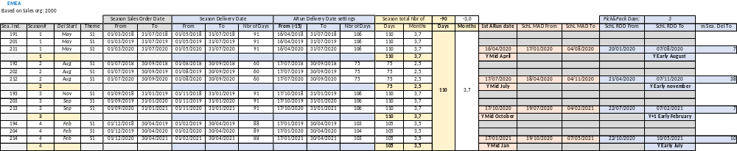
Appendix : Samples Season Delivery Window

Slide 72
Appendix : Customers Season Delivery Window

