Slide 1
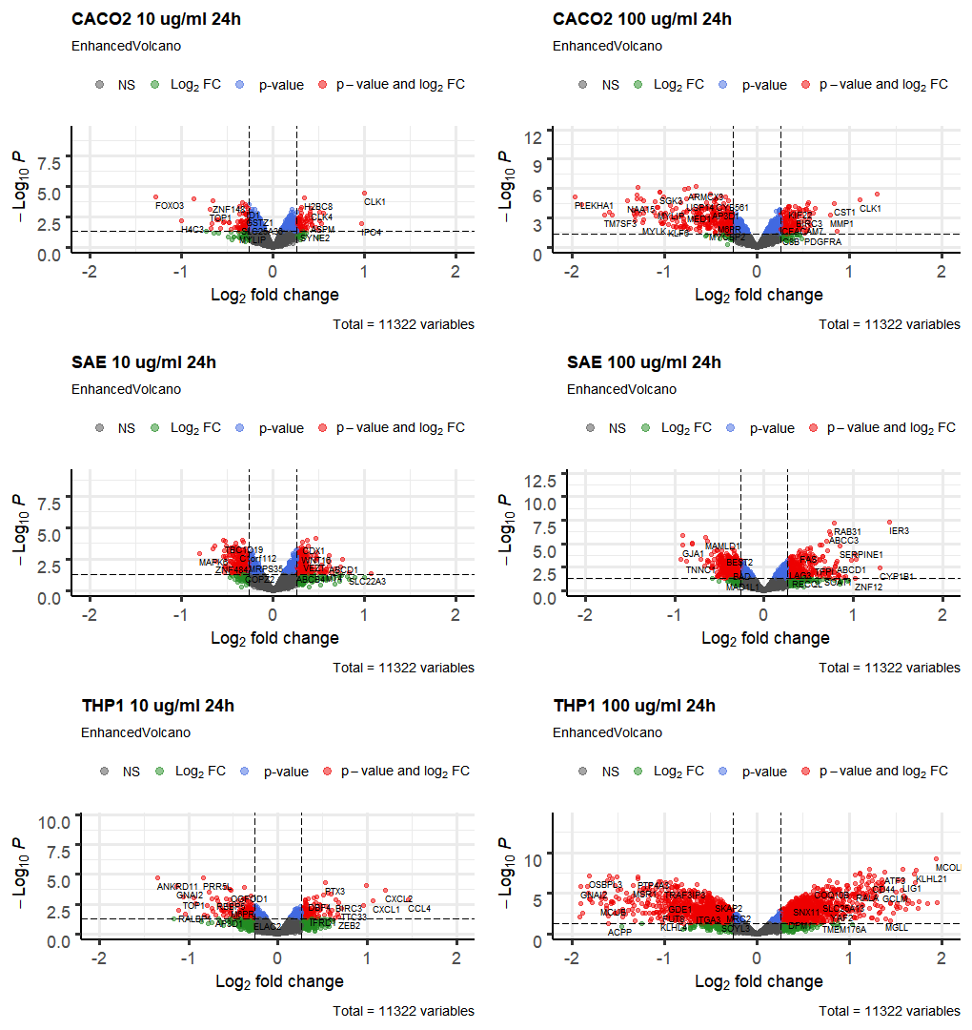
Down: 87
Up: 77
Down: 314
Up: 192
Down: 320
Up: 227
Down: 601
Up: 359
Down: 176
Up: 129
Down: 1201
Up: 1154

