Slide 1
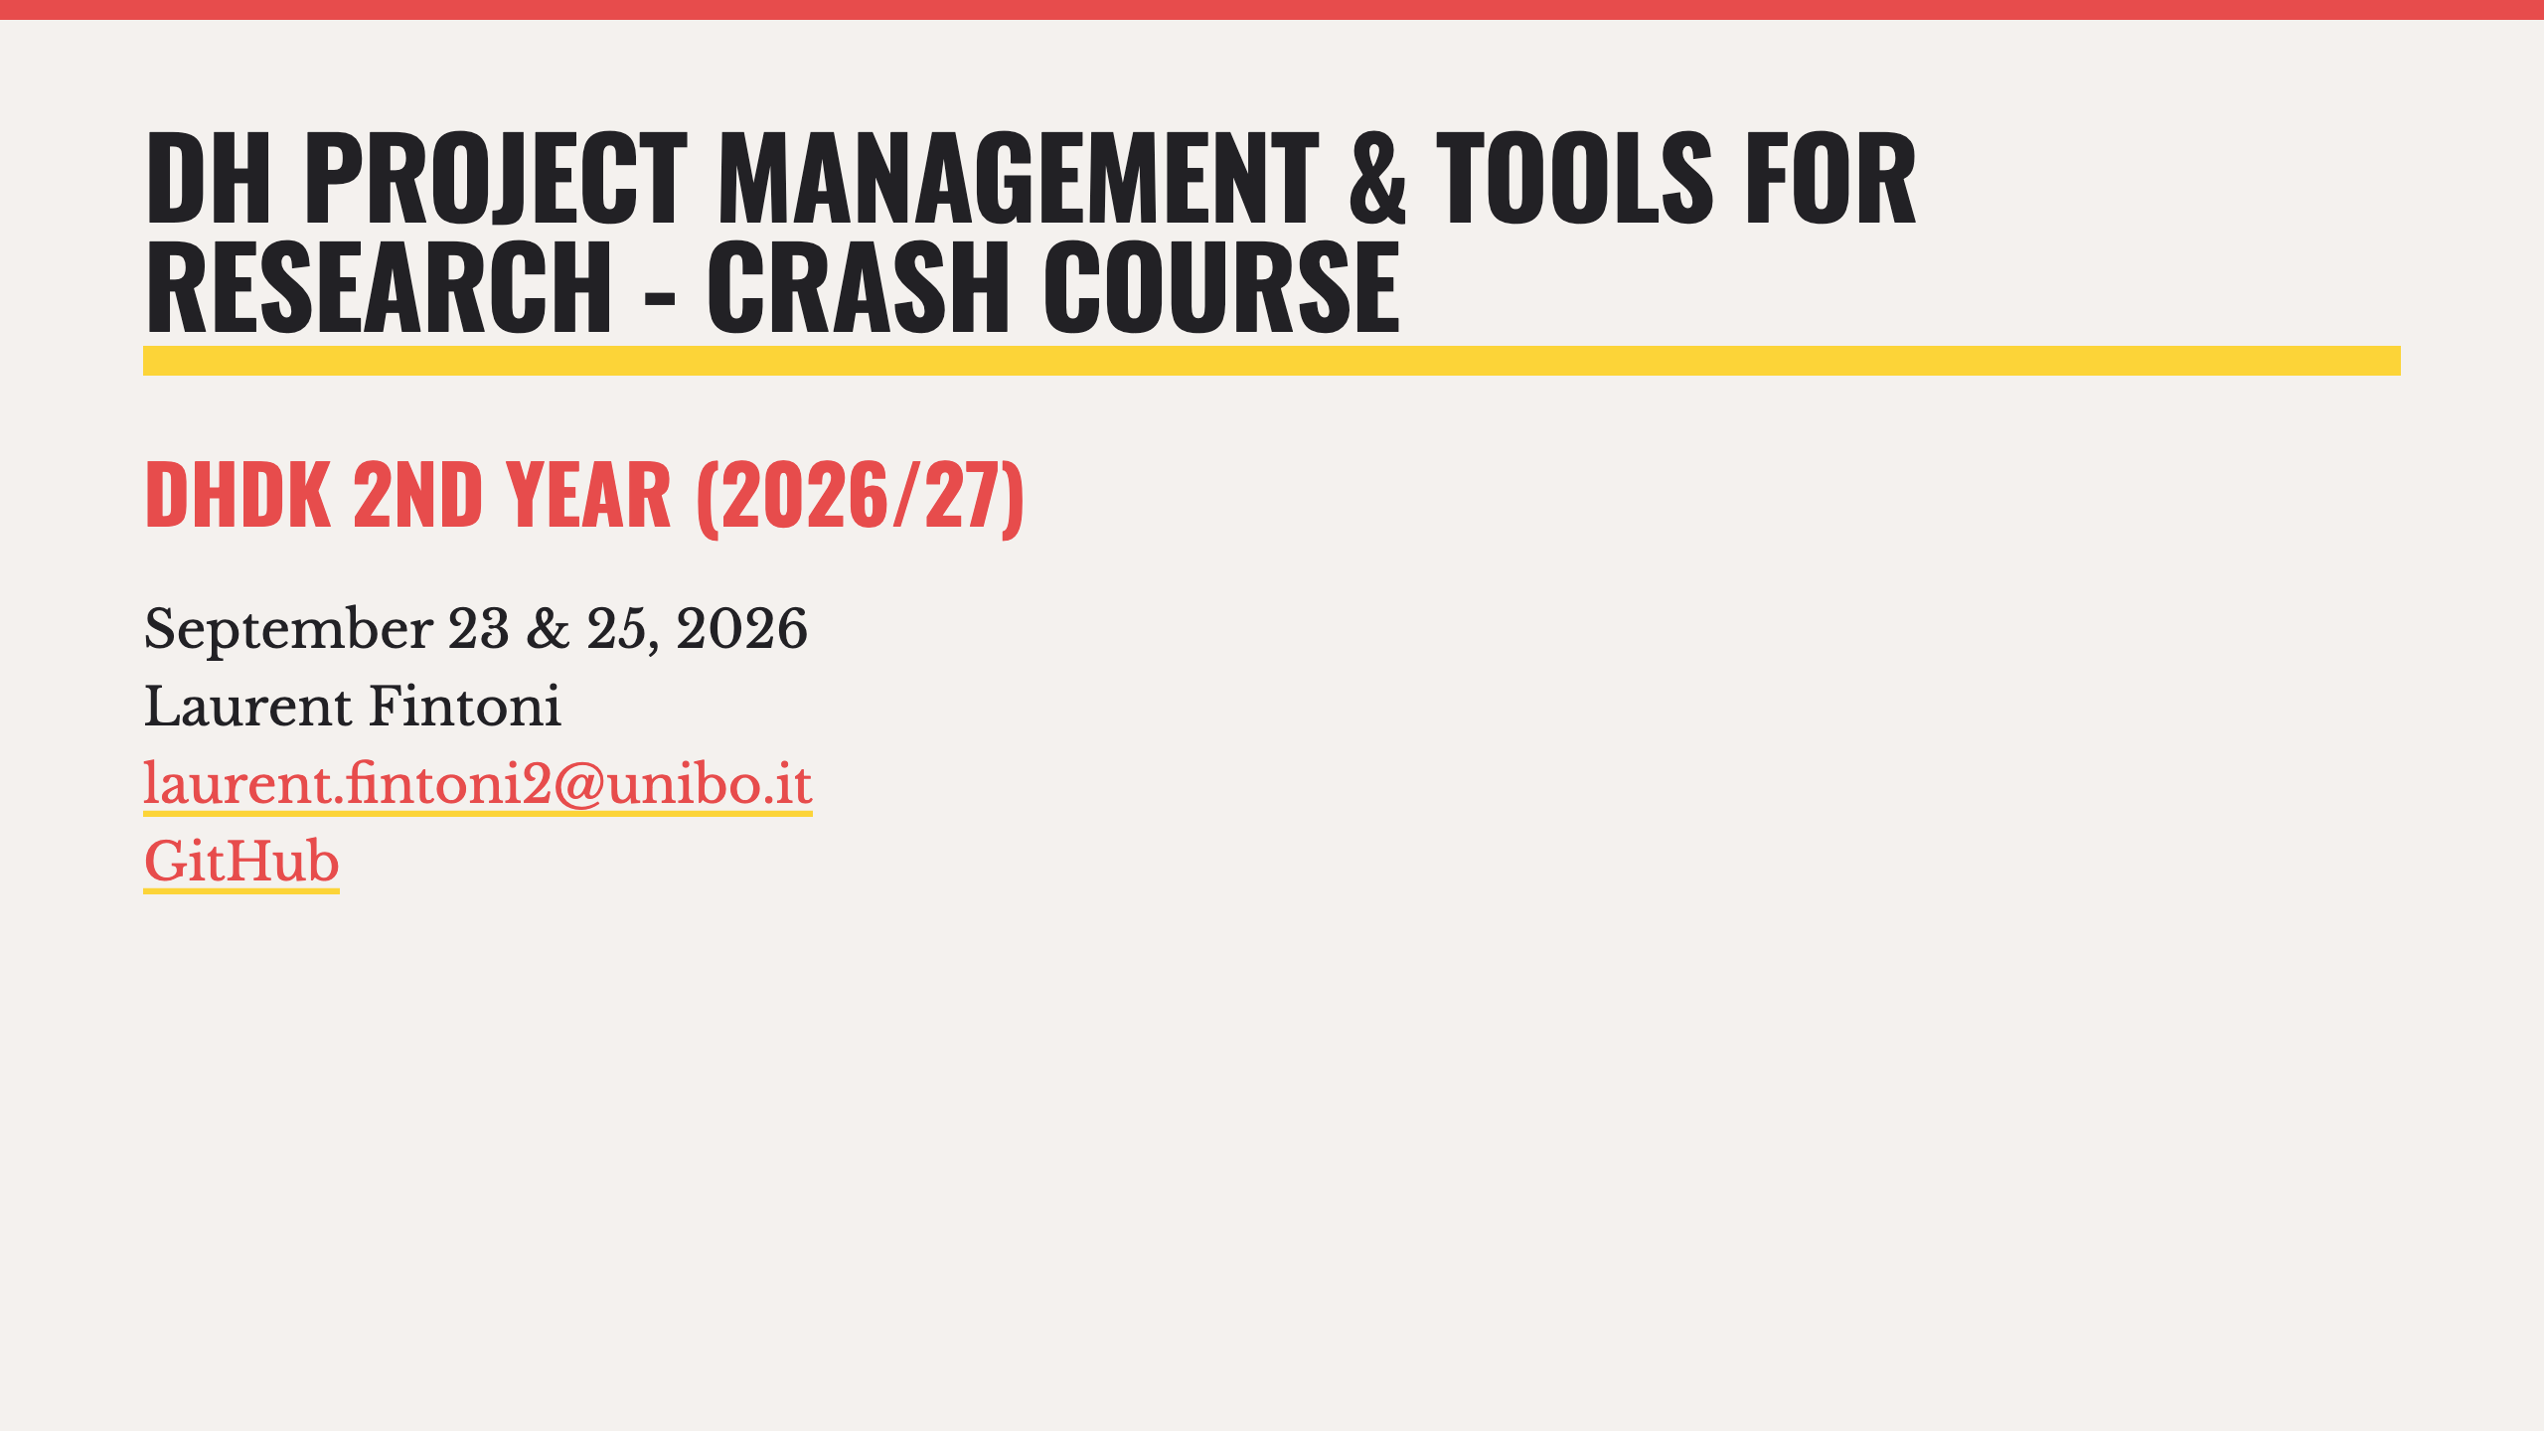

Slide 2
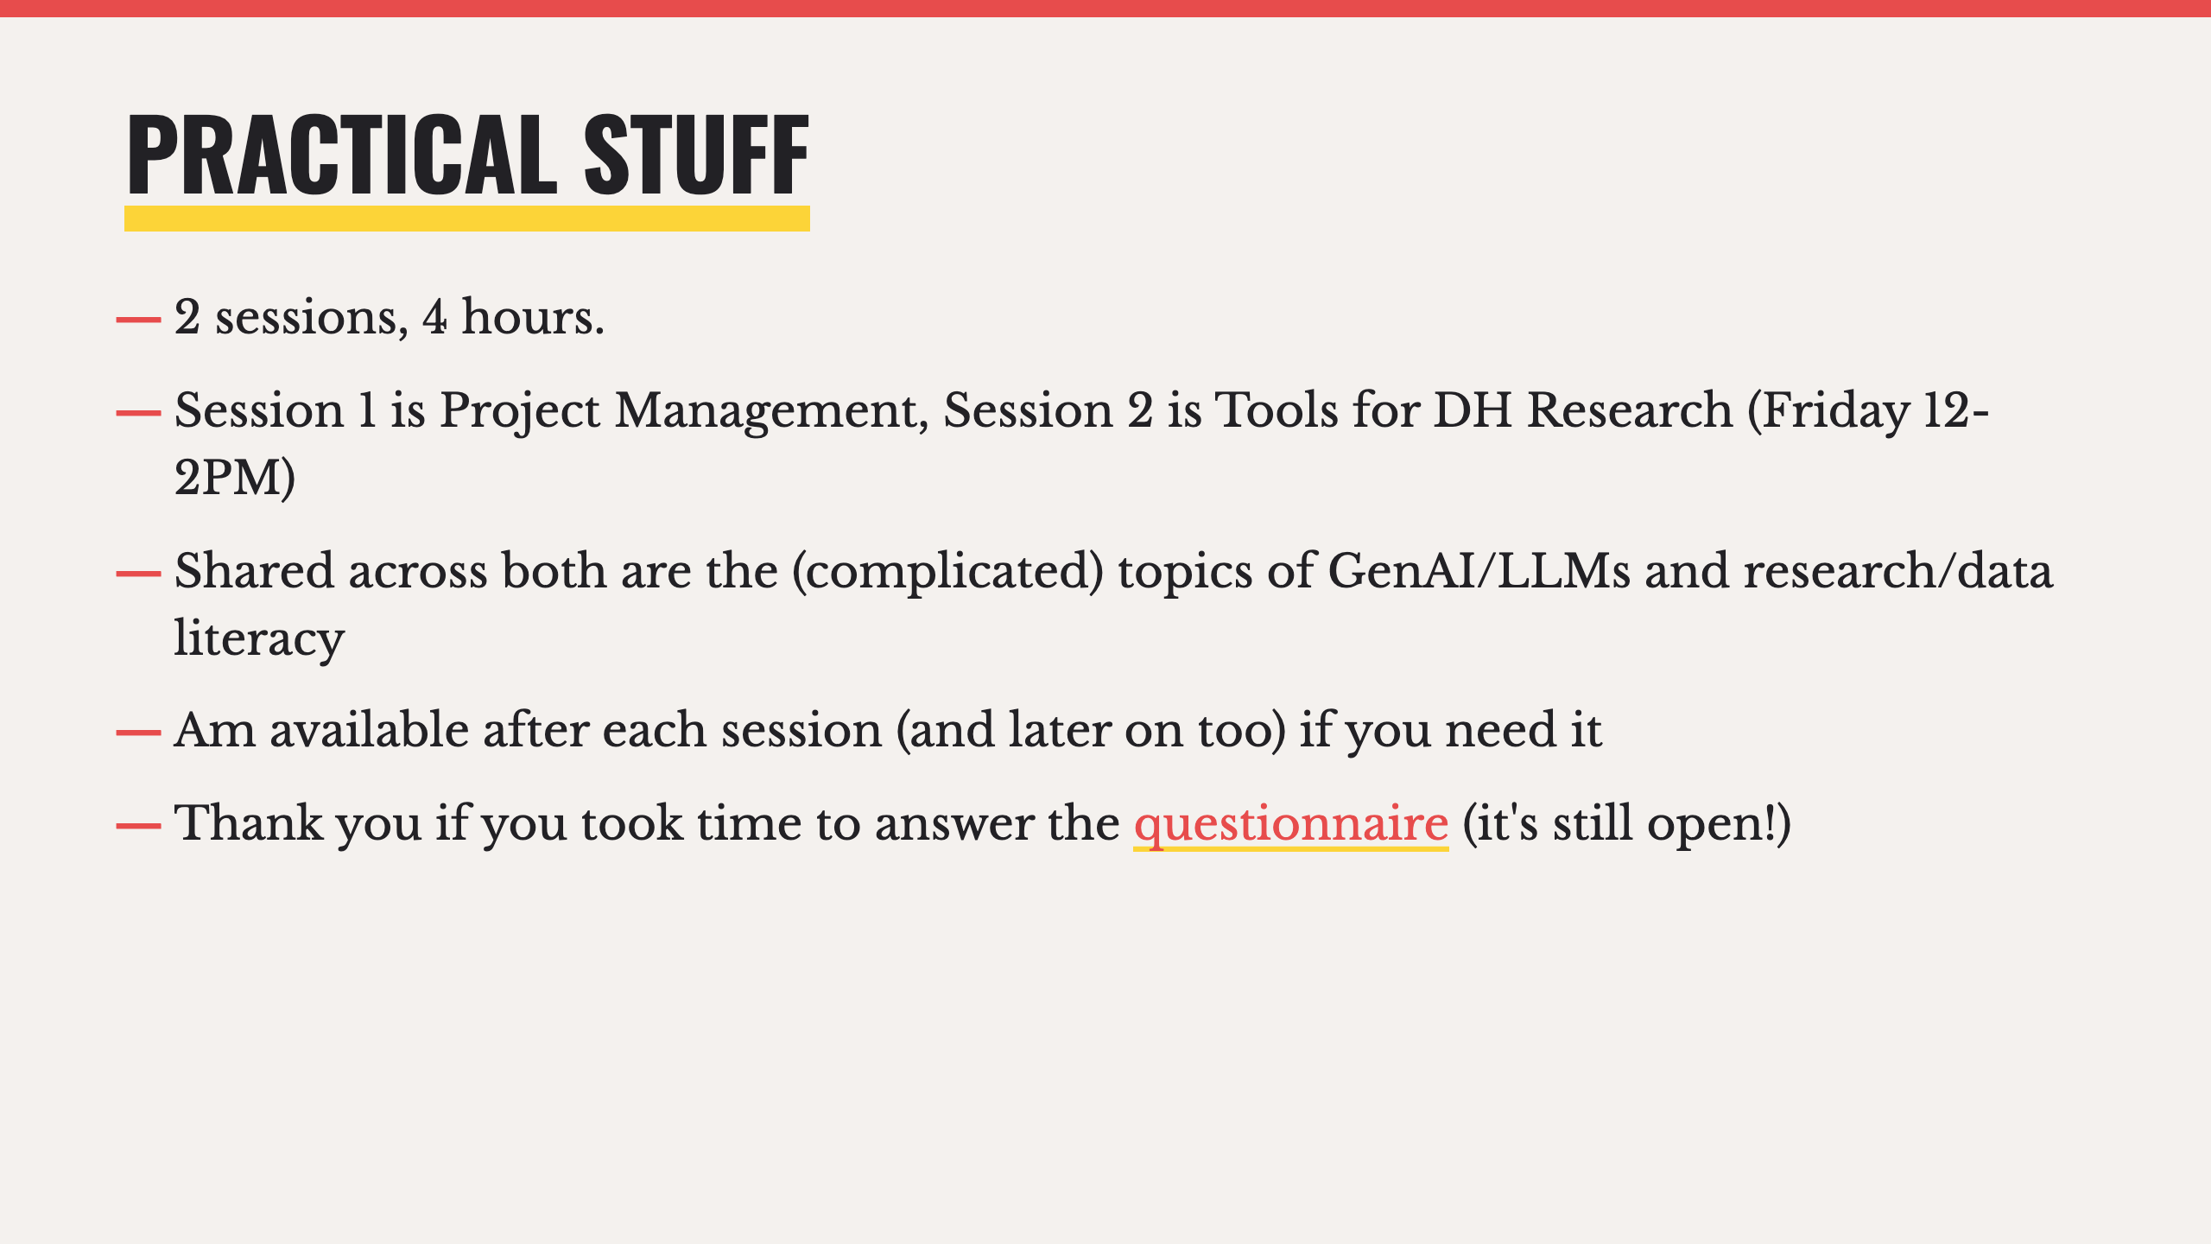
Notes:
- The sessions are interconnected, best if you can attend/follow/catch up on both as there's a fair amount of crossover
- We'll discuss what we can in the time we have
- There's an hour after each session before the lab is occupied again so if needed I'm happy to hang around and discuss anything you may want to

Slide 3
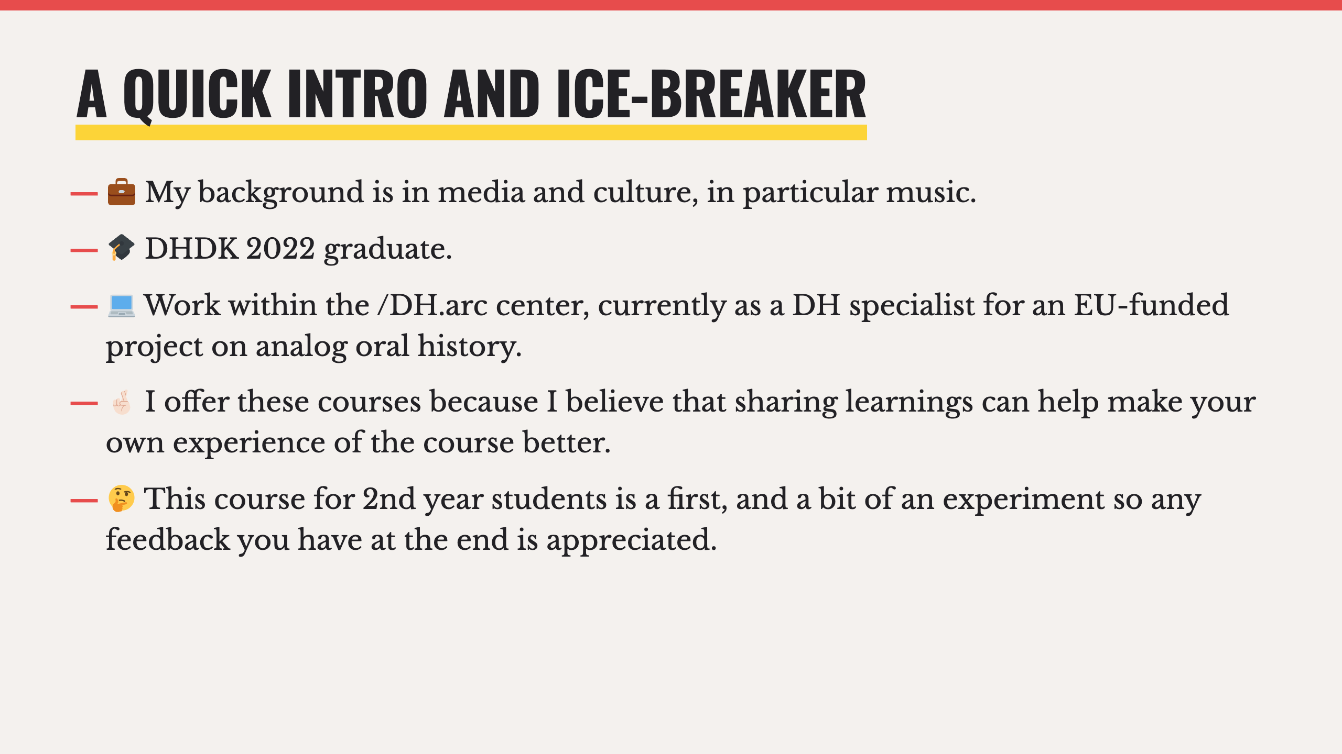

Slide 4
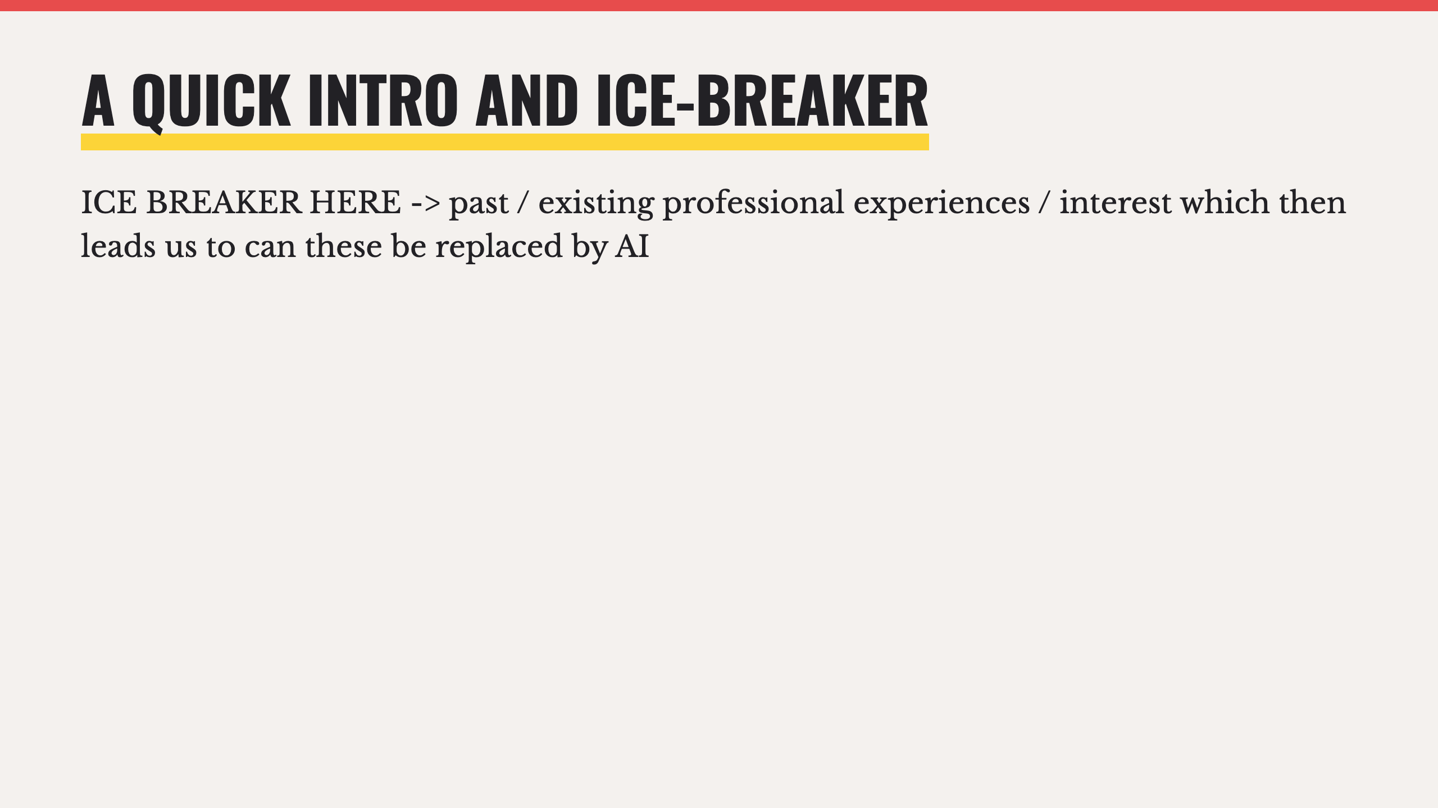

Slide 5
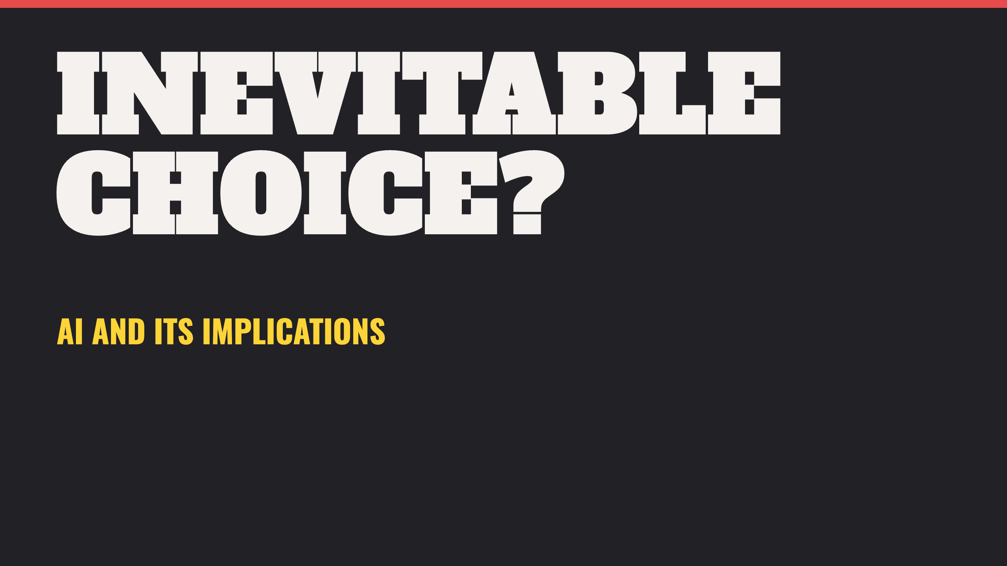

Slide 6
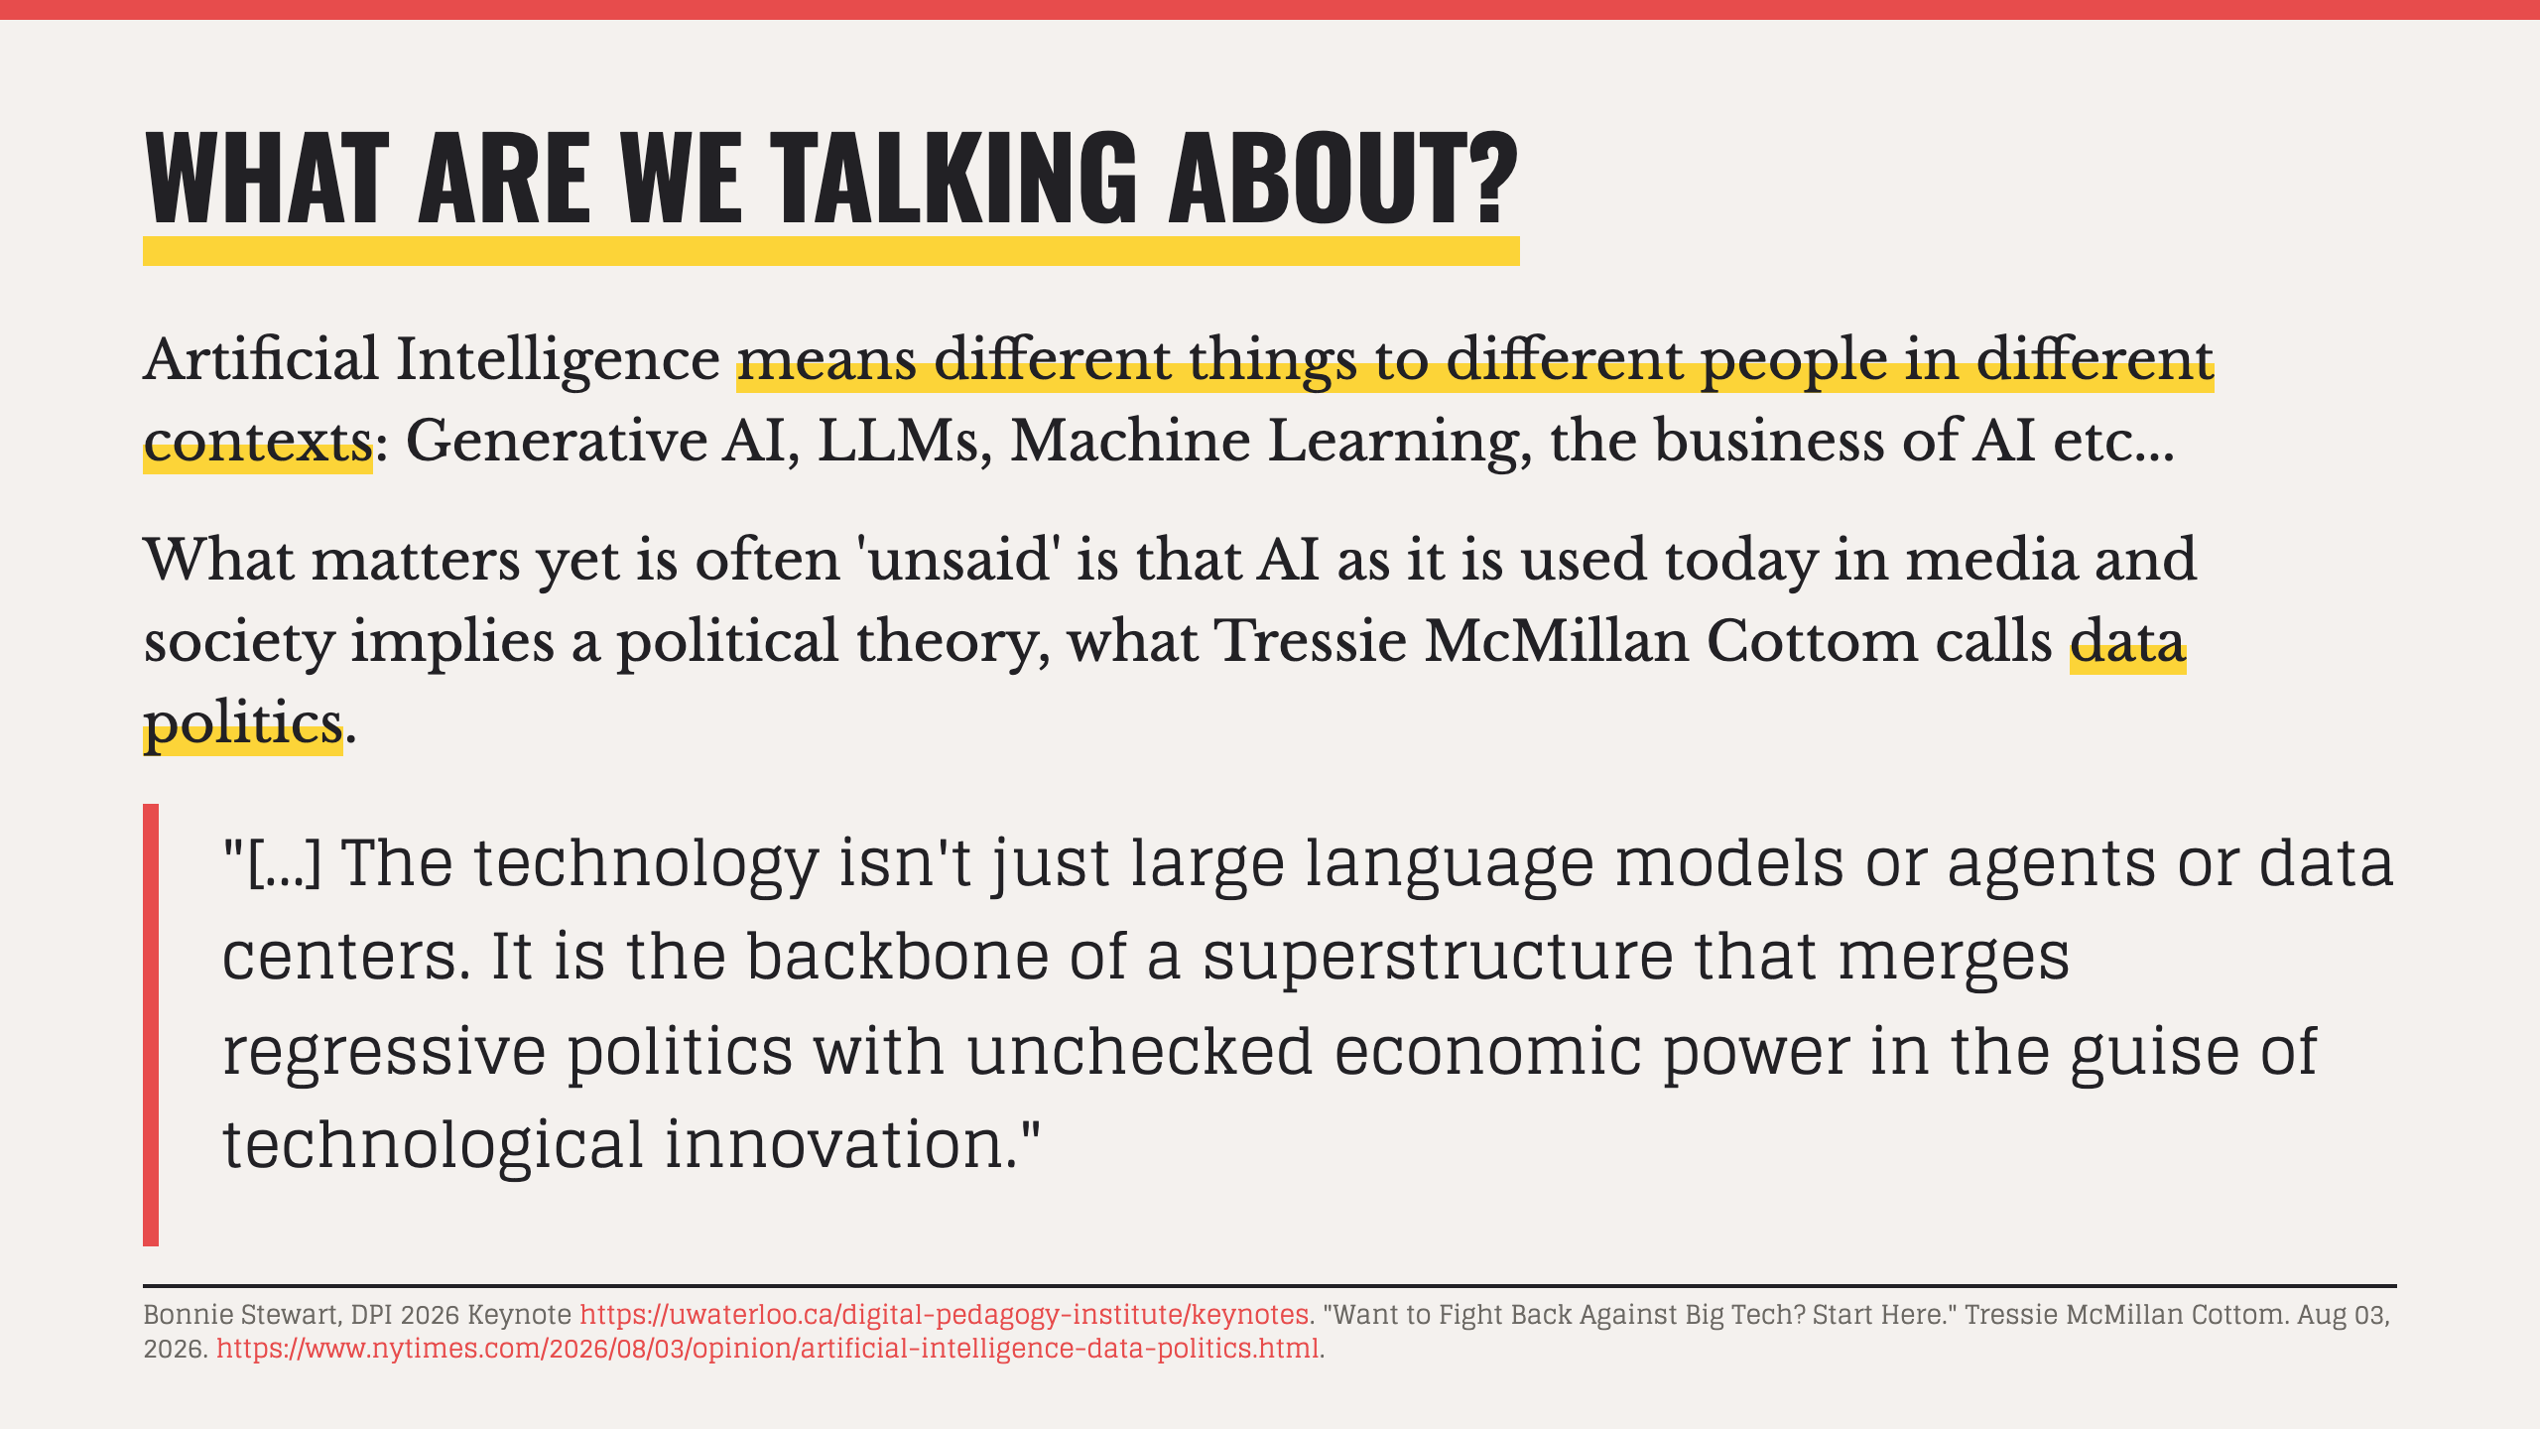
Notes:
- The words we use matter. Think about what you are implying when you use a specific term.

Slide 7
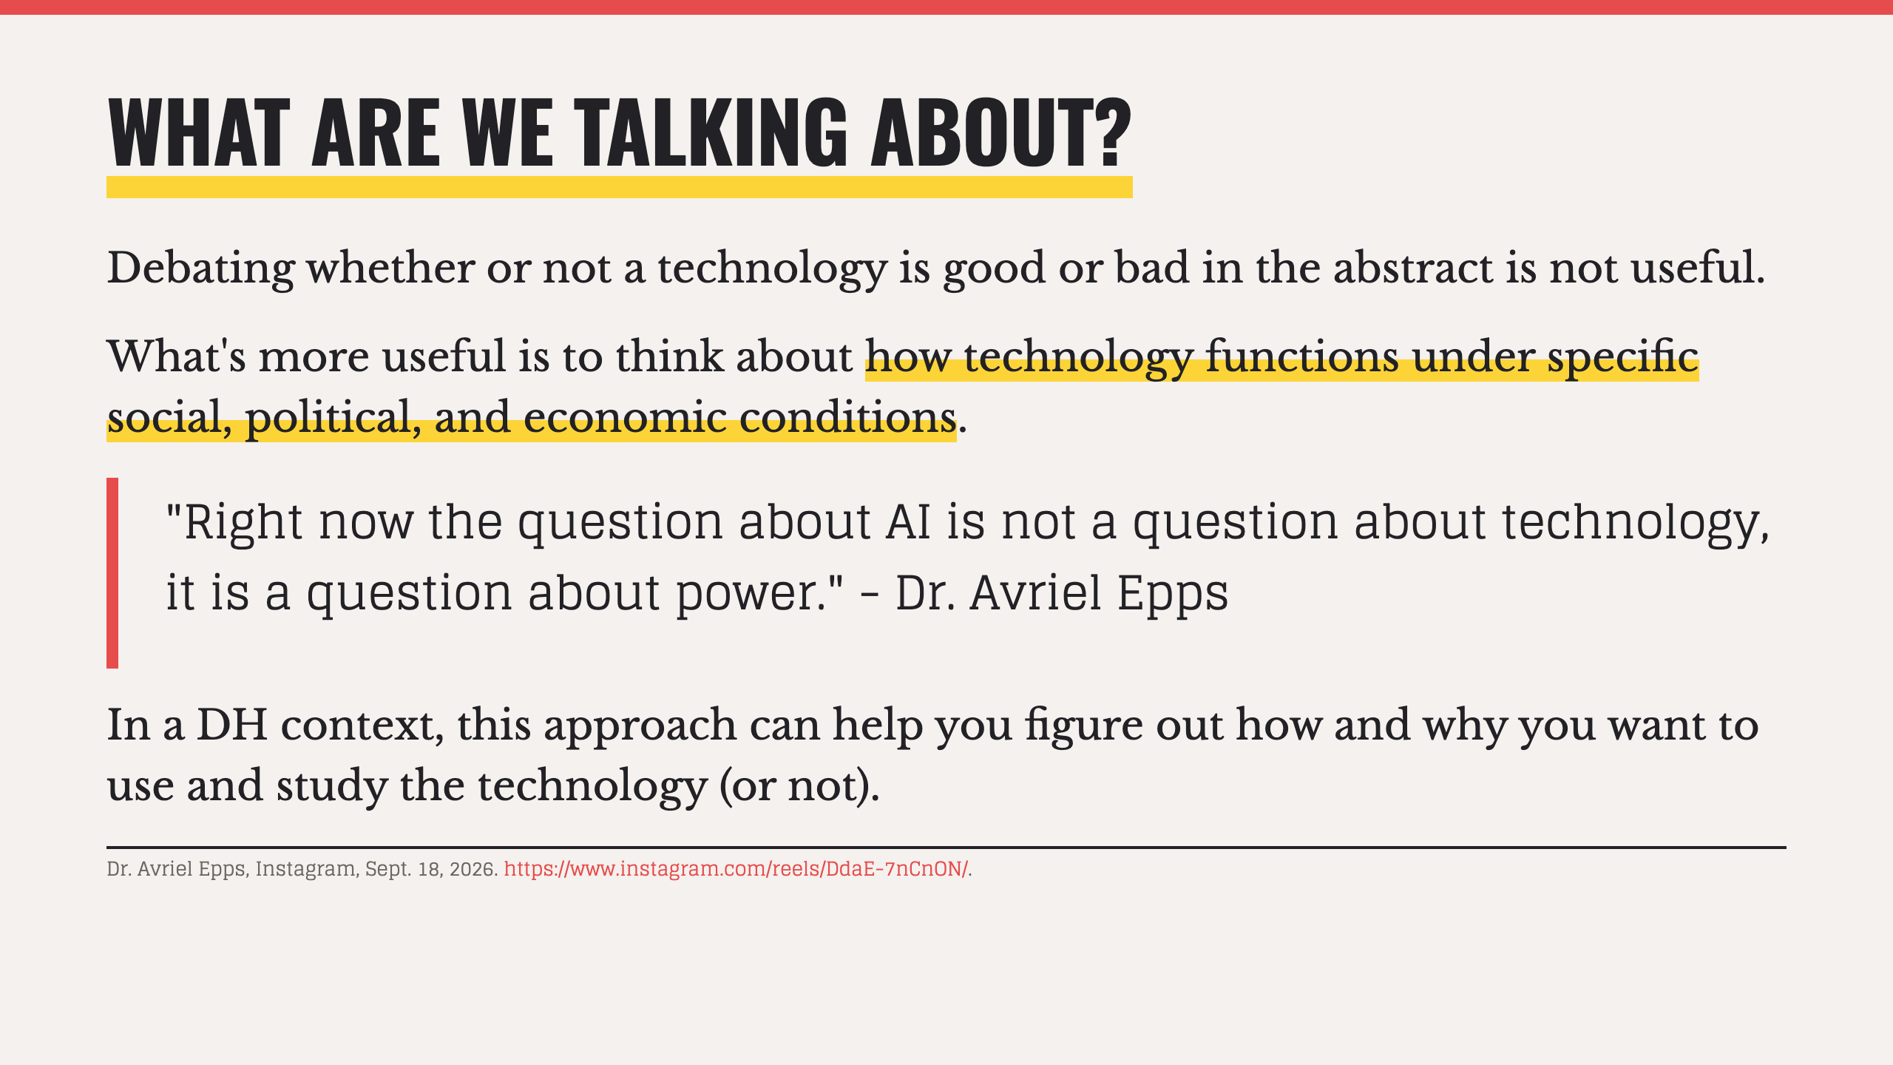

Slide 8
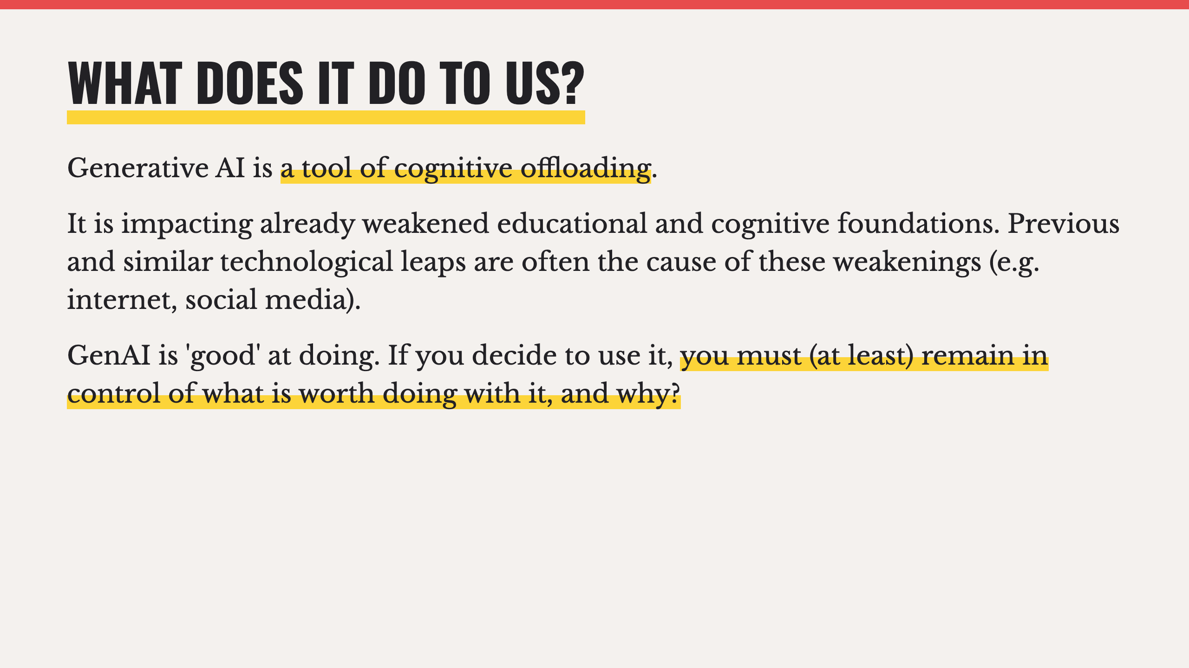
Notes:
- Another way to look at this is that while GenAI does simplify things, if you choose to use it so, it also complicates others, whether that be your own learning or the need to manage it.

Slide 9
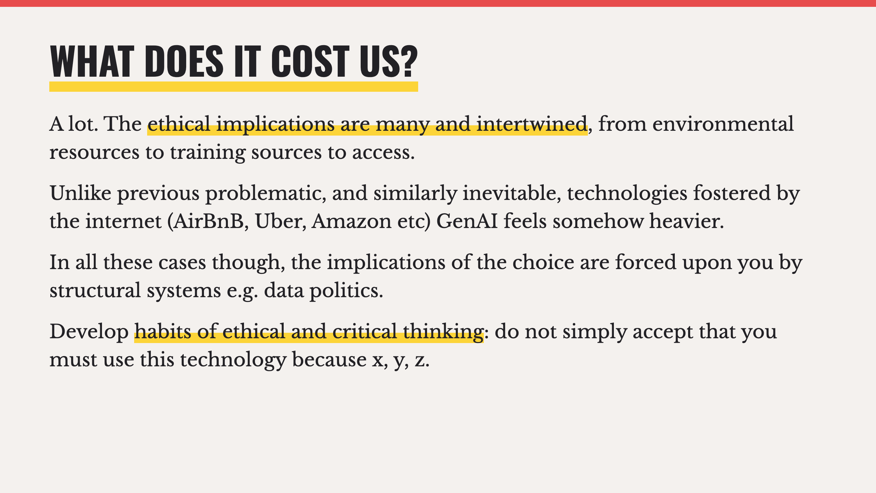
Notes:
- It's one thing to wave away the implications of having something delivered to you the next day. It's another waving away the implications of generating images, audio, video, or text with a few lines of text in seconds. The immediacy of it feeds the burden.

Slide 10
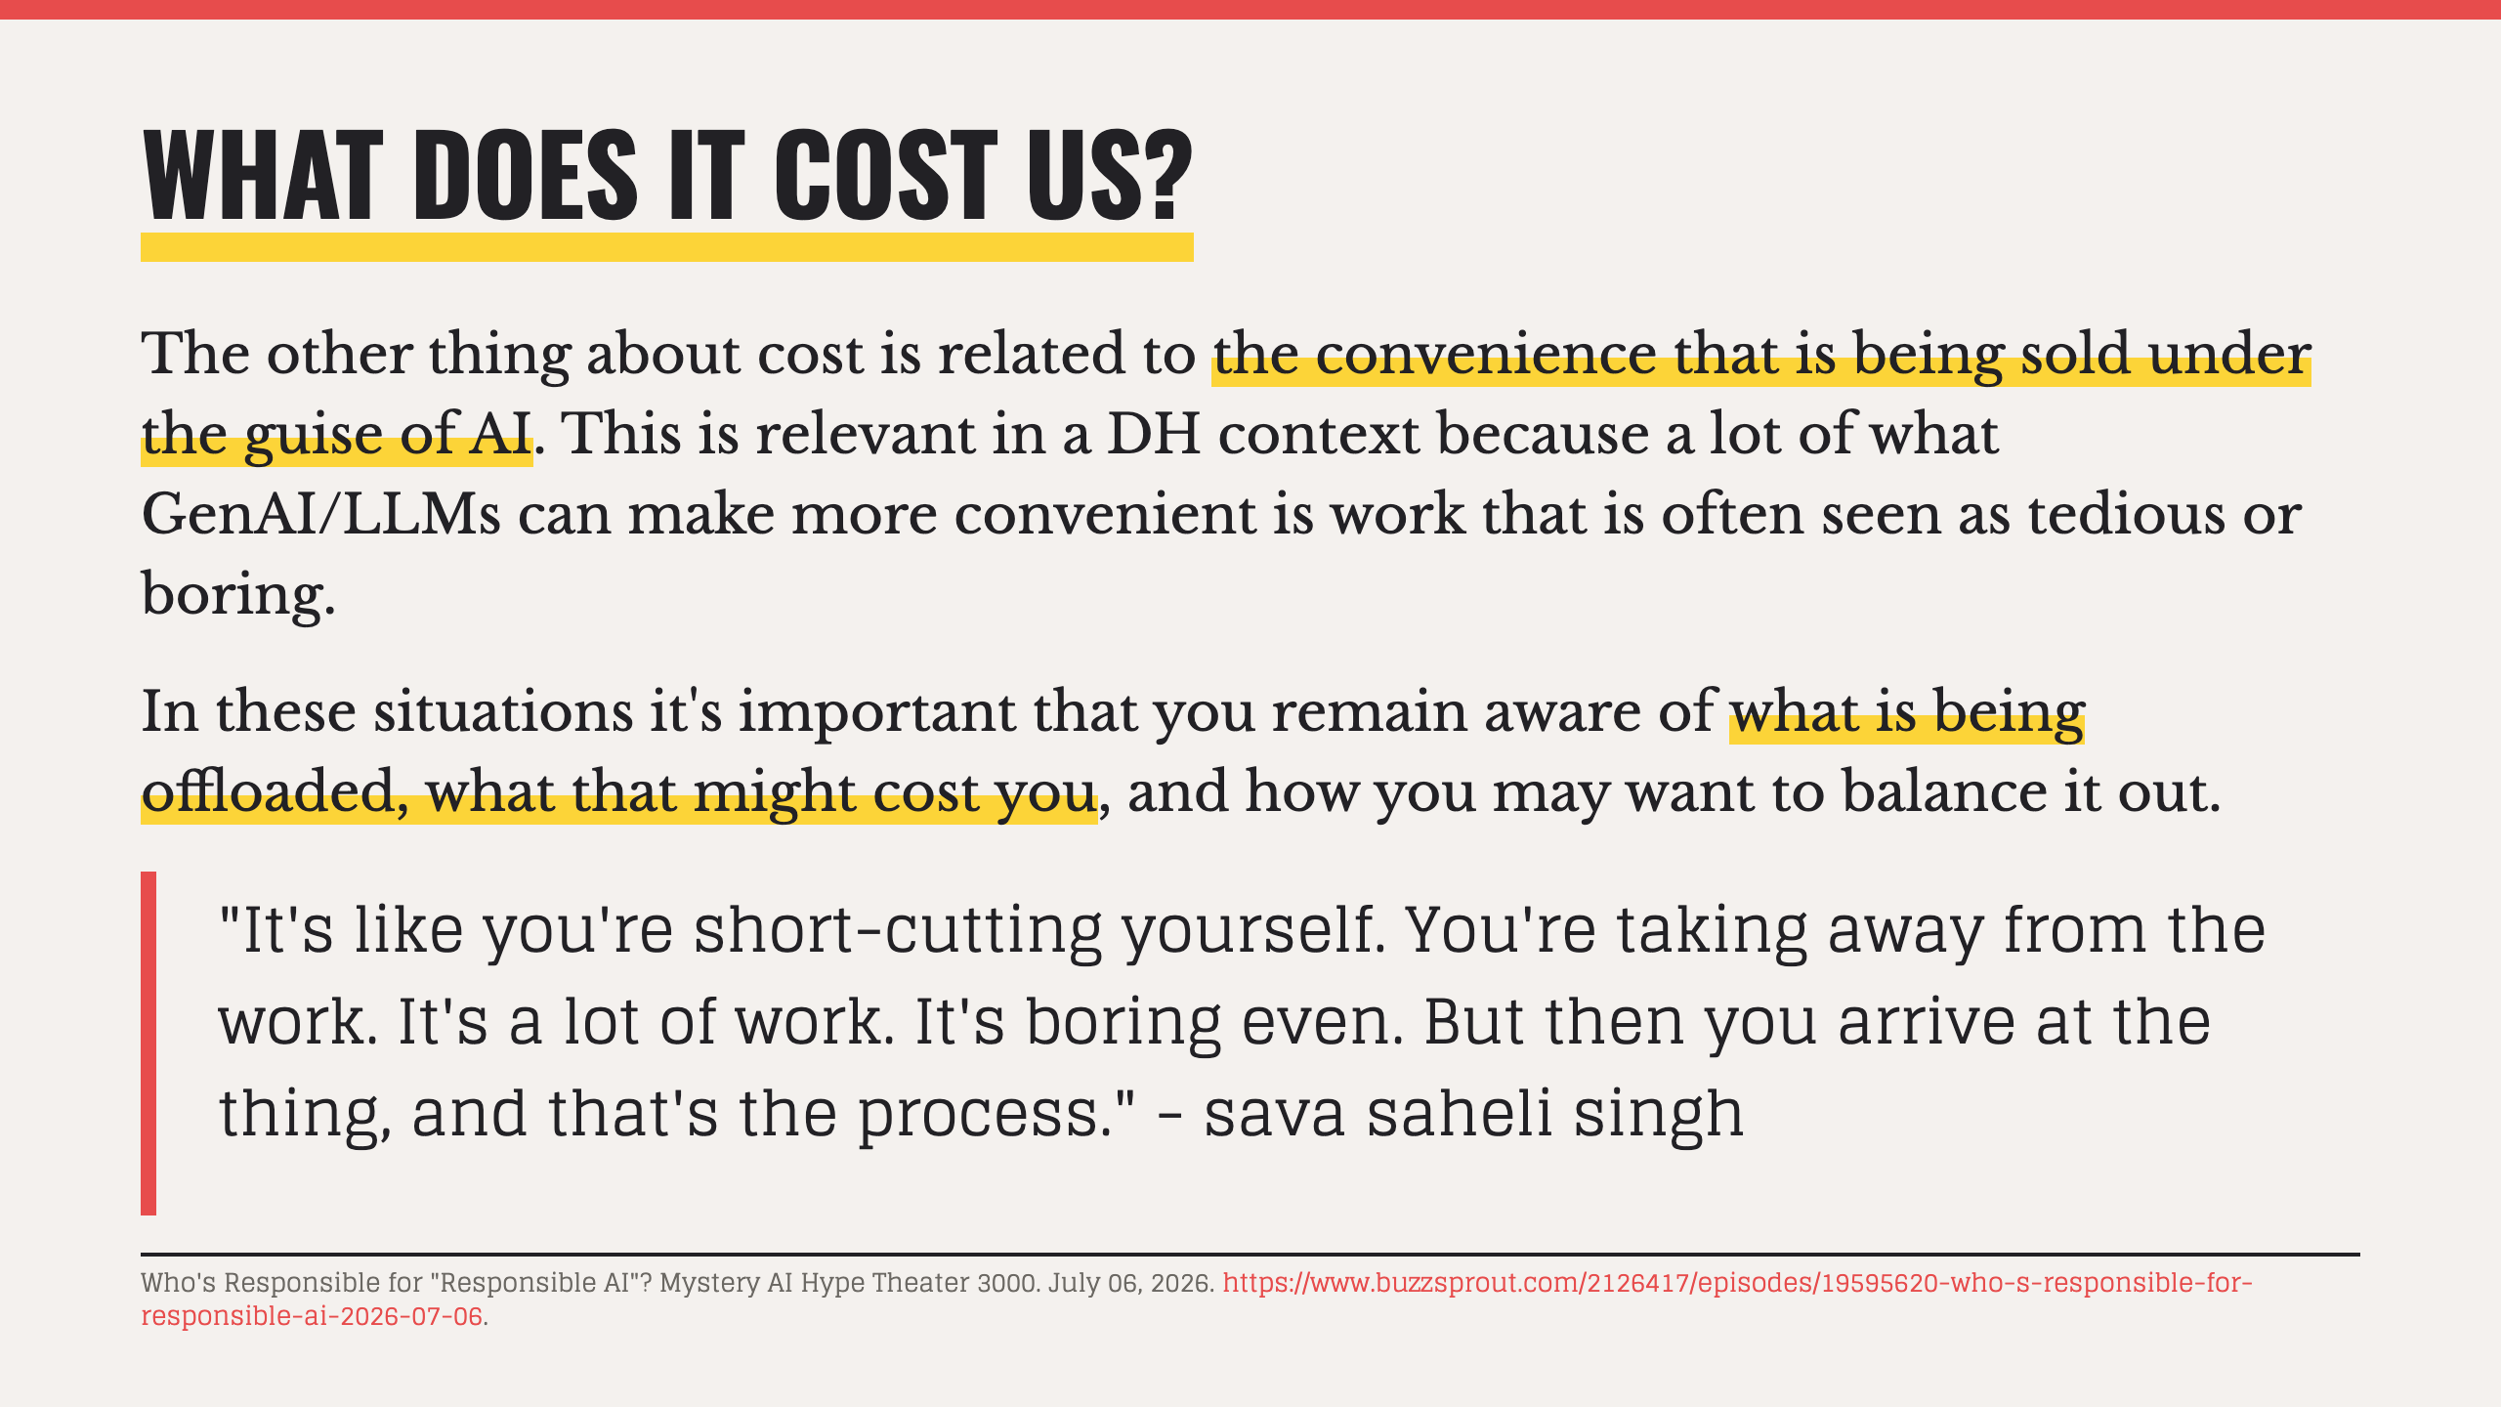
Notes:
- While it may feel counterintuitive, a lot of what is deemed tedious or boring work things like literature review, data cleaning, virtual enviroment setups, boilerplate code, etc... is often just as important and can lead to crucial insights that feed other parts of the work.

Slide 11
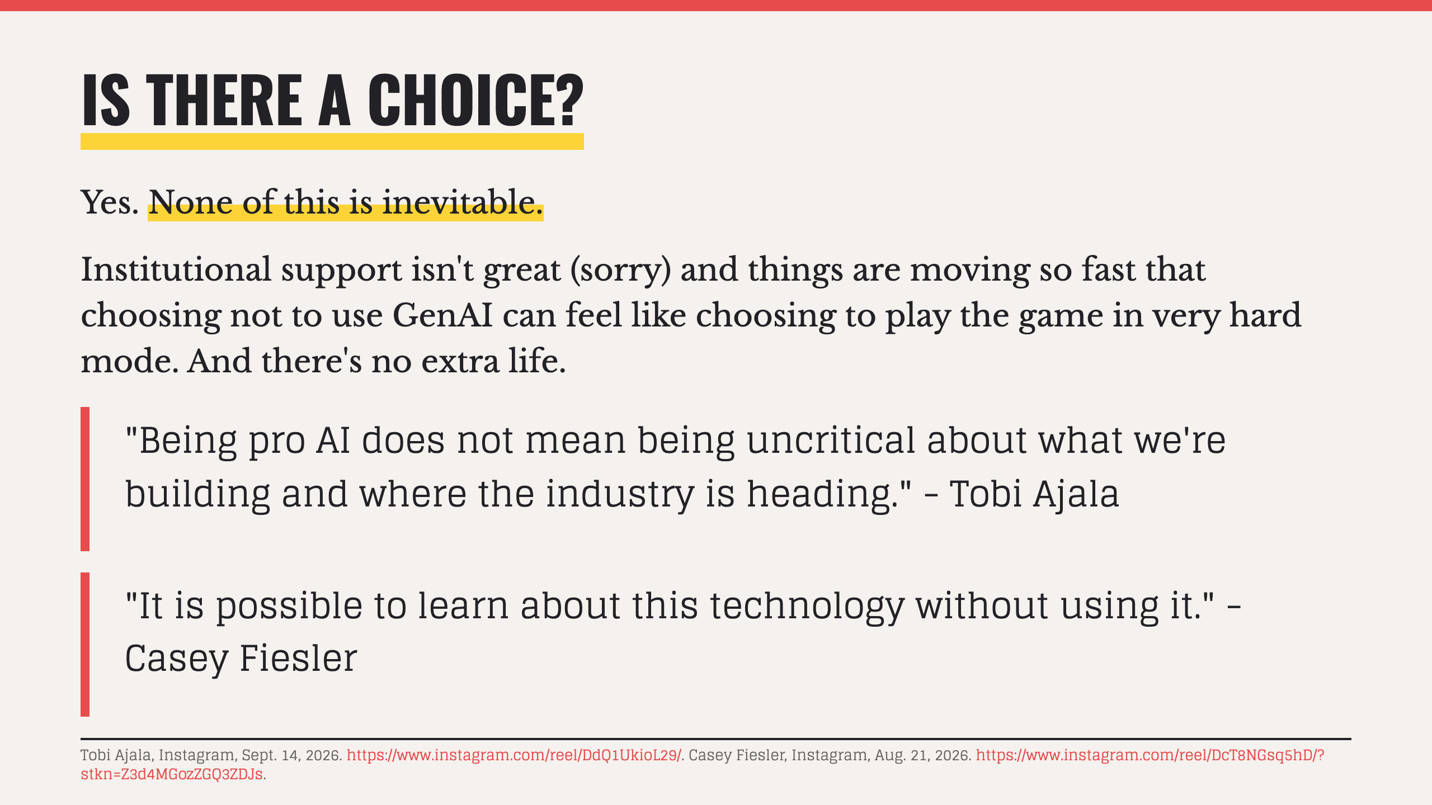

Slide 12
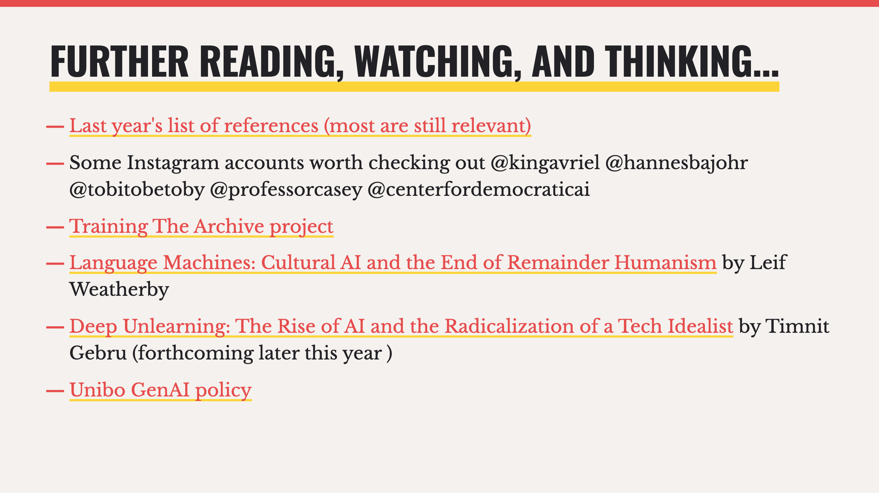

Slide 13
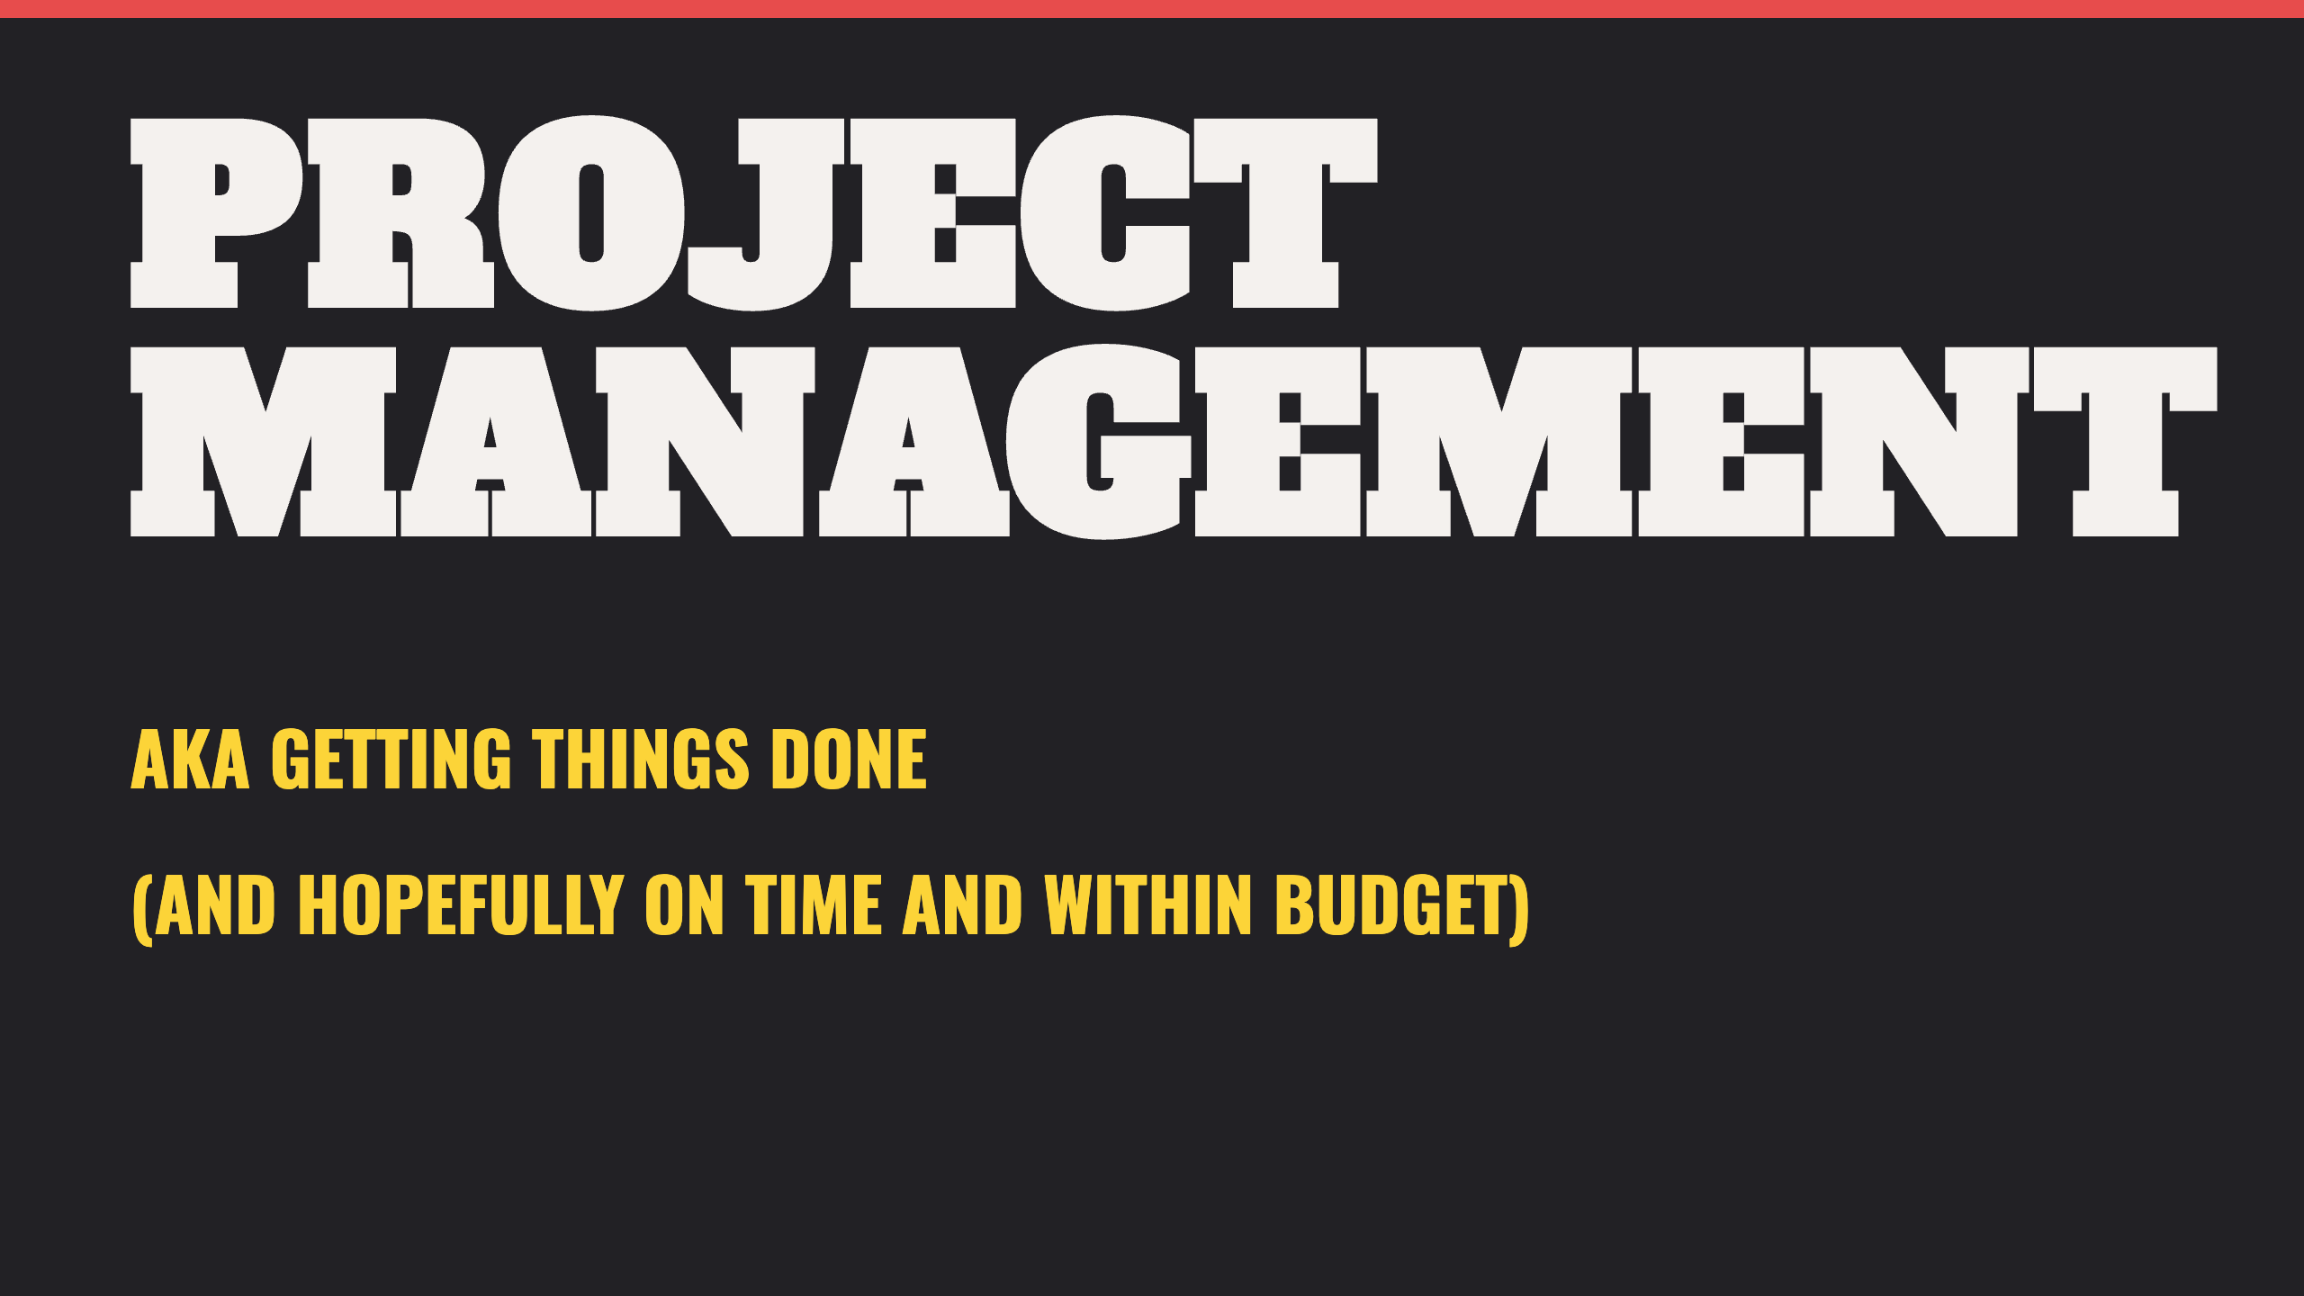
Notes:
- What we'll cover on this topic today assumes a degree of basic familiarity with Project Management, based on some of your feedback via the questionnaire.

Slide 14
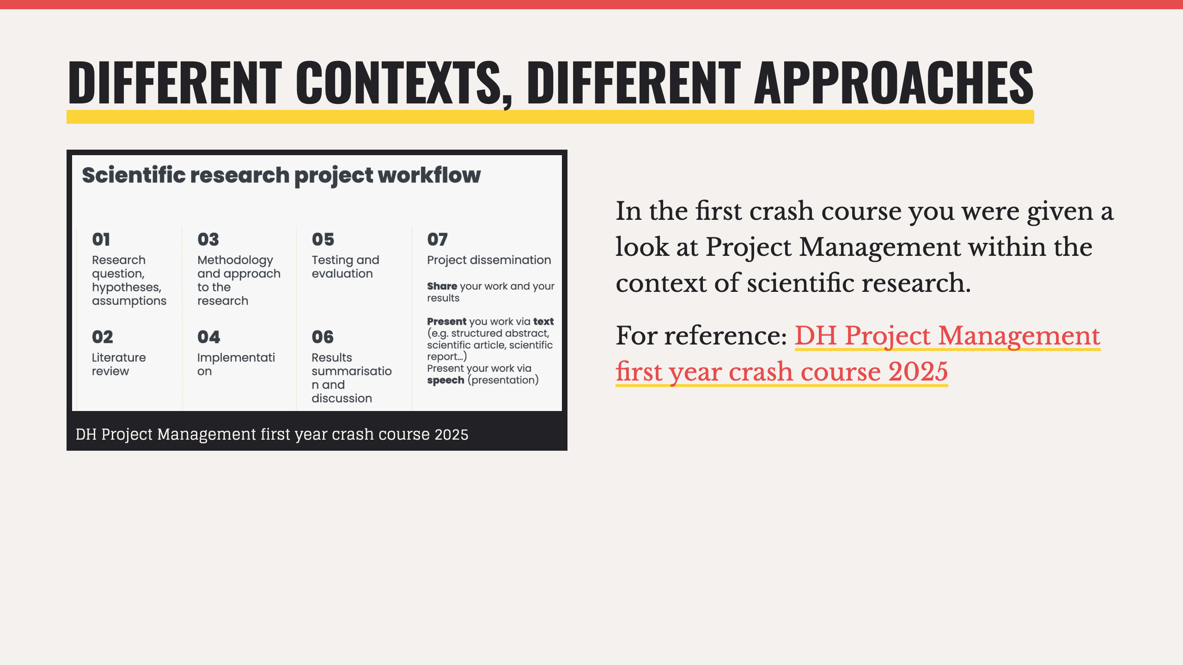

Slide 15
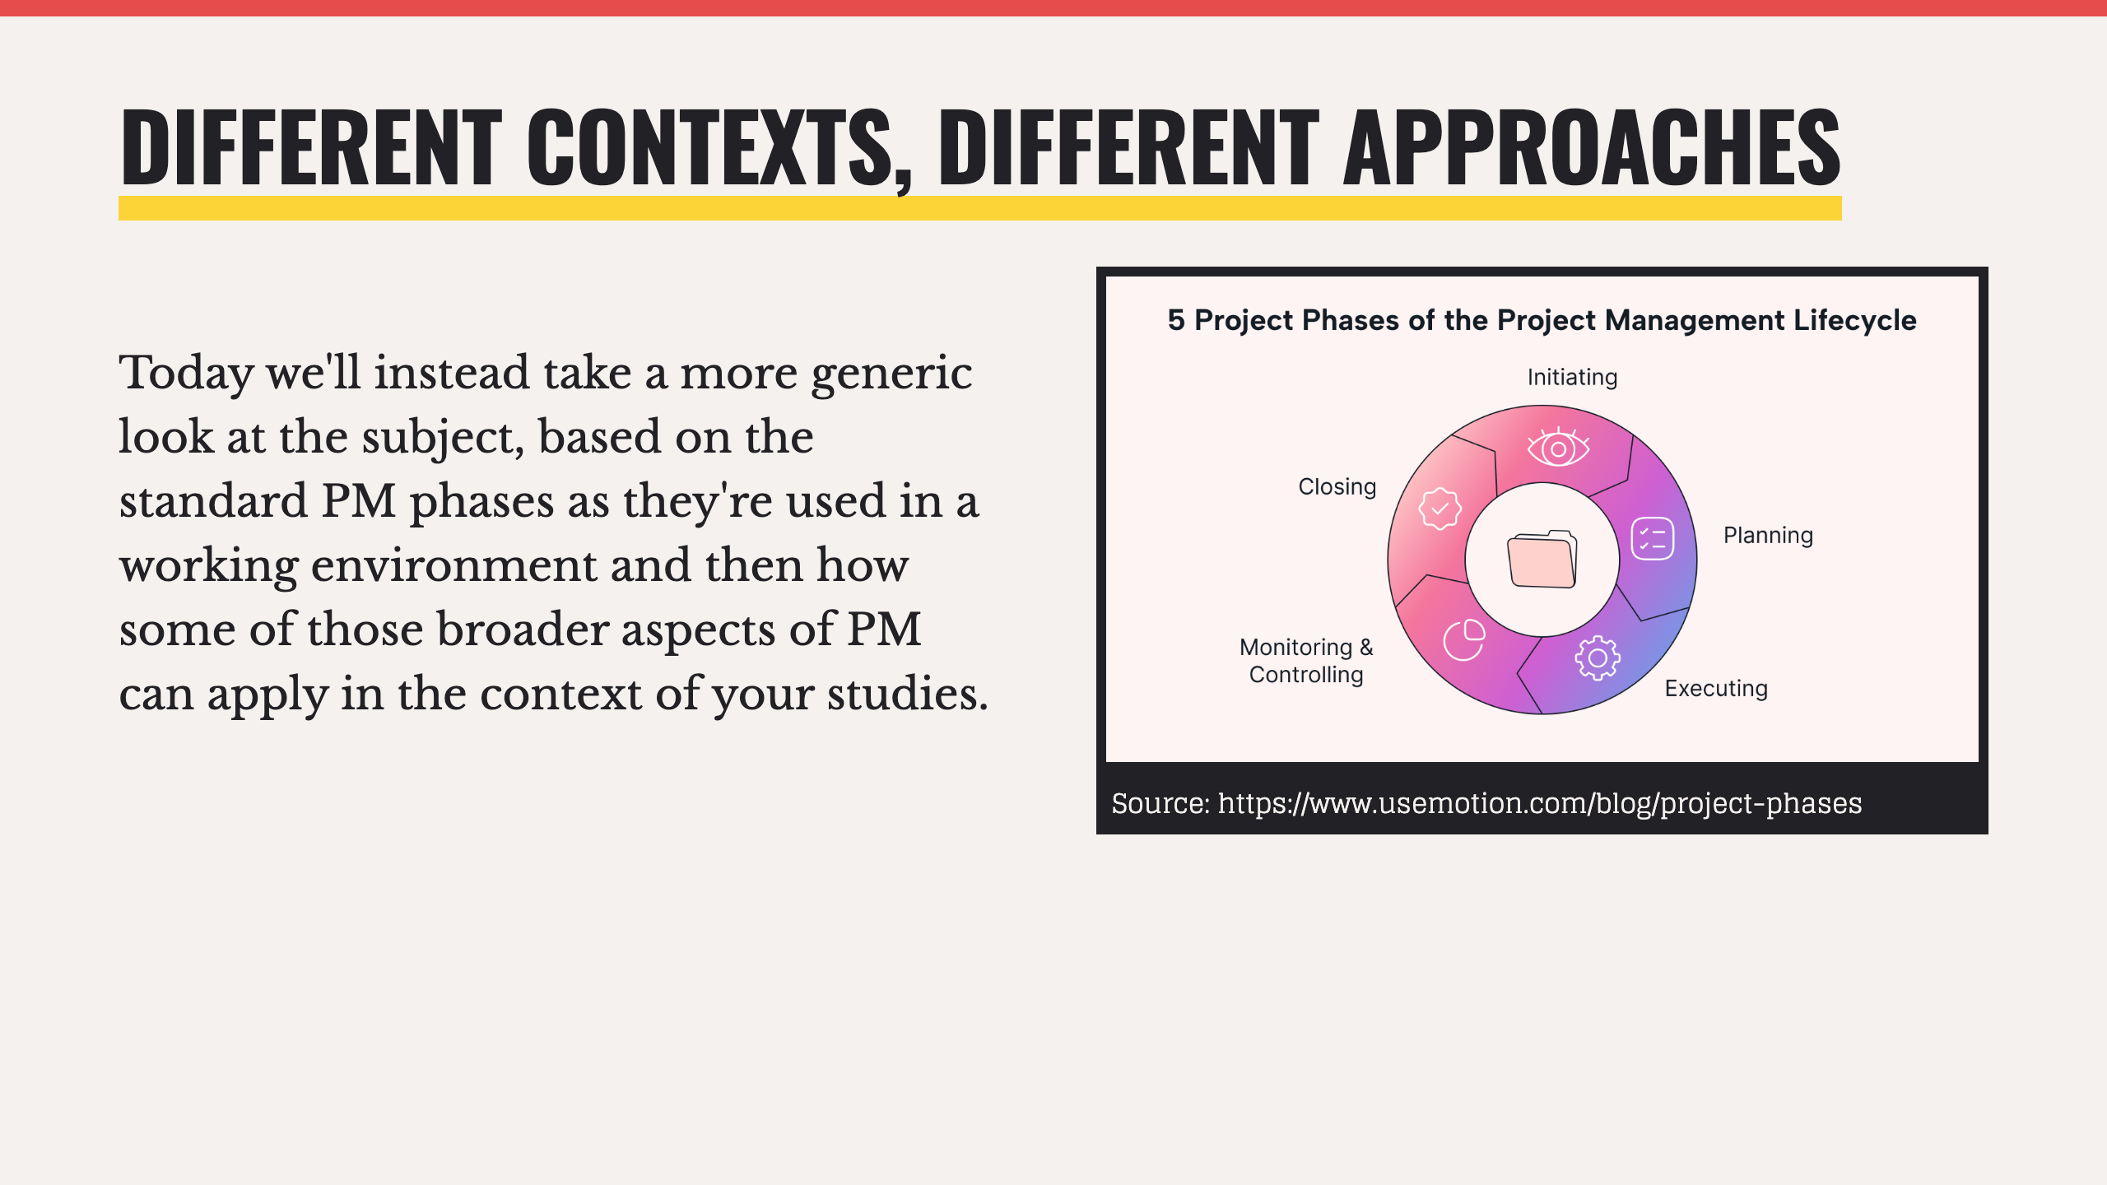

Slide 16
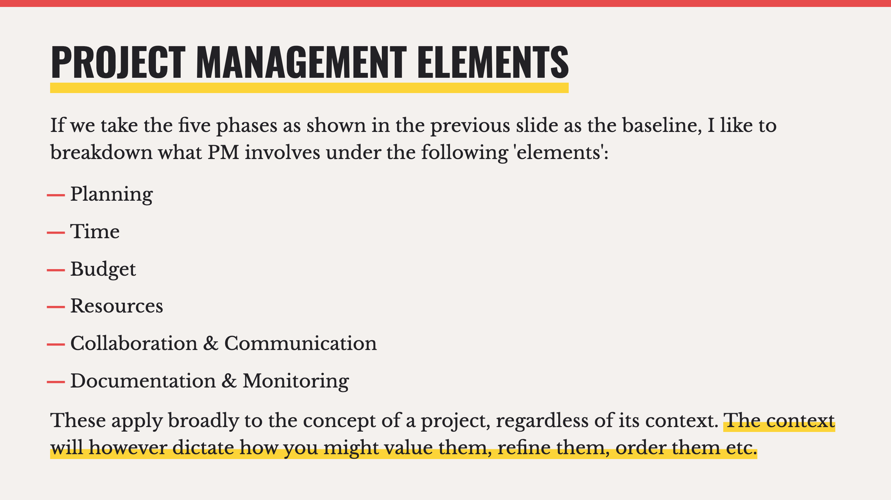

Slide 17
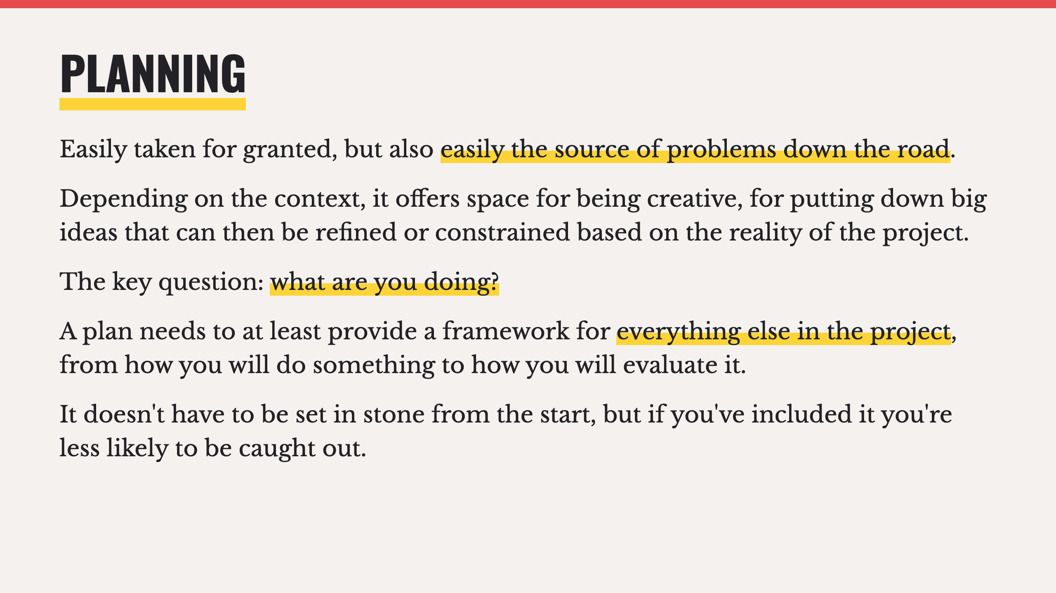
Notes:
- It's totally normal to make mistakes at the planning stage, to forget something, or get it wrong. No plan is perfect, it's having it and learning through doing it over and over that matters. It's a way of laying out all the questions you have, and if you can already include answers great, otherwise at least you know you need that answer.

Slide 18
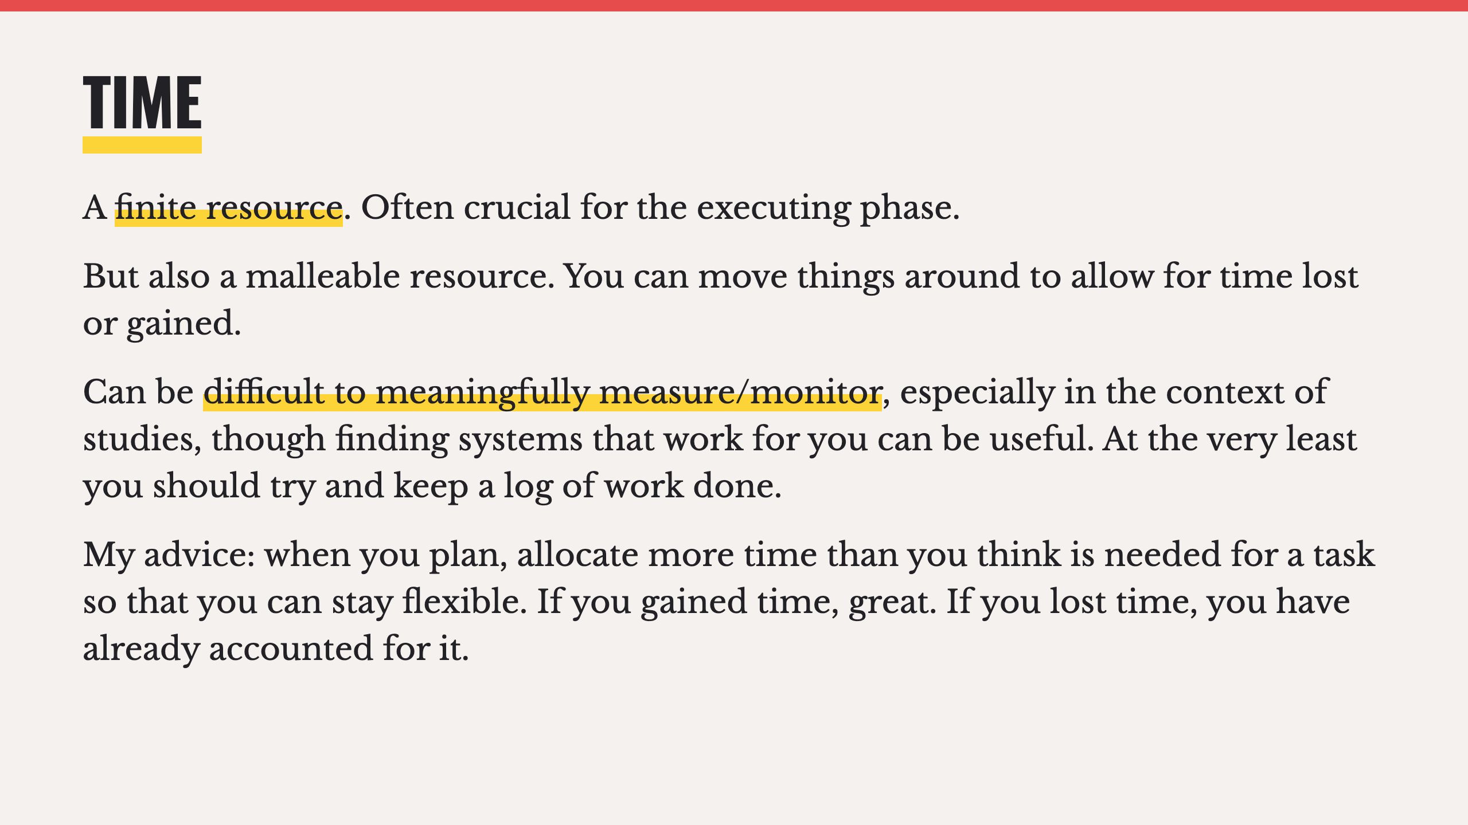

Slide 19
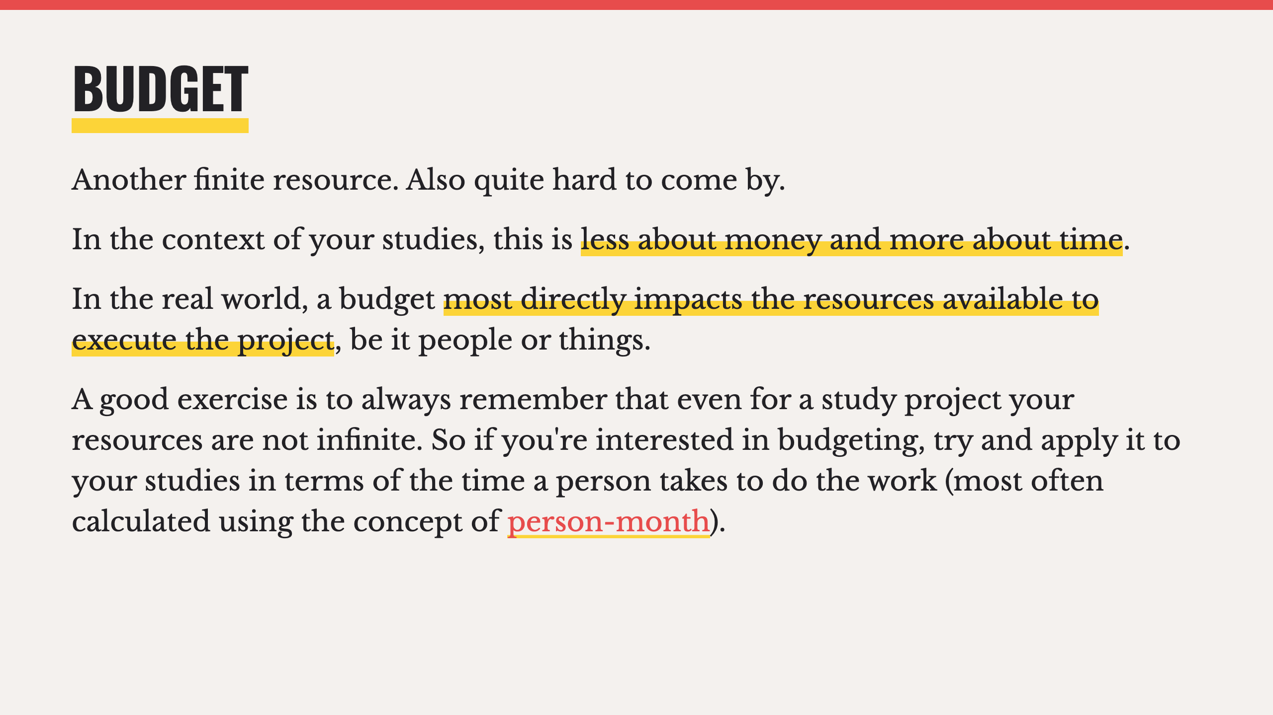
Notes:
- I'll show you some real world budgets in a bit, so you can get a sense of what time and budget mean practicaly.

Slide 20
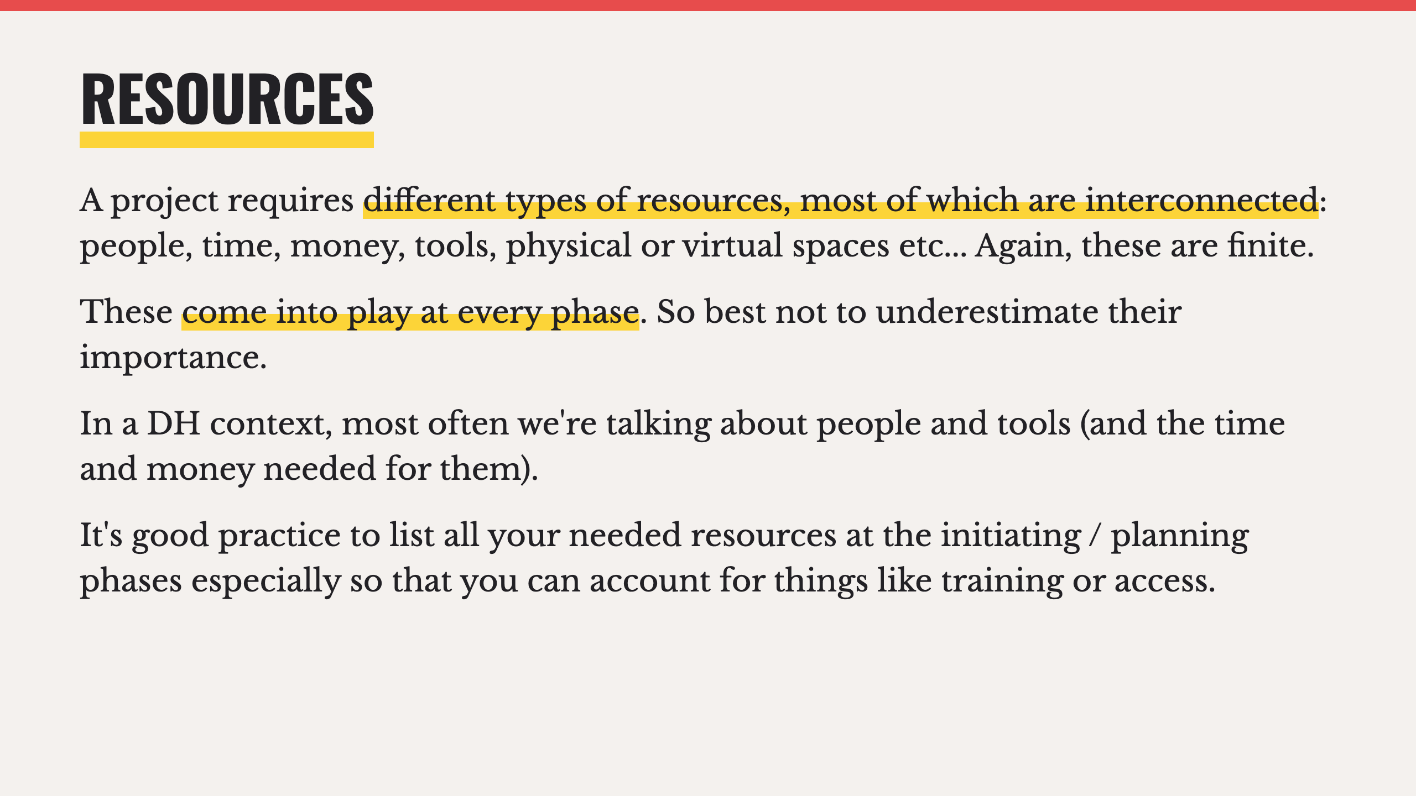

Slide 21
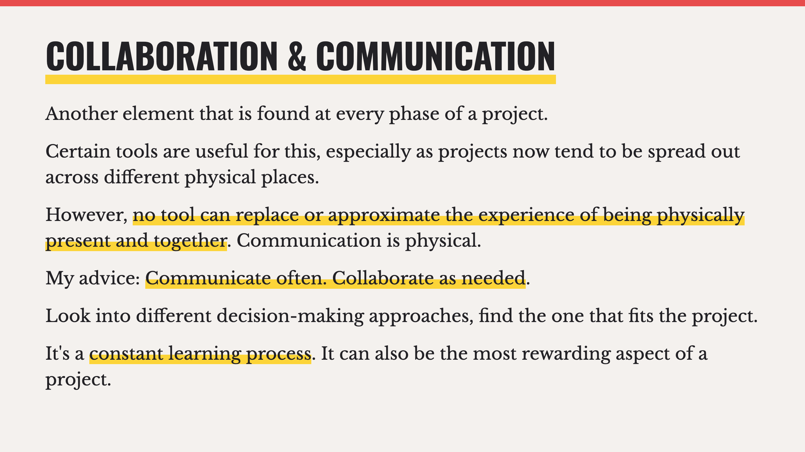
Notes:
- Slack, Notion, Discord, Zoom, shared calendars, Trello, Figma, etc.
- Sometimes it's better for one person to take something on rather than collaborate, as long as they communicate what is happening to others.

Slide 22
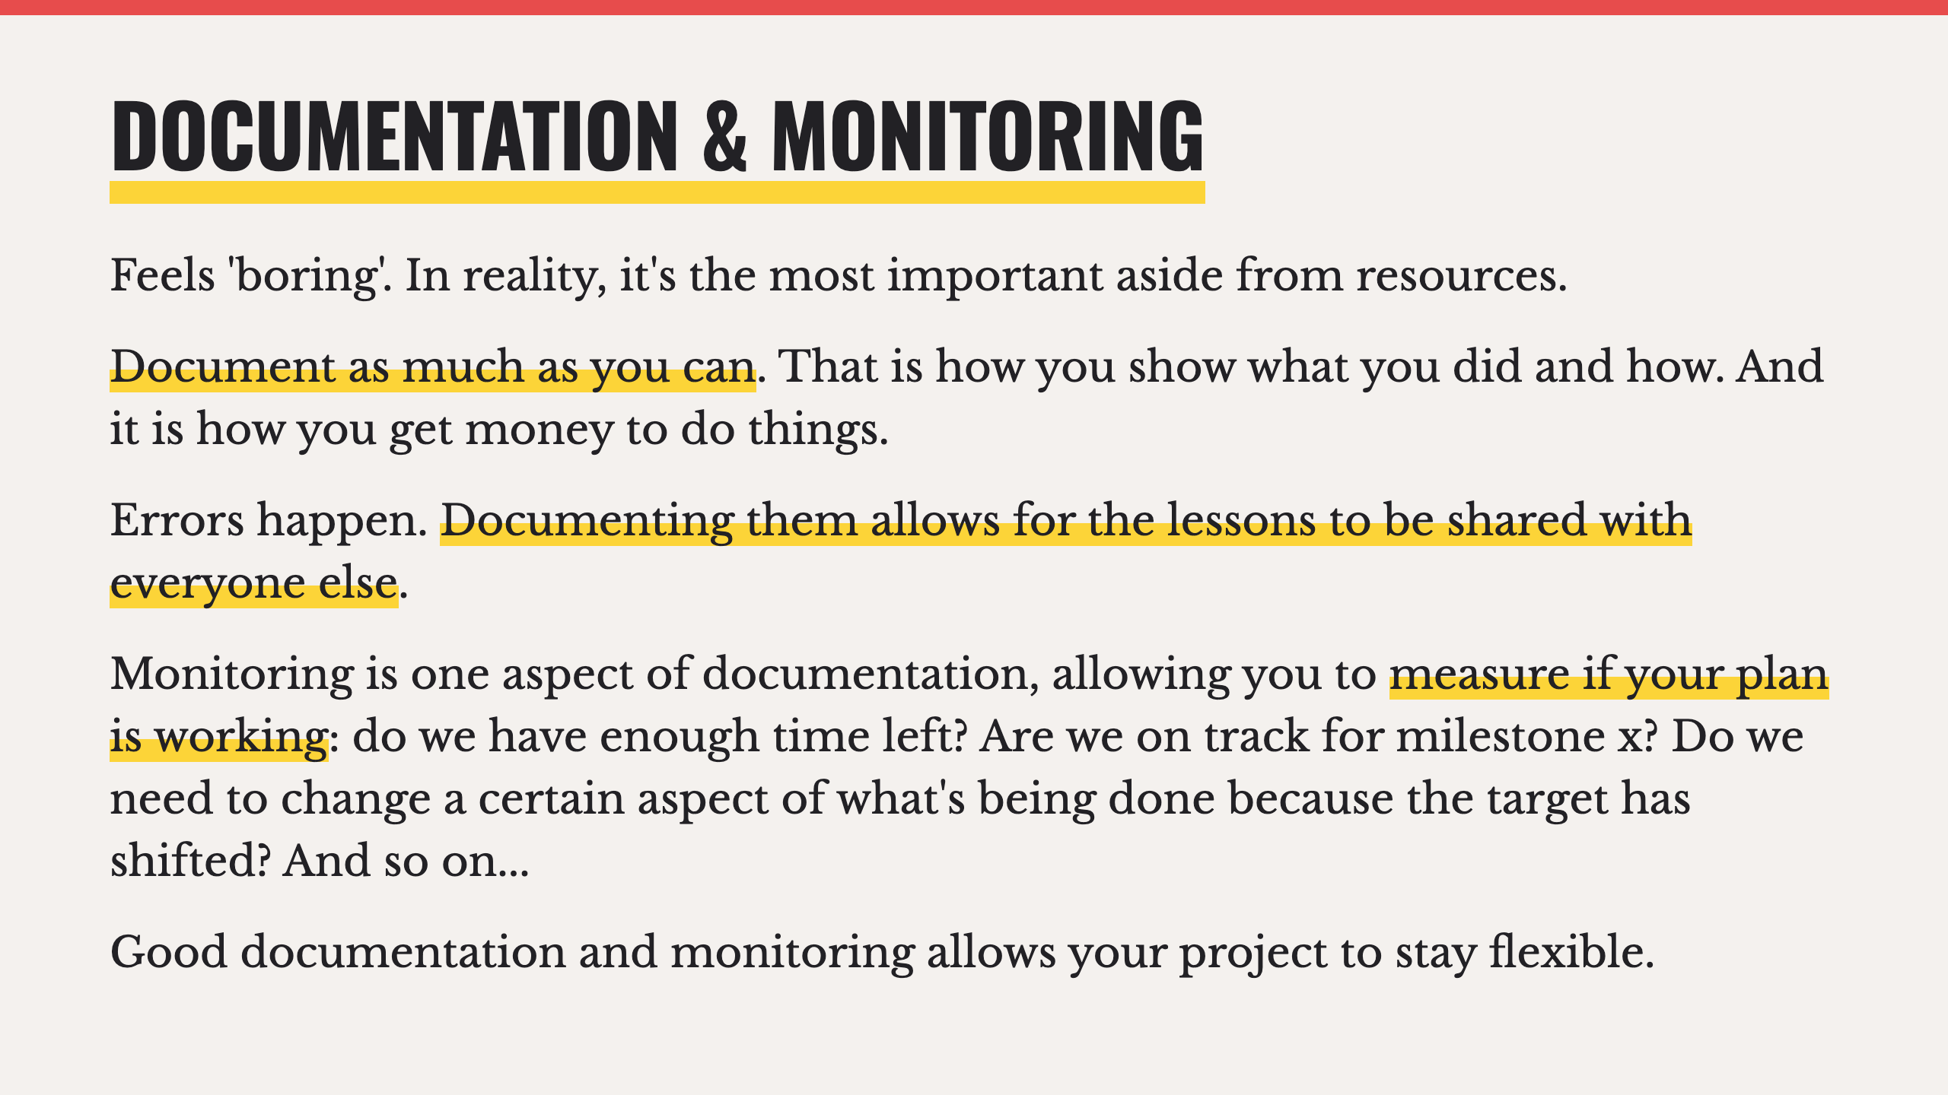

Slide 23
