Slide 1
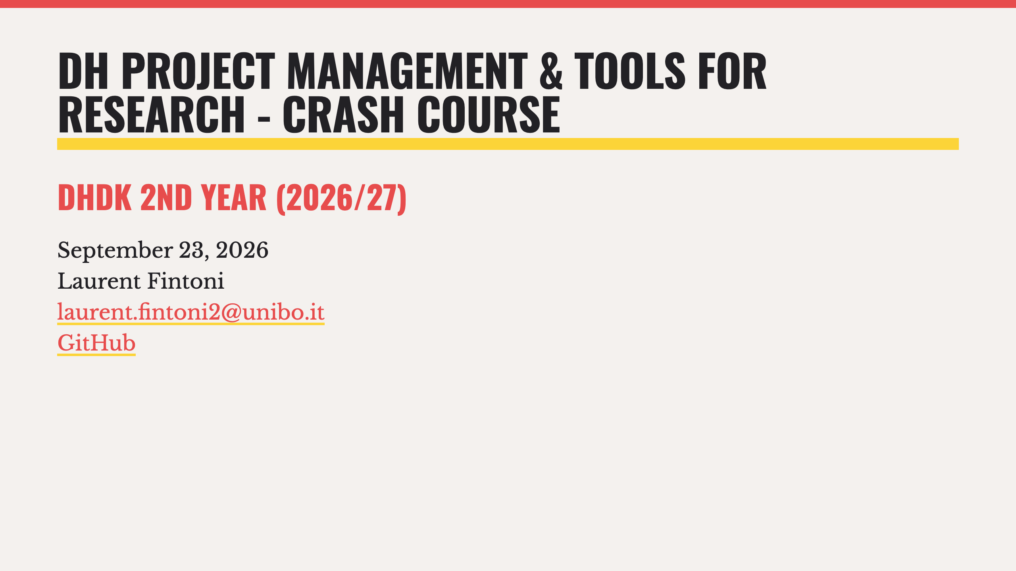

Slide 2
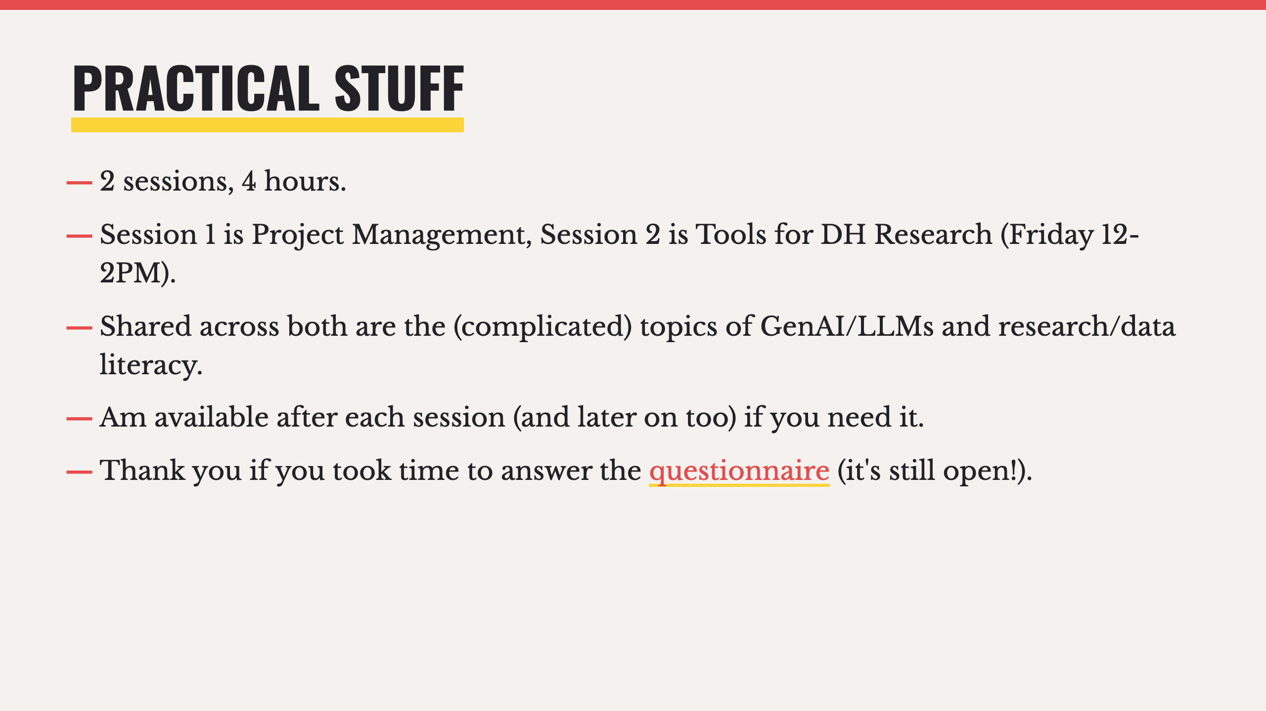
Notes:
- The sessions are interconnected, best if you can attend/follow/catch up on both as there's a fair amount of crossover
- We'll discuss what we can in the time we have
- There's an hour after each session before the lab is occupied again so if needed I'm happy to hang around and discuss anything you may want to

Slide 3
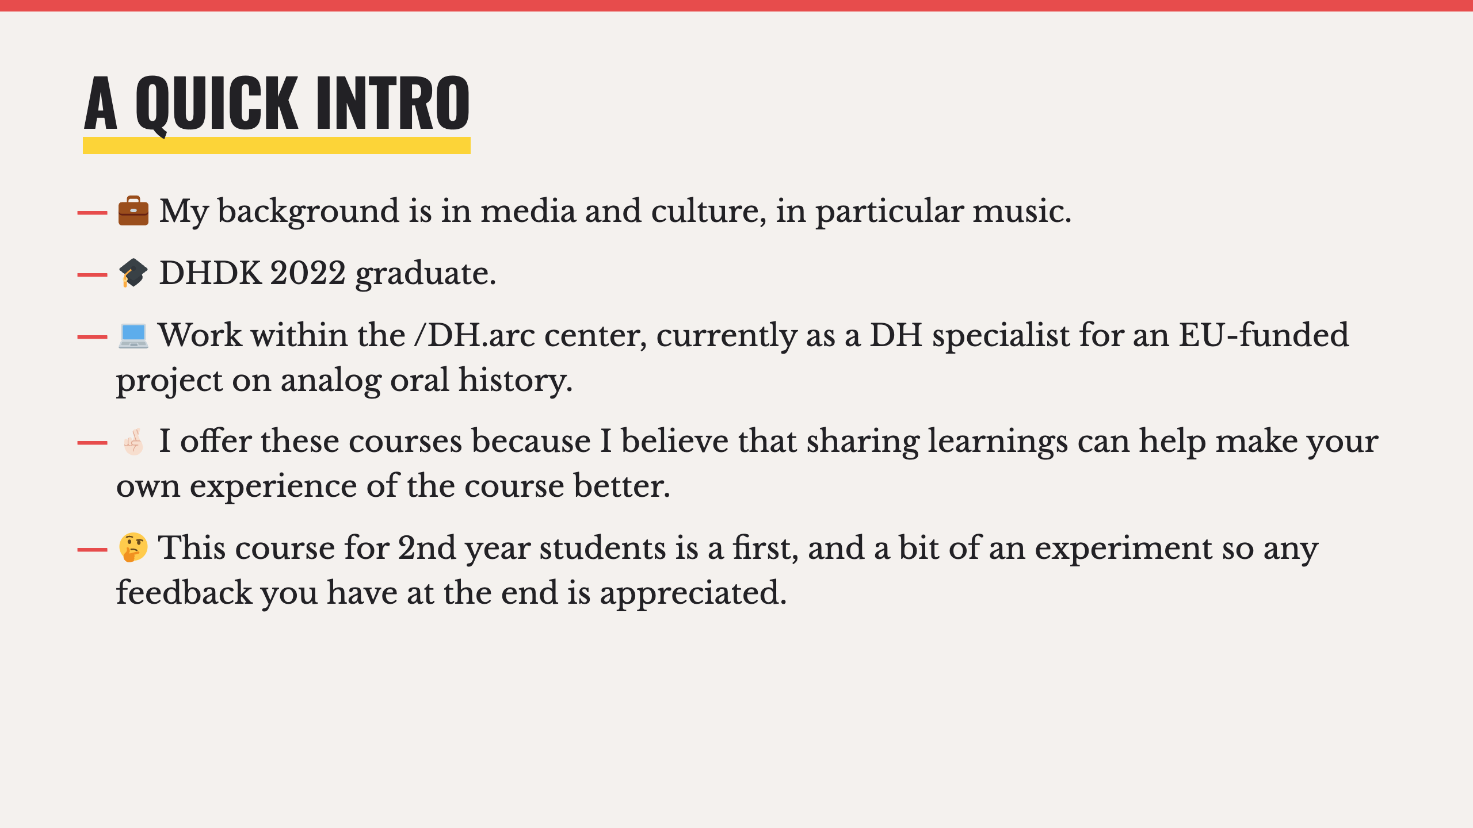

Slide 4
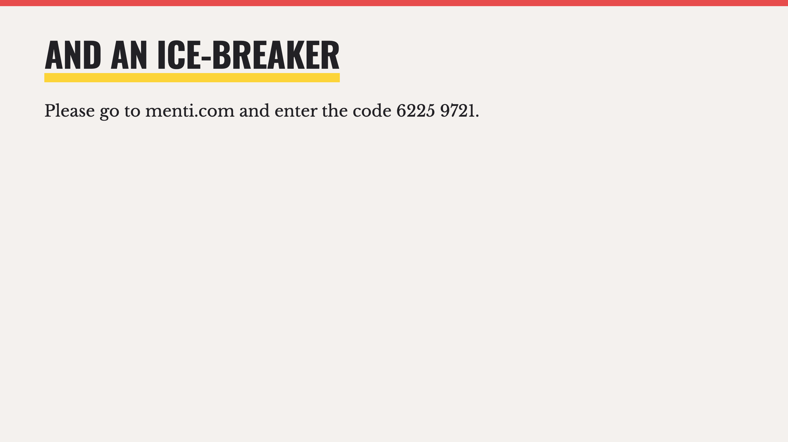
Notes:
- let's hope this works!
- you shouldn't need to login to answer

Slide 5
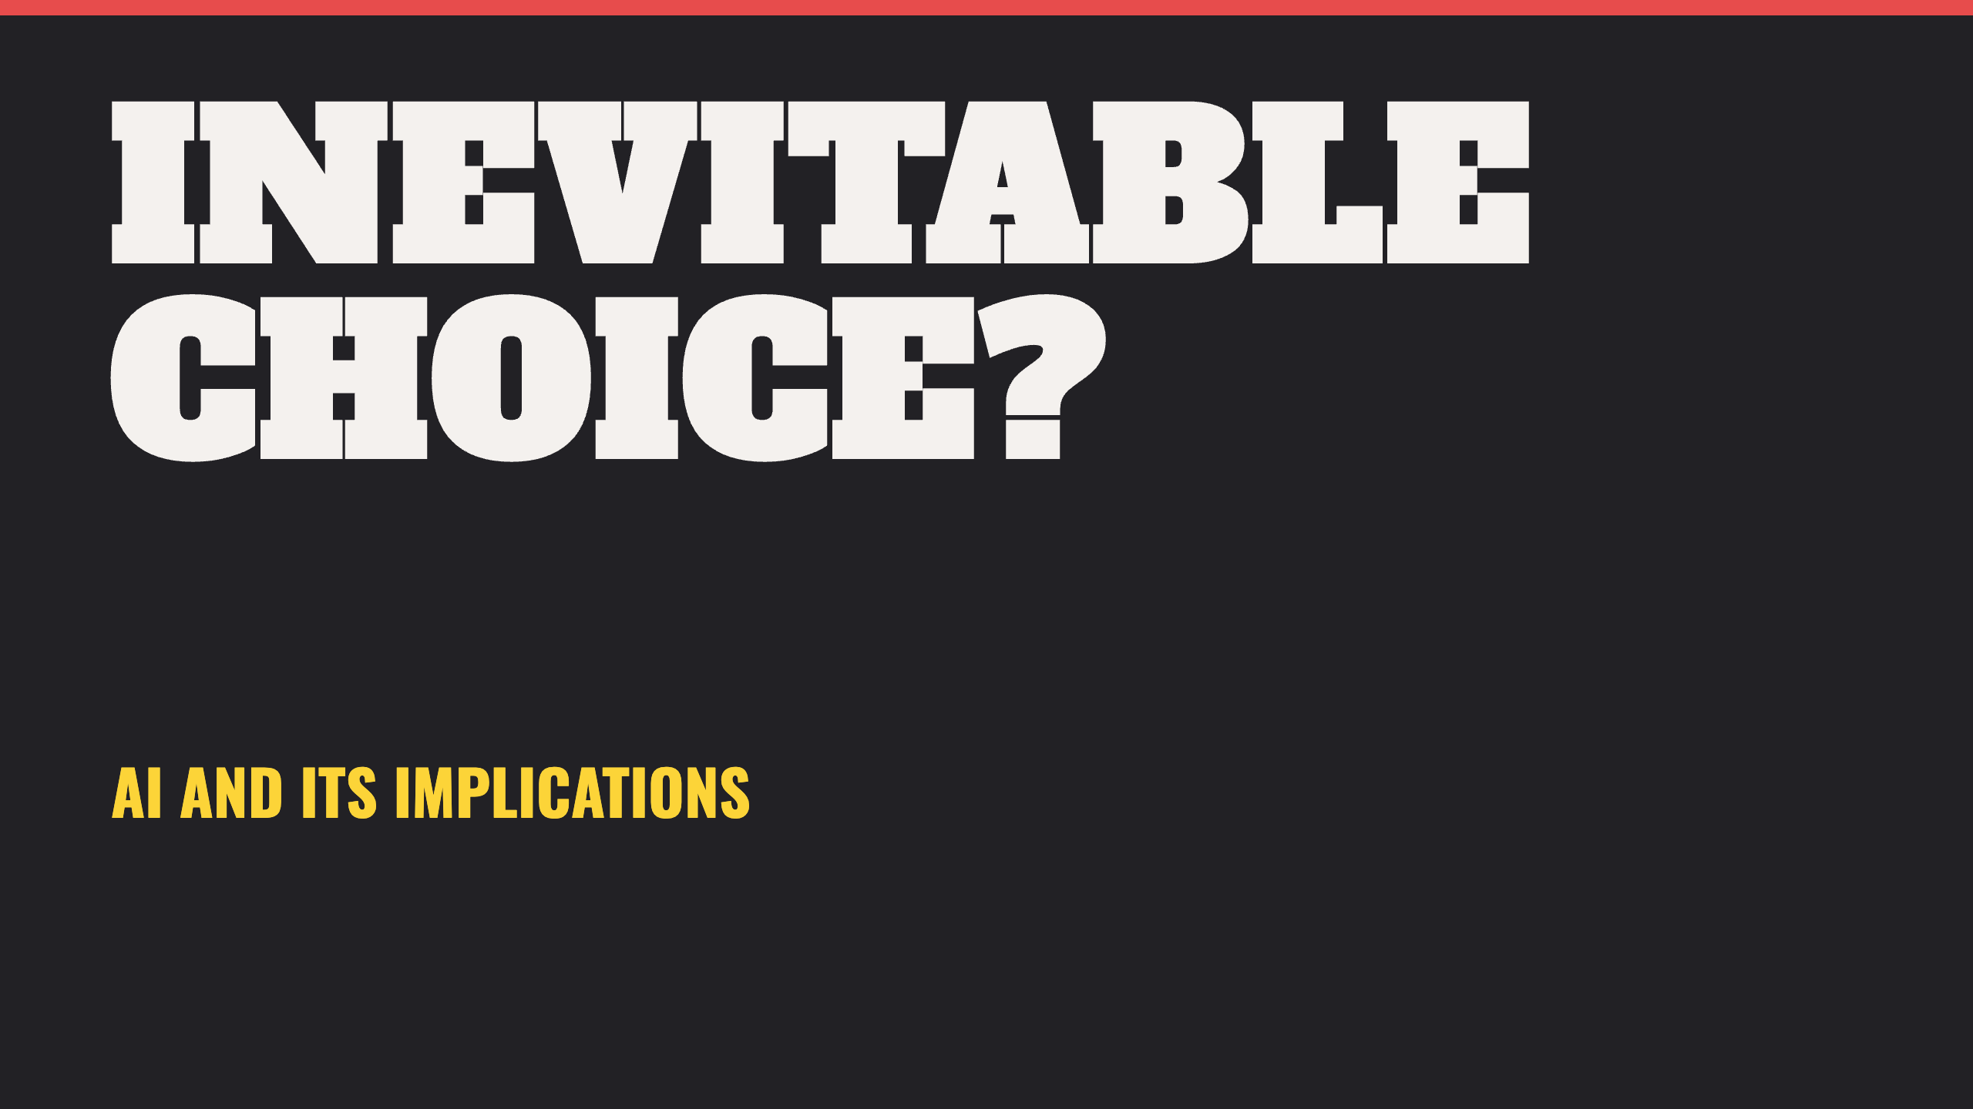
Notes:
- Ok before we get into project management, i wanted to take a quick detour into everyone's favorite topic of the day, to give some context about AI and how it will be discussed in these two crash courses, but also to give you some hopefully useful food for thought with regards to what it means for you as students, potential Digital Humanists, but also humans in this moment in time.

Slide 6
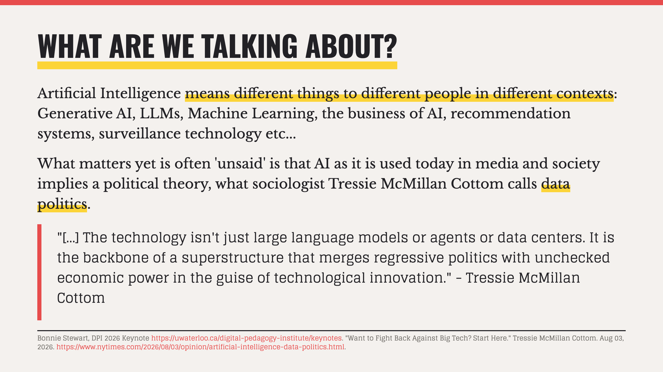
Notes:
- The words we use matter. Think about what you are implying when you use a specific term. But also specificity can help you navigate the ethical implications of the technology.
- In this presentation I will try and use specific terms like GenAI or LLMs to be more specific.
- Personally i also try and call it machine when I talk about it, to avoid the anthropomorphising that is being forced upon us.

Slide 7
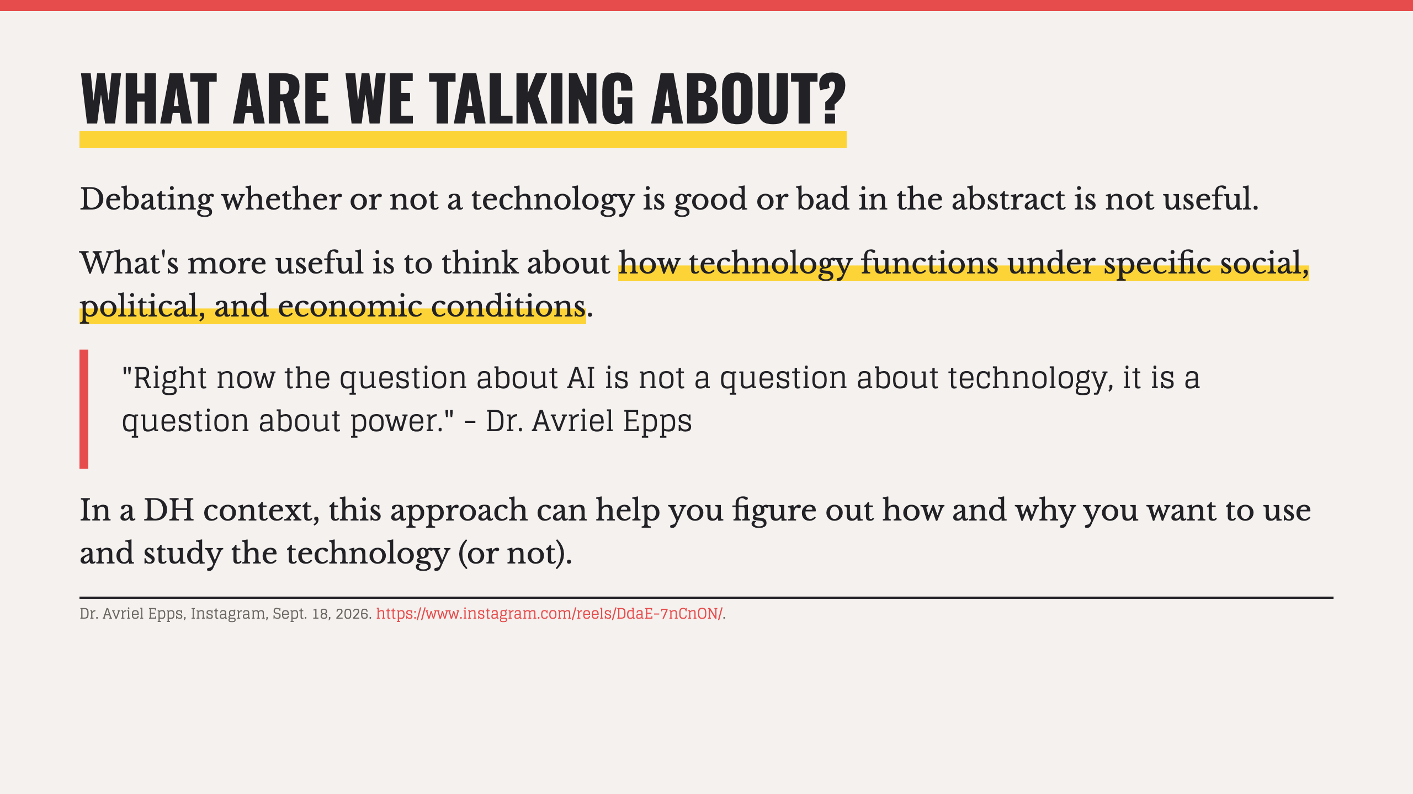

Slide 8
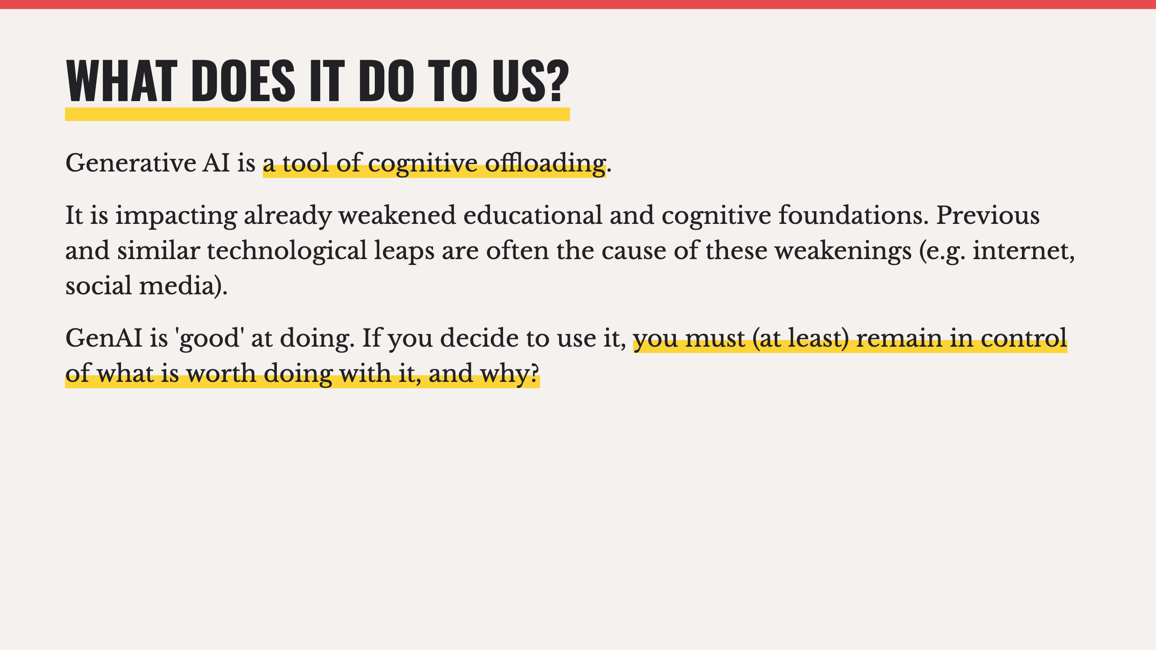
Notes:
- Another way to look at this is that while GenAI can 'simplify' things, if you choose to use it so, it also complicates others, whether that be your own learning or the need to manage it.

Slide 9
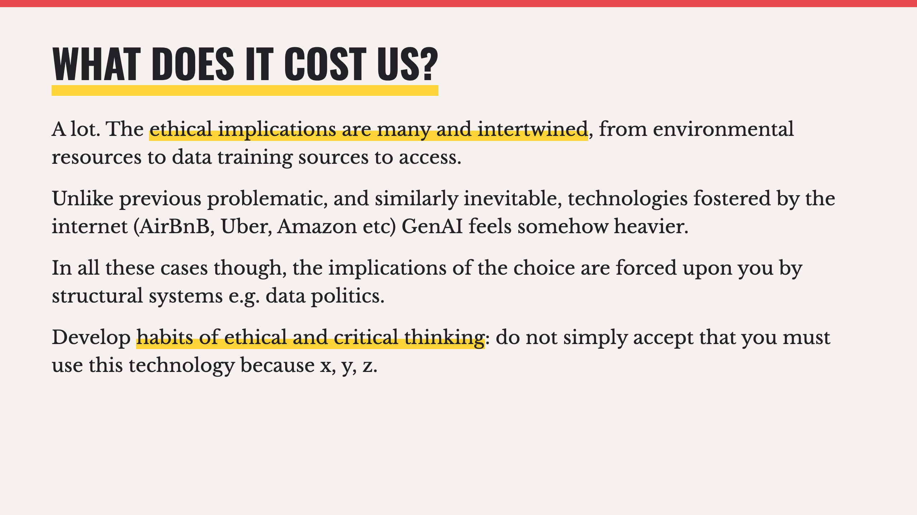
Notes:
- It's one thing to wave away the implications of having something delivered to you the next day. It's another waving away the implications of generating images, audio, video, or text with a few lines of text in seconds. The immediacy of it feeds the burden.
- I was 'slow' to adopt GenAI and LLMs for the work that I do and having done so does not absolve me of the ethical implications and complications of my choice. I am strongly opposed to the use of GenAI to generate creative work, yet I have become somewhat comfortable with using it for coding and organizational work. It's an, arguably, untenable position but one that I feel partially forced into by the system.

Slide 10
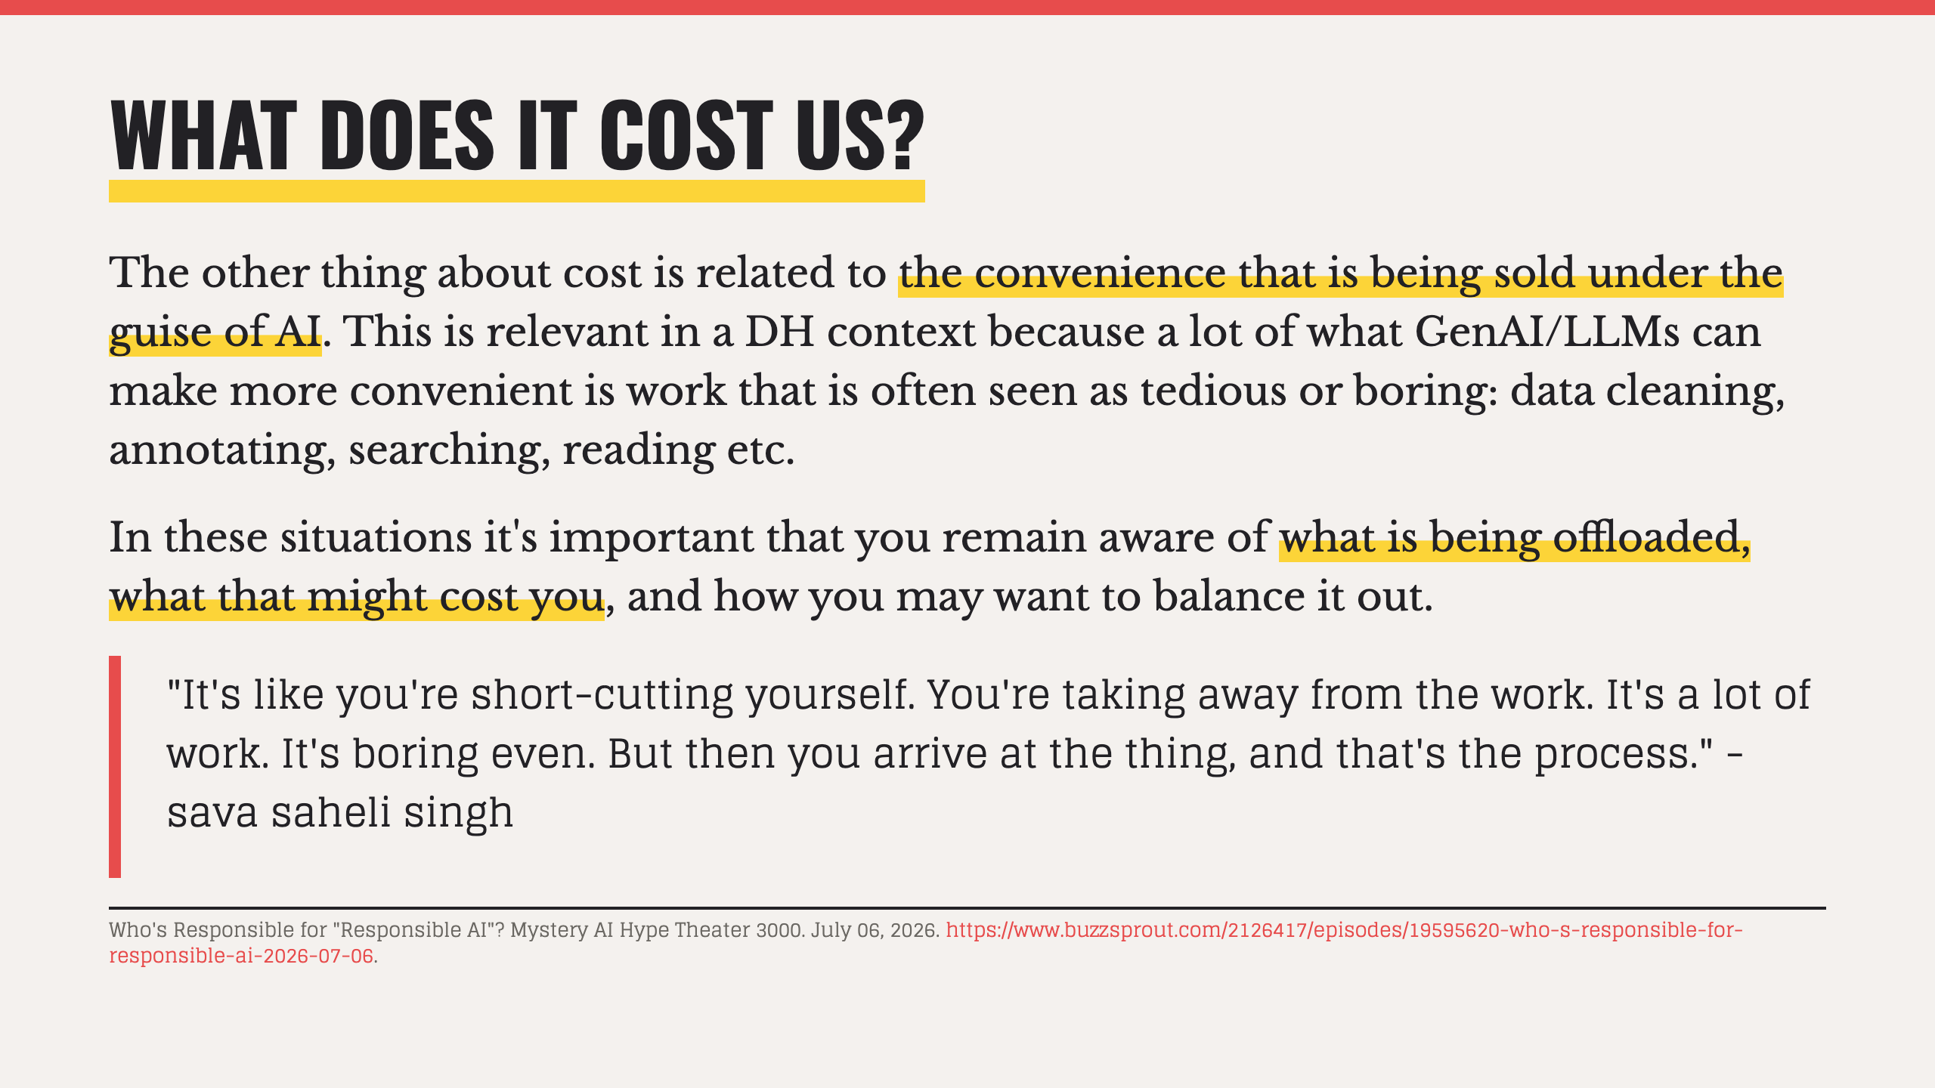
Notes:
- Truly most, if not all, of the insights I have ever had doing DH work, but also journalism work and other things I enjoy, have come from the type of work that GenAI/LLMs are most often sold as being able to solve or automate or simplify. You have to be careful what you sacrifice.

Slide 11
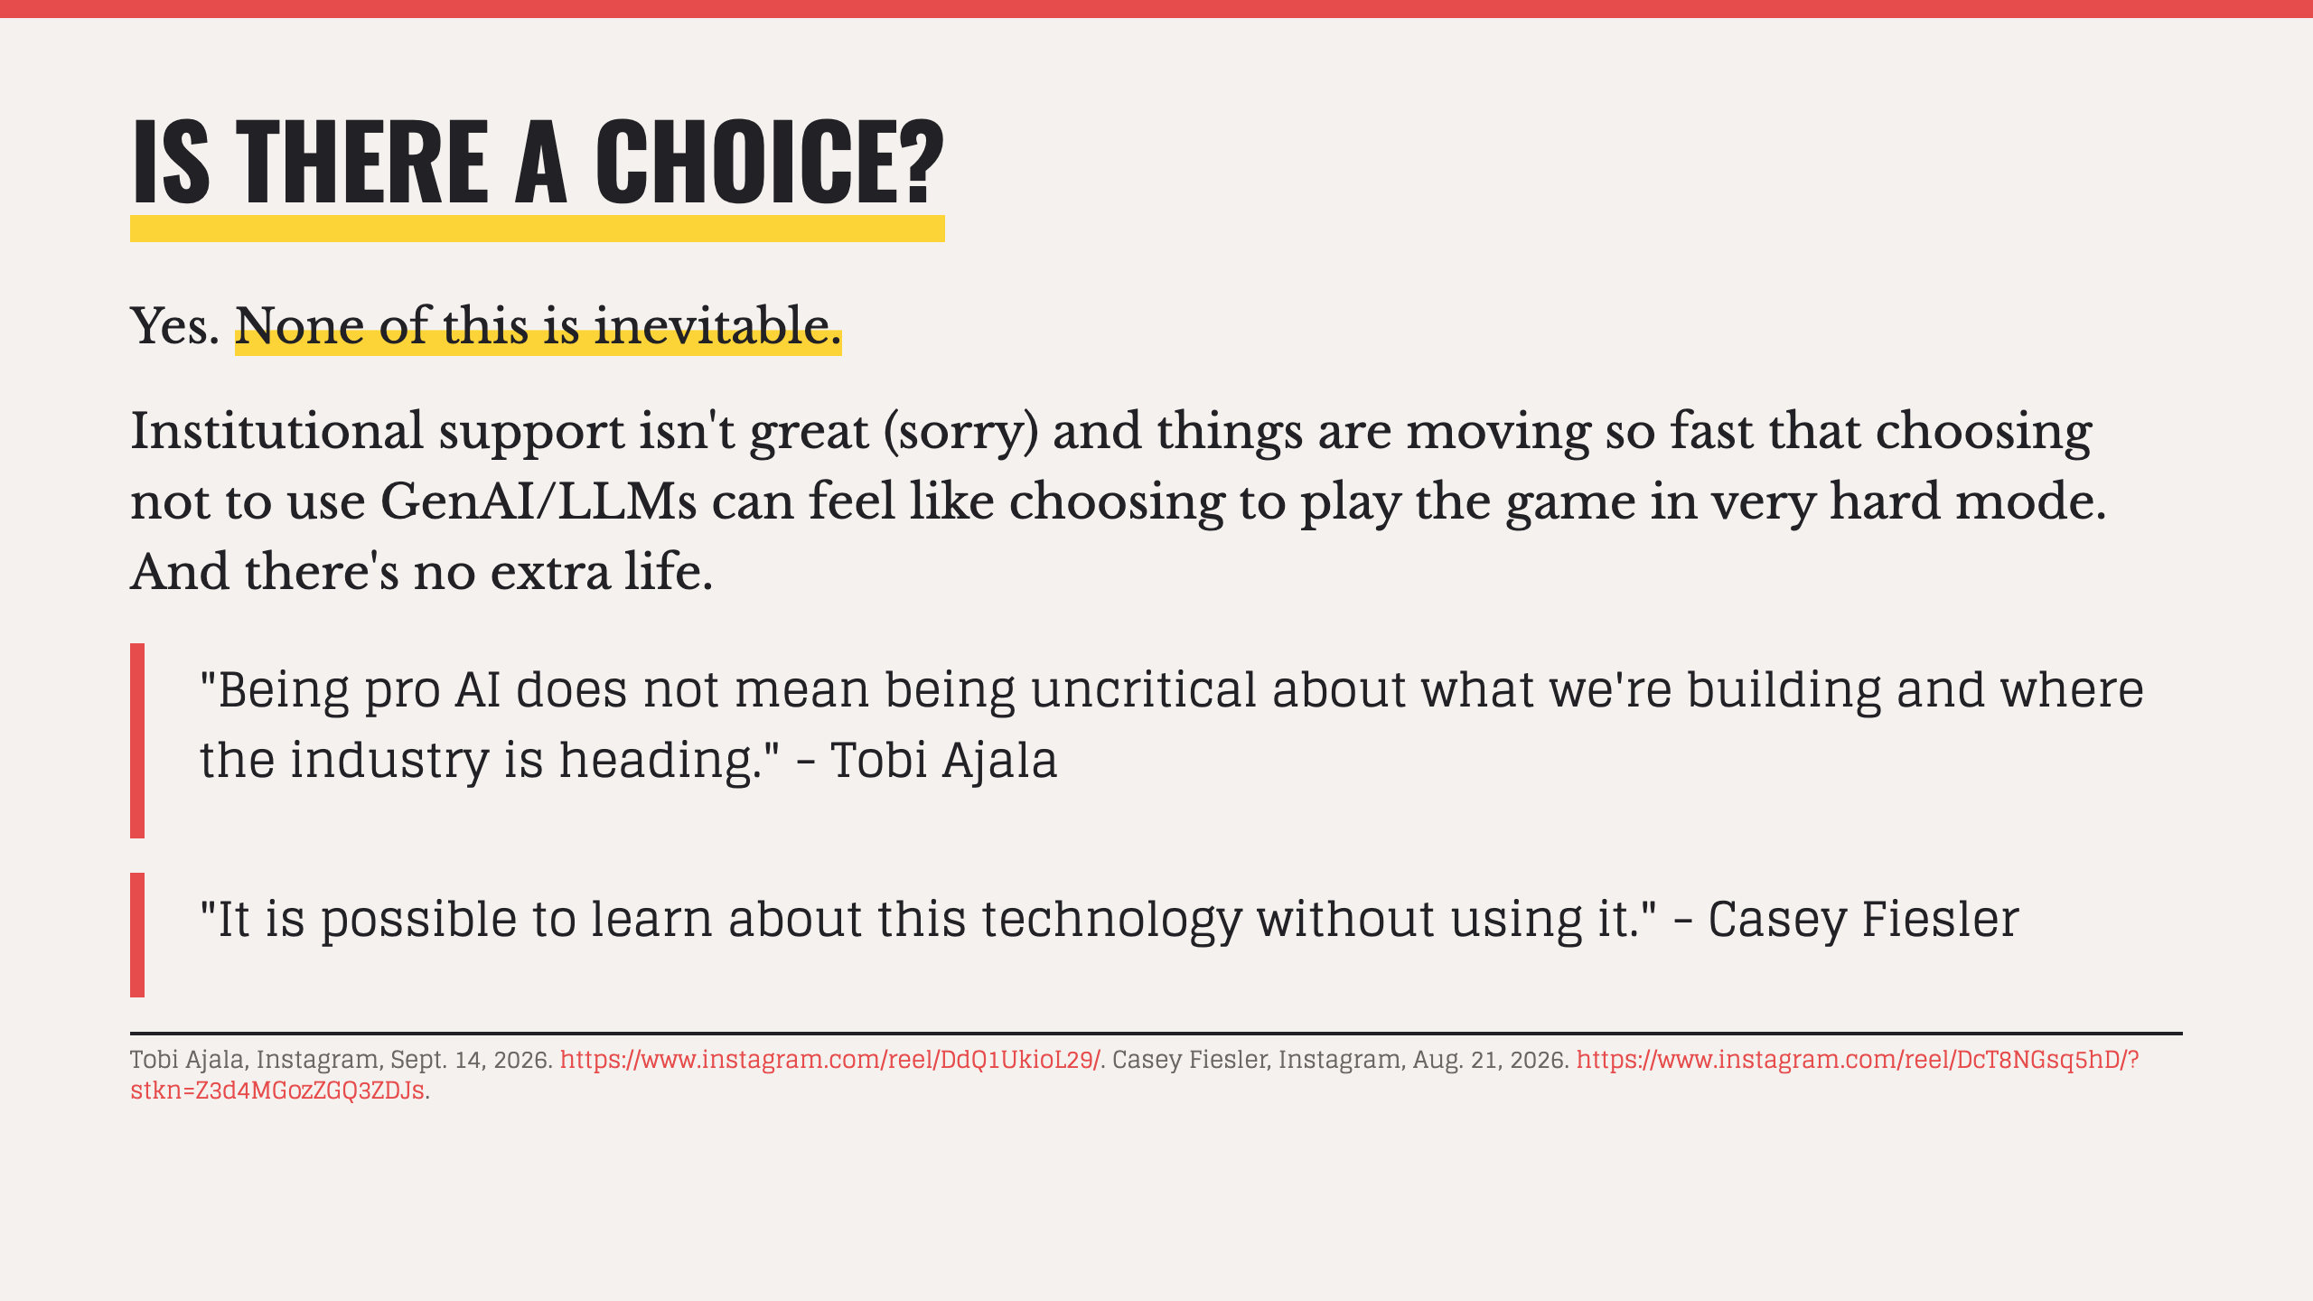
Notes:
- I cannot stress enough that choosing not to use these technologies is absolutely fine but I also understand that there are other factors, such as systemic pressure, that may make the choice seem either impossible or negative.
- This isn't the space for a debate about institutional responsibilities, though that is a debate that you should be aware of, so here for me the video game analogy feels most apt.

Slide 12
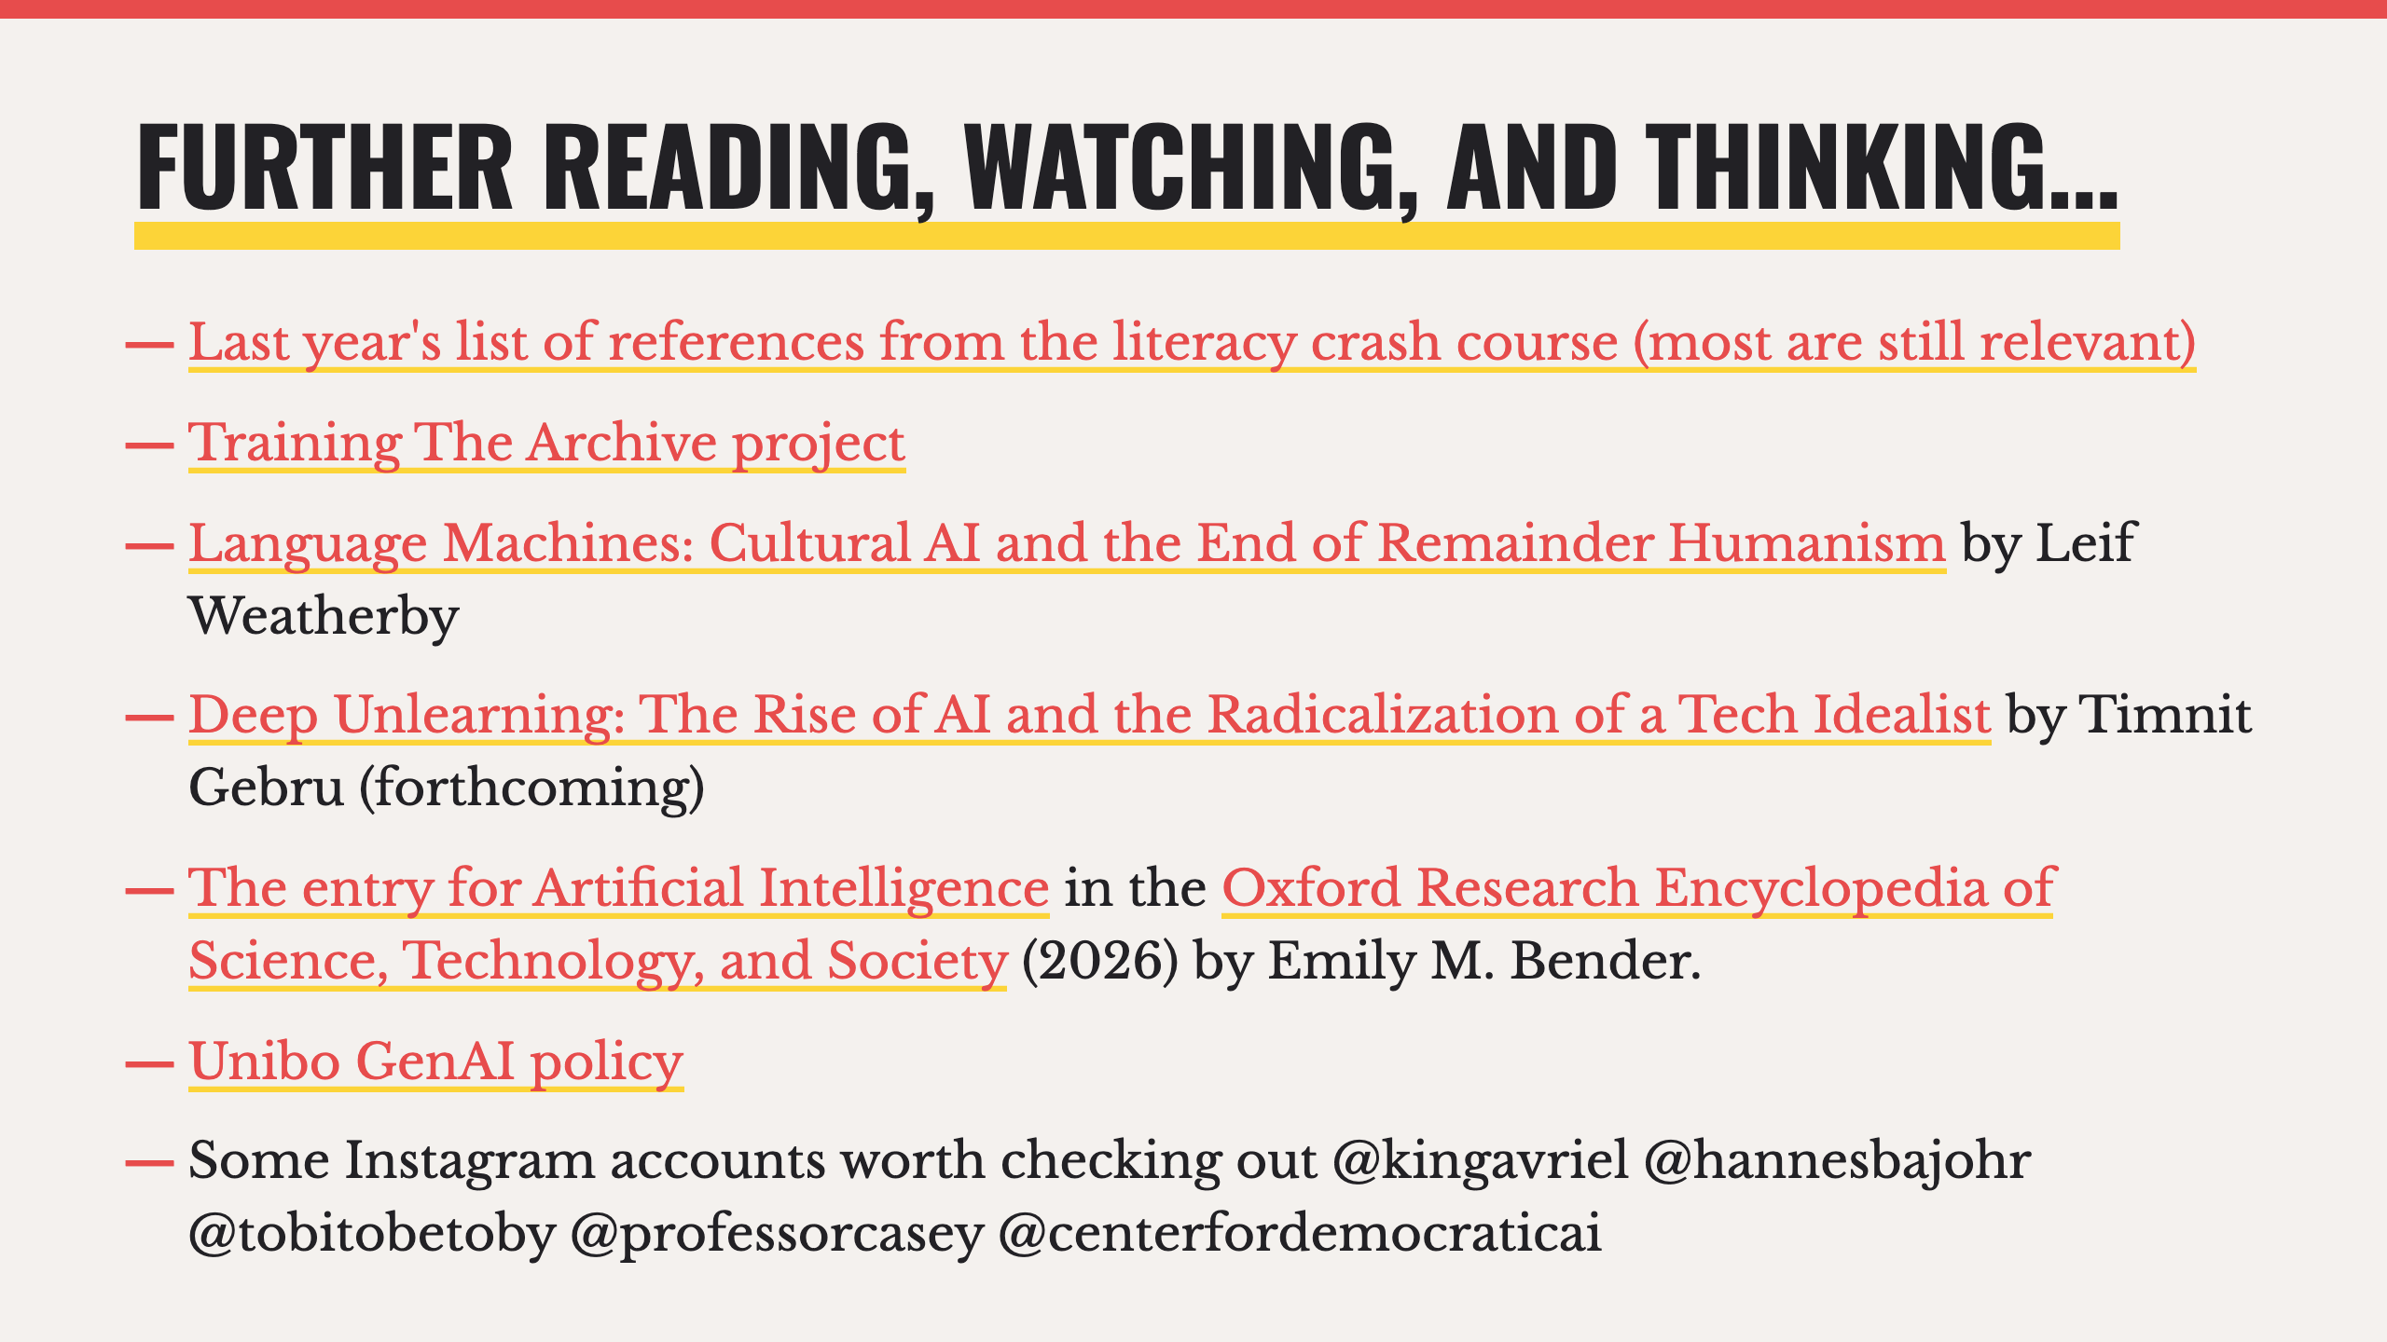

Slide 13


Slide 14
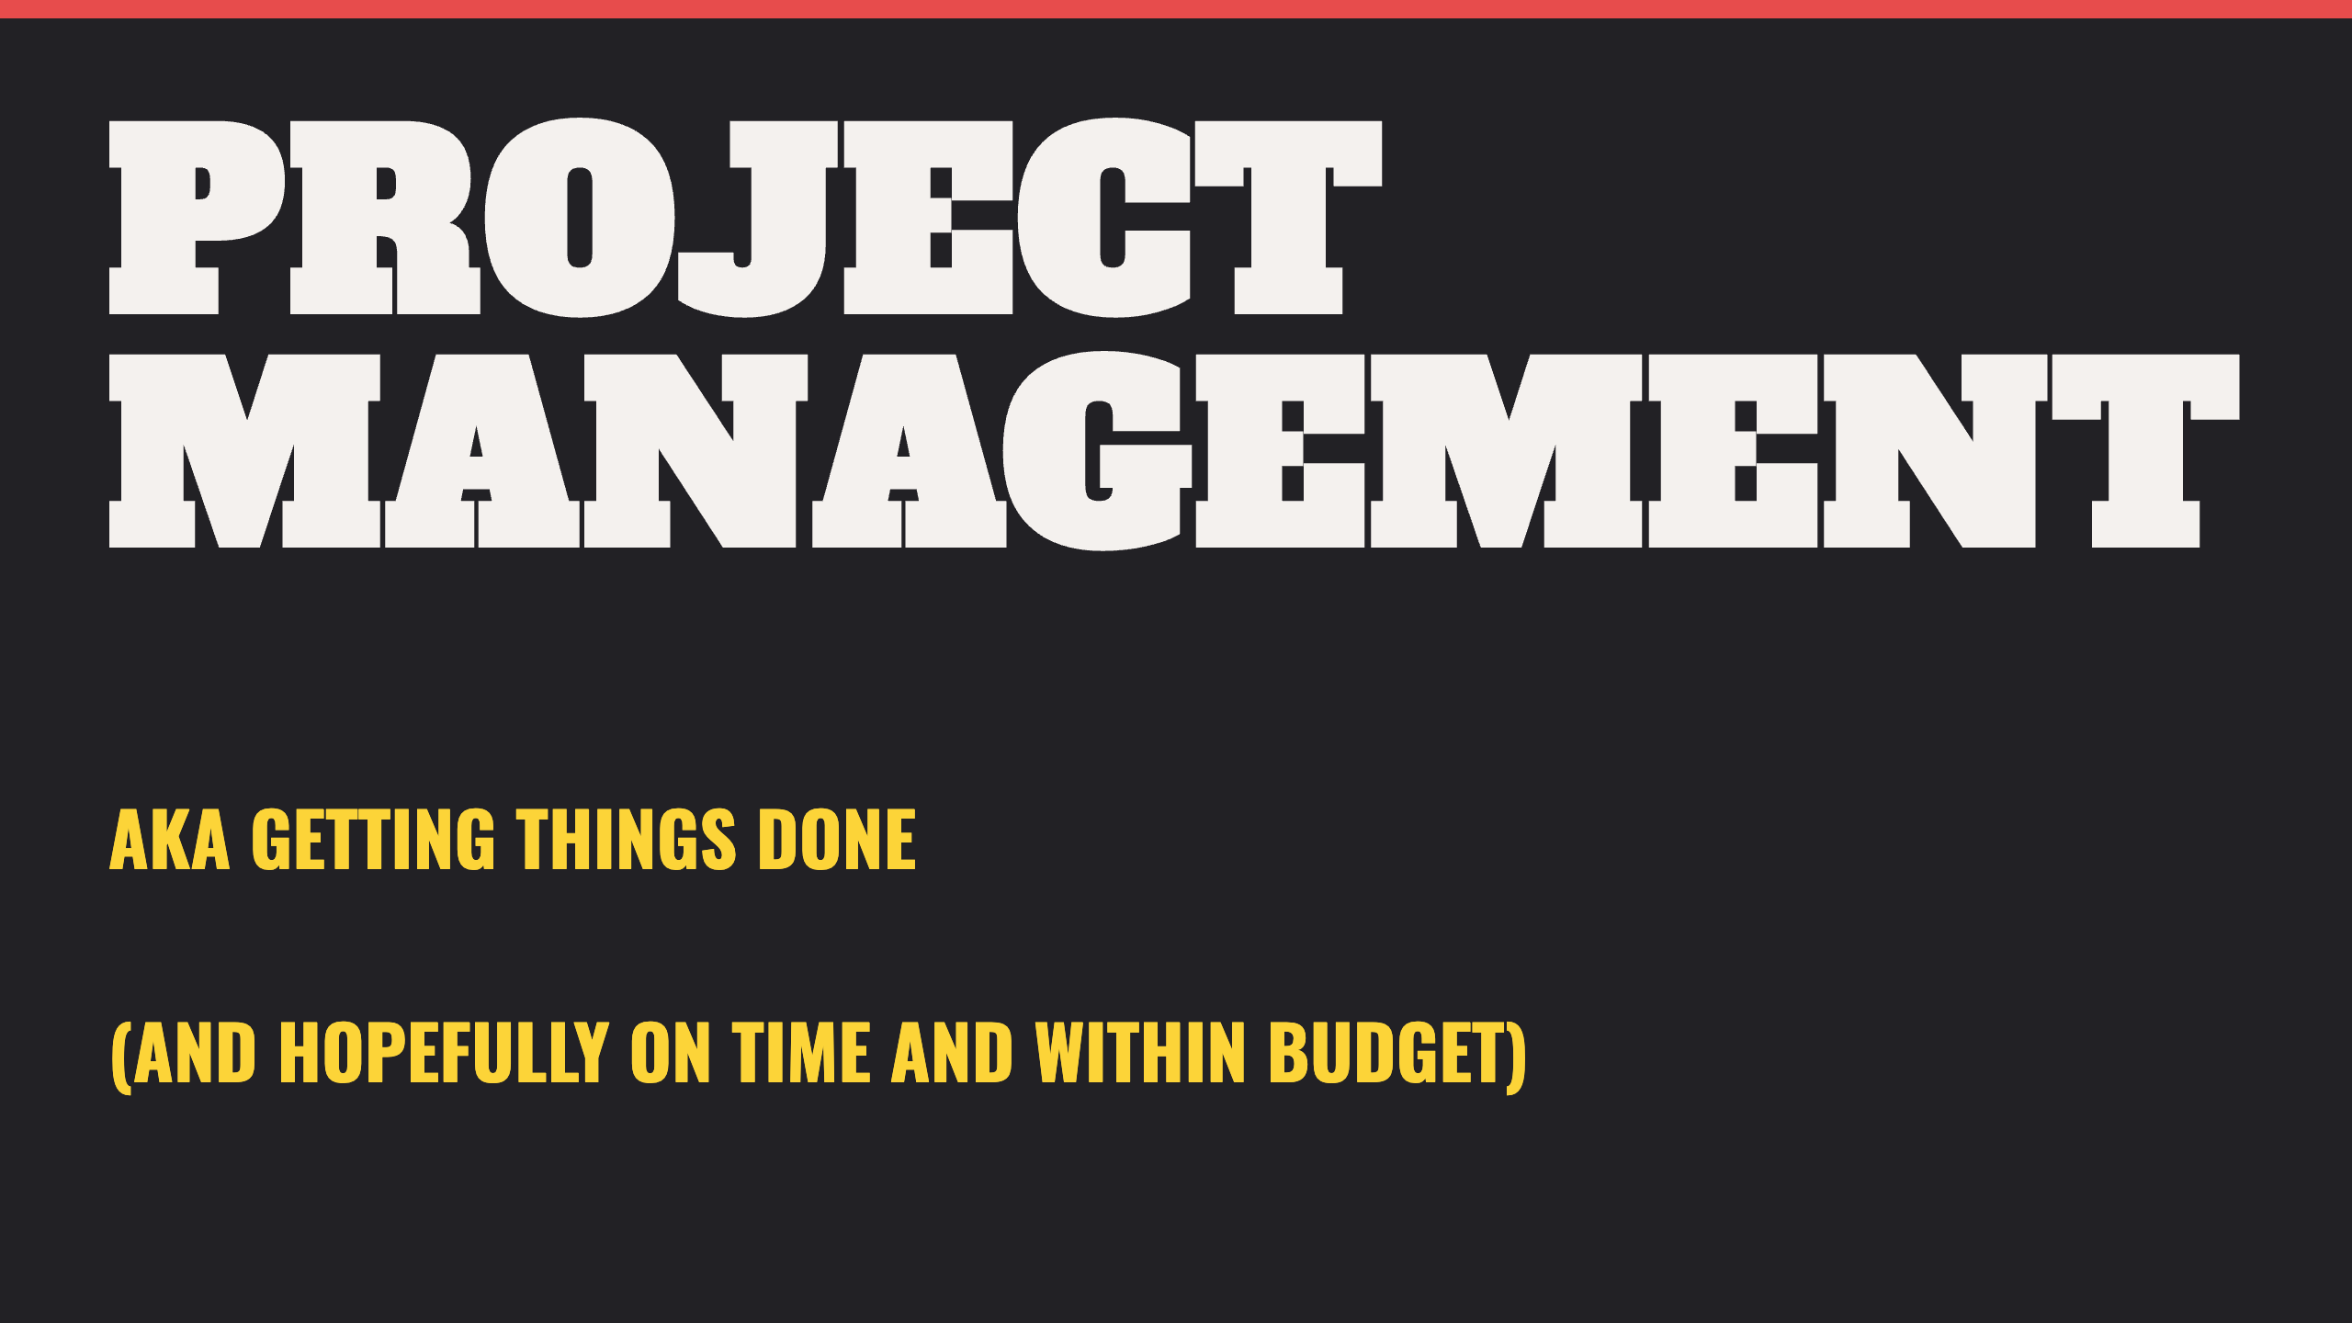
Notes:
- What we'll cover on this topic today assumes a degree of basic familiarity with Project Management, based on some of your feedback via the questionnaire.

Slide 15
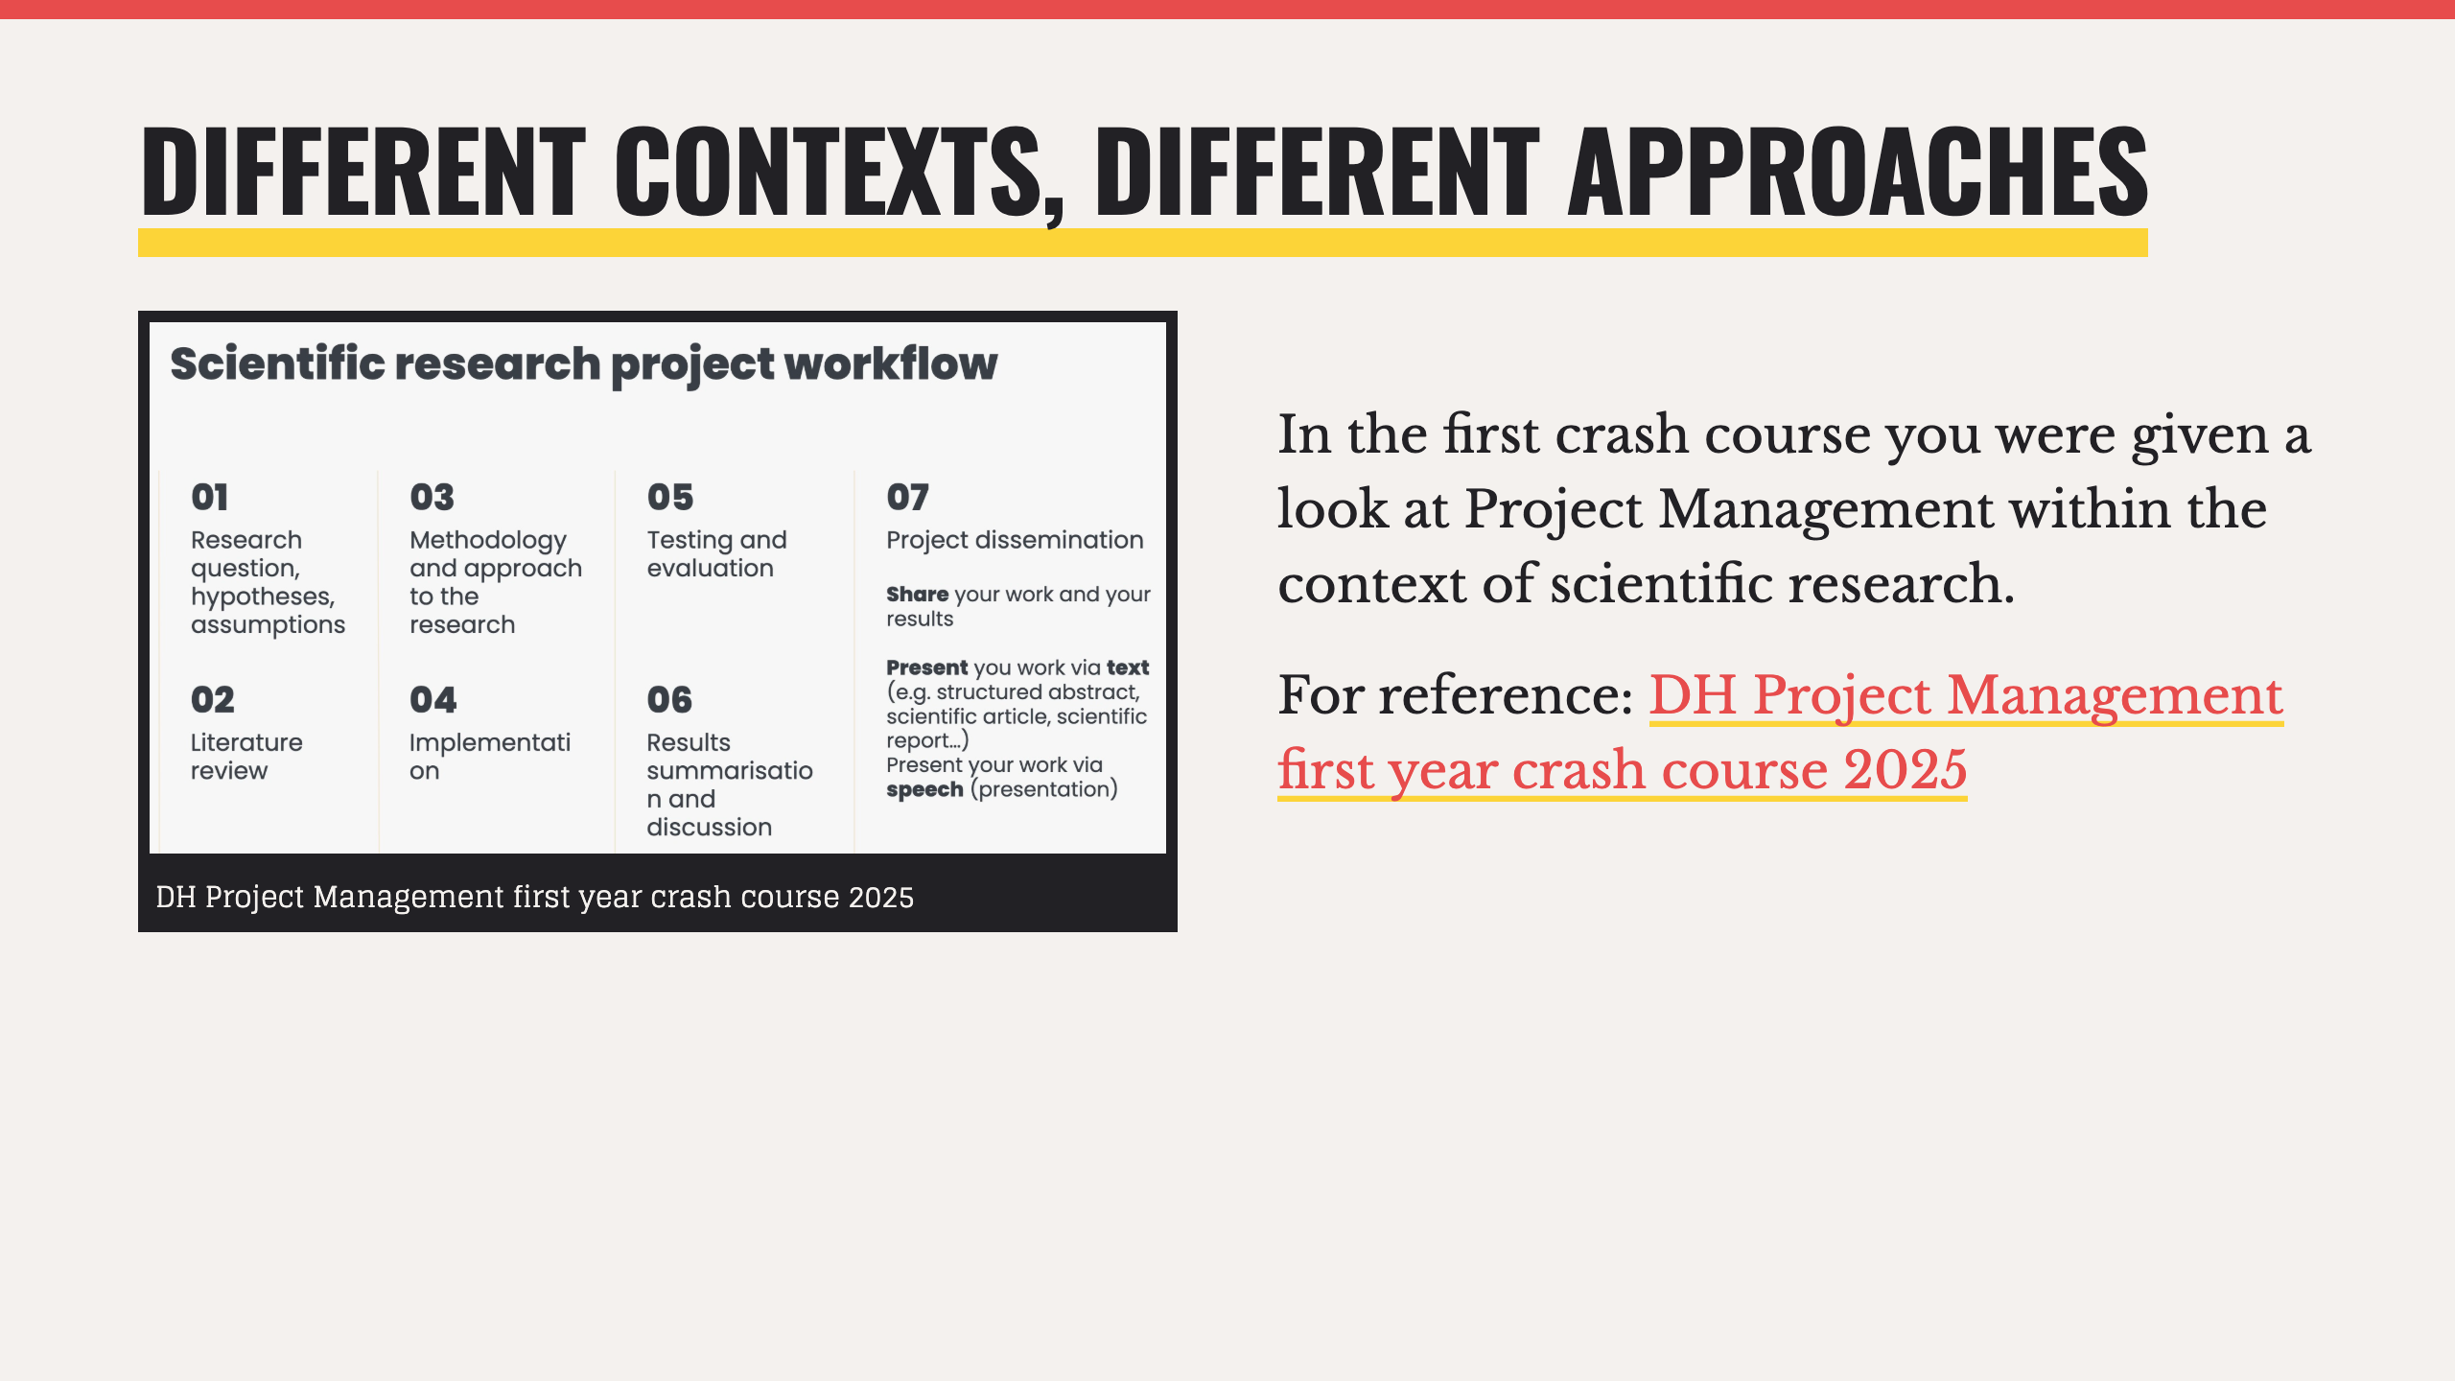

Slide 16
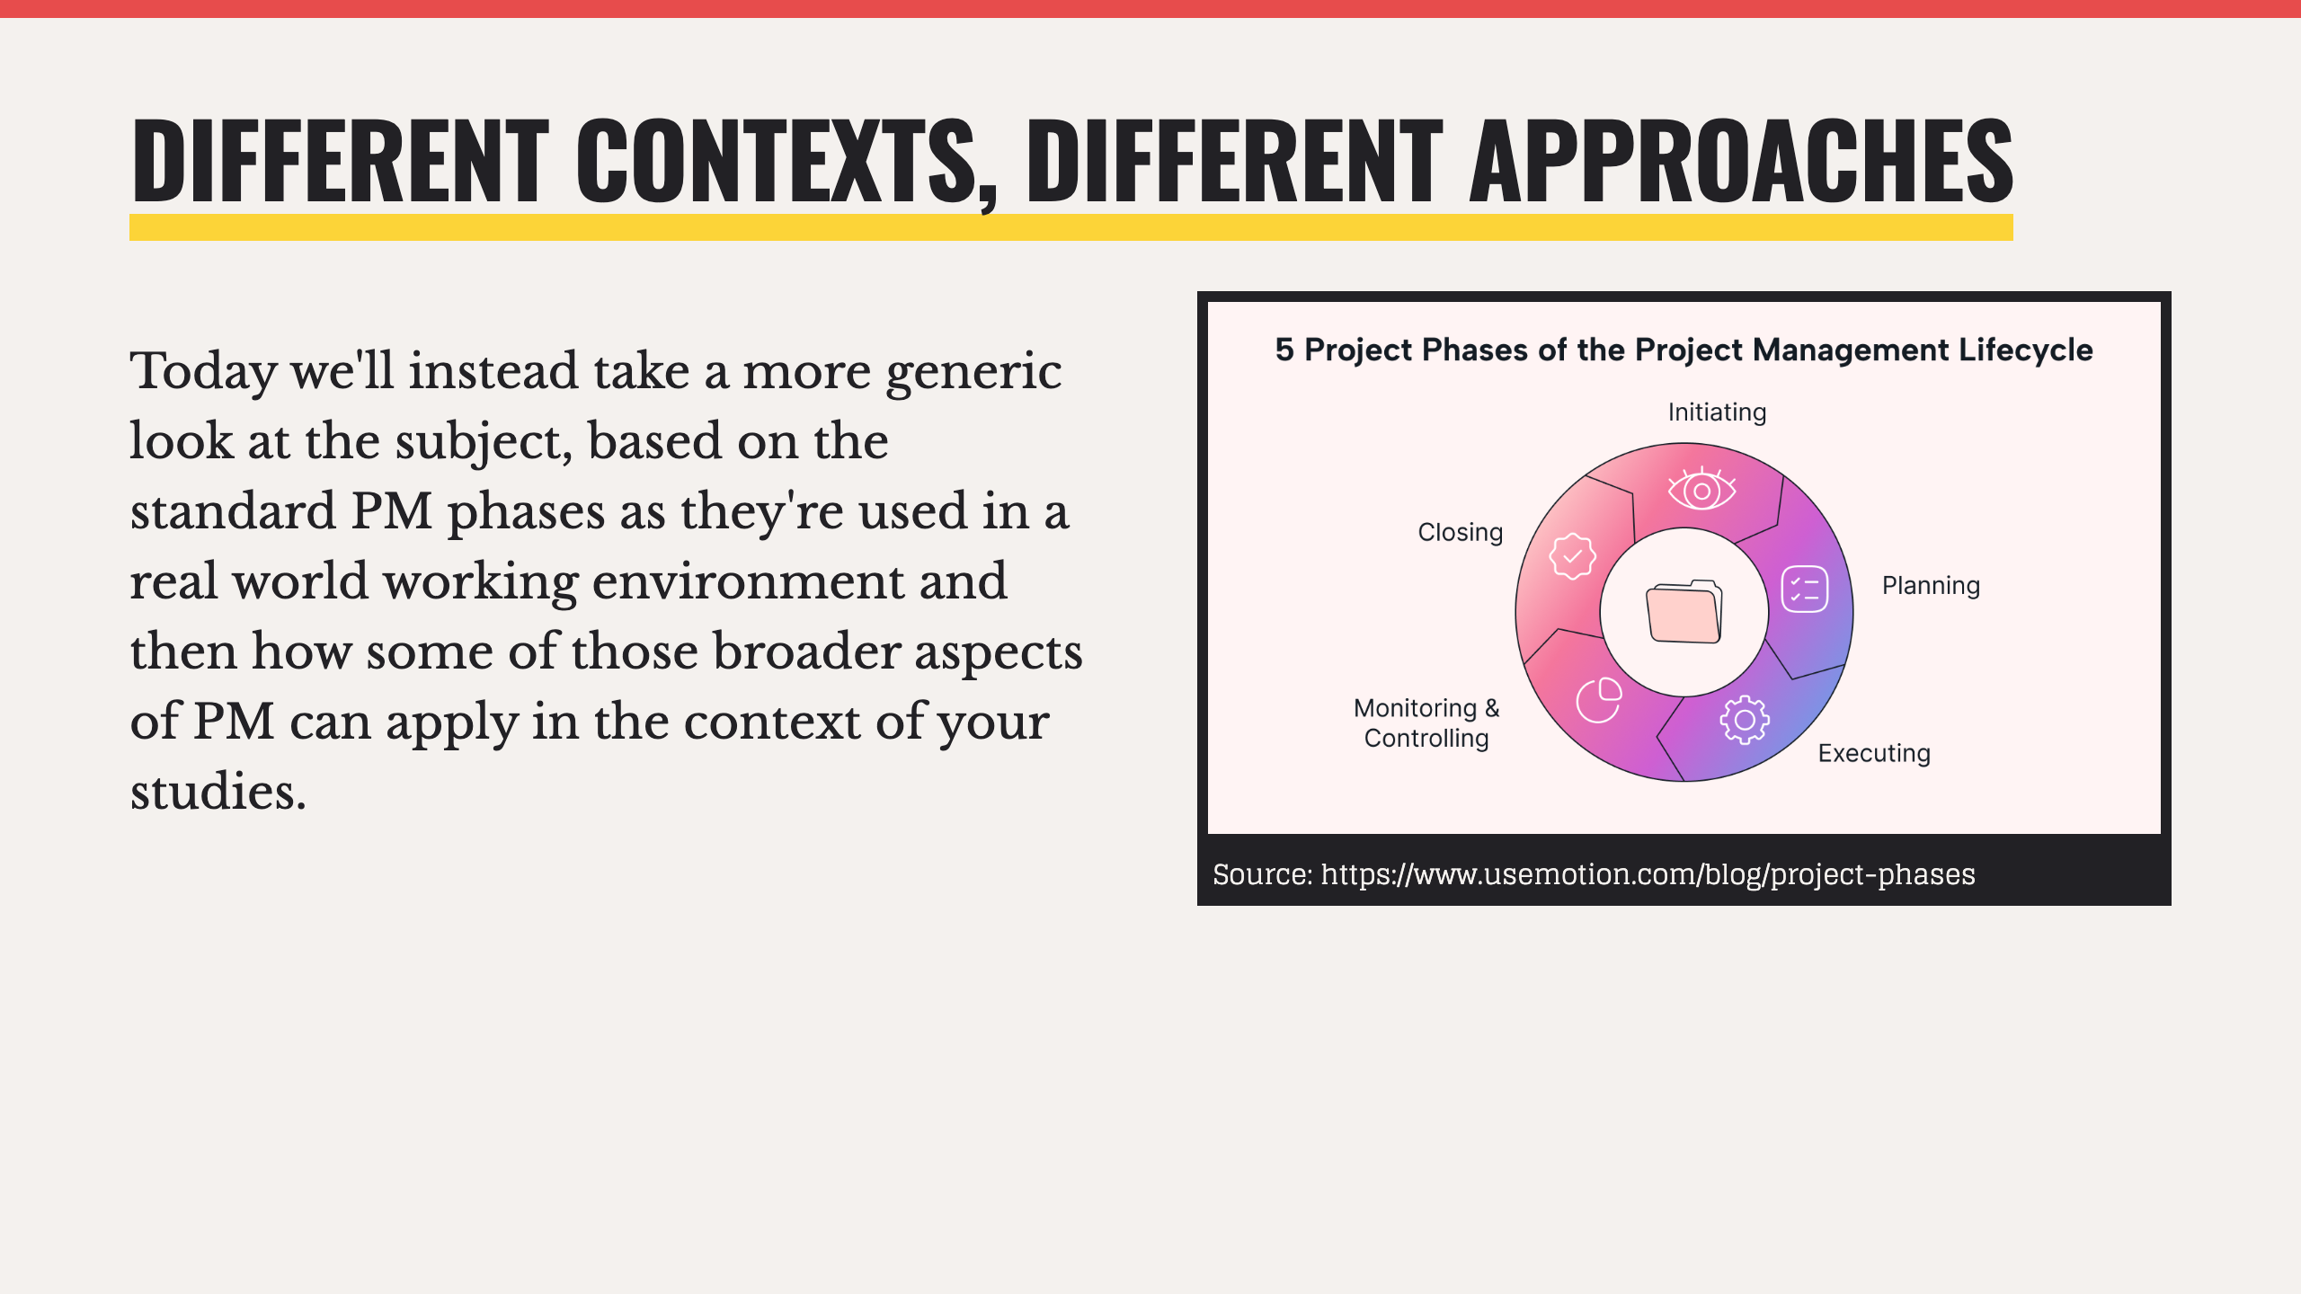

Slide 17
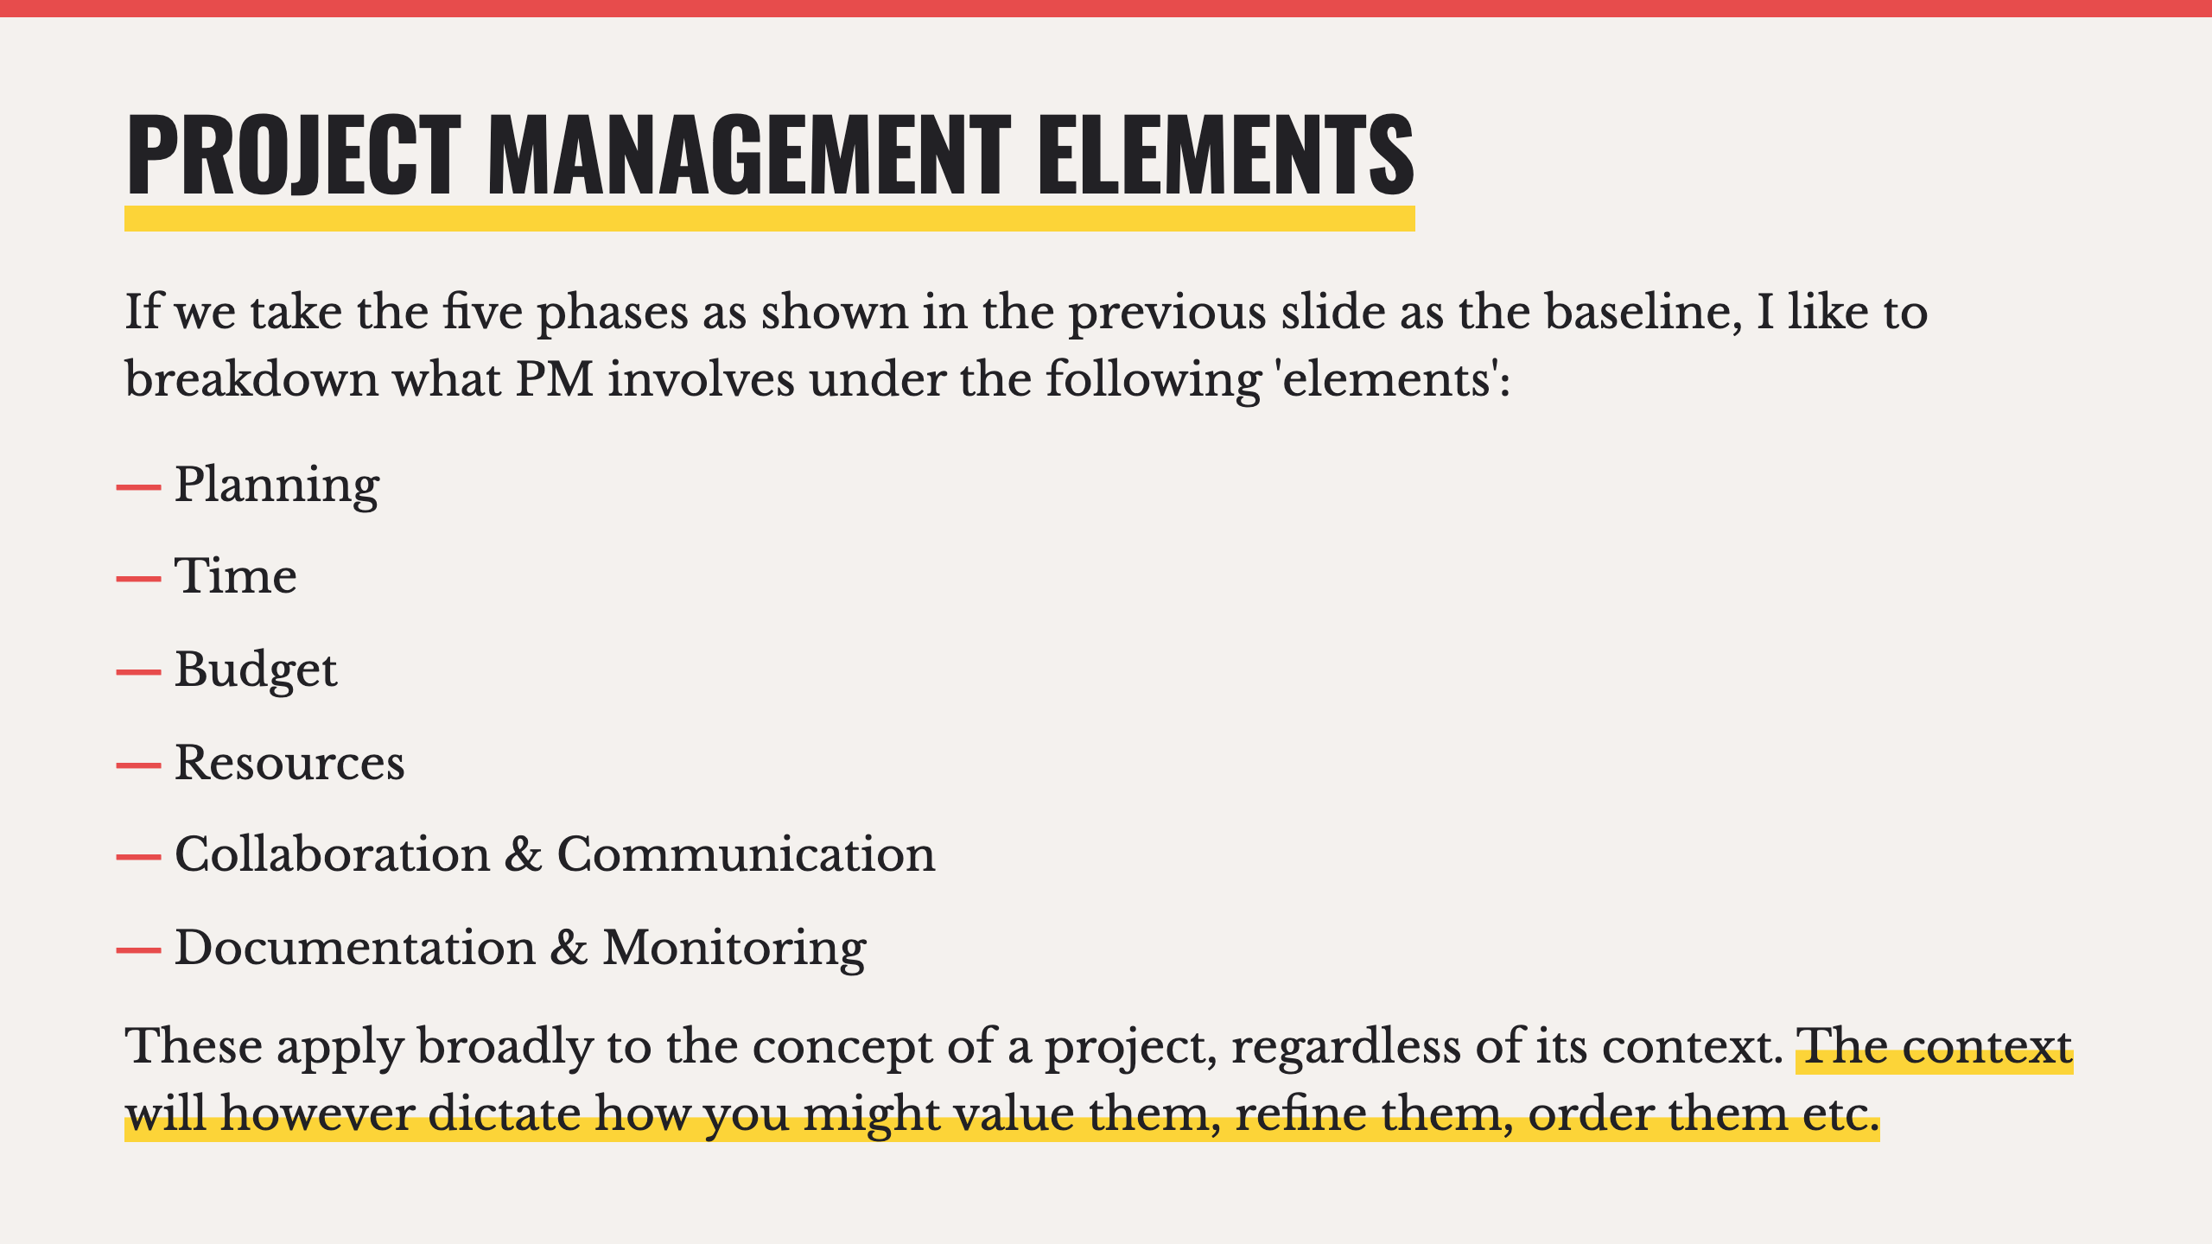

Slide 18
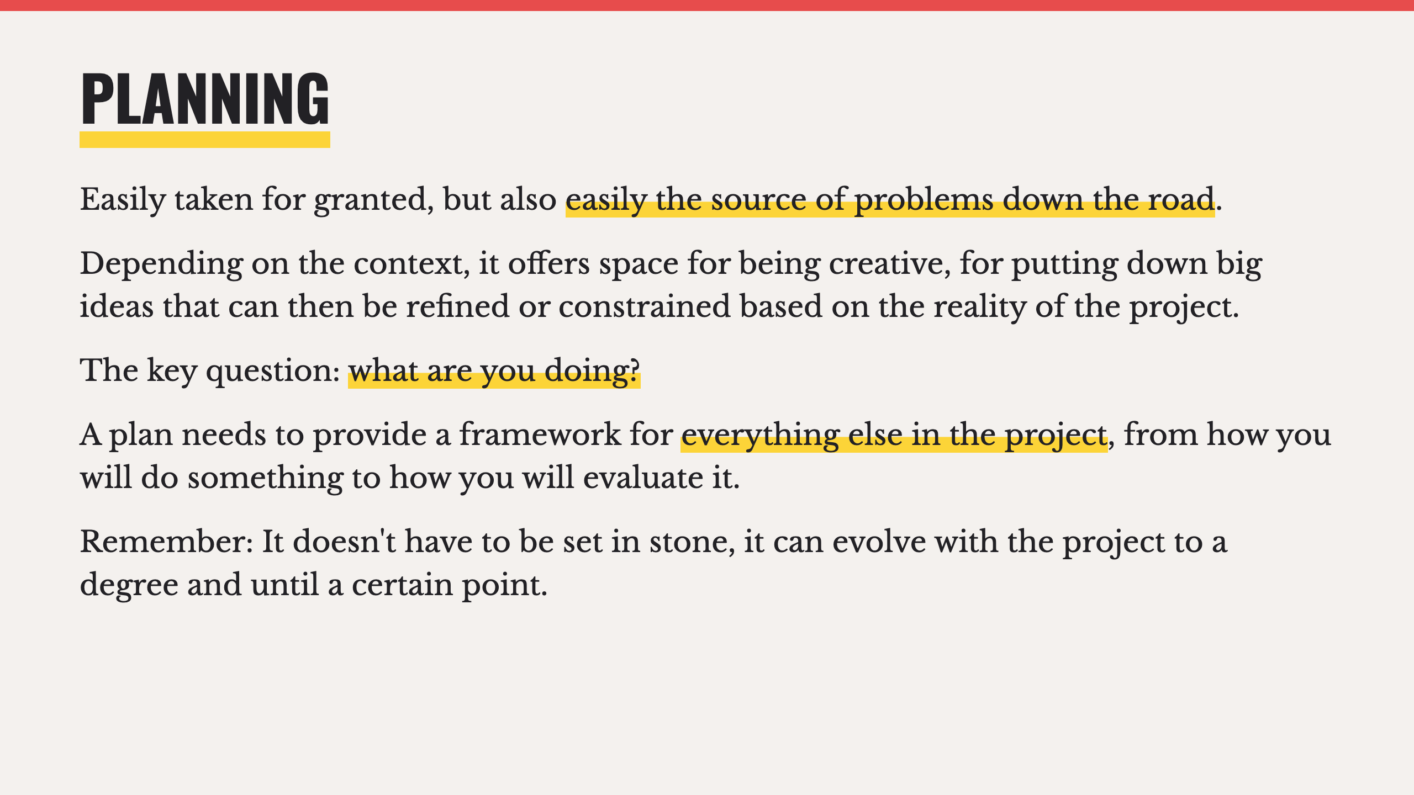
Notes:
- It's totally normal to make mistakes at the planning stage, to forget something, or get it wrong. No plan is perfect, it's having it and learning through doing it over and over that matters. It's a way of laying out all the questions you have, and if you can already include answers great, otherwise at least you know you need that answer.

Slide 19
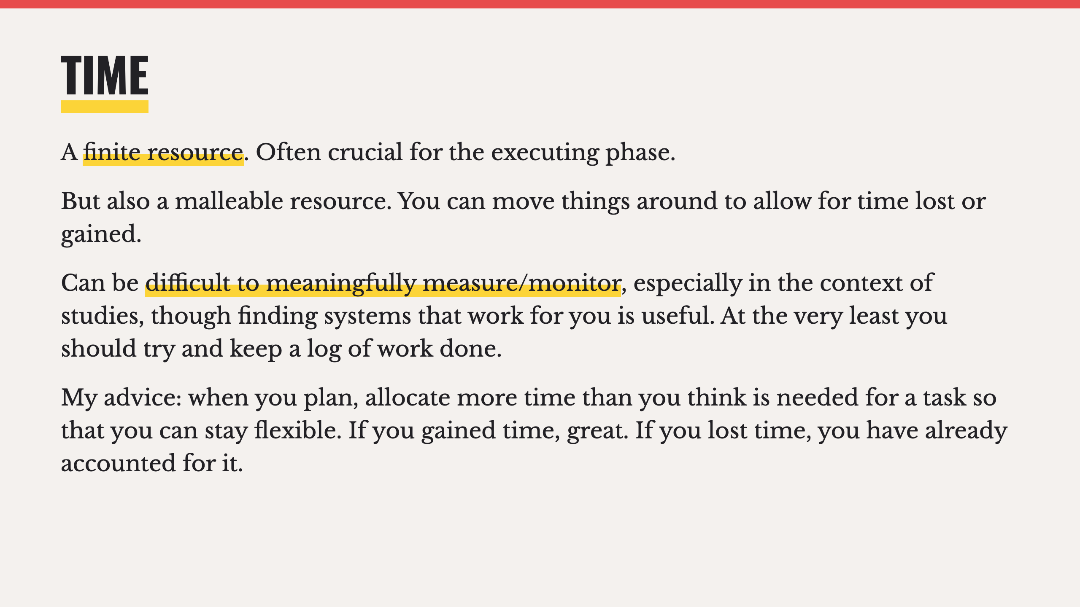

Slide 20
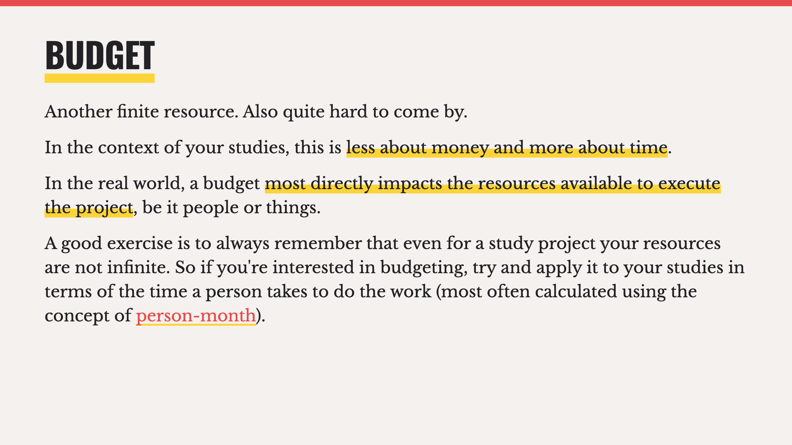
Notes:
- I'll show you some real world budgets in a bit, so you can get a sense of what time and budget mean practicaly.

Slide 21
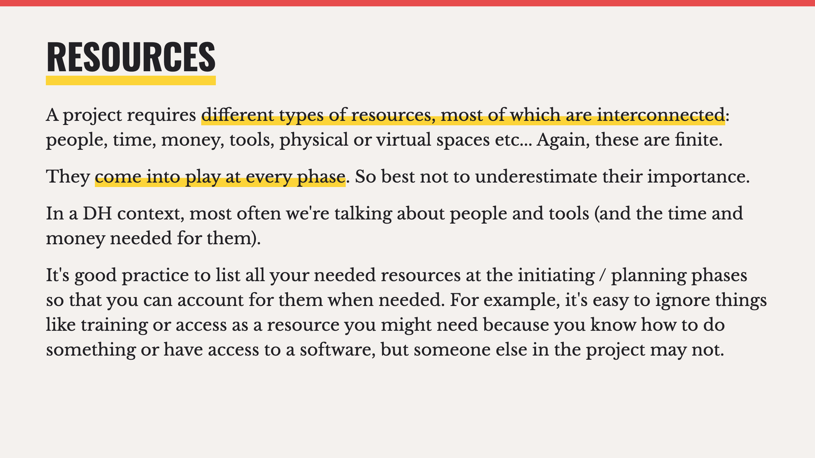

Slide 22
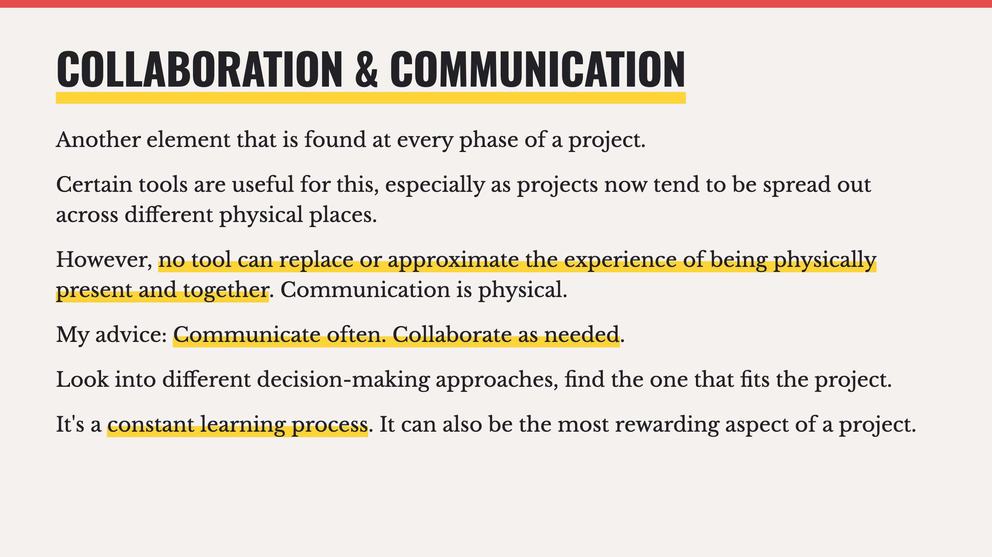
Notes:
- Slack, Notion, Discord, Zoom, shared calendars, Trello, Figma, etc.
- Sometimes it's better for one person to take something on rather than collaborate, as long as they communicate what is happening to others.
- Consensus can be useful but sometimes there's also the need for someone to be 'in charge'.

Slide 23
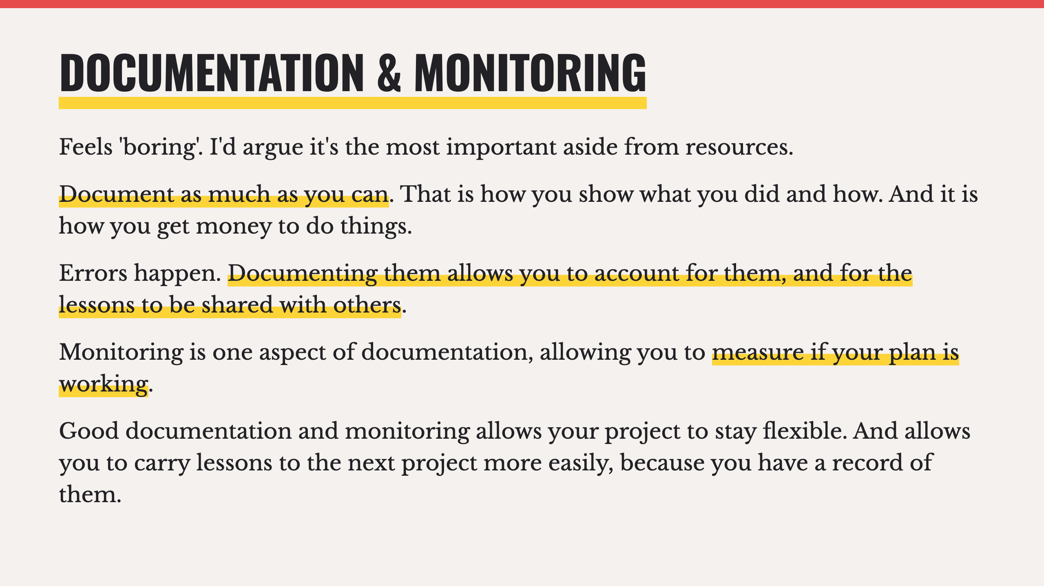
Notes:
- Monitoring should help you answer questions like: do we have enough time left? Are we on track for milestone x? Do we need to change a certain aspect of what's being done because the target has shifted? And so on...

Slide 24
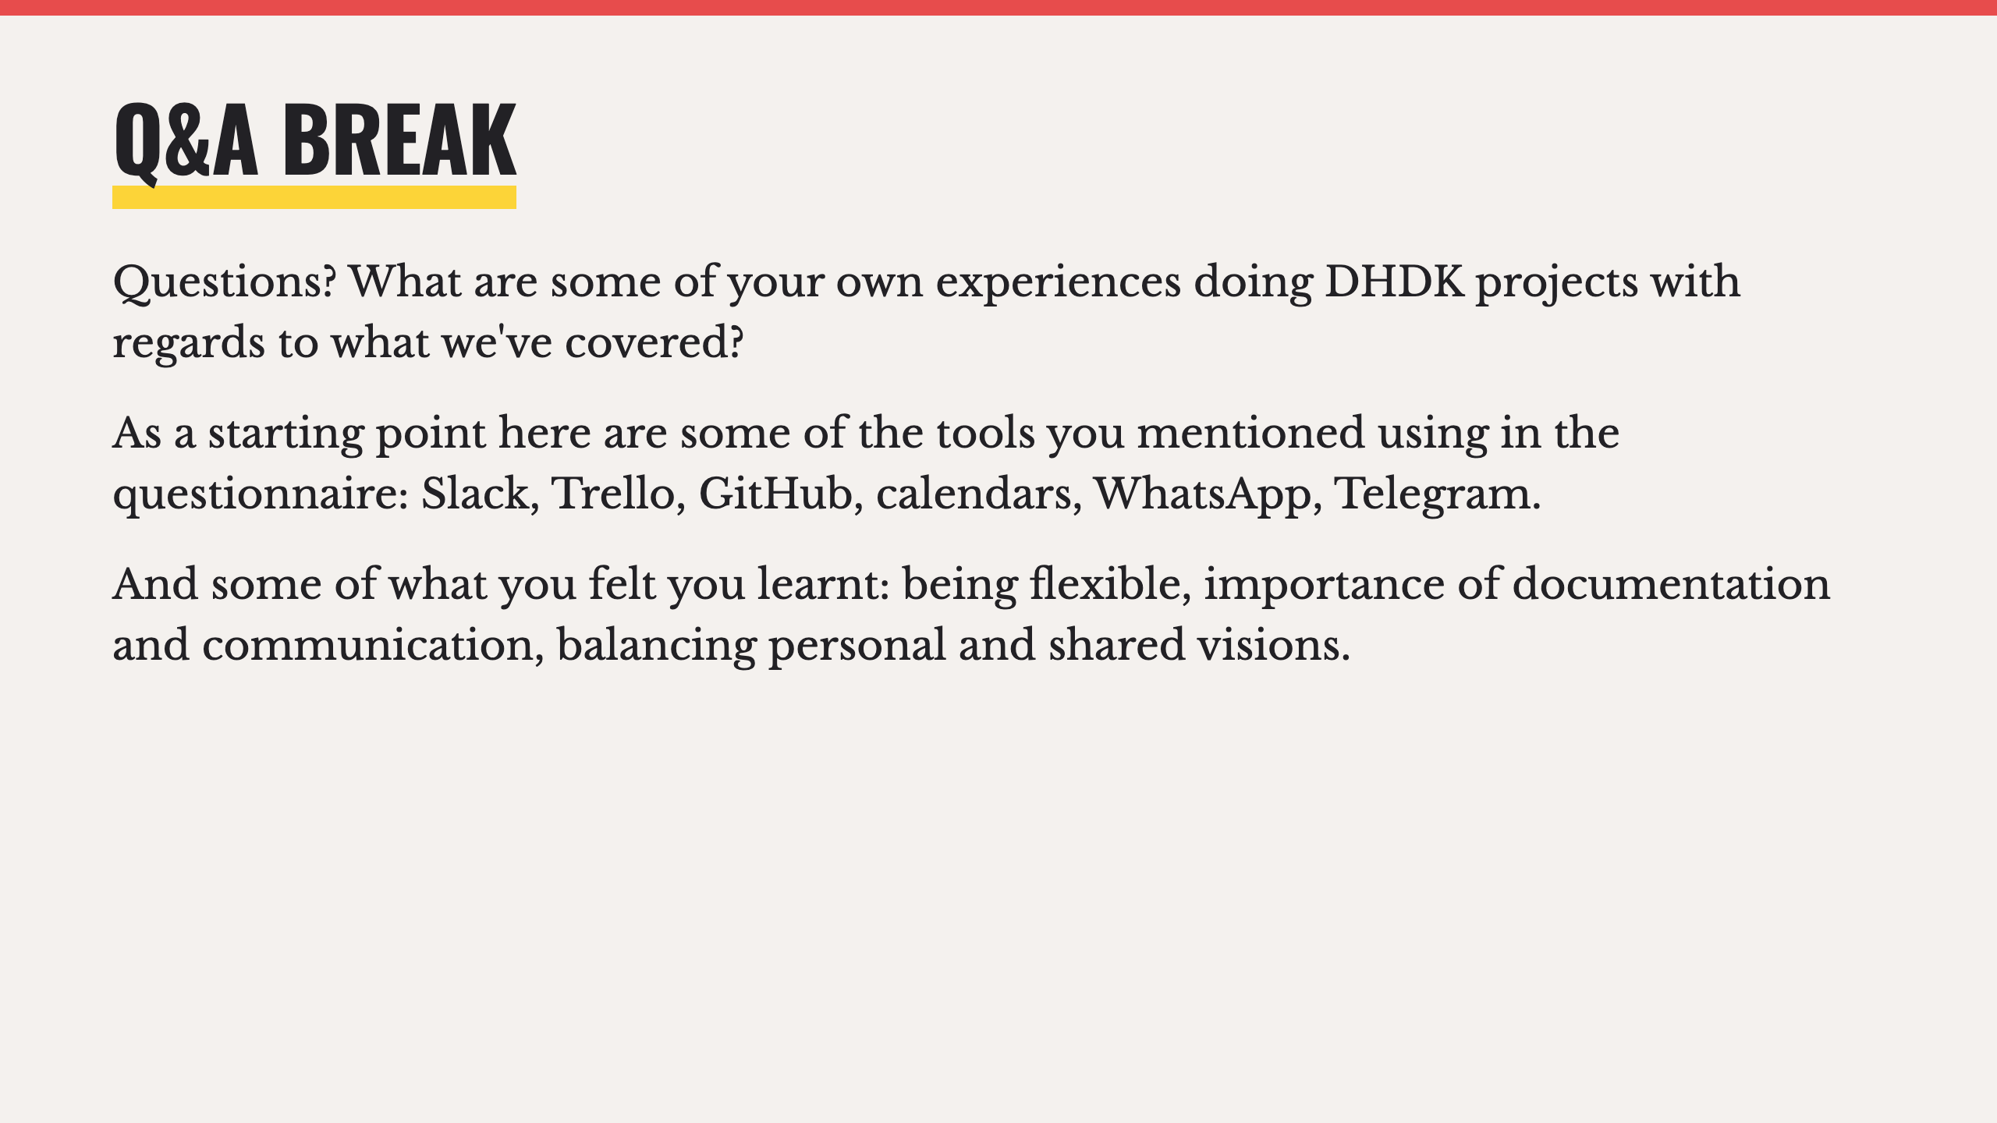

Slide 25
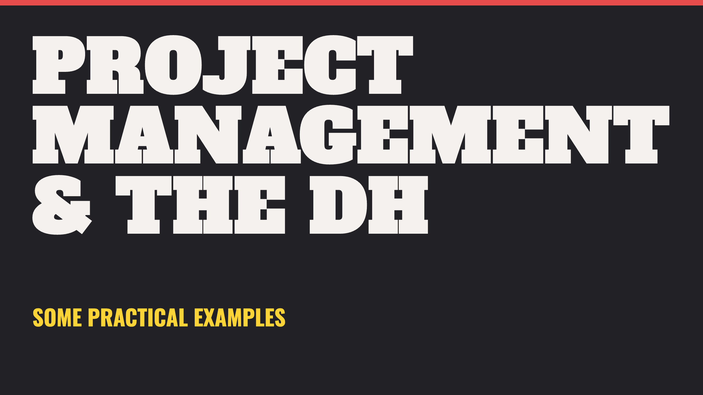

Slide 26
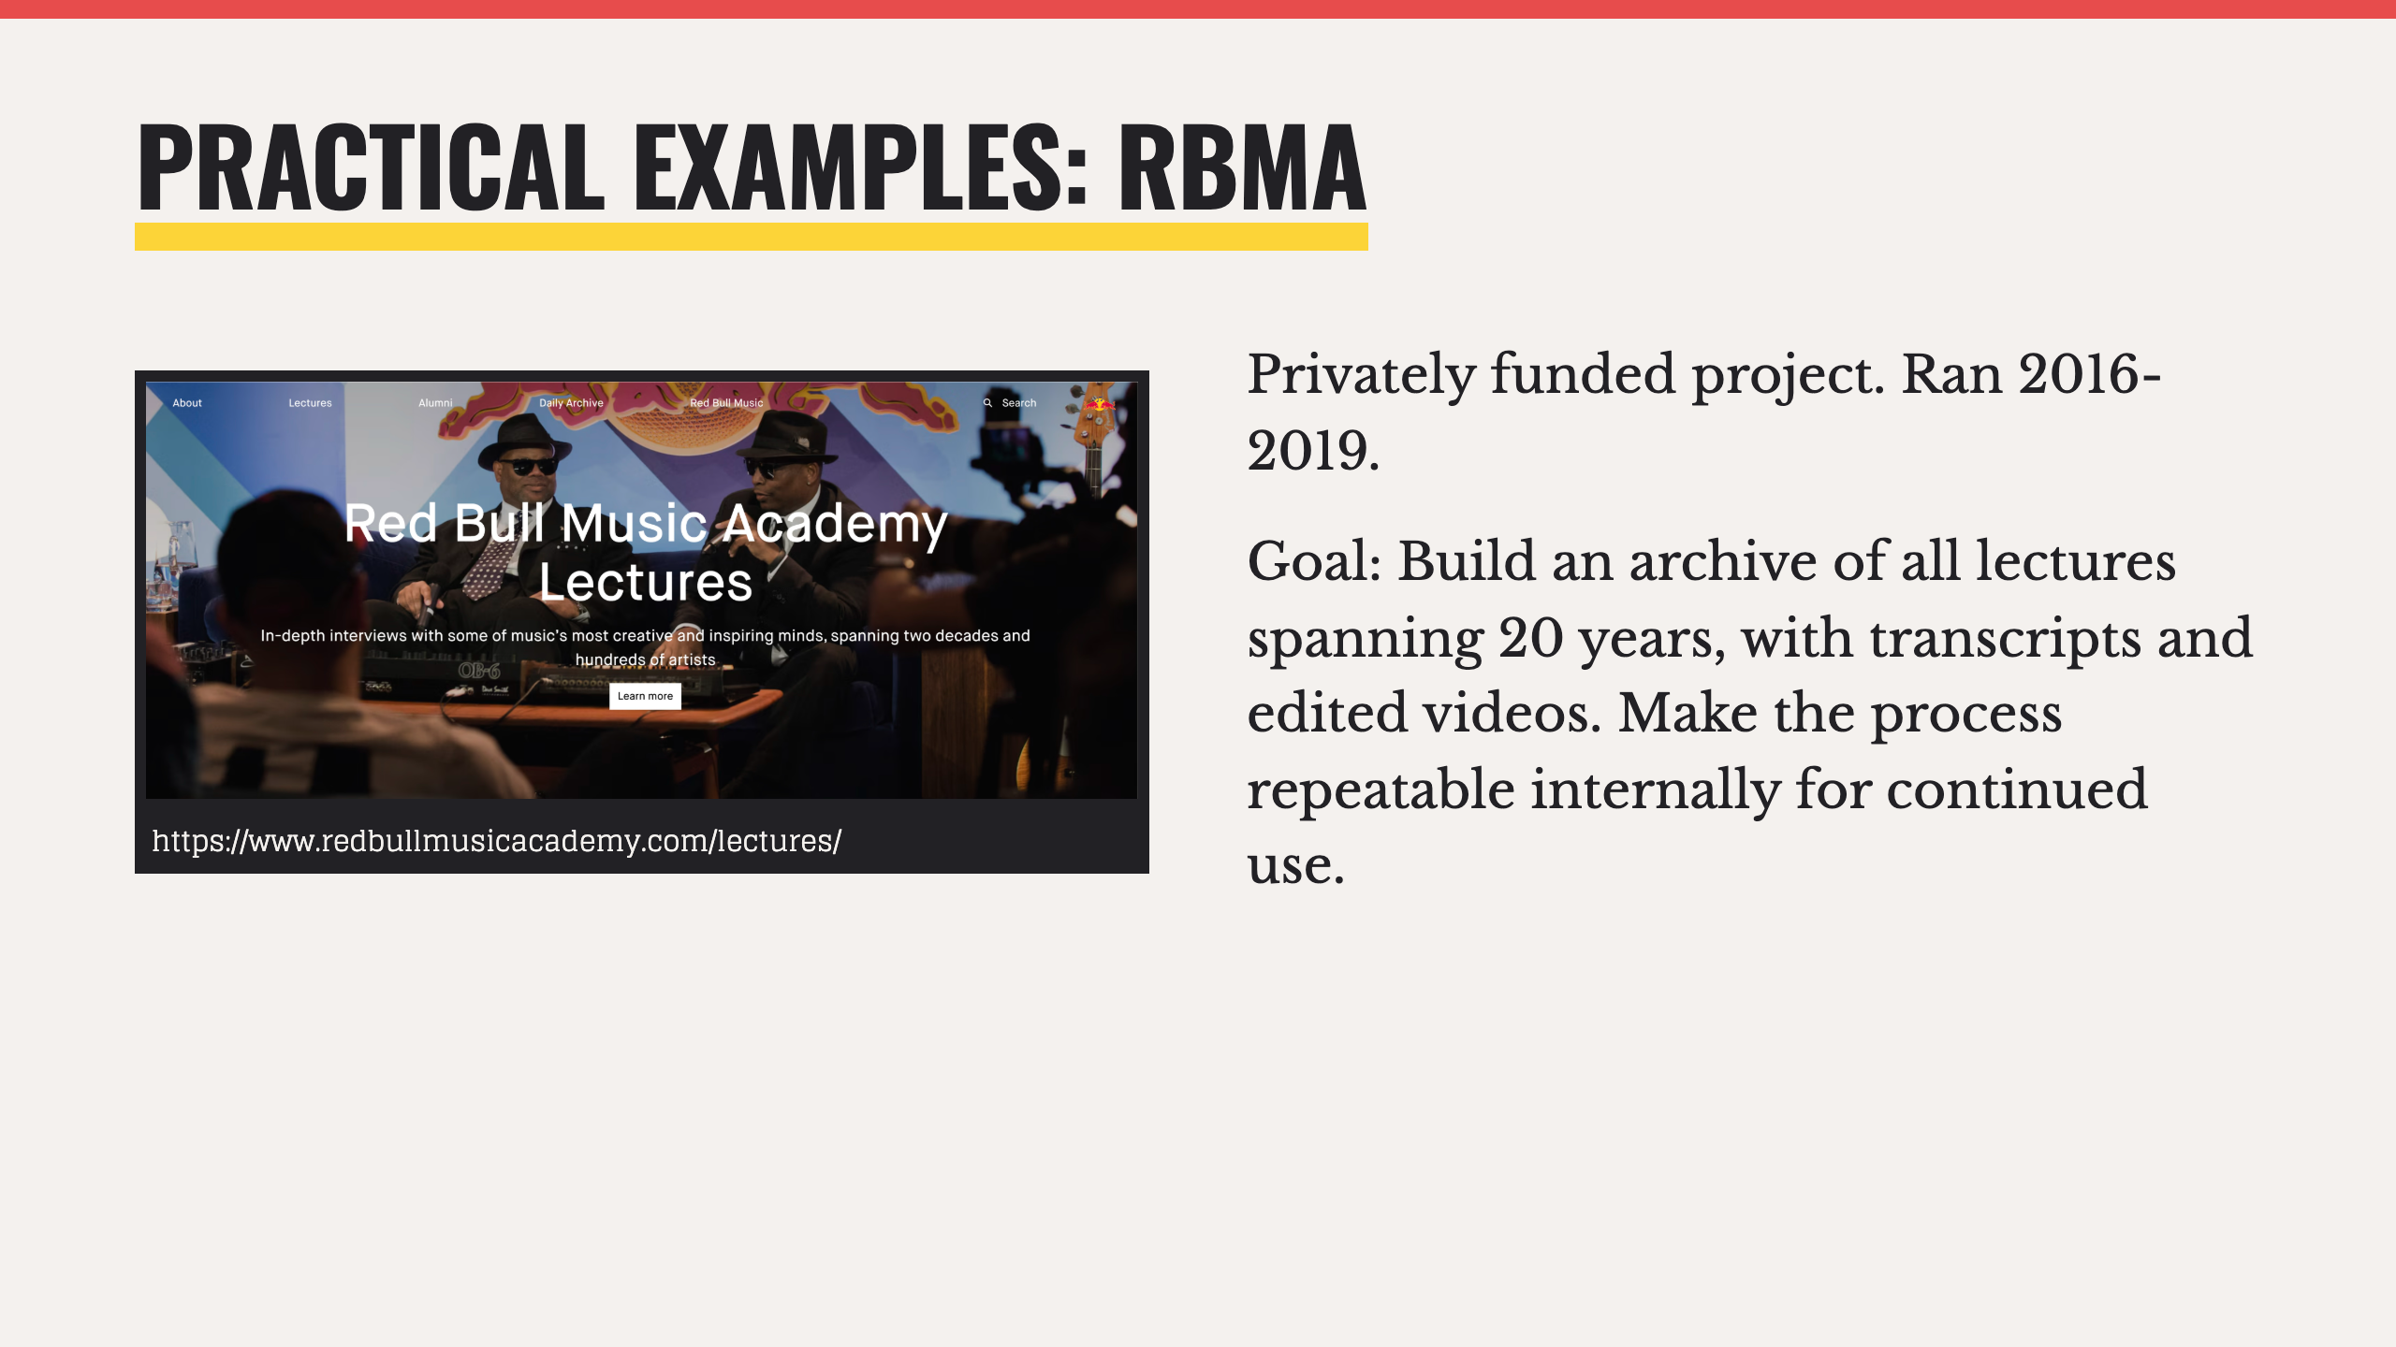

Slide 27
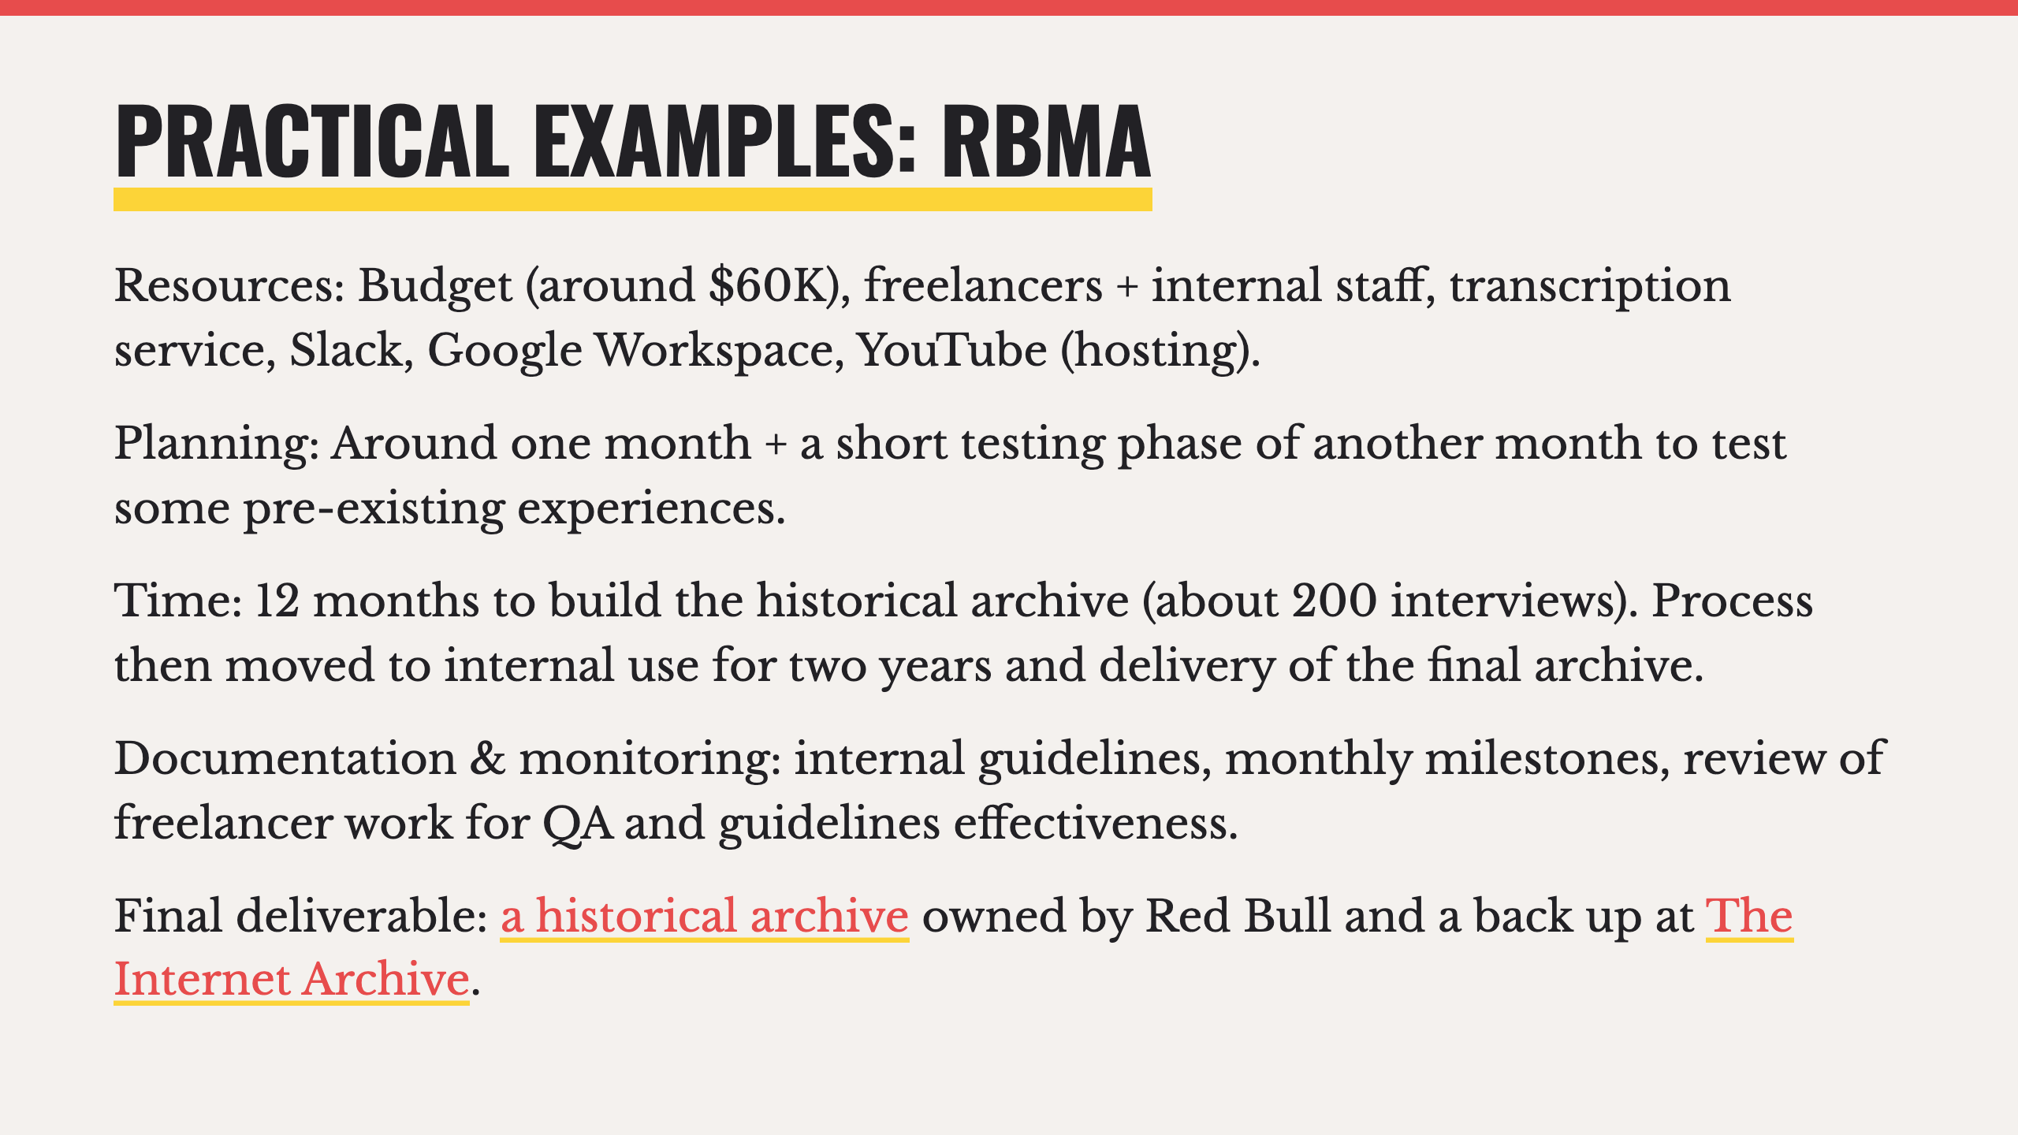

Slide 28
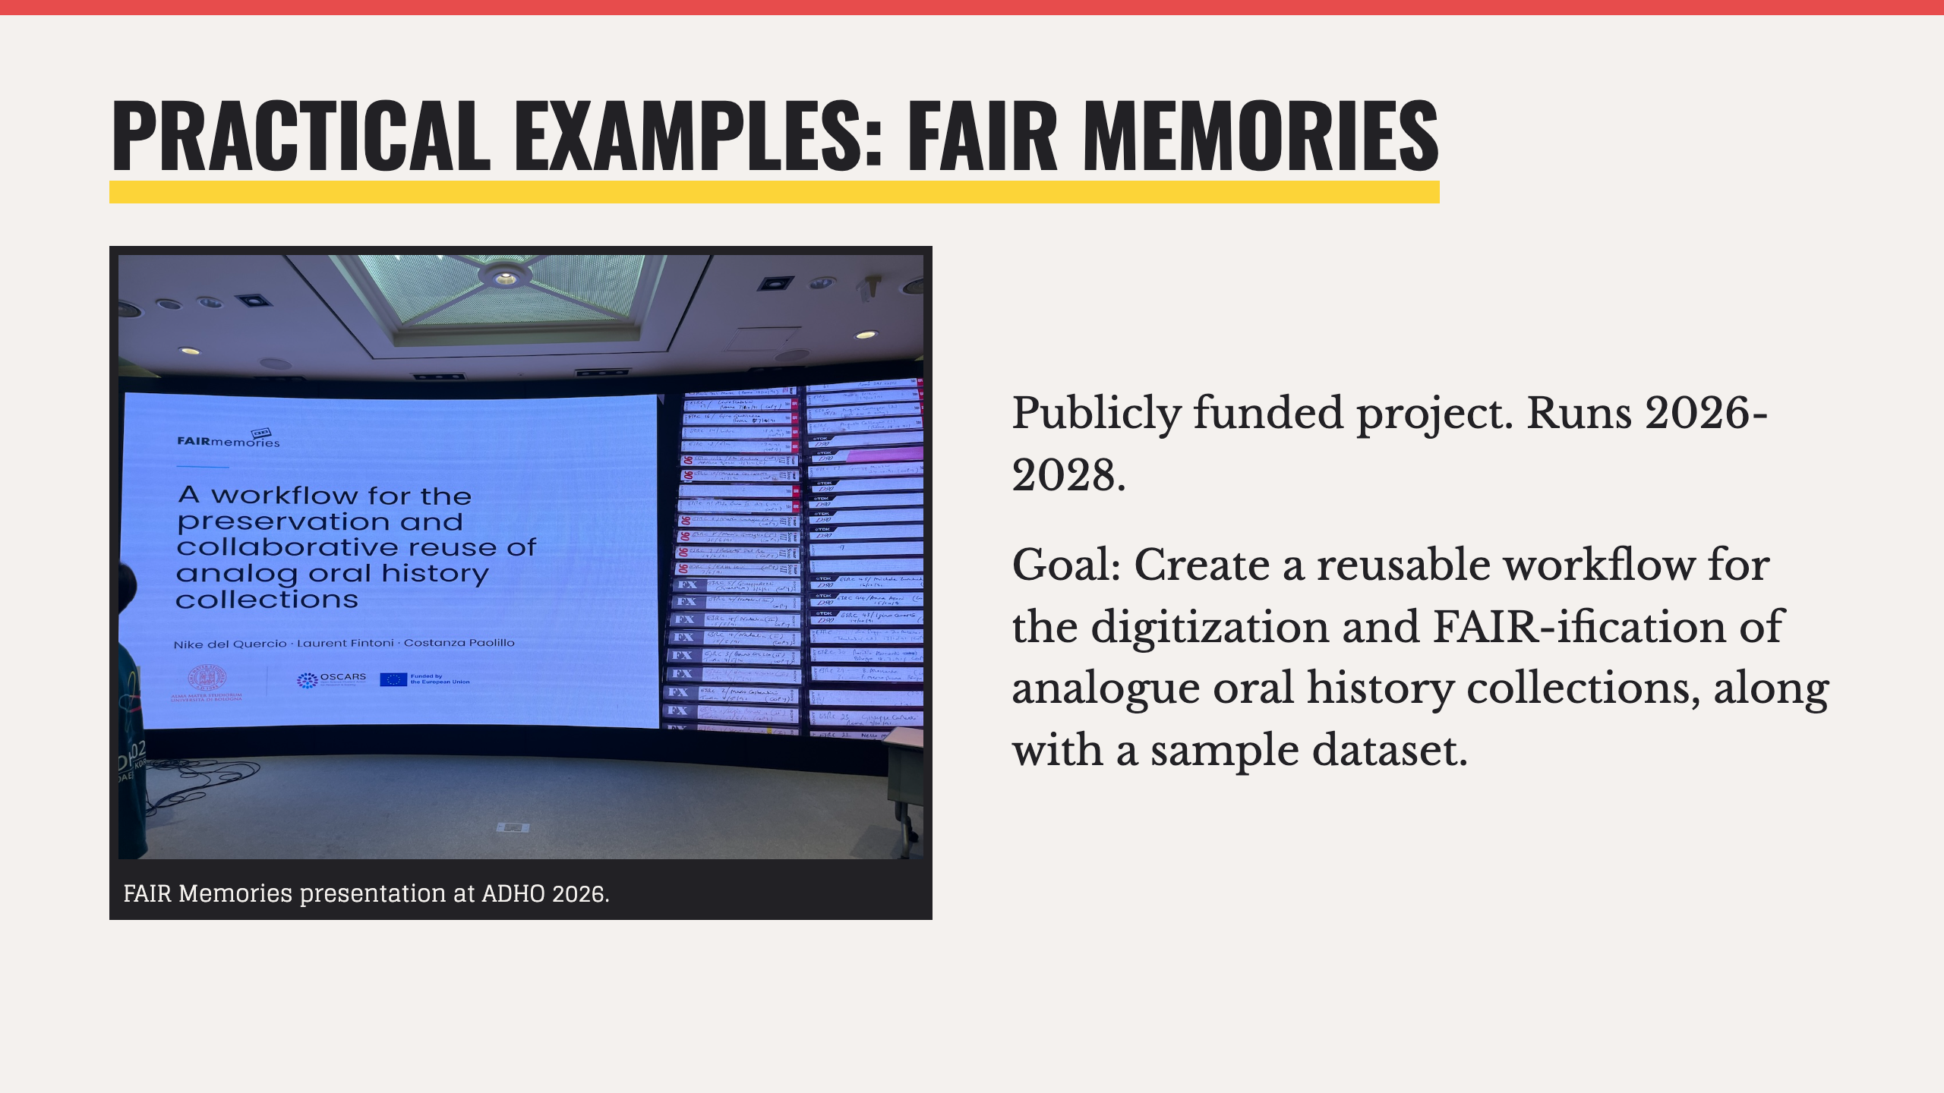

Slide 29
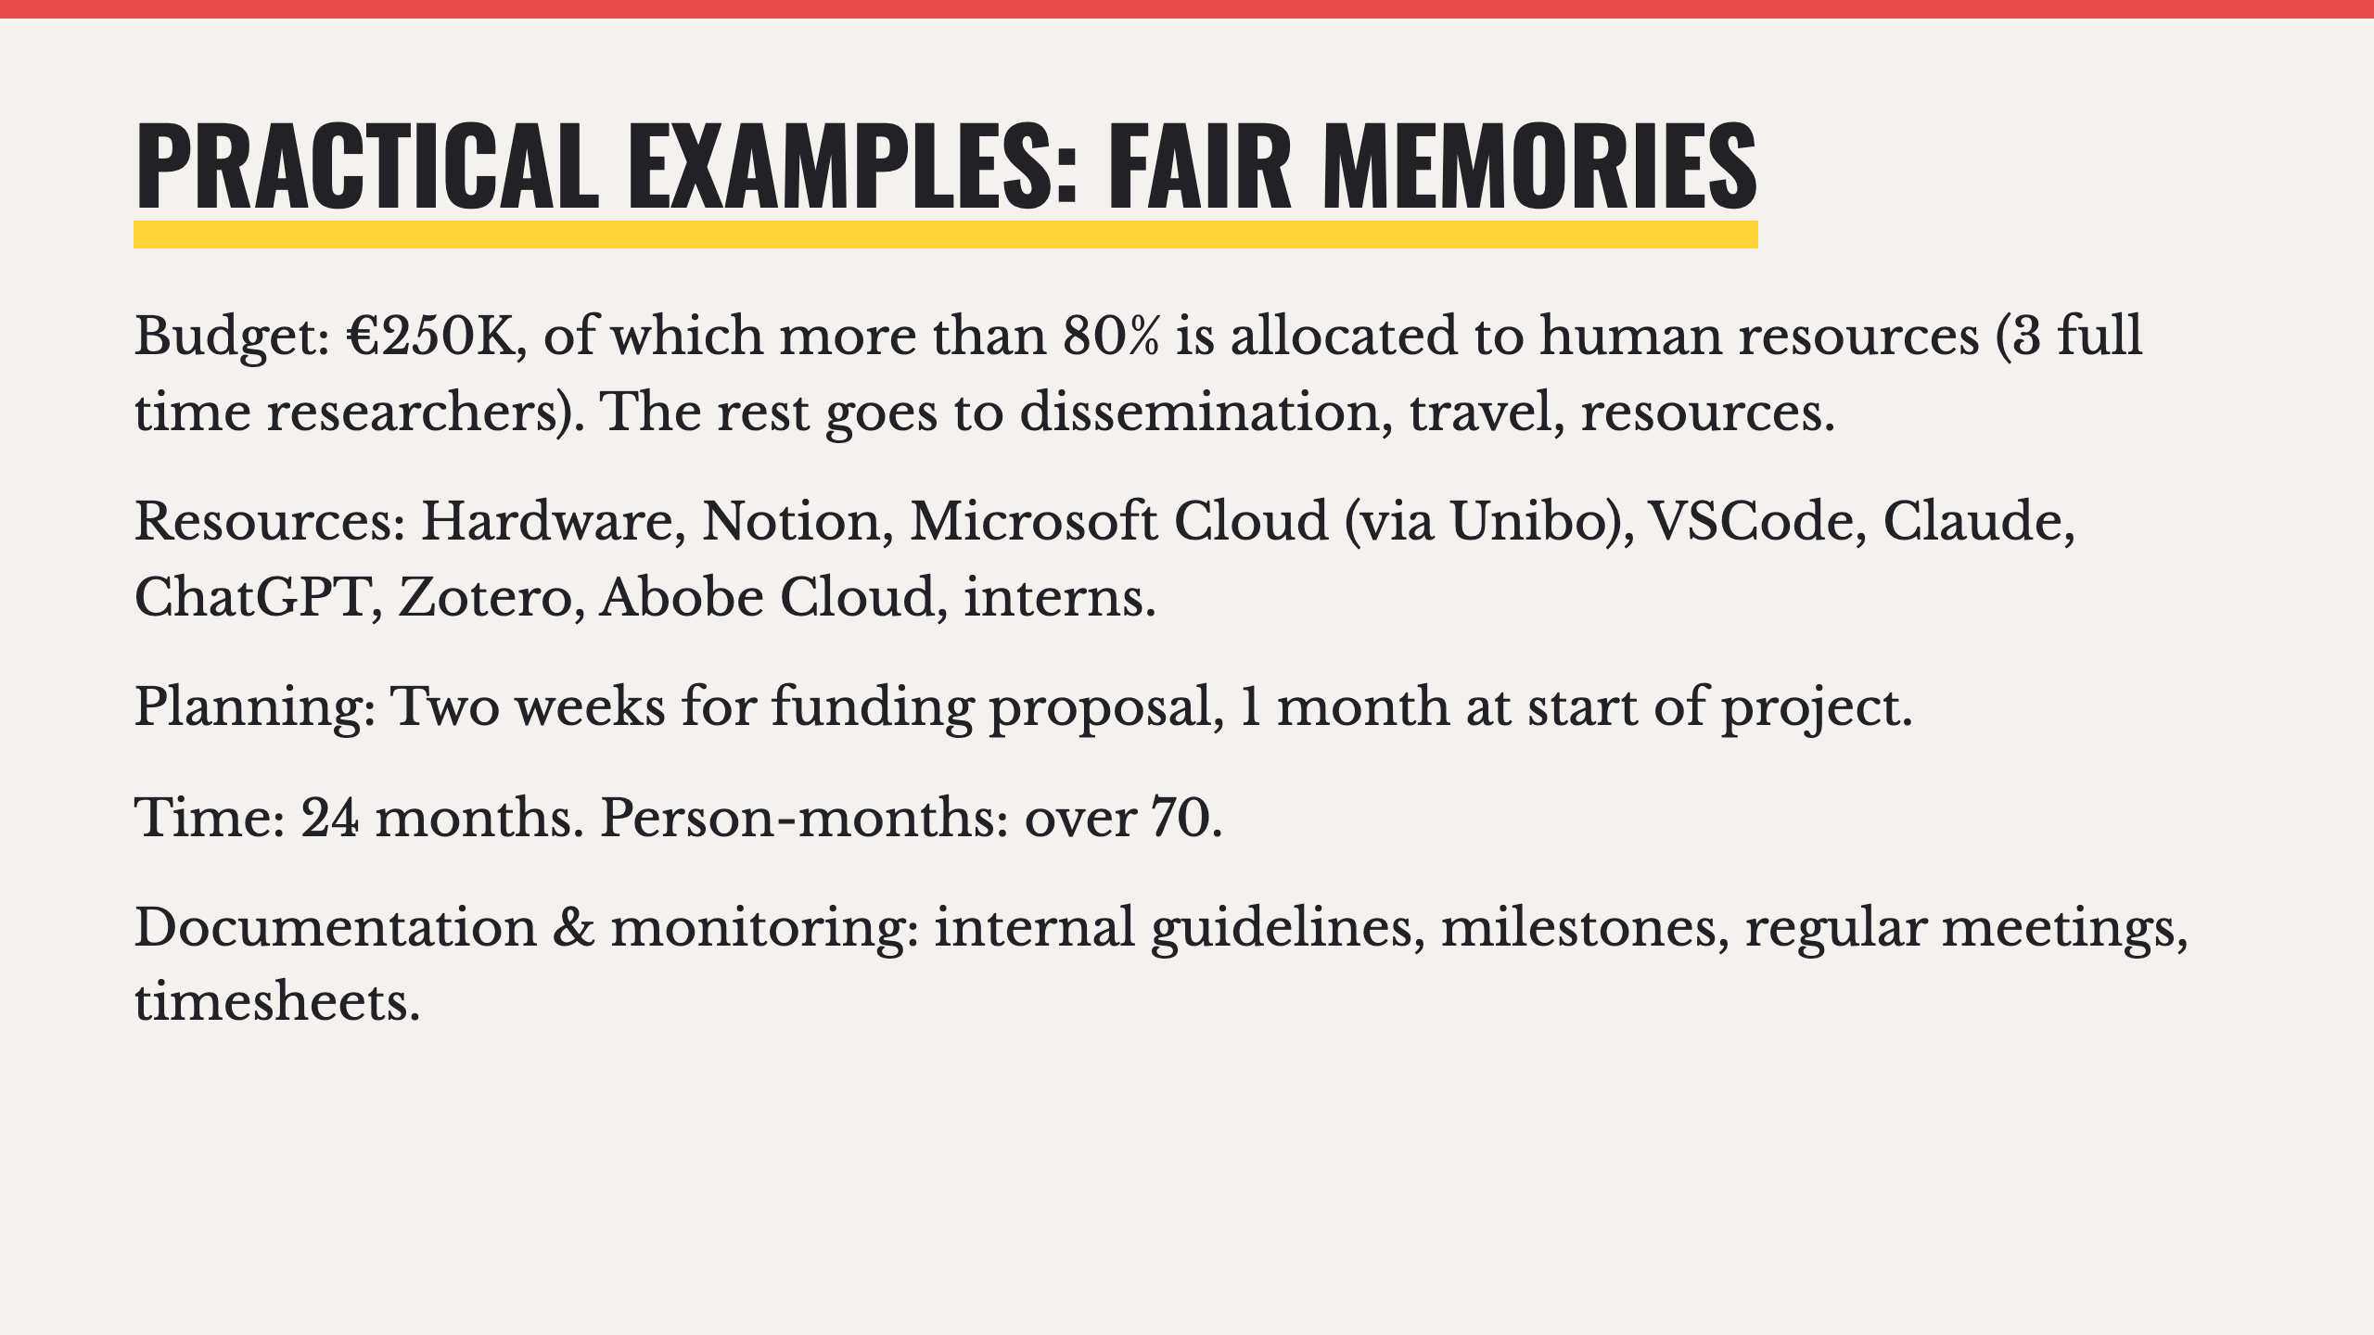

Slide 30
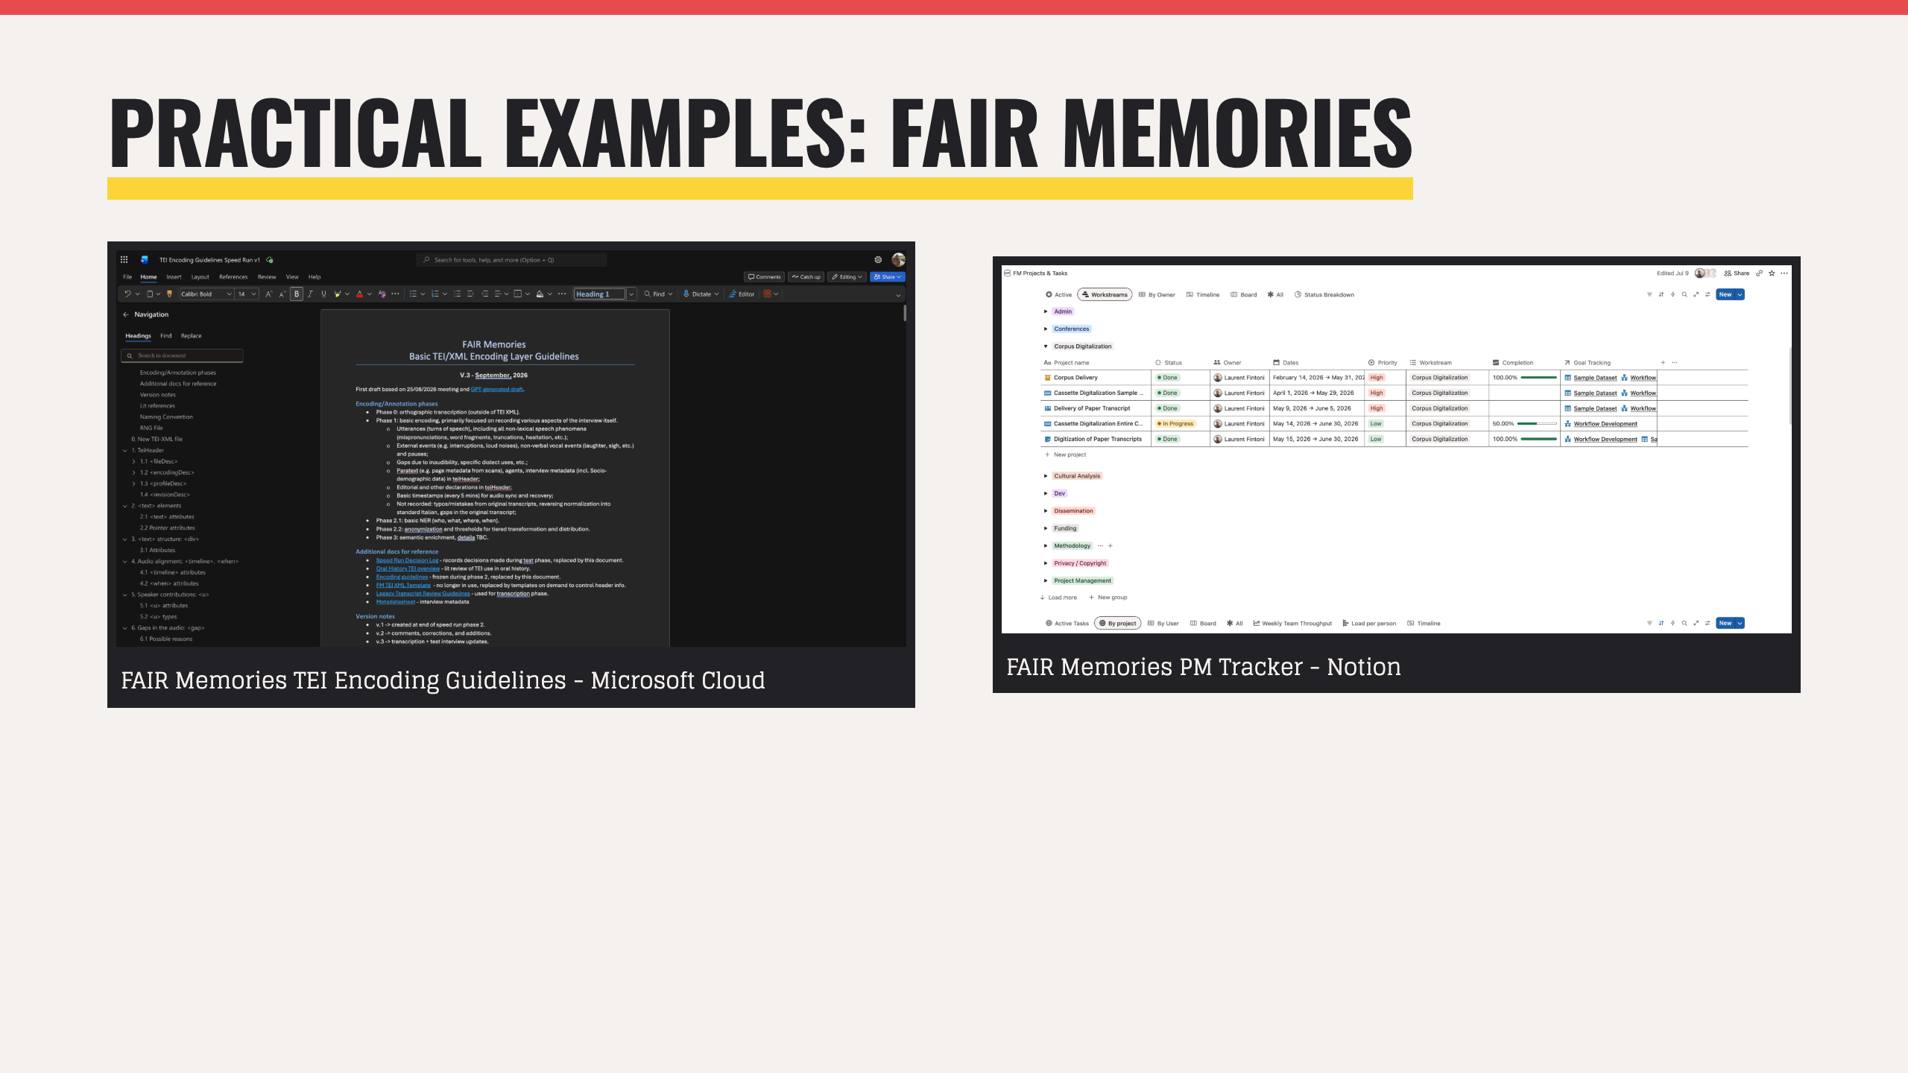

Slide 31
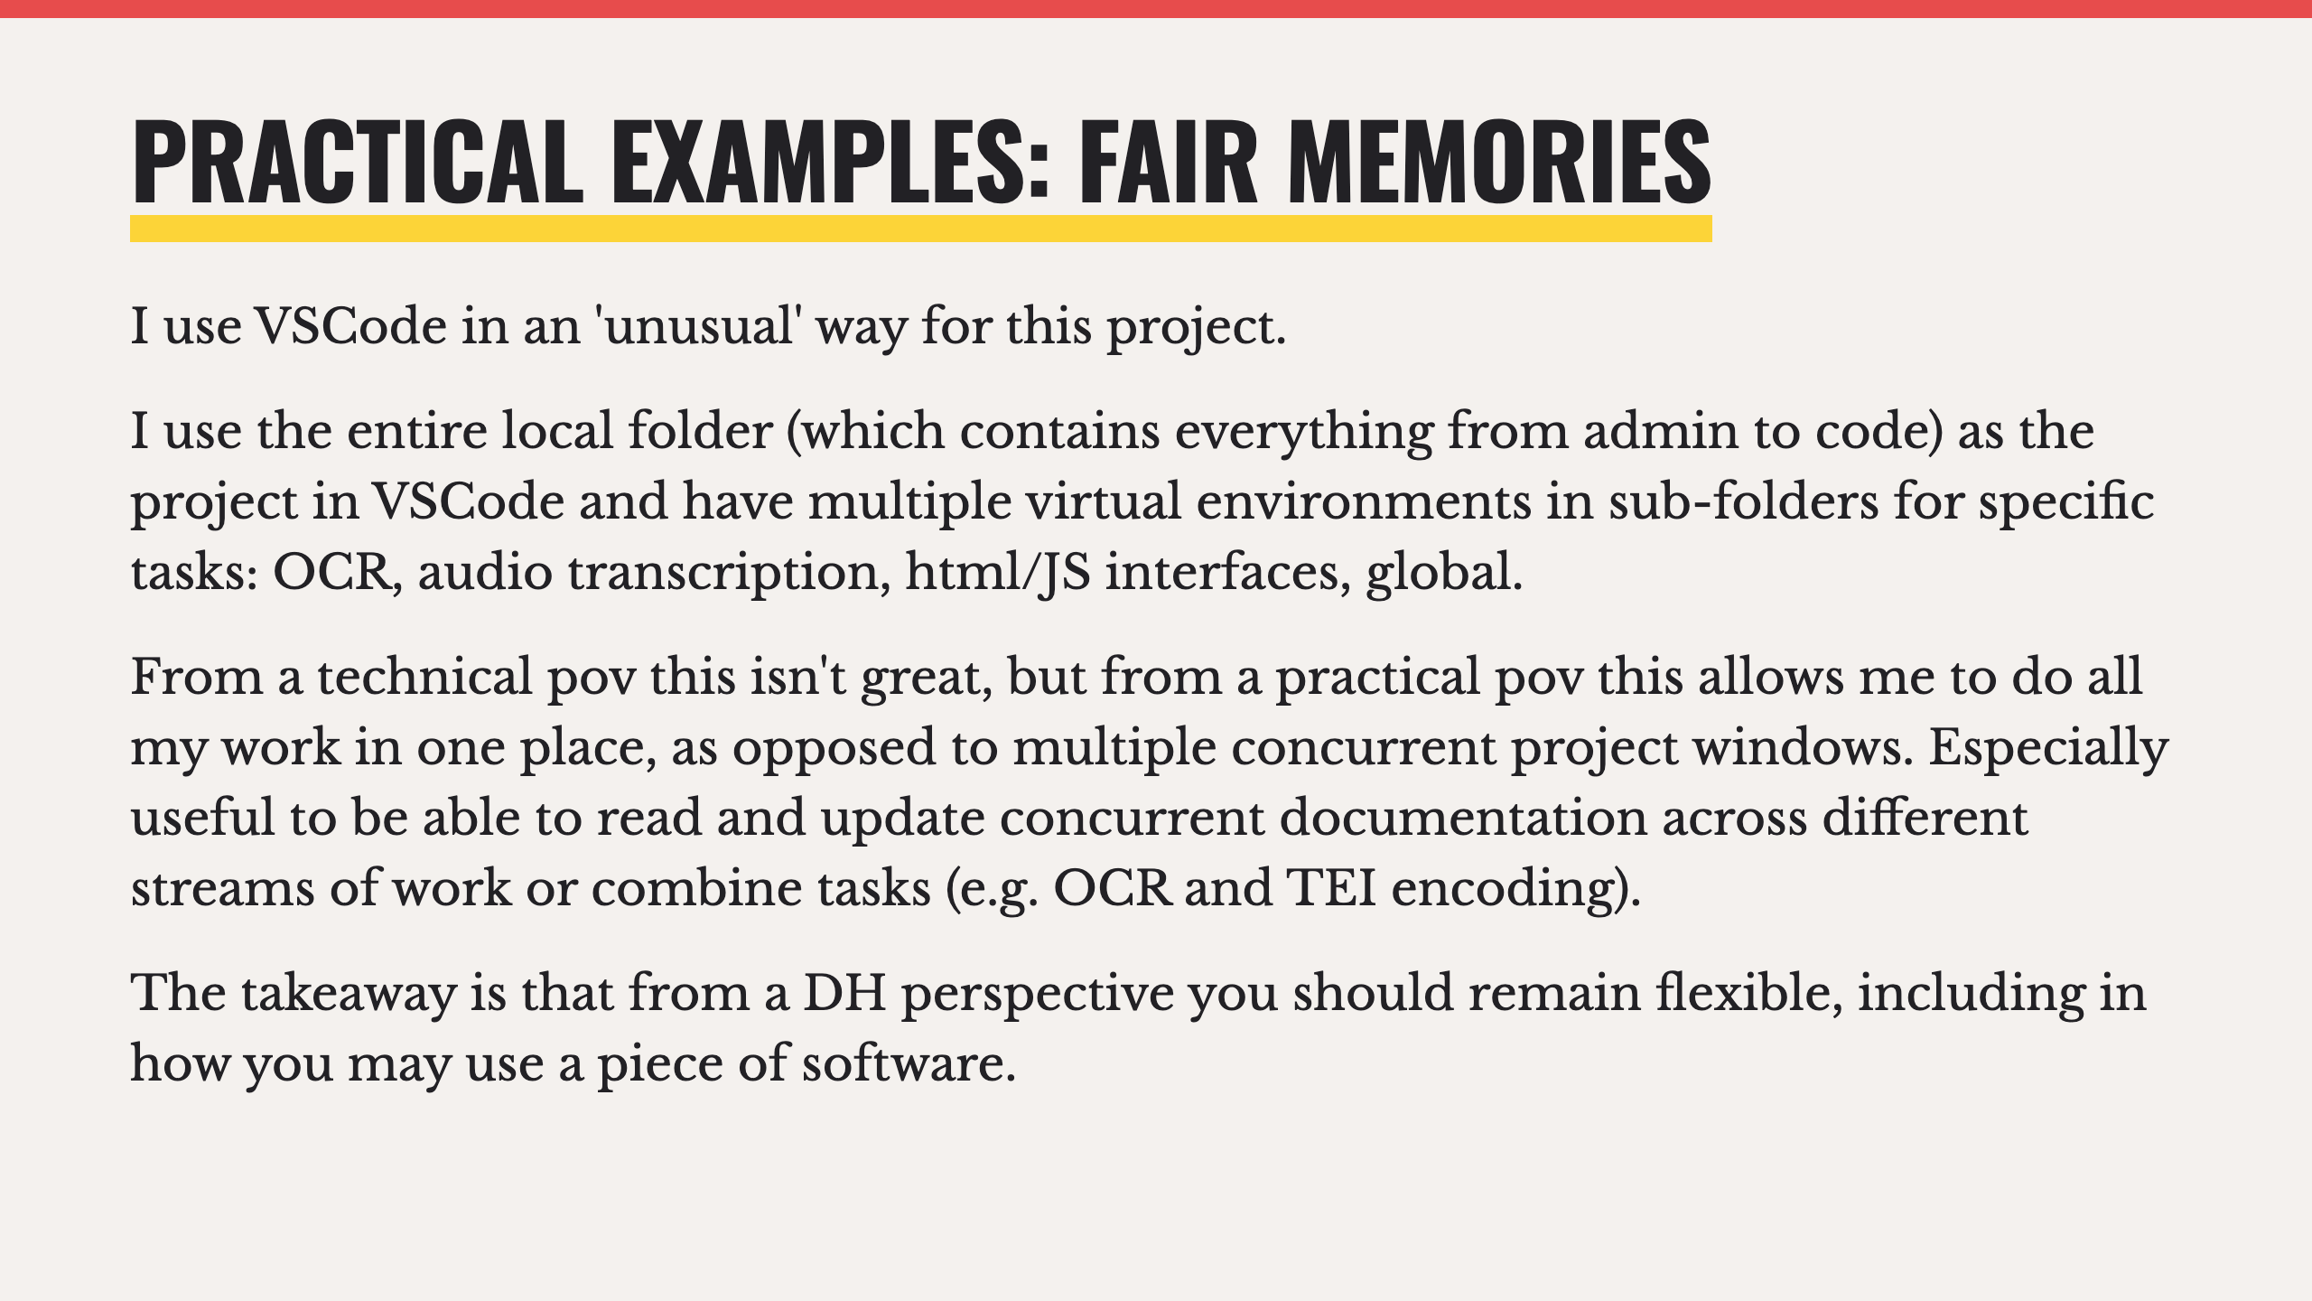

Slide 32
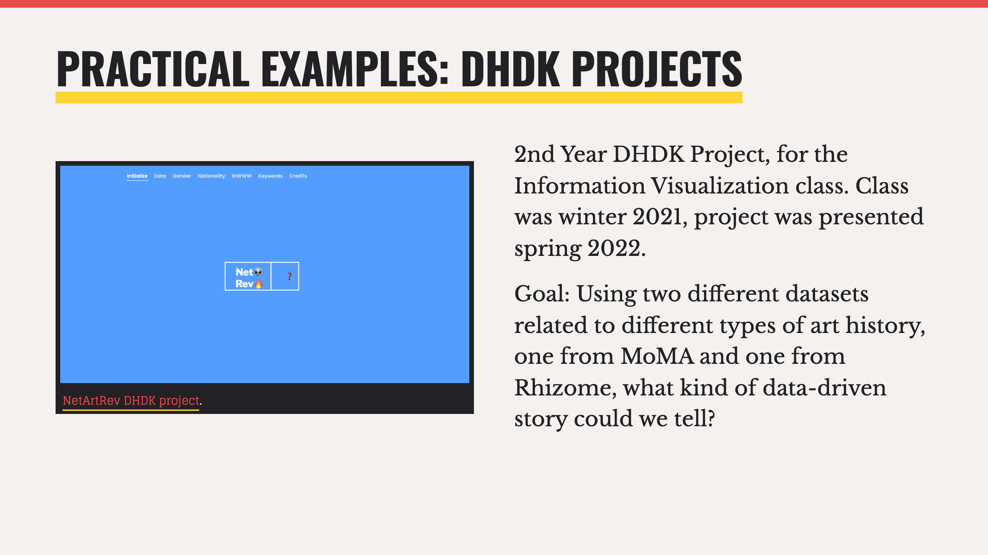

Slide 33
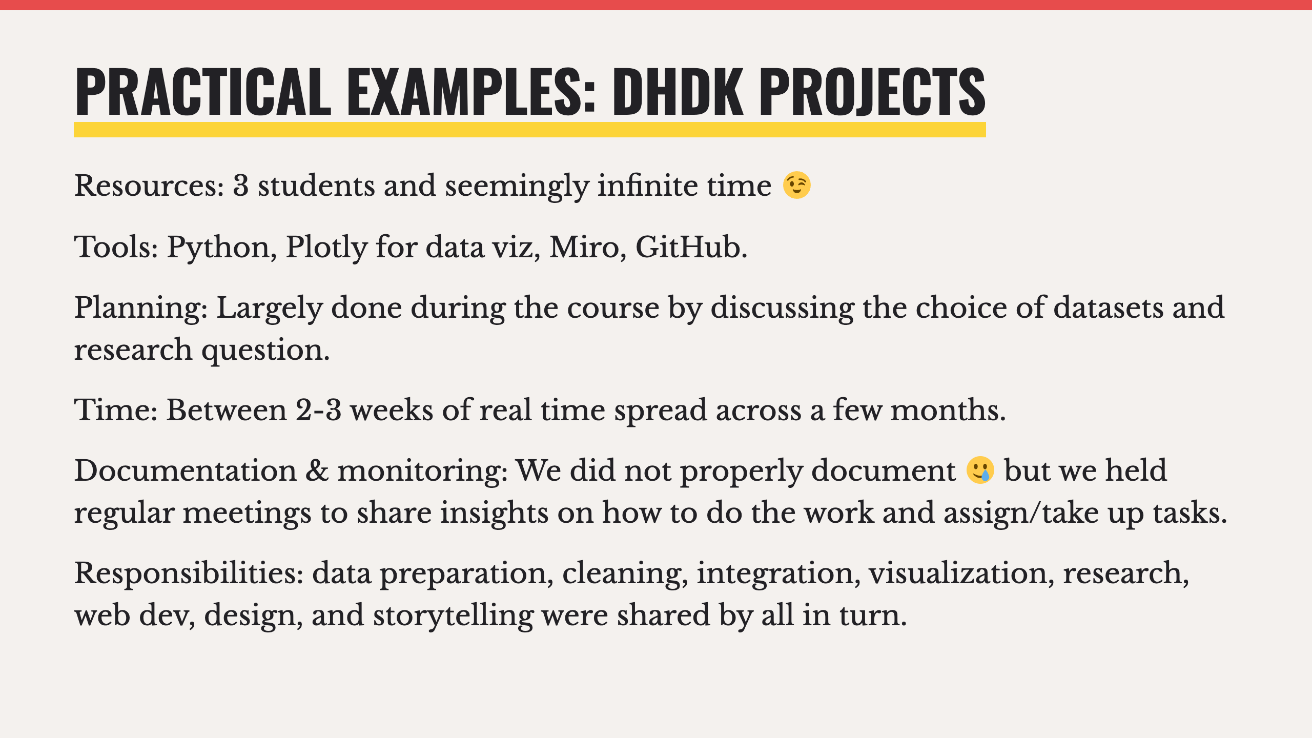

Slide 34
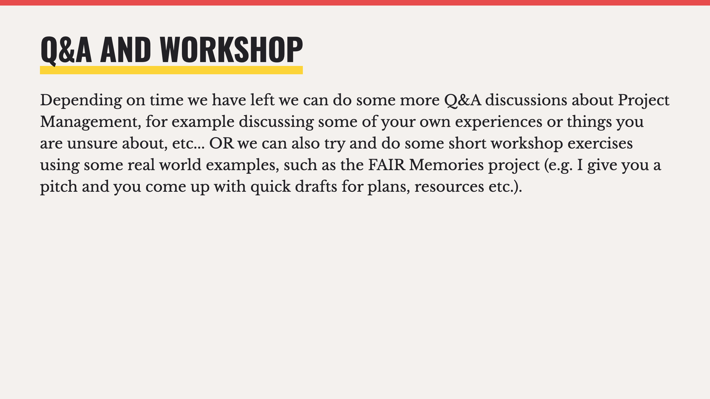

Slide 35


