Slide 1
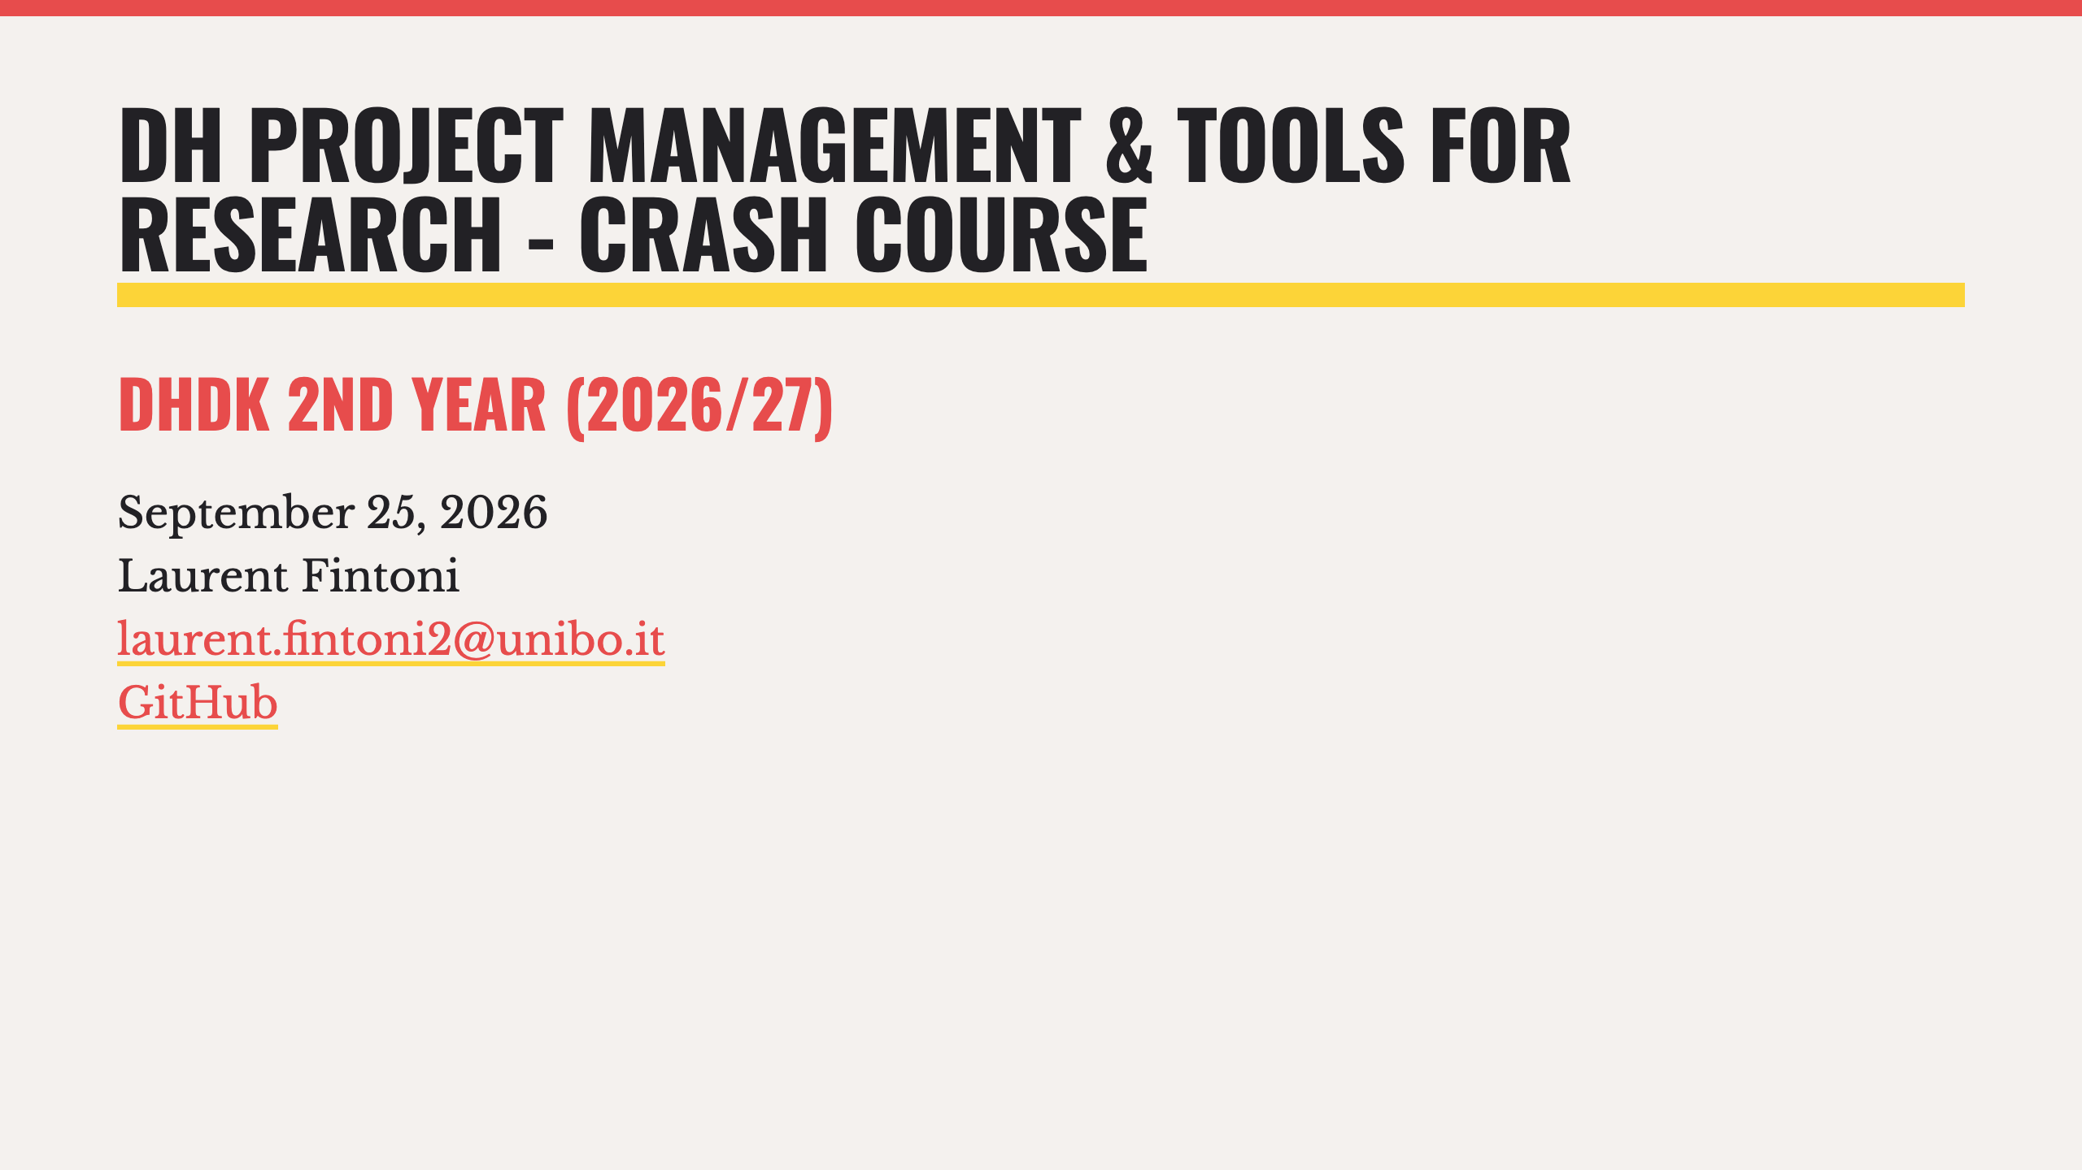

Slide 2
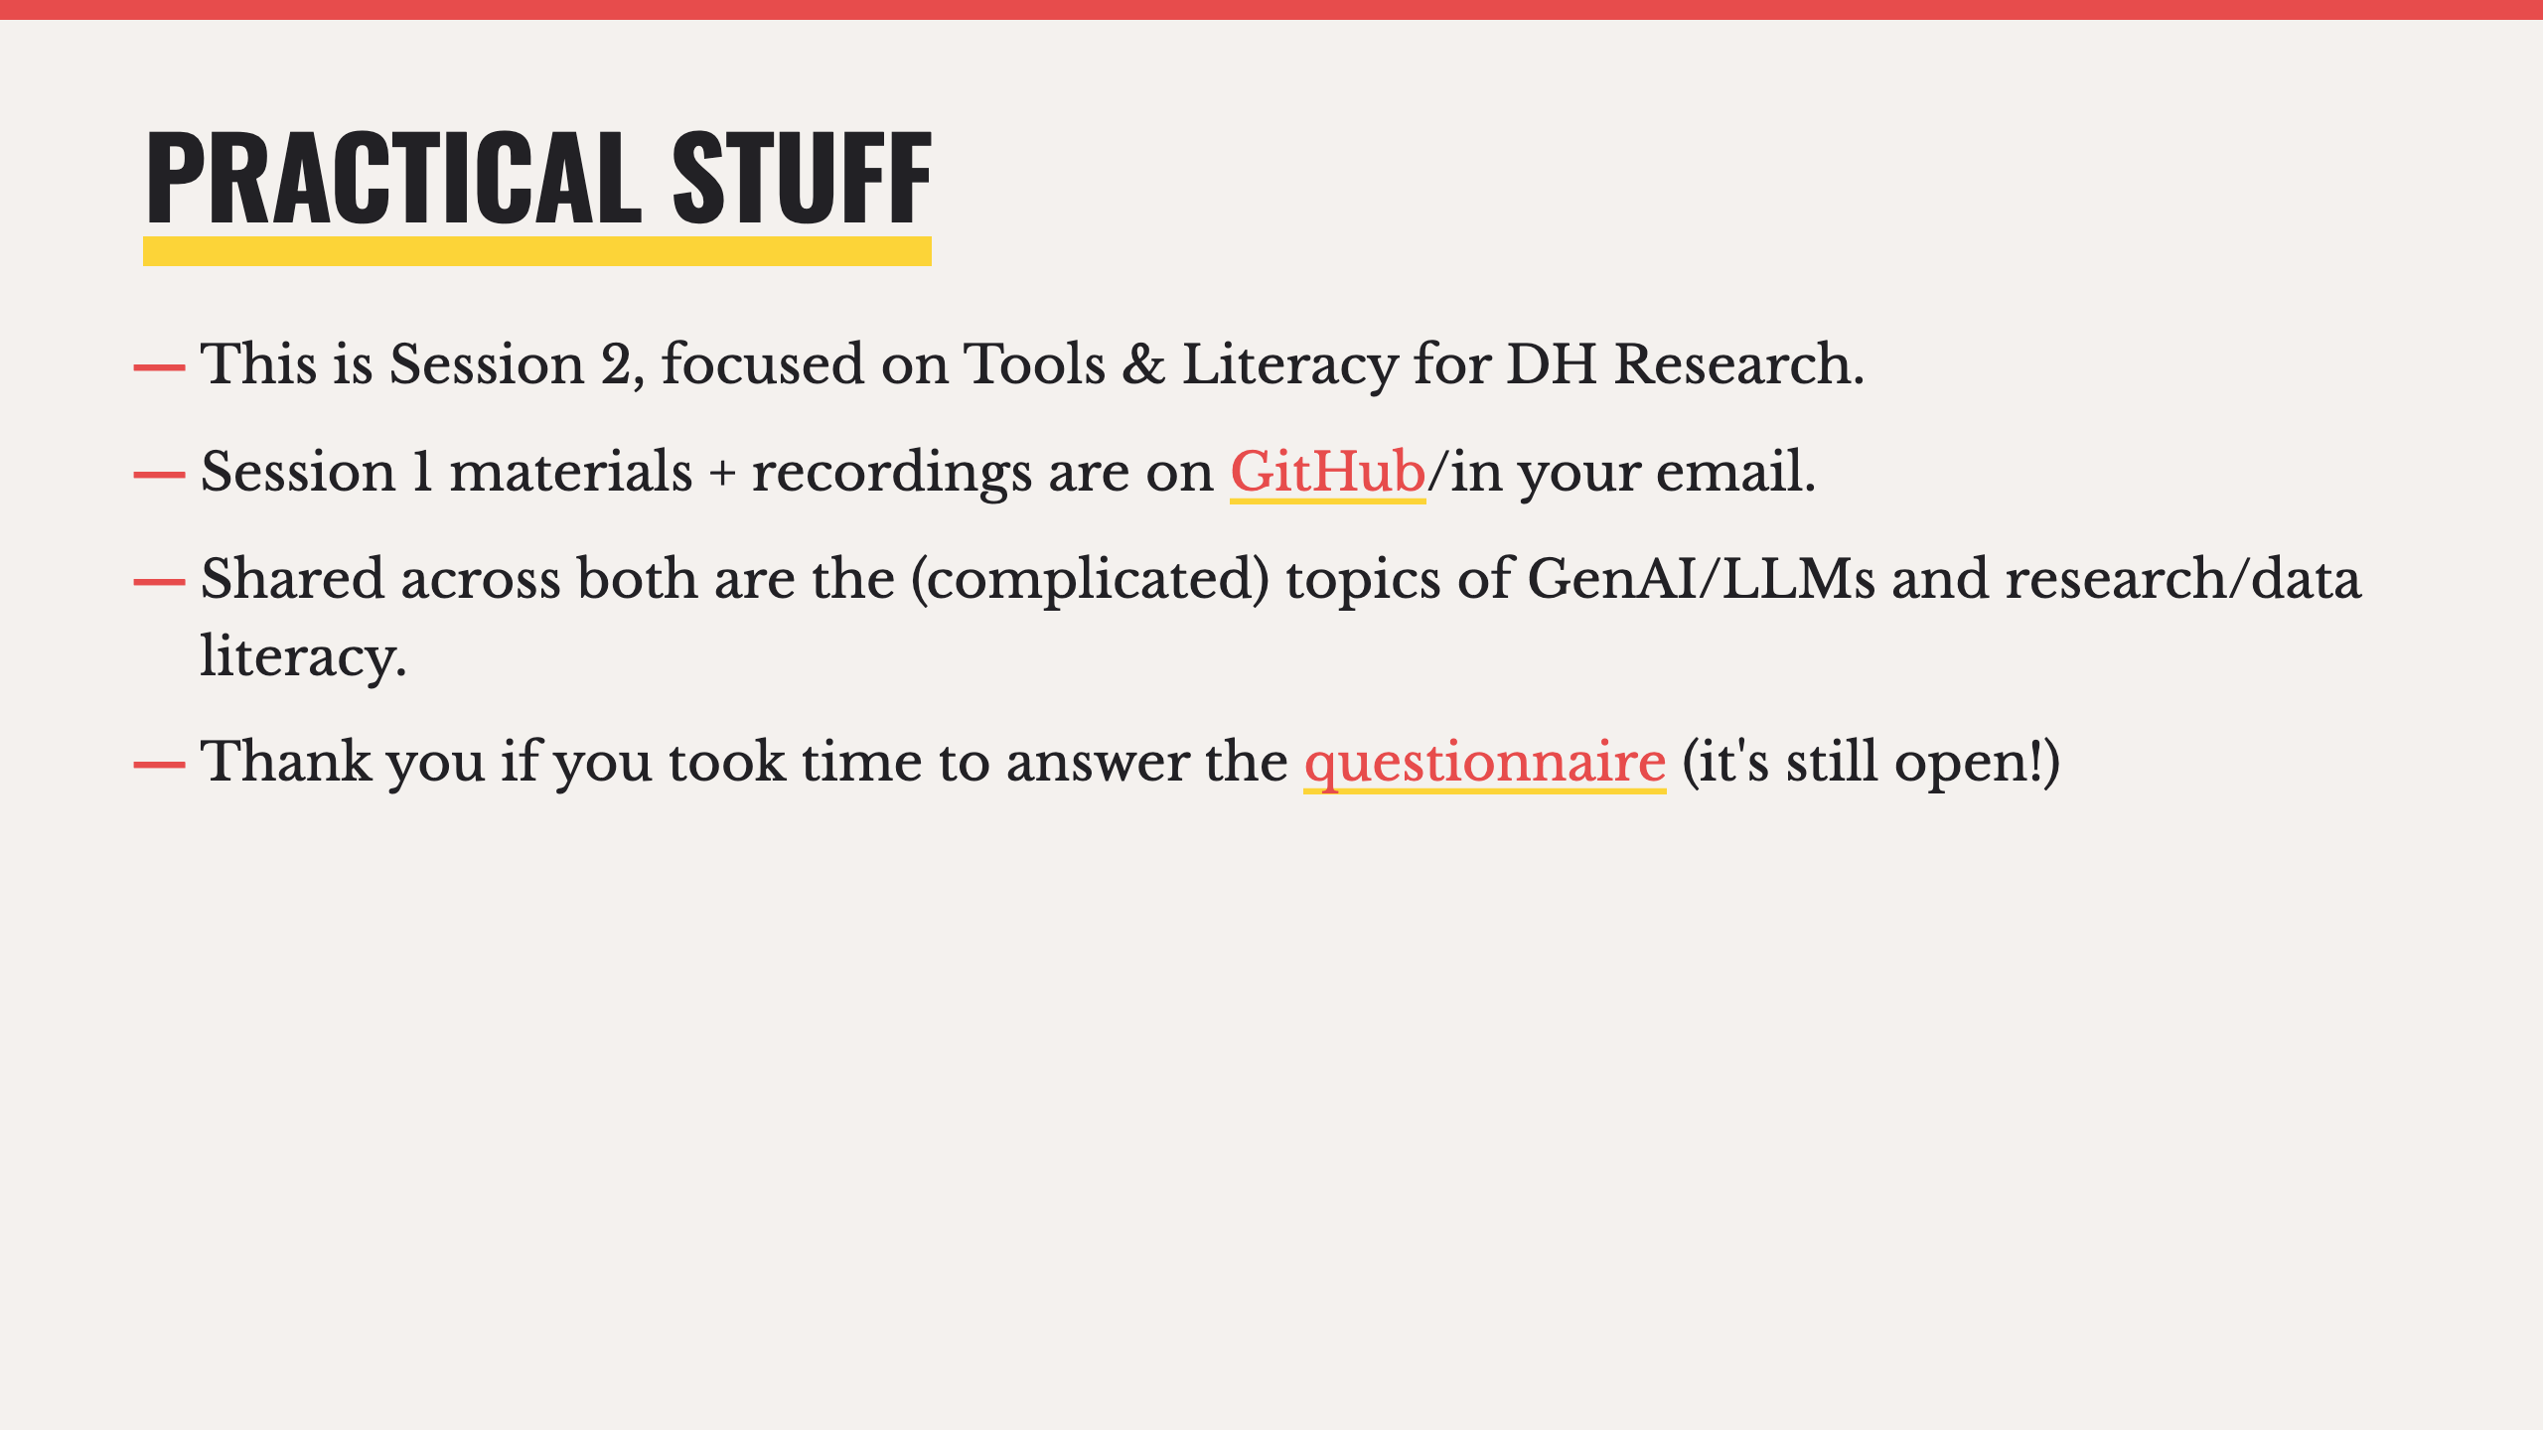

Slide 3
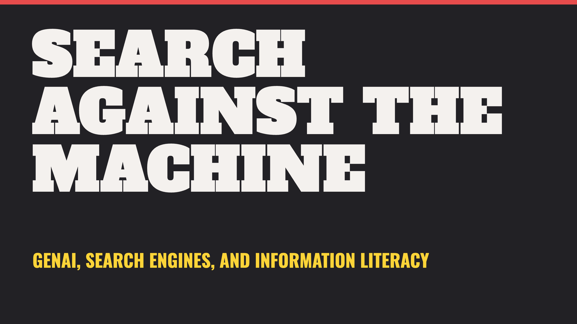
Notes:
- So first up is an update on SEs, and how things have changed since last year, most notably in terms of how GenAI and LLMs have permeated so many aspects of what used to be traditional search functions online.

Slide 4
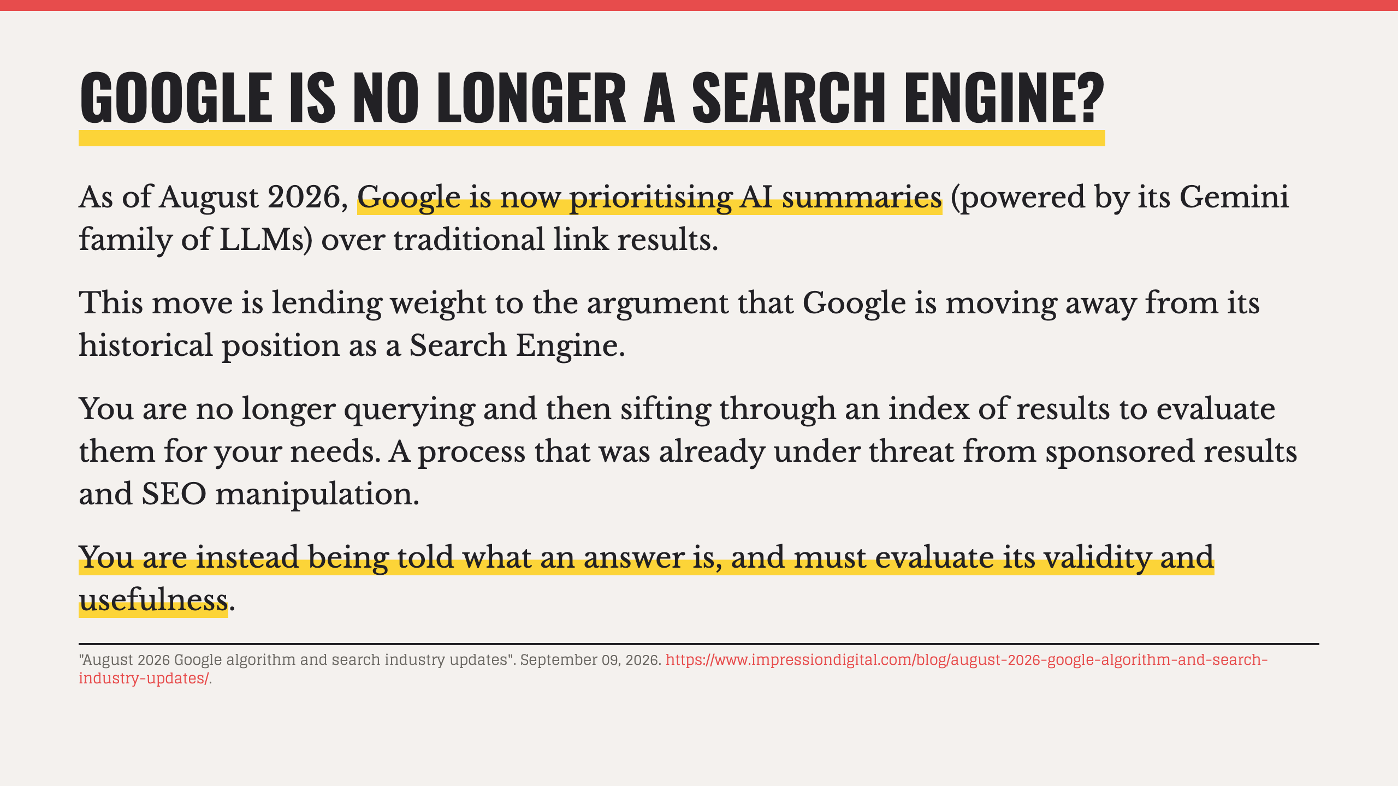
Notes:
- If this shift holds, this is likely to be an important moment in the history of the internet and digital information literacy.
- It's also important to remember that AI summaries in Google are being added to the already existing sponsored results and semantic results it was prioritising before this latest switch. So traditional results are now fighting against multiple other commercially-driven interests.

Slide 5
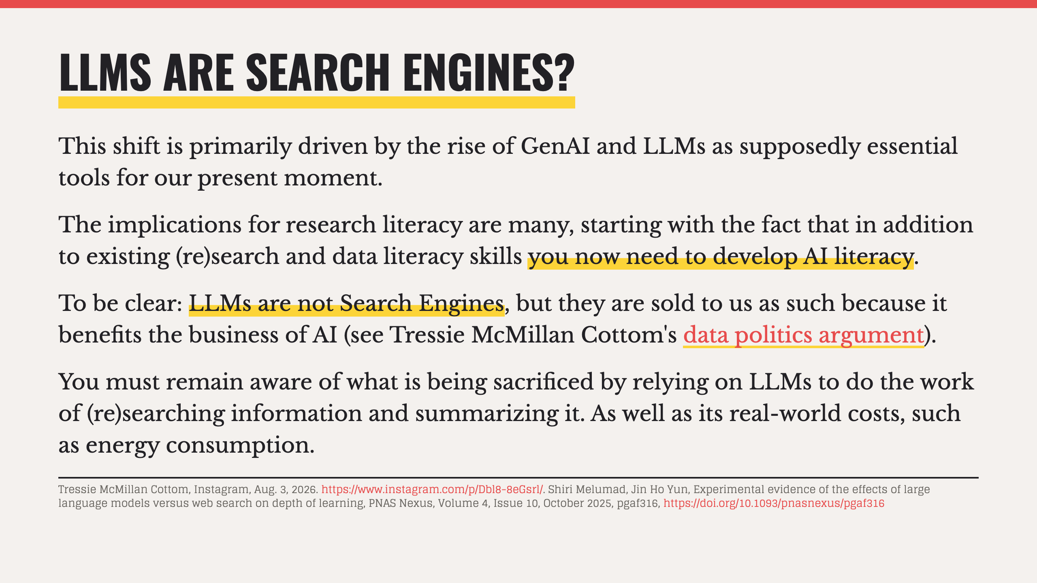
Notes:
- AI literacy has different threads, in this particular context I'm referring to the need to understand how an AI summary is produced, what it lacks, what it costs, what it hides, etc...
- The costs of an AI-assisted search are still being understood but we know that the cognitive impacts are real.

Slide 6
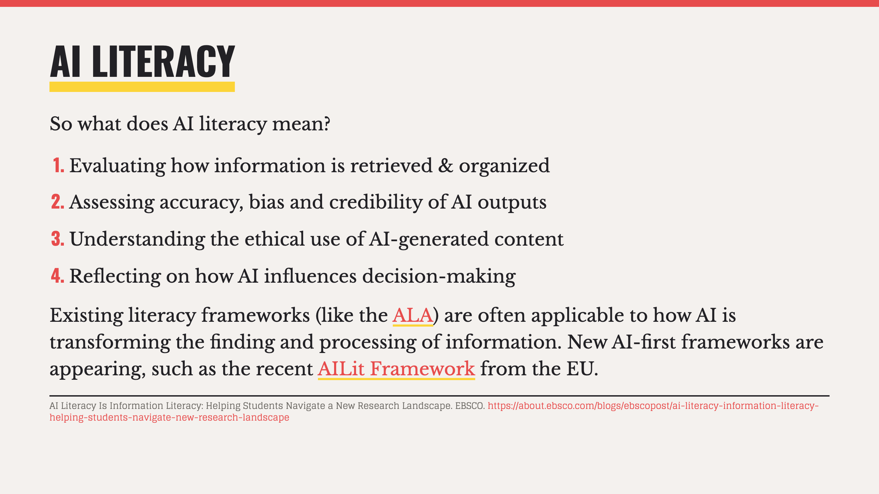
Notes:
- If there is time/interest, show the example of the EBSCO source being unconfirmable.

Slide 7
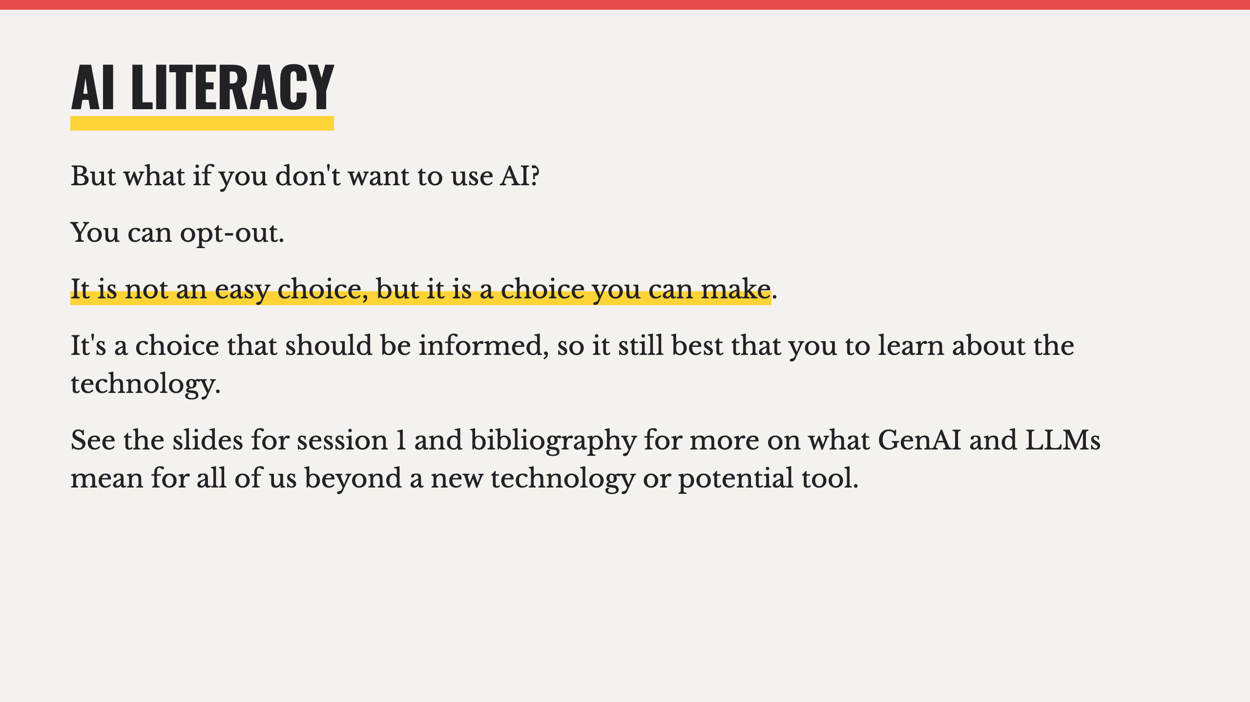
Notes:
- Currently missing from a lot of frameworks and discussions about what it means to learn or work with AI is a seemingly obvious part of the argument: what about those who don't want to?

Slide 8
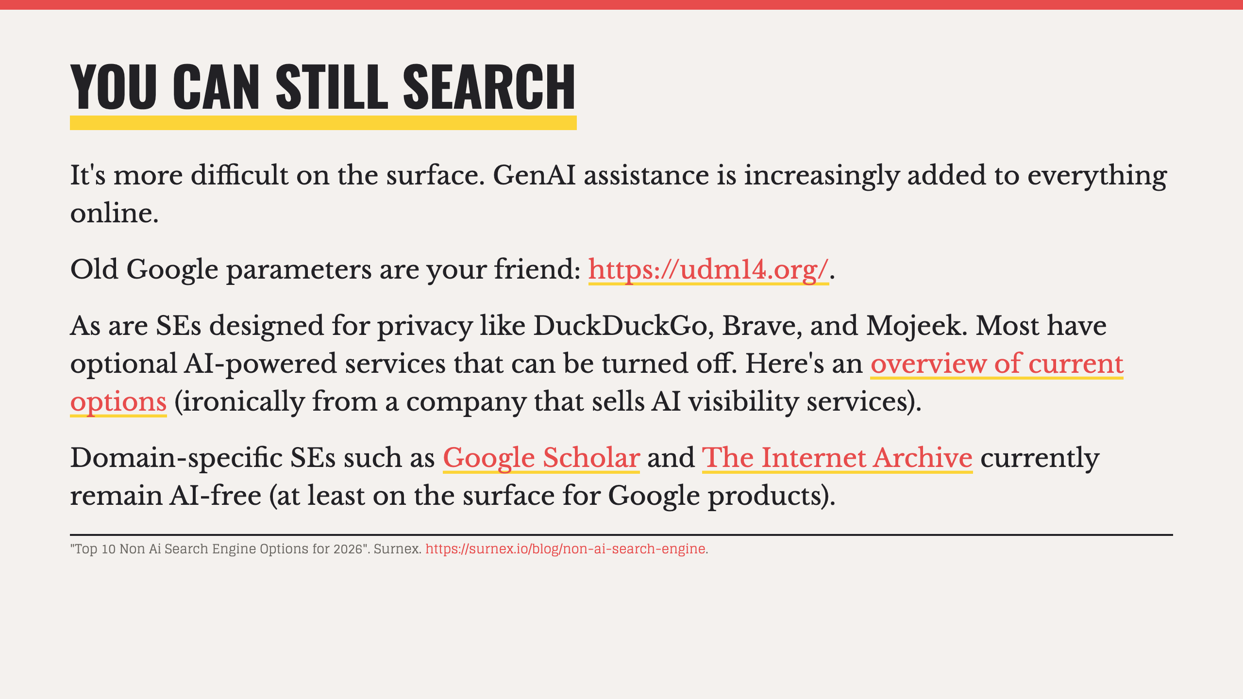

Slide 9
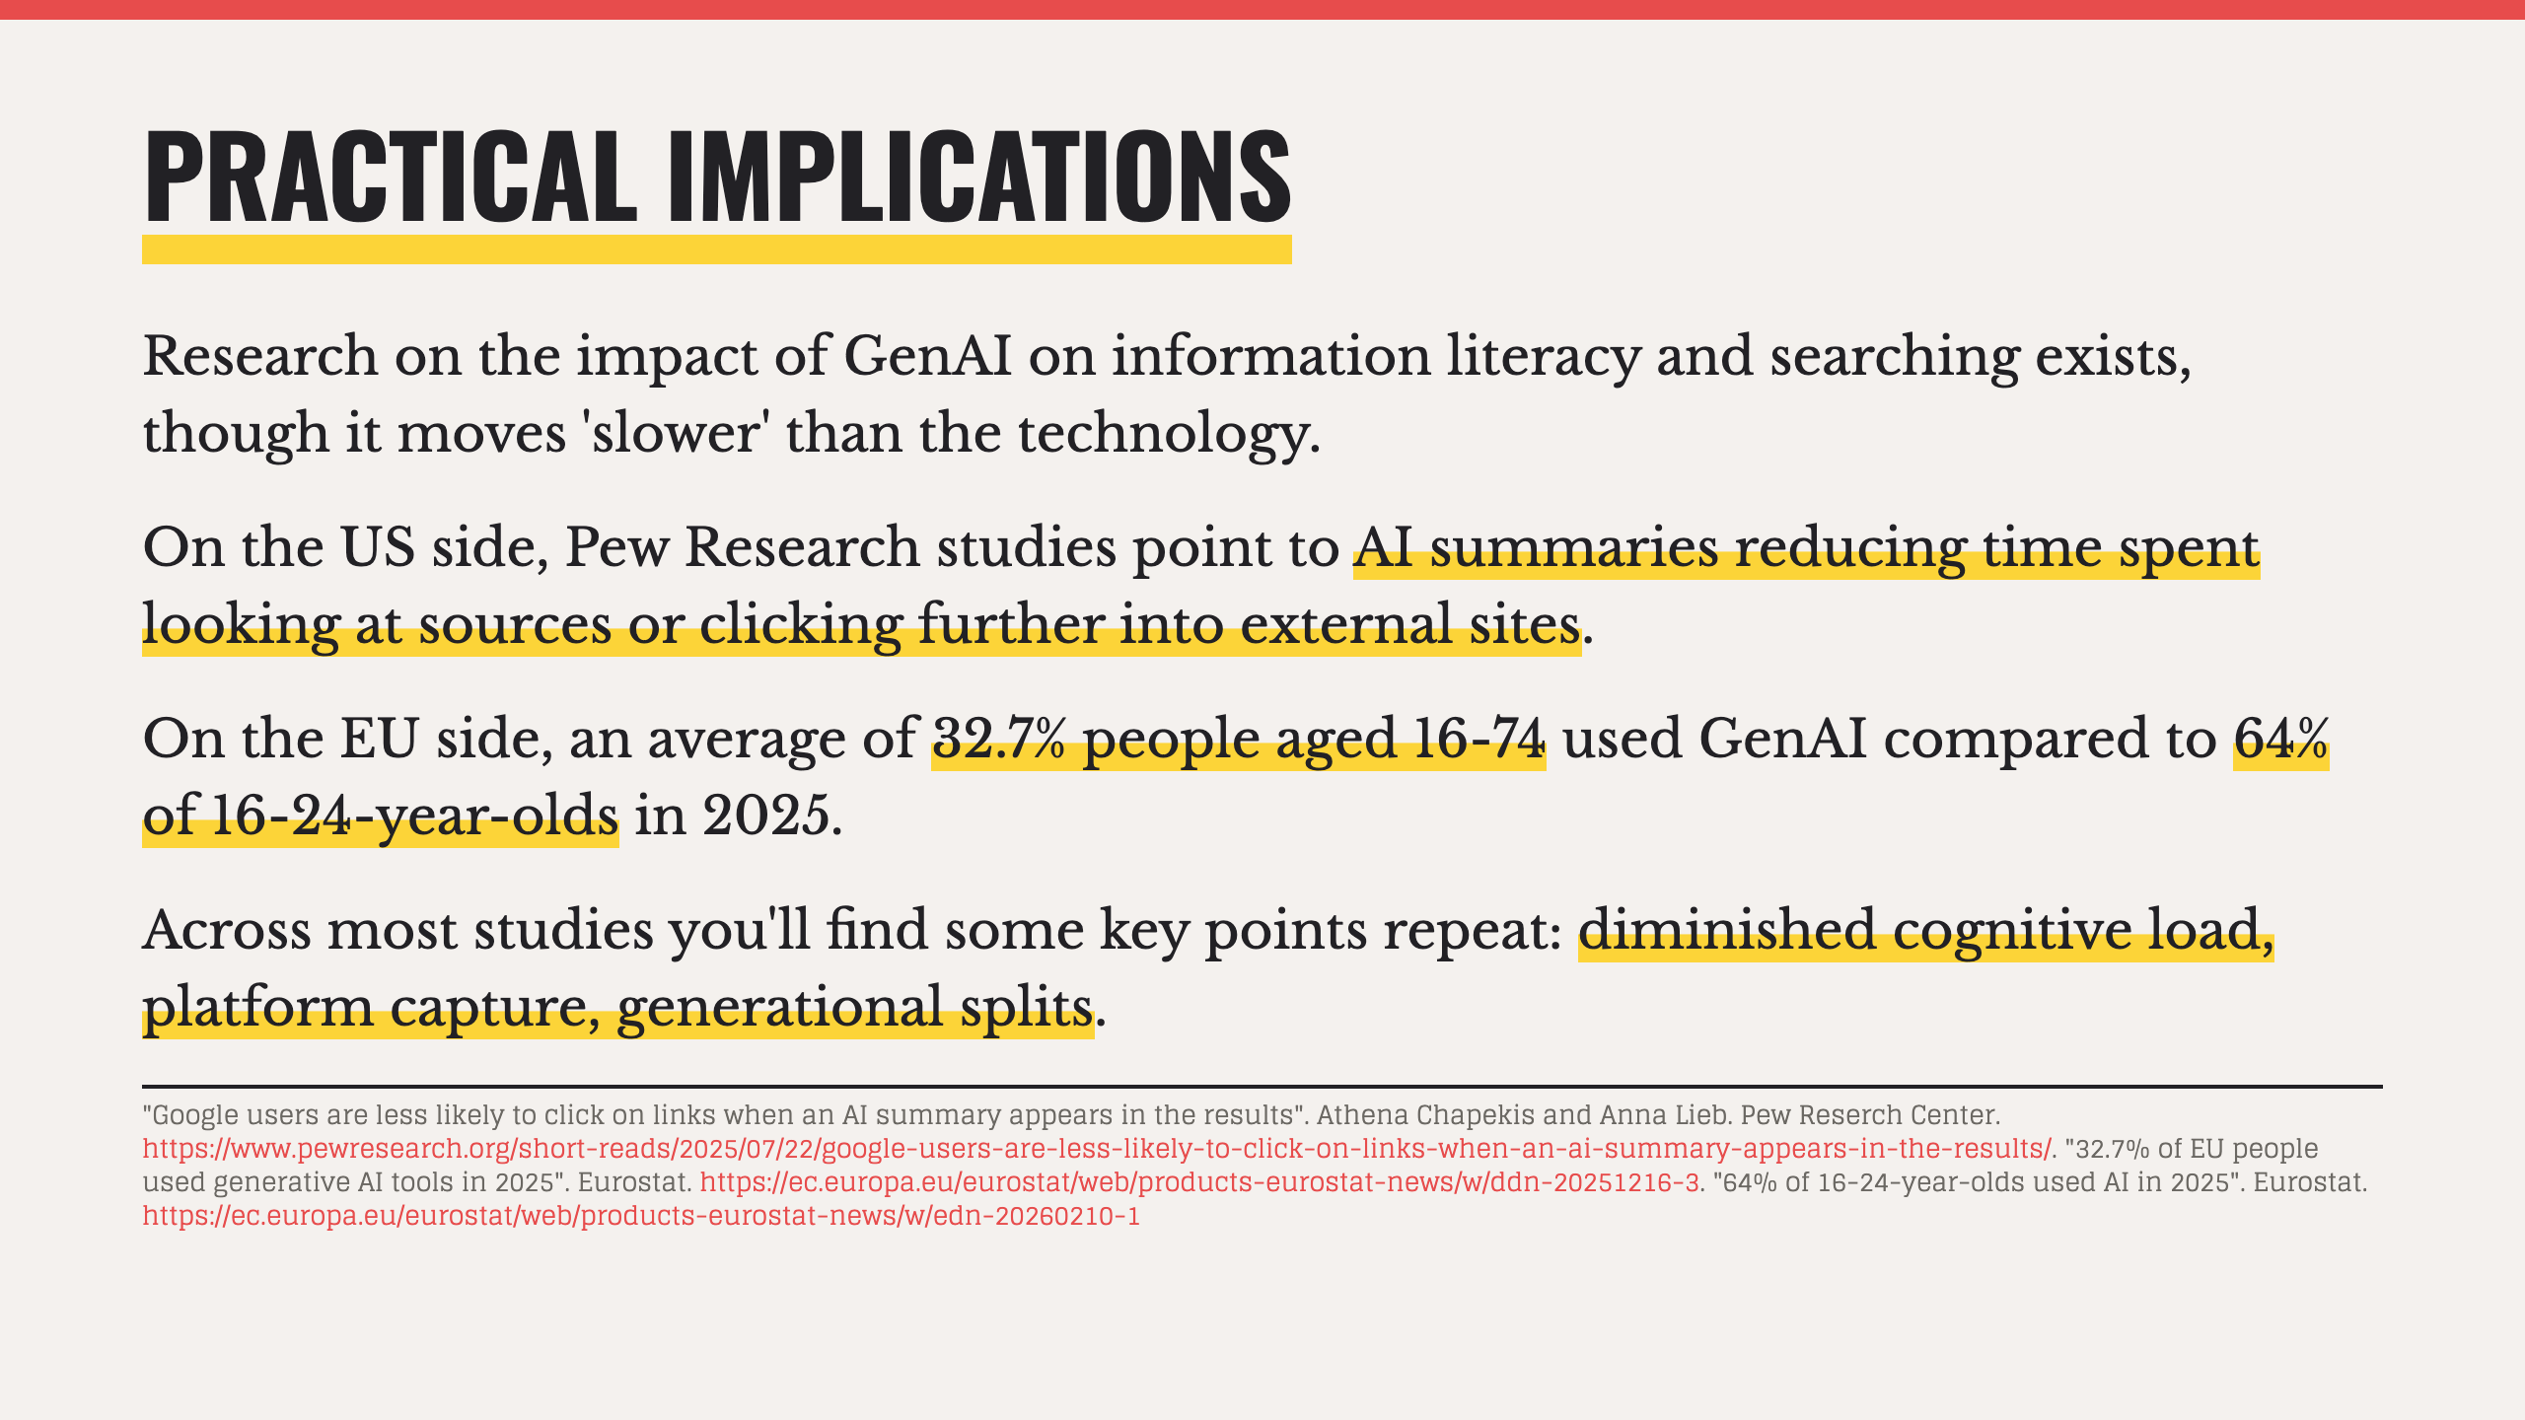

Slide 10


Slide 11
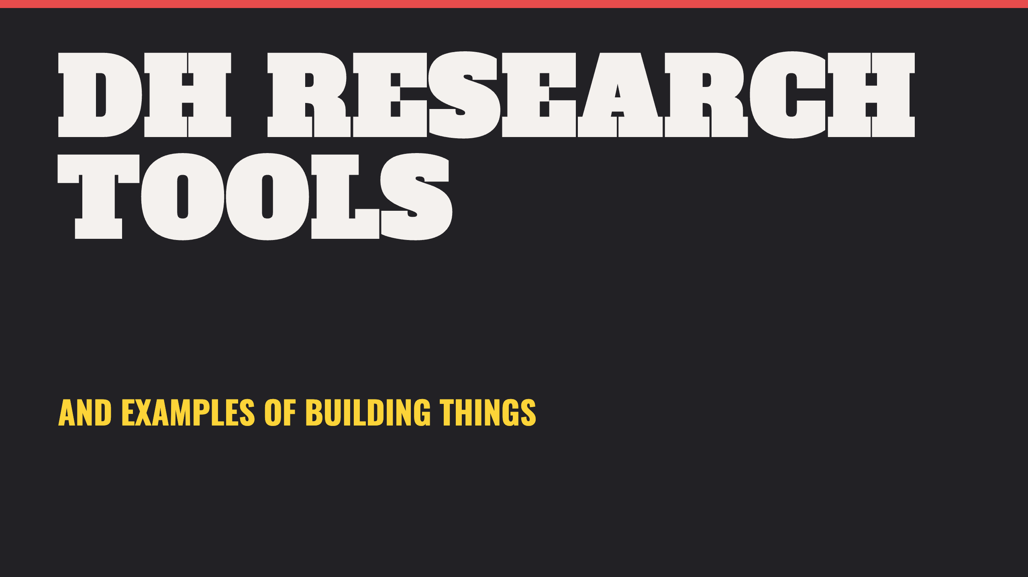
Notes:
- What we'll cover on this topic today assumes a degree of basic familiarity with tools and project-based work, based on some of your feedback via the questionnaire.

Slide 12
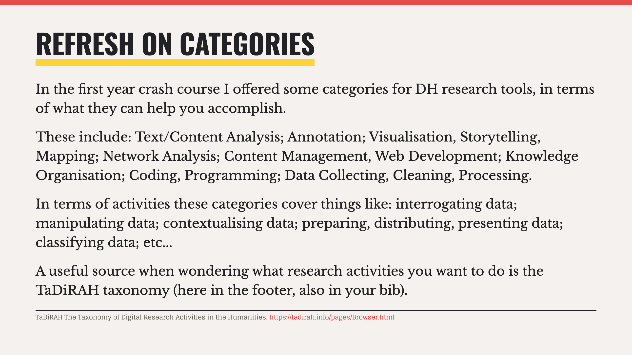
Notes:
- These categories and activities are not exhaustive, but intended as top level. You can get more granular, which Tadirah does.

Slide 13
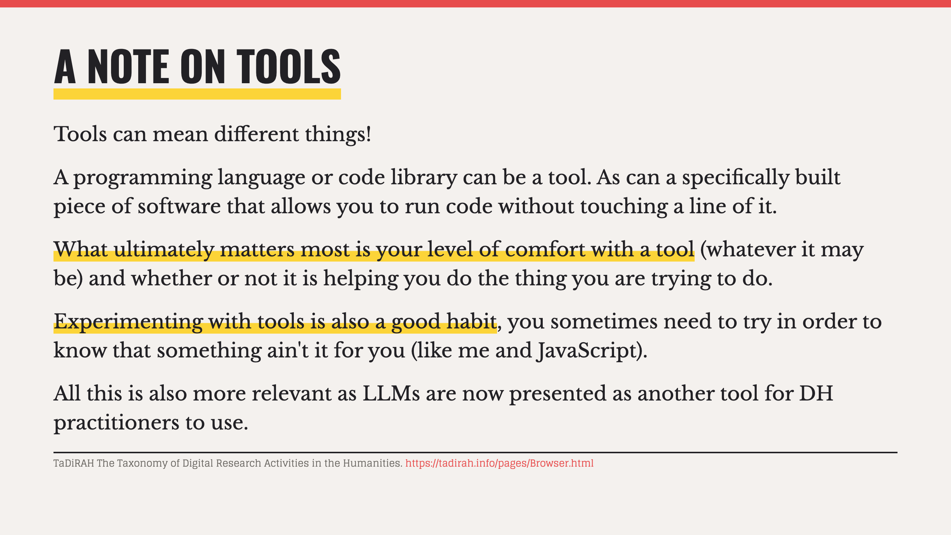

Slide 14
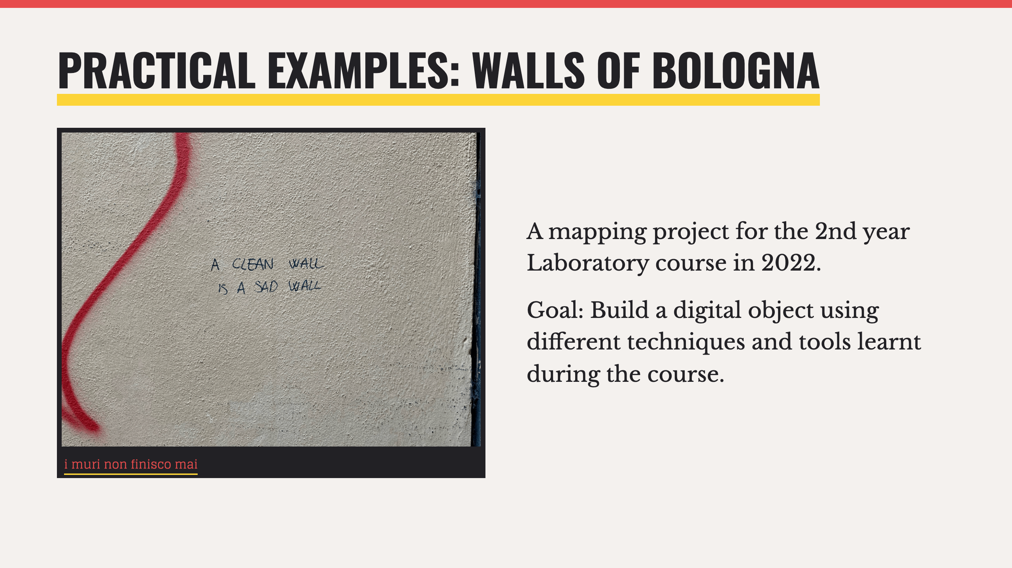

Slide 15
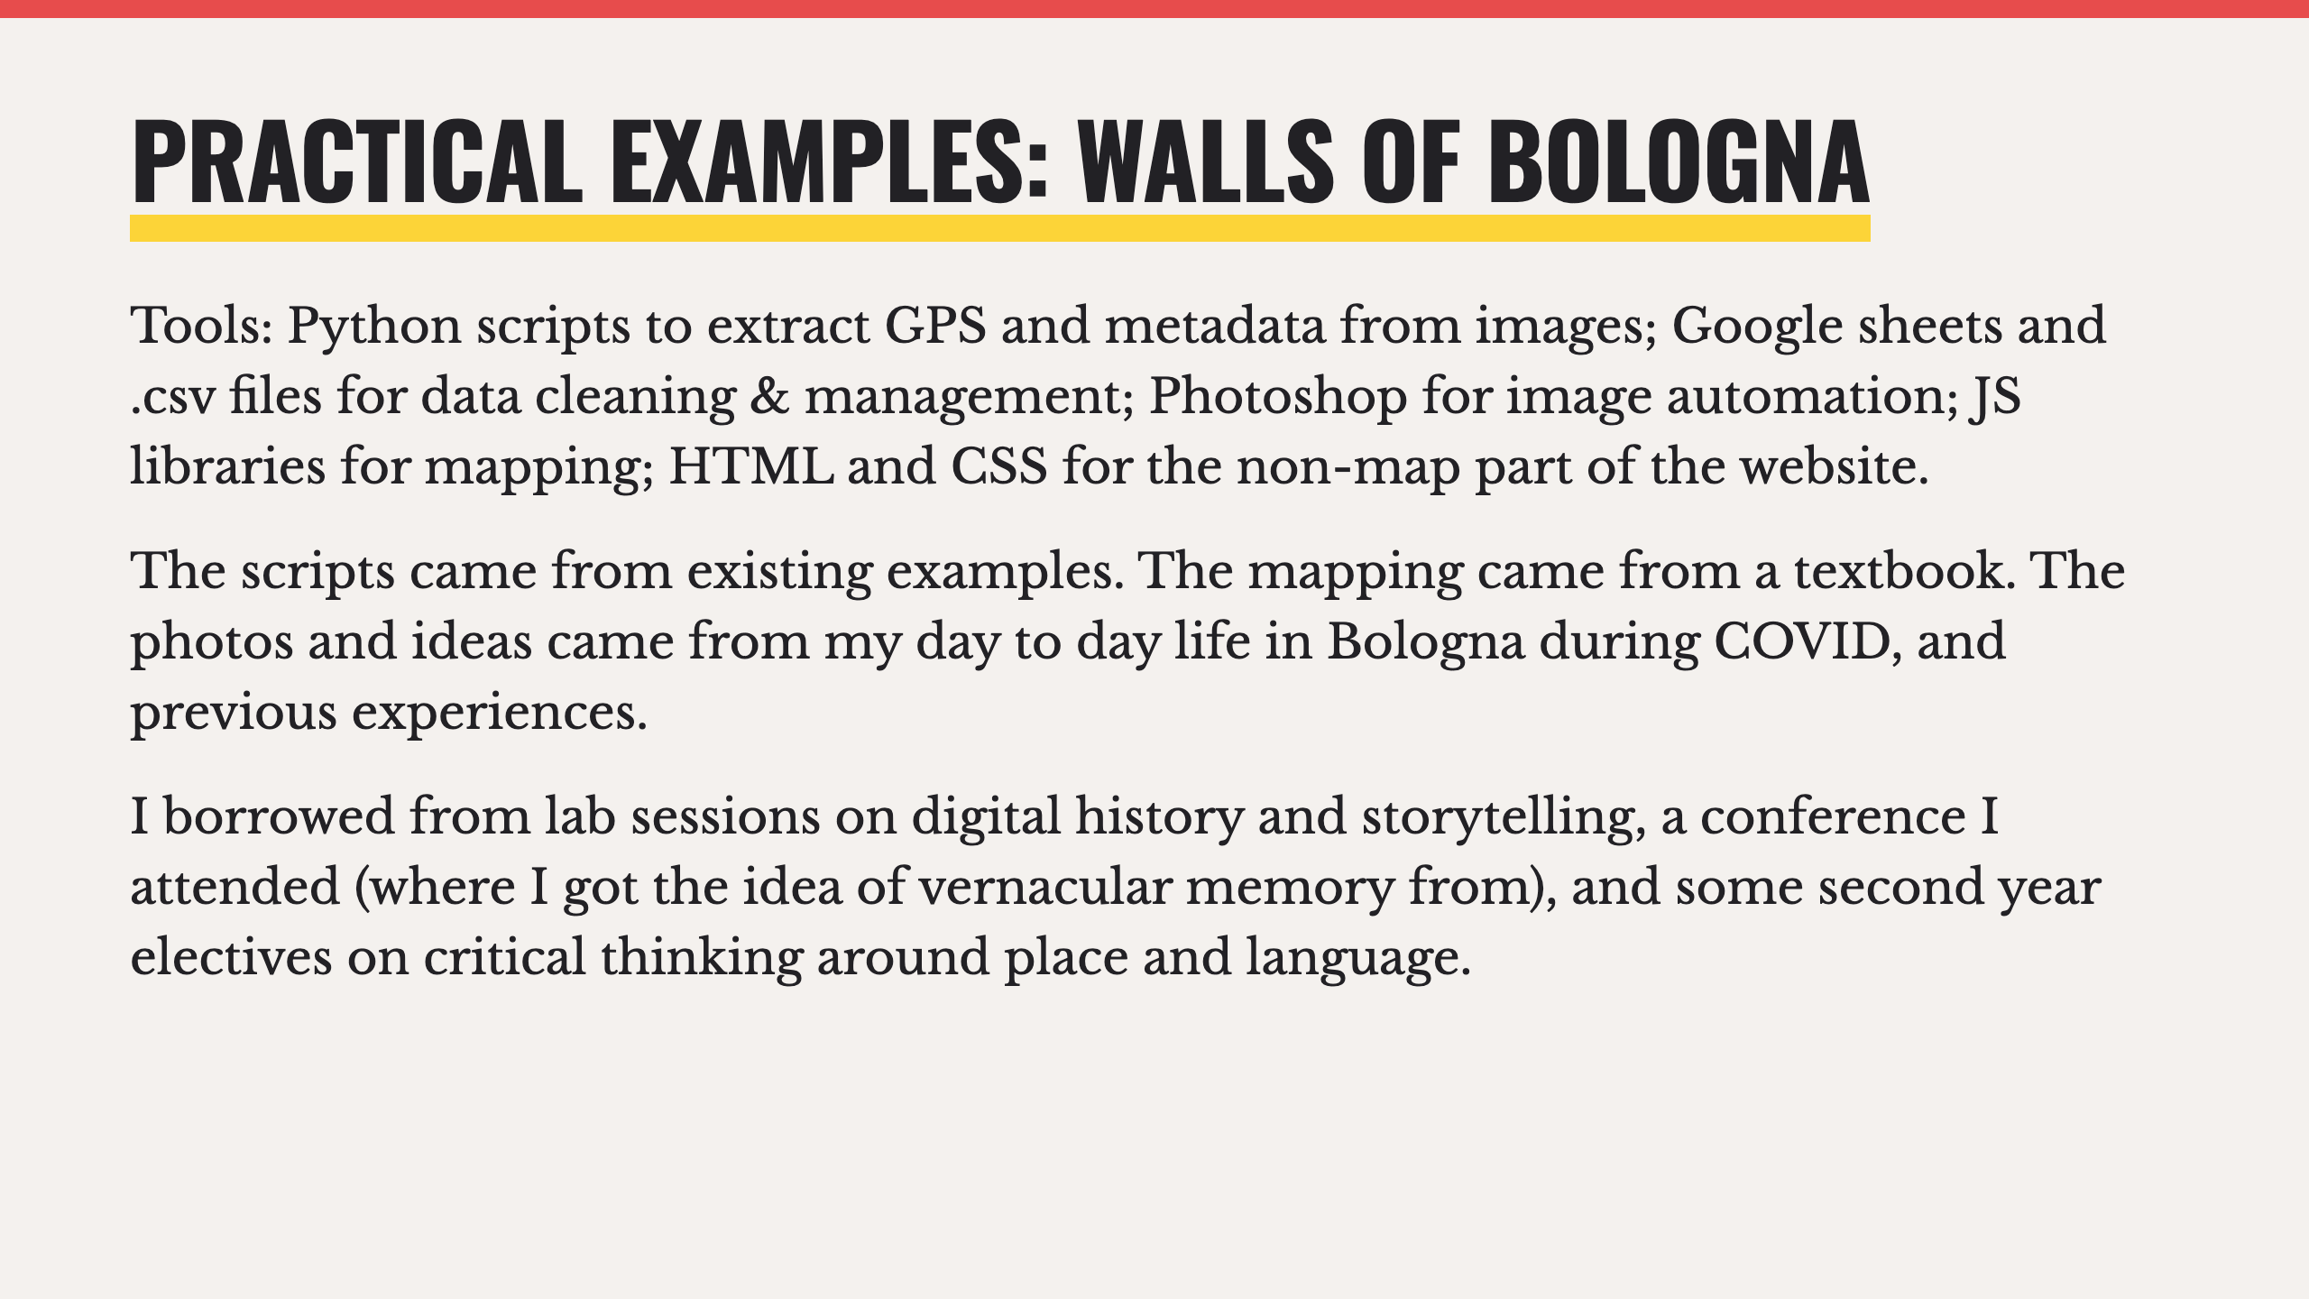

Slide 16
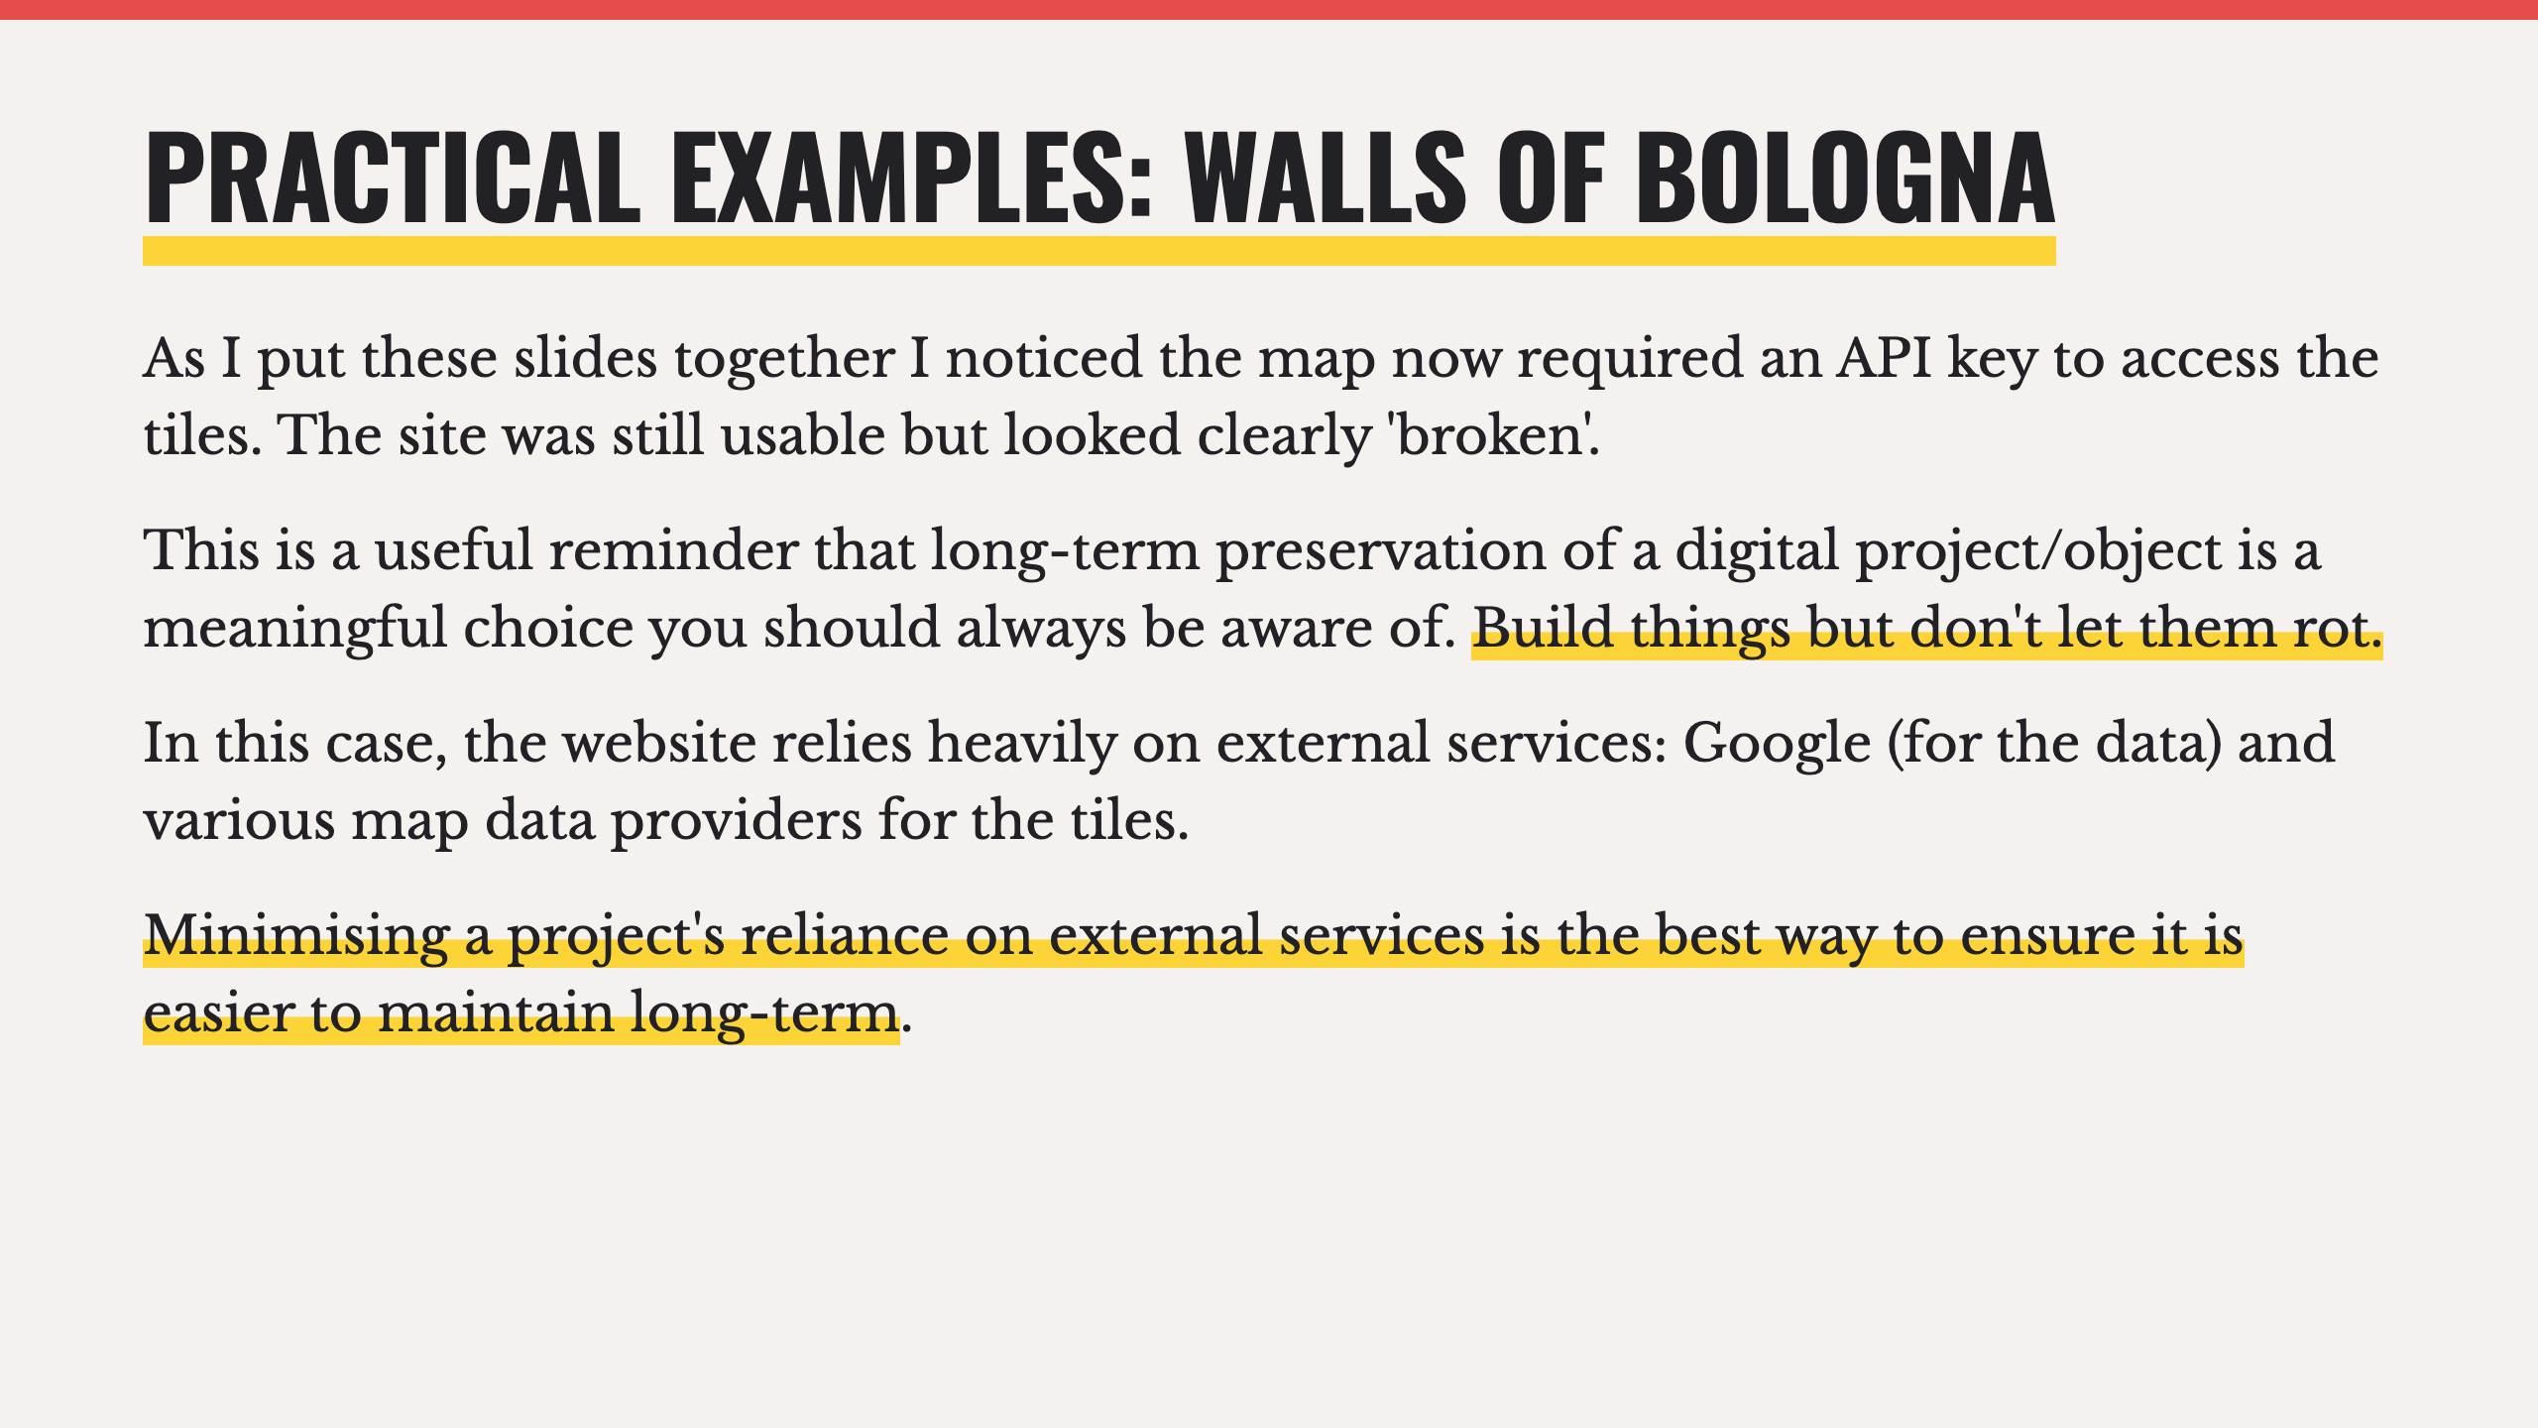

Slide 17
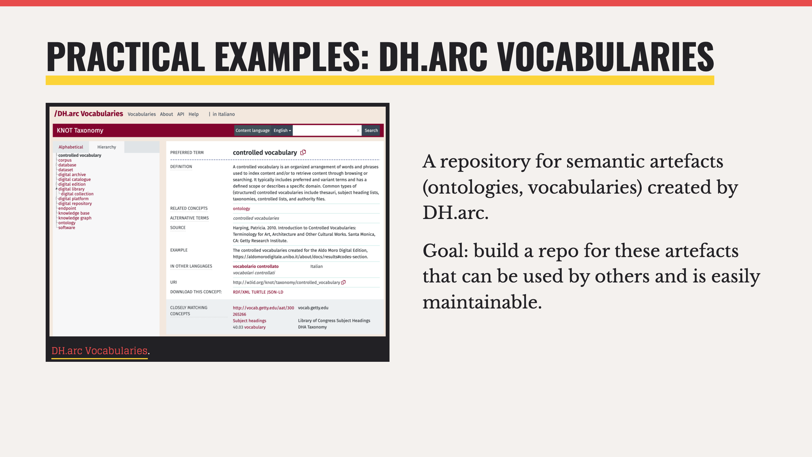

Slide 18
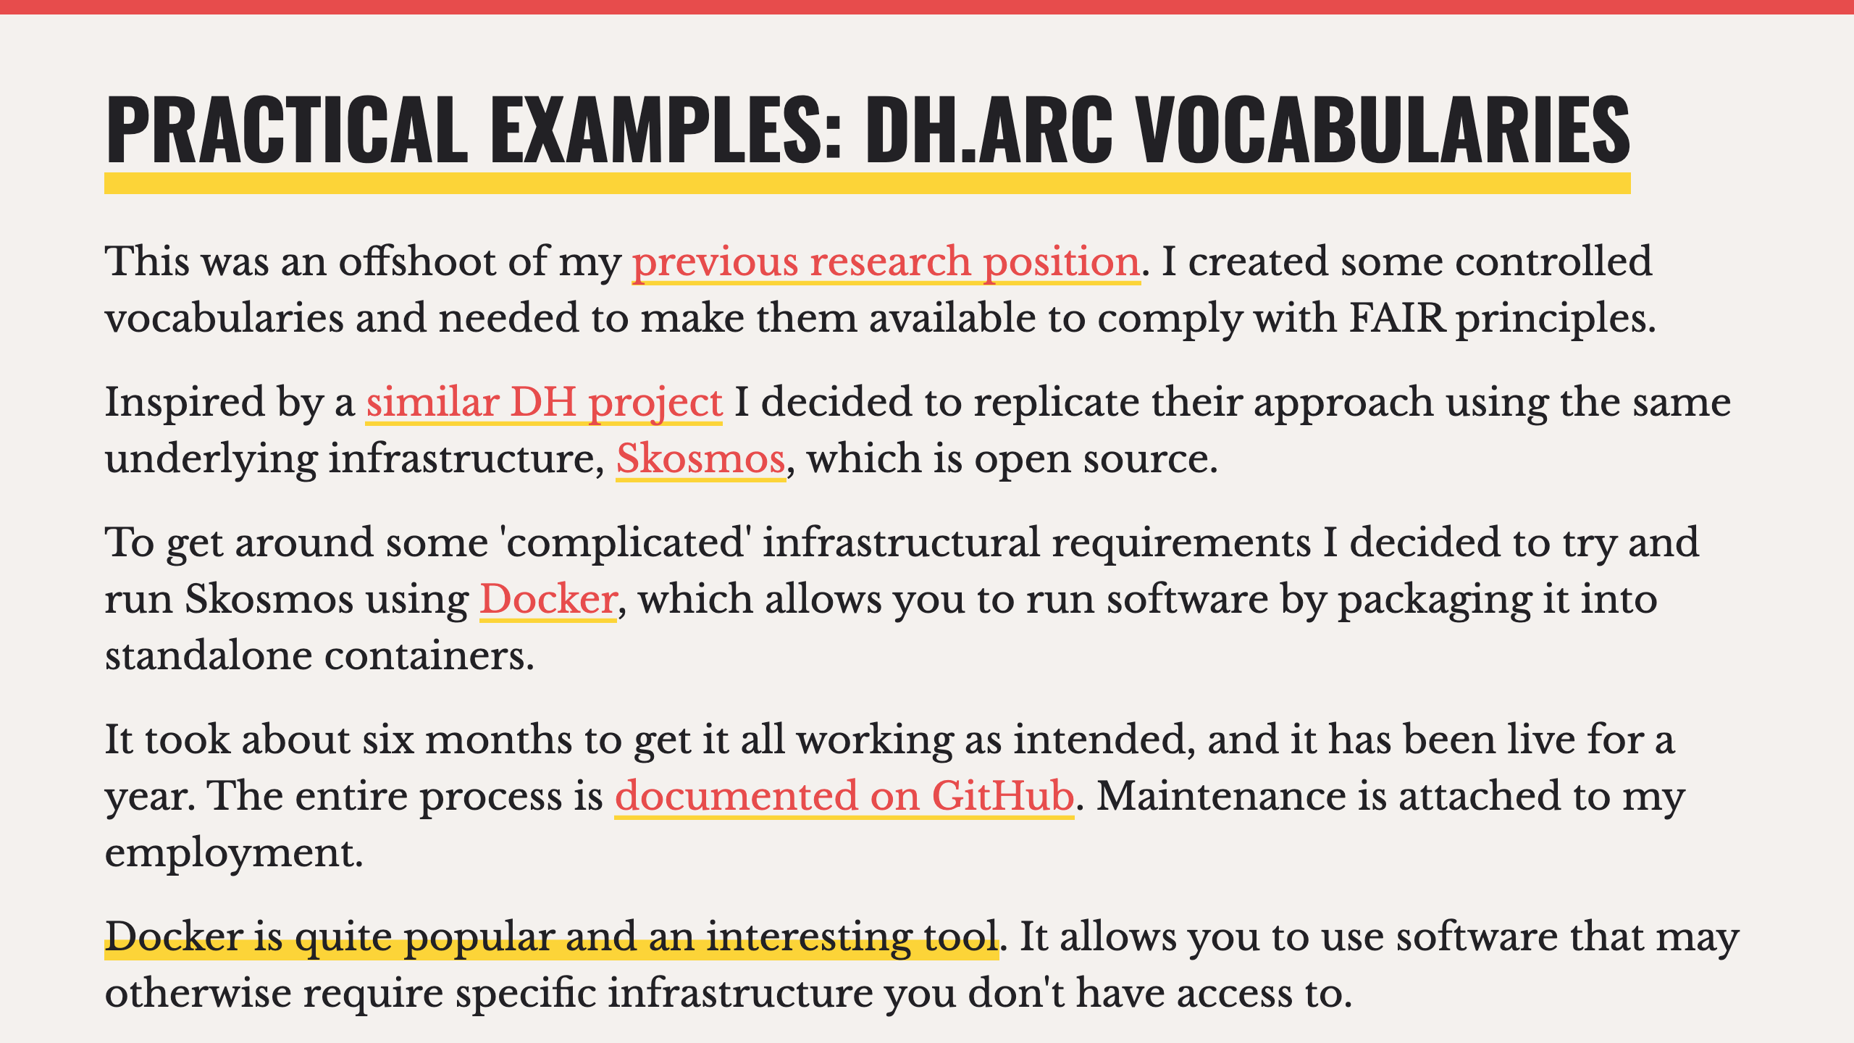

Slide 19
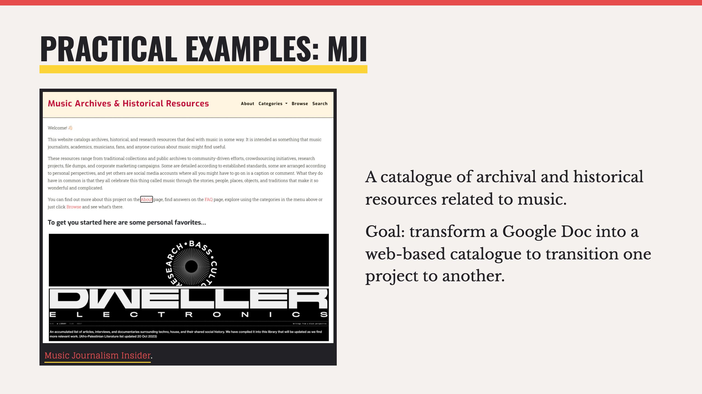

Slide 20
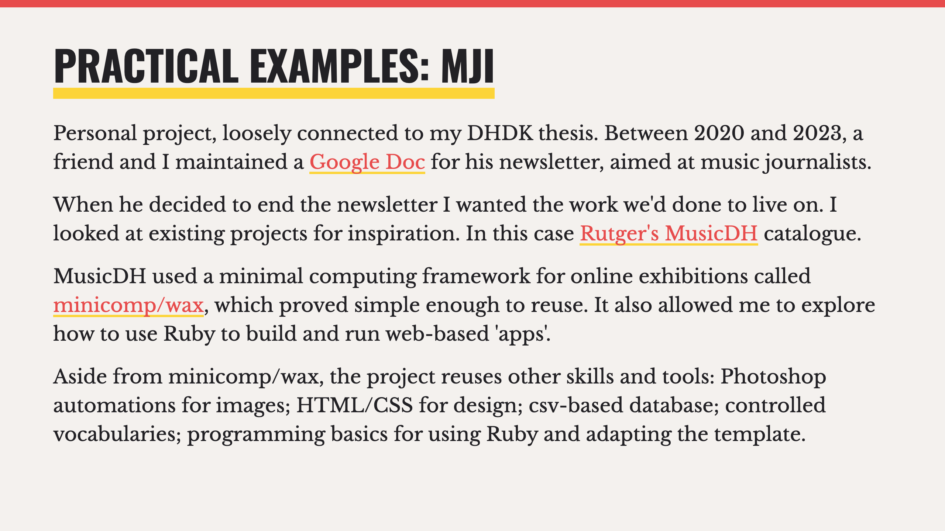

Slide 21
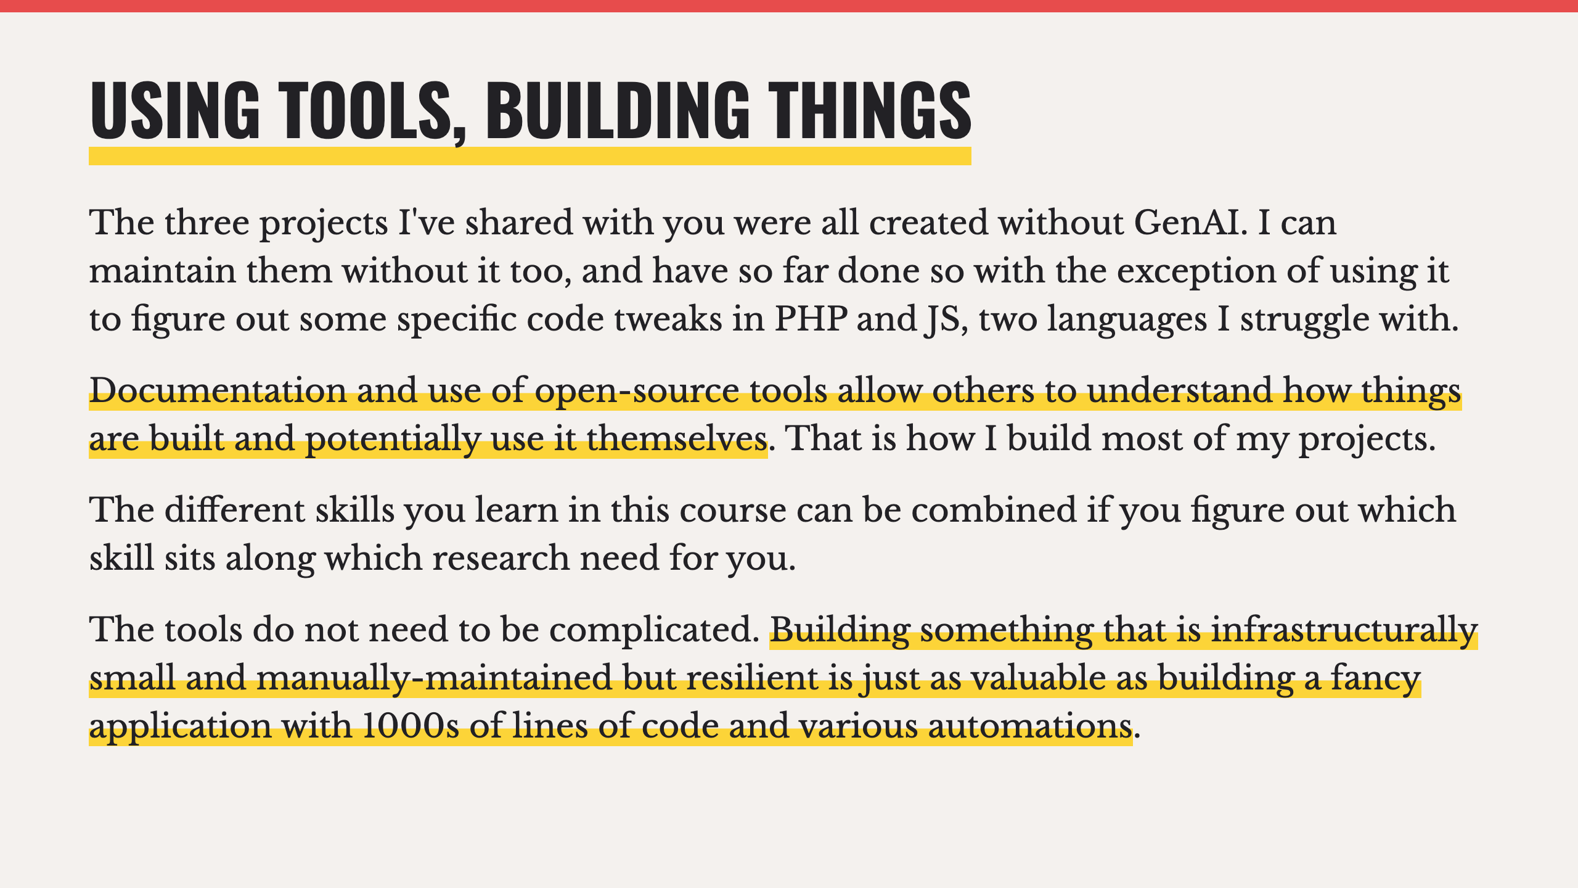

Slide 22


Slide 23
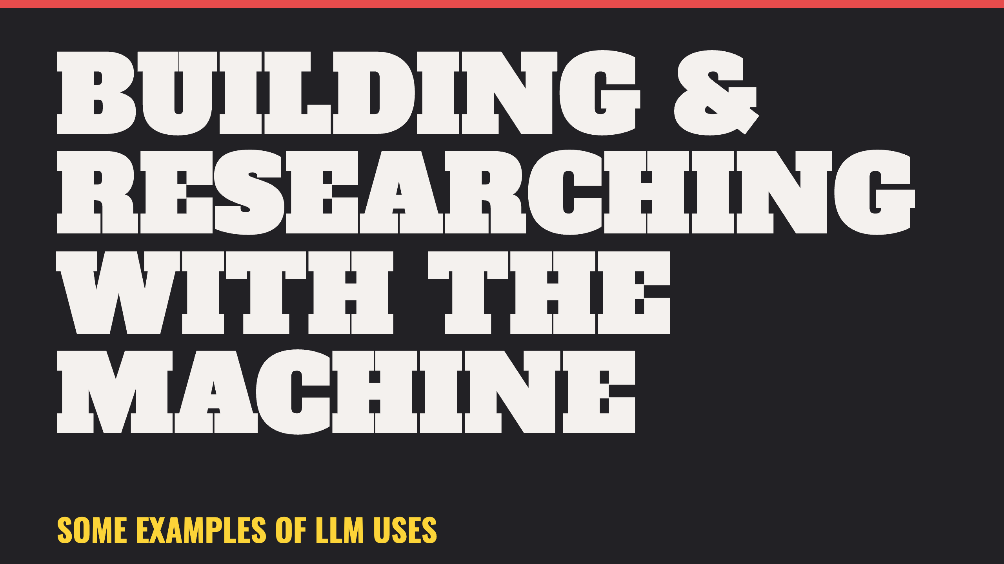

Slide 24
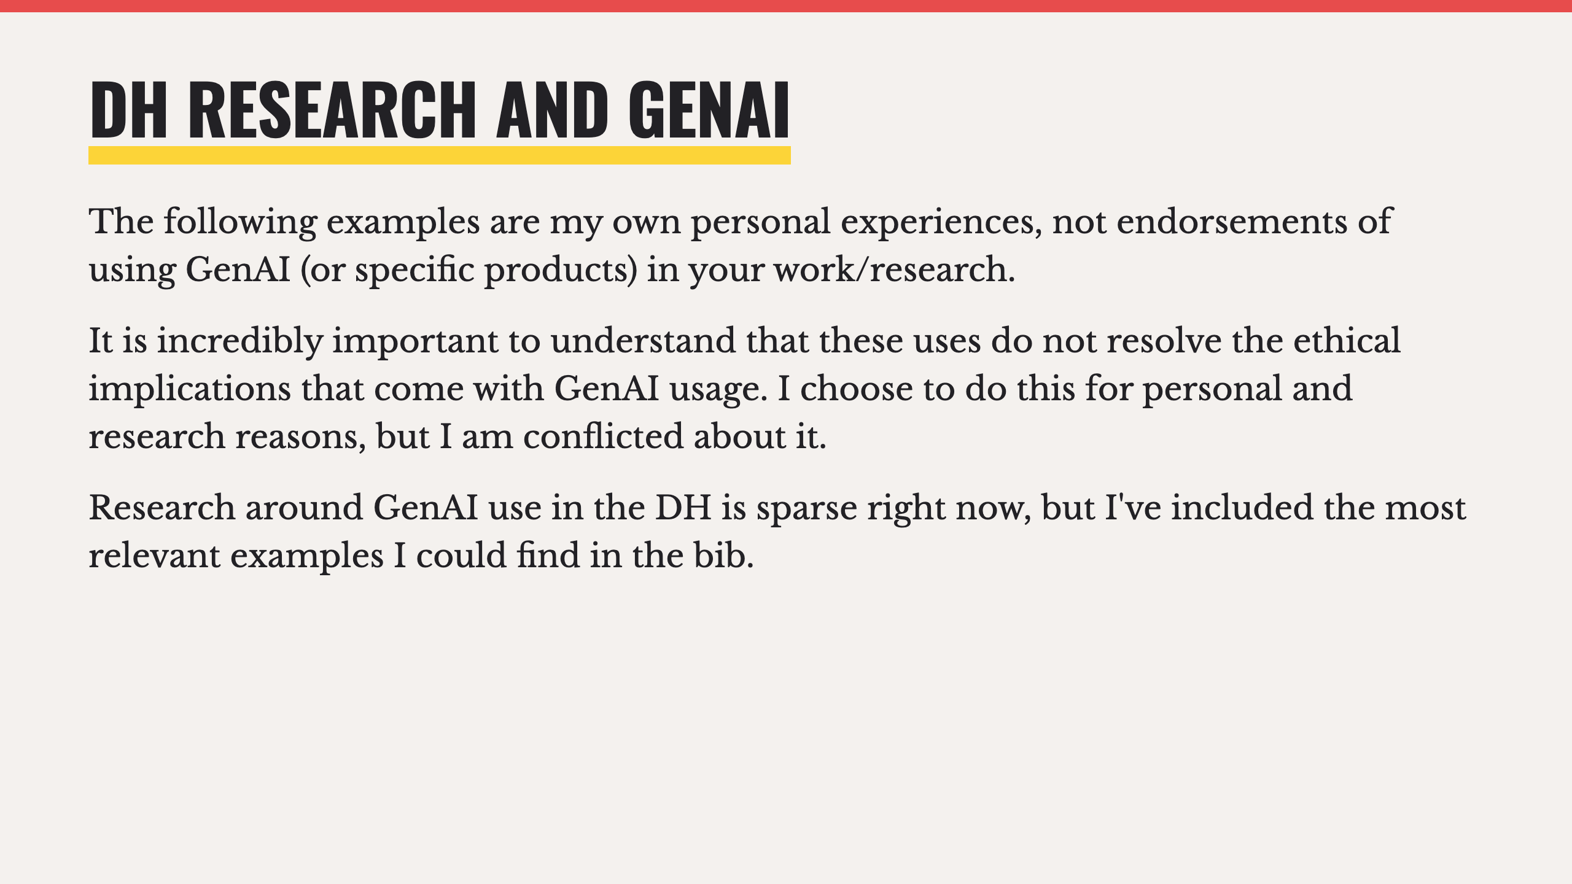

Slide 25
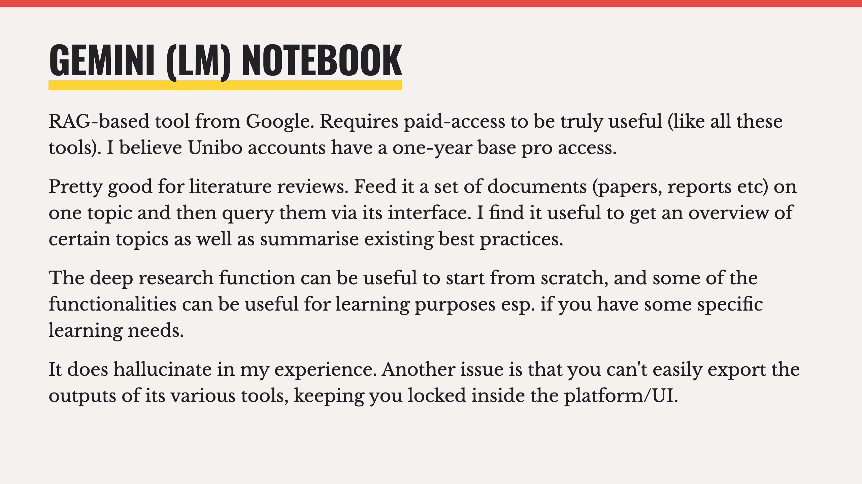

Slide 26
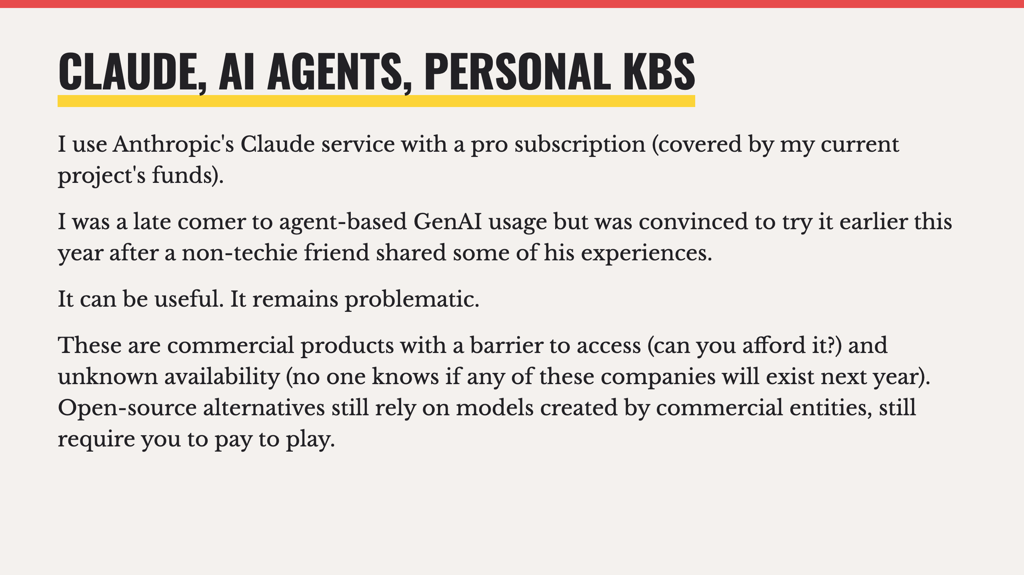

Slide 27
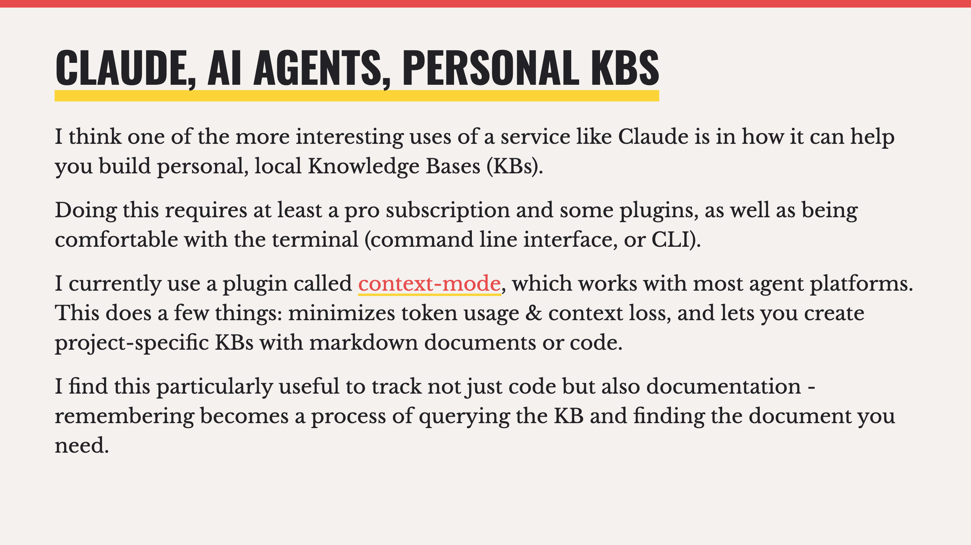

Slide 28
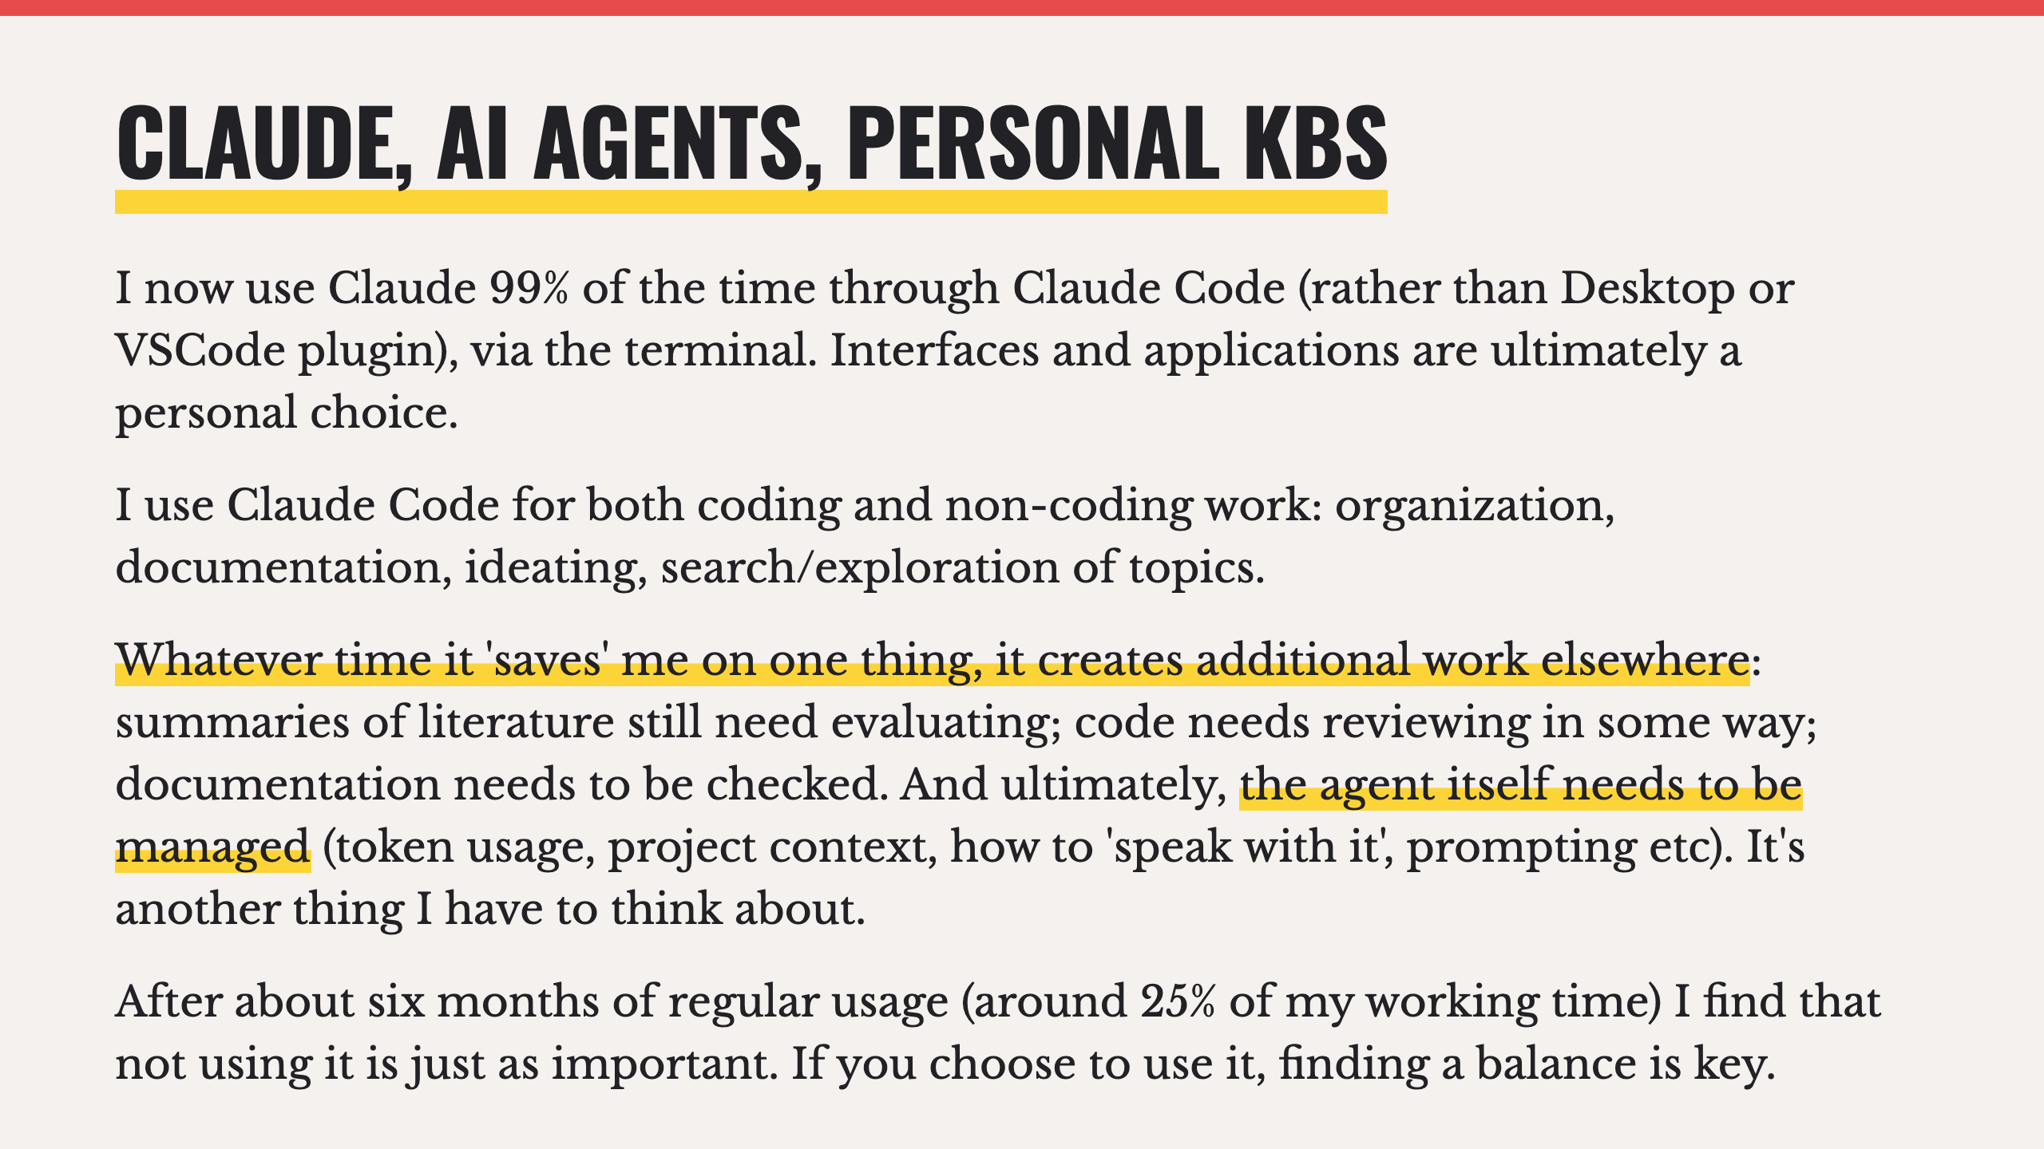

Slide 29
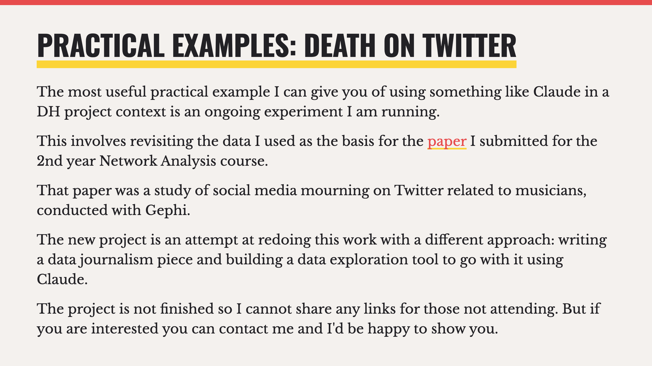

Slide 30
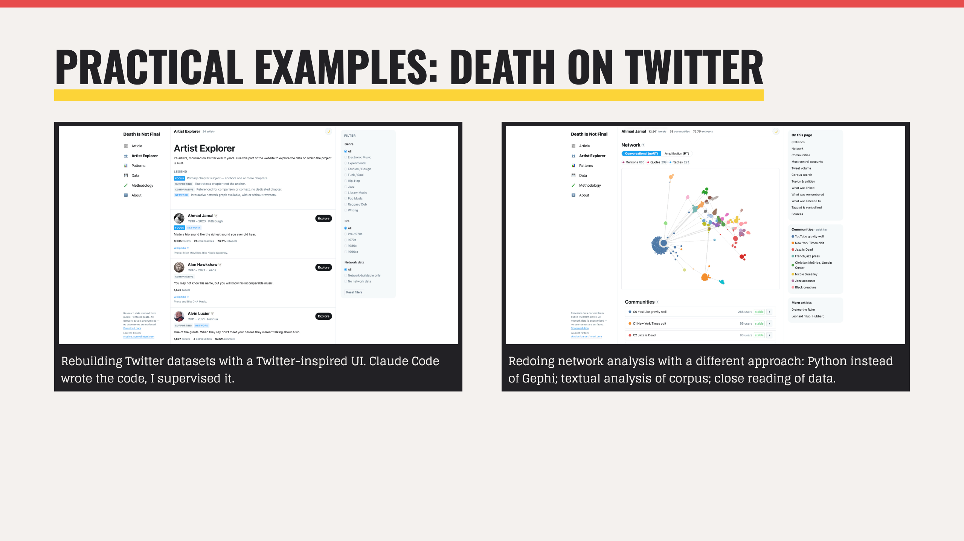

Slide 31


