Slide 1











Eden HAZARD
Eden HAZARD
My rating
Total rating
?
88
82.569
Skill My rating XXX score
General
87 88
More
Personal details
Rating history
Videos
Detailed skills
Comments
Last matches

Slide 2
Eden HAZARD
Eden HAZARD
My rating
Total rating
?
88
82.569
Skill My rating XXX score
General
Physical
Tactical
Shooting
Passing
Dribbling
Mentality
Header
Speed
Vision
87 88
69 68
73 75
90 91
85 65
94 99
89 85
83 70
90 92
86 93

Slide 3
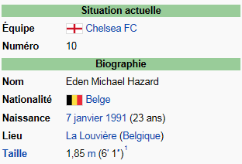
Eden HAZARD
Eden HAZARD
My rating
Total rating
?
88
82.569
Personal details
Rating history
100
90
80
70
60
50
40
30
20
10
01.2014
02.2014
03.2014
04.2014
05.2014
06.2014
07.2014
08.2014
09.2014
10.2014
11.2014
12.2014
More

Slide 4
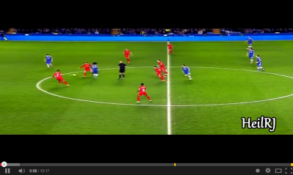
Eden HAZARD
Eden HAZARD
My rating
Total rating
?
88
82.569
Personal details
Rating history
Videos
Last matches
Chelsea – Arsenal
Newcastle – Chelsea
Chelsea – Southampton
Chelsea – Manchester City
More
More

Slide 5

Add a player
First name
Last name
Wikipedia Preview
Team
Country
Picture
Link wikipedia
Add a picture
Type the link
CREATE THE PLAYER

Slide 6

Ranking
Filter by:
League
Spain
England
Belgium
Italy
France
Nationality
Position
Player | Overall | Attitude | Shooting | Passing | Header | Dribbling | Speed
Eden Hazard | 7,5 | 9,5 | 8,0 | 7,5 | 7,5 | 8,0 | 8,5
Mamadou Sako | 7,5 | 9,9 | 8,0 | 9,9 | 8 | 8,0 | 7,0
Steven Gerard | 6,9 | 8,0 | 5,6 | 7,1 | 7,1 | 7,0 | 7,6
Luis Suarez | 6,7 | 6,5 | 7,3 | 7,1 | 6,4 | 7,1 | 8,5
Arjen Robben | 6,5 | 7,3 | 5,6 | 6,0 | 7,5 | 5,2 | 4,8
Lionel Messi | 6,5 | 7,3 | 5,6 | 6,0 | 7,5 | 5,2 | 4,8
Eden Hazard | 6,0 | 8,0 | 4,0 | 8,0 | 8,0 | 8,0 | 5,0
Mamadou Sako | 6,0 | 8,0 | 4,0 | 8,0 | 8,0 | 8,0 | 5,0
Steven Gerard | 6,0 | 8,0 | 4,0 | 8,0 | 8,0 | 8,0 | 5,0
Luis Suarez | 6,0 | 8,0 | 4,0 | 8,0 | 8,0 | 8,0 | 5,0
Arjen Robben | 6,0 | 8,0 | 4,0 | 8,0 | 8,0 | 8,0 | 5,0
Lionel Messi | 6,0 | 8,0 | 4,0 | 8,0 | 8,0 | 8,0 | 5,0

