Slide 1
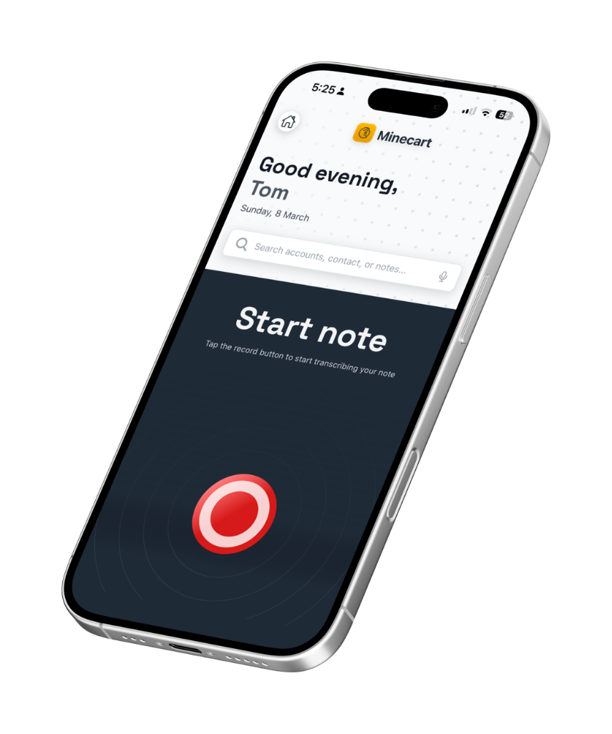


Minecart App
Overview : Parts Distributors

Slide 2
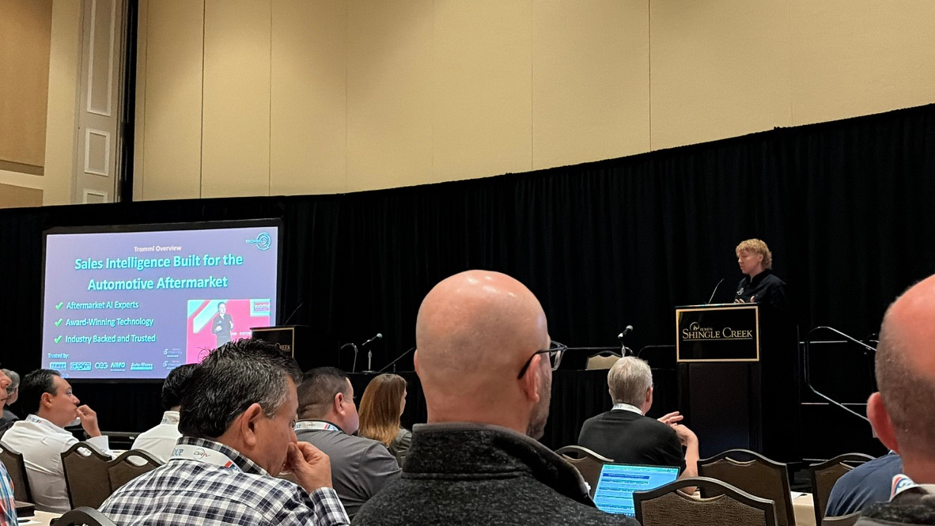






Tromml Overview
Sales Intelligence Built for the Automotive Aftermarket
Aftermarket AI Experts
Award-Winning Technology
Industry Backed and Trusted
Trusted by:

Slide 3
The Situation
A rep's job grew, and so did what a rep hears
THEN
NOW, ON TOP OF THAT
Build shop relationships
Run promotions and events
Fix online order issues
Drop off flyers
Warranty and quality claims
Take stock orders and returns
Pricing and account changes
Digital ads and upsells
Every new duty is a new conversation. Reps hear more about your market than anyone in the building.

Slide 4
The Situation
Almost none of it makes it back
THEN
NOW
IN THE GAP
Competitor moves
Accounts about to switch
Product issues
Promo results
Shops ready to buy
Reps hear
Reaches you
Reps hear
Reaches you
The job grew. The channel back didn't. Every fix so far asked the rep to type.

Slide 5
Our Solution
Built for the Aftermarket
Reps talk, not type. Every stop captured.
Managers see the field without chasing it.
What the business learns, it keeps.
Built for the aftermarket from the first line of code.

Slide 6
Our Solution
Works with what you already run
Your CRM and sales data stay where they are. Minecart writes back.
Your system says what happened. Minecart says what was said, and what to do next.
Reps change nothing. They talk instead of type.
Your data is yours.

Slide 7
How It Works
Four moves, one loop
Capture
Action
Every pass compounds
Signal
Attention

Slide 8
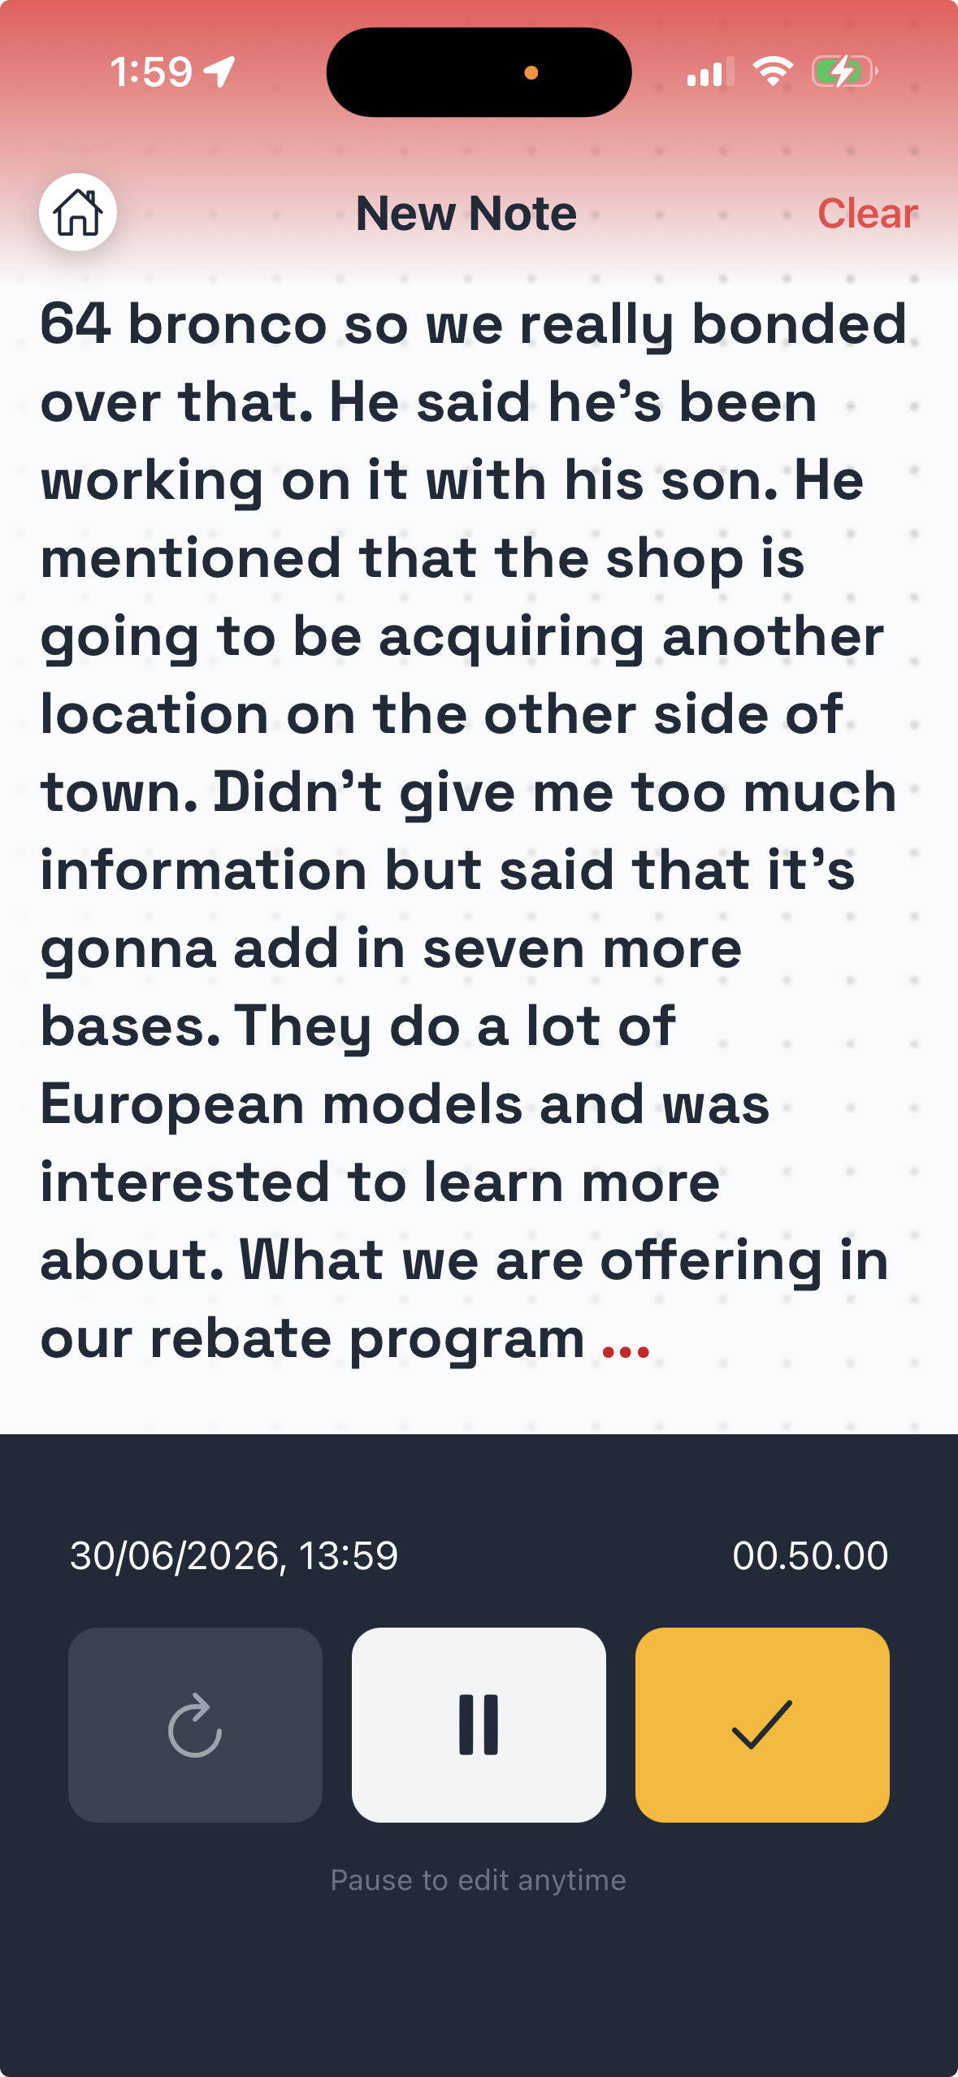
For the Rep
After the stop: talk, don't type
90 seconds in the truck. One button.
No form. No account to pick.
Everything the shop said, as the rep said it.
REP
Capture
What the rep gets back
The evening.
Action
Signal
Attention

Slide 9
For the Rep
Minecart does the filing
Filed to the right account and contact.
Opportunities and risks pulled out and named.
Follow-ups created. CRM fields written back.
Screen needed
Filed note: contact, opportunity, follow-up, CRM fields
REP
Capture
What the rep gets back
No cleanup at night.
Action
Signal
Attention

Slide 10
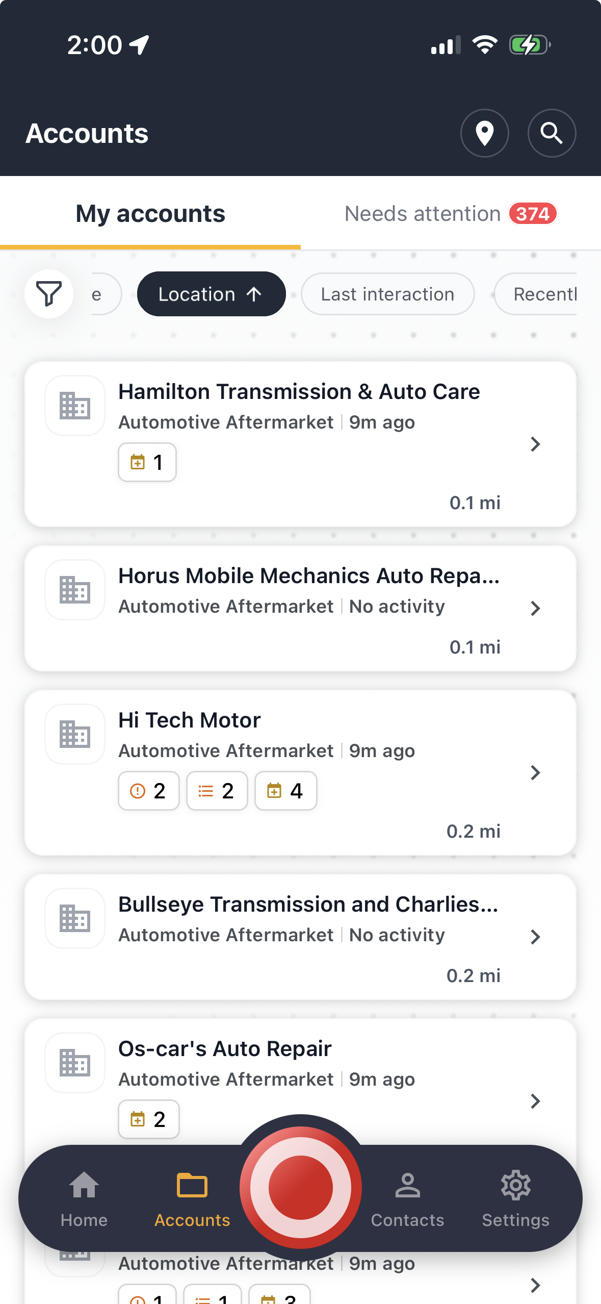
For the Rep
What needs you
Accounts that need attention, ranked.
Follow-ups due. Accounts gone quiet.
Sorted by where the rep is standing.
REP
Capture
What the rep gets back
Nothing slips.
Action
Signal
Attention

Slide 11
For the Rep
Build the week
Start from what is due and who is at risk.
Filter by program, tier, last visit, area.
A note today becomes a follow-up on the right day.
Screen needed
Lists and filters: due follow-ups, accounts to watch, programs
REP
Capture
What the rep gets back
A plan built from their own notes.
Action
Signal
Attention

Slide 12
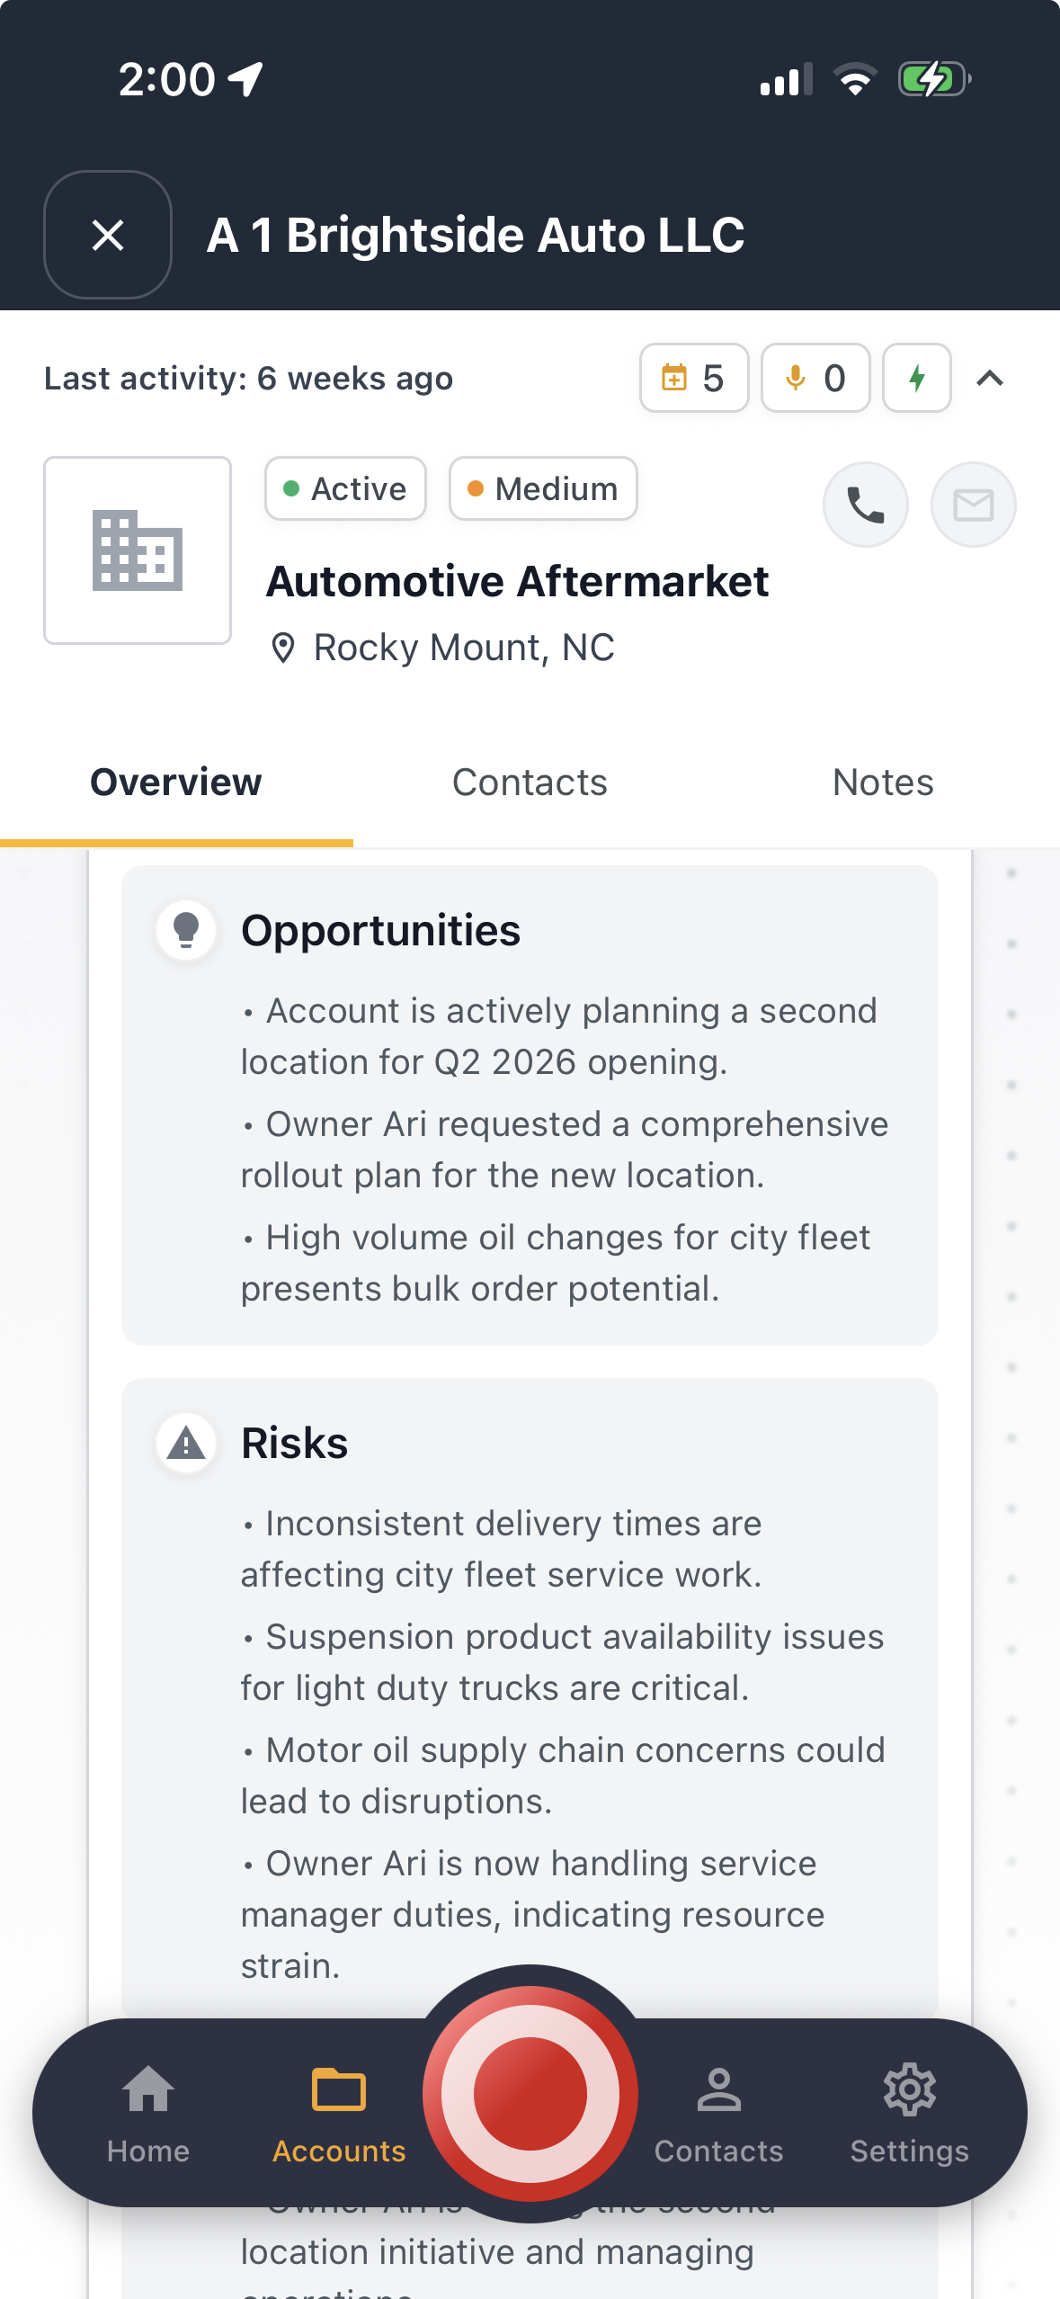
For the Rep
In the truck: the briefing
Who they are, what they buy, what was said last time.
Opportunities and risks at the top.
The one thing to raise when they walk in.
REP
Capture
What the rep gets back
The relationship.
Action
Signal
Attention

Slide 13
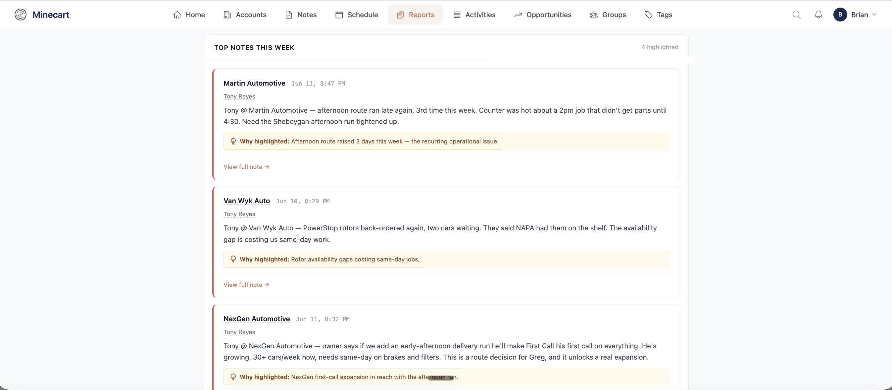
For the Manager
See the field without chasing it
Every rep's week, by account, in one read.
The notes that matter, and why.
No Friday recap. No "good visit."
MANAGER
Capture
What the manager gets back
Action
Signal
Monday.
Attention

Slide 14
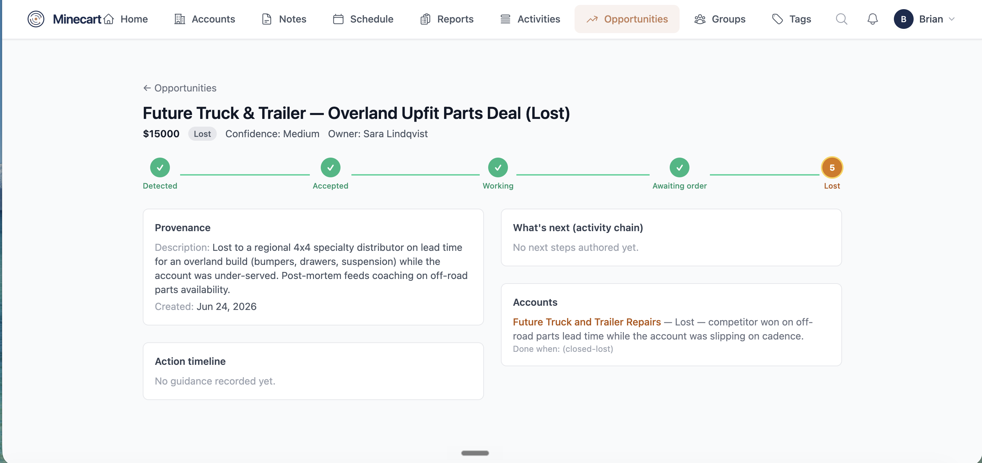
For the Manager
Drill in
The conversation history behind every account.
Every opportunity traced to the note that found it.
Leave a note that reaches the rep before the visit.
MANAGER
Capture
What the manager gets back
Action
Signal
The whole story.
Attention

Slide 15
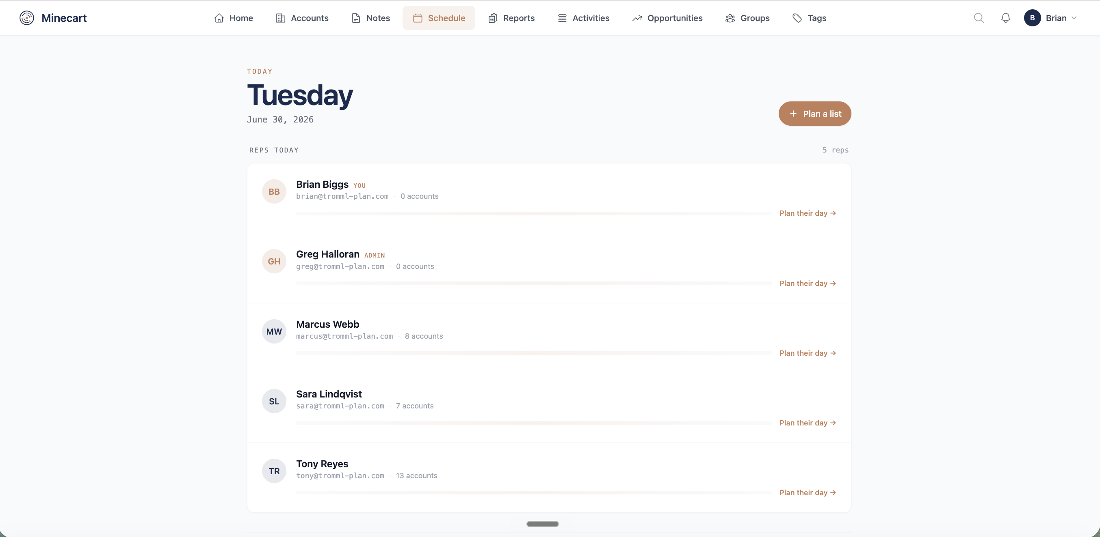
For the Manager
Steer the team
Set priorities once. They land in every rep's week.
Plan a list for a rep, a program, a region.
Which promos landed. Who is at risk. What shops are saying.
MANAGER
Capture
What the manager gets back
Action
Signal
One plan, whole team.
Attention

Slide 16
For the Manager
Back in the door, aligned
What the shop said, the same day
Rep
What to raise, before the next visit
Manager

Slide 17
For the Whole Business
One set of conversations, many readers
Sales
New reps
Counter
What the field
heard
Leadership
Product and quality
Marketing
Captured once. Read by every team. Kept when reps move on.

Slide 18
What Customers Say
"I didn't know a single button could change my business so much."
Angelo Capoli, Capoli Sales
"You absolutely nailed it. Time well spent."
Don Gritzmacher, President, Enders & Associates
"Made an extremely complicated topic more understandable and useful."
Chris Cherry, President, Cherry Sales Associates

Slide 19
What It Found
85,000 calls
300 field notes
5 support calls
One morning report
A $29,000 assembly ask
4 invisible work orders
OK4WD: about 170 calls a day, one report on the desk each morning.
One quarter of notes from a distributor field team surfaced a request nobody had logged.
A manufacturer's support calls, read together, showed work orders and a misrouted brand line.
Case cards are de-identified. Figures as recorded in the engagements.

Slide 20

Recognized by the Industry
Trusted by
Recognized by
ACI Parts Plus, live deployment
MEMA HDMRC and Marketing Executive Council workshops
Workshops for Auto Care, MEMA, SEMA, CVSN, APSG

Slide 21
Let's Not Boil the Ocean
How we start
1
2
3
4
Pick one team
Connect your data
Run it
Review
A region, a few reps, the accounts they already call on.
Your account list and sales data. No CRM project.
Reps talk after every stop. Managers get the morning report.
A record of every conversation and a business review in hand. Yours either way.
If at any point the engagement is not delivering value, you can opt out.
Lauren McCullough, CEO | lauren@tromml.com

