Slide 1
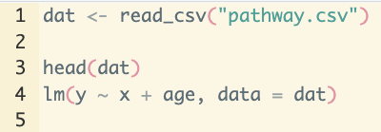
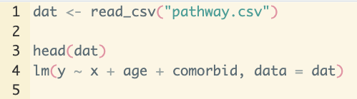
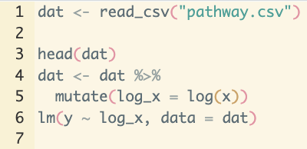
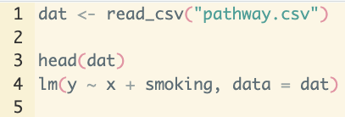

Slide 2
Main branch (Time 1)
- model adjusts for age only
main
1
Corinne’s branch (Time 4)
- deletes age and comorbidities
- adds smoking
2
3
4
Lauren’s branch (Time 2)
- adds comorbidities to adjustment set
5

Slide 3
Main branch (Time 1)
- model adjusts for age only
main
1
Corinne’s branch (Time 2)
- deletes age and comorbidities
- adds smoking
2
3
Lauren’s branch (Time 2)
- adds comorbidities to adjustment set
2
4
Merge conflict!
The main branch changed since Corinne pulled the file. GitHub doesn’t know which changes to keep (i.e., should the model adjust only for smoking? What about age and comorbidities?)

Slide 4
main
1
Successful merge into main
3
2
Lauren’s branch
- adds comorbid

Slide 5
These never merge and have no interaction after point 1. There would be no merge conflict here since they are separate repositories now!
main
1
Lauren’s forked repository
- Same as main, but now on a parallel and independent track!

Slide 6
Old versions

Slide 7
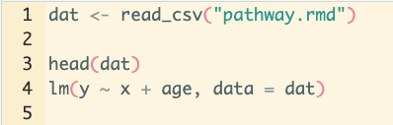
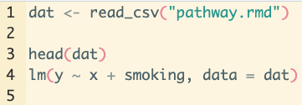
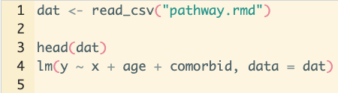
Corinne’s branch
- deletes age and comorbidities
- adds smoking
Main branch (Time 1)
- model adjusts for age only
2
main
1
2
3
Two successful merges into main
Lauren’s branch
- adds comorbidities to adjustment set

Slide 8
Corinne’s branch
- deletes age and comorbidities
- adds smoking
Main branch (Time 1)
- model adjusts for age only
2
Merge conflict!
The main branch changed since Corinne pulled the file. GitHub doesn’t know which changes to keep (i.e., should the model adjust only for smoking? What about age and comorbidities?)
main
1
2
3
Main branch (Time 2)
- model adjusts for age and comorbidities

Slide 9
main
1
2
Successful merged into main
Lauren’s branch
- adds comorbid

Slide 10
Corinne’s branch
- deletes age
- adds smoking
Merge conflict!
The main branch changed since Corinne pulled the file. GitHub doesn’t know which changes to keep (i.e., should the model adjust only for smoking? What about age and comorbidities?)
1
2
3

