Slide 1


A shift in data sharing paradigms: a case study of the ways in which big data and complex algorithms allow for increased data sharing while preserving privacy
Lauren Wilner
University of Washington
SER 2023

Slide 2
Outline
Data sharing and privacy
Current directions
Particularities of sharing/protecting GPS data
A case study: walkboutr
Next steps

Slide 3
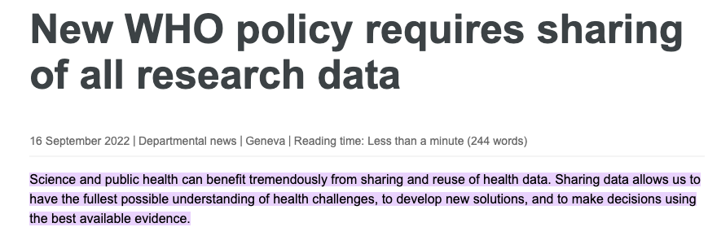

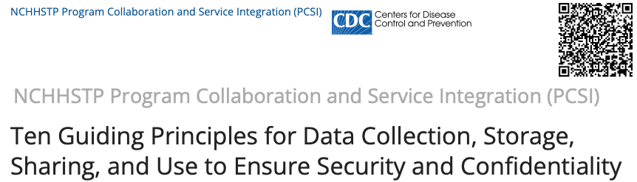
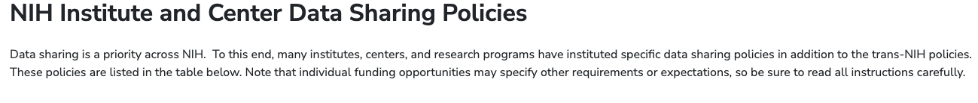
The case for the importance of data sharing
Coordination
Collaboration
Surveillance
Cost-effectiveness
Model robustness
Health equity
Notes:
Data sharing is a critical piece of public health research:
Coordination and collaboration among researchers
Timely and accurate surveillance
Gains in cost-effectiveness of research
More data to inform models and therapies
Essential for advancement in health equity
https://www.who.int/news/item/16-09-2022-new-who-policy-requires-sharing-of-all-research-data#:~:text=Science%20and%20public%20health%20can,using%20the%20best%20available%20evidence.
https://www.cdc.gov/surveillance/pdfs/Surveillance-Series-Bookleth.pdf
https://www.cdc.gov/nchhstp/programintegration/tenguidingprinciples.htm
https://sharing.nih.gov/other-sharing-policies/nih-institute-and-center-data-sharing-policies

Slide 4
The case for the importance of privacy-positive algorithms in public health
Ethical responsibility to data providers and individuals represented by the data
Patient protection
Compliance
Ability to use larger datasets without risk of confidentiality breaches
Notes:
Compliance: regulatory agencies that require privacy (HIPAA)

Slide 5
Data sharing: current directions
Data perturbation
Differential privacy (DP)
Federated Learning (FL)
Blind analysis
Homomorphic encryption
Summarization
Simulated/synthetic data
Notes:
“Differential privacy is a mathematically rigorous definition of privacy that aims to protect against all possible adversaries. In layperson's terms, statistical noise is applied to the data so that overall patterns can be described, but data on individuals are unlikely to be extracted.”
https://www.census.gov/about/policies/privacy/statistical_safeguards.html
https://www.census.gov/library/working-papers/2022/adrm/CED-WP-2022-004.html
https://www.sciencedirect.com/science/article/pii/S2666389921002282
https://www.jmir.org/2023/1/e43664
https://www.sciencedirect.com/science/article/abs/pii/S0065245819300269

Slide 6
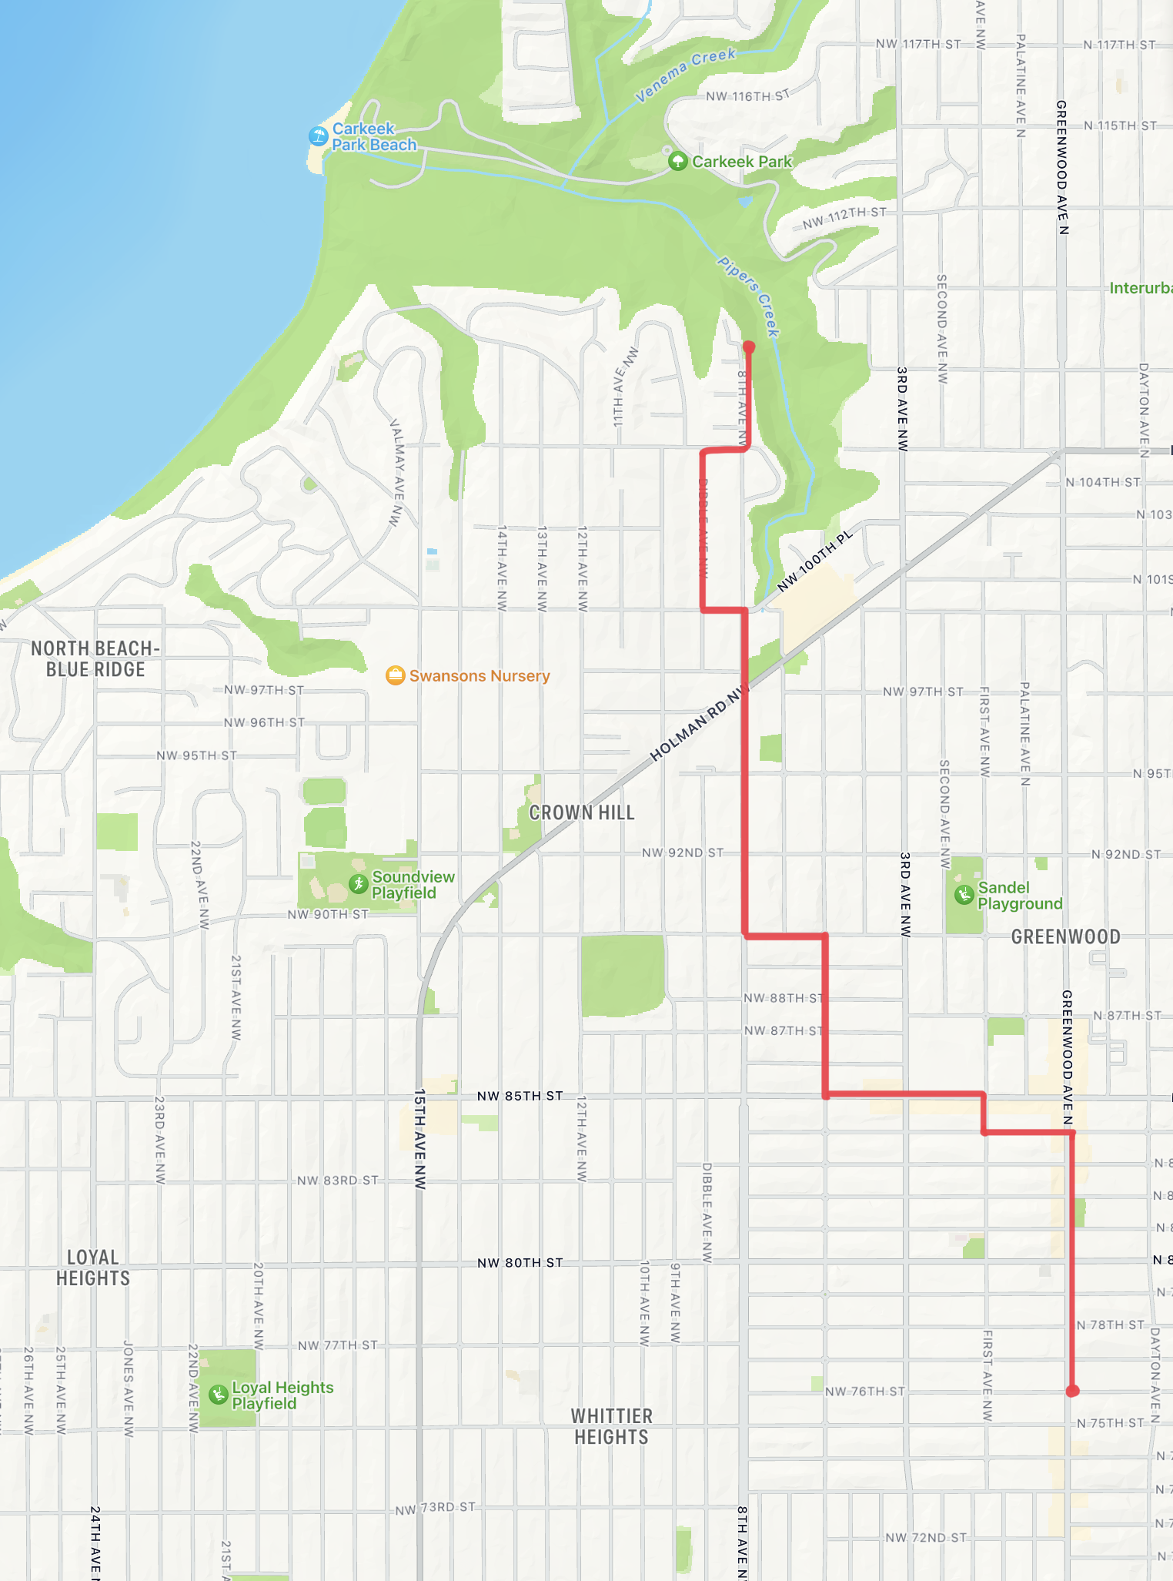
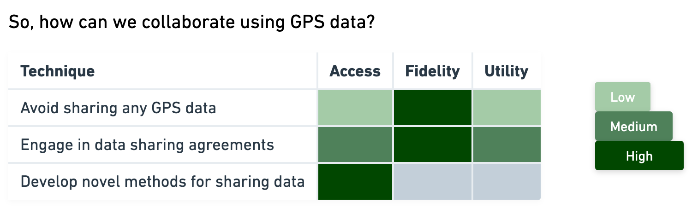
Data sharing: GPS data
GPS information is particularly sensitive
Data perturbation doesn’t work

Slide 7
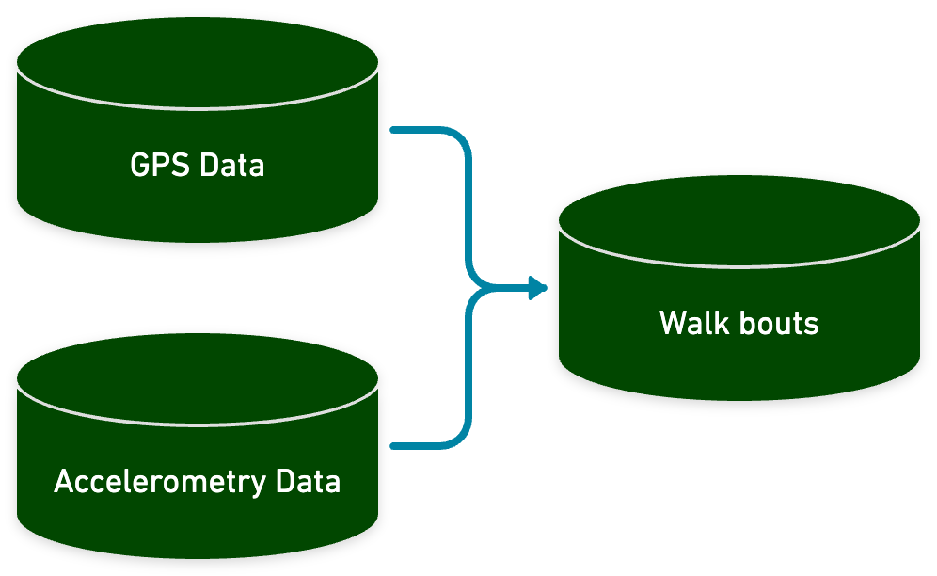
A case study: walkboutr
Inputs: Identifiable GPS and Accelerometry Data
Goal: Identify walking bouts and share these bouts
Process: walkboutr
Notes:
A walk bout is X.
We started this because of TRAC etc.
A walk bout is important because of X.
Walkboutr does X.
Make sure to define walk bout!!!!
Give TRAC example of seattle and transit stops.
The goal of walkboutr is to process GPS and accelerometry data into walking bouts. walkboutr will either return the original dataset along with bout labels and categories, or a summarized and de-identified dataset that can be shared for collaboration.

Slide 8
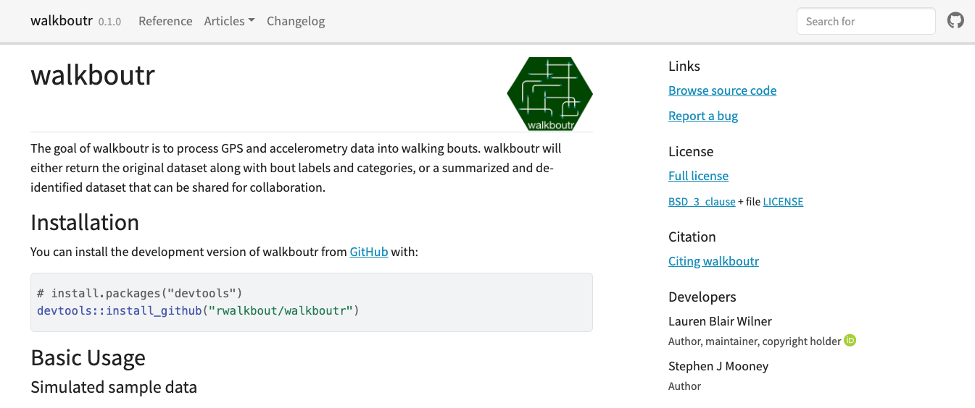
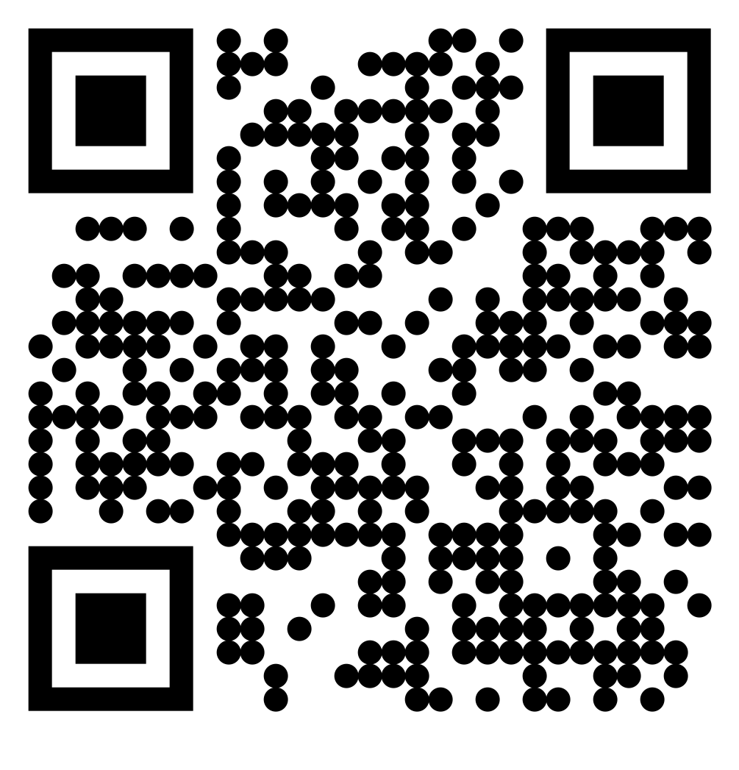
walkboutr

Slide 9
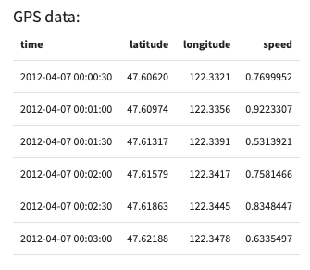
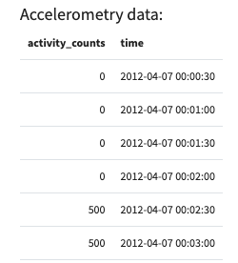
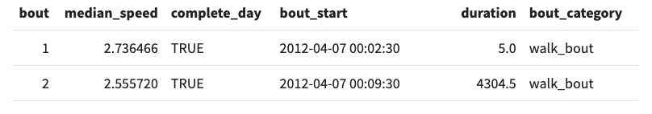
walkboutr inputs and outputs
Notes:
First label data points, then collapse data. In the summarization, we de-identify the data
Mention simulation of data

Slide 10
walkboutr
Notes:
EXPLAIN WALKBOUTR HERE

Slide 11
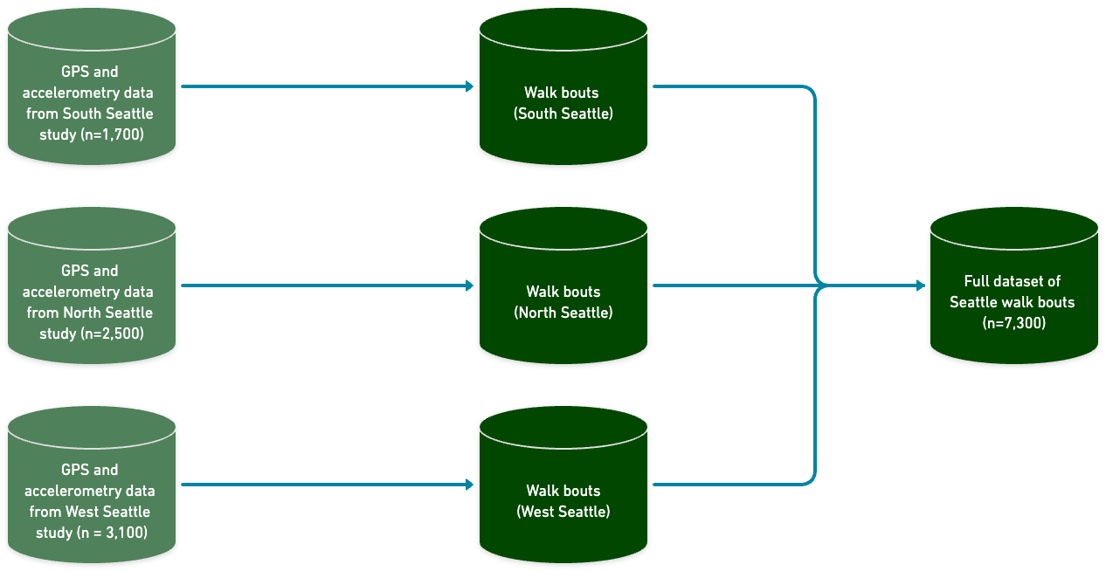
walkboutr as a model of data sharing
Identifiable
Unidentifiable
Notes:
Data can be collected at multiple sites, by multiple researchers, with identifying information.
Data are run through walkboutr.
Data are de-identified, shareable, poolable.
Datasets for analyzing walking are now comprehensive, larger, more inclusive than any individual site has access to.

Slide 12
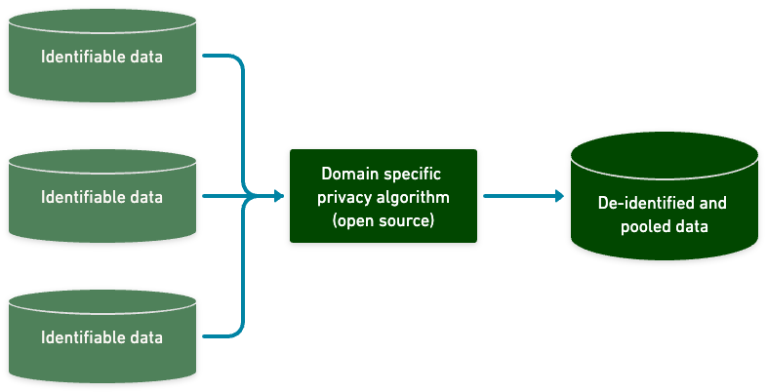
How can the premise of walkboutr be used in other research spaces?
Notes:
walkboutr follows a general model:
identifiable input data → shareable, poolable, de-identified data
Transform sensitive, identifying information (GPS data) into usable, and relevant research datasets without sharing the GPS data itself
Ensure essential information for use cases are preserved without sensitive data
How can we use this model with different data sources?
Can we write an algorithm that processes EHR data from various health systems and outputs a dataset that is de-identified and poolable?
Can we develop a schema for large cohort studies whereby we can run data through a complex algorithm to de-identify the data in a standard, uniform way?
Use words like “preprocessing” and ”deidentifying”
The role walkboutr can play in diff spaces – ie sharing EHRs is not something we can readily do, but sharing de-identified, unidentifiable time periods of high ER use throughout a given calendar year is something we can share. If hospitals around Washington state were to do this and share the results, there could be a pooled dataset with significantly more data to do a large analysis of peak ER use times and how to allocate staffing. Or, can we perturb the data such that the individuals represented in the EHR database are completely unrecognizable or traceable. And every medical provider could run EHR data through said algorithm and then pool with other providers in order to look at a much larger dataset of whichever outcome is of interest?
Mention how this premise can be used when there is a standardized formats
But if there is something else that is identifying but not the same format, this
Is difficult but not impossible.

Slide 13
Next Steps
Develop standards and protocols to support the development of complex algorithms in the public health space
Data sharing ethics and privacy protocols
Training for epidemiology students in big data management and complex algorithm development
Shared schema for large cohort studies and other data sources

Slide 14
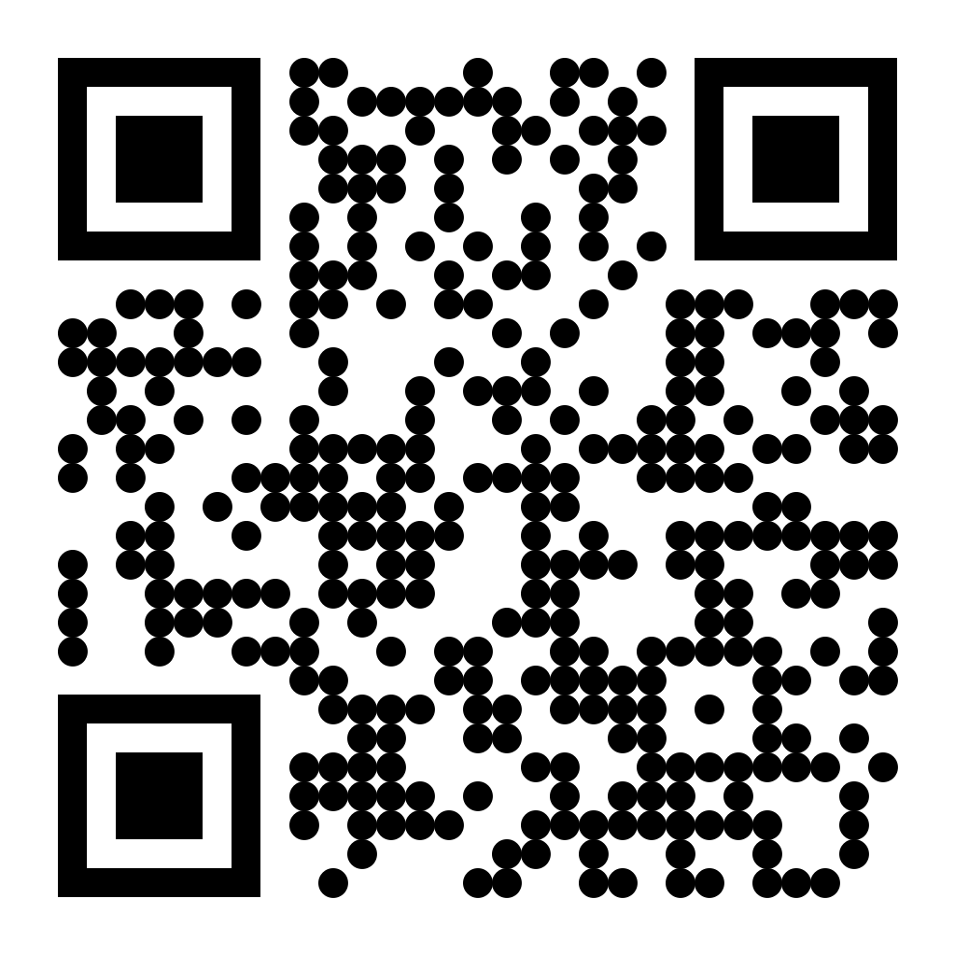
Thank you! Lauren Wilner wilnerl@uw.edu

