Slide 1

Phunware Interview Project Weather App
Lauren Yew
Notes:
Started 4/17/2016 - Completed 4/24/2016

Slide 2
Project Requirements
US Zip Code List
List-Detail Navigation
Zip Code Weather Detail
Add a Zip Code
Error Handling and Validation
Android API to Interact with Weather API

Slide 3
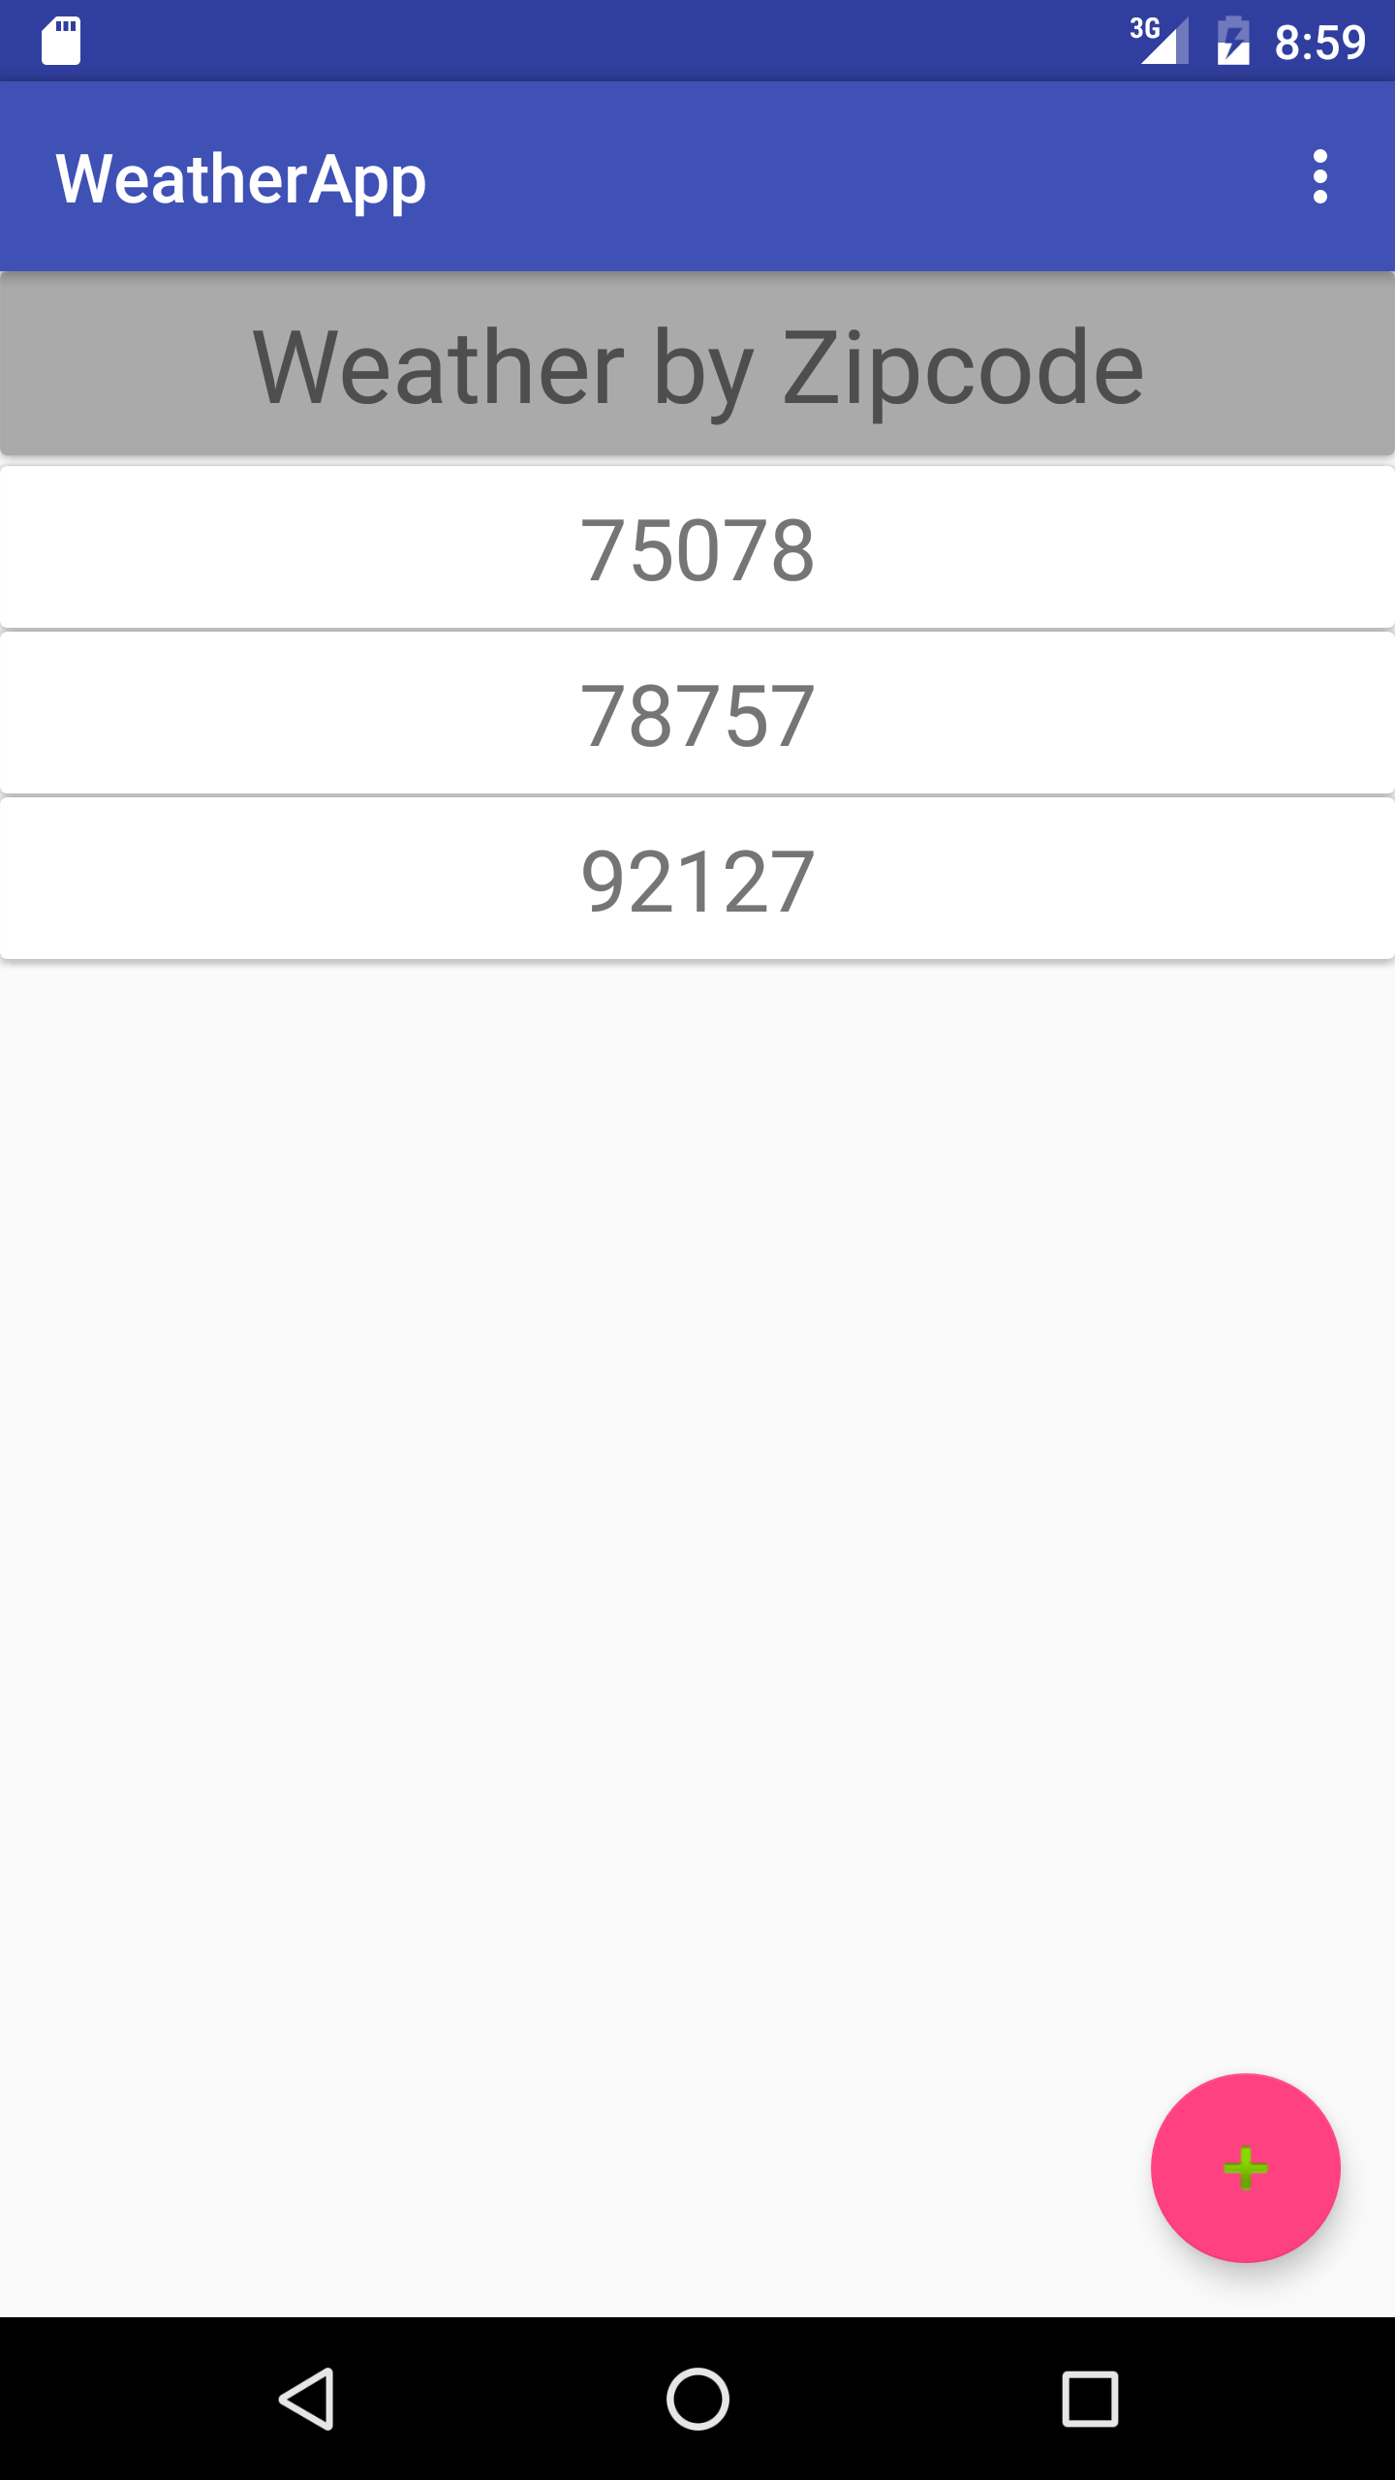
Zip Code List & Navigation
Pre-populated with at least 3 entries
Selecting zip code list item takes the user to weather detail
Sorted zip code set
List data stored in Shared Preferences (available across app sessions)
RecyclerView

Slide 4
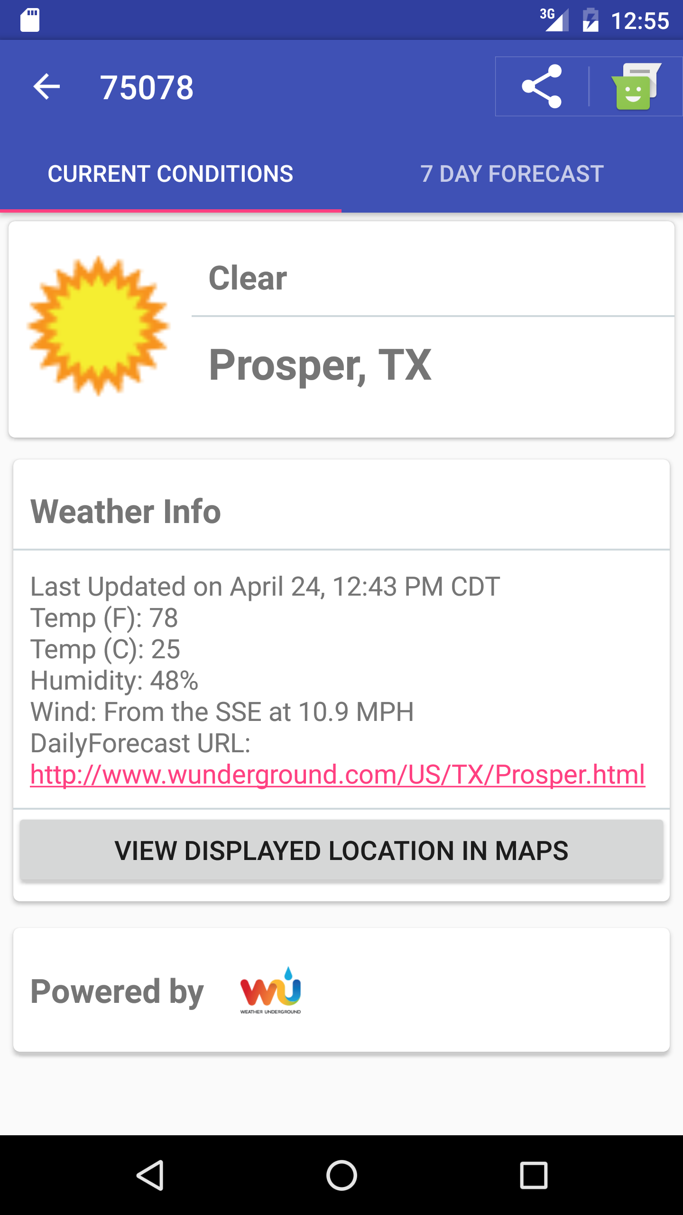
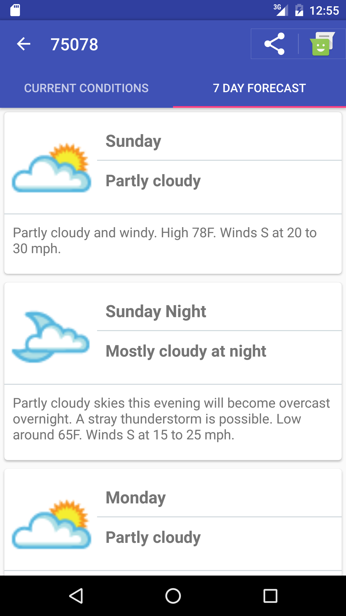
Weather Detail
Cached weather data
Eviction after 1 minute
Picasso loaded images
Auto web-link for url
Open location Button
Weather API logo

Slide 5
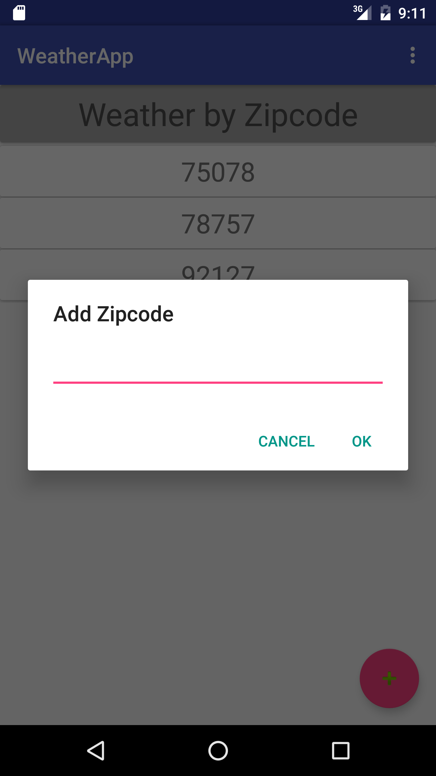
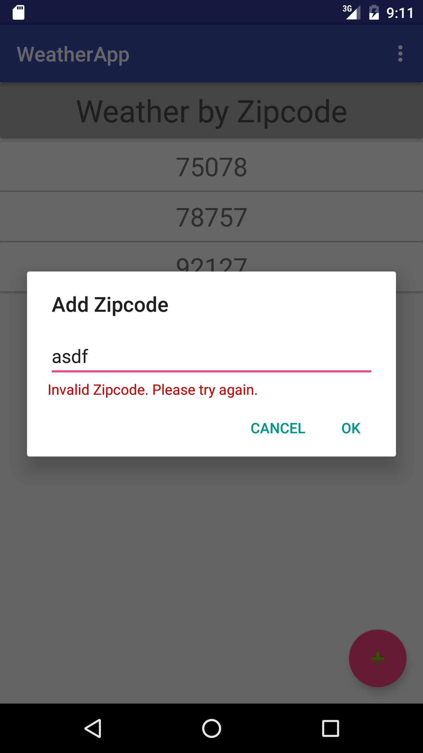
Add a Zip Code
Zip code added to cache and Shared Preferences
Observer pattern on cache to update list
Invalid user input error
Flow to weather detail
Handles duplicates

Slide 6
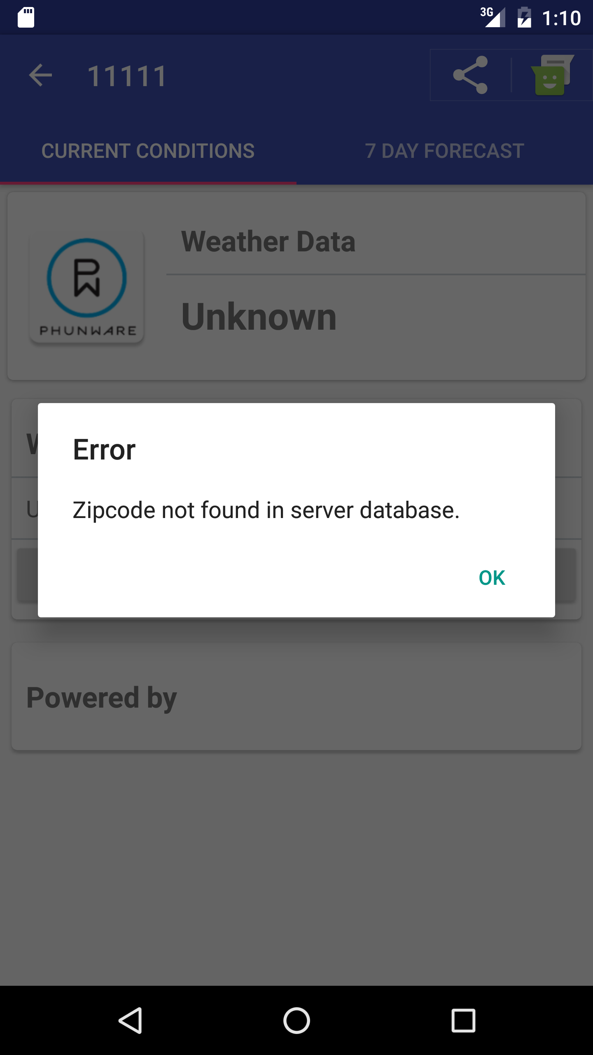
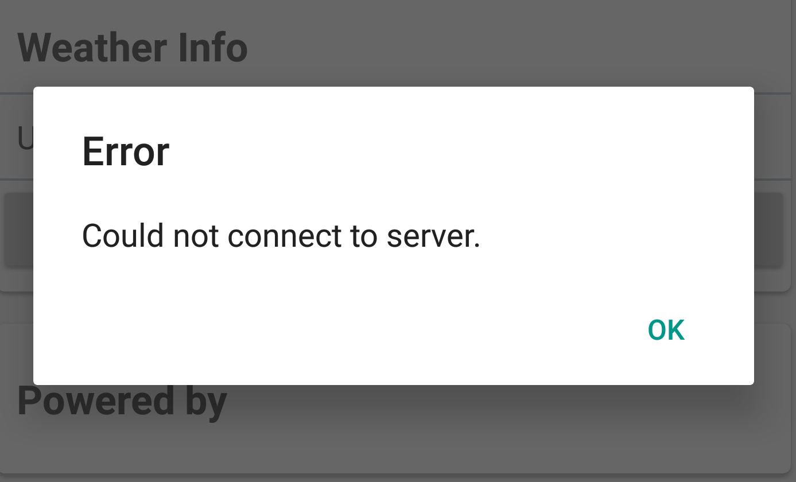
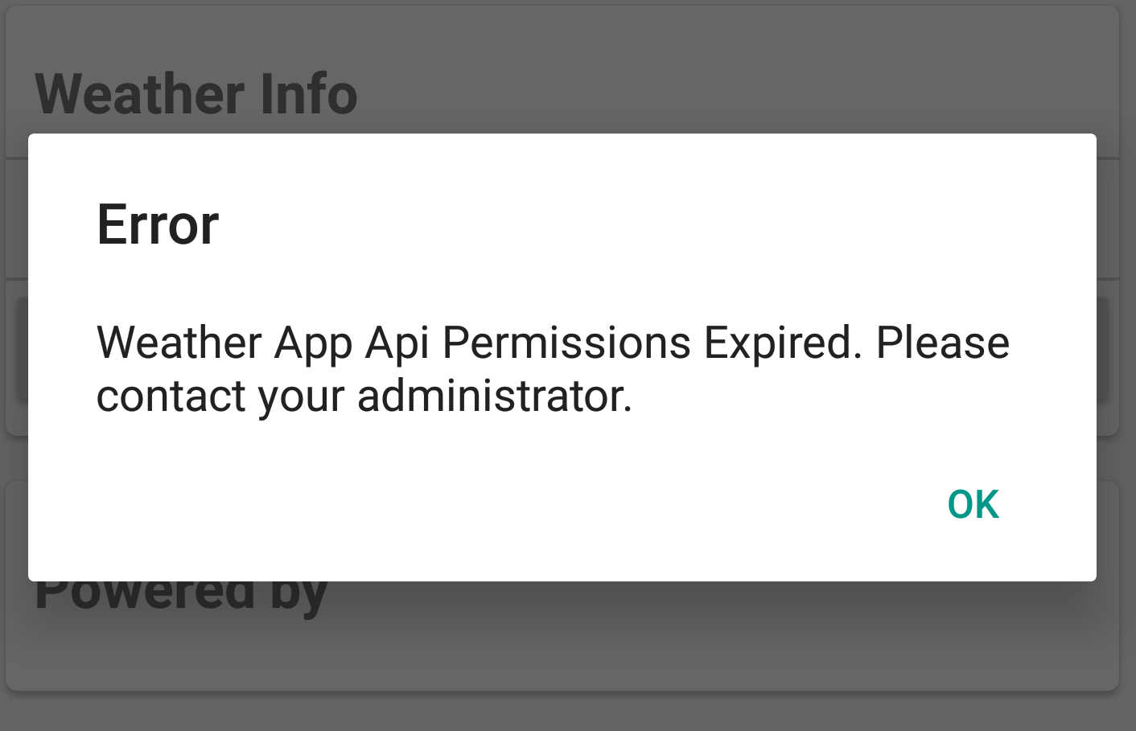
Error Handling and Validation
Connection errors
Invalid app key for weather API
Zip code not found

Slide 7
Challenges
Best Practices for Background Network Calls
Best Practices for Safe UI Updates
Detail Cache Eviction
Saving Zip Code List
Creating a Generic Service API / Response Listener

Slide 8
Extra Features
Clear the Zip Code List Option
Weather Detail Tab Navigation
Sharing Weather Data
Phunware Icon and Splash Screen
Activity Instrumentation Tests
Zix Code Cache Unit Test

Slide 9
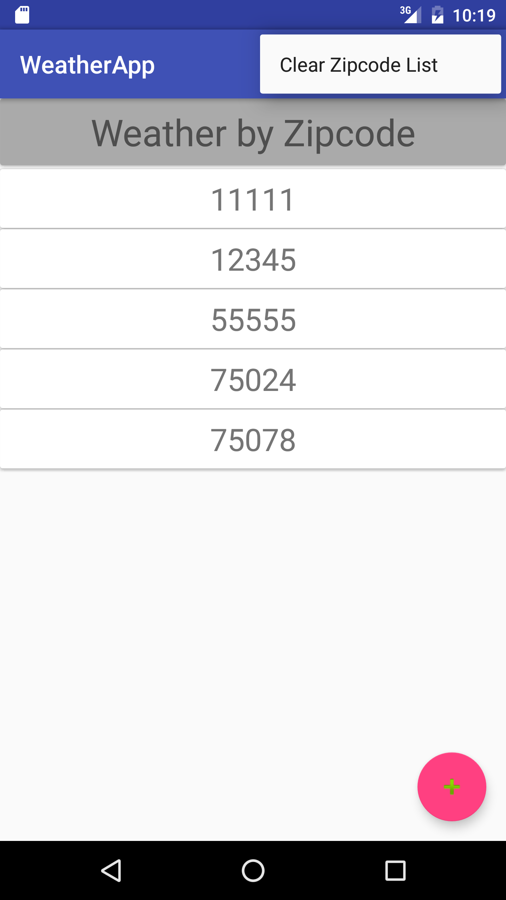
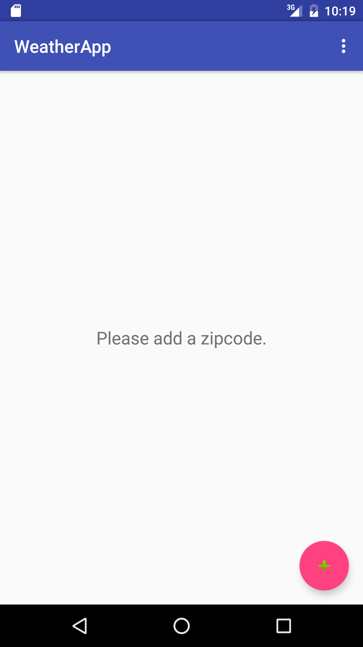
Clear the Zip Code List
List dropdown option
Clears Shared Preferences and cache
Empty list view

Slide 10
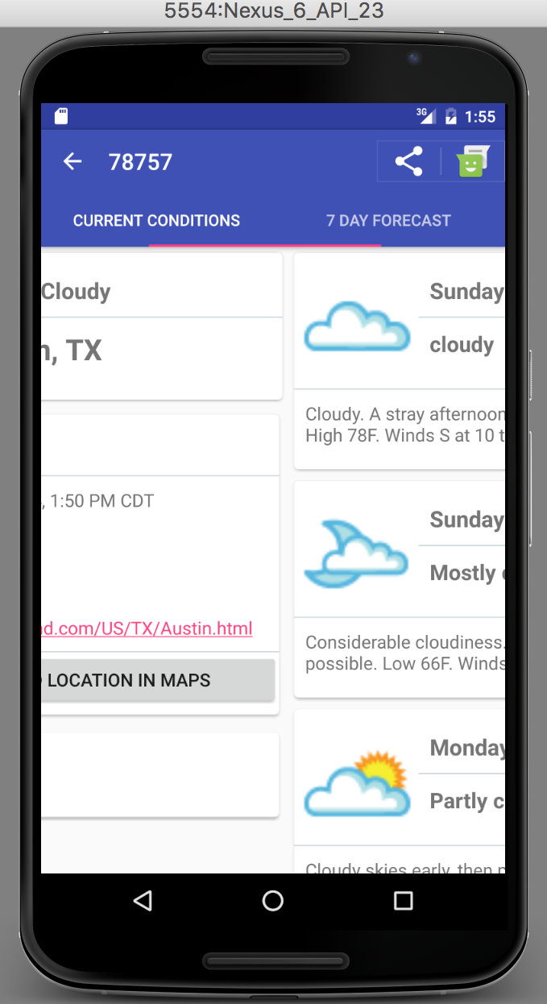
Weather Detail Tab Navigation
ViewPager + TabLayout
Switch detail options :(select tab, swipe detail)
Data call starts when tab is viewed

Slide 11
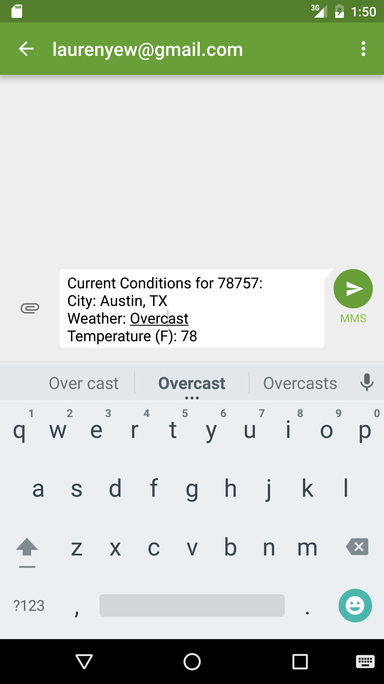
Sharing Weather Data
ShareActionProvider
Share weather detail page information
Weather API error handling

Slide 12
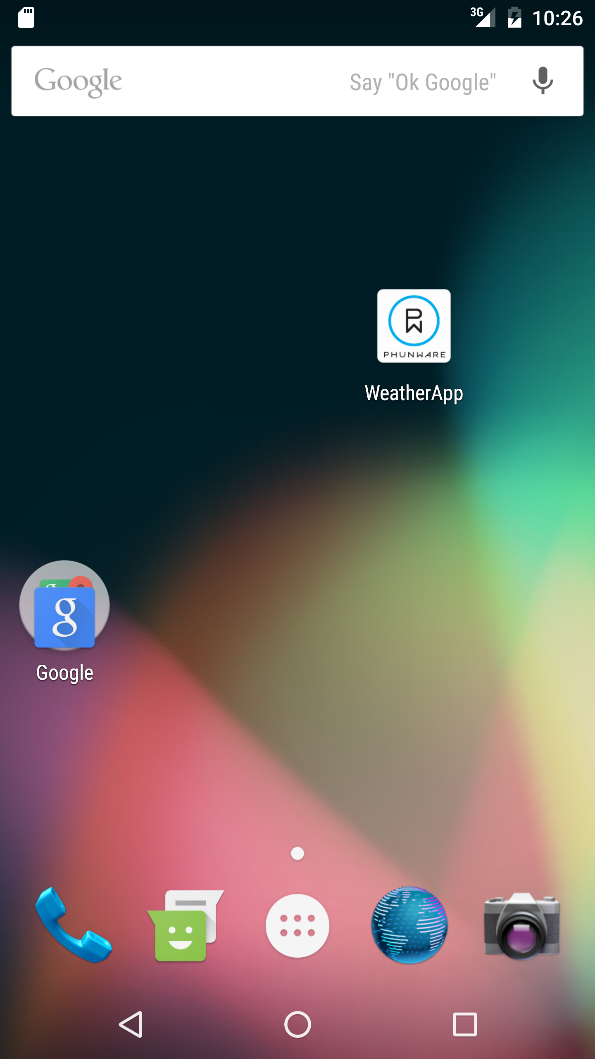
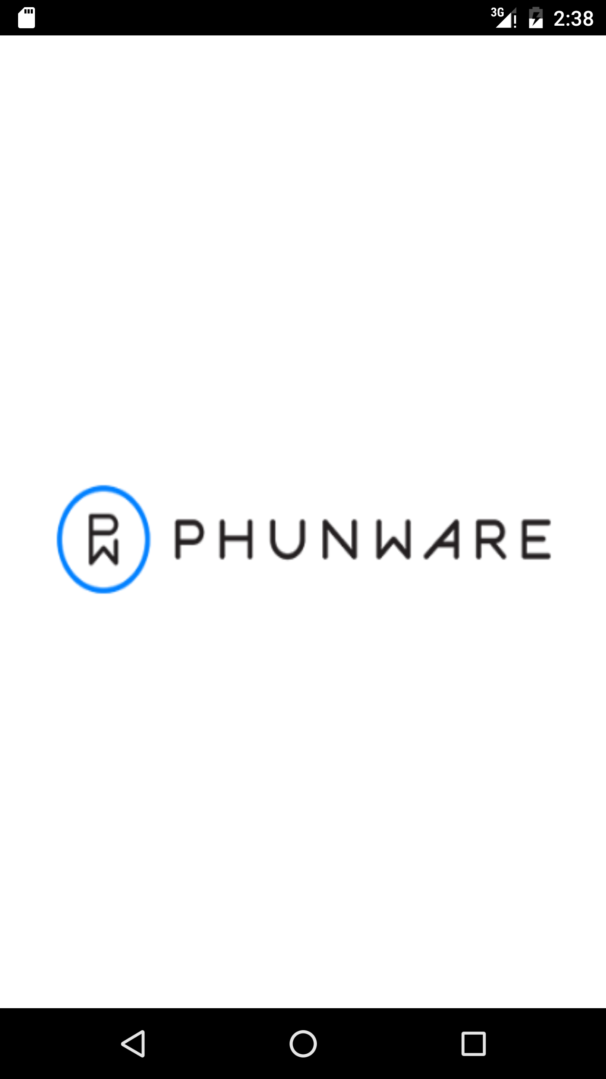
Phunware Icon & Splash Screen
Customized icon from logo
Splash screen suggested best practice for initial startup responsiveness
Android Developers: Keeping Your App Responsive

Slide 13
Future Improvements
Location Entry Swipe to Delete
Weather Map/Satellite Function
Weather Notifications
Update User Interface Look and Feel
Show Updated Weather Data Previews in List Entries
Expand Add Location Options
Service API Unit Tests / Eviction Cache Unit Test

Slide 14
DEMO

Slide 15
Code Walkthrough

Slide 16
Acknowledgements
Original requirements for this project provided by Phunware, Inc.
Used weather API from Weather Underground, Inc.
http://www.wunderground.com
Phunware icon: http://i.stack.imgur.com/vZvvQ.png
Phunware splash logo:
http://cdn2.phunware.com/wp-content/uploads/2015/03/pw_logo_HD.png

