Slide 1
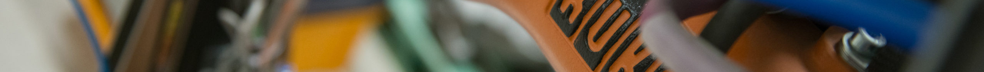
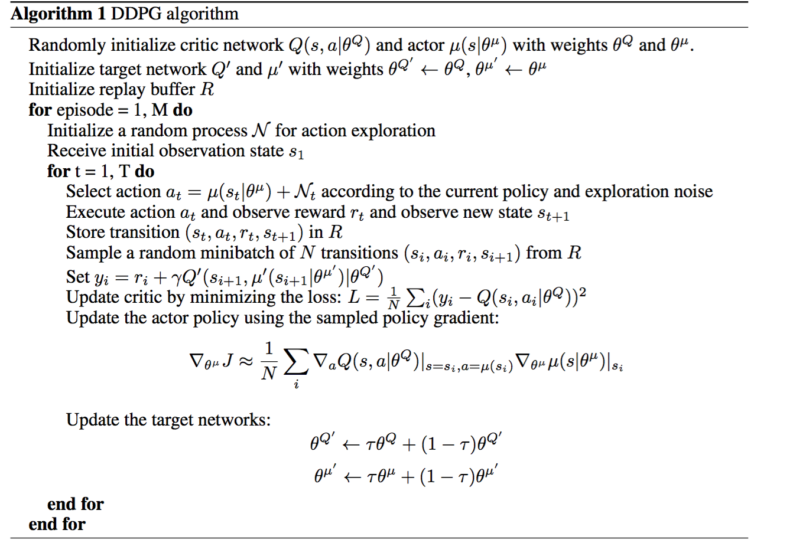
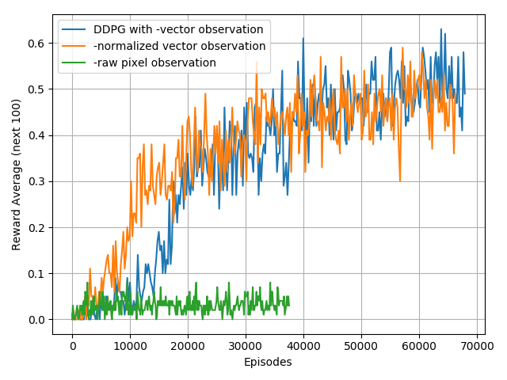
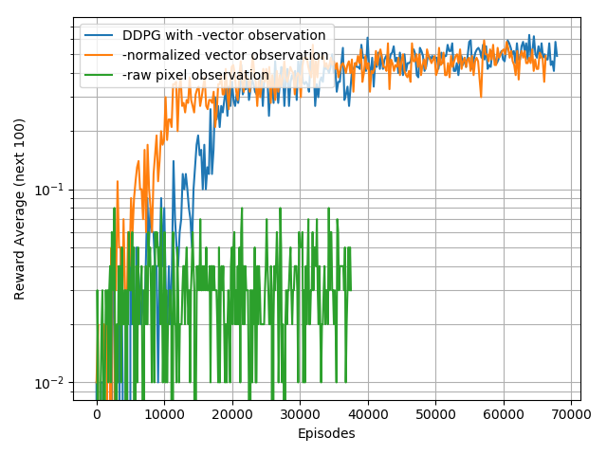
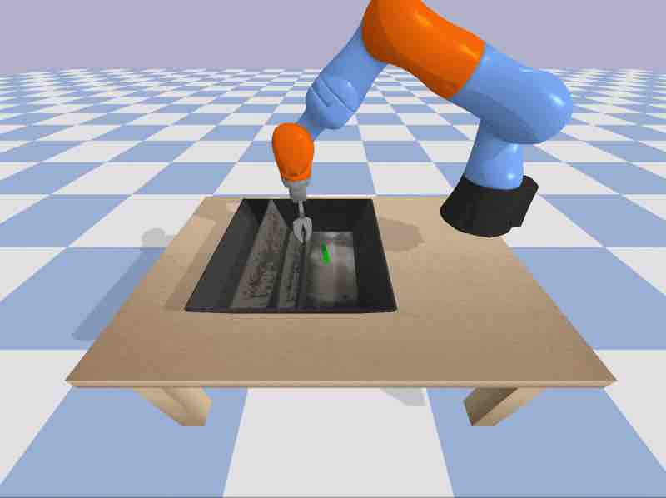
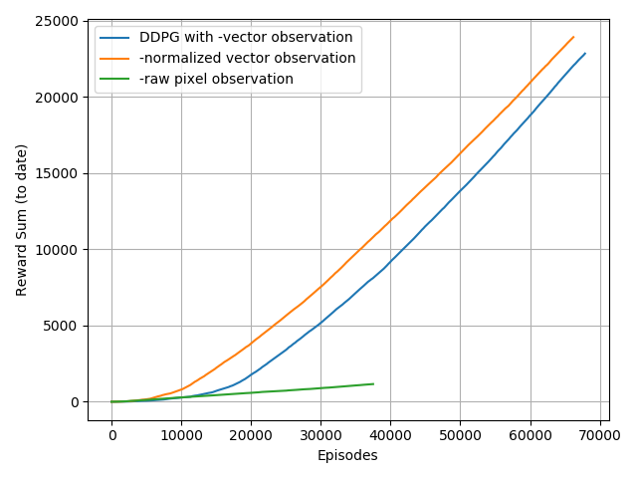
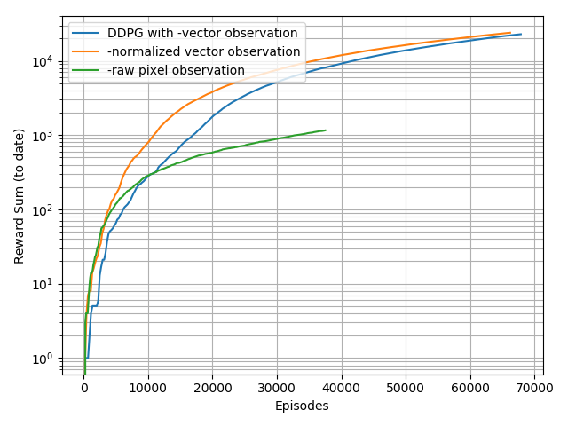
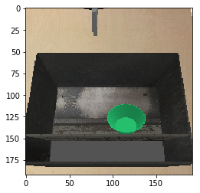
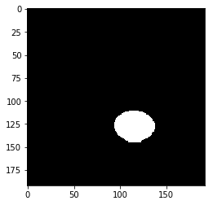
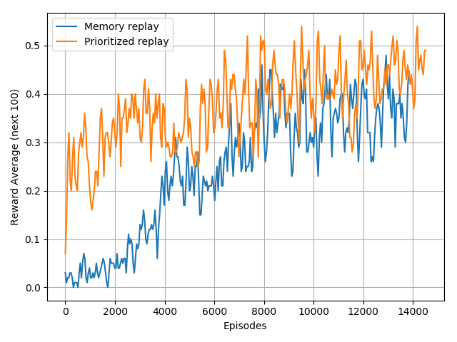
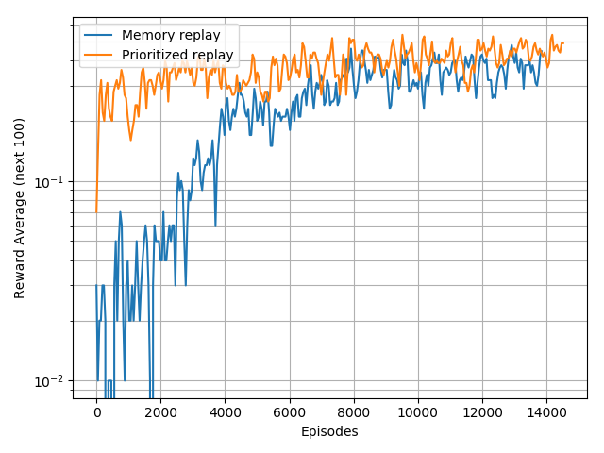
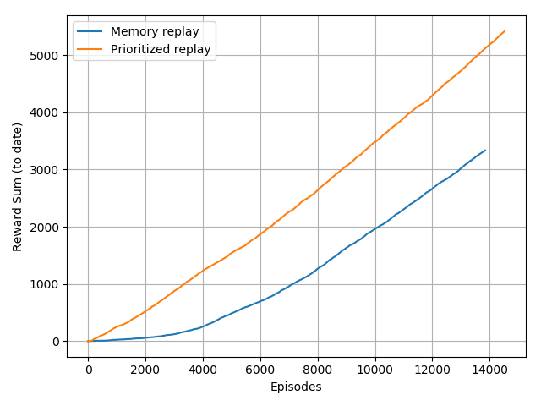
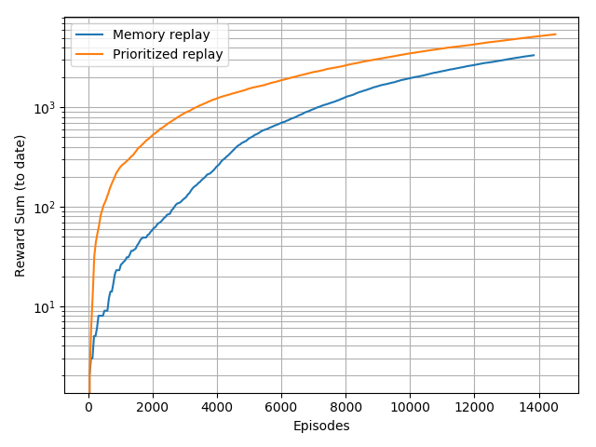
Project ID: 23
10703 World 2 Kuka Environment Exploration
Ding A., Yuhang Y., Yang L., Zheng L.
Carnegie Mellon University
Introduction
Deep Deterministic Policy Gradient
Results
In this project our goal is to learn a control policy for basic manipulation task. We focus on lifting a target object over a certain height in a KUKA virtual environment. The virtual environment consists of a KUKA robot arm, at least one object, and a table surface, as shown in Figure 1. Our objective is to develop an effective reinforcement learning algorithm suitable for this sparse-reward, continuous-action environment.
We start with using Dueling Network Architectures for Deep Reinforcement Learning (Dueling DQN) as our baseline, assuming discrete action space. Later, we train the agent using Deep Deterministic Policy Gradient (DDPG) to work with continuous action. Finally we are looking into combining DDPG with Hindsight Experience Replay (HER) for the better performance.
DDPG is an actor-critic, model-free algorithm based on the deterministic policy gradient that can operate over continuous action spaces (Lillicrap et al., 2016).
Our network consists of 2 hidden layers, each have 64 hidden units. We used Adam optimizer with initial learning rate 1e-4 for the critic network and 1e-3 for the actor network.
We achieved an average successful rate of 50% with 50000 episodes. Compare to our baseline, the successful rate increased slightly but we observe a more stable learning process.
However, one significant drawback of DDPG is that it can not make full use of the experience, namely, in other words, it suffers from the sparse reward of the environment. Such limitation lead to slow convergence.
Figure 1. Kuka Virtual Environment
Baselines
For our baseline we choose Dueling DQN. We tried to train the agent with basic DQN, but the agent was not able to learn. We have also considered REINFORCE algorithm, but because of the sparse reward in the environment, most of the updates come from the transitions that belongs to the failed trajectory, which makes the agent extremely hard to learn. In contrast to REINFORCE, dueling DQN learns from its memory replay, so the agent is more likely to learn from useful transitions. We also compared two Dueling DQN, one with regular memory replay, and the other with prioritized replay, which sample the transitions with priorities according to its rewards. We believe this way the agent will have a higher probability to learning from the successful trajectories and hence in some extend help with the sparse reward.
Another advantage of Dueling DQN is the faster convergence. Its two-stream structure allows the network to better differentiate actions from one another, therefore significantly improves the learning. We found that many states the values of the different actions are very similar, and there are many actions to choose from. DQN only updates Q values for the action it chose at each iteration, whereas Dueling DQN updates all Q(s, a) associated with a given state, resulting faster learning (Mnih, V et al. 2013).
Figure 3. DDPG Pseudo Code
Image preprocessing
Figure 5. Learning Curve Comparison
We first try to use flattened pixel values as observation for the DDPG, A2C and PPO2 algorithm. The observation space is (32 * 32 * 3), and the results are not desirable.
Then we feed a (192 * 192 * 3) image to the pretrained NasNet model. It’s last fully-connected layer outputs 1000 features. The training is slow, not finished.
Finally we use 3-channel Otsu thresholding to transform the colored image to a binary map and locate the item and gripper on pixel indexes, as shown in Figure 4.
Experiments |  | Environment
Algorithm | Features | Action space | Observation | Height hack | Ave. Reward per 100 epi.
DDPG | / | Continuous | Vector | FALSE | 0.4~0.6
 | Raw pixels |  | Image | TRUE | 0.02~0.08
 | CNN |  | Conved_Image | FALSE | ~0.02(not finished)
Dueling-DQN | / | Discrete | Vector | TRUE | 0.3~0.4
 | Prioritized replay |  | Vector | TRUE | 0.4~0.5
PPO2 | Raw pixels | Continuous | Image | TRUE | 0.04~0.05
Actor Critic | Raw pixels | Continuous | Image | TRUE | 0.06~0.08
Obs(
Item_x,
Item_y,
Gripper_x,
Gripper_y,
Gripper_z,
Gripper_angle)
3-channel
Otsu
Thresholding
Table 1. Performance table
Discussions
Reward sparsity
We find the most difficulty comes from the sparsity nature of reward. We assume that since most of the states would receive rewards zero, the agent had hard time telling the different between states and actions, which leads to very slow learning.
Image input CNN
We also tried to use Raw pixels and CNN output as our observations. Although we assume that this may not provide more information than vectorized observation, our main goal for using CNN is to try to build a end-to-end pipeline.
Figure 4. Attempt to convert image observation to vector
Implementation details
Observation normalization: Observation is normalized based on running mean and running std.
Replay Buffer: We used a replay buffer of size 10000 with batch size 64.
Stability optimization: We create copies for the actor and critic networks to calculate the target values. Their weights are updated by the following rule: θ′ ← τθ + (1 − τ)θ′
Adaptive Noise: We add noise to the network for better exploration as open.ai suggested. Parameter space noise injects randomness directly into the parameters of the agent, altering the types of decisions it makes such that they always fully depend on what the agent currently senses.
Future Works
HER is used as an add-on for an existing algorithm such as DDPG to better utilize the sparse and binary reward in the environment. Besides the real goal, HER also treats each state as a pseudo-goal. After each action, a set of pseudo-goals are samples and the rewards are calculated. HER stores rewards for both the real and pseudo goals in the replay buffer. The reward function and transitions are known and depend on the goal. This algorithm makes efficient use of the experience, as the agent is able to learn from mistakes — it would succeed if the goal had been the pseudo-goal. (Andrychowicz)
Figure 2. Baseline performance with Dueling DQN

