Slide 1
Practice 5
Yao Zhao

Slide 2
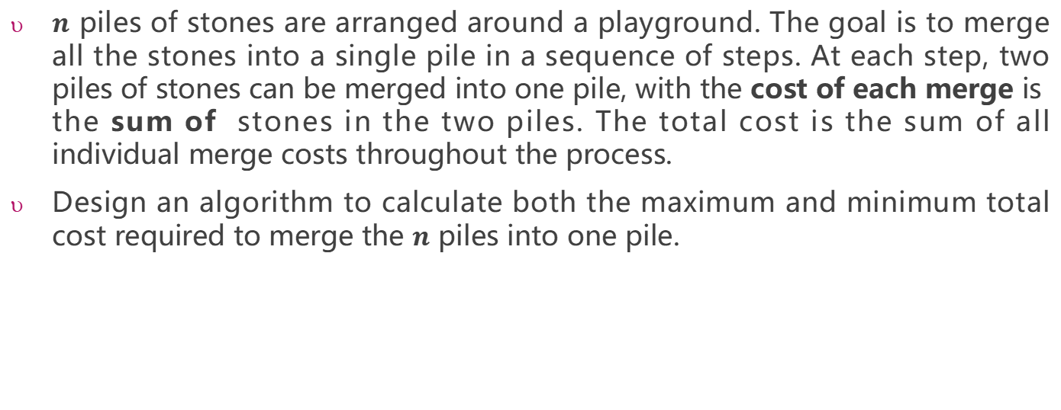
Question 1
$n$ piles of stones are arranged around a playground. The goal is to merge all the stones into a single pile in a sequence of steps. At each step, two piles of stones can be merged into one pile, with the cost of each merge is the sum of stones in the two piles. The total cost is the sum of all individual merge costs throughout the process.
Design an algorithm to calculate both the maximum and minimum total cost required to merge the $n$ piles into one pile.
最小代价的时候每次选2个最小的进行合并，最大代价的时候选2个最大的进行合并

Slide 3
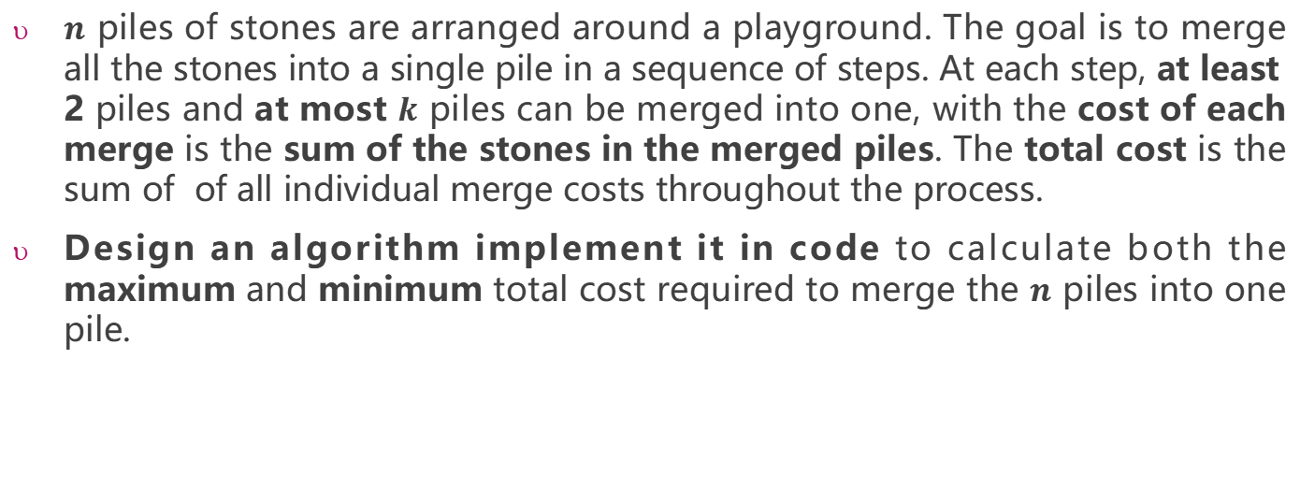
Question 2
$n$ piles of stones are arranged around a playground. The goal is to merge all the stones into a single pile in a sequence of steps. At each step, at least 2 piles and at most $k$ piles can be merged into one, with the cost of each merge is the sum of the stones in the merged piles. The total cost is the sum of of all individual merge costs throughout the process.
Design an algorithm implement it in code to calculate both the maximum and minimum total cost required to merge the $n$ piles into one pile.
最小代价的时候每次选k个最小的进行合并，但是如果不能正好合并的时候一开始补0，
最大代价跟上一题一样，每次选两个最大的进行合并

Slide 4
Input
3
3 4
1 2 3
5 3
4 5 6 3 2
6 4
4 5 6 3 2 10
Output:
the number of testcases
n
11 6
64 29
120 39
k
maximum and minimum total cost of
test case 1
the number of stones

Slide 5
The practice will be checked in this lab class or the next lab class(before Apr.20) by teachers or SAs.
This practice will contribute 1 mark to your overall grade. Late submissions within 2 weeks after the deadline (before May.4)will incur a 20% penalty, meaning that you can only get 80% of the score.

