Slide 1
GPU Double Gaussian Peak Z' Analysis
Notes
CrossSecLimitUnbinned is the code unchanged since Sam sent it
CrossSecLimitDoublePeak is the code where we can input a function of a double peak
Before inputting the double-peak function I used CrossSecLimitDoublePeak code with a single gaussian inputted. This is what happend on the bottom left of the slide 3.

Slide 2
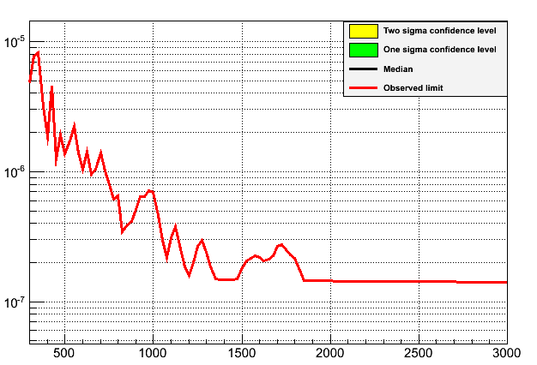
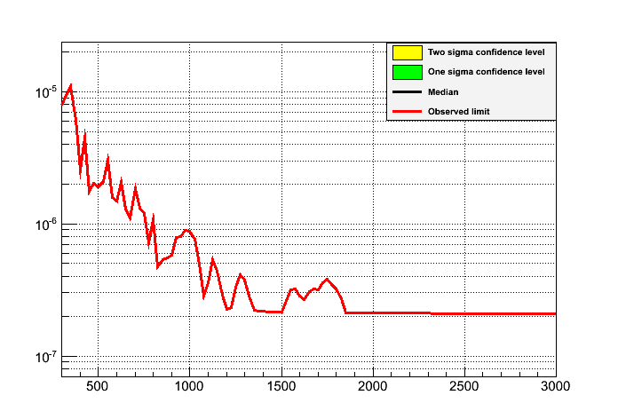
Double Peak 25 Gev Steps
sep = 1.025, relAmp = 0.45, massRes from data
NrExpts = 0
Unbinned MultiMass 25 GeV Steps
NrExpts = 0
Single Gaussian created uisng CrossSecLimitUnbinnedMultiMass

Slide 3
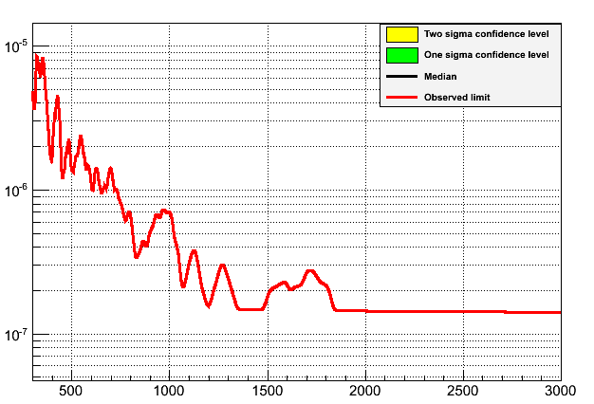
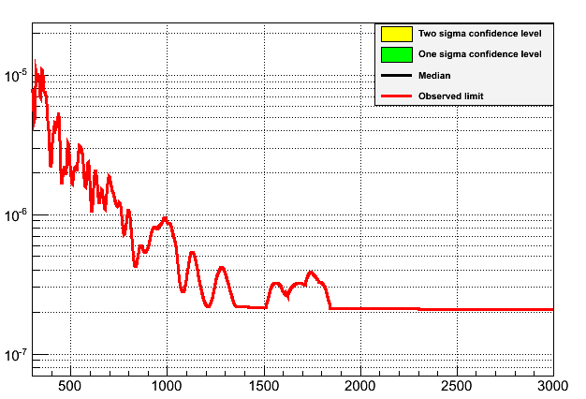
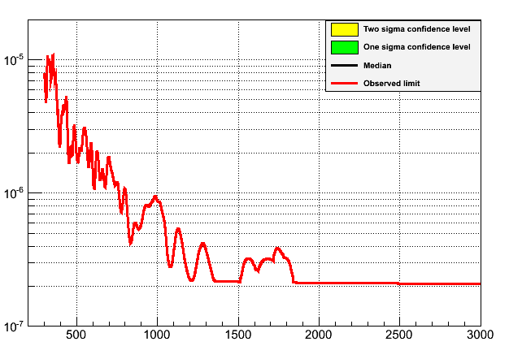

Double Peak with 1GeV Steps
Single Peak with 1 GeV Steps
Using the CrossSecLimitUnbinnedMultiMass programme.
Single Peak with 1GeV Steps
Using the CrossSecLimitDoublePeak set to run a single Gaussian
Sam's Single Peak with 1GeV Steps
Sam ran CrossSecLimitUnbinnedMultiMass and I plotted the root file

Slide 4

Varying size of relAmp
25 GeV Steps, seperation = 1.025, massRes from data.
RelAmp = 0.45
RelAmp = 1.0

Slide 5
Varying Seperation and Relative Amplitude of peaks
Looking at different observed limits by adjusting the separation of the peaks and relative Amplitude.
This is done with the integration range being (1+/- massRes*15)*mass.
This is so the intergration includes the peaks which have a higher seperation.
Mass Resolution taken from data.
NrExp = 0. This is why there is no green and yellow areas.

Slide 6
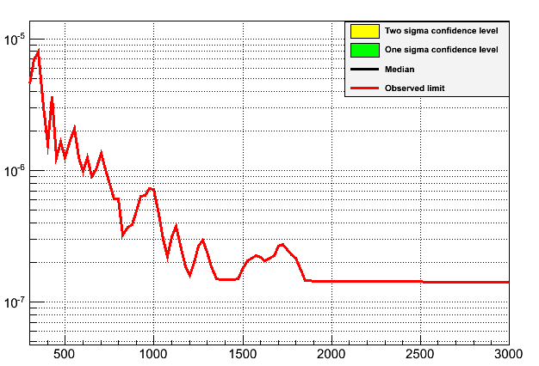
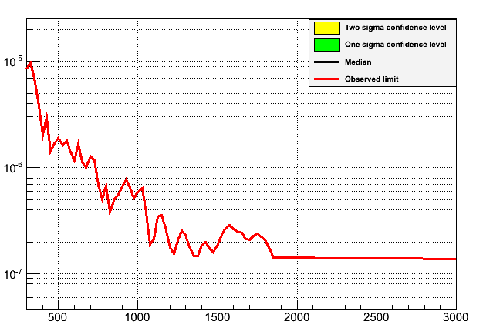

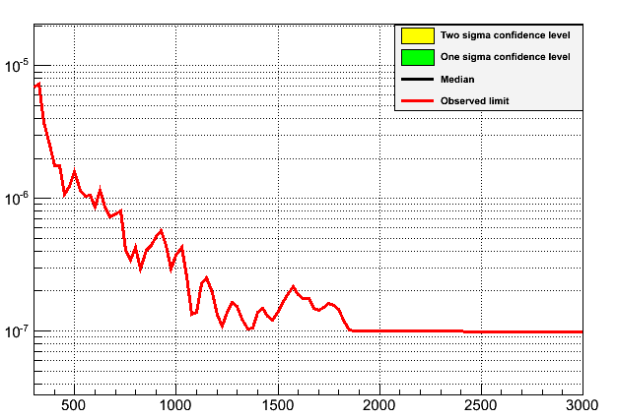
Sep = 1.025, relAmp = 0.45
Sep = 1.1 relAmp = 0.45
Sep = 1.025, relAmp = 1
Sep = 1.1, relAmp = 1

Slide 7

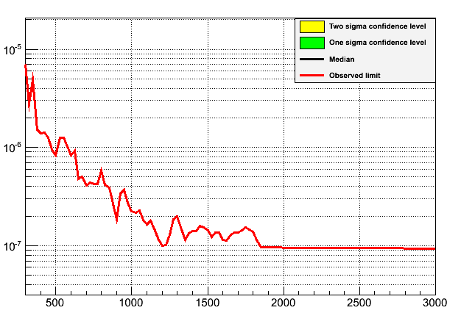
Higher Seperations
25 GeV Steps, massRes taken from data,
relAmp = 1,
intergration range (1+/- massRes*25)*mass
Sep = 1.025
Sep = 1.2

Slide 8
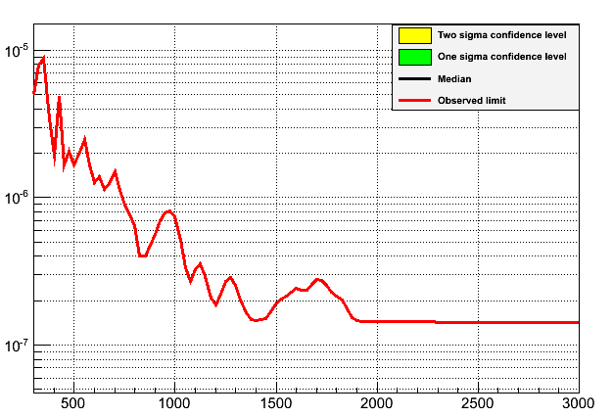
Varying size of mass resolution
25 GeV Steps, seperation = 1.025,
relAmp = 0.45
massRes taken from data
massRes = 0.02

Slide 9
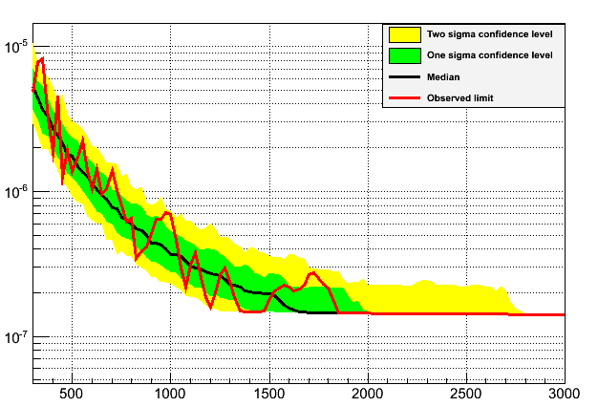
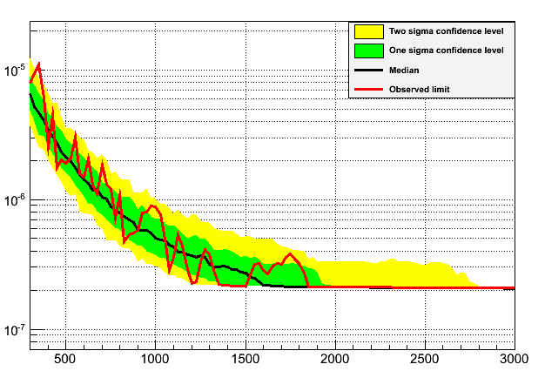
Limits - NrExpts = 150
Sep = 1.025, relAmp = 0.45, 25 GeV steps, massRes taken from data.
Double Peak using CrossSecLimitDoublePeak
Single Peak using CrossSecUnbinnedMultiMass

Slide 10
