Slide 1
Decay Distributions for Vector Quark X Decay
Same Sign Leptons for XXbar decay
Leptons from ttbar decay
A lepton and a jet from W+Jet Decay

Slide 2
X Xbar Decay
Histograms to show
Two Body Mass, Energy and Pt
Angular and Cos(Theta) Distributions
Charge, Mass and Pt for the two Lepton Inputs (Gen1 and Gen2)
Mass of all Leptons and Sum of Masses of the leptons
Missing Energy Distribution

Slide 3
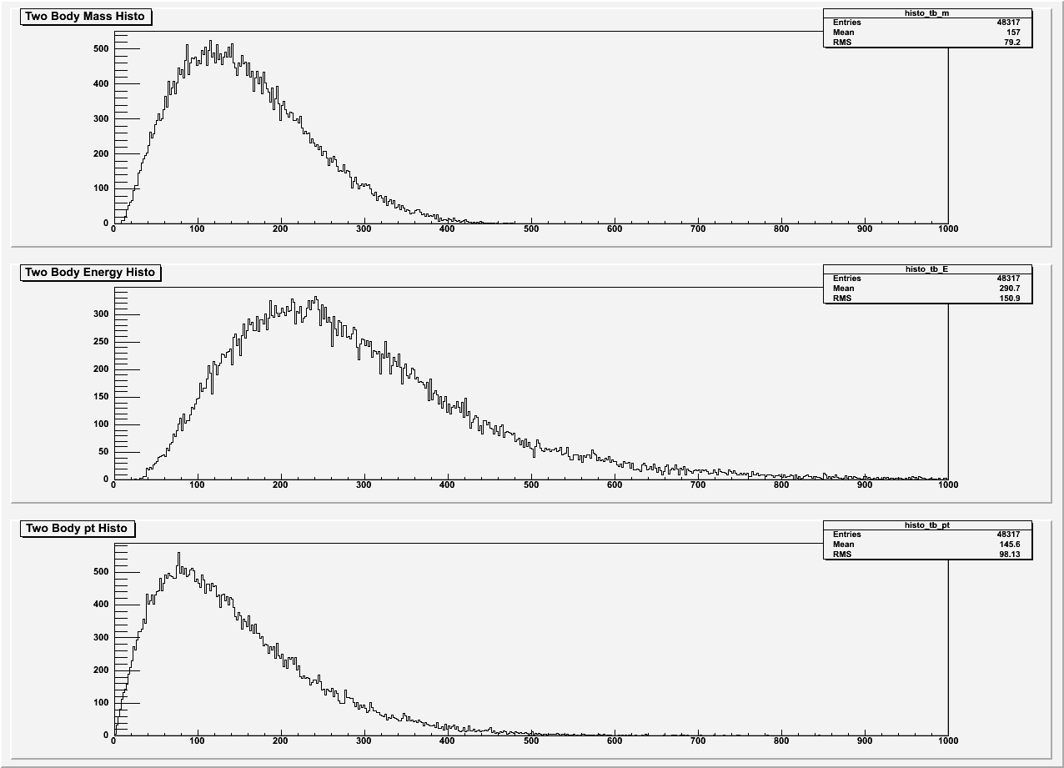
Two-body mass, energy and pt distribution of lepton pairs
200,000 events # of Bins = 500

Slide 4
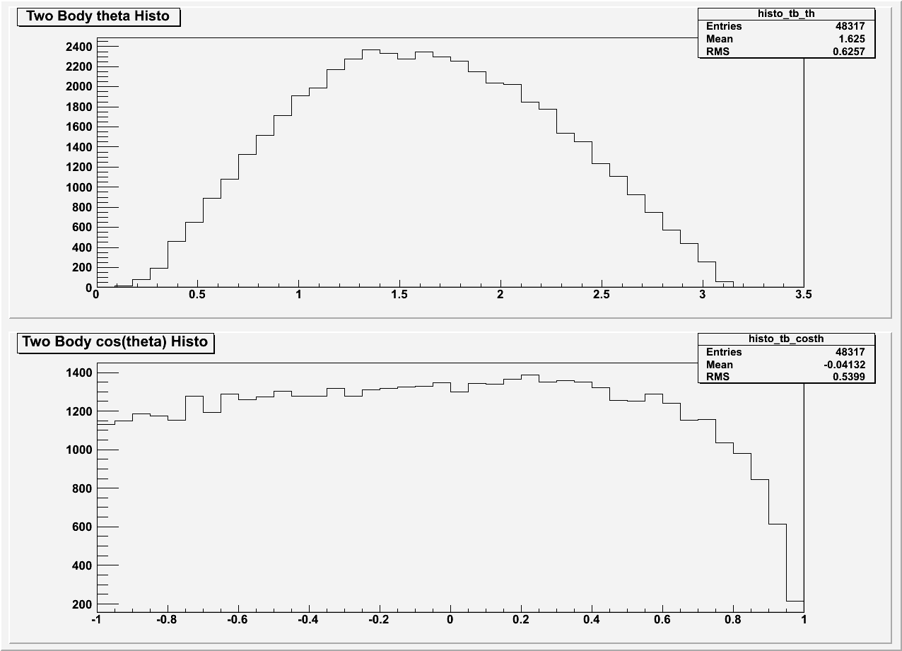
Angular distribution of lepton pairs
200,000 events # of Bins = 40

Slide 5
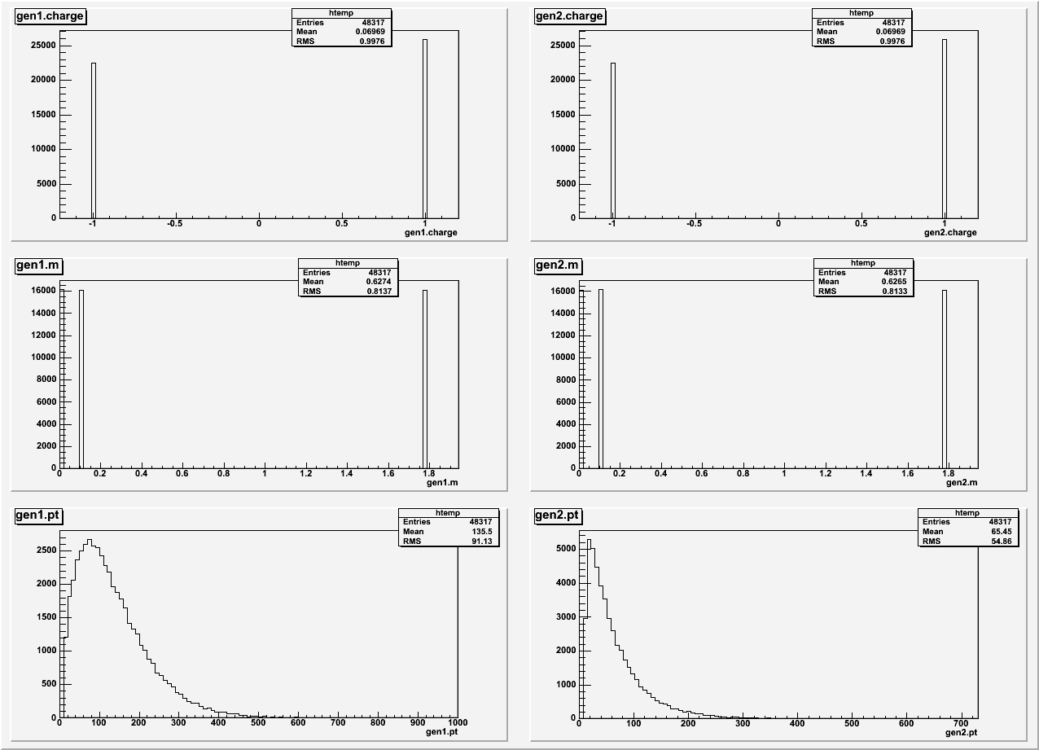
Distributions of the two lepton inputs (gen1 and gen2)
200,000 events # of Bins = 500

Slide 6
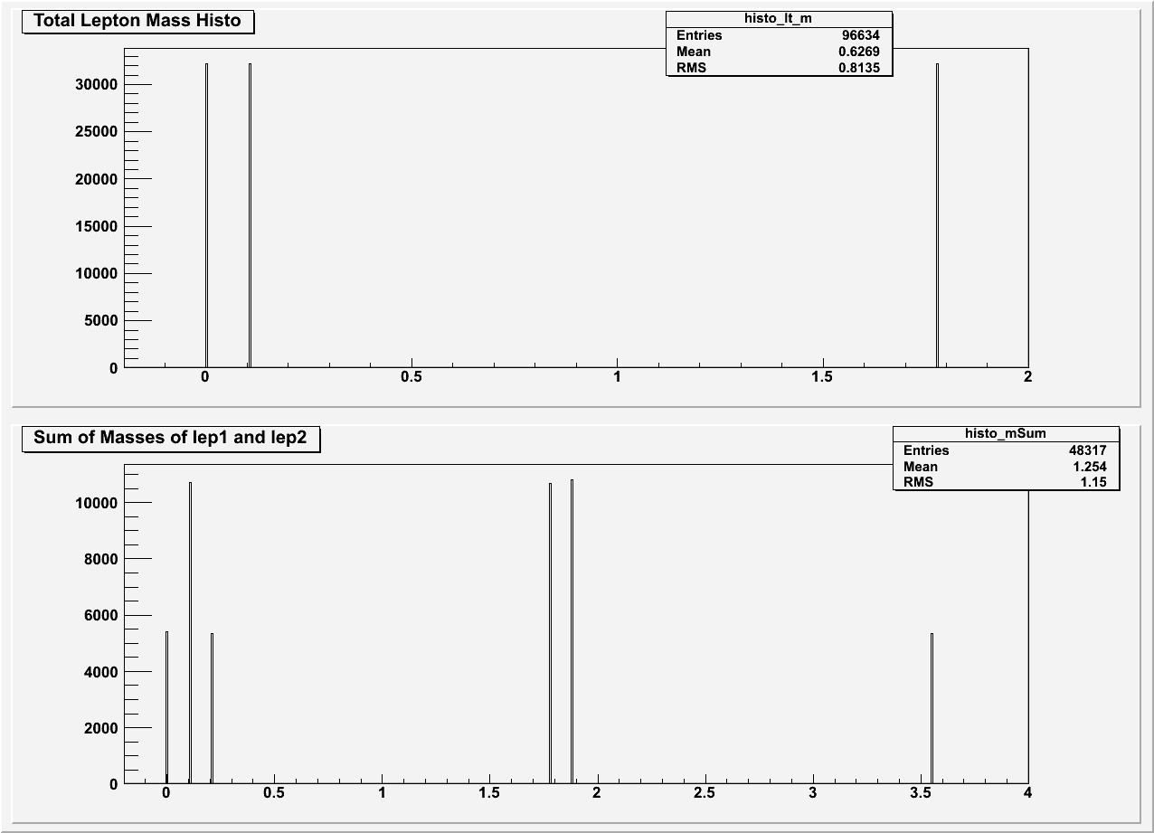
Distributions for leptons
200,000 events # of Bins = 500

Slide 7
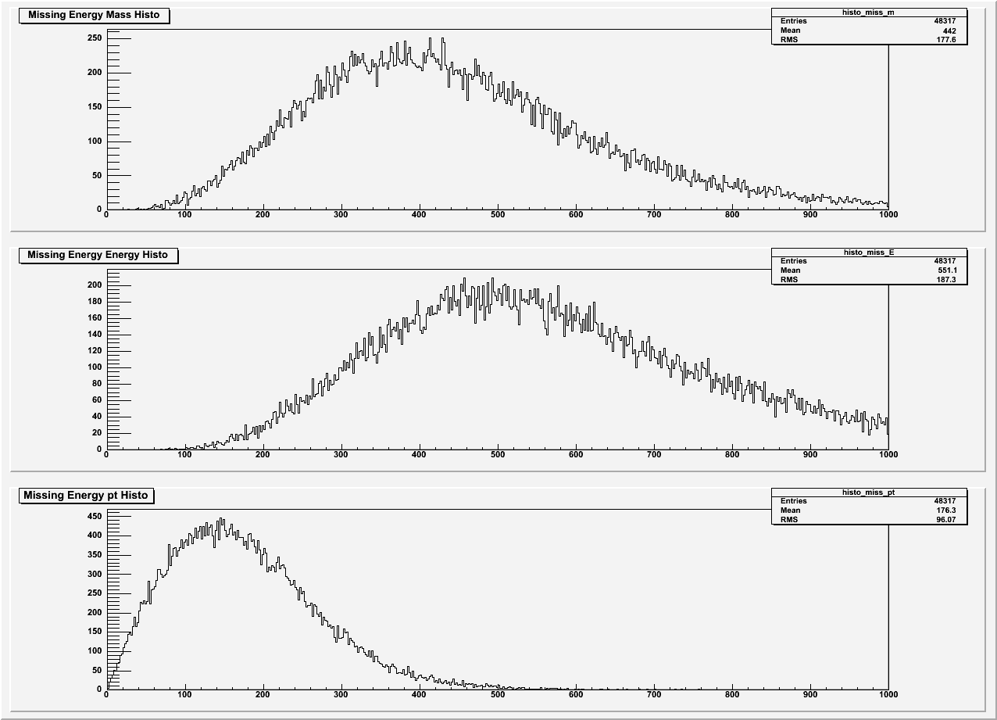
Missing Energy Distributions
200,000 events # of Bins = 500

Slide 8
t tBar Decay
Histograms to show
Two Body Mass, Energy and Pt
Angular and Cos(Theta) Distributions
Charge, Mass and Pt for the two Lepton Inputs (Gen1 and Gen2)
Mass of all Leptons and Sum of Masses of the leptons
Missing Energy Distribution

Slide 9
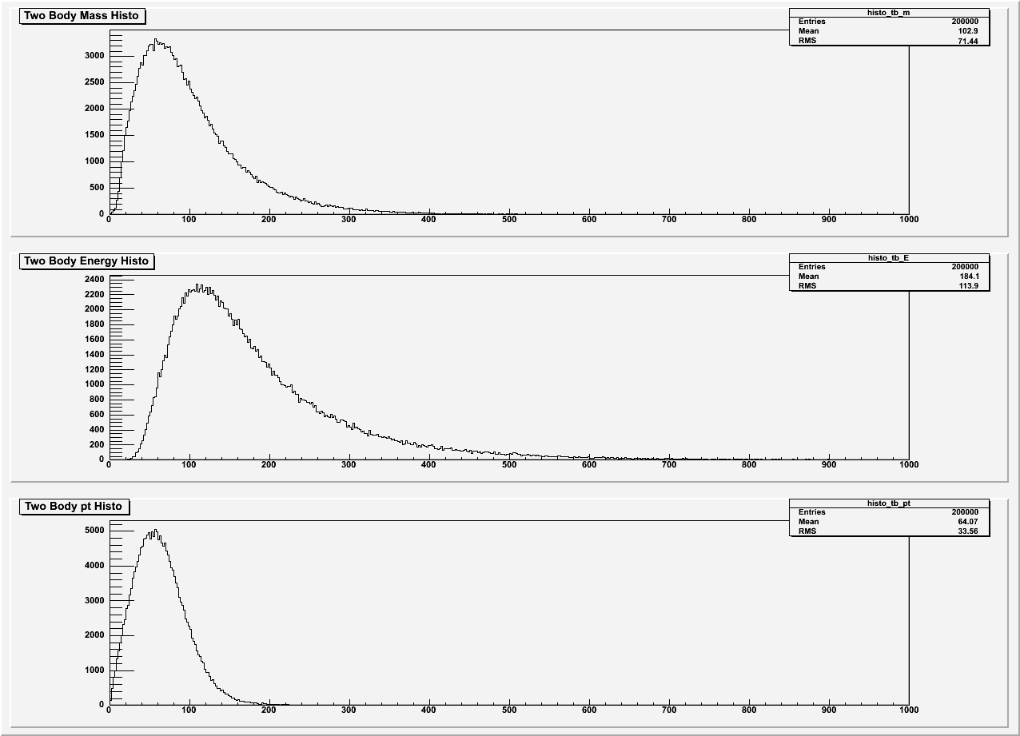
Two-body mass, energy and pt distribution of lepton pairs
200,000 events # of Bins = 500
Two-body mass, energy and pt distribution of lepton pairs
200,000 events # of Bins = 500

Slide 10
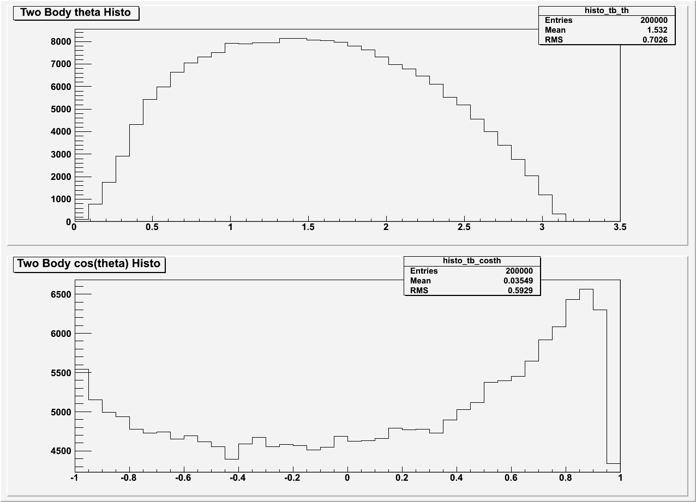
Angular distribution of lepton pairs
200,000 events # of Bins = 40

Slide 11
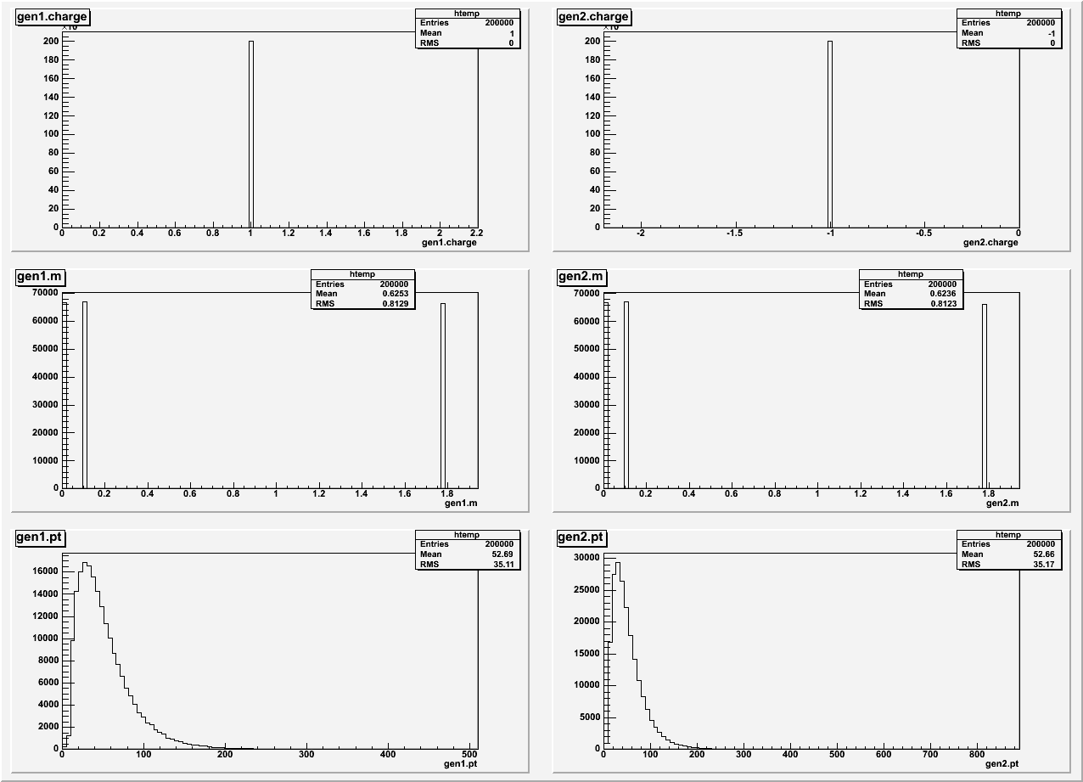
Distributions of the two lepton inputs (gen1 and gen2)
200,000 events # of Bins = 500

Slide 12
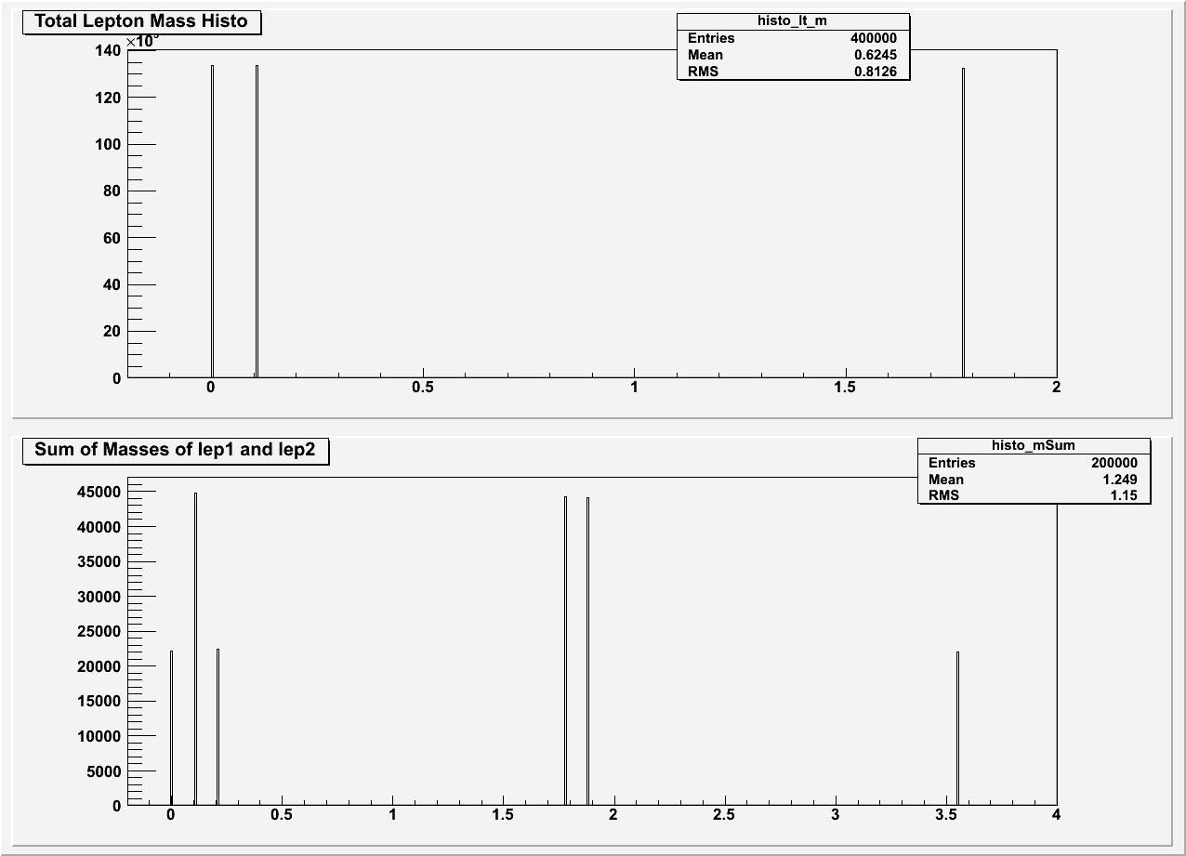
Distributions for leptons
200,000 events # of Bins = 500

Slide 13
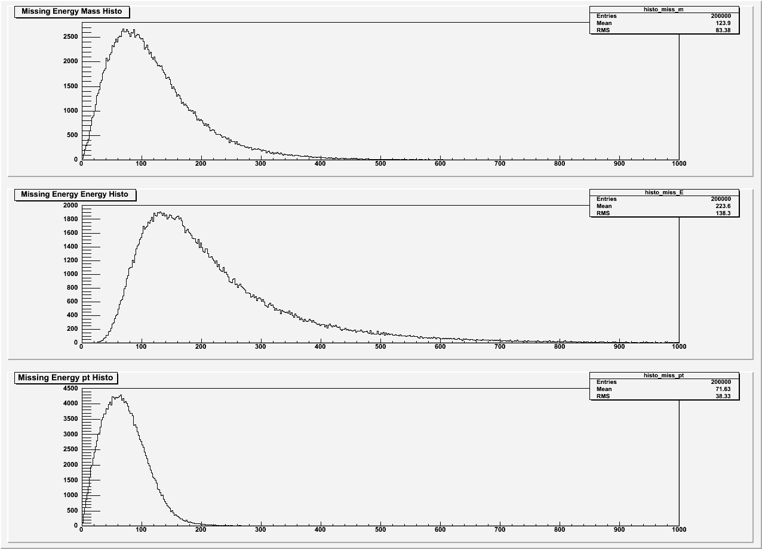
Missing Energy Distributions
200,000 events # of Bins = 500

Slide 14
W + Jet Decay
Histograms to show
Two Body Mass, Energy and Pt
Angular and Cos(Theta) Distributions
Charge, Mass and Pt for the Lepton and Jet Input (Gen1 and Gen2 respectively)
Missing Energy Distribution

Slide 15
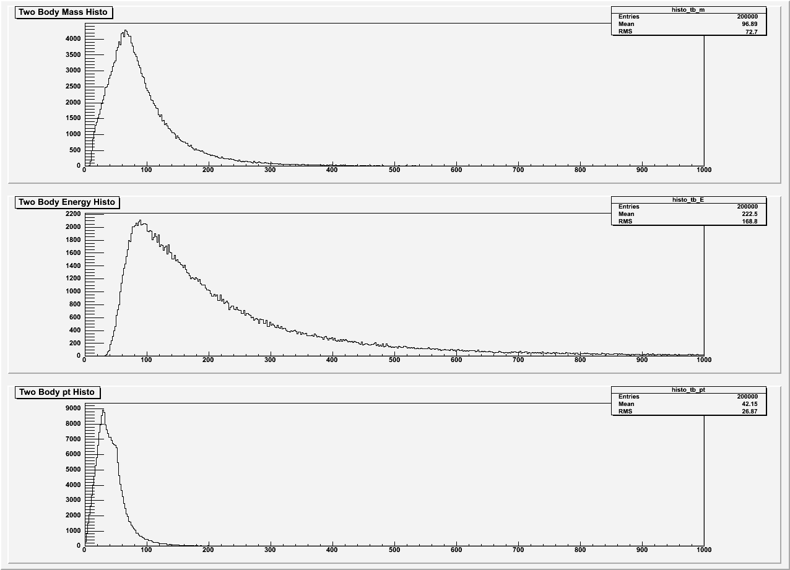
Two-body mass, energy and pt distribution of jet and lepton pairs
200,000 events # of Bins = 500
Two-body mass, energy and pt distribution of lepton pairs
200,000 events # of Bins = 500

Slide 16
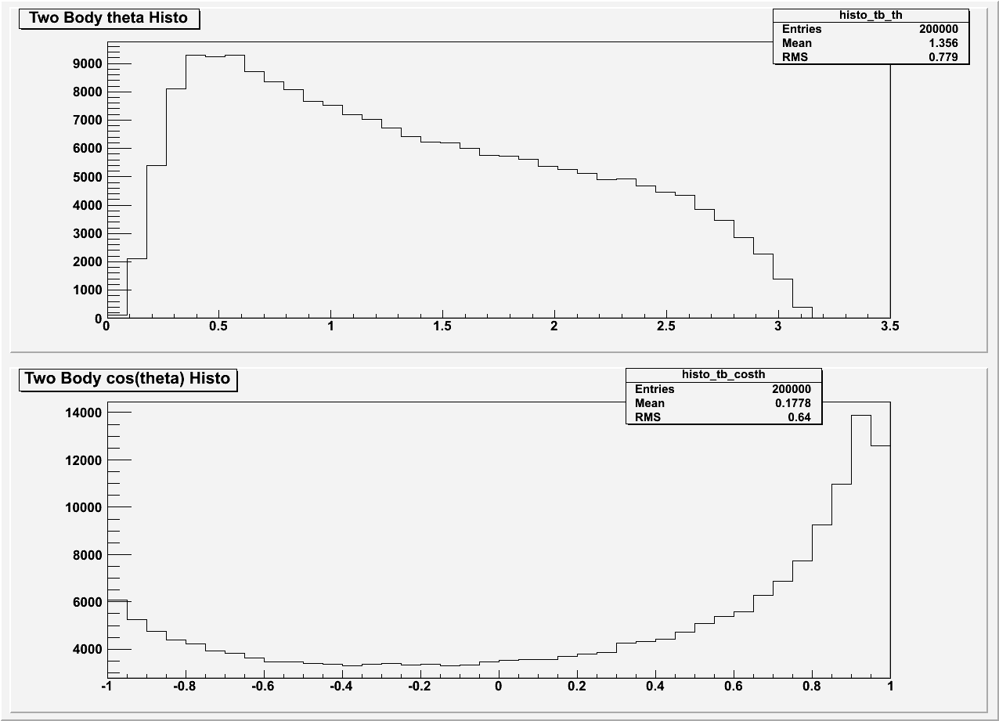
Angular distribution of lepton pairs
200,000 events # of Bins = 40

Slide 17
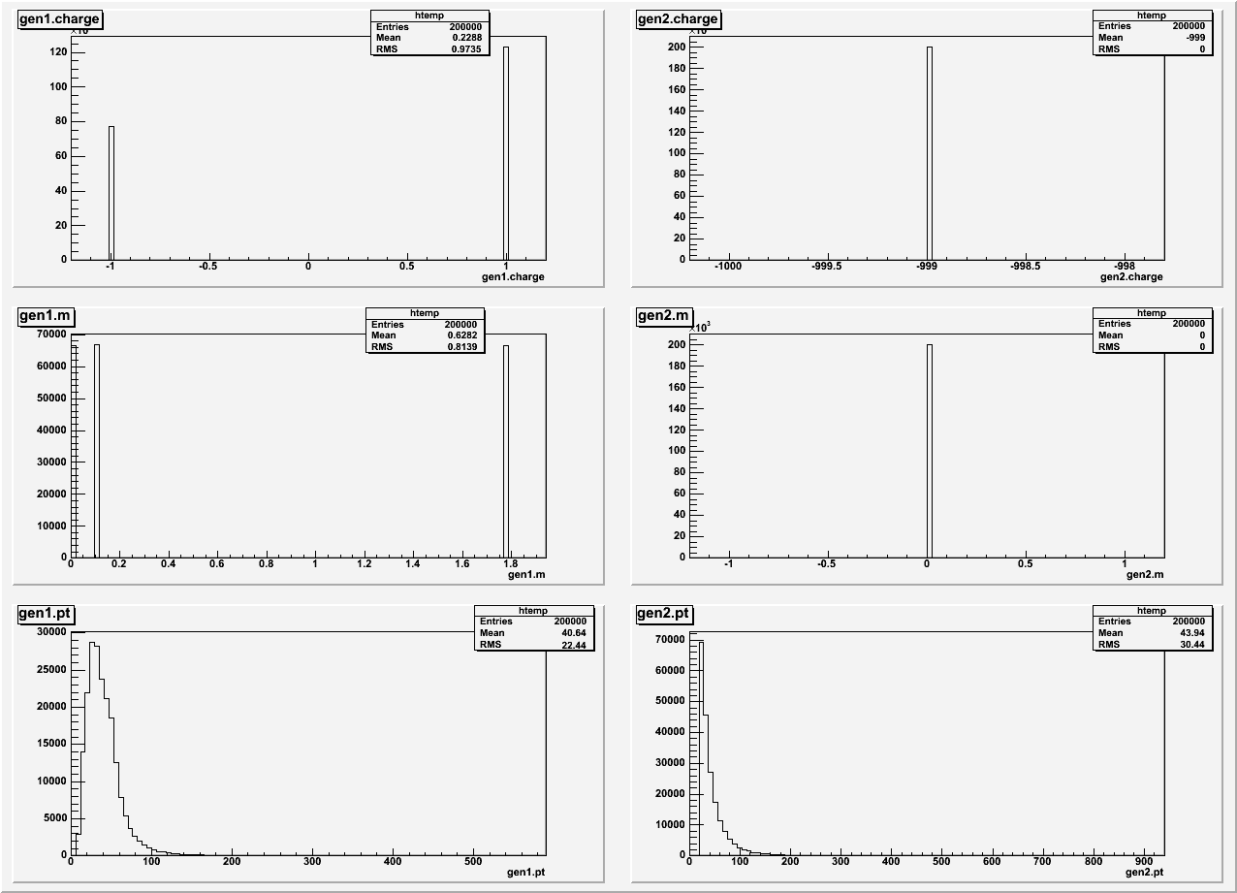
Distributions of the lepton and jet input (gen1 and gen2 respectively)
200,000 events # of Bins = 500

Slide 18
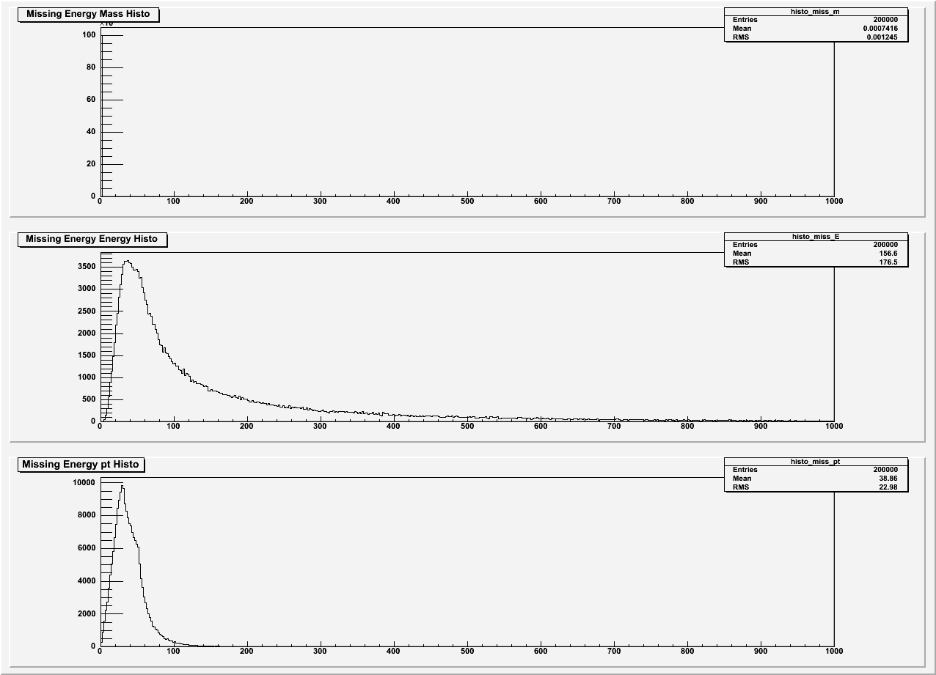
Missing Energy Distributions
200,000 events # of Bins = 500

Slide 19
Edge Analysis
Analysis of why there is an edge on the pt curve of the W+Jets
Histograms to show
TwoBody mass, energy and pt
Ptotal for 2 and 3 body of W+Jets
Input energy for 2 and 3 body of W+ Jets

Slide 20
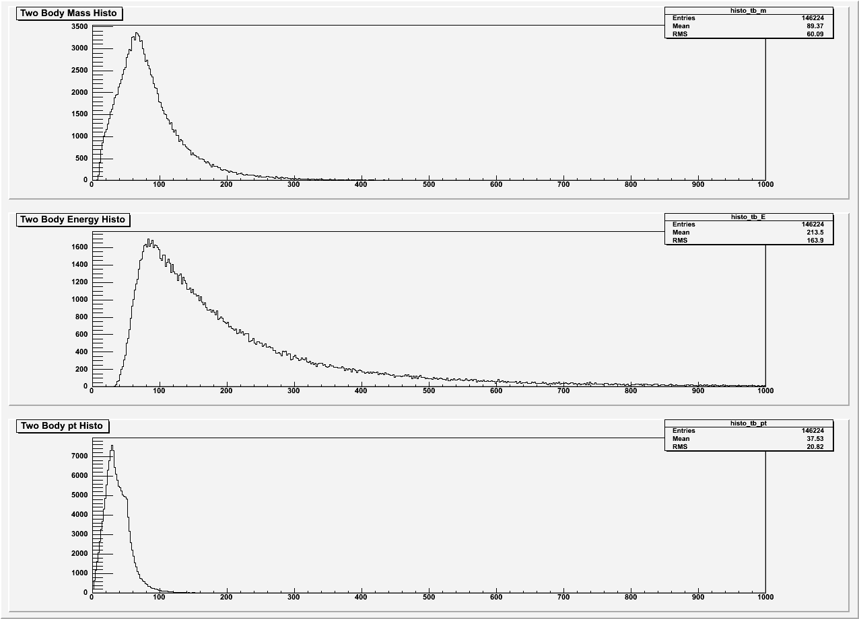
Two-body mass, energy and pt distribution of two-body jet and lepton pairs
146,224 events # of Bins = 500

Slide 21
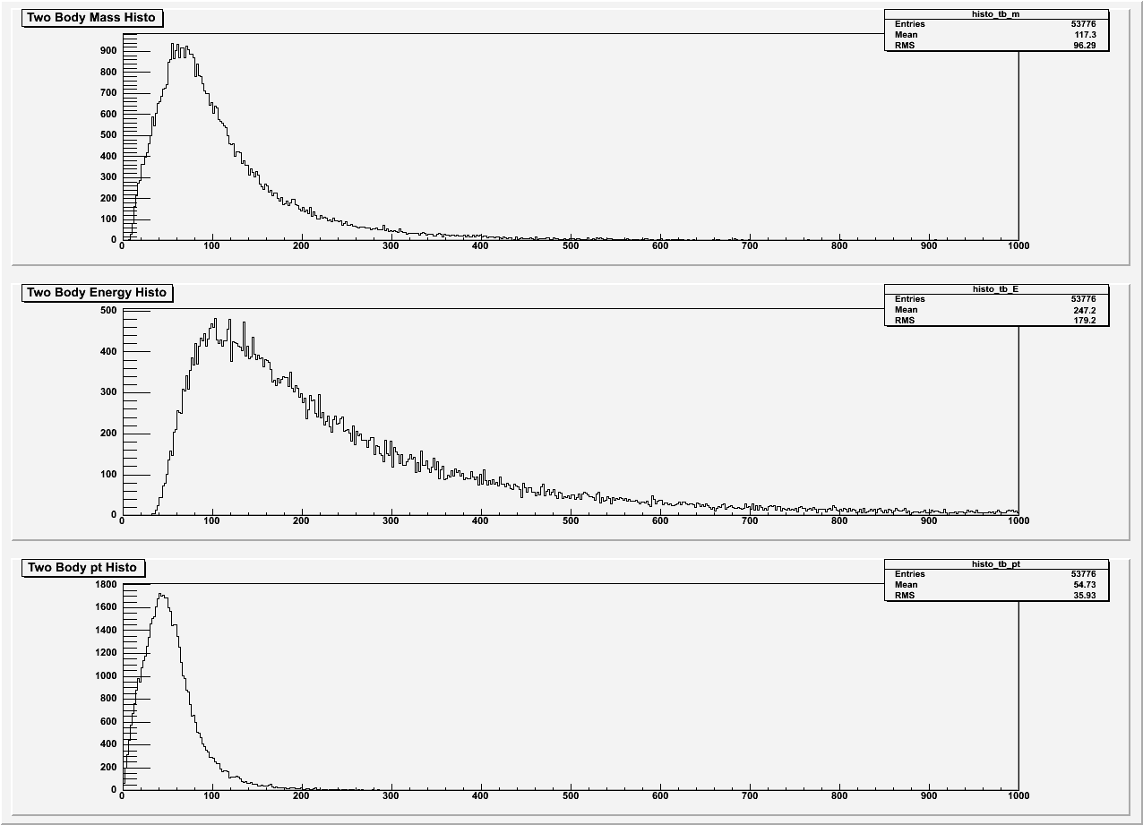
Two-body mass, energy and pt distribution of three-body jet and lepton pairs
53,776 events # of Bins = 500

Slide 22
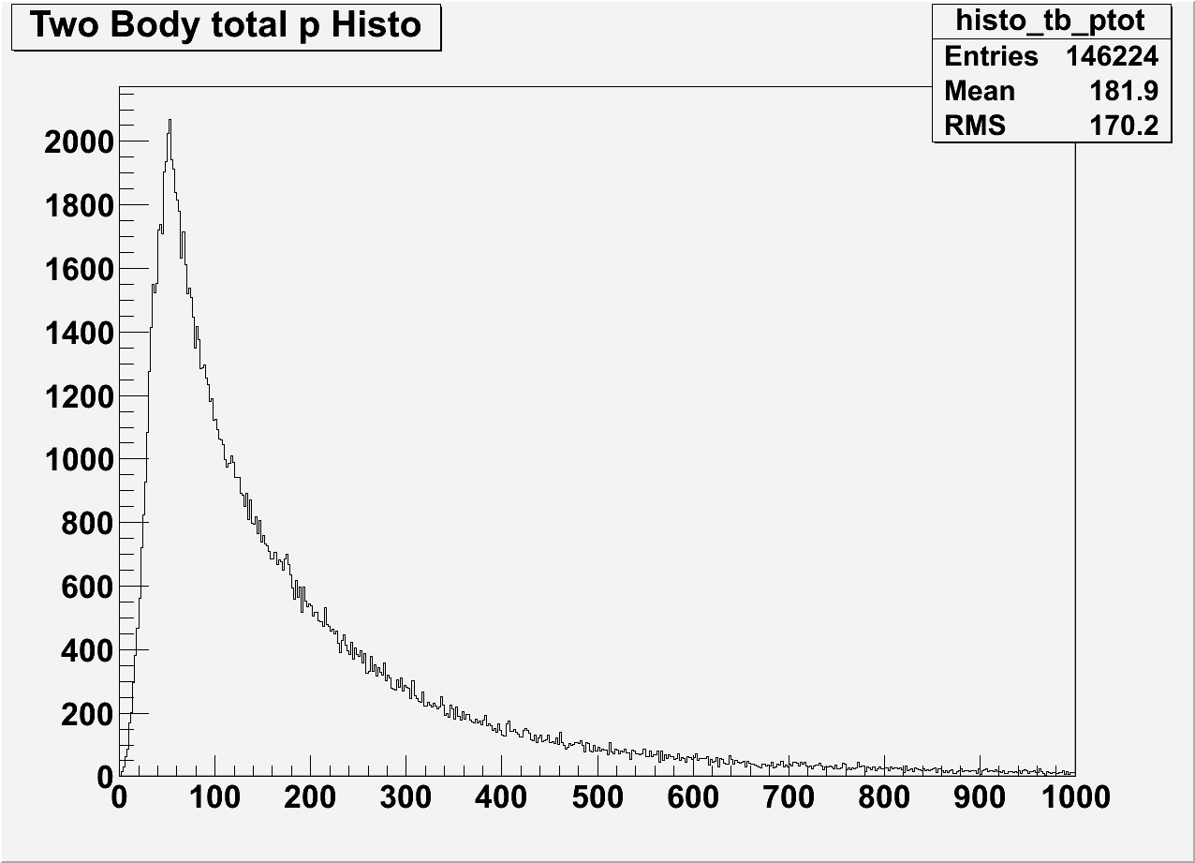
Total Momentum of two-body W+Jets events
146,224 events

Slide 23
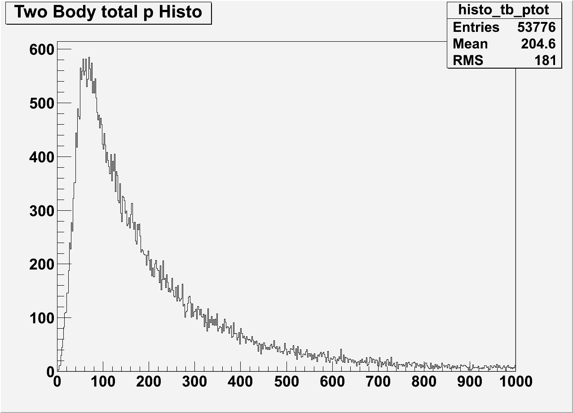
Total Momentum of three-body W+Jets events
53,776 events

Slide 24
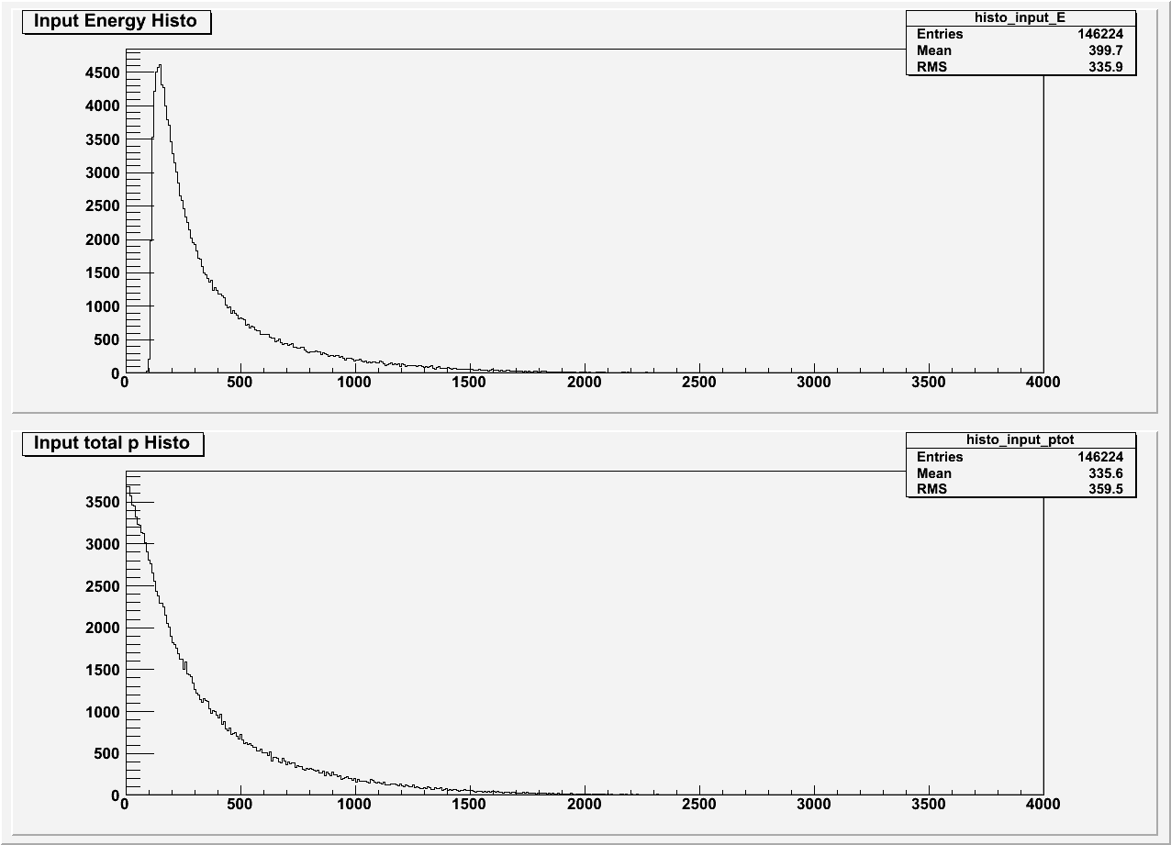
Input distro of two-body W+Jets events
146,224 events

Slide 25
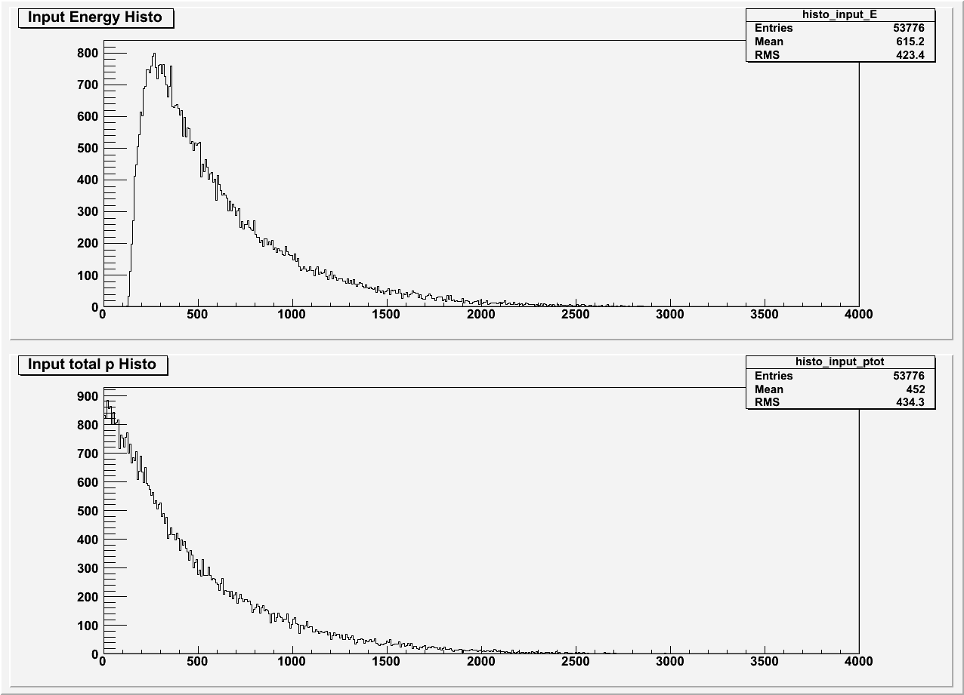
Input Distro of three-body W+Jets events
53,776 events

