Slide 1
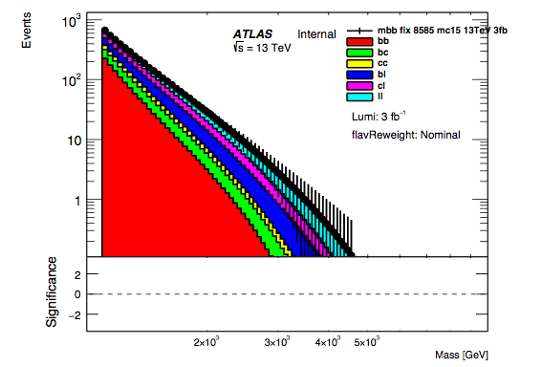
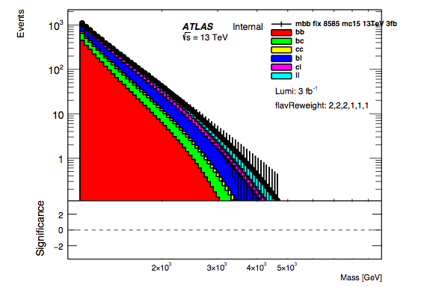
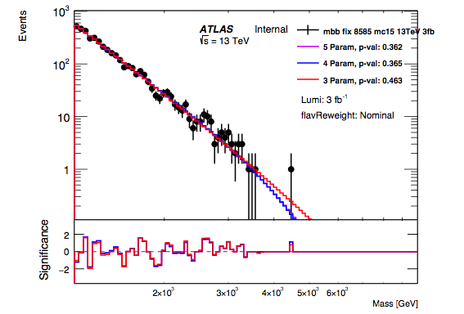
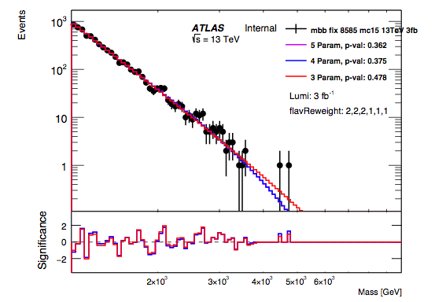
Test of Robustness of Fit Against Changes in Flavour Composition
Test that fitting procedure is robust to changes in the flavour composition
=> Create templates for each of the flavour combinations by fitting to individual spectra.
=> Adding the fractions with different weights to produce spectra with different flavour combinations
Nominal
b-jets
doubled
Apply Poisson fluctuations to create ‘data-like’ distributions.
These are fitted to and then p-values of fits are compared for the two different flavour compositions
This is repeated for 100 different ‘data-like’ distributions.
Mean p-values
 | Nominal | b-jets doubled
3 Par. Fit | 0.325 +/- 0.024 | 0.308 +/- 0.024
4 Par. Fit | 0.280 +/- 0.023 | 0.267 +/- 0.022
5. Par Fit | 0.283 +/- 0.022 | 0.276 +/- 0.022
Nominal
b-jets
doubled

Slide 2



Spurious Signal Tests for Varying Flavour Compositions
Test a spurious signal due to discrepancies between fit and background for different flavour compositions
=> Use spectra created templates for each of the flavour combinations by fitting to individual spectra.
=> Adding the fractions with different weights to produce spectra with different flavour combinations
Nominal
b-jets
doubled
Fit to the above spectra using 3-parameter fit function.
Use search phase of BumpHunter to search for discrepant regions
No significant spurious signal found
Large p-values
Wide signal unlike benchmark models.
This study not currently in supporting note in CDS.
Documented and ready to go.
Can go in next version.
Nominal
b-jets
doubled

