Slide 1


Flavour Fit Studies
Laurie McClymont, Andreas Korn
With thanks to Jeff and Lydia!
Di-bjet Meet
3 February 2016

Slide 2
Getting the Flavour Fractions
We want to understand how varying the flavour composition will affect the fitting function. => Are the fitting functions robust to changes flavour composition? => Vary the amount that different flavour combinations contribute and fit.
Comment from JDM Approval => Further tests requested. => Are we introducing a spurious signal in changing flavour fraction?
Details
Pythia8EvtGen MC Di-Jet Sample
- di-b-jet Ntuple production
Standard Dijet Resonance Cuts
- Leading Jet pT > 410 GeV - Sublead Jet pT > 50 GeV
- |y*| < 0.6
- mjj > 1100 GeV
Using fixed cut 85% for both jets. - mbb_fix_8585
Cone matching truth flavour
- jetHadronConeExclTruthLabelID
Work Flow
phys-exotics/jdm/dijet/inputs/Btag/MC15_DiJet_20151104
Packages used
- DijetHelpersPackage:
=> Create scaled distributions.
=> Vary flavour fractions.
=> Create p-values of fit. - Dijet Statistical Packages: => Using search phase from this package
=> Bumphunter to search for discrepant regions
=> Spurious signal check

Slide 3
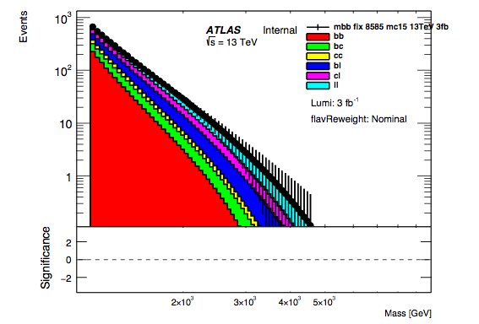
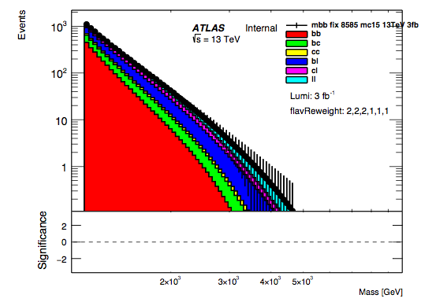
Stacking the Flavour Fractions
Create flavour fractions
=> Creating histograms from fits to 20 fb⁻¹ scaled to 3 fb⁻¹
=> Adding the fractions in different ways to produce various spectra
This creates new scaled like distributions.
Nominal
b-jets doubled

Slide 4
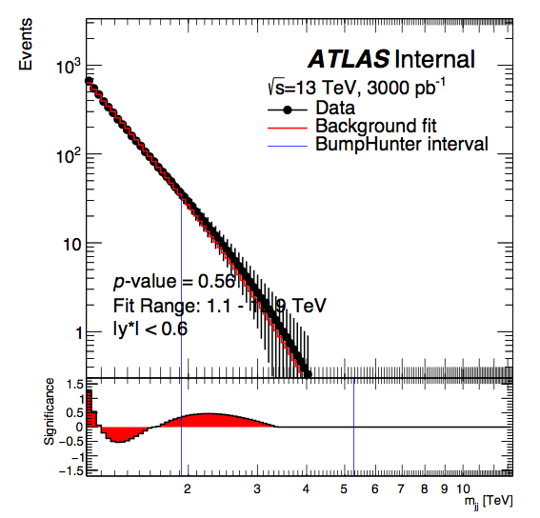
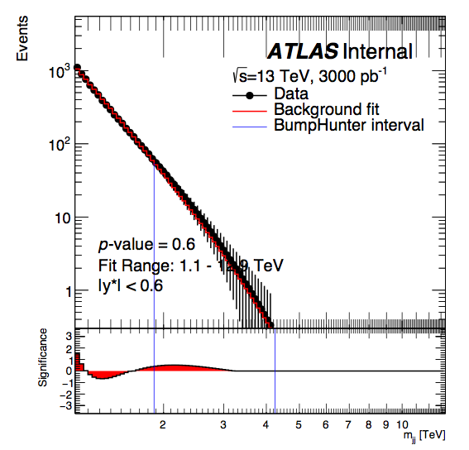
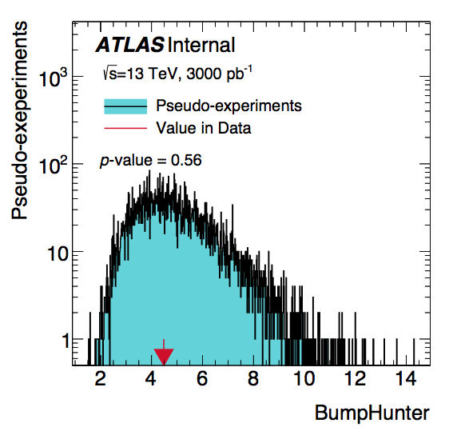
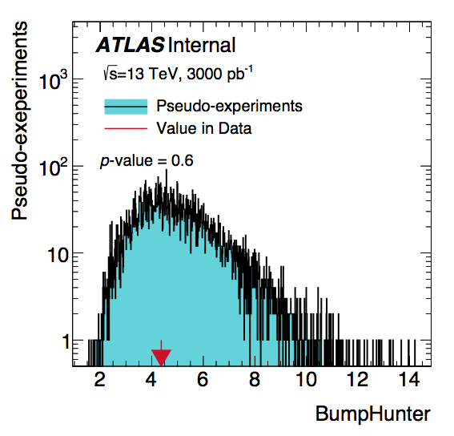
Looking for a spurious signal
We then fit to this scaled using 3-parameter fit function
Run bumphunter to look for significant deviations
Nominal
b-jets doubled

Slide 5
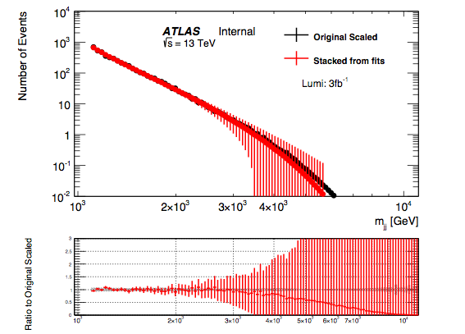
Looking for a spurious signal
However I know, that stacking doesn’t match MC above 4 TeV
So I will also try cutting off at 4 TeV (and 5 TeV)

Slide 6
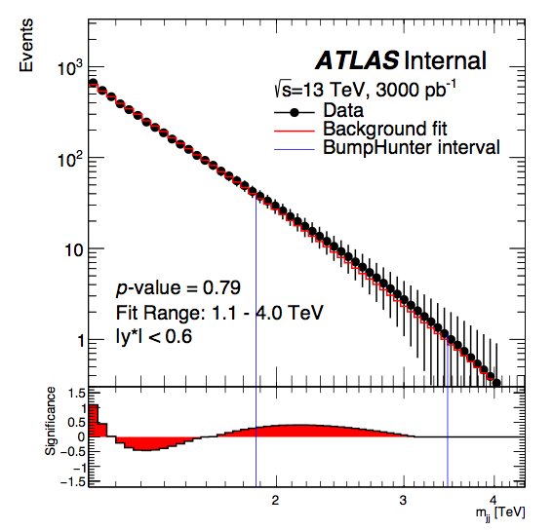
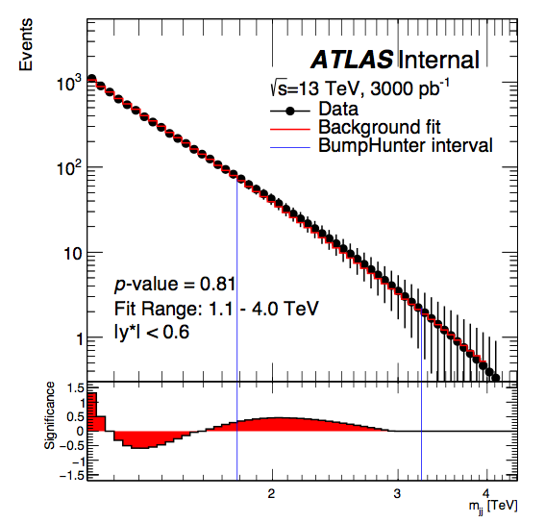
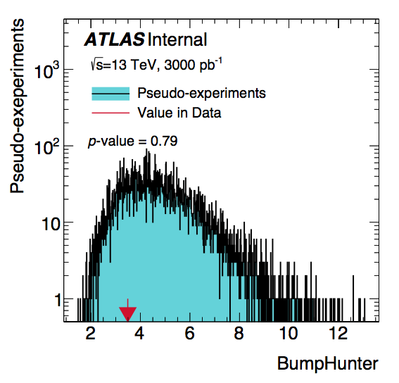
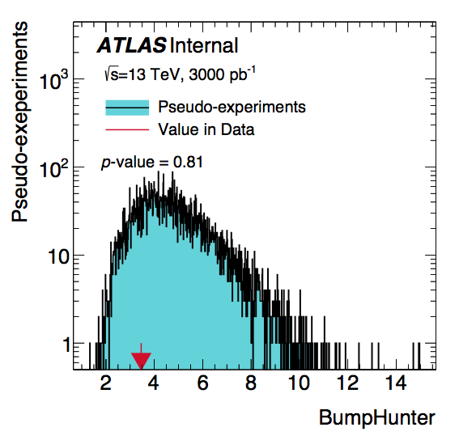
Looking for a spurious signal
Cut off at 4 TeV
Nominal
b-jets doubled

Slide 7
Looking for a spurious signal
Cut off at 5 TeV == To be added!
Nominal
b-jets doubled

Slide 8
Conclusions
Spurious Signal Tests
Check scaled dijet mass spectrum for any large deviations.
Cutting scaled spectra off at 4 TeV
Bumphunter values: - Nominal = 0.79 - b-Jet Content = 0.81
No obvious problem here.
This is documented and ready to go in note…
Also done last week: p-Value of fitting function
Fitted to ‘data-like’ distributions.
We see no drop in performance (p-value) in the case where b-jet content is doubled.
Evidence that fit is robust to flavour fraction.
Systematic from fit parameters and fit function choice are enough.
This is documented and in note already

Slide 9
Backup:
p-Value of Fits Study

Slide 10
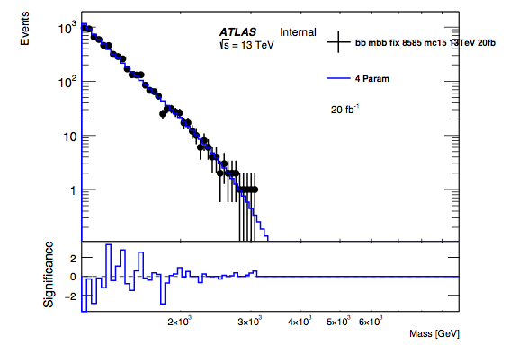
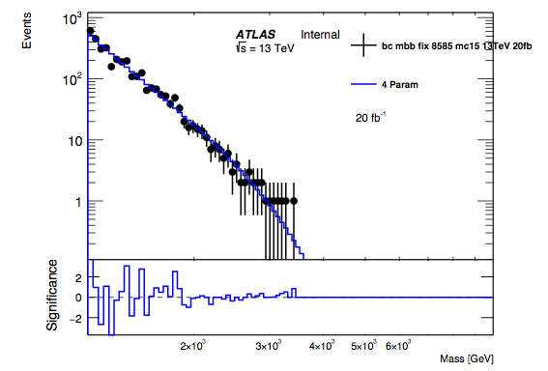
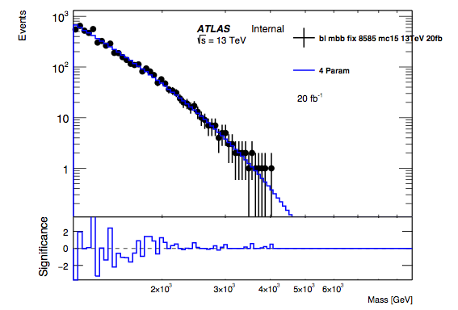
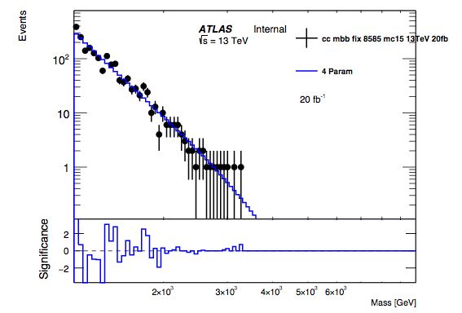
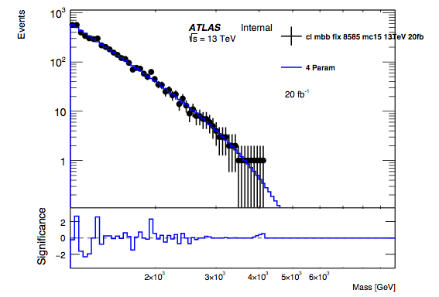
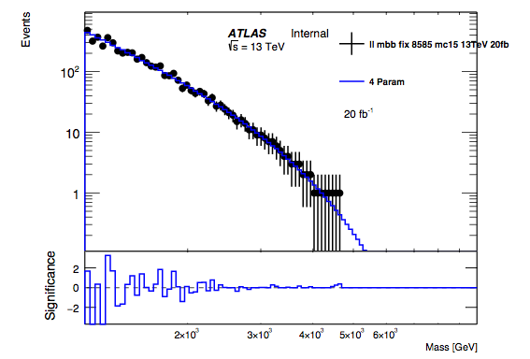
Getting the Flavour Fractions
Flavour fractions are extracted from MC using truth information.
The dijet mass spectrums for these flavour fractions are then scaled to 20fb⁻¹
The dijet mass spectrums are fitted to using the 4-parameter fit function.
bb
bc
bl
cc
cl
ll

Slide 11
Stacking the Flavour Fractions
Create flavour fractions
=> Creating histograms from fits to 20 fb⁻¹ scaled to 3 fb⁻¹
=> Adding the fractions in different ways to produce various spectra
This creates new scaled like distributions.
Nominal
b-jets doubled

Slide 12
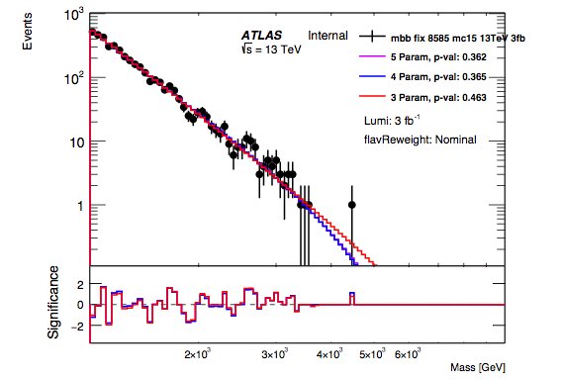
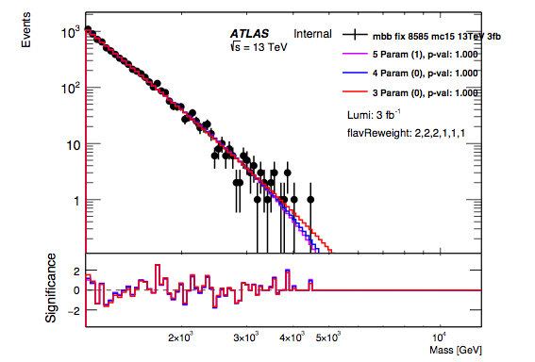
Making Data-Like
By applying poisson fluctuations we can create ‘data-like’ distribution
These are fitted using the 3, 4 and 5 parameter fit function
Nominal
b-jets doubled

Slide 13
Making Data-Like
By applying poisson fluctuations we can create ‘data-like’ distribution
These are fitted using the 3, 4 and 5 parameter fit function
Nominal
b-jets doubled
To calculate p-value of a fit:
Take the fit function and apply poisson fluctuations. (Pseudo-experiment)
Re-fit to the pseudo-data using the same fit function.
Compare quality of fit to pseudo-experiment to that of the original fit.
- For a measure quality of fit I use negative log likelihood
Repeat 1000 times and count fraction of pseudo-experiments that have a worse quality of fit than the original fit.

Slide 14
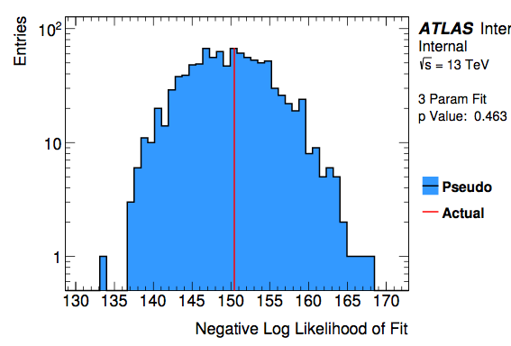
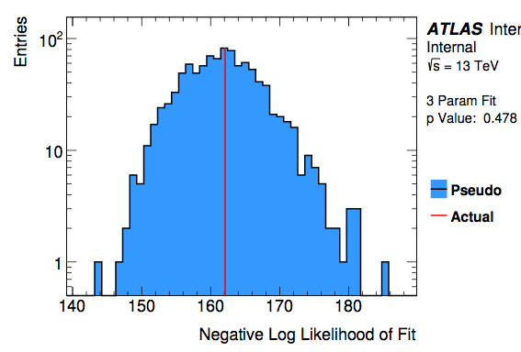
Making Data-Like
By applying poisson fluctuations we can create ‘data-like’ distribution
These are fitted using the 3, 4 and 5 parameter fit function
Nominal
b-jets doubled

Slide 15
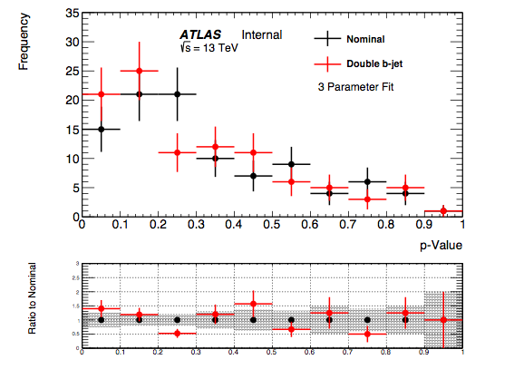
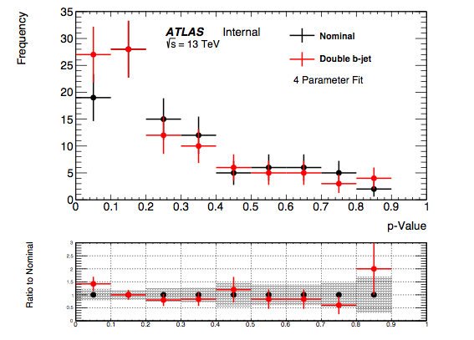
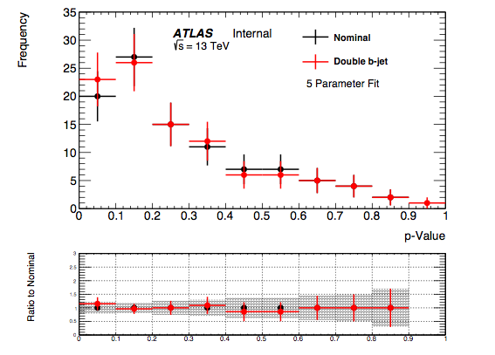
Many More Data-Like
Different sets of poisson fluctuations means a different ‘data-like’ spectrum
Each ‘data-like’ dist. can be fitted to, giving a different p-value for each fit variation.
100 different data-like distributions have been studied
Nominal
Mean p-values
 | 3-Para. Fit | 4-Para. Fit | 5-Para. Fit
Nominal | 0.325 +/- 0.024 | 0.280 +/- 0.023 | 0.283 +/- 0.022
b-jet Doubled | 0.308 +/- 0.024 | 0.267 +/- 0.022 | 0.276 +/- 0.022

Slide 16
Backup:
b-Tagged Dijet Analysis

Slide 17
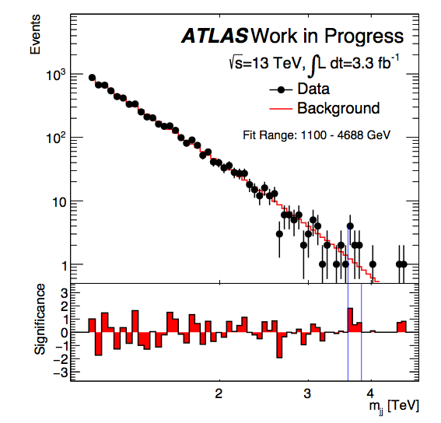
Introduction
Fitting Function
We use a smoothly falling fitting function to fit to background
This comes in a 3, 4 or 5 parameter versions
Setting p4 and p5 to zero
Varying Flavour Composition
It is known that the fitting function can fit to the Monte-Carlo
However MC is not a perfect prediction of reality
What if there are more b-jets in the data than in the MC - Can we still fit to data in this case? Is our fitting function robust.
2 b-tags
where,

