Slide 1
The prior
Notes:
Scientist course, day 1, session 1. The vignette is Rmd/prior.Rmd, then Rmd/production.Rmd. One decision: a productivity benchmark. It does not set a catch limit.

Slide 2
A productivity benchmark
Notes:
Say this before the file is opened. The assessment FMSY for blue shark, about 0.18, is not the number this session records.

Slide 3
Day 1
What this session records
The prior, not the assessment
It does not set a catch limit
Worked stock: blue shark
No case: shortfin mako
FishLife for Prionace glauca. The assessment FMSY, about 0.18, stays off this slide and out of the file.
Notes:
Open Rmd/prior.Rmd only after this slide. The marked block is already on Prionace glauca.

Slide 4
Day 1
Where FMSY comes from
Schaefer: BMSY is half of K
FMSY is r/2
Steepness and M move the shape
The 2018 score is this prior, as a rank
A low score and a low FMSY are the same biology. Blue shark is the most productive of these sharks. Mako is rank 1 for longline.

Slide 5
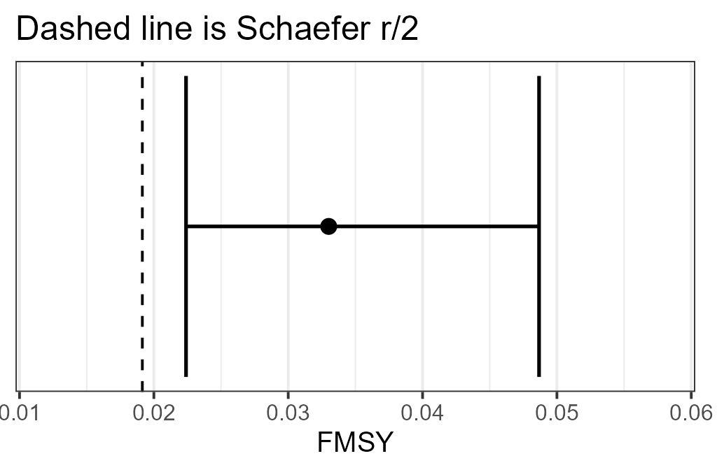
Day 1
Three numbers to match
r = 0.038
FishLife FMSY = 0.033
Schaefer r/2 = 0.019
Notes:
The dashed line is Schaefer r/2. The bar is the lognormal 95% range from CV 0.2, which the marked block sets. FishLife does not supply that CV.

Slide 6
Day 1
In the file
Open Rmd/prior.Rmd
Leave Prionace glauca, level species
Render, and match the three numbers
Set level to genus and raise the CV
Prionace has one species, so the mean stays put and the interval widens. Alopias has two, so the mean moves.
Notes:
Instructor renders first. The room changes only the marked block, then renders again.

Slide 7
Day 1
Their case
Point the block at their stock
If it is missing, use the genus
Or type r and FMSY
Copy the 2018 productivity score
They leave with r, FMSY, the CV, and whether the prior is stock, species, or genus. The file does not calculate the score.

Slide 8
The production curve
Notes:
Same session. Managers move the sliders in shiny/production. Scientists change the marked block in Rmd/production.Rmd. Both read shiny/production/presets.csv.

Slide 9
Day 1
The same model
The peak of the curve is MSY
BMSY is the biomass at that peak
FMSY is MSY divided by BMSY
Shape 2 is Schaefer
The path is this model, run for 40 years while F/FMSY rises. It is not the assessment's historical series.

Slide 10
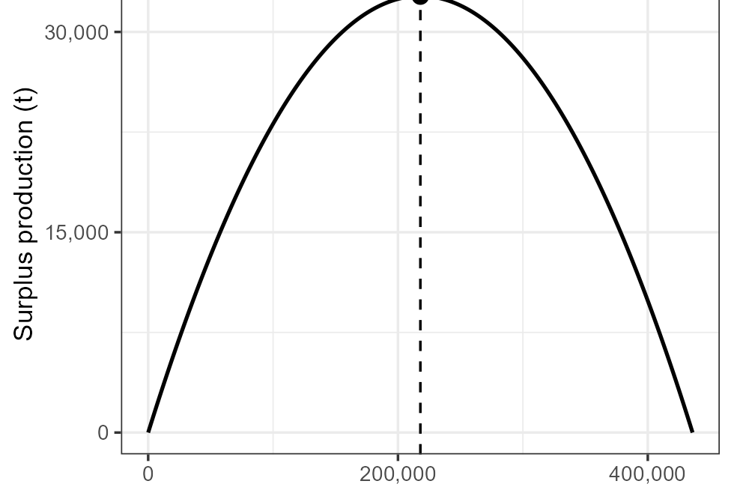
Day 1
Match the curve
ICCAT, blue shark, North
Leave r, K, m and F/FMSY as NA
MSY 32,689 t
BMSY/K 0.50, FMSY 0.150
Notes:
These are the preset row, not the FishLife prior. r starts at 0.30 so the Schaefer peak equals the published MSY.

Slide 11
Day 1
Then change one input
Set m to 1.5 and render again
Record the new MSY and BMSY/K
Put m back to NA
Shortfin mako, North: MSY 1,883 t
They leave with MSY, BMSY, BMSY/K, FMSY, and the cell the path ends in. No case: ICCAT shortfin mako, North.

