Slide 1





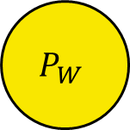



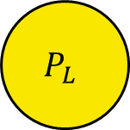

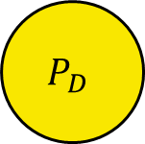





$φ_{DD}$
$φ_{LD}$
$$P_{D}$$
$$P_{L}$$
$$F_{D}$$
$m_{out}$
$$F_{L}$$
$$P_{A}$$
$$P_{W}$$
$$F_{A}$$
$$F_{W}$$
$φ_{DL}$
Treatment threshold, $M$
$$P_{S}$$
Parasite burden
Treatment efficacy, $ε_{i}$
$$F_{S}$$
WILD ENVIRONMENT
$m_{in}$
time
DOMESTIC ENVIRONMENT
LINK ENVIRONMENT

