Slide 1
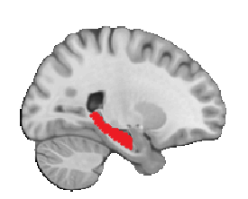
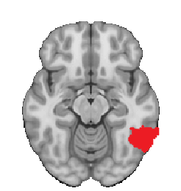
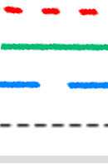
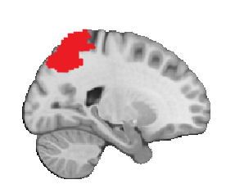
Q75
Q-mean
Q25
Control mean activation
Confidence interval
Disease severity direction
SCD+
MCI
A
B
Y = -0.081*X + 0.001*age
- 0.113*sex (male) – 0.151
Y = -0.096*X + 0.000*age
- 0.104*sex (male) – 0.337
fMRI BOLD signal
Left hippocampal volume (Z scores)
Left hippocampal volume (Z scores)
C
D
Y = 0.093*X – 0.209*X2 + -0.002*age
+ 0.022*sex (male) + 0.472
Y = 0.232*X – 0.034*X2 + 0.002*age
+ 0.096*sex (male) - 0.122
fMRI BOLD signal
Cortical thickness (Z scores)
Associative memory performance

