Slide 1

LAR TGW-3D
Luca Maria Lauricella
Valerio Marini

Slide 2
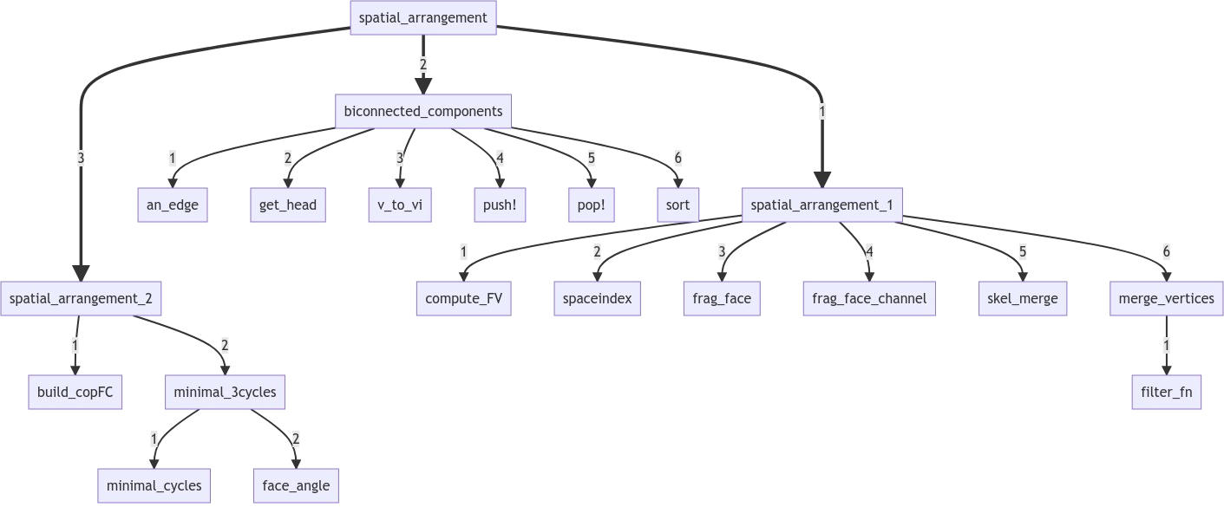
LAR TGW-3D

Slide 3
Functions:
function frag_face_channel(in_chan, out_chan, V, EV, FE, sp_idx)
function frag_face(V, EV, FE, sp_idx, sigma)
function merge_vertices(V::Lar.Points, EV::Lar.ChainOp, FE::Lar.ChainOp, err=1e-4)
function spatial_arrangement_1(V::Lar.Points, copEV::Lar.ChainOp, copFE::Lar.ChainOp, multiproc::Bool=false)
function removeinnerloops(g, nFE)
function spatial_arrangement_2(rV::Lar.Points, rcopEV::Lar.ChainOp, rcopFE::Lar.ChainOp, multiproc::Bool=false)
function spatial_arrangement(V::Lar.Points, copEV::Lar.ChainOp, copFE::Lar.ChainOp, multiproc::Bool=false)
LAR TGW-3D

