Slide 1

Comparison of Matching Algorithms
Laura Bledaite and Lukas Siemon
Source: http://news-accounts.com/wp-content/
uploads/2011/10/matching-puzzle-pieces-sky.jpg
Notes:
Lukas

Slide 2
Outline
Problem Definition
Algorithms - Reverse Nearest Neighbor - Global Greedy - Stable Marriage - Hungarian Algorithm
Tests
Conclustions

Slide 3
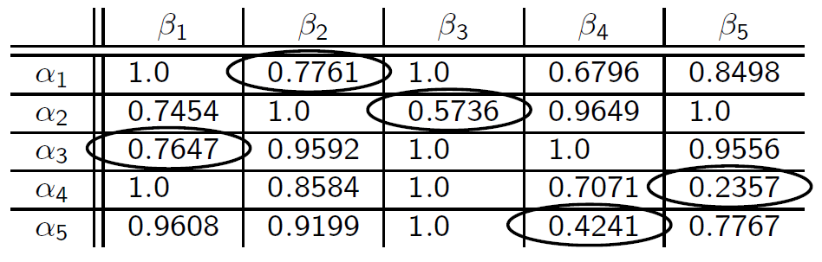
Problem Definition
Why do we need matching?
Notes:
Lukas
example taken from course slides
global greedy approach (discussed in class)
in this case correct solution
Other requirements! (e.g. women / man matching)
other/better ways to do the matching?

Slide 4
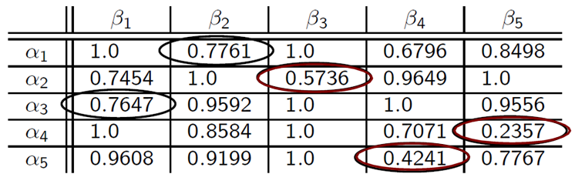
Reverse Nearest Neighbor
Notes:
Lukas
-selects only if unique smallest value

Slide 5
Stability
 | Y1 | Y2 | Y3
X1 | 0.25 | 0.28 | 0.31
X2 | 0.2 | 0.26 | 0.32
X3 | 0.15 | 0.24 | 0.33
Notes:
Laura
-tries to find a stable matching
-global greedy is always stable
-we think (but did not prove) that the results for unique row/col entries are always unique
-this result is not stable (explain!)
Say that GG = SM

Slide 6
Global Greedy
0.2357
0.4241
0.5736
0.6796
0.7071
0.7454
0.7647
0.7761
0.7767
…
Notes:
Laura
-sorts values and tries to assign if still possible

Slide 7
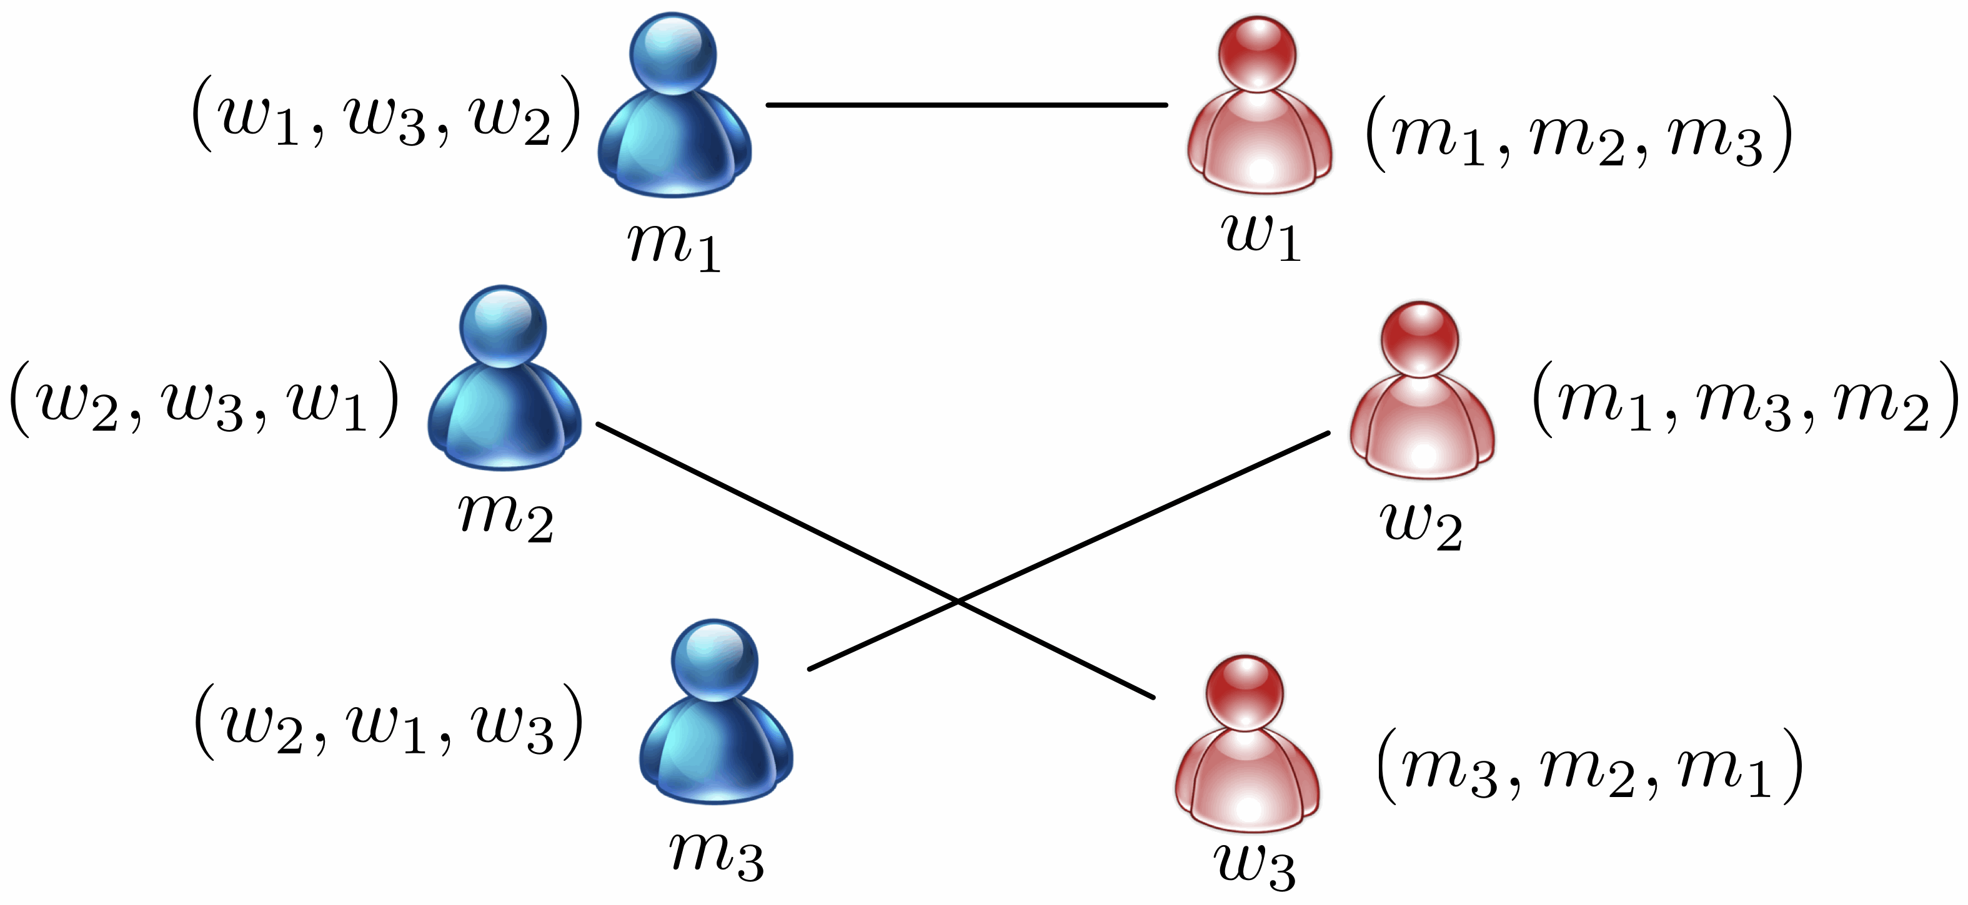
Stable Marriage
Source: http://iqua.ece.toronto.edu/wp-content/uploads/2011/05/sm.gif
Notes:
Laura
-”strange” things can happen
-this is a stable match even though w3 would rather be with m3

Slide 8
Hungarian Algorithm
Notes:
Lukas
-tries to find the optimal solution (e.g. minimizing the sum of the distances), while matching as many entries as possible

Slide 9
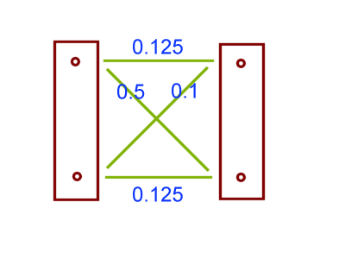
Difference HA and SM
Notes:
Lukas
Explain differences between HA and SM

Slide 10

Quality Testing
Used some real world data sets
Checked Recall and Precision
Source: http://t3.gstatic.com/images?q=tbn:ANd9GcRUI0FuGF1i
YiRXSFOpfVo9YYB5_88qObv4bDUgkXo4LBtejkybmny0fka_
Notes:
Lukas
-RNN high precision
-other algorithms performed similar
-HA might be a tiny bit better, usually not worth the increased cost though (as we will see)
-Bolzano address tree distances

Slide 11
Runtime Testing
RNN O(N^2)
GG O(N^2 * log(N))
SM O(N^2 * log(N))
HA O(N^4)
Notes:
Laura
And for absolute values:
RNN by far the fastest,
GG and SM similar
Original GG is N^2, but we have to do preprocessing

Slide 12
Conclusion
RNN good if you want high insurance
GG, SM, HA similar F-1 value
Notes:
Laura
What else?

Slide 13

Demo
Source: http://www.payperhead101.com/wp-content/uploads/2012/03/free-pph-demo.jpg

