Slide 1
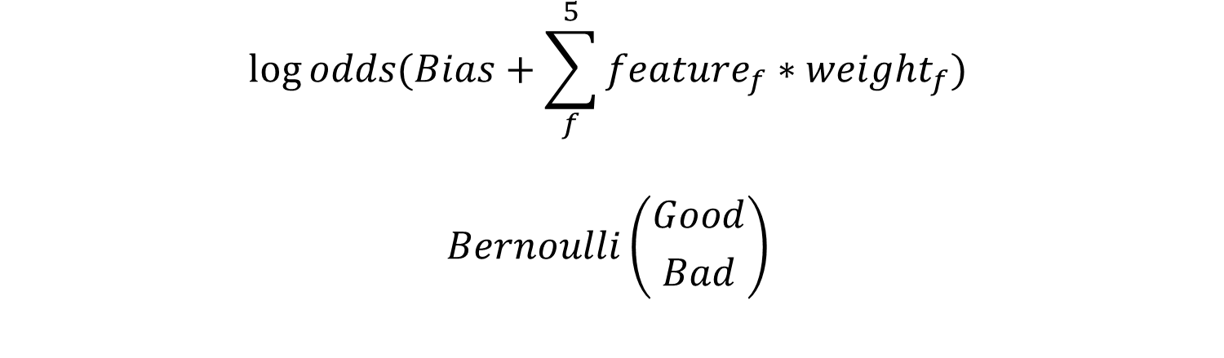
$$log⁡odds(Bias+\sum_{f}^{5}{feature_{f}∗weight_{f}})$$
$$Bernoulli\left({Good \atop Bad}\right)$$

Slide 2

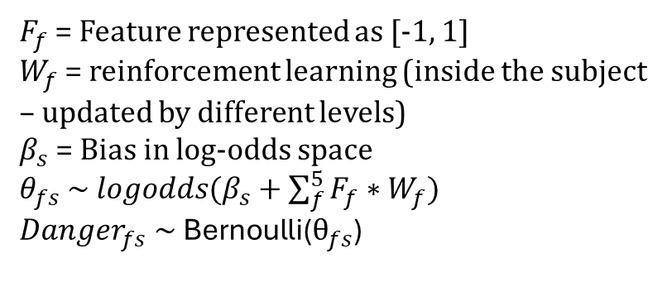




$$F_{f}$$
$$W_{f}$$
$F_{f}$ = Feature represented as [-1, 1]
$W_{f}$ = reinforcement learning (inside the subject – updated by different levels)
$β_{s}$ = Bias in log-odds space
$θ_{fs} \sim logodds(β_{s}+\sum_{f}^{5}{F_{f}∗W_{f}})$
$$Danger_{fs} \sim \text{Bernoulli}\text{(}θ_{fs}\text{)}$$
$$β_{s}$$
$$θ_{fs}$$
$$Danger$$
feature f
subject s

Slide 3






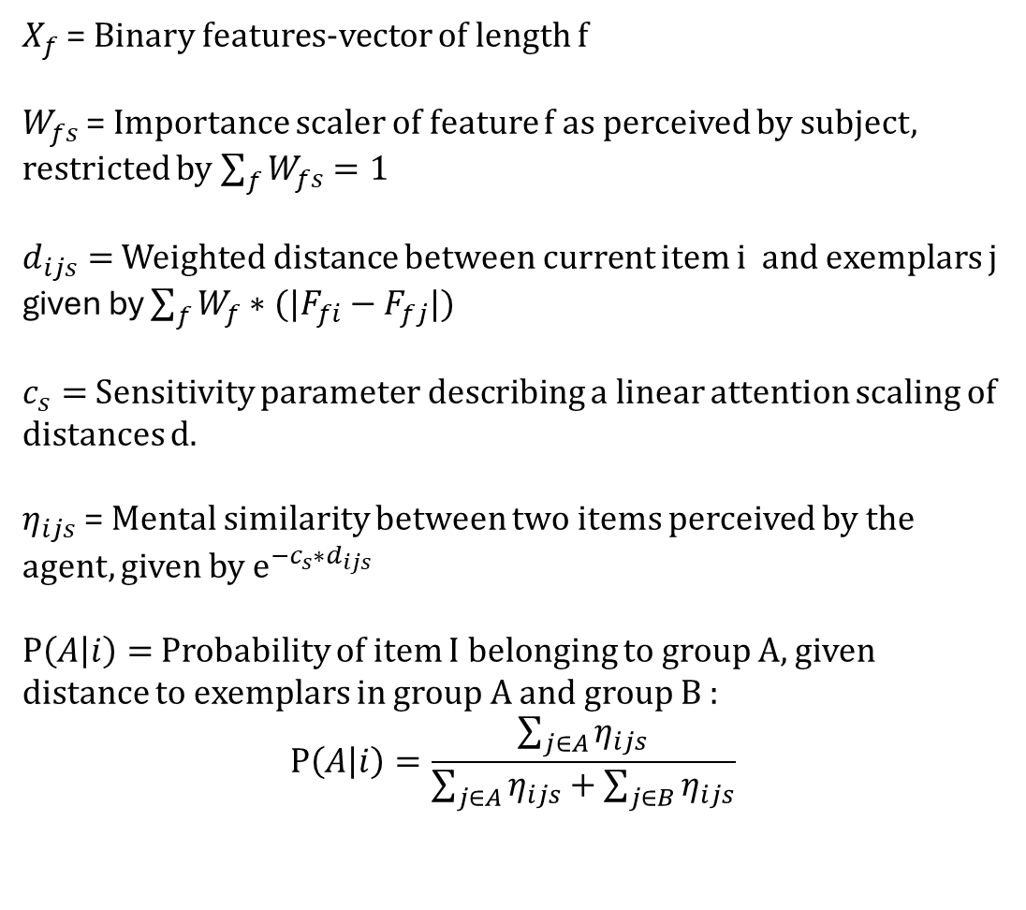
$X_{f}$ = Binary features-vector of length f
$W_{fs}$ = Importance scaler of feature f as perceived by subject, restricted by $\sum_{f}{W_{fs}}=1$
$d_{ijs}=$Weighted distance between current item i and exemplars j
given by $\sum_{f}{{W_{f}∗(|F}_{fi}−F_{fj}|)}$
$c_{s}=$ Sensitivity parameter describing a linear attention scaling of distances d.
$η_{ijs}$ = Mental similarity between two items perceived by the agent, given by $e^{−c_{s}∗d_{ijs}}$
$P\left(A | i\right)=$ Probability of item I belonging to group A, given distance to exemplars in group A and group B :
$$P\left(A | i\right)=\frac{\sum_{j∈A}{η_{ijs}}}{\sum_{j∈A}{η_{ijs}}+\sum_{j∈B}{η_{ijs}}}$$
$$X_{f}$$
$$d_{ijs}$$
$$W_{fs}$$
feature f
$$c_{s}$$
$$η_{ijs}$$
exemplar j
$$P(A|i)$$
subject s
current item i

Slide 4
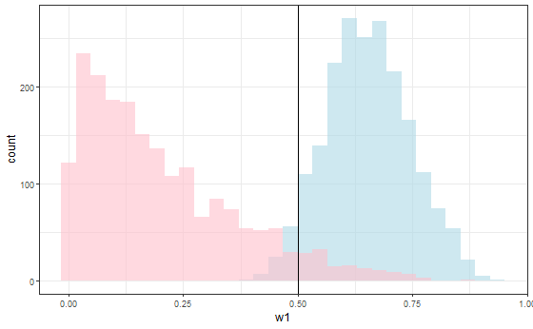
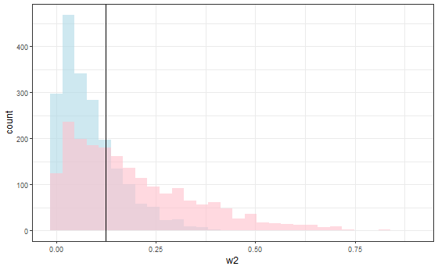
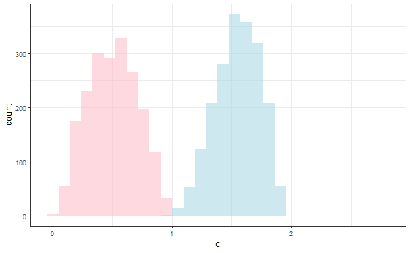
Weight recovery for Skewed3, at four different c-values: c(0.5, .125, .125, .125, .125) c = 2.8
= prior distribution
= true value
= posterior distribution
w[1] =.5
w[2] =.125
c =2.8

Slide 5
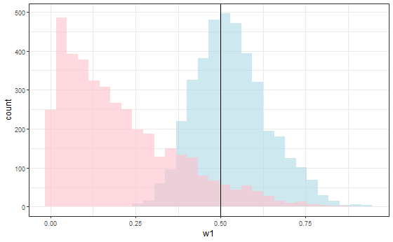
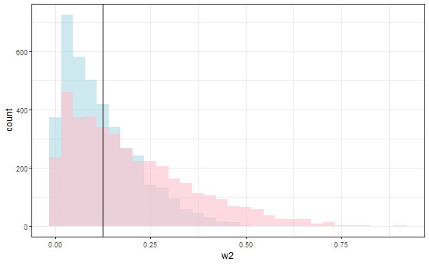
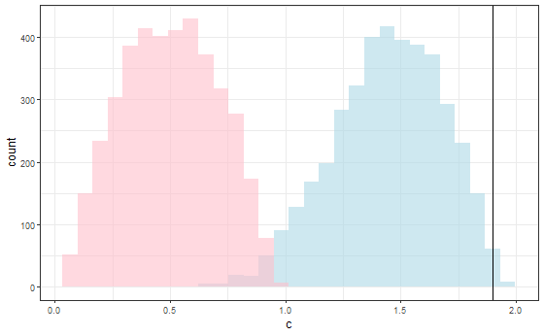
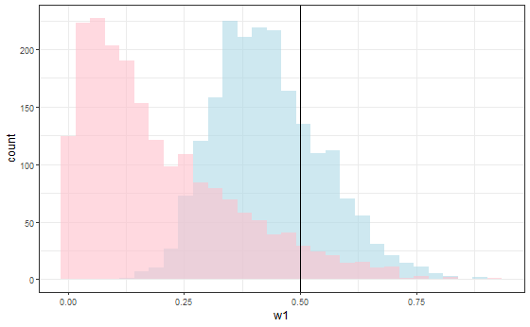
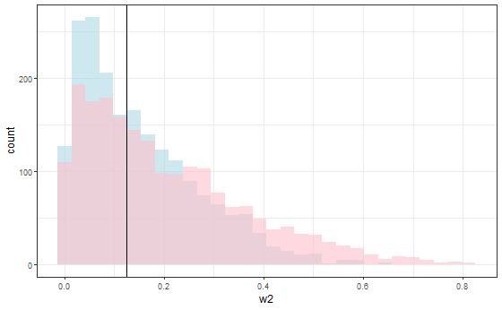
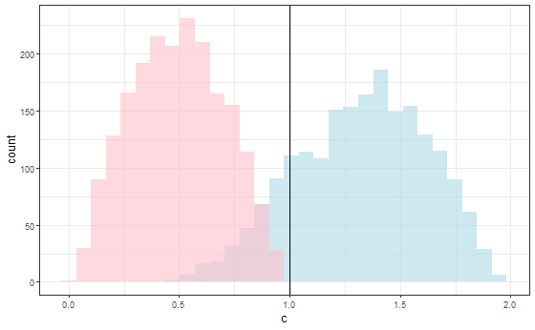
c = 1.9:
= prior distribution
= true value
= posterior distribution
c = 1.0:
w[1] =.5
w[2] =.125
c =1.9
= prior distribution
= true value
= posterior distribution
w[1] =.5
w[2] =.125
c =1.

Slide 6
c = 1.0:
= prior distribution
= true value
= posterior distribution
w[1] =.5
w[2] =.125
c =1.

Slide 7
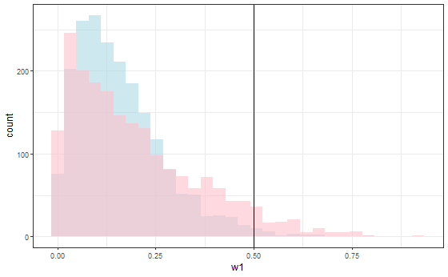
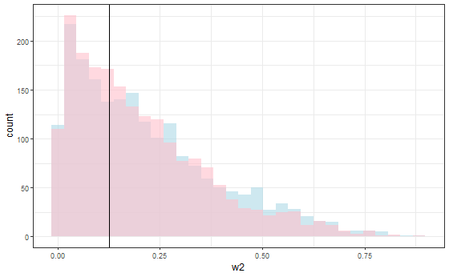
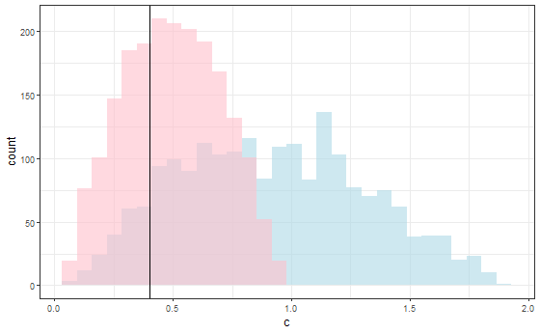
c = 0.4:
= prior distribution
= true value
= posterior distribution
w[1] =.5
w[2] =.125
c =0.4

