Slide 1
Network structure of Bert
Trm 1
…
Trm N
Trm END
Encoder Layer :
12 x 768 Attention Layers
Trm 1
…
Trm N
Trm END
Position 1
…
Position N
Position END
+
+
+
Embedding 1
…
Embedding N
Embedding END
Embedding Layer
+
+
+
Token 1
…
Token N
Token END
Text String

Slide 2
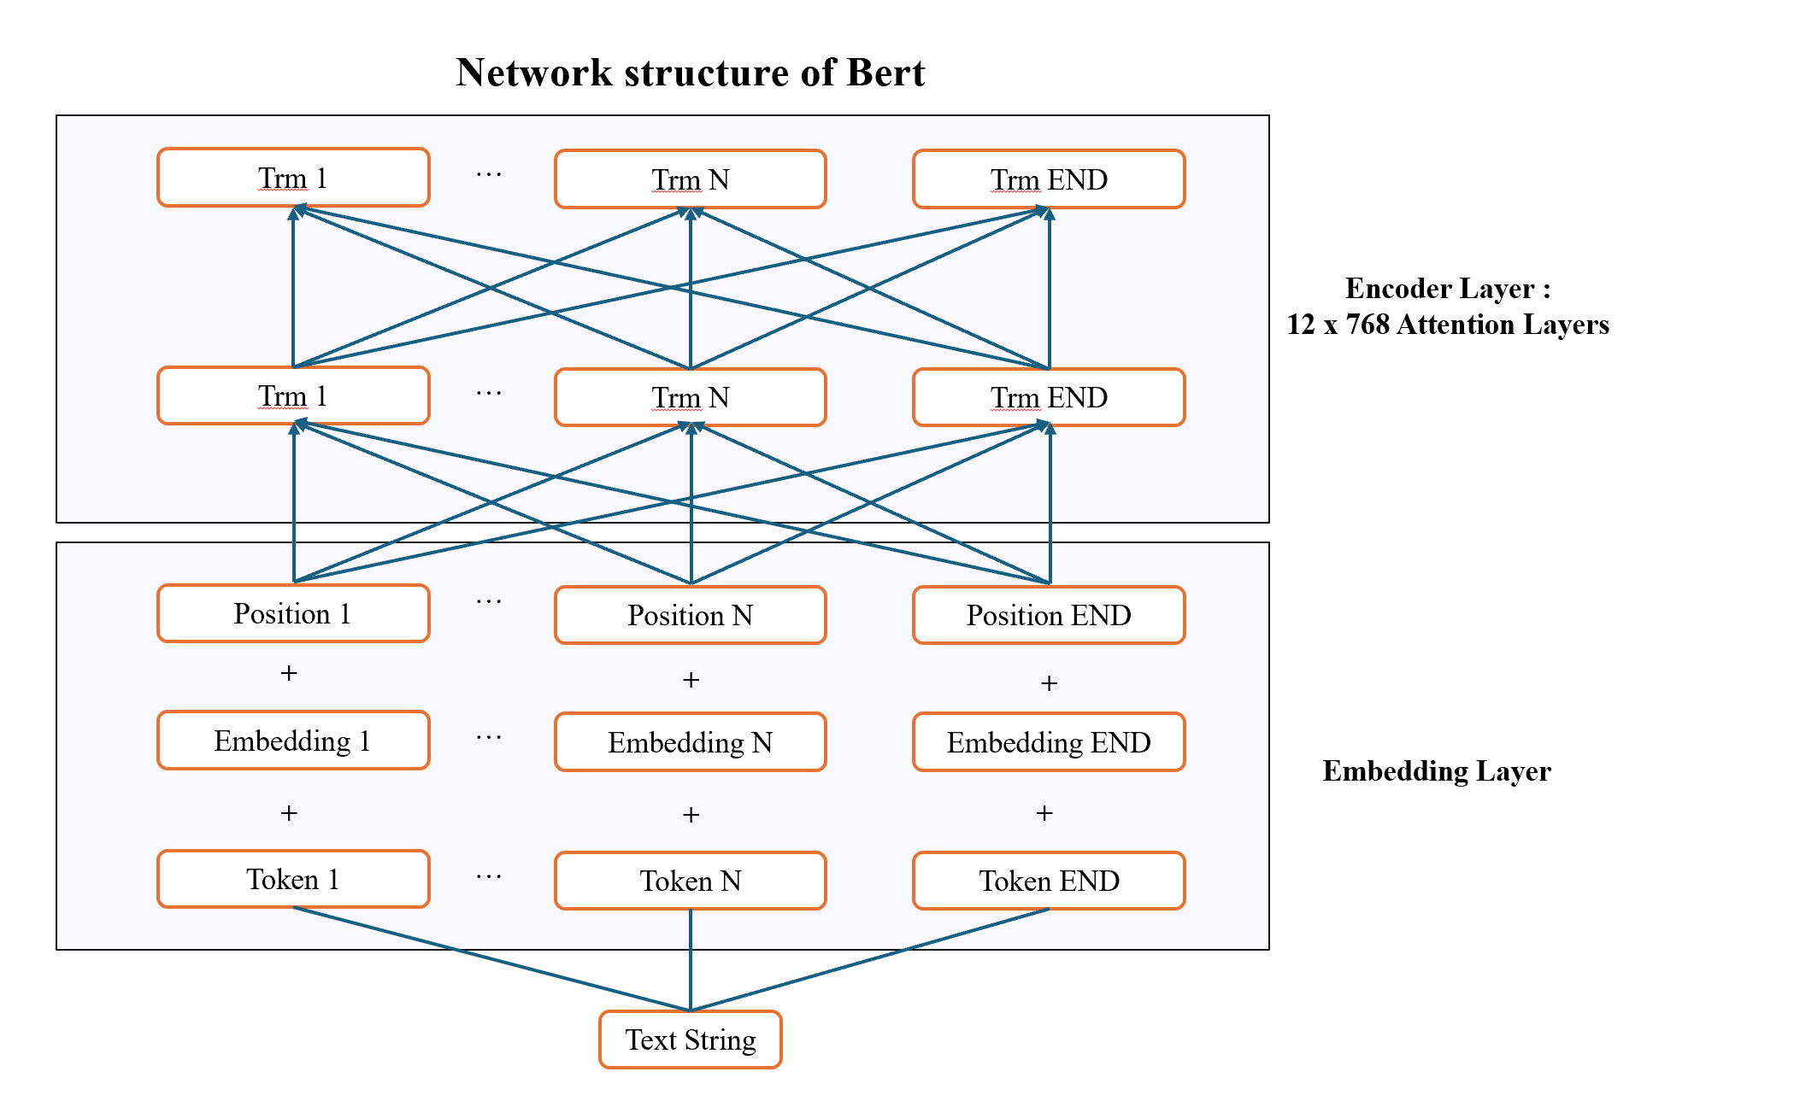
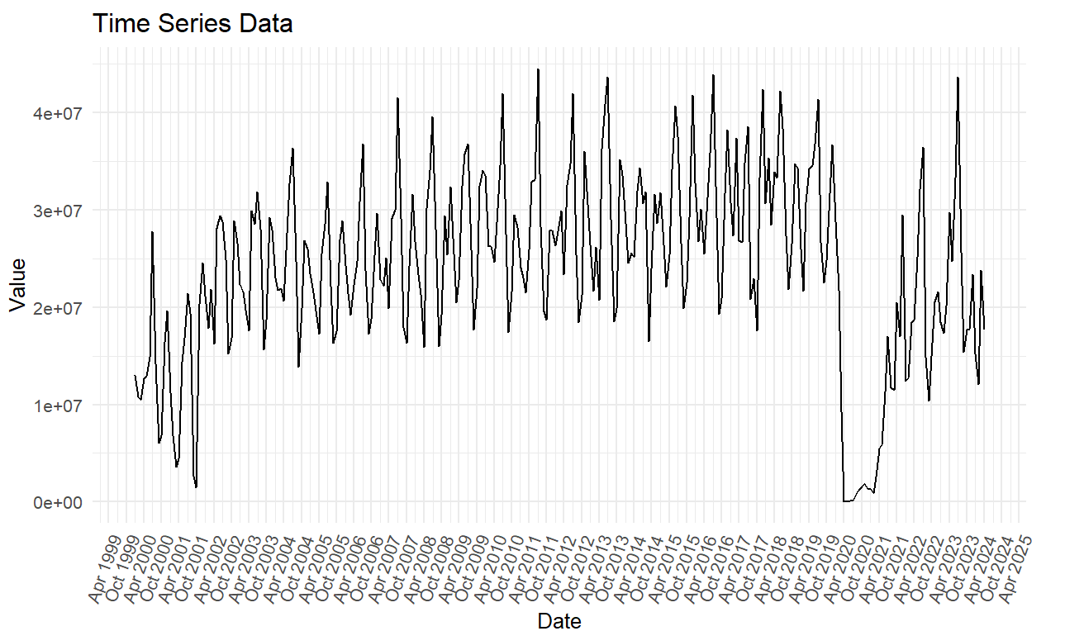
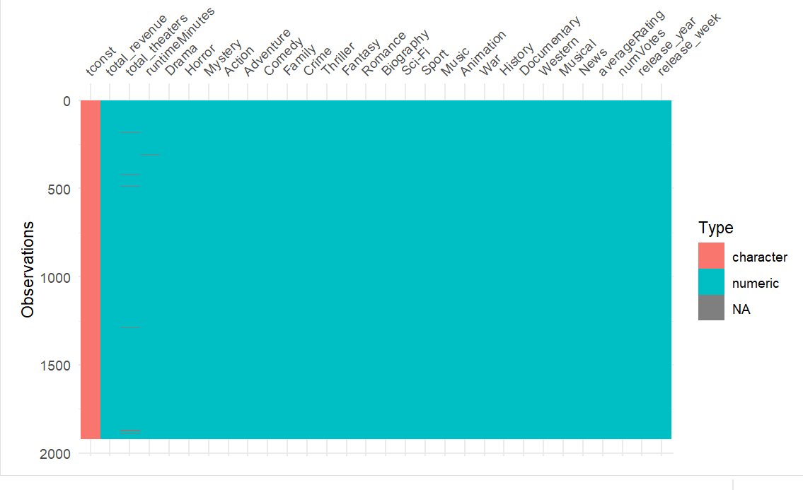
Workflow of model construction
4 XGBoost regression models-
Conditional inclusion of ratingScore and PCA-dimensions
Testing Data – RMSE scoring
Parameter optimisation through cross-validation
Training Data
Conditional inclusion:
80/20 split
PCA-reduction to 50 dimensions
Preprocessing – and data partitioning
Embedding of layer 11:
Time Series Revenue Data:
Tabular IMDb Data

Slide 3
Model Ranking:
IMDb + Timeseries + PCA RMSE: 10,541,000
1.
IMDb + Timeseries RMSE: 13,651,000
2.
IMDb + Timeseries RMSE, no rating-score : 13,707,000
3.
IMDb + Timeseries + PCA RMSE, no rating-score: 14,242,000
4.
Baseline ‘predict the mean model ’ RMSE: 44,290,000
5.

Slide 4
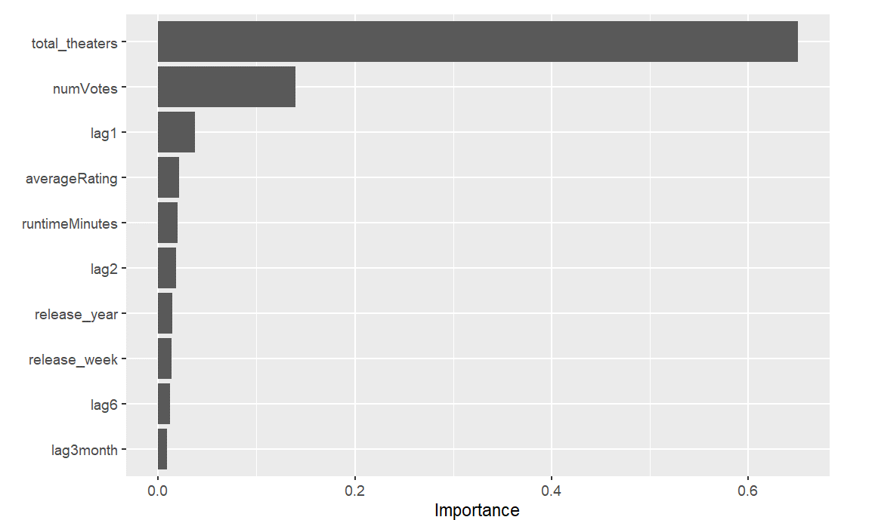
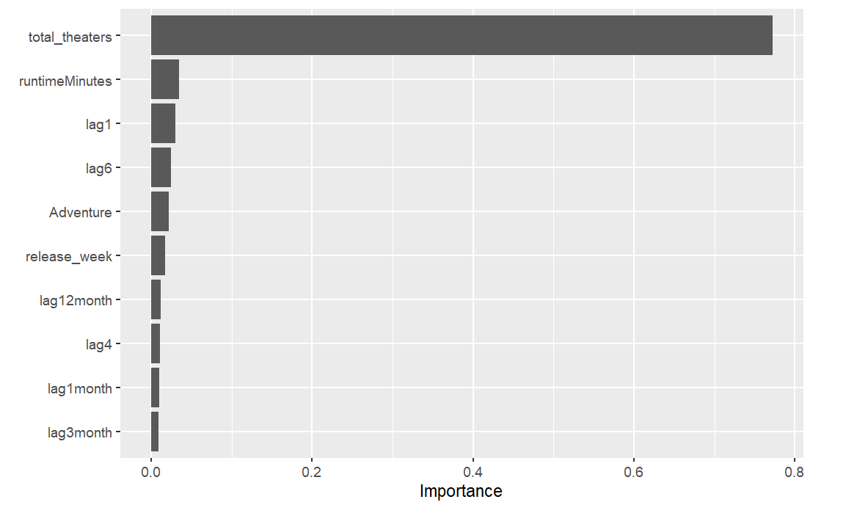
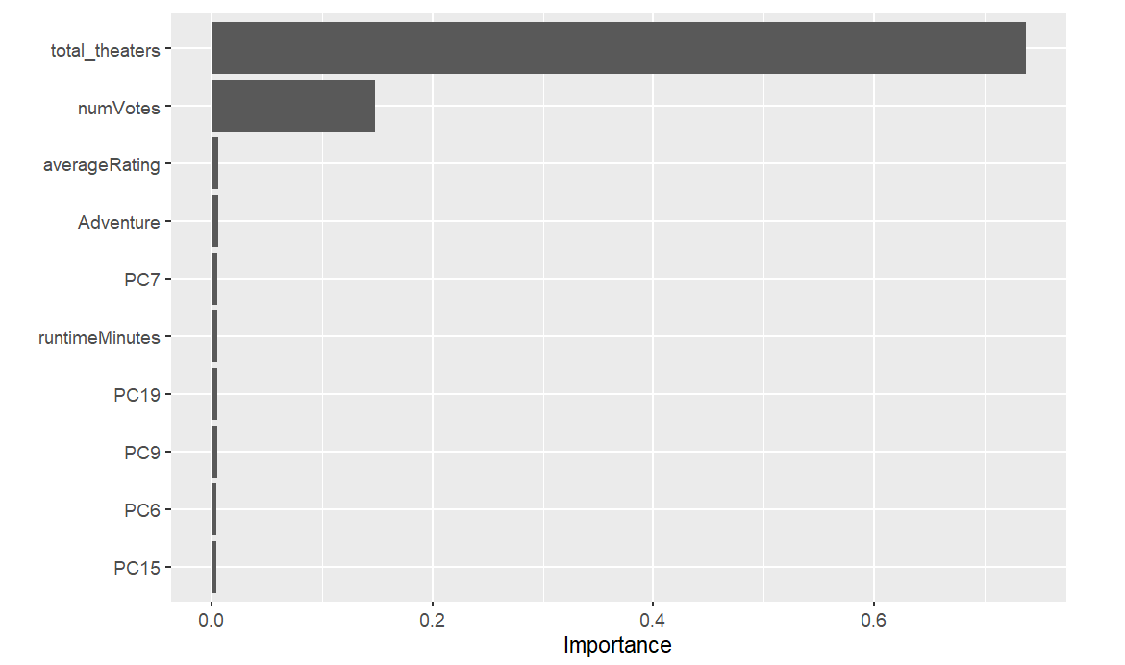
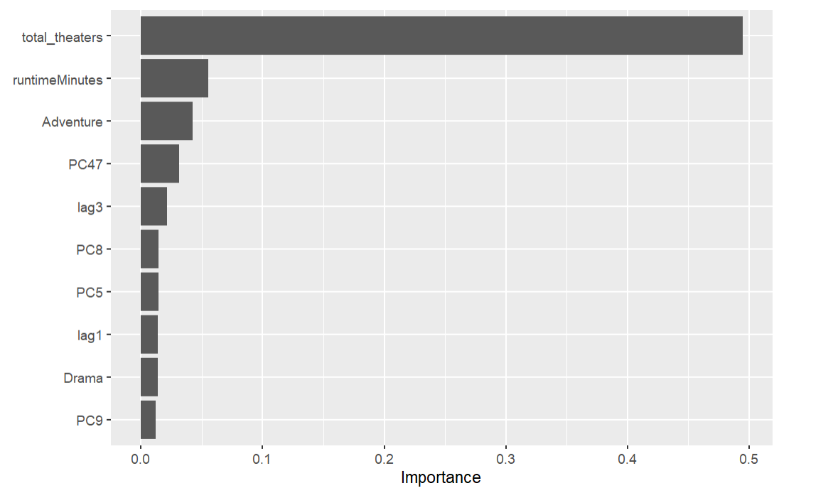
IMDb + Timeseries
IMDb + Timeseries, no rating-score
IMDb + Timeseries + PCA
IMDb + Timeseries + PCA, no rating-score

