Slide 1
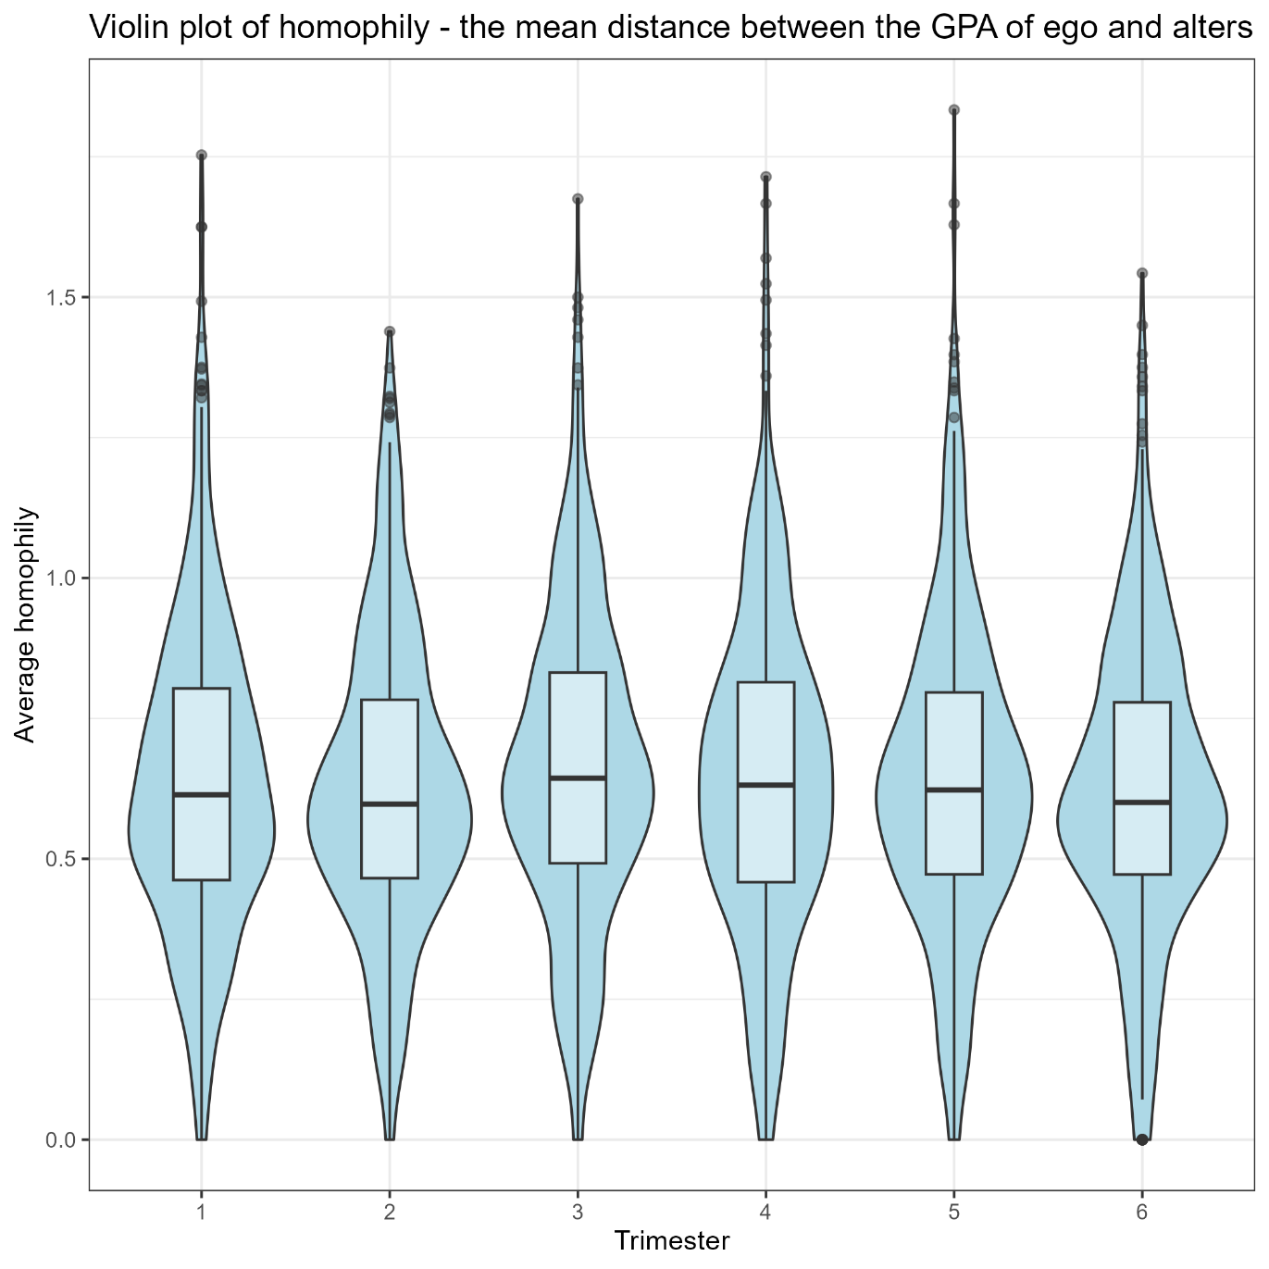
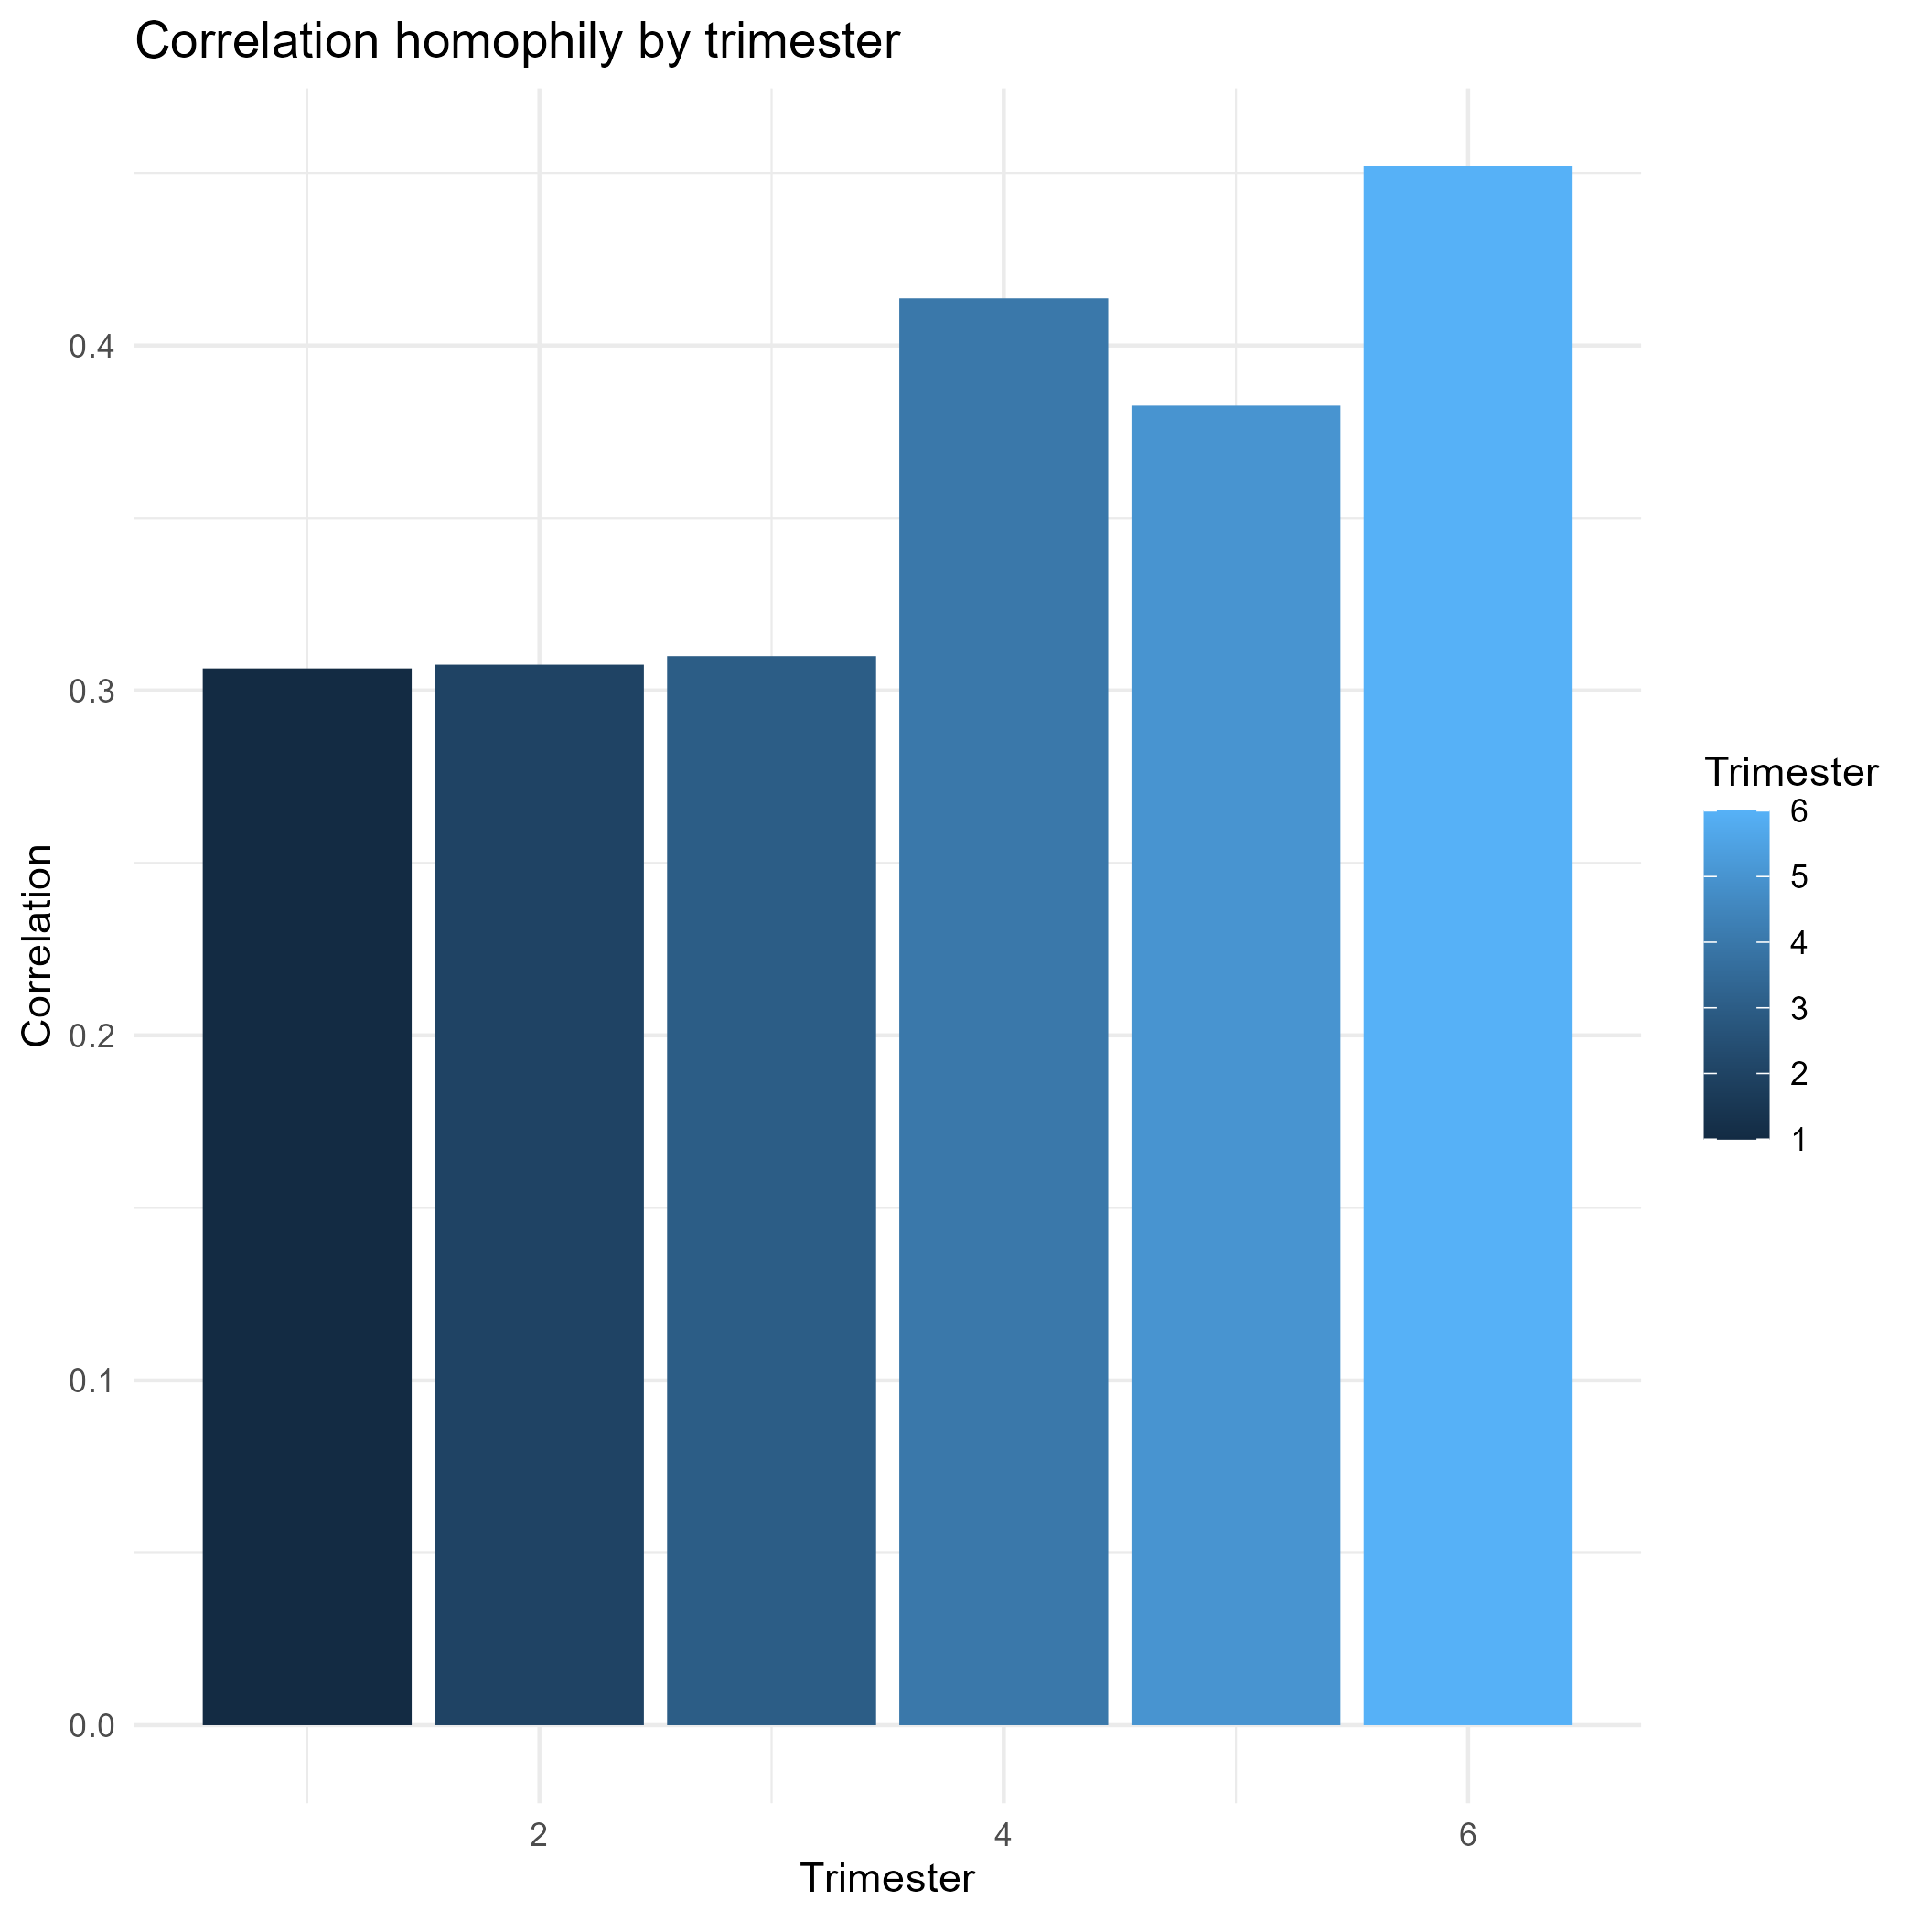
(A)
(B)

Slide 2
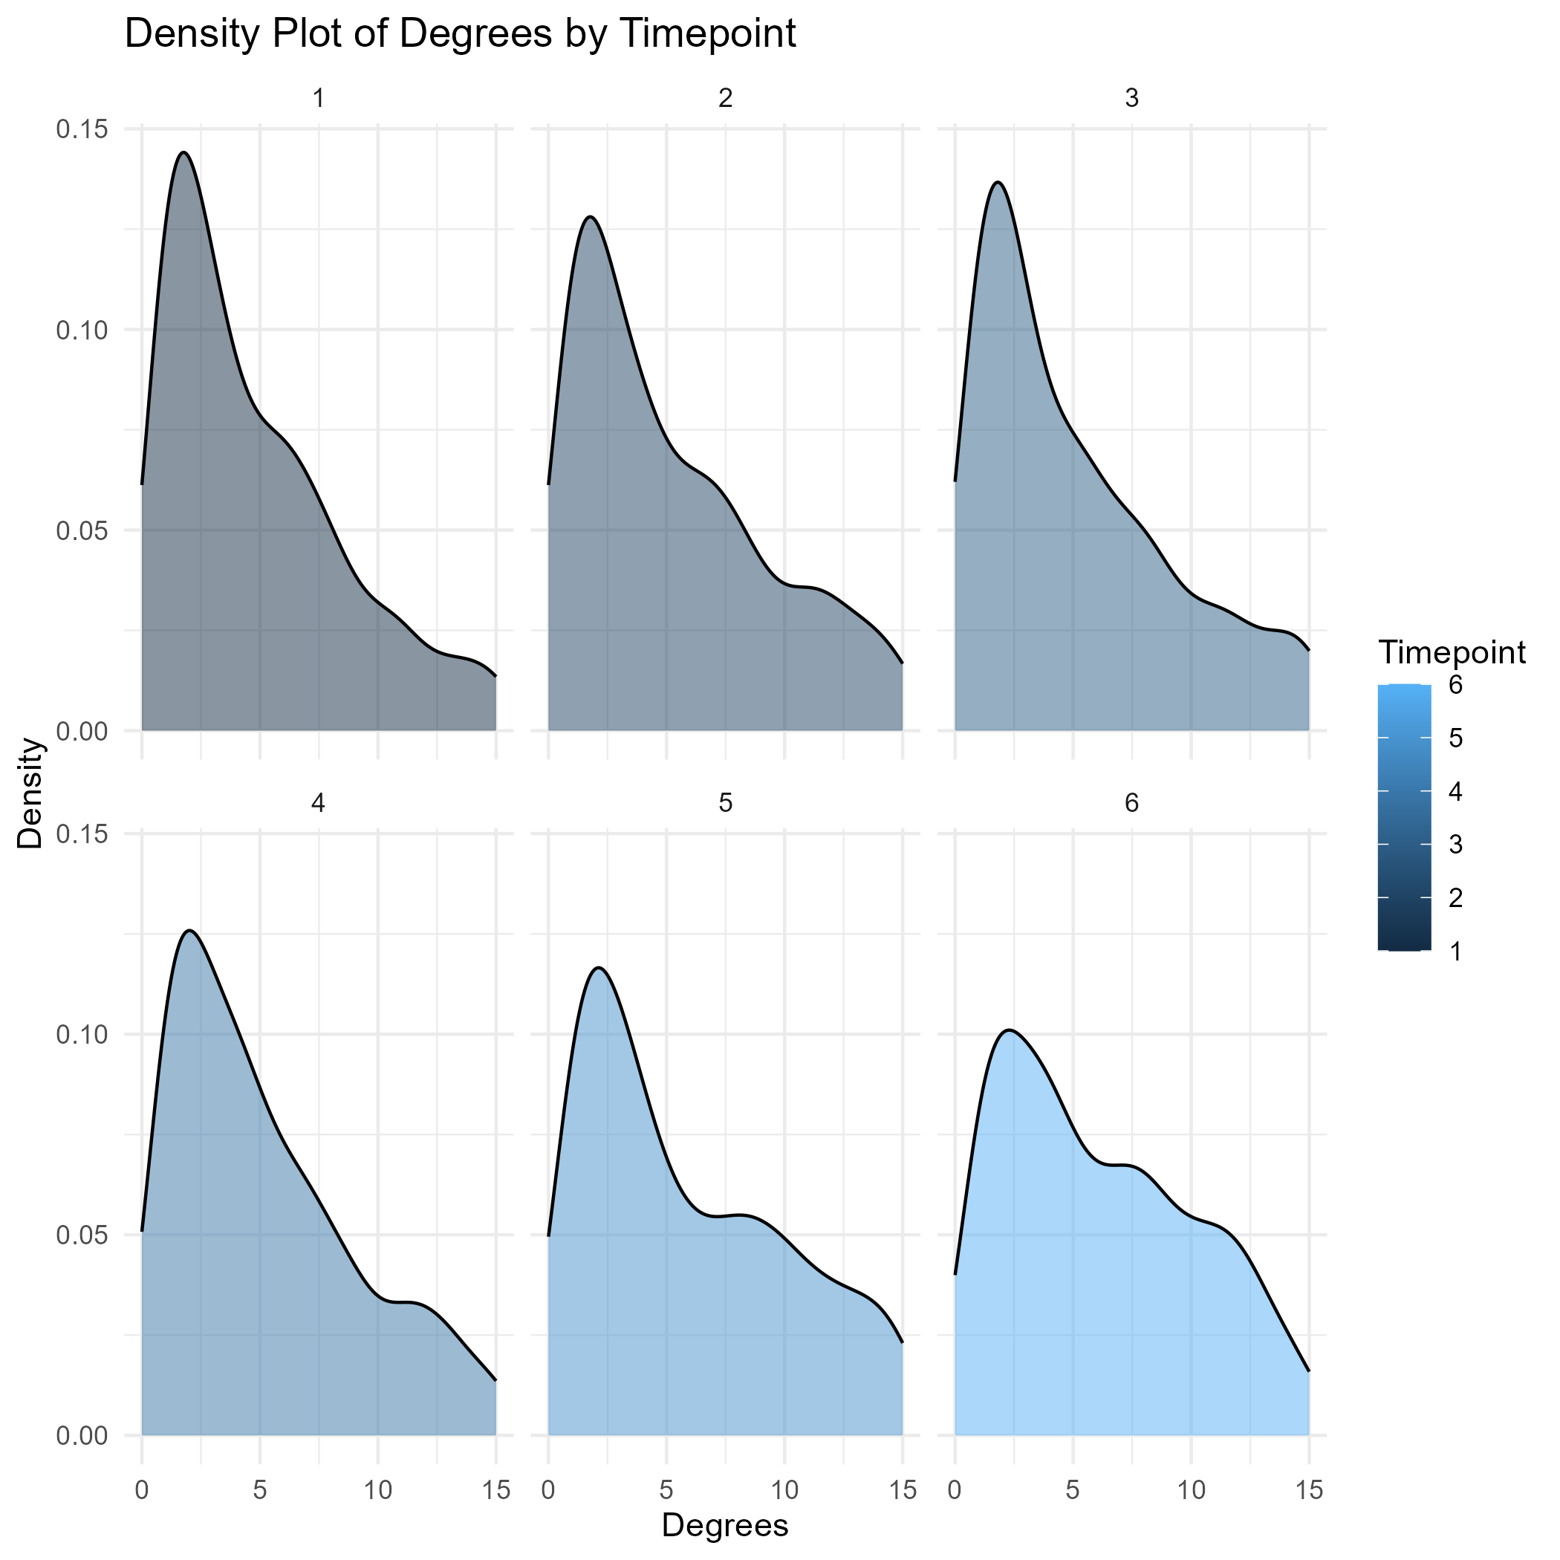
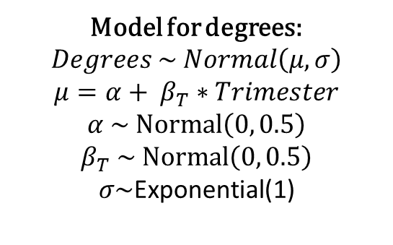
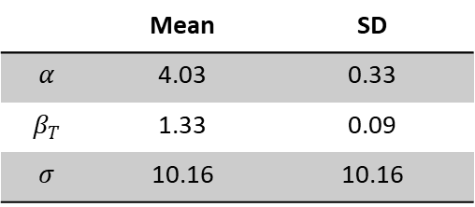
Trimester | Mean degrees | SD
1 | 4.71 | 7.08
2 | 6.10 | 8.98
3 | 6.56 | 9.17
4 | 6.24 | 9.82
5 | 8.23 | 11.08
6 | 7.93 | 10.25
(B)
Model for degrees: $$Degrees \sim Normal\left(μ, σ\right)$$
$$μ=α+ β_{T}∗Trimester$$
$$α \sim Normal\left(0, 0.5\right)$$
$$β_{T} \sim Normal\left(0, 0.5\right)$$
$$σ\sim \text{Exponential}\text{(1)}$$
Distribution for parameters
 | Mean | SD
$$α$$ | 4.03 | 0.33
$$β_{T}$$ | 1.33 | 0.09
$$σ$$ | 10.16 | 10.16
(C)
(A)

Slide 3
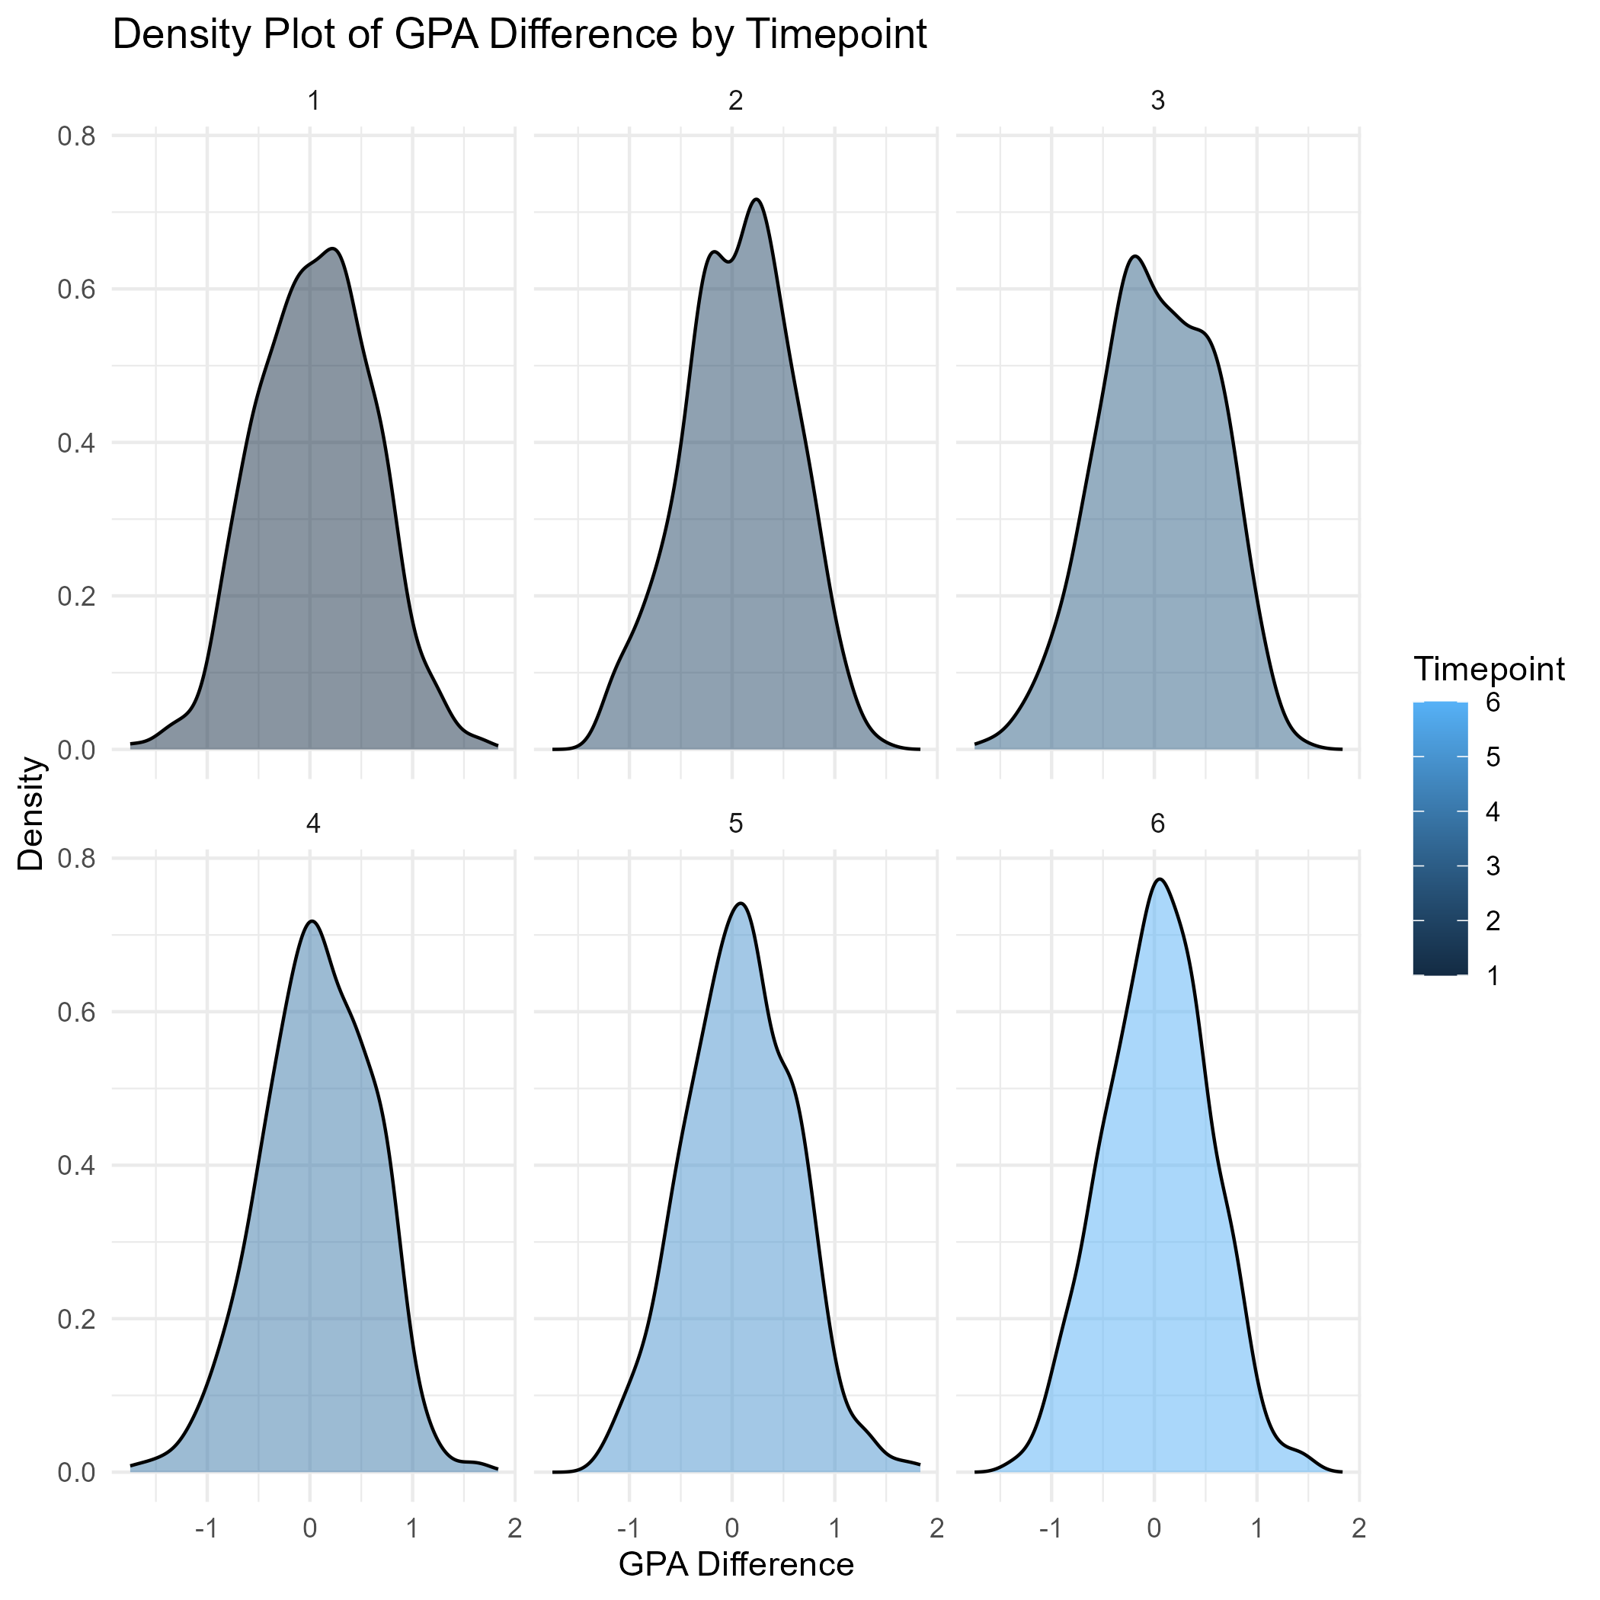
Trimester | Mean difference | SD
1 | 0.05 | 0.56
2 | 0.06 | 0.53
3 | 0.03 | 0.56
4 | 0.07 | 0.53
5 | 0.08 | 0.53
6 | 0.03 | 0.5
(B)
(A)

Slide 4
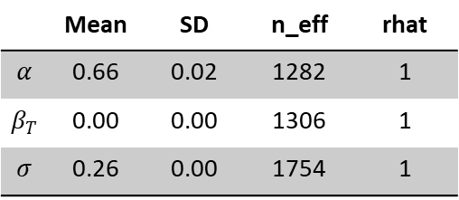
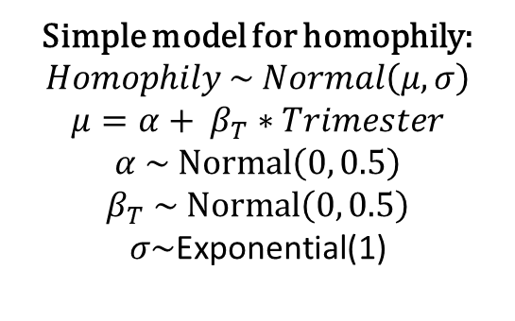
Simple model for homophily: $$Homophily \sim Normal\left(μ, σ\right)$$
$$μ=α+ β_{T}∗Trimester$$
$$α \sim Normal\left(0, 0.5\right)$$
$$β_{T} \sim Normal\left(0, 0.5\right)$$
$$σ\sim \text{Exponential}\text{(1)}$$
Posterior distribution of parameters
 | Mean | SD | n_eff | rhat
$$α$$ | 0.66 | 0.02 | 1282 | 1
$$β_{T}$$ | 0.00 | 0.00 | 1306 | 1
$$σ$$ | 0.26 | 0.00 | 1754 | 1

Slide 5
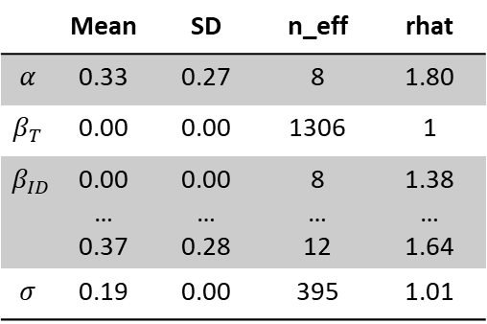
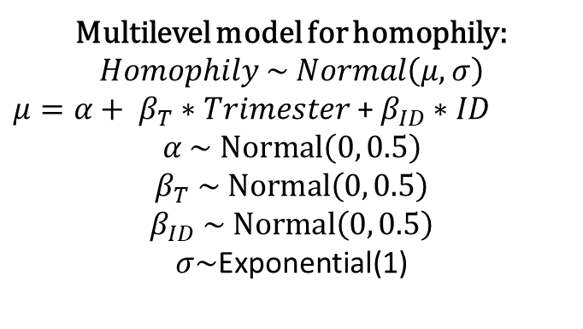
Multilevel model for homophily: $$Homophily \sim Normal\left(μ, σ\right)$$
$μ=α+ β_{T}∗Trimester$ + $β_{ID}∗ID$
$$α \sim Normal\left(0, 0.5\right)$$
$$β_{T} \sim Normal\left(0, 0.5\right)$$
$$β_{ID} \sim Normal\left(0, 0.5\right)$$
$$σ\sim \text{Exponential}\text{(1)}$$
Posterior distribution of parameters
 | Mean | SD | n_eff | rhat
$$α$$ | 0.33 | 0.27 | 8 | 1.80
$$β_{T}$$ | 0.00 | 0.00 | 1306 | 1
$$β_{ID}$$ | 0.00 … 0.37 | 0.00 … 0.28 | 8 … 12 | 1.38 … 1.64
$$σ$$ | 0.19 | 0.00 | 395 | 1.01

