Slide 1
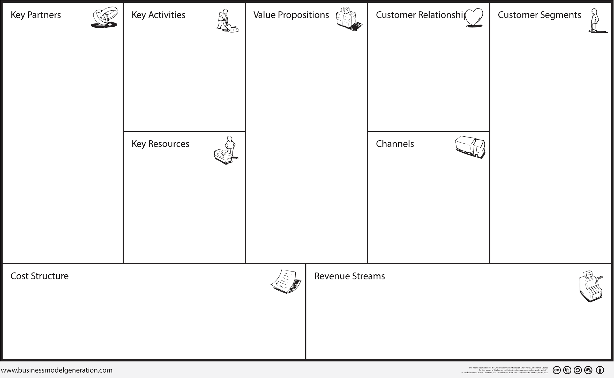
Municipalities
Software development
Free real time public transport data
Mass customers
Casual users
High volume users
Software developers
Software
Google App Engine
Cloud ShowPlace
Software development and mantenance
Complaint management
Storage cost
Marketing?
Free limited basic account
One time purchase pro account

