Slide 1
Wireless Sensor Network for Monitoring Environmental Factors in Industrial Installations
Authors:
Lauro Manoel Lima da Gama
João Batista Hidaka de Oliveira Gaia
Antonio de Pádua Soares Junior
Msc, Almir Kimura Junior
Universidade do Estado do Amazonas – UEA

Slide 2
MQTT
Small code footprint
Publish / Subscribe
Avaiable in Various languages and devices
Limited Bandwidth
All messages pass through broker

Slide 3
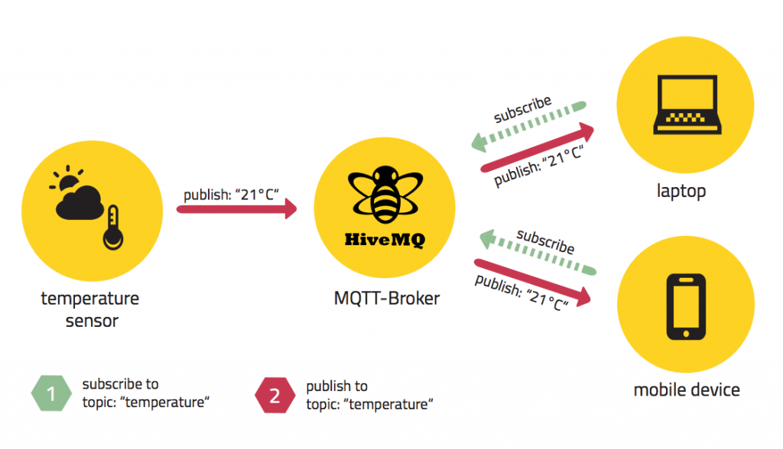
Publish/ Subscribe protocol
Source: http://www.hivemq.com/blog/mqtt-essentials-part2-publish-subscribe

Slide 4
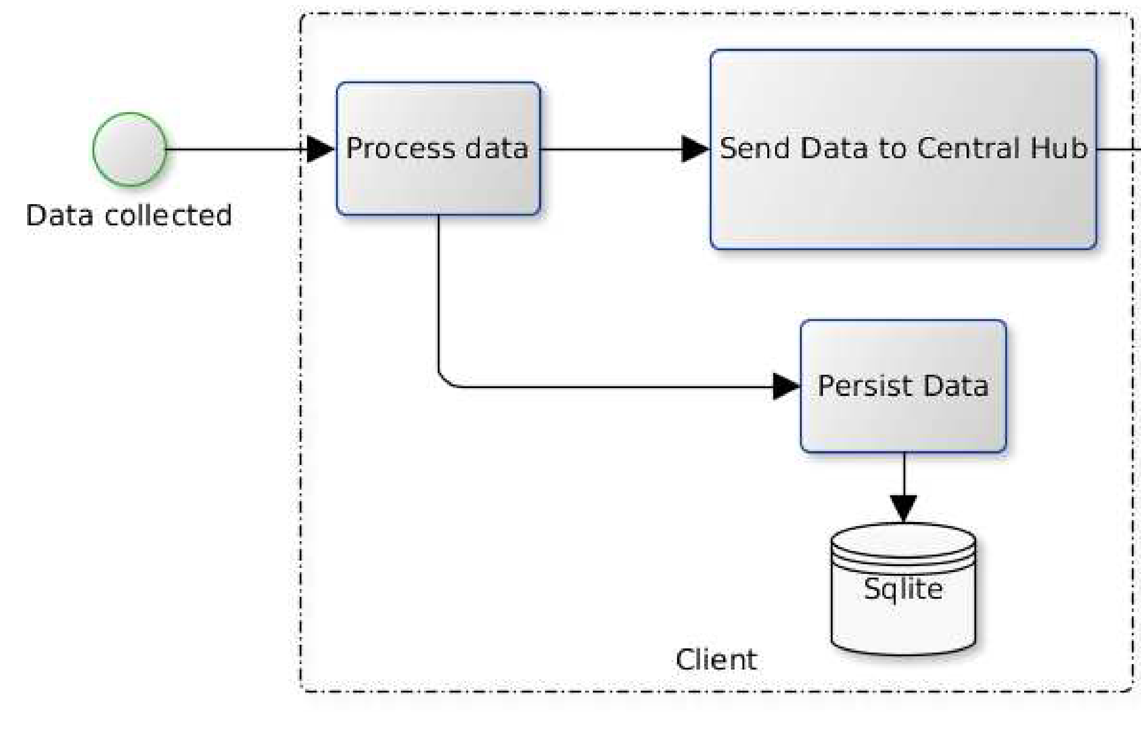
Node Diagram
28/10/15

Slide 5
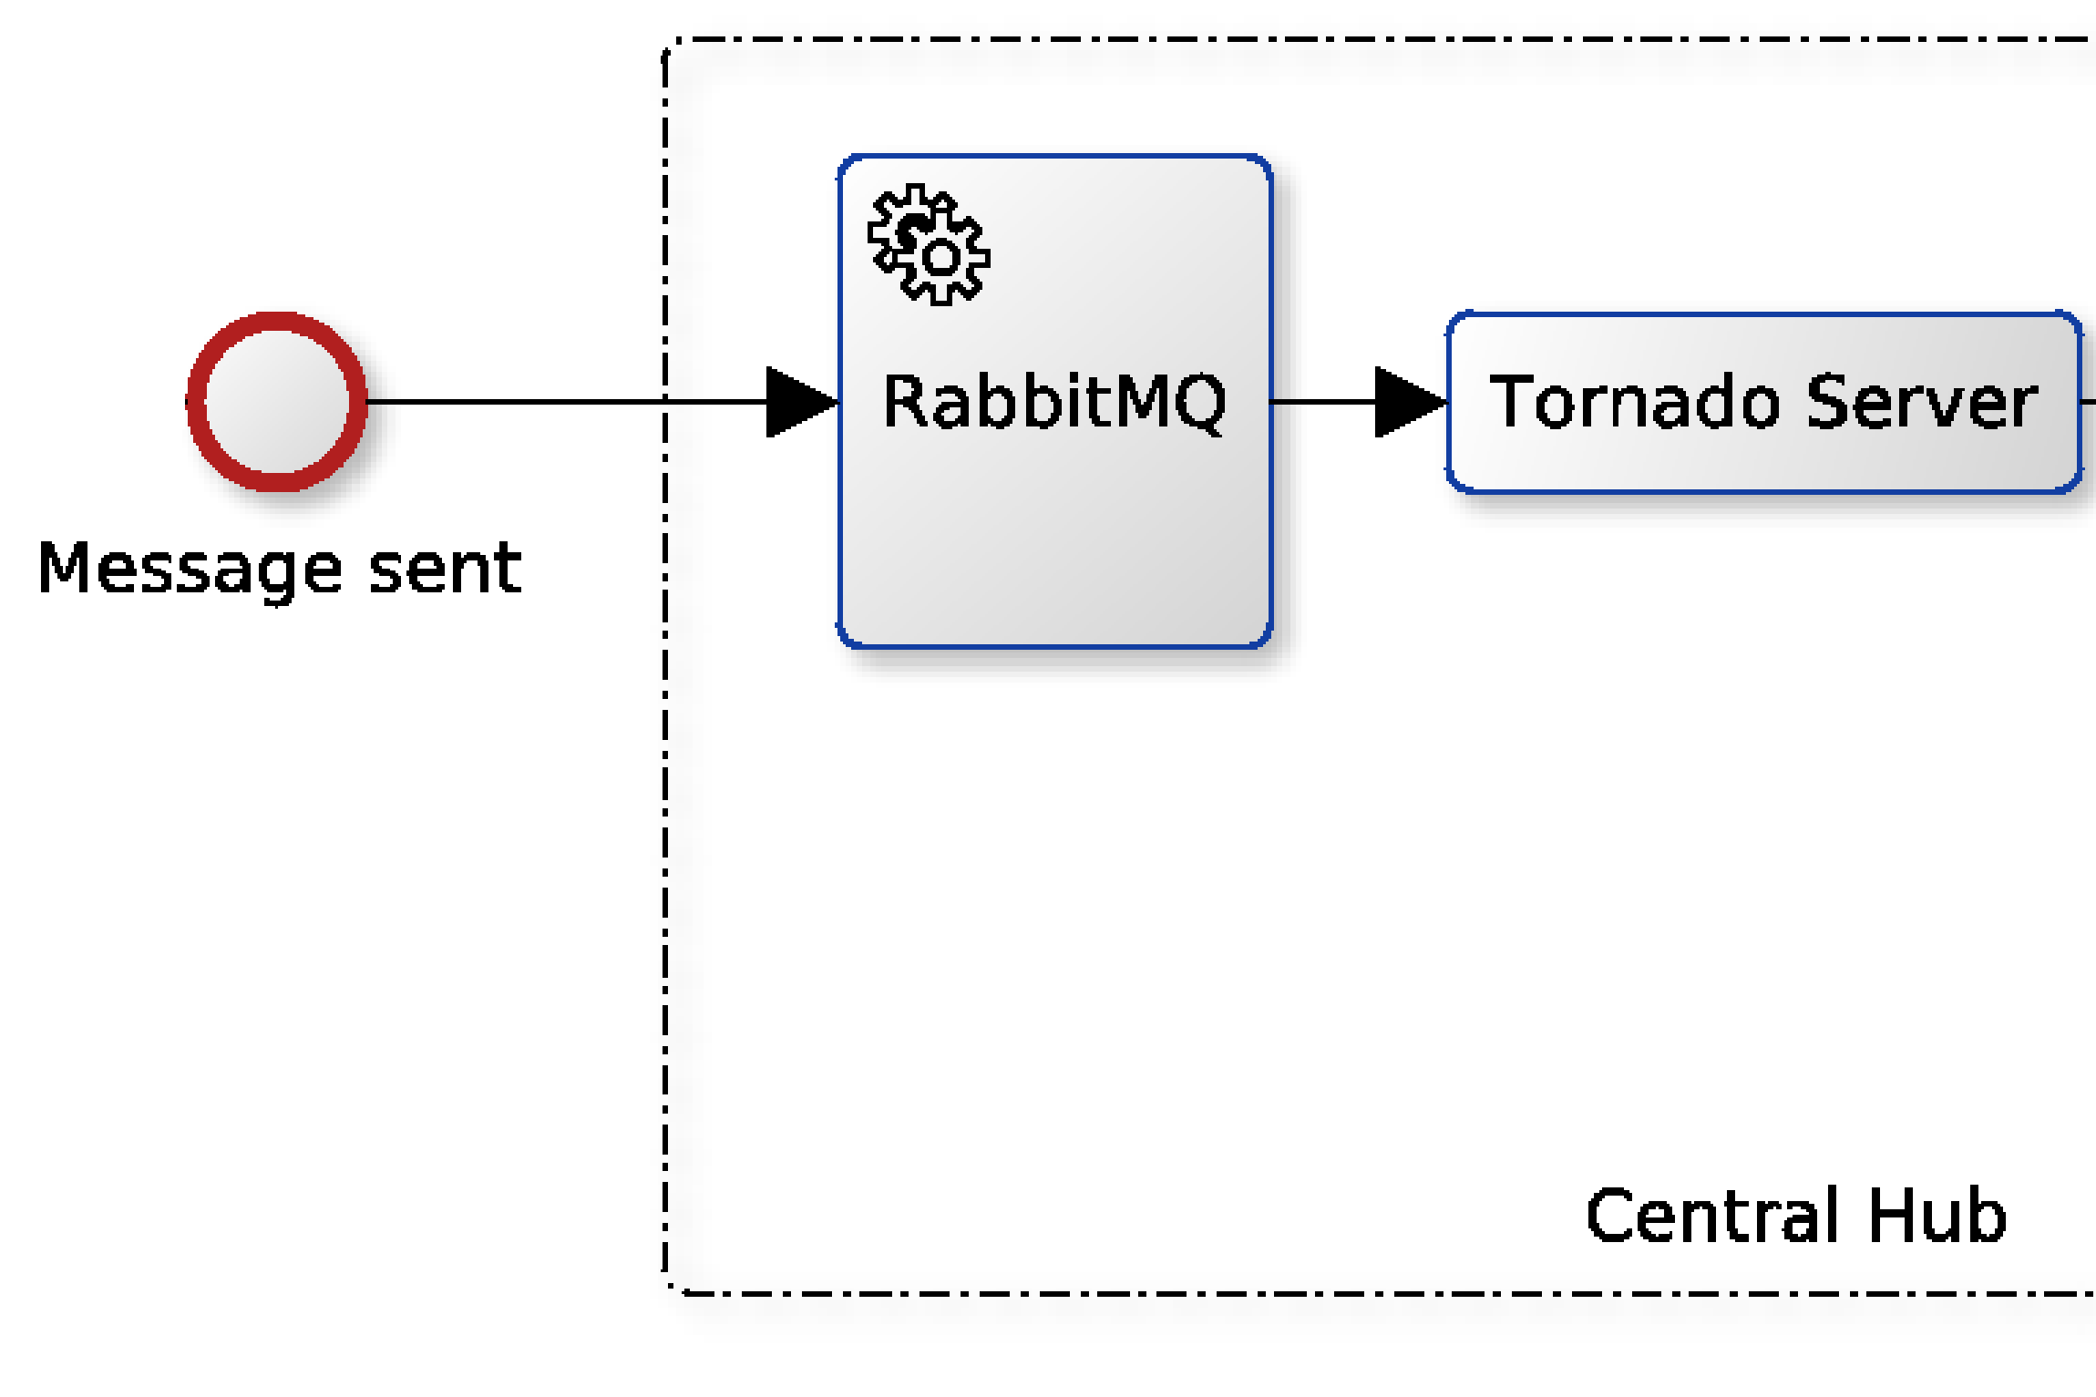
Central Hub Diagram
28/10/15

Slide 6
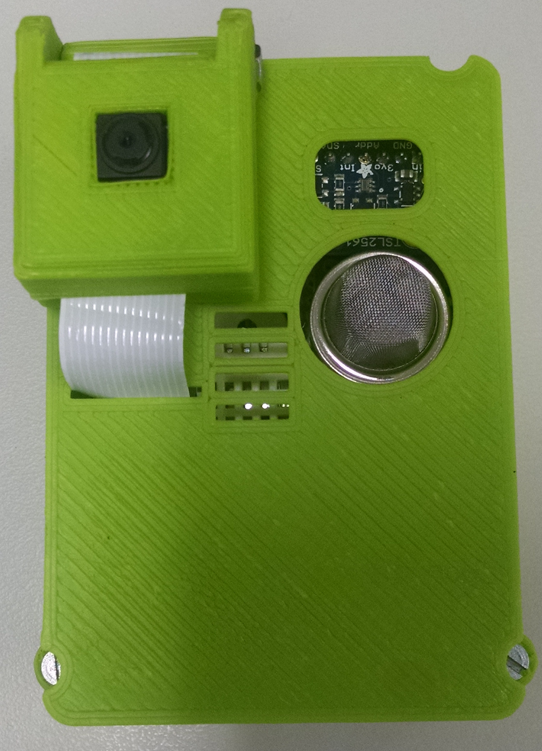
Collector Node

Slide 7
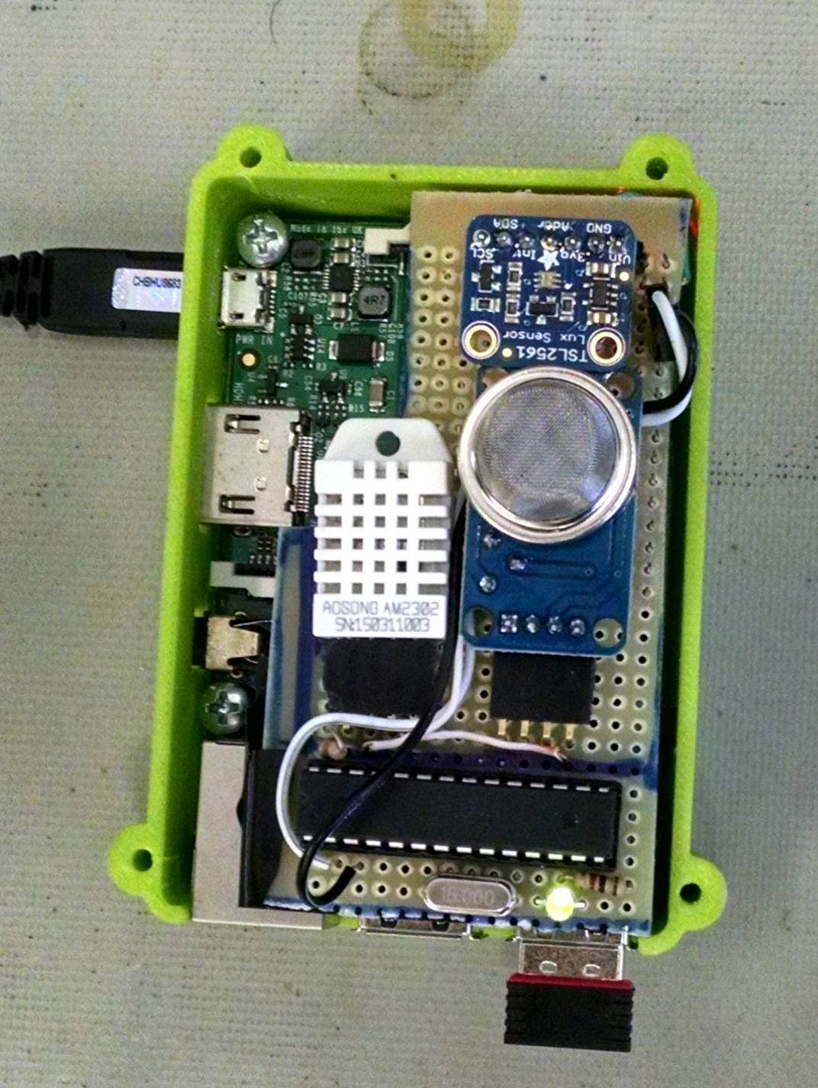
View from above

Slide 8
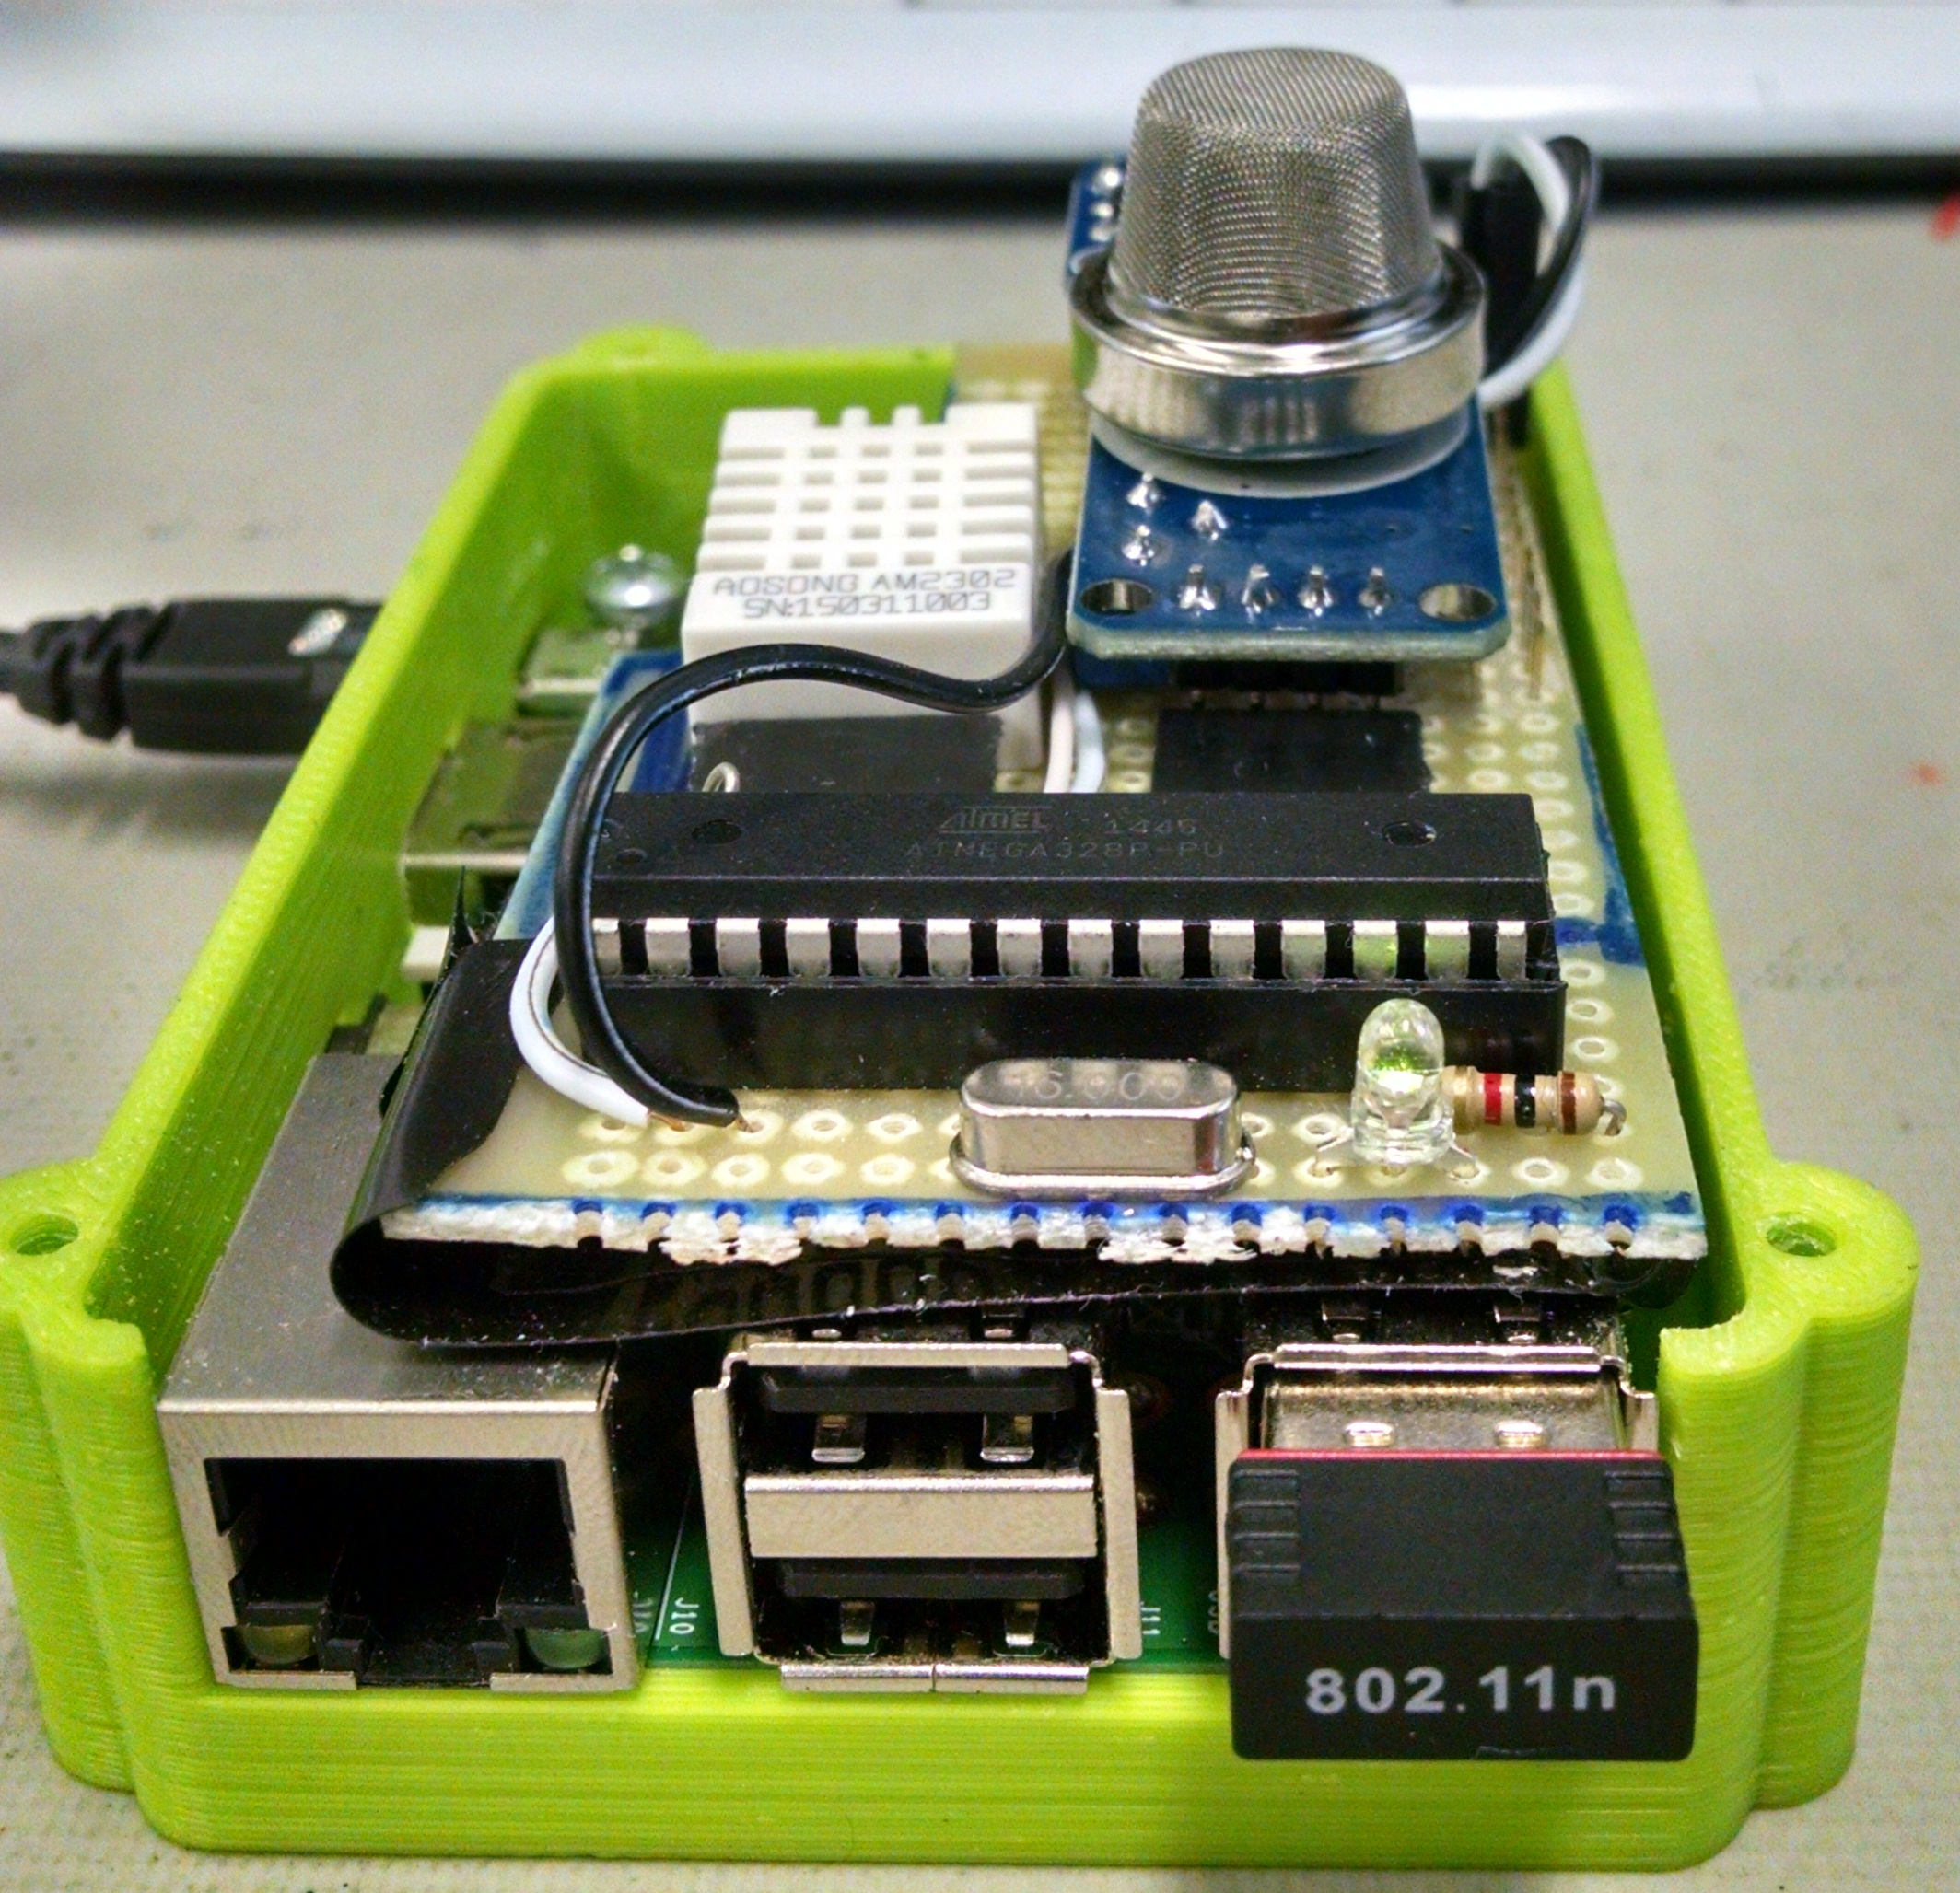
Sensor details

Slide 9
Technology utilized on prototype
Programming Language
Python
Http Server
Tornado
Database
PostgreSQL
SQLite
Packages
Pika
Flask
Message format
Json
Devices
Raspberry Pi 1 B+
Atmel ATmega328
Sensors
Temp & humidity sensor DHT22
Gas presence Sensor MQ2
Luminance sensor TSL2561

Slide 10
Results

Slide 11
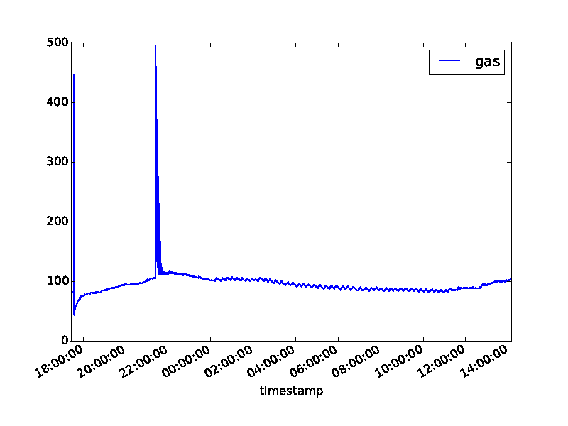

Slide 12
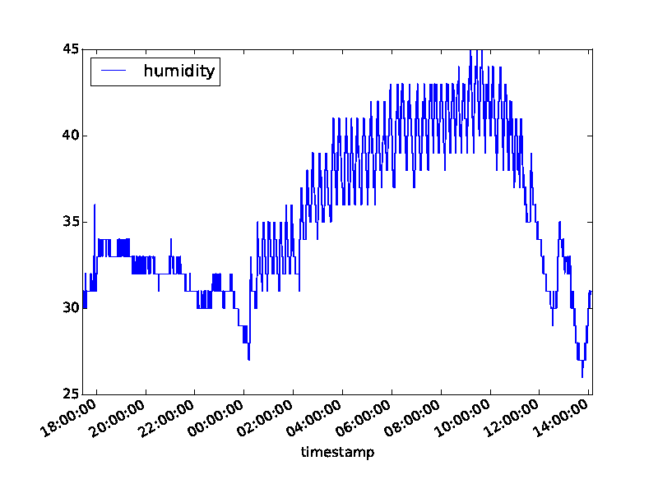

Slide 13
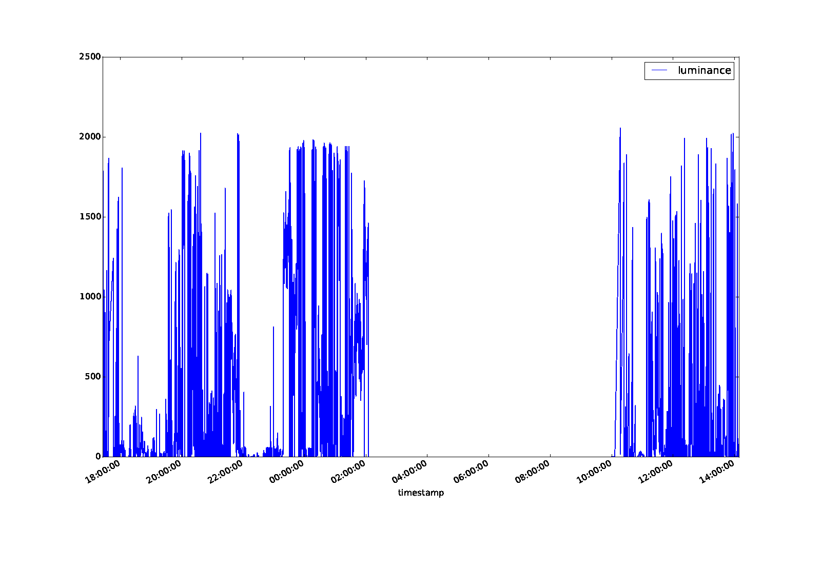

Slide 14
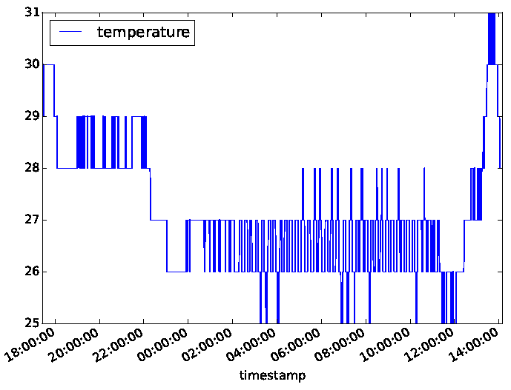

Slide 15
Possibilities of use
Profiling of work conditions
Fast response in case of emergencies
Distributed control of air conditioning central

Slide 16


Acknowledgements
28/10/15

Slide 17
Wireless Sensor Network for Monitoring Environmental Factors in Industrial Installations
Thank you!

