Slide 1
NoTFLIX
Advanced Solutions Engineer Candidate Presentation
Lauro Salazar
DevOps/Systems Engineer
Austin, TX
Outline:
What is Notflix?
Methodology and Tech used
Developer Workflow
Operations Diagram
Performance
Demo

Slide 2






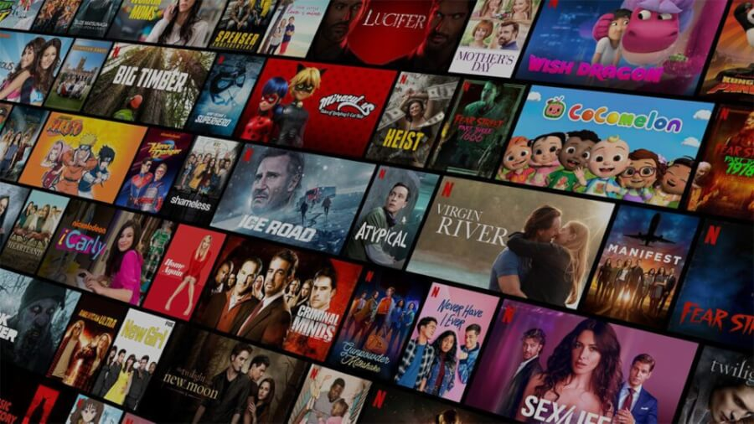



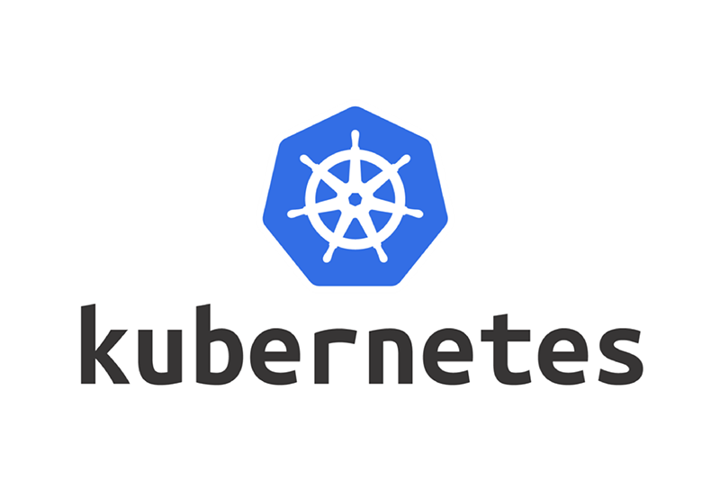


What is Notflix?
Notflix is a fast and lightweight media streaming platform, built on ReactJS - on top of the Microsoft Azure public cloud, and Verizon’s CDN integrated into Azure’s Media Services platform.
Hosted across the US, UK, and Southeast Asia, with multiple CDN POP’s to present video streaming media at low latencies - supporting HLS, DASH, and RTMPS.
Technology used
NoTFLIX

Slide 3
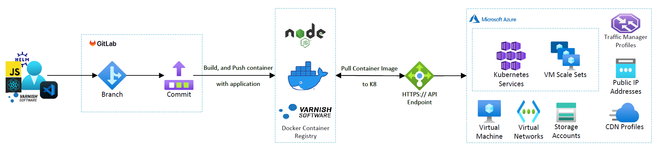
Developer Workflow
Developer centric workflow – for speedy releases using Gitlab CI/CD, and container orchestration using Kubernetes.
Effortlessly and dynamically spin up dev environments using Infrastructure as Code, and rollback releases in case of issues.
NoTFLIX

Slide 4
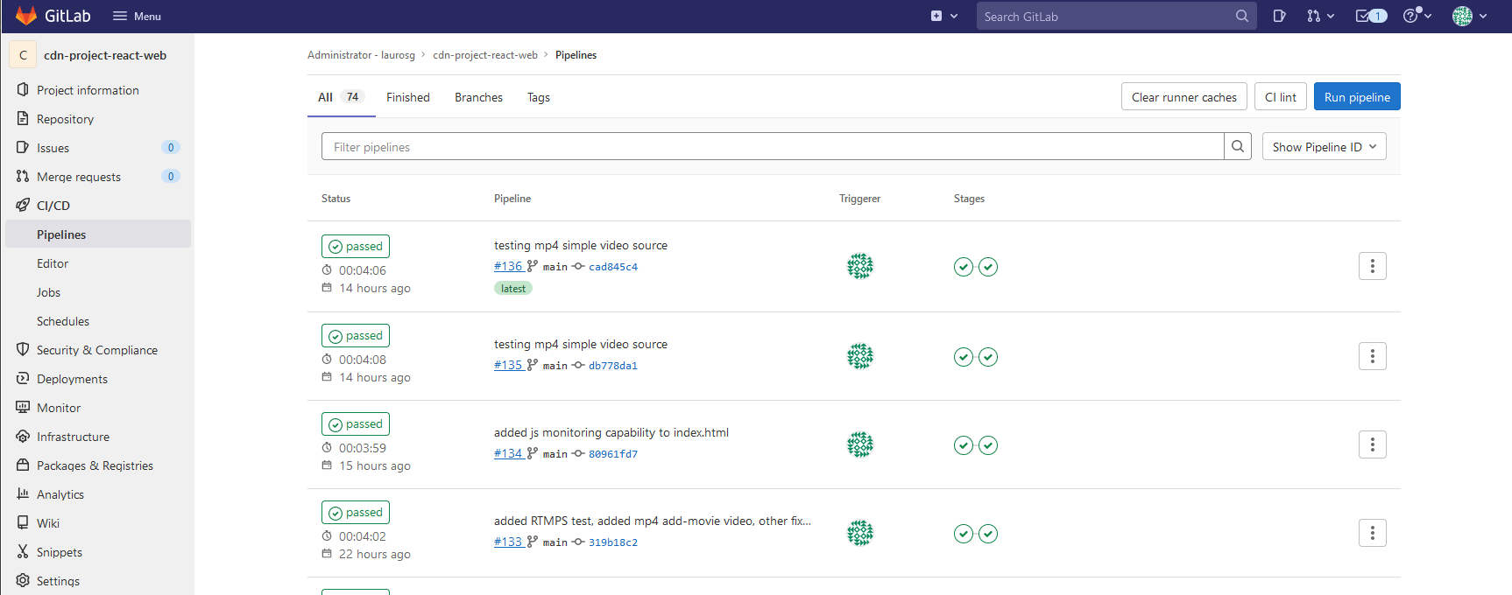
Developer Workflow
Gitlab – Track releases and Infrastructure changes
NoTFLIX

Slide 5
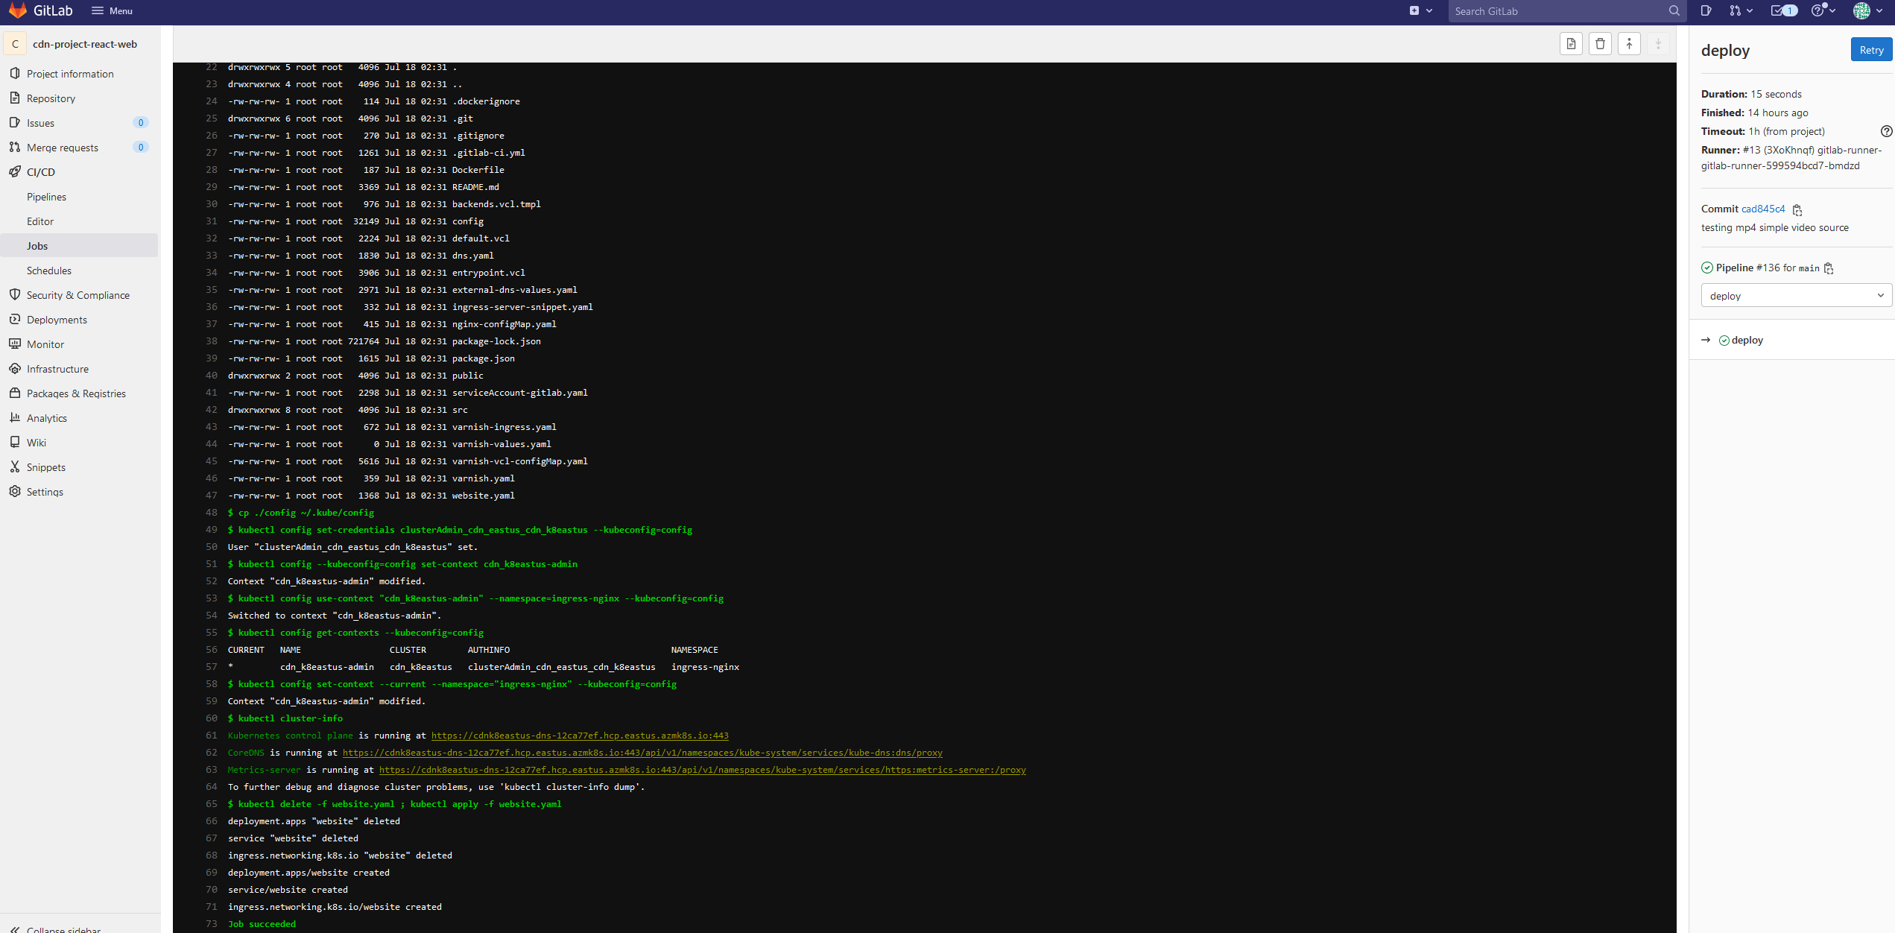
Developer Workflow
Gitlab – Track releases and Infrastructure changes
NoTFLIX

Slide 6
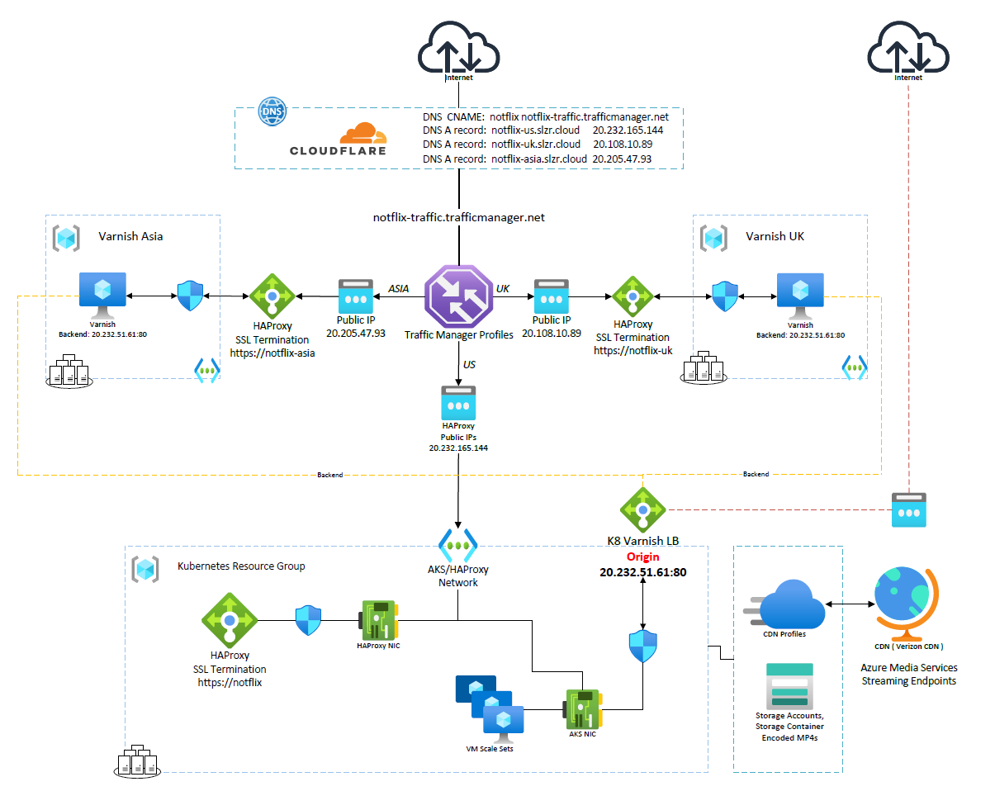
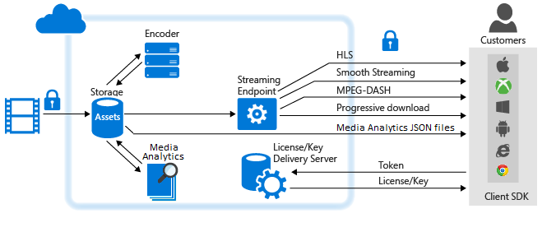
Operations Diagram
The original supplied MP4 ( stored in a Storage Account ) is Encoded in the Adaptive Preset to present as streaming endpoints, linked to the CDN’s public DNS names. The client will be presented with a video from 1080p or down to 180p depending on their connection.
*. streaming.media.azure.net CNAME https://cdn-edge.slzr.cloud
Azure Traffic Manager will redirect client traffic to the best endpoint based on latency Performance ( or Geo location if configured )
HAProxy is used for SSL Termination using Let’s Encrypt in front of the Varnish Servers.
Remote Varnish UK and SEAsia region servers will cache content from the Origin: US East on the Kubernetes Endpoint - over HTTP. http://9b3511a1e1d1930eb4b037896c0401021451101c.slzr.cloud
Azure Media Services will read media Assets Encoded in the Dynamic Streaming preset - stored as MP4s in a Storage Account Container and based on CDN Profile - publish to the Verizon CDN.
NoTFLIX

Slide 7
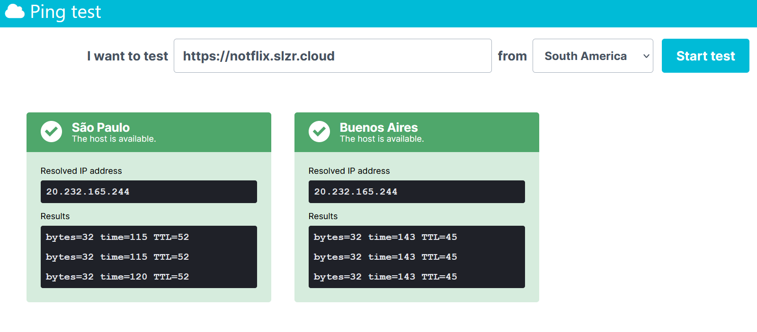
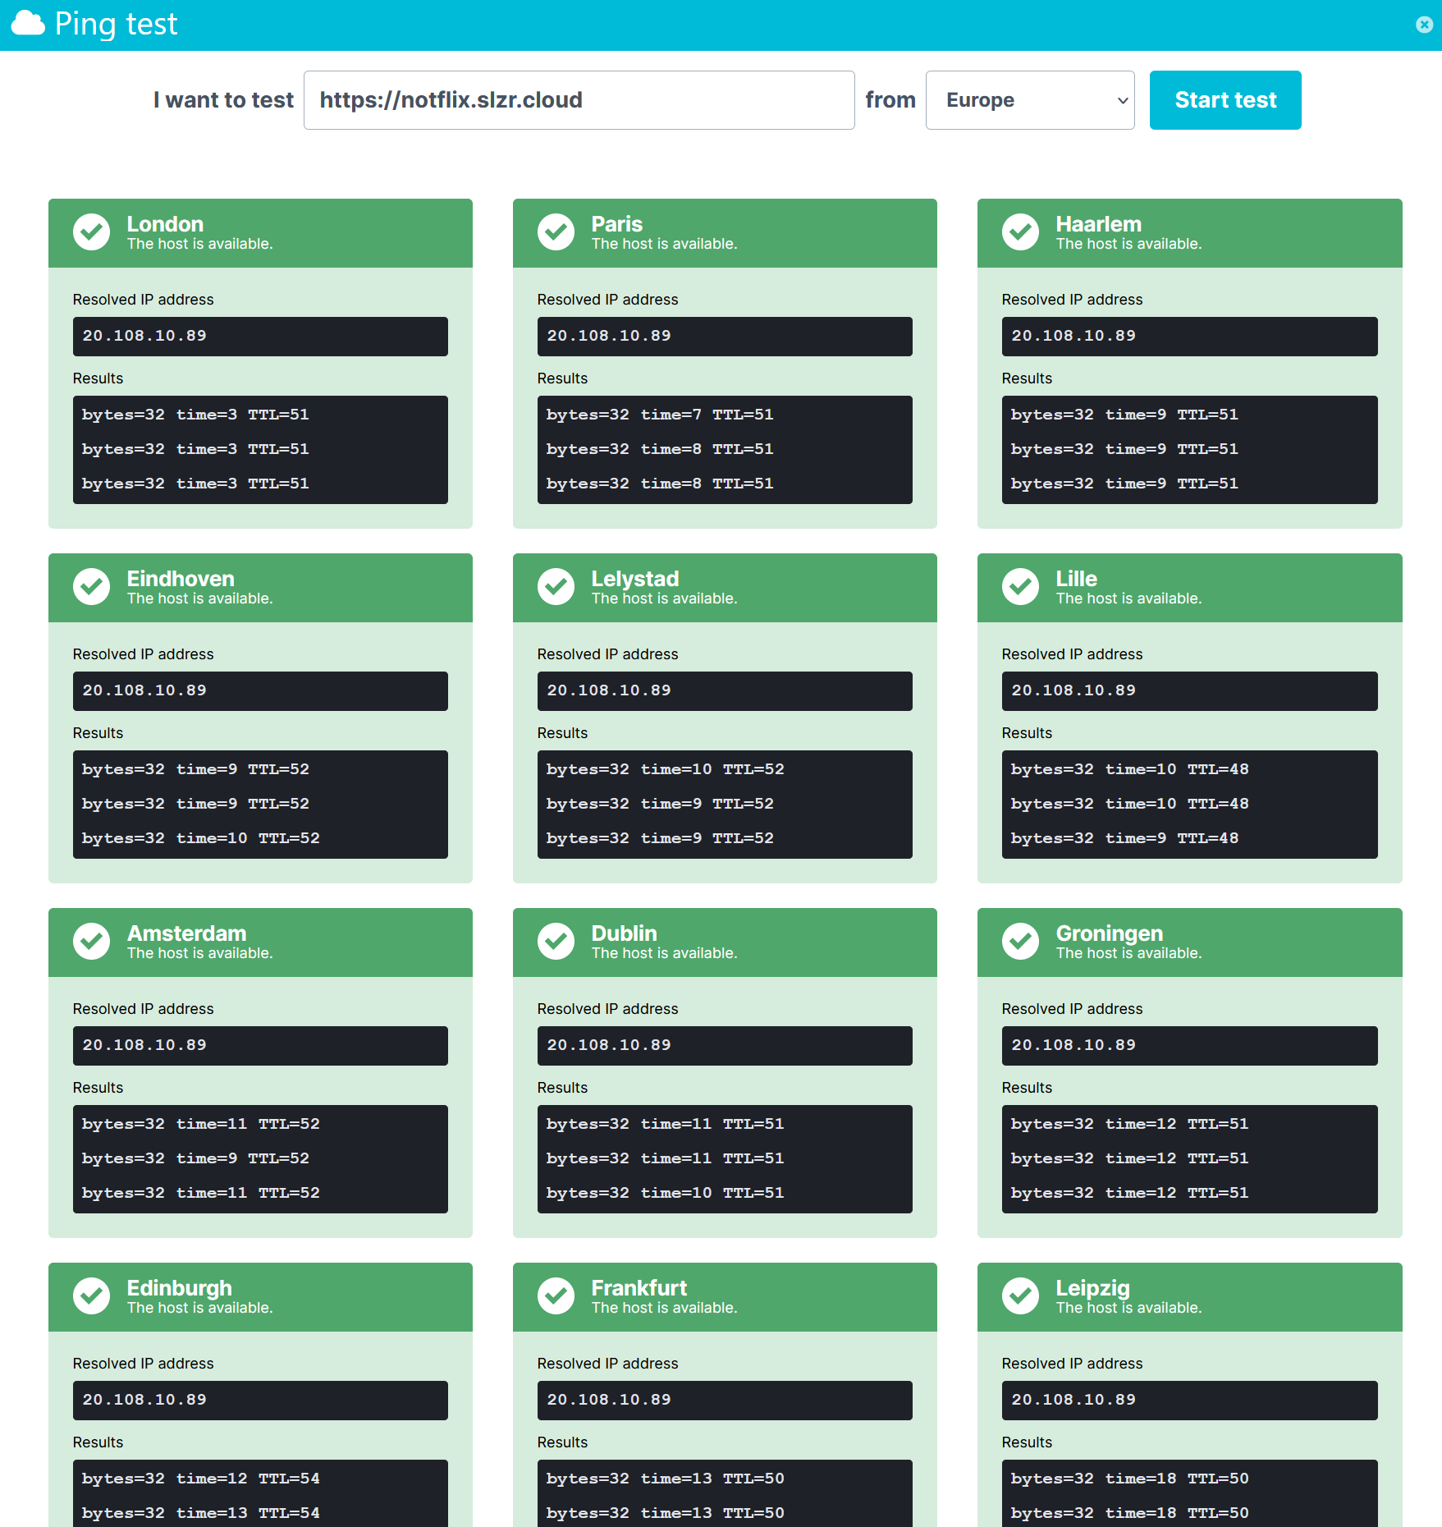
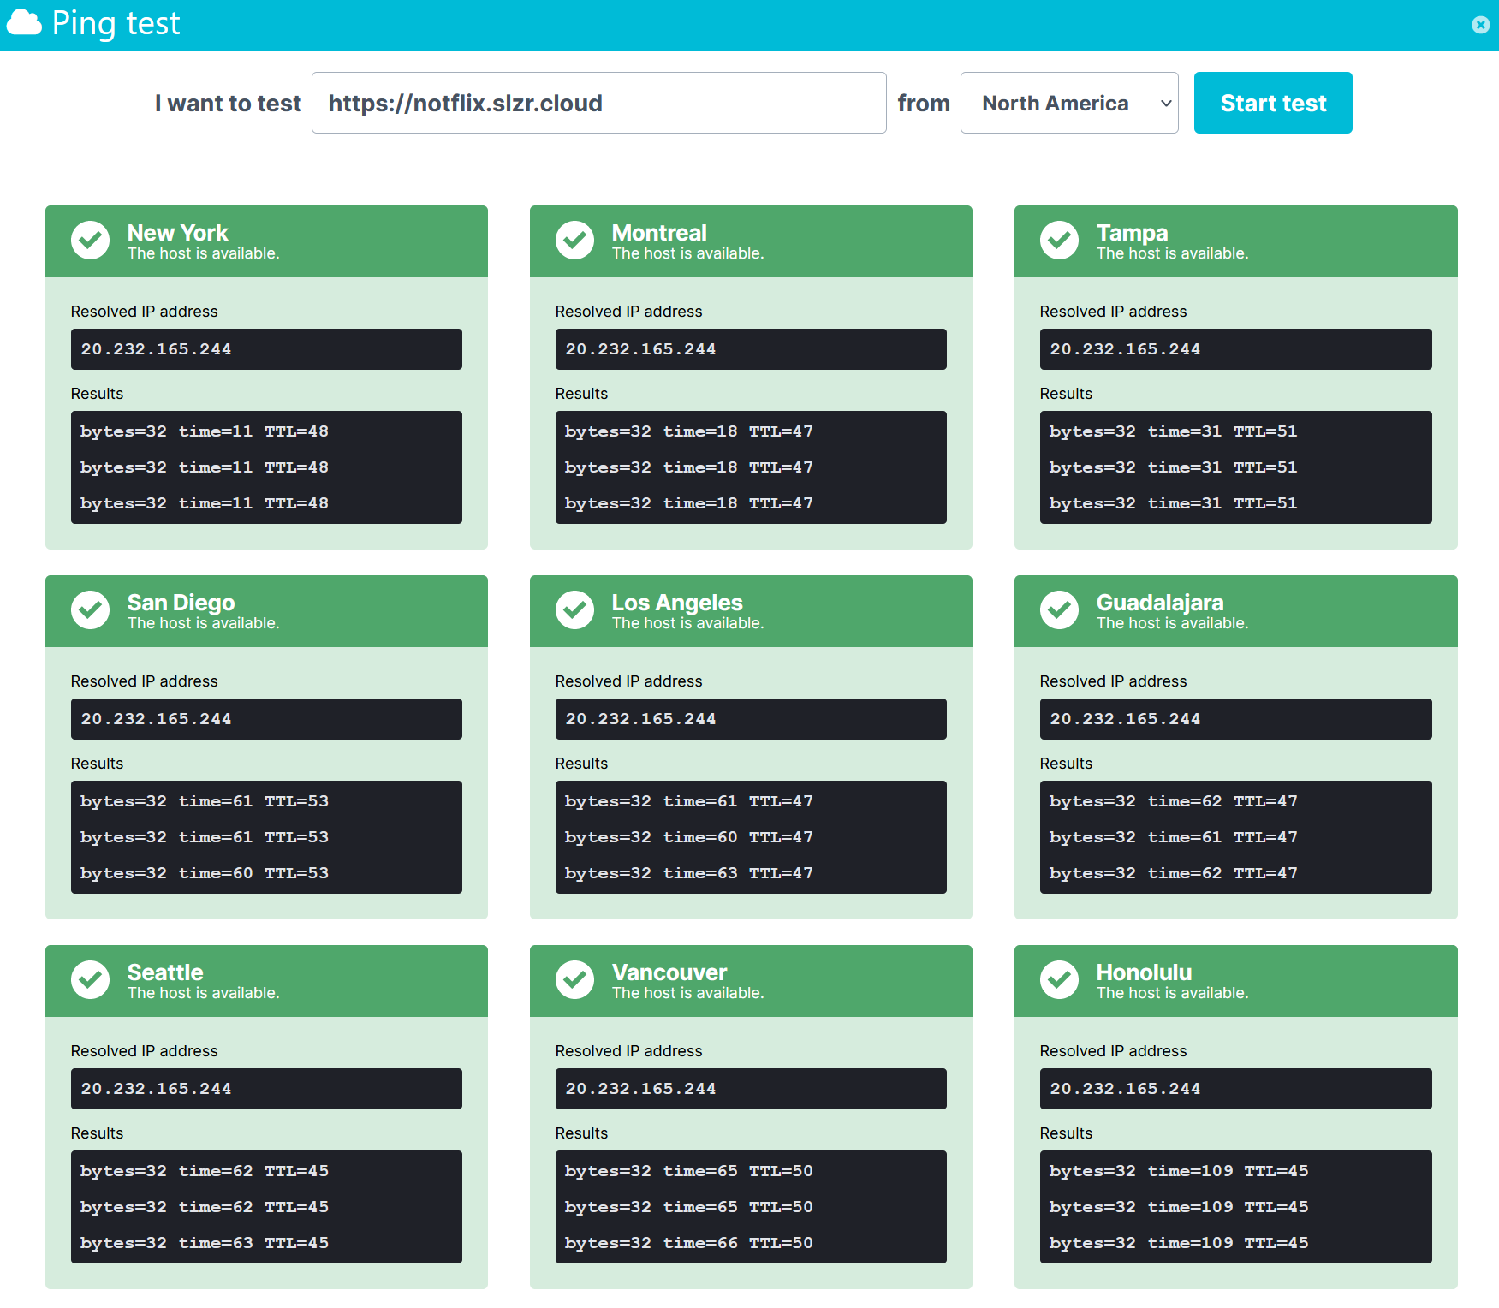
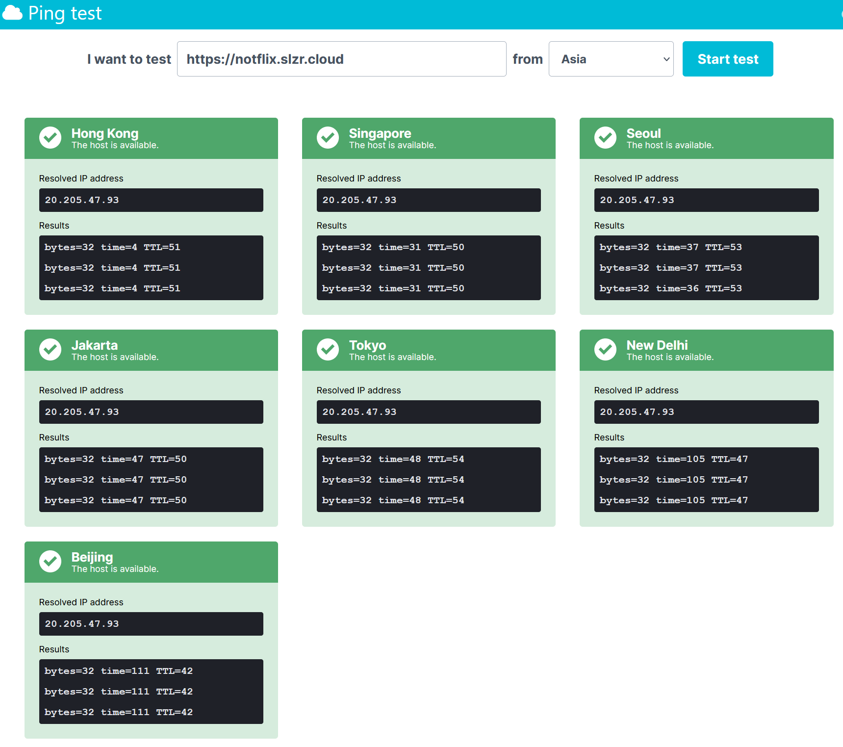
Performance
Uptrends Tests - Ping
NoTFLIX

Slide 8
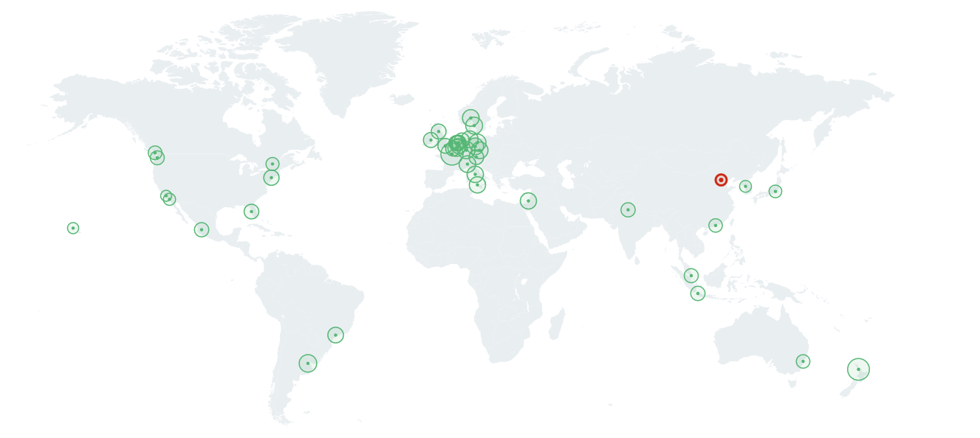
Performance
Uptrends Tests – ( Verizon ) CDN Performance
All locations where Azure Media Services Endpoints are presenting our Encoded videos
NoTFLIX

Slide 9
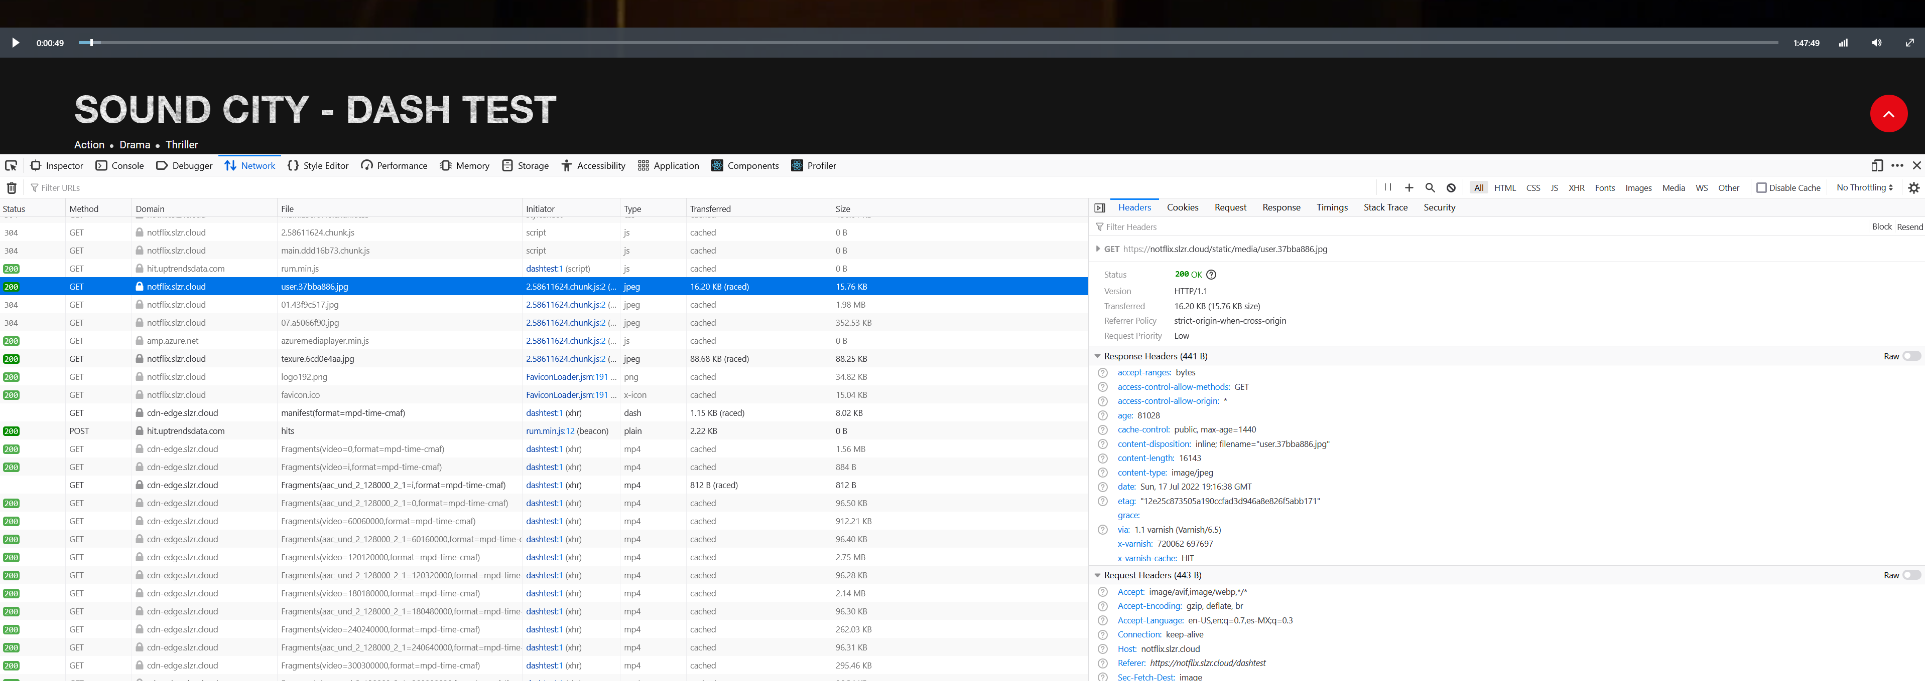
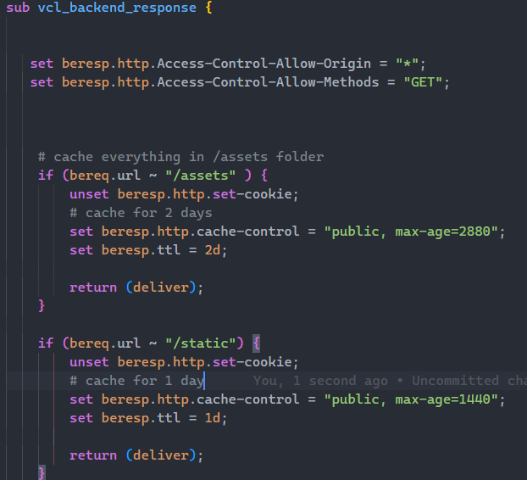
Headers
NoTFLIX

Slide 10
DEMO
https://notflix.slzr.cloud
NoTFLIX

