Slide 1
A Multi-Agent RAG Architecture with a Heterogeneous Verification Court
Specialized judge agents + a veto arbiter to defeat semantic drift and tangential support
Clinical ADRD caregiving QA · deterministic orchestration · frozen generator · free APIs · no fine-tuning

Slide 2
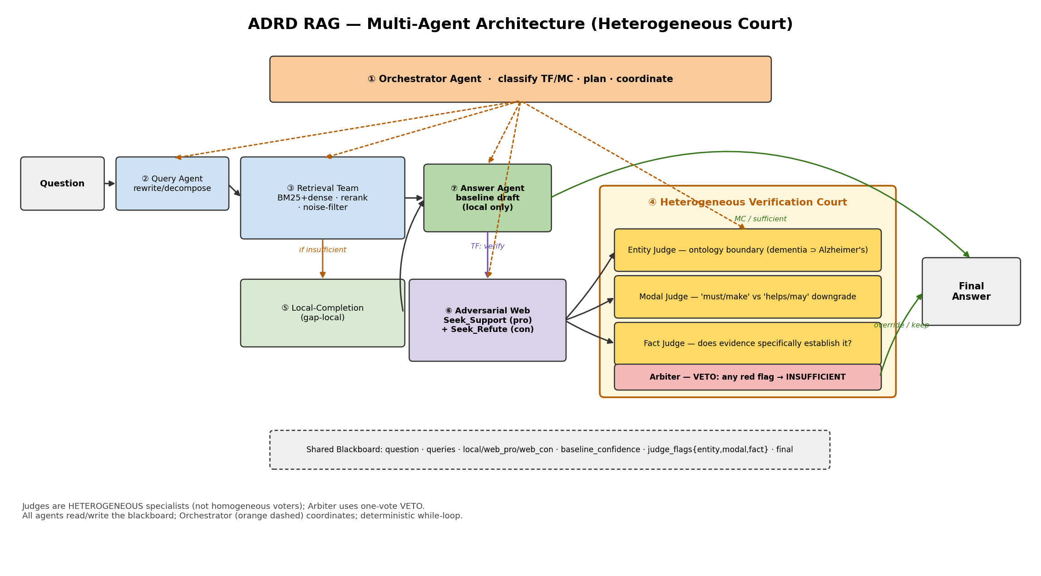
Architecture Overview
• Seven specialized agents coordinated by an Orchestrator over a shared Blackboard (deterministic while-loop)
• Retrieve → draft answer → (for True/False) adversarially verify → decide
• Key upgrade: the sufficiency judge is a heterogeneous COURT of specialists, not homogeneous voting

Slide 3
The Seven Agents
Agent | Role
① Orchestrator | Classify TF/MC, plan the workflow, coordinate agents, assemble the context
② Query Agent | Rewrite/decompose the question into retrieval queries; targeted sub-queries on a gap
③ Retrieval Team | Hybrid BM25 + dense retrieval → noise filter → cross-encoder rerank → local evidence
④ Verification Court | Heterogeneous judges (Entity/Modal/Fact) + veto Arbiter — KEY UPGRADE
⑤ Local-Completion | Gap-guided local re-retrieval (free, tried first)
⑥ Adversarial Web | Dual pro/con web queries to defeat search confirmation bias
⑦ Answer Agent | Frozen GPT-4, strict grounding; produces the baseline draft and final answer

Slide 4
The Heterogeneous Verification Court — Key Upgrade
• Problem with homogeneous voting: 5 identical agents reduce random hallucination but share the SAME systematic blind spots — they reach a confident WRONG consensus. If a plain prompt can't tell 'must' from 'helps', calling it 5× won't either.
• Solution: three SPECIALIST judges cross-examine the evidence + a veto Arbiter:
Judge | Blocks | Rule
Entity Judge | Ontology-boundary leakage | Evidence about a broader class ('dementia') cannot support a claim about a specific subtype ('Alzheimer's pathology') → MISMATCH
Modal Judge | Modal / degree swap | Statement asserts obligation ('must / make them') but evidence only shows benefit ('helps / may') → DOWNGRADE
Fact Judge | Missing fact | Does the evidence SPECIFICALLY establish the claim? → TRUE / FALSE / NO-INFO
Arbiter (VETO) | False overrides | Any MISMATCH / DOWNGRADE / NO-INFO → INSUFFICIENT, regardless of the Fact judge
• Effect: overrides the baseline only on decisive, entity- and modality-aligned evidence; otherwise keeps it → churn eliminated by construction

Slide 5
Adversarial Retrieval & the Shared Blackboard
• Adversarial Web-Research Agent (defeats confirmation bias)
– Fires BOTH a support-seeking (pro) and a refutation-seeking (con) query in parallel
– Writes web_pro / web_con to the blackboard → the Court judges amid CONFLICTING evidence, not a one-sided echo
• Shared Blackboard (a plain dataclass — transparent, serializable, ablatable)
– question · queries · evidence{local, web_pro, web_con} · baseline_confidence
– judge_flags{entity, modal, fact} · sufficiency · final_decision · full trace
• Deterministic while-loop orchestration (no LangGraph/AutoGen)
– 100% transparent control flow; every gate is ablatable — flip judge_flags.modal off, re-run, measure the delta

Slide 6
Why Heterogeneous > Homogeneous — and Validation
• Heterogeneous specialization targets SYSTEMATIC blind spots; homogeneous redundancy only lowers random noise
• Validated on the diagnosed churn cases:
– Entity judge blocks the ontology-leakage case (dementia-general evidence vs an Alzheimer's-pathology claim)
– Hardened (few-shot) Modal judge blocks the degree-swap case ('make them play by the rules' vs 'rules help')
– Both preserve genuine knowledge-gap fixes; the veto Arbiter architecturally solves the supplementation churn
• Engineering & research properties
– Frozen generator · free APIs · no fine-tuning; the cognitive defenses are reified as distinct specialist agents
– Every judge is an independent, ablatable module — clean per-component ablation for the paper

