Slide 1
Sufficiency-Aware Corrective RAG for Clinical Caregiving QA
Detect insufficient local knowledge, then complete it with gap-guided, type-aware retrieval
Generalizable strategies · frozen generator · free APIs only · no fine-tuning

Slide 2
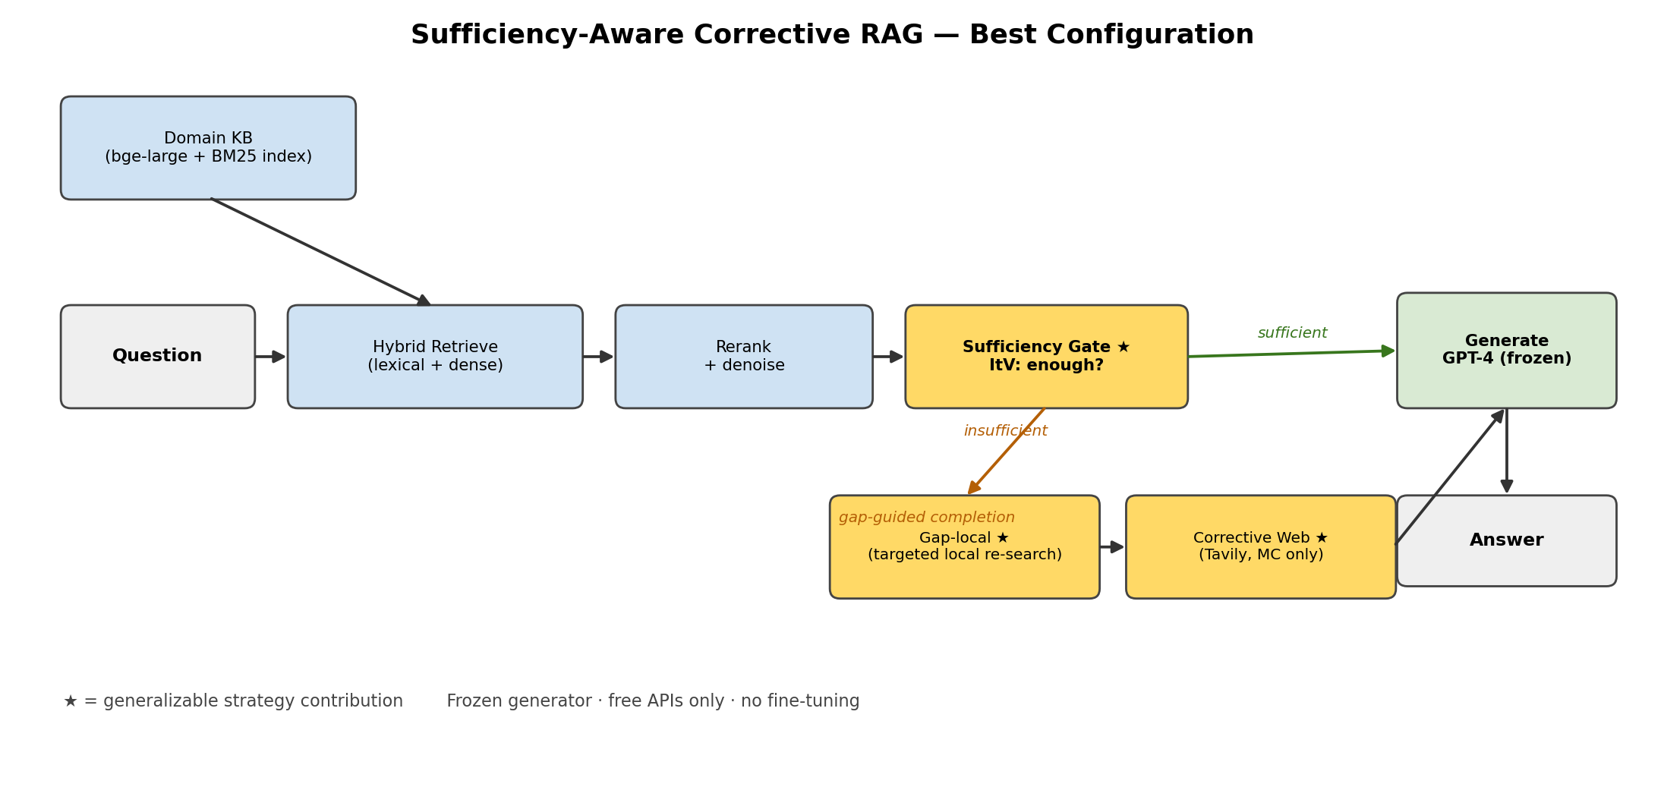
System Architecture — Best Configuration
• Retrieve → judge sufficiency (ItV) → if insufficient, complete (gap-local, then web for MC) → generate

Slide 3
① Evaluate SUFFICIENCY, not Relevance
Gate decides per question: is the retrieved context enough to ANSWER (not just on-topic)?
• Models (cheap, no training): gpt-4o-mini for Identify + Verify · all-MiniLM-L6-v2 for consensus
• Algorithm — Identify-then-Verify (3 steps):
– Identify ×5: prompt 'name the single most important MISSING fact, or NONE' (temp 0.7) → 5 hypotheses
– Score: none_frac = fraction answering 'NONE'. If none_frac ≥ 0.6 → SUFFICIENT (runs agree nothing missing)
– Else Verify: pick consensus gap (highest mean cosine-sim among the 5) → ask 'is it PRESENT in context?'
· PRESENT ⇒ the gap was hallucinated ⇒ SUFFICIENT | ABSENT ⇒ truly missing ⇒ INSUFFICIENT
• Scoring basis: agreement that nothing is missing + attribution that the named gap is genuinely absent
• Why it generalizes: judges answerability of the actual question, independent of topical overlap
– Sufficiency AUC 0.73, vs relevance/confidence baselines 0.47–0.68 (next-to-last slide)

Slide 4
② Gap-guided, LOCAL-first Completion
Turn the identified gap into targeted queries and re-search the local KB first (free)
• Mechanism: missing-info phrase → gpt-4o-mini rewrites into focused query/queries → hybrid re-retrieve
– MERGE new + original passages → bge-reranker-v2-m3 re-scores ALL → keep top-k → re-run the gate
– (found passages are cross-encoder re-ranked with the originals — not blindly appended)
• Real example — MC_008 ('loved one frowns & turns away during a conversation — why?')
– gate's gap: "specific strategies to prevent catastrophic reactions during interactions"
– decomposed → 4 targeted queries:
· 'catastrophic reaction dementia management' · 'caregiver response to agitation in dementia'
· 'dementia gentle touch / verbal reassurance / catastrophic-reaction prevention' · 'active listening …'
– → the targeted query surfaces the catastrophic-reaction passage the generic question-query had buried
• Effect: on a gate-blocked subset, LOCAL-only gap recovery fixed 2/6 — zero network, zero cost
• Why it generalizes: works on any KB; converts 'what's missing' into precise retrieval

Slide 5
③ Type-aware Completion Routing
Tested whether external web evidence helps ALL question types — it does not
• Experiment: 14 questions that triggered web, Tavily backend, measured answer flips vs no-web:
Question type | Web fired on | Fixed | Broke | Net
MC (pick best option) | 4 | 1 (MC_016) | 0 | +1
TF (binary true/false) | ~8 | 0 | 2 (TF_035, TF_046) | −2
• Analysis: MC = pick-best-option → more evidence helps; TF = binary entailment → extra/contradicting sentences flip the verdict
• Decision: fire web for MC only; TF keeps gap-local (local, noise-free)
• Effect: +3 on full 149 (135 → 138); TF rose to 111/120
• Why it generalizes: applies to any selection-vs-verification task split

Slide 6
④ Denoised Corrective Retrieval
Bring external knowledge in WITHOUT flooding the answer
• Per external source (Tavily / PubMed):
– sentence-split → drop boilerplate/junk (regex filter) & sentences <15 chars → cap 12 sentences/source
– near-duplicate dedup across sources
• Before merging:
– relevance pre-filter — rerank web sentences vs question, keep top-20
• Merge & select:
– merge web + local → GLOBAL cross-encoder rerank (bge-reranker-v2-m3)
– local-floor guard: reserve ≥8 of top-k for LOCAL passages so web can't crowd out the answer (over-cap web deferred)
• Do we store the external knowledge back into the KB?
– No — results are CACHED by query hash (reproducibility), but NOT persisted to the vector store; used in-context per question only
– Future improvement: persist ItV-verified external facts back into the KB to grow it over time
• Why it generalizes: a standard denoising chain for any web-augmented RAG

Slide 7
Ablation — Effect of Each Strategy
Strategy removed | Measured on | Effect
Type-aware routing (→ web on TF too) | full 149 | 138 → 135 (−3)
Corrective web backend (Tavily → DuckDuckGo) | web-firing MC subset | loses MC_016 (DDG: 0 confirming hits)
Gap-local re-retrieval | gate-blocked 6-Q subset | −2 recovered answers
Sufficiency gate (ItV → NLI answerability) | sufficiency AUC | 0.73 → 0.675
Sufficiency gate (ItV → CRAG off-the-shelf eval) | sufficiency AUC | 0.73 → 0.47 (below random)
• Mixed scope (full-149 where available, else AUC / targeted subset) — labeled per row; full per-component 149 ablations are a next step

Slide 8
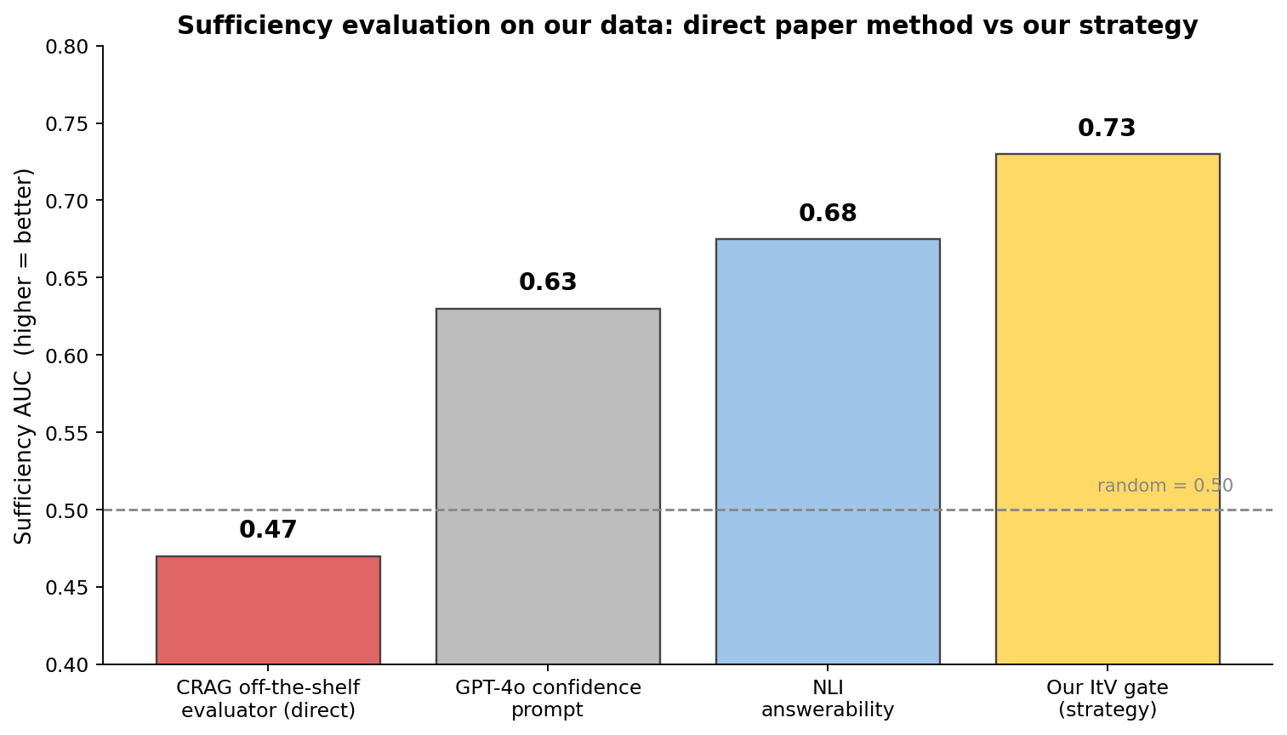
Direct Paper Method vs Our Strategy — and End-to-End Result
• CRAG's off-the-shelf evaluator, used directly on our data: AUC 0.47 (below random)
• Our ItV sufficiency strategy: AUC 0.73
• AUC is dataset-agnostic — the gain is the STRATEGY, not benchmark tuning
•
• End-to-end on ADRD-Bench:
– 92.6% overall · 95.8% on unambiguous items
– frozen GPT-4 · free APIs · no fine-tuning

Slide 9
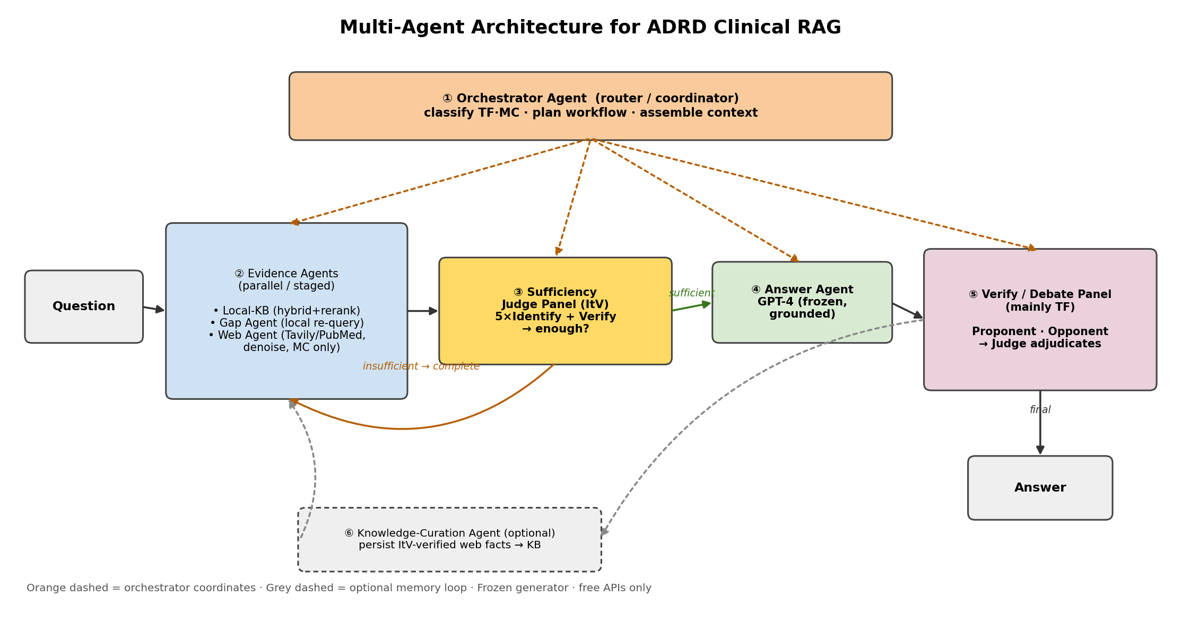
Multi-Agent Architecture (design)
Role-specialized agents coordinated by an orchestrator; net-new lever = verify/debate panel
• ① Orchestrator — route & coordinate
• ② Evidence agents — Local-KB / Gap / Web
• ③ Judge Panel — ItV sufficiency (5 Identify + Verify)
• ④ Answer agent — frozen GPT-4
• ⑤ Debate panel — Proponent/Opponent/Judge (TF) — NEW
• ⑥ Curation agent — persist verified facts (optional)
• Only ⑤ is a net-new accuracy lever; must be A/B-tested

