Slide 1

Note: The data and information in this document is reflective of a hypothetical situation and client. This document is to be used for KPMG Virtual Internship purposes only.
Sprocket Central Pty Ltd
Data analytics approach
[Division Name] - [Engagement Manager], [Senior Consultant], [Junior Consultant]

Slide 2
Note: The data and information in this document is reflective of a hypothetical situation and client. This document is to be used for KPMG Virtual Internship purposes only.
Agenda
Introduction
Data Exploration
Model Development
Interpretation

Slide 3
Note: The data and information in this document is reflective of a hypothetical situation and client. This document is to be used for KPMG Virtual Internship purposes only.
Introduction
Approach for New Customer Data analysis :
Approach for New Customer Data analysis :
Age distribution
Bike purchase
Job industry
Number of cars owned

Slide 4
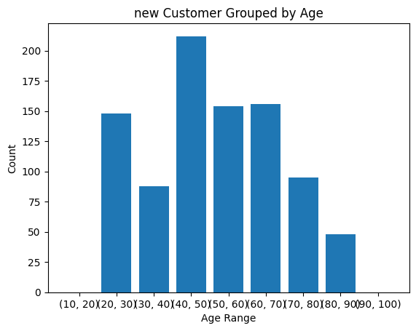
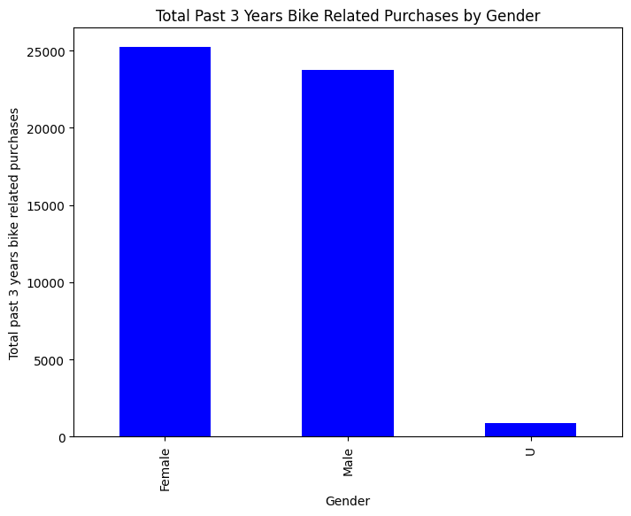
Note: The data and information in this document is reflective of a hypothetical situation and client. This document is to be used for KPMG Virtual Internship purposes only.
Data Exploration: Age Distribution & Bike Purchases
New customers are more from the age group of 40-50 , followed by 50-60 & 60-70.
Fewer customer are from 10-20 & 80-90 for obvious reasons.
Data shows high count in terms of bike purchased in last 3 years is slightly greater for female.
The target audience for our marketing and advertising should be inclined to provide focus on females than males.

Slide 5
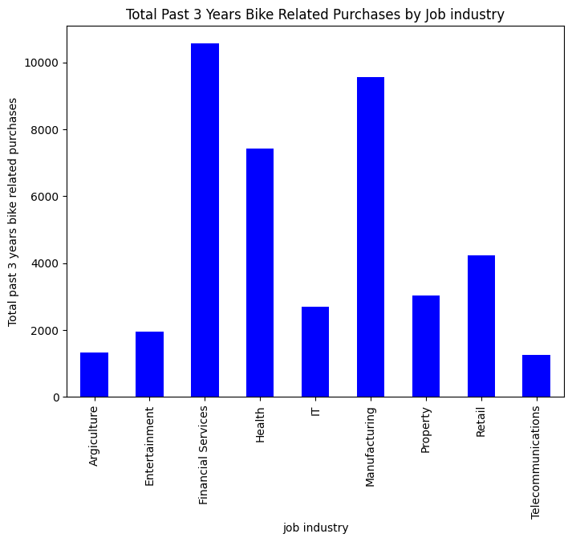
Note: The data and information in this document is reflective of a hypothetical situation and client. This document is to be used for KPMG Virtual Internship purposes only.
Data Exploration: Job Industry
Financial Services, Manufacturing, and Health are the top three profit-generating industries, followed by retail and property.

Slide 6
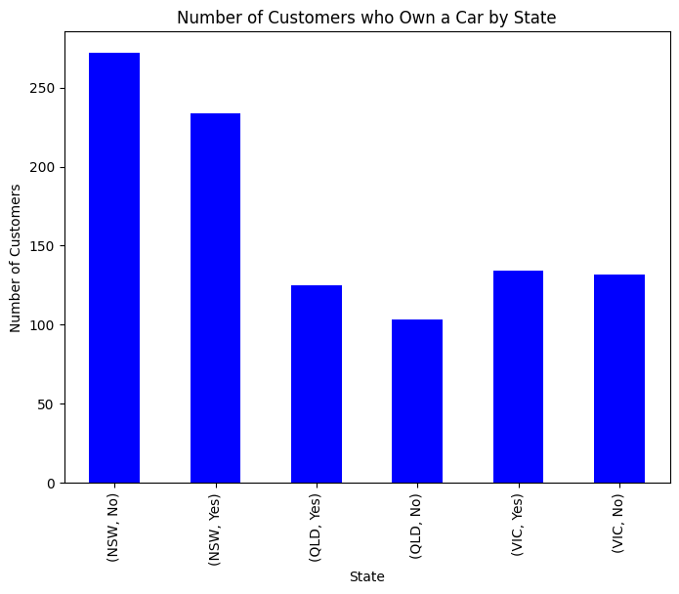
Note: The data and information in this document is reflective of a hypothetical situation and client. This document is to be used for KPMG Virtual Internship purposes only.
Data Exploration: Number of cars owned
Out of three states, New South Wales, could be potential market opportunities for the company.
New South Wales has the biggest potential since the number of people who own vehicles is nearly equal to the number of individuals who do not own cars, indicating that there is room for value customers there.
VIC and QLD has more customers that own car that who don’t but we can try to have something so that those owns car will buy bikes.

Slide 7
Note: The data and information in this document is reflective of a hypothetical situation and client. This document is to be used for KPMG Virtual Internship purposes only.
Model Development
CUSTOMER CLASSIFICATION – Targeting High Value Customers
The following are the high-value clients to target from the new list :
Aged between 40-50.
Most of the high value customers are female compared to male
Working in Financial Service, Manufacturing and Health.
Who are currently living in New South Wales and Victoria.

Slide 8
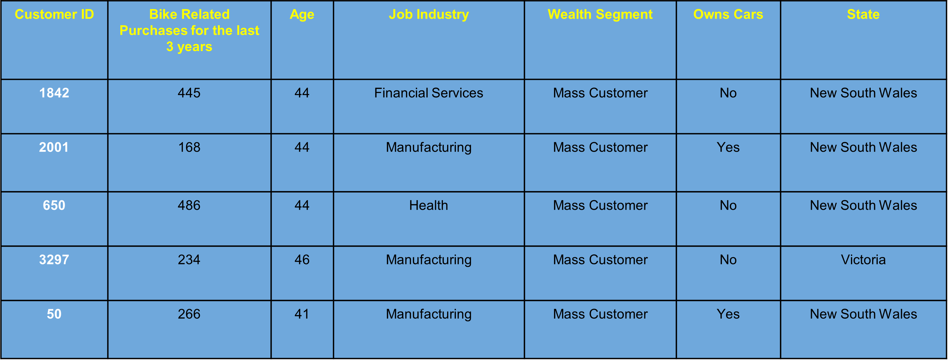
Note: The data and information in this document is reflective of a hypothetical situation and client. This document is to be used for KPMG Virtual Internship purposes only.
Interpretation
HIGH-VALUE CUSTOMER SUMMARY TABLE

Slide 9
Note: The data and information in this document is reflective of a hypothetical situation and client. This document is to be used for KPMG Virtual Internship purposes only.
Thank You

