Slide 1
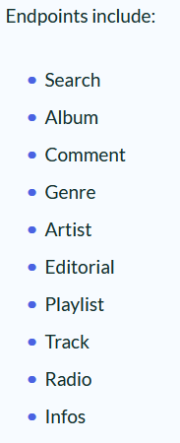

Deezer Simple API

Slide 2
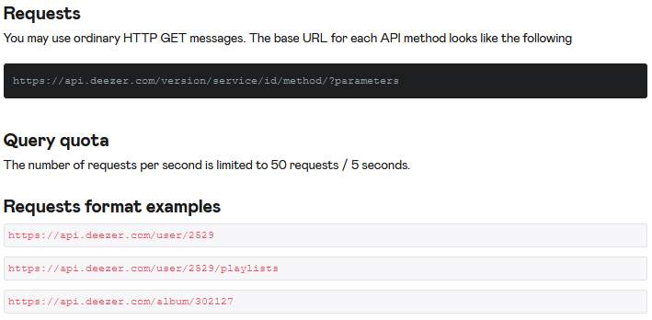

Slide 3
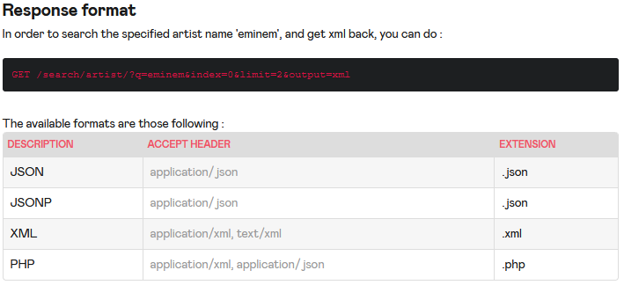

Slide 4
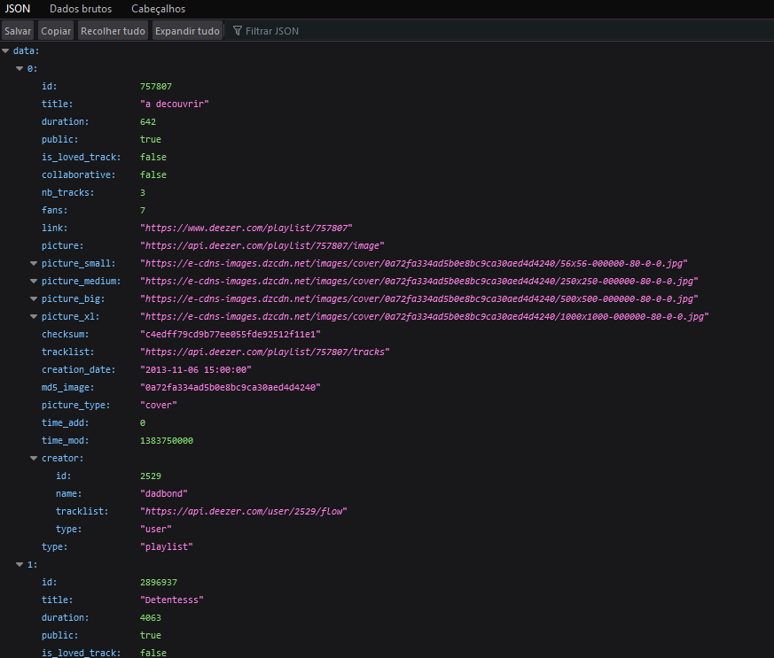
Resposta: JSON
https://api.deezer.com/user/2529/playlists

Slide 5
Utiliza meio de autenticação? Se sim, Qual:
OAuth 2.0 protocol
User Authentication
App Authorization
App Authentication

Slide 6

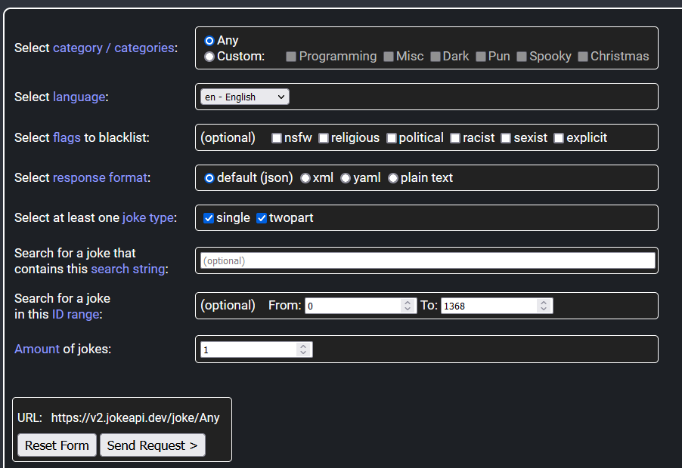
Pesquisar

Slide 7
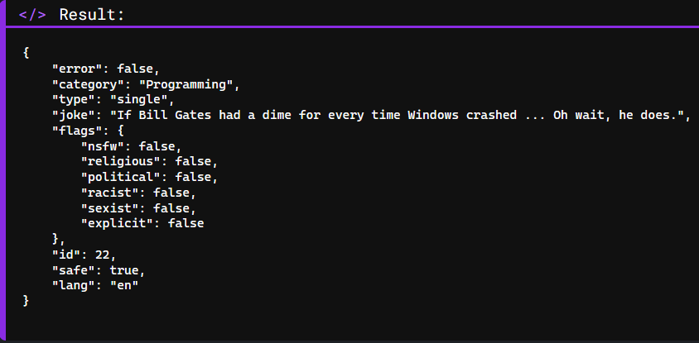

Slide 8
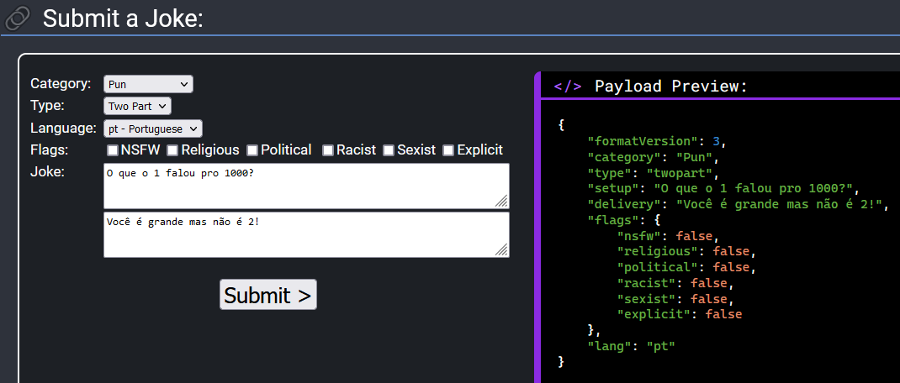
Enviar

Slide 9
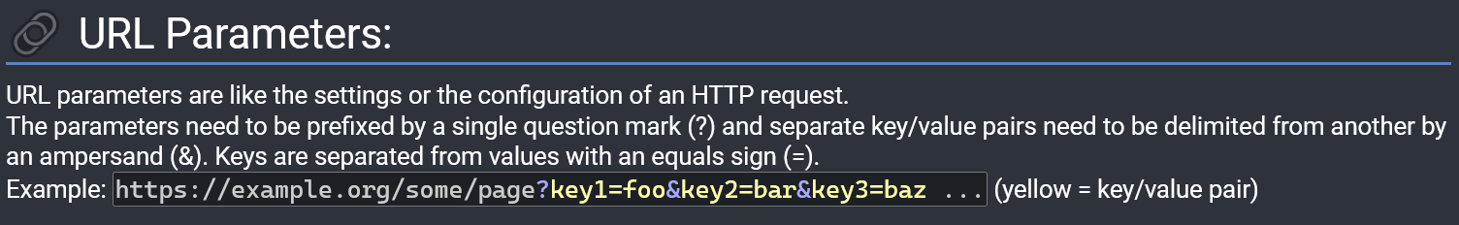
Entrada: URL

Slide 10
Saídas
JSON, XML, YAML ou texto
Sem autenticação!
“without any API token, membership, registration or payment”
120 requests por minuto

Slide 11
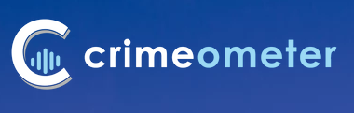
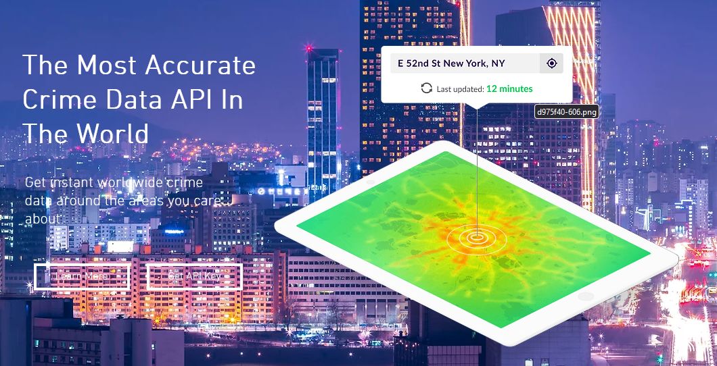

Slide 12
End Points
incidents/raw-data
incidents/stats
incidents/raw-data-coverage
crime-incidents
crime-incidents-by-source
crime-incidents-by-city (cityname)
crime-incidents-by-city (citykey)
stats
By Zipcode
By Exact Zipcode
By Name
By Alias
By Zipcode and Name
By Exact Name
By Zipcode and Exact Name

Slide 13
Requests: URL
https://api.crimeometer.com/v3/sex-offenders/records?exact_name=DUREN, BRANNON

Slide 14
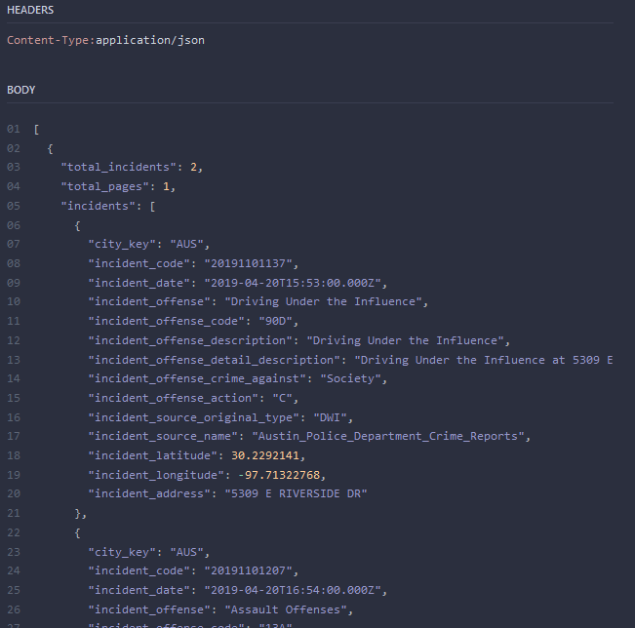
Resposta: JSON

Slide 15
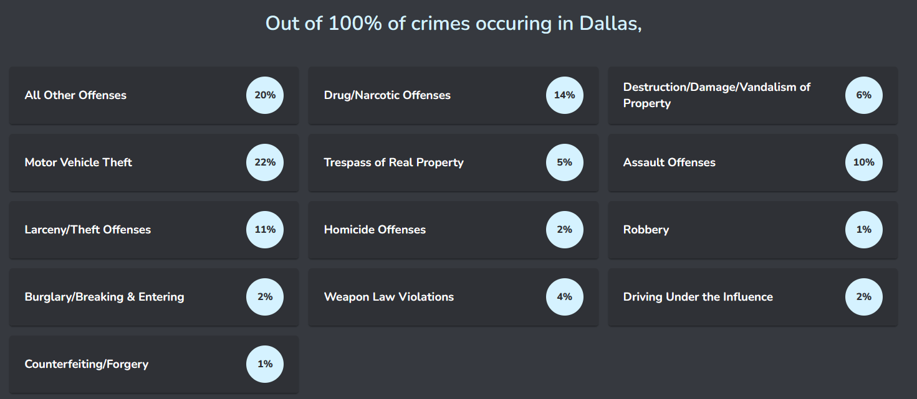

Slide 16

Autenticação

