Slide 1


Learning and Knowledge Management
Module 2: Selenium Suite
Accenture CSI Confidential Material. Do not duplicate or distribute

Slide 2
Module Objectives
At the end of this module, you will be able to:
Discuss Selenium Suite components such as Selenium Remote Control (RC), Selenium WebDriver, Selenium IDE and Selenium Grid

Slide 3
Topic List
Introduction To Selenium Suite
Selenium Remote Control (RC) WebDriver
Selenium IDE Selenium Grid

Slide 4
Topic List
Introduction To Selenium Suite
Selenium RC Web Driver Selenium IDE
Selenium Grid

Slide 5
Introduction To Selenium Suite (1)
Introduction to Selenium
Selenium automates the user interaction with browsers. This capability of Selenium tool is used for test automation of HTML based web applications.
Selenium is open Source hence no additional licensingcost is incurred to the project.
S
e l e n i u m
S
u p p o r t s
Windows
Linux
Mac
Platform
Firefox
Internet Explorer
Safari
Browsers
C#
Java
JavaScript
Objective-C
Perl
PHP
Python
Ruby
Languages
iOS Mobile Device
Android Mobile Device
Mobile

Slide 6

Introduction To Selenium Suite (2)
Selenium v2
Selenium v3
Selenium RC
(Remote Control)
Selenium WebDriver
Selenium Suite
Selenium
Grid
Selenium
WebDriver
Selenium Suite
Selenium Grid
Selenium IDE
Selenium IDE

Slide 7
Topic List
Introduction To Selenium Suite
Selenium RC
Web Driver
Selenium IDE
Selenium Grid

Slide 8
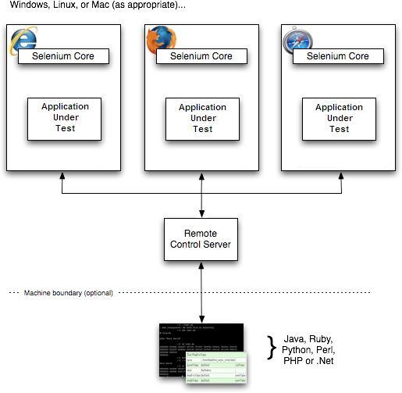
Selenium Remote Control (RC)
Selenium Remote Control (RC) is a test tool for web application .
Selenium RC can be used by any programming language which is compatible with HTTP.
These websites needs to be opened in any JavaScript enabled browsers while running the tests.
Selenium RC is composed of 2 parts:
A server
Client libraries
The client libraries communicatewith the server using selenium commands .
The server in turn communicates with the browser with selenium-
Core JavaScript commands. The browser then runs these JavaScript Commands.
Selenium RC is great for testing complex AJAX based web
applications.

Slide 9
Topic List
Introduction To Selenium Suite
Selenium RC Web Driver Selenium IDE Selenium Grid

Slide 10
Selenium WebDriver
WebDriver overcomes the limitations of the Selenium RC.
The Web Driver ‘drives’ the browser directly using the browser’s built in support for automation
There are specific java classes that needs to be used to implement mainly ChromeDriver, EventFiringWebDriver, FirefoxDriver, GeckoDriver, HtmlUnitDriver, InternetExplorerDriver,PhantomJSDriver,RemoteWebDriver,SafariDriver
Web Driver supports dynamic web pages where we see that the elements of the page gets changed even if the parent page does not get reloaded
The well designed OO API provides the solutions to earlier problems in testing out the modern day advanced web applications

Slide 11
Topic List
Introduction To Selenium Suite
Selenium RC Web Driver Selenium IDE
Selenium Grid

Slide 12
Selenium IDE
Selenium IDE is an integrated development environment (IDE) for creating Selenium test scripts.
Selenium IDE is a Firefox plugin, and allows recording, editing, and debugging tests.
Selenium IDE comes with Selenium Core, which makes it easy to record and play back the tests in the actual environment.
In selenium IDE it is possible to record the testing and even updatethe scripts manually.
IDE tool supports record and playback, this is the easiest way to create selenium automated scripts.
It has the feature of setting breakpointsin the script to help debug.
Selenium IDE supports formatting of scripts to native languages like java, C#, Python, Ruby.

Slide 13
Topic List
Introduction To Selenium Suite
Selenium RC Web Driver Selenium IDE
Selenium Grid

Slide 14
Selenium Grid
Introduction of Selenium Grid
Selenium Grid can be used to execute test scripts on a Remote Machine.
Several tests can be executed simultaneously on different remote machines to create a distributed test environment.
Selenium Grid can be used to increase the performance of a large and slow test suite.
Using Selenium Grid shortens the turnaround time for the test results . This is very beneficial for projects following
Agile methodology
It is widely used to run the tests in multiple browsers, multiple versions of the browser and browsers running on different operating systems
Selenium Grid is very flexible and can be used with all permutation combination of browsers, operating systems and versions of the browsers.
Selenium Grid 2.0 is the latest release.

Slide 15
Selenium Support(Bindings)
Popular Language bindings for Selenium
C# : Nunit/MSTest
Java : Junit/TestNG
JavaScript : WebdriverJS, WebdriverIO, NightwatchJS
PHP: Behat + Mink
Python: unittest, pyunit, py.test, robot framework
Ruby : RSpec, Test::Unit

Slide 16

Knowledge Checks
State True or False
1) Selenium suite consists of 4 tools.

Slide 17
Knowledge Checks
State True or False
1) Selenium 1/RC is now no longer used

Slide 18
Knowledge Checks
State True or False
1) It is difficult to increase the performance of tests using selenium Grid

Slide 19
Knowledge Checks
State True or False
1) Web Driver did not overcome the same origin policy issue.

Slide 20
Module Summary
Now, you should be able to:
Discuss Selenium Suite components such as Selenium Remote Control (RC), Selenium WebDriver, Selenium IDE and Selenium Grid

Slide 21
Reference
http://www.seleniumhq.org/docs/03_webdriver.jsp
http://www.seleniumhq.org/projects/webdriver/
http://www.seleniumhq.org/docs/01_introducing_selenium.jsp#brief- history-of-the-selenium-project
http://www.seleniumhq.org/docs/07_selenium_grid.jsp

Slide 22
Thank You

