Slide 1




Learning and Knowledge Management
Module 3: TestNG Framework
Accenture CSI Confidential Material. Do not duplicate or distribute

Slide 2
Module Objectives
At the end of this module, you will be able to:
Explain designing TestNG Framework
Illustrate how to install TestNG plugin for Eclipse
Demonstrate TestNG test cases with Annotations

Slide 3
Topic List
TestNG Framework
TestNG Plugin For Eclipse
TestNG Test Cases With Annotations

Slide 4
Topic List
TestNG Framework
TestNG Plugin For Eclipse
TestNG Test Cases With Annotations

Slide 5
TestNG Framework (1)
What is TestNG ?
TestNG(NG stands for “next generation” is a test automation framework.
It was developed by Cedric Beust.
It is used in
Unit testing
Functional testing
Integration Testing

Slide 6
TestNG Framework (2)
TestNG Features
Reports
Parallel Execution
Annotation Based
Execution as a Suite
Grouping of Tests

Slide 7
Topic List
TestNG Framework
TestNG Plugin For Eclipse
TestNG Test Cases With Annotations

Slide 8
TestNG Plugin For Eclipse (1)
Pre-requisites
Install
JDK
Eclipse

Slide 9
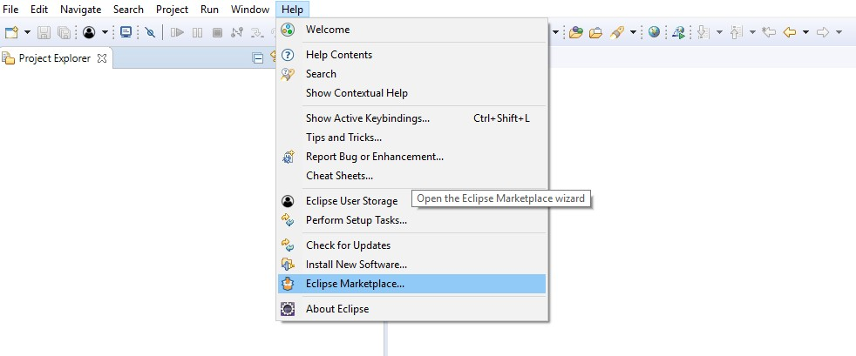
TestNG Plugin For Eclipse (2)
Install TestNG plugin for eclipse from Eclipse Marketplace and search for TestNG plugin and restart eclipse to see the TestNG plugin installed successfully

Slide 10
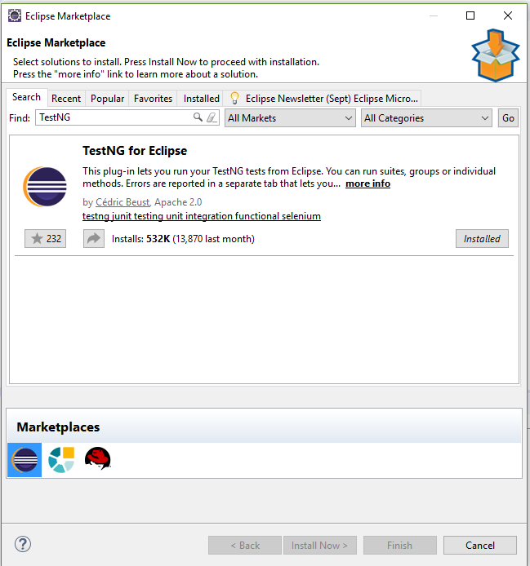
TestNG Plugin For Eclipse (3)
Open Eclipse Market place wizard and search for TestNG plugin and install by accepting License agreement

Slide 11
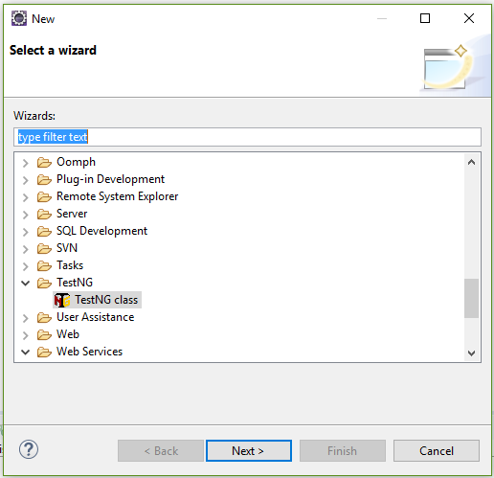
TestNG Plugin For Eclipse (4)
How to create a TestNG class

Slide 12
Topic List
TestNG Framework
TestNG Plugin for Eclipse
TestNG Test Cases With Annotations

Slide 13
TestNG Test Cases With Annotations (1)
TestNG Annotations
@BeforeSuite
@AfterSuite
@BeforeTest
@AfterTest
@BeforeClass
@AfterClass
@BeforeMethod
@AfterMethod
@DataProvider
@Test

Slide 14
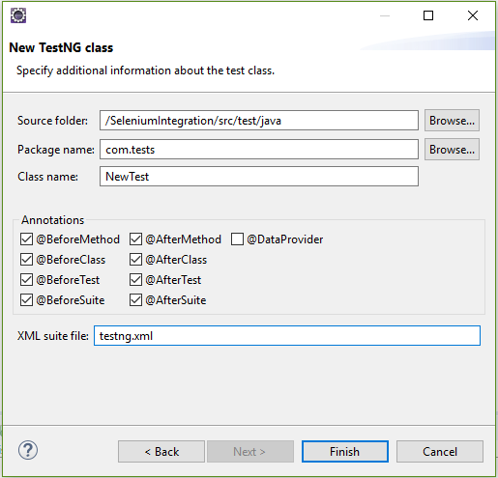
TestNG Test Cases With Annotations (2)
Selecting TestNG Annotations through wizard

Slide 15
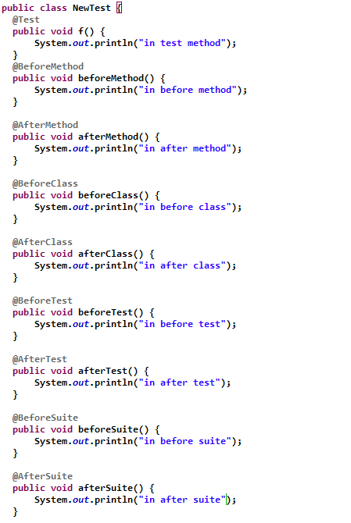
TestNG Test Cases With Annotations (3)
Selecting TestNG Annotations through wizard

Slide 16
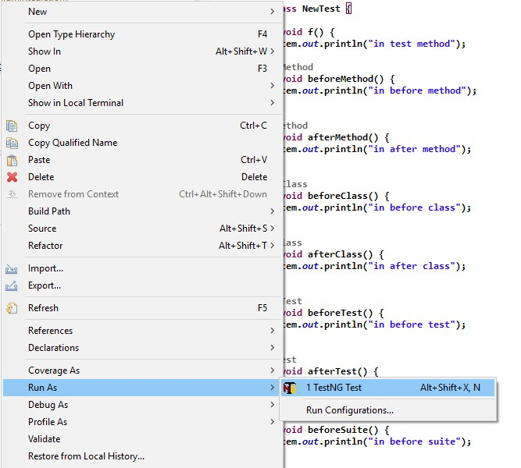
TestNG Test Cases With Annotations (4)
Executing the Test Case

Slide 17
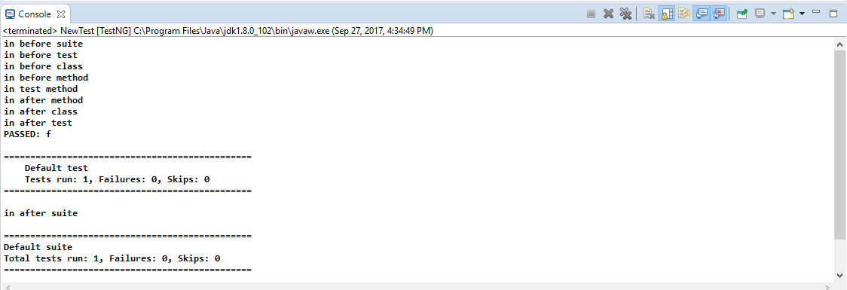
TestNG Test Cases With Annotations (5)
Console Output

Slide 18
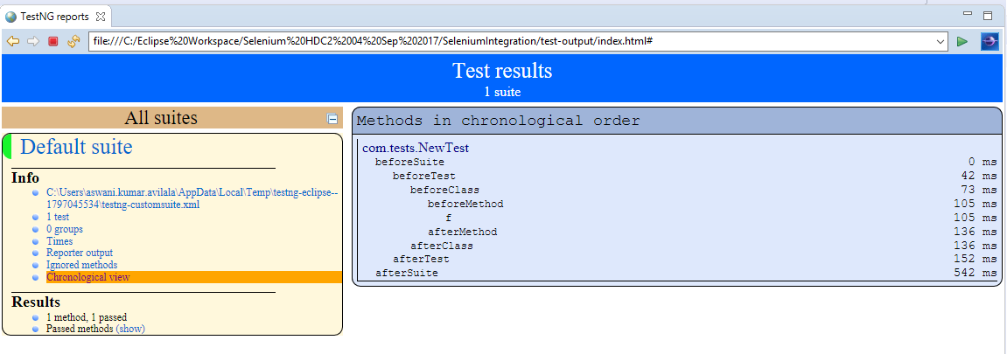
TestNG Test Cases With Annotations (6)
HTML Reports

Slide 19
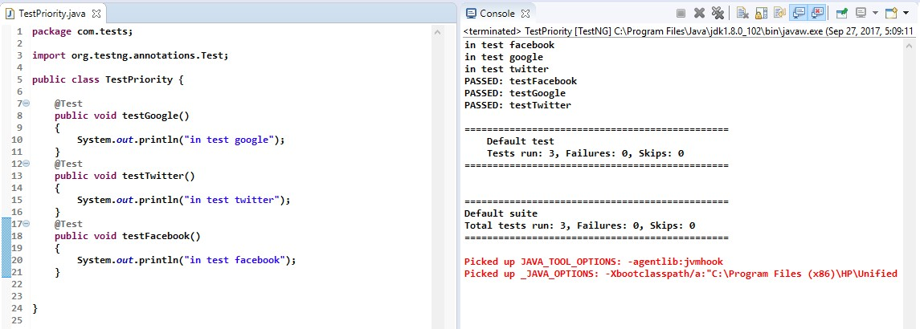
TestNG Test Cases With Annotations (7)
Tests without Priority
The Test methods in TestNG class will execute in alphabetical order by default.

Slide 20
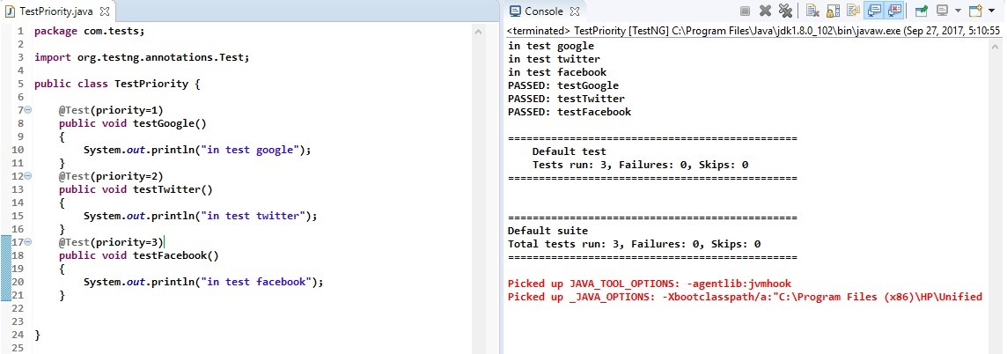
TestNG Test Cases With Annotations (8)
Use of priority and description in TestNG.
The Test methods in TestNG class will execute in alphabetical order by default. To customize the order of execution, pass priority in @Test as the argument with numeric value.
The least number will have the highest priority to execute.

Slide 21
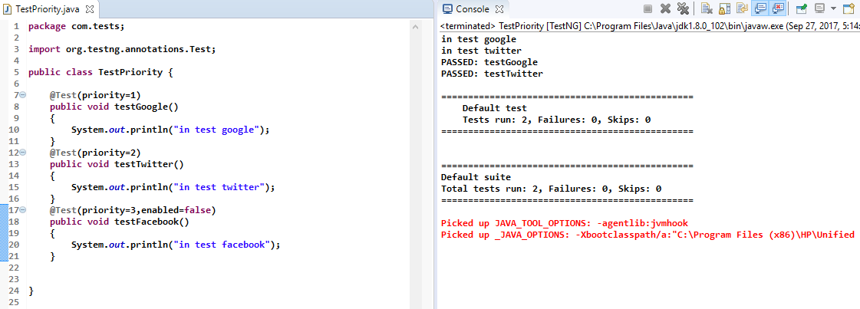
TestNG Test Cases With Annotations (9)
To disable a particular Test Case .
All the Test methods in TestNG class will be executed by default. To stop execution of a particular test method we need to pass an argument enabled=false

Slide 22
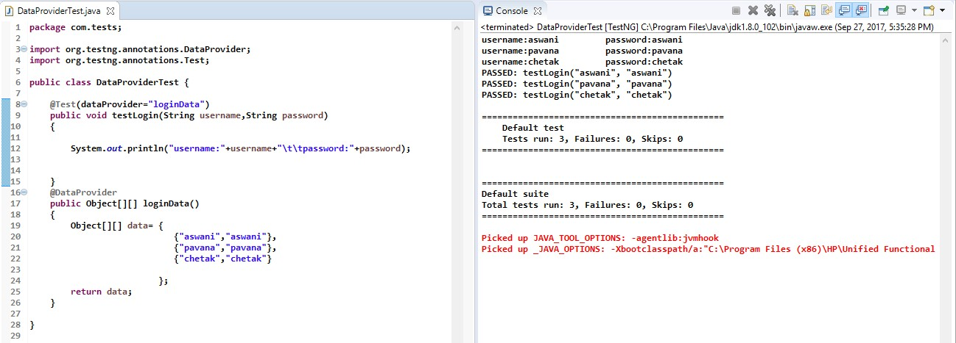
TestNG Test Cases With Annotations (10)
Data Provider
Data Provider hook is used to pass data from a source to a particular test method to replace the constant values with
variables.

Slide 23
Module Summary
Now, you should be able to:
Explain designing TestNG Framework
Illustrate how to install TestNG plugin for Eclipse
Demonstrate TestNG test cases with Annotations

Slide 24
Reference
http://testng.org/doc
http://www.seleniumhq.org/docs/

Slide 25
Thank You

