Slide 1


Learning and Knowledge Management
TestNG Features
Accenture CSI Confidential Material. Do not duplicate or distribute

Slide 2
Ground Rules
For a successful class, please:
Arrive on time
Turn all cell phones off
Wear business formal attire
Assist your colleagues; show respect to all individuals regardless of their skill and knowledge level
Do not use class time to surf the net, check e-mail, or use instant messaging
Adhere to attendance policy as directed by your local training coordinator
Copy right © 2017 Accenture All Rights Reserv ed.

Slide 3
Learning and Knowledge Management
Module : TestNg Features
Accenture CSI Confidential Material. Do not duplicate or distribute

Slide 4
Data Provider
@DataProvider :
It symbols a method as providing data for the test method. The annotated method returns an Object[][] where each Object[] is assigned as parameter list of the test case. The @Test method which receives data from the DataProvider have to use a dataProvider name same as the name of this annotation.
Attributes:
Name - The name of the data provider. If not mentioned, the name of the data provider will be automatically set to the method
name.
Parallel -If set as true, test cases generated by data provider runs in parallel. Default value is false.

Slide 5

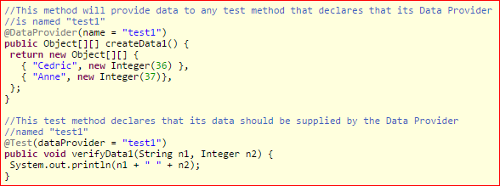
Parameters with Data Providers
Data Provider example :
A @Test method mention the Data Provider as a dataProvider attribute in the method parameter. The name should corresponds to a method within the annotated class with annonation @DataProvider(name="...") with a same name as shown in the above example.

Slide 6

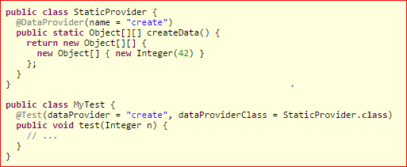
Data provider in different class
By default, data provider is looked in the same test class or else in its base classes.
For data provider in any other class,
it should be a static method or a class with non-arg constructor, and you can give the class name where it can be searched in the dataProviderClassattribute:

Slide 7


Data Provider Injection (1)
TestNG uses test context for the Data Provider injection.
The Data Provider method returns any of the following two types:
An array of array of objects (Object[][])
- The first dimension's size tells the count of the test method will be called.
- The second dimension size holds an array of the objects which must be compatible with number of the parameter types in the test method signature.
When the test method have lot of parameters, the good approach is to use Iterator<Object> which create the test data lazily.TestNG
invokes the iterator and iterator will pass the data one by one.
For example :

Slide 8

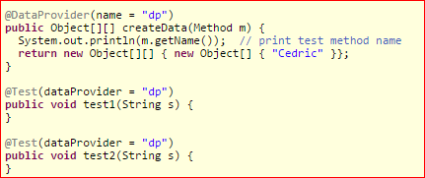


Data Provider Injection (2)
If the @DataProvidertakes java.lang.reflect.Method as the first parameter, TestNG passes the current test method as a first parameter. This is useful if several test methods uses the same @DataProviderand you are returning a different values depending upon which particular test method @DataProvider is supplying data for.
For example:
will display:

Slide 9
Parameters
Test methods can’t be parameter-less. You can have any arbitrary number of parameters in each of the test method, and you can tell TestNG to pass the correct parameters using @Parameters annotation.
@Parameters:
It passes parameters to @Test method.
Value:
Value is a list of variables used to fill the parameters within the method. Two ways to set parameters: using testng.xml or programmatically.

Slide 10




Parameters
Parameters from testng.xml:
Simple values can be specified in your testng.xml:
In the given code, the first-name in the XML parameter can be mapped with the firstName of the Java method in the above code.

Slide 11
Parameters
The @Parameters annotation locations:
On any of the method having annotation @Test, @Before/@After.
Using constructor of the test class, TestNG calls the particular constructor with parameters to initialize the values which are mentioned in testng.xml.
Notes:
The XML parameters are mapped with the Java parameters in the same order as they are mentioned in the annotation, else TestNG will throw an exception.

Slide 12




Parallel execution using Data Provider
With the parallel attribute, Data providers can be executed in parallel :
Parallel execution from an XML file:

Slide 13

Parallel Execution
Parallelism and time-outs:
You can tell TestNG to execute tests in the separate threads in different ways.
Parallel suites:
It is useful for running several suite files (e.g. "java org.testng.TestNG testng1.xml testng2.xml") .
For Example:

Slide 14


Parallel Tests , Methods
parallel="methods":
TestNG execute all test methods in the separate threads. The Dependentmethods will also execute in separate threads however they will follow the order specified.
parallel="tests":
TestNG executes all the methods in the same <test> tag within the same thread, however, each <test> tag will be executed in a separate thread which allowsto group all classes which are not thread safe within the same <test>.

Slide 15



Parallel classes, instances
parallel="classes":
TestNG execute all the methods within the same class within the same thread, however each class executes in a separate thread.
parallel="instances":
TestNG executes all the methods within the same instance within the same thread, however, two methods on the two different instances will be executing in the different threads.
In @Test method you can specify different threads using threadPoolSize, invocation count and the timeout:

Slide 16
Listeners
To modify TestNG behavior there are interfaces broadly called "TestNG Listeners". Below are the few Listeners:
IAnnotationTransformer - (doc, javadoc)
IAnnotationTransformer2 - (doc, javadoc)
Ihookable - (doc, javadoc)
IInvokedMethodListener - (doc, javadoc)
IMethodInterceptor - (doc, javadoc)
IReporter - (doc, javadoc)
ISuiteListener - (doc, javadoc)
ITestListener -(doc, javadoc)

Slide 17

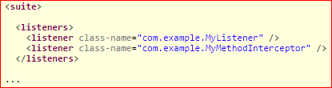
Listeners
These are the following ways to let testNG know about the listeners:
Using -listener with command line.
Using <listeners> with testng.xml file.
Using @Listeners on test classes.
listeners with testng.xml and Java:

Slide 18


Listeners
listeners in Java:
Note: The @Listeners annotation can be applied to your entire suite file like they are specified in testng.xml file.
Test results : Assert, Success, and failure
A test is successful if it is completed without any exception, or if it throw an expected exception.
Test cases containsthe calls that can throw an exception/error, or else of many assertions (like Java "assert" keyword).
Assert failure triggers an “AssertionErrorException”, which makes a test case failure.

Slide 19




Listeners
Test method example:
TestNG also have JUnit's Assert, which can perform assertions on complex objects:

Slide 20
Logging and results using listeners
Results of the tests run are produced in index.html in the specified directory after launching SuiteRunner and this file also points to many text files and other HTML that have the results of the entire suite.
It's simple to generate reports with TestNG using Listeners and Reporters:
Listeners implements org.testng.ITestListener interface and notifies in real time of test start, pass, failure and many more.
Reporters implements org.testng.IReporter interface and notifies when will all the suites have been executed by the TestNG.
For example, to generate PDF report for test run, it is not needed to be informed in the real time of the test execution so you can use an IReporter. For real-time reporting of test cases, like UI with a progress bar ITestListener can be the good choice.

Slide 21

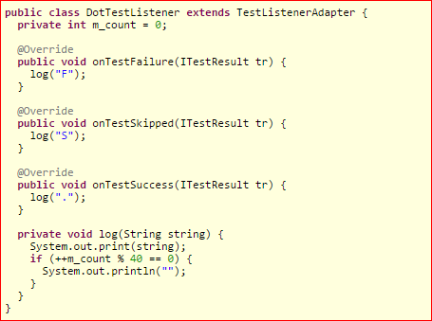
Logging Listeners
For example: Below image depicts logging with listeners.

Slide 22

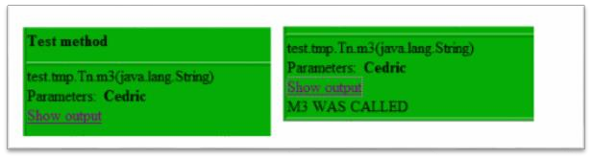
Logging reports
The org.testng.IReporter method:
This method can be invoked by TestNG after all the suites executes and you can examine its parameters to get all the information about the completed run.
Reporter API:
For logging messages which should appear in the HTML reports, use class org.testng.Reporter: Reporter.log("M3 WAS CALLED")

Slide 23
Module Objectives
At the end of this module, you will be able to:
Explain TestNg features.

Slide 24
Module Summary
Now, you should be able to:
Explain TestNg features.

Slide 25
Reference
http://testng.org/doc/

Slide 26
Thank You

