Slide 1



Learning and Knowledge Management
API Testing
Accenture CSI Confidential Material. Do not duplicate or distribute

Slide 2
Course Objectives
At the end of this module, you will be able to:
Basics of API Testing.
Identify the opportunities for API testing in an Application.
Determine the approach for API Testing.
Tools available for API Testing.
Selection of Tools for API Testing.
Balancing the API Testing & UI testing.

Slide 3
Classification of APIs
Web service APIs
SOAP
REST
XML-RPC and JSON-RPC
WebSocket APIs
Library-based APIs (SDK)
Class-based APIs (object orientation)
Java API
Android API
OS functions and routines
Access to file system
Access to user interface
Object remoting APIs
CORBA
.NET Remoting

Slide 4
Selecting API’s for Automation
The APIs to automate need to be selected in the context of the project, based on the functionality, architecture & interactions with other systems
The list on the page specifies an order just considering the ease of automation and external tools available
Web service APIs
SOAP
REST
XML-RPC and JSON-RPC
WebSocket APIs
Library-based APIs (SDK)
Class-based APIs (object orientation)
Java API
Android API

Slide 5
Benefits API’s for Automation
Test the application early before UI is implemented
Easy to maintain
User Interface(UI) tests are fragile and need to be updated for every change in the UI
Fast Execution
UI test are expensive and take longer time to execute
Application can be tested extensively for the functionality excluding the UI

Slide 6
Popular API Testing Tools
HTTP based API
SOAPUI
RestAssured
PostMan
Tricentis
Advanced REST Client
APICLI (Nodejs)
Custom application
Non-HTTP
Custom application
Custom Application can be built in multiple technologies
Java
.Net
Python or Similar

Slide 7
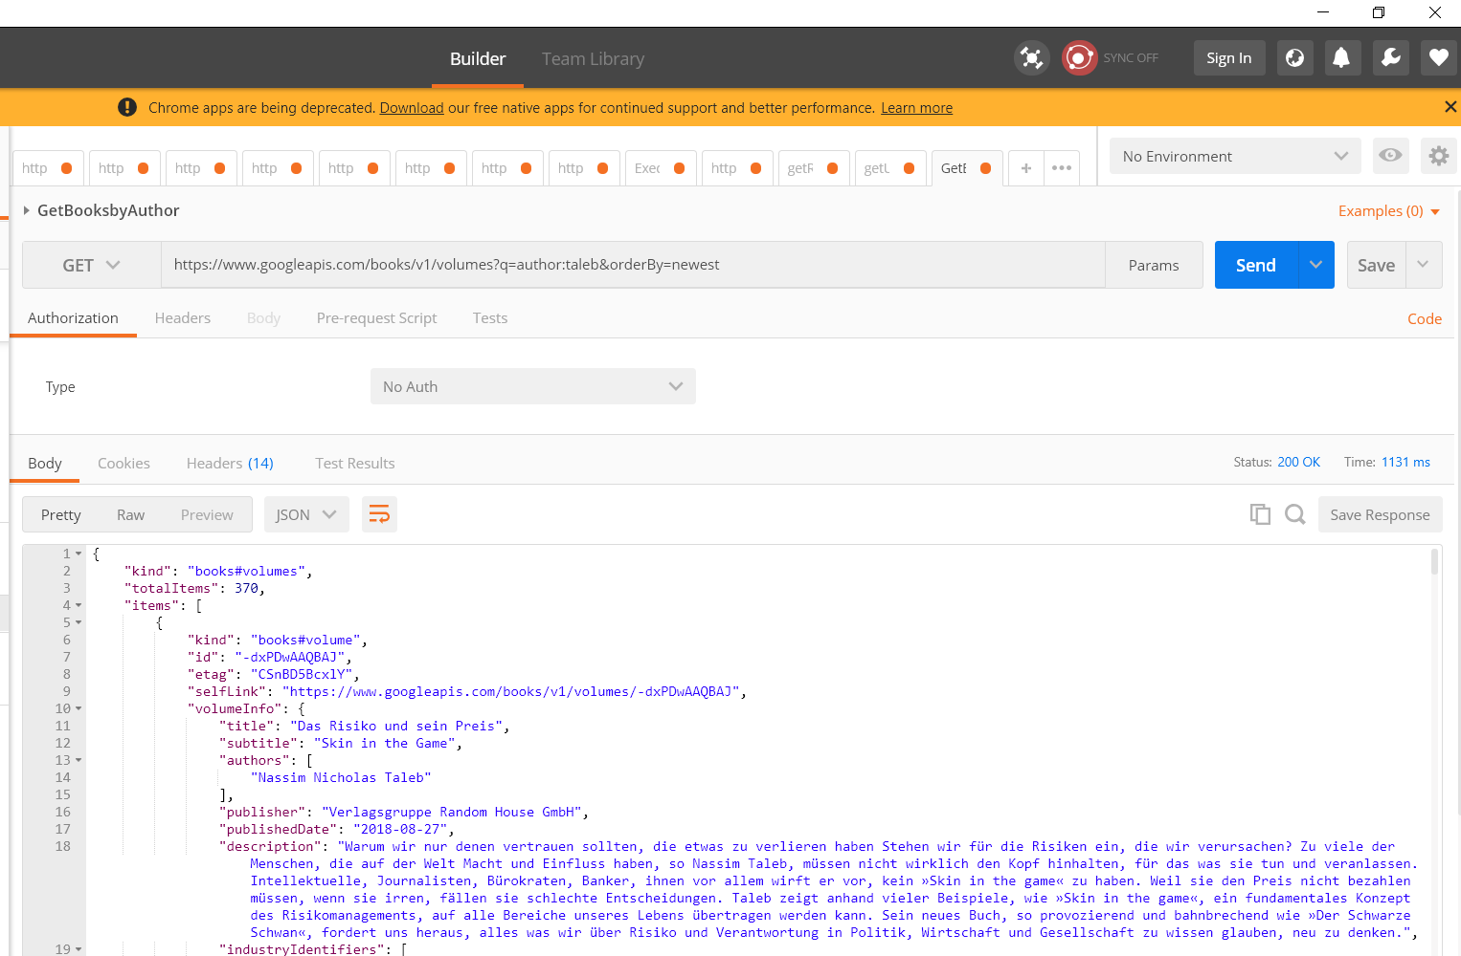
API Testing at a Glance via PostMan
PostMan can be used for automating the HTTP based APIs
Postman is available at : https://www.getpostman.com/
Supports SOAP and REST API
Allows for easy manipulation and creation of request
Simple Validation of the responses
Support for the all industry standard authentication mechanisms
Enables to define environments and parametrization

Slide 8
Thank You

