Slide 1




Learning and Knowledge Management
Module 4: Introduction to WebDriver
Accenture CSI Confidential Material. Do not duplicate or distribute

Slide 2
Module Objectives
At the end of this module, you will be able to:
Explain Selenium WebDriver
Compare Selenium WebDriver and Selenium RC
Illustrate how to create Maven Project and add Selenium WebDriver dependency
Discuss the execution of Selenium scripts in different browsers

Slide 3
Topic List
Selenium WebDriver
Create Maven Project With WebDriver Dependency Execution Of Selenium Scripts In Different Browsers

Slide 4
Topic List
Selenium WebDriver
Create Maven Project With WebDriver Dependency Execution Of Selenium Scripts In Different Browsers

Slide 5
Selenium WebDriver (1)
Introduction to Selenium WebDriver
WebDriver API is used for testing web applications across different browsers.
Selenium scripts using Web Driver API can be implemented in different programming languages like java, C#, python, ruby, java script .
WebDriver is faster than Selenium RC because of its simpler architecture.
WebDriver directly talks to the browser while Selenium RC needs the help of the RC Server in order to do so.

Slide 6
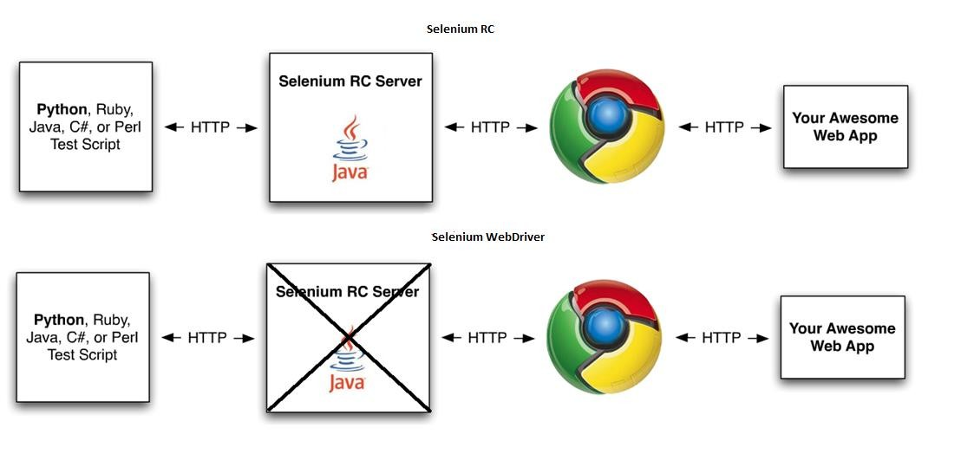
Selenium WebDriver (2)
Selenium RC vs Selenium WebDriver Architecture

Slide 7
Topic List
Selenium WebDriver
Create Maven Project With WebDriver Dependency Execution Of Selenium Scripts In Different Browsers

Slide 8
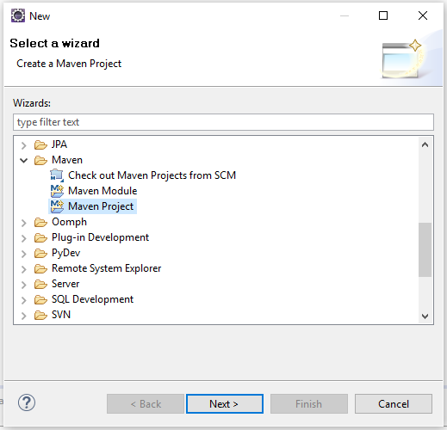
Create Maven Project With WebDriver Dependency (1)
Step 1 : Create a maven project in Eclipse as shown and click on Next
Note : (Prerequisite Step) Check for Maven location in the system. If not available then download maven from https://maven.apache.org/download.cgi and copy the binary zip file to the local drive. To enable maven commands set the path for maven using MAVEN_HOME as a variable. Can ignore this prerequisite step if maven is already available.

Slide 9
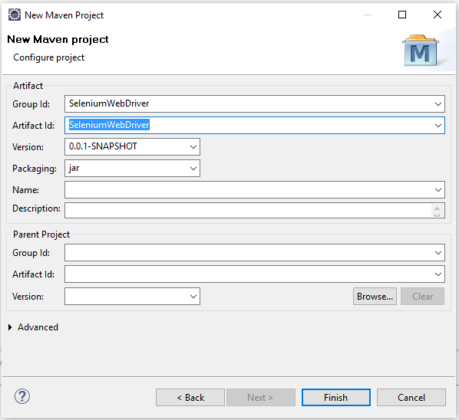
Create Maven Project With WebDriver Dependency (2)
Step 2: Enter the name of the Group Id & Artifact Id and click on Finish.
Then, the Maven project structure is created.

Slide 10
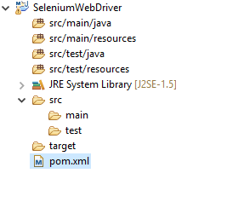
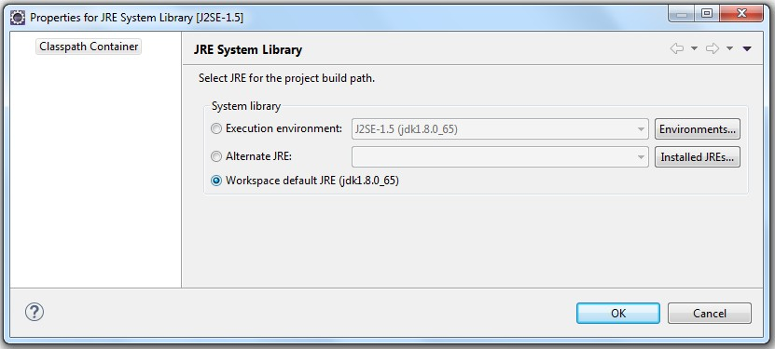
Create Maven Project With WebDriver Dependency (3)
Step 3: Right click on JRE System Library and select properties. Change the classpath container to Workspace Default JRE and click OK.

Slide 11
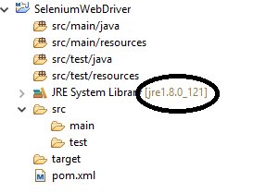
Create Maven Project With WebDriver Dependency (4)
Step 4: Ensure that by changing the class path container, JRE System Library has to change to the current java library

Slide 12
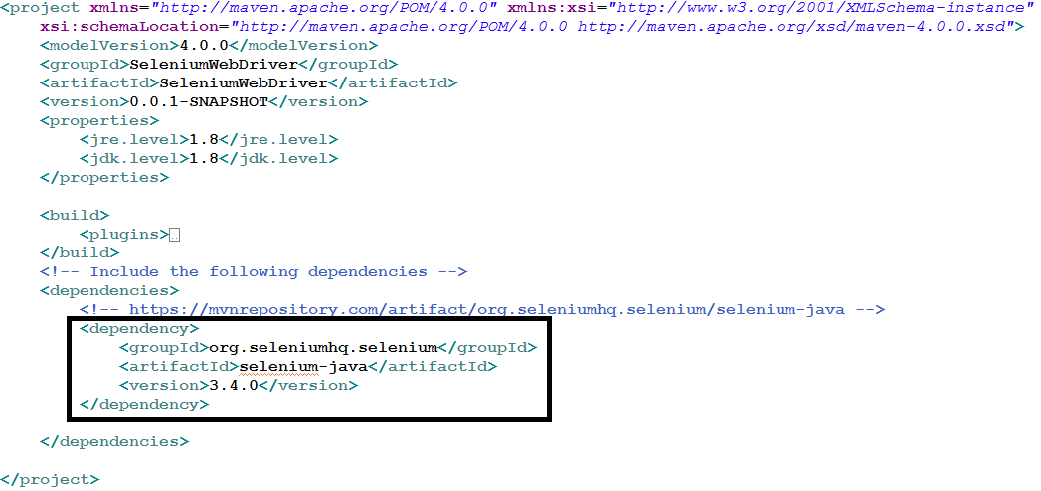
Create Maven Project With WebDriver Dependency (5)
Step 5: Open the pom.xml to add the Selenium WebDriver dependency from the maven central repository and save the pom.xml
After saving pom.xml, Maven Dependencies will be shown in the project

Slide 13
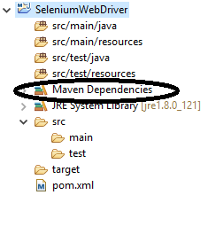
Create Maven Project With WebDriver Dependency (6)
Step 6: Expand Maven Dependencies to check the Selenium WebDriver library.

Slide 14

Create Maven Project With WebDriver Dependency (7)
Step 7 : Required Dependencies / Plugins
Add the below plugins and dependencies in the pom.xml file
Dependencies
selenium-java/selenium-server
TestNG
Plugins
maven-compiler-plugin
maven-surefire-plugin
Below attached is the pom.xml for reference, given after adding plugins and dependencies

Slide 15
Topic List
Selenium WebDriver
Create Maven Project With WebDriver Dependency Execution Of Selenium Scripts In Different Browsers

Slide 16
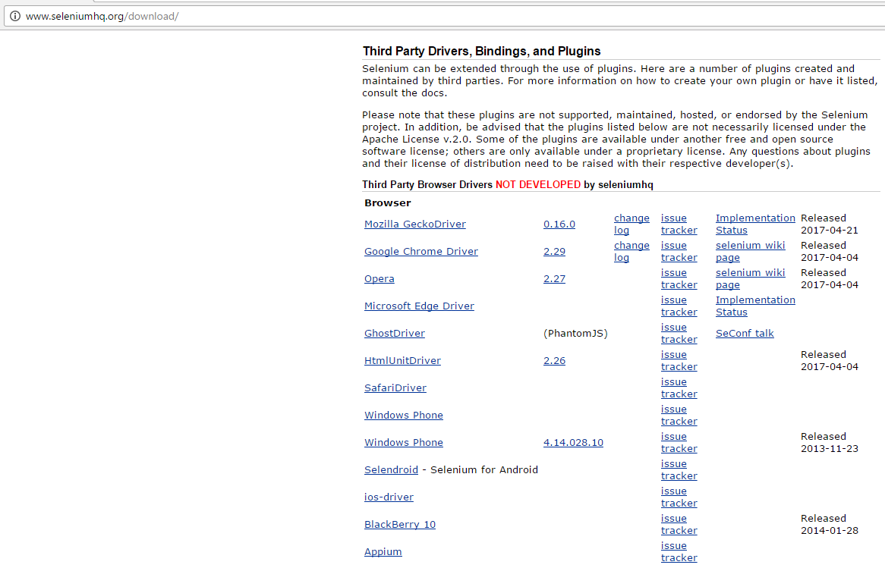
Execution Of Selenium Scripts In Different Browsers (1)
Download drivers for different browsers from http://www.seleniumhq.org/download

Slide 17
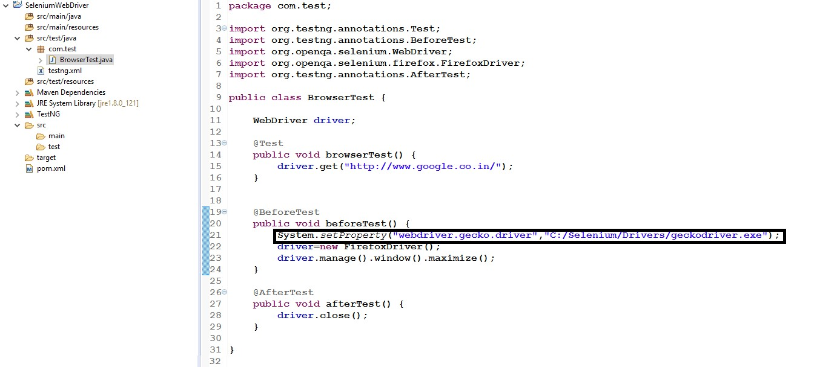
Execution Of Selenium Scripts In Different Browsers (3)
Execution of Selenium scripts with Firefox

Slide 18
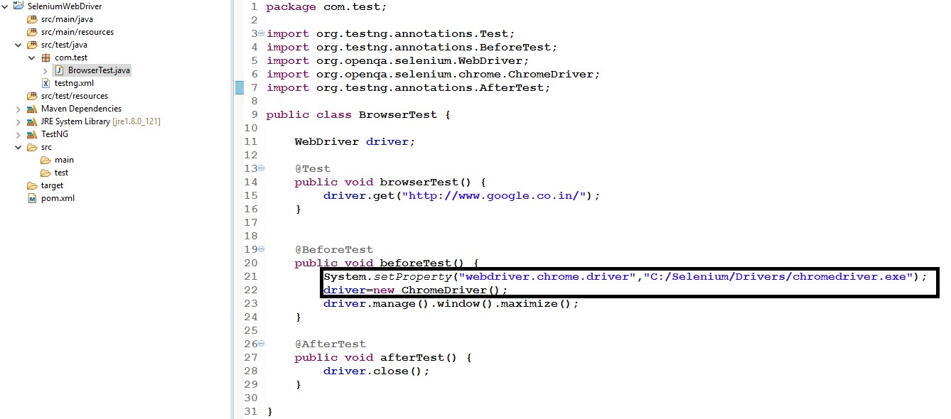
Execution Of Selenium Scripts In Different Browsers (4)
Execution of Selenium scripts with Chrome

Slide 19
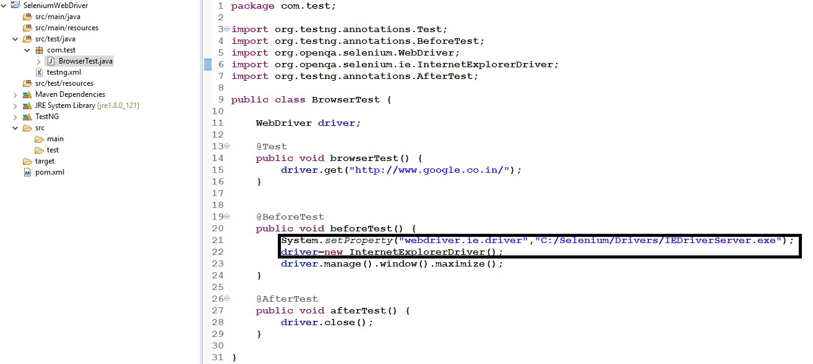
Execution Of Selenium Scripts In Different Browsers (5)
Execution of Selenium scripts with IE

Slide 20
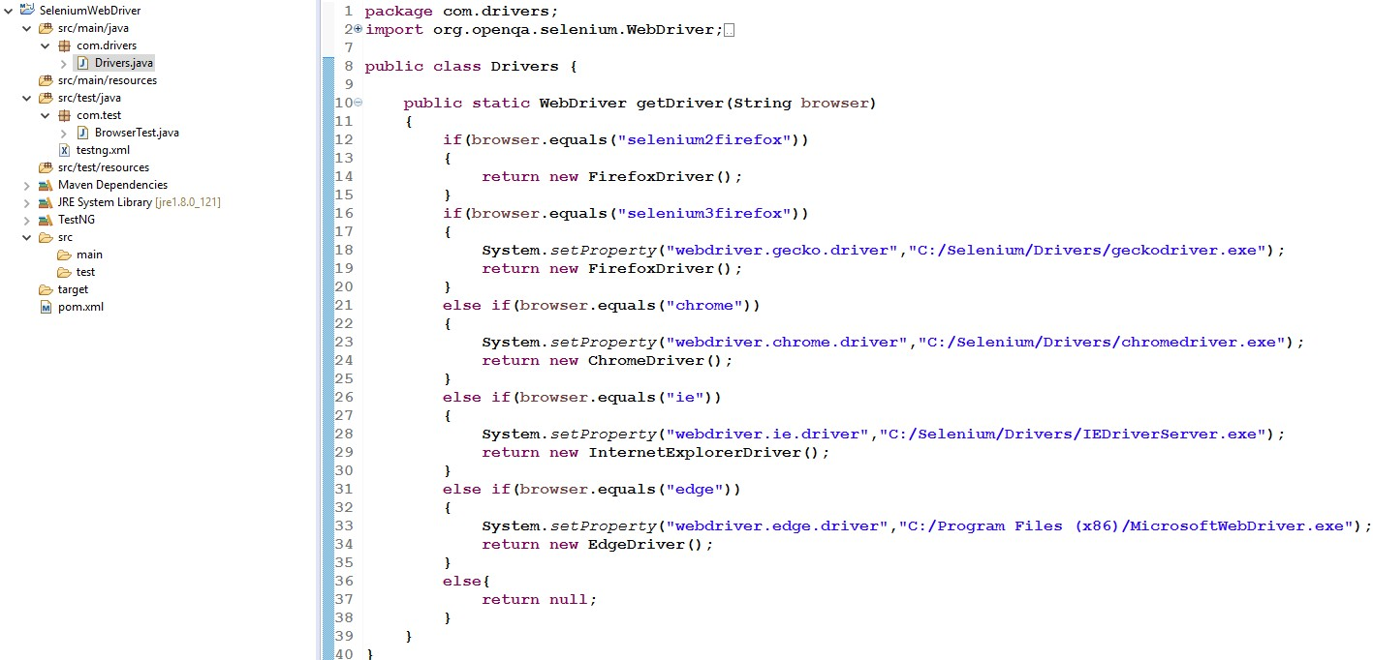
Execution Of Selenium Scripts In Different Browsers (6)
Creating a Utility Class for driver instances

Slide 21
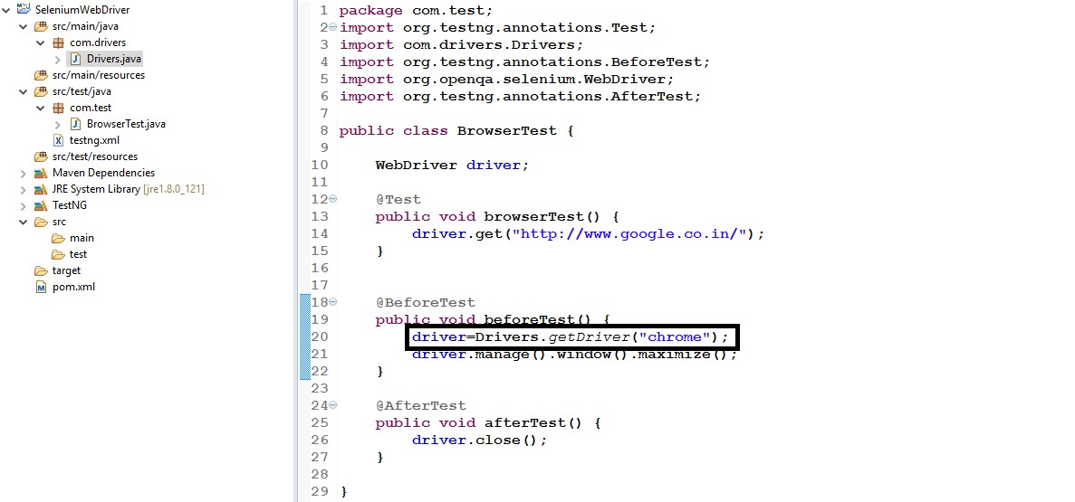
Execution Of Selenium Scripts In Different Browsers (7)
Using the Utility Class in TestNG test cases

Slide 22
Module Summary
Now, you should be able to:
Explain Selenium WebDriver
Compare Selenium WebDriver and Selenium RC
Illustrate how to create Maven Project and add Selenium WebDriver dependency
Discuss the execution of Selenium scripts in different browsers

Slide 23
Thank You

