Slide 1




Module 5: WebDriver Application
Programming Interface (API)
Learning and Knowledge Management
Accenture CSI Confidential Material. Do not duplicate or distribute

Slide 2
Module Objectives
At the end of this module, you will be able to:
Explain Selenium WebDriver API
Identify Web Elements using Selenium Locators
Explain how to use WebDriver commands and manage timeouts

Slide 3
Topic List
Introducing WebDriver API
Selenium Locators WebDriver Commands WebElement Commands Wait Commands

Slide 4
Topic List
Introducing WebDriver API
Selenium Locators WebDriver Commands WebElement Commands Wait Commands

Slide 5
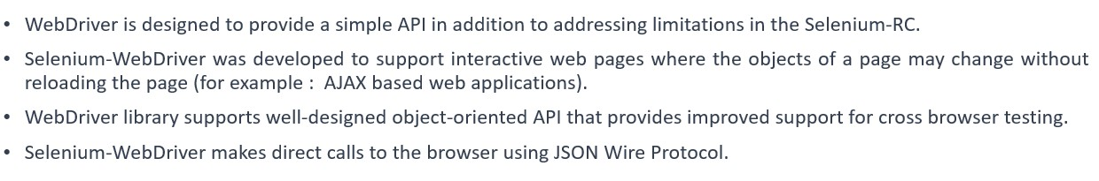
Introducing WebDriver API (1)
WebDriver API

Slide 6
Introducing WebDriver API (2)
WebDriver(selenium-java) and selenium-server
If the tests have to be executed on the local machine we need to just use WebDriver API (selenium-java) as artifact ID.
This doesn’t require to start selenium-server as WebDriver API will directly interact with browser.
When a selenium-server is required?
Using Selenium Grid (hub-node) architecture to distribute your tests over multiple machines or virtual machines (VMs).
Connect to a remote machine using RemoteWebDriver by passing Remote machine address and desired capabilities.

Slide 7
Introducing WebDriver API (3)
WebDriver is the main interface to use for testing in selenium, which represents an idealized web browser.
The methods in this interface fall into three categories:
Control of the browser itself
Selection of Web Elements
Debugging aids
Click here to refer the WebDriver API documentation
WebDriver [Interface]
FirefoxDriver
[Class]
InternetExplorerDriver
[Class]
ChromeDriver
[Class]
OperaDriver
[Class]
Safari Driver
[Class]
RemoteWebDriver
[Class]

Slide 8
Topic List
WebDriver API
Selenium Locators WebDriver Commands WebElement Commands Wait Commands

Slide 9
Selenium Locators (1)
Locating Elements
Id
Name
Class Name
Link Text
Partial Link Text
Tag Name
CSS Selectors
XPath

Slide 10
Selenium Locators (2)
Locating Elements By Id
Use this strategy when an element's id attribute is available
Locates an element by using id attribute.
Java Syntax :
WebElement uid=driver.findElement(By.id(“policy_no”));
Cons : Id strategy works well on elements with only fixed ids and not generated ones

Slide 11
Selenium Locators (3)
Locating Element By Name
Use this strategy when an element's name attribute is available
Locates an element by using name attribute.
Java Syntax :
WebElement username=driver.findElement(By.name(“userName”));
Note : If there are duplicate names available WebDriver will locate the first occurrence name.

Slide 12
Selenium Locators (4)
Locating Element By Class Name
Use this strategy when an element's class attribute is available
Locates an element by using class attribute.
Java Syntax :
WebElement search=driver.findElement(By.className(“gsfi”));
Note : When class name has spaces (for example class=“abc xyz”) then you can take the first word of the class name
instead of the full name, otherwise it displays an error message.
Syntax:
WebElement search= driver.findElement(By.className(“abc”));

Slide 13
Selenium Locators (5)
Locating Element By Link Text
This strategy is used to locate the anchor element containing the specified text. For Example : Hyperlinks with text
Locates the link using it’s text.
Java Syntax :
WebElement search=driver.findElement(By.linkText(“Even More Apps”));
Pros : Will select only anchor elements, Useful when testing navigation.
Cons: You have to know the text of the link before.

Slide 14
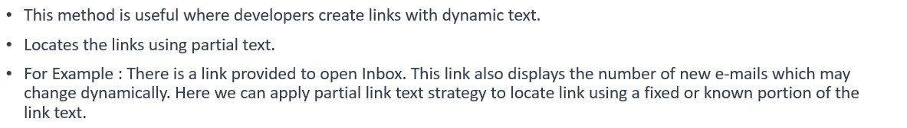
Selenium Locators (6)
Locating Element By Partial Link Text
Java Syntax :
WebElement inboxlink=driver.findElement(By.partialLinkText(“Inbox”));

Slide 15
Selenium Locators (7)
Locating Element By Tag Name
This strategy is useful to select the element/elements by specifying the tag name.
Locate elements using tag name.
For Example: To find number of rows displayed in a web table. Locating all <tr> tags and so on.
Java Syntax :
List<WebElement> noofrows=driver.findElements(By.tagName(“tr”));

Slide 16
Selenium Locators (9)
Locating Element By CSS Selectors
By using ID selector
CSS Syntax : css=tag#id
Java Syntax : WebElement uid=driver.findElement(By.cssSelector(“input#policy_no”));
By using Class selector
CSS Syntax : css=tag.class
Java Syntax : WebElement uid=driver.findElement(By.cssSelector(“input.policy”));
By using Attributes selector
CSS Syntax : css=tag[attribute=value][attribute=value]
Java Syntax : WebElement logo=driver.findElement(By.cssSelector(“img[alt=‘hplogo’]”));

Slide 17
Selenium Locators (10)
Locating Element By CSS Selectors Contd..
By using Attribute Name Selector
CSS Syntax: css=tag[attribute]
Java Syntax: WebElement logo=driver.findElement(By.cssSelector(“img[alt]”));
A Boolean not()pseudo-class can also be used to locate elements not matching the specified criteria.
Java Syntax: WebElement logo=driver.findElement(By.cssSelector(“img:not([alt])”));
By performing partial match on attribute values
Syntax | Example | Description
^= | input[id^=‘ctrl’] | Starting with: For example, if the ID of an element is ctrl_12, this will locate and return elements with ctrl at the beginning of the ID.
$= | input[id$=‘_userName’] | Ending with: For example, if the ID for an element is a_1_userName, this will locate and return elements with _userName at the end of the ID.
*= | input[id*=‘userName’] | Containing: For example, if the ID of an element is panel_login_userName_textfield, this will use the userName part in the middle to match and locate the element.

Slide 18
Selenium Locators (11)
Locating Element By CSS Selectors Contd..
Location by DOM structure using Absolute Path
CSS absolute path refer to the very specific location of the element considering its complete hierarchy in the DOM.
Example: css=html body div div form input
Parent to child relationships with > or space separator
Example: css=html>body>div>div>form>input
Child to child relationships with + separator
Example: css=html>body>div>div>form>input+input+input
Locating by DOM structure using Relative Path
With relative path we can locate an element directly, irrespective of its location in the DOM.
Example: css=form[id=‘f1’]>div>input
Finding the nth child element
Example: css=div#_eEe *:nth-child(3) – this example is for identifying “Telugu” link in Google Home page.

Slide 19
Selenium Locators (12)
Locating Element By XPath
XPath, the XML path language, is a query language for selecting nodes from an XML document. All the major
browsers support XPath HTML pages are represented as XHTML documents in DOM.
Selenium supports XPath for locating elements using XPath expressions or queries.
Locating elements with XPath works very well with a lot of flexibility. However, this is the least preferable locator strategy due to its slow performance.
One of the important differences between XPath and CSS is, with XPath we can search elements backward or forward in the DOM hierarchy while CSS works only in a forward direction. This means with XPath we can locate a parent element using a child element.

Slide 20
Selenium Locators (13)
Locating Element By XPath Contd..
Finding elements with absolute path Example: xpath=/html/body/form
Finding elements with relative path Example: xpath=//form
Finding elements using index
Example: xpath=//form/input[1]
Finding elements using attributes values
Example: xpath=//input[@name=‘username’] With multiple attributes:
Example: xpath=//input[@name=‘username’][@class=‘required’]
Example: xpath=//input[@name=‘username’ and @class=‘required’] Example: xpath=//input[@name=‘username’ or @class=‘required’]

Slide 21
Selenium Locators (14)
Locating Element By XPath Contd..
Finding elements using attributes Example: xpath= //img[@alt]
Performing partial match on attribute values
Syntax | Example | Description
starts-with() | xpath=//input[starts-with(@id,’ctrl’)] | Starting with: For example, if the ID of an element is ctrl_12, this will locate and return elements with ctrl at the beginning of the ID.
ends-with() | xpath=//input[ends-with(@id,’_userName’)] | Ending with: For example, if the ID of an element is a_1_userName, this will locate and return elements with _userName at the end of the ID
contains() | xpath=//input[contains(@id,’userName’)] | Containing: For example, if the ID for an element is panel_login_userName_textfield, this will use the userName part in the middle to match and locate the element.

Slide 22
Selenium Locators (15)
Locating Element By XPath Contd..
Matching any attribute using a value
Example: xpath=//input[@*=‘username’]
Using Xpath text function
Example: xpath= //a[text()=‘తెలుగు’]
Finding elements using exact text value Example: xpath=//a[.=‘తెలుగు’]

Slide 23
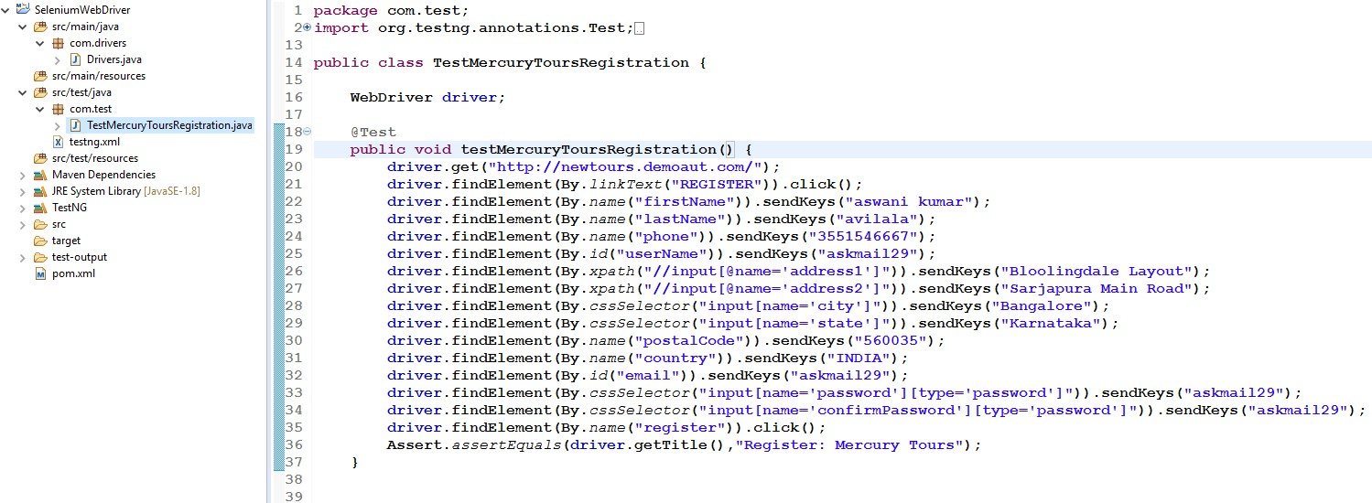
Demo on Selenium Locators (1)
Open the link http://newtours.demoaut.com . Find the Register link to submit the user details successfully and create a user id.

Slide 24
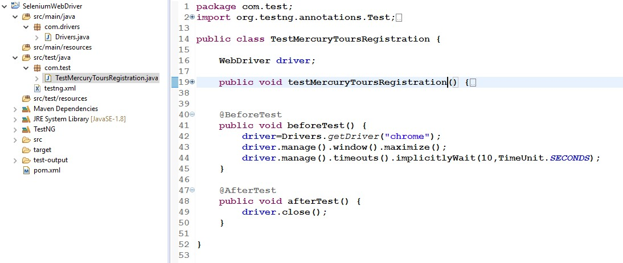
Demo on Selenium Locators (2)

Slide 25
Topic List
WebDriver API
Selenium Locators WebDriver Commands WebElement Commands Wait Commands

Slide 26
WebDriver Commands (1)
Get Methods
Get methods retrieve information about the page that we deal with. Given below are some important "get" methods:
Get – driver.get() send the AUT URL to the browser
Get Title – driver.getTitle() gets the title of the current page.
Get Current URL – driver.getCurrentUrl() gets the current URL of the page which is loaded on browser.
Get Page Source – driver.getPageSource() gets the source code of the web page.
Find Web Element Commands
Access a Web Element : driver.findElement() command finds the first Web Element
Access list of Web Elements : driver.findElements() command finds all elements within current web page.

Slide 27
WebDriver Commands (2)
Navigate Methods
Navigate To - navigate().to() method is like get() command. To(String URL) sends the URL to the browser
Navigate to back page - navigate().back() will go back to previous page on the browser's history.
Navigate to forward page - navigate().forward() method takes you forward by one page on the browser's history.
Refresh page - navigate().refresh() reloads the current page.

Slide 28
WebDriver Commands (3)
Other Useful Methods
Switch To - driver.switchTo().window(“windowName”) switches from one window to another window.
Switching To Frames - driver.switchTo().frame(“frameName”) is used to switch to a particular frame/iframe.
Handling Alerts - driver.switchTo().alert() is used to handle java script pop up windows.
Close - close() closes the current instance/window of the browser
Quit - quit() method is used to close all browser windows which is opened by WebDriver for that instance.

Slide 29
Topic List
WebDriver API
Selenium Locators WebDriver Commands WebElement Commands Wait Commands

Slide 30
WebElement Commands (1)
Accessing Elements in a Form
The sendKeys() sends text to the field where input type is text.
Example: driver.findElement(By.name(“username”)).sendKeys(“selenium”);
The clear() is used to clear the text .
Example: driver.findElement(By.name(“username”)).clear();
getText() gets the text for an element.
Example: driver.findElement(By.id(“resultStats”)).getText();
The click() is used to toggle the element on/off(Radio, Checkbox).
Example: driver.findElement(By.cssSelector(“input[value=‘Business’]”)).click();
Example: driver.findElement(By.linkText(“Register here”)).click();
The submit() submits the form.
Example: driver.findElement(By.name(“password”)).submit();

Slide 31
WebElement Commands (2)
Accessing Elements in a Form Contd..
To handle drop down boxes:
•
•
Import the package org.openqa.selenium.support.ui.Select Instantiate the drop-down box as a “Select” object in WebDriver
Example: Select ddCountry = new Select(driver.findElement(“By.name(“country”));
ddCountry.selectByVisibleText(“INDIA”);
Given Below are the most common methods used on drop-down elements.
selectByVisibleText() & deselectByVisibleText() - Selects/Deselects the option matching the text .
selectByValue() & deselectByValue() - Selects/deselects the option matching the value.
selectByIndex() & deselectByIndex() - Selects/deselects the option matching the index.
isMultiple() - Returns TRUE / FALSE to check multiple selection on option.
deselectAll() – All selected entries are cleared

Slide 32
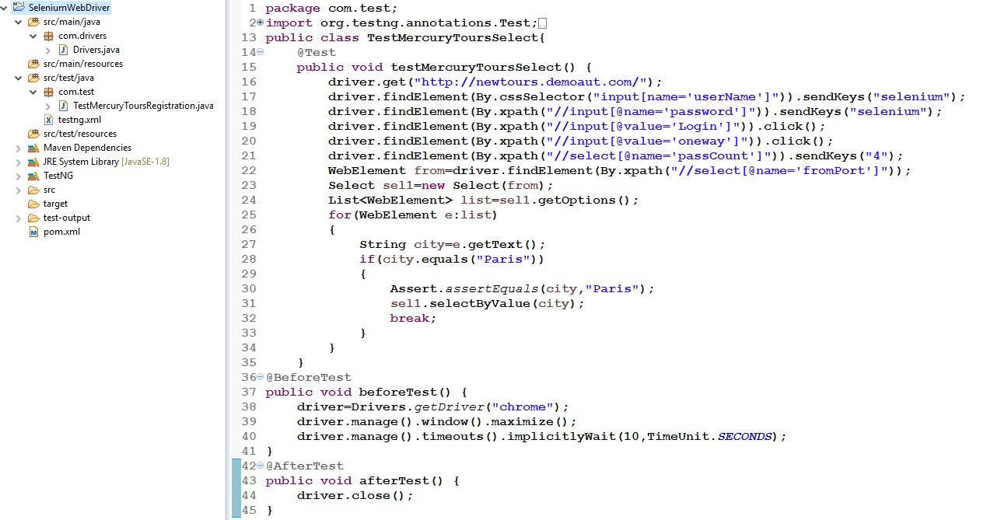
Demo on Web Element Commands
Using Select Class find an option in the drop down box.

Slide 33
Topic List
WebDriver API
Selenium Locators WebDriver Commands WebElement Commands Wait Commands

Slide 34
Wait Commands (1)
Code Snippet for performing Implicit Wait
Example : WebDriver driver = new FirefoxDriver();
driver.manage().timeouts().implicitlyWait(10, TimeUnit.SECONDS); driver.get("http://newtours.demaut.com/");
WebElement myDynamicElement = driver.findElement(By.id("myDynamicElement"));

Slide 35
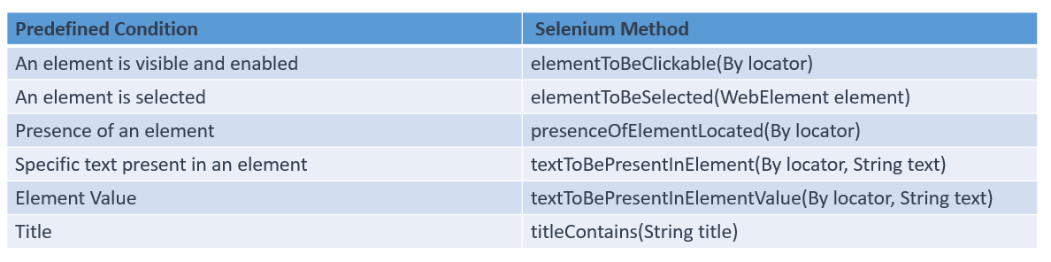
Wait Commands (2)
Synchronizing a test with an Explicit Wait

Slide 36
Wait Commands (3)
Code Snippet for performing Explicit Wait
Explicit Wait is applied on a specific condition for particular web element.
An explicit wait is the code you define to wait for a certain condition to occur before proceeding to further execution of test steps.
Used mainly for AJAX based web elements.
Example : WebDriverWait wait=new WebDriverWait(driver, 20); wait.until(ExpectedConditions.presenceOfElementLocated((By.xpath("//input[@id='Passwd']"))));
The above code waits up to 20 seconds before throwing a Timeout Exception or if it finds the element will return it in 0 - 20 seconds.

Slide 37
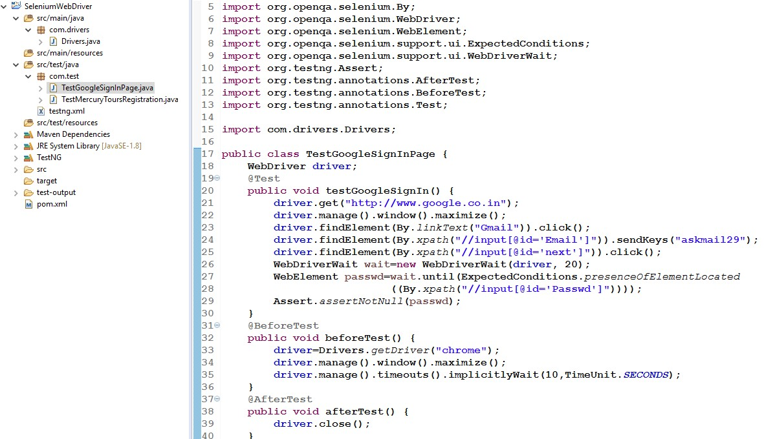
Demo on Wait Commands
Explicit Wait Demo

Slide 38
Module Summary
Now, you should be able to:
Explain Selenium WebDriver API
Identify Web Elements using Selenium Locators
Explain how to use WebDriver commands and manage timeouts

Slide 39
Thank You

