Slide 1




Learning and Knowledge Management
POM – Page Object Model
Accenture CSI Confidential Material. Do not duplicate or distribute

Slide 2
Ground Rules
For a successful class, please:
Arrive on time
Turn all cell phones off
Wear business formal attire
Assist your colleagues; show respect to all individuals regardless of their skill and knowledge level
Do not use class time to surf the net, check e-mail, or use instant messaging
Adhere to attendance policy as directed by your local training coordinator
Copy right © 2017 Accenture All Rights Reserv ed.

Slide 3
Learning and Knowledge Management
Module 1: Page Object Model : POM
Accenture CSI Confidential Material. Do not duplicate or distribute

Slide 4
Module Objectives
At the end of this module, you will be able to:
Describe Page Object Model.

Slide 5
Page Object Model(POM)
Page Object Model in a nutshell
Selenium test cases can be unmaintainable for the reasons of too many duplicacy in the code.
Duplicated code reason is the repeated functionality which results in duplicated usages of locators.
If any locator changes in future, you have to go through the whole test code to change locators wherever necessary. Hence using the page object model approach, we can make easy test code and can reduce or eliminate duplicacy in the test code. Besides it also enhances the readability and gives interactive documentation.
Using POM, we can also create tests with fewer keystroke. POM implementation can be done by separating the abstraction of the test objects(elements) and the test scripts.
Page Object Design Pattern advantages :
Clean parting between code and page specific code like locators (or their usages for an UI Map) and layout.
Only one package for the (services or operations) offered by the pages.

Slide 6
Structure of POM
POM approach is to create a separate class file for script maintenance which is to locate web elements, perform actions on them, or to verify them. These classes can be reused in all other scripts using that elements. In future, if web element changes, we only need to change in 1 class file and not in all the different scripts, where we are using it.
POM ensures readability, maintainability, and reusability.
With non structure POM, the web-elements and the test methods remains in the same class make it tightly coupled.
With POM based structure, the web-elements remains in a separate class which only contains the web objects and the test methods remains in a separate class which call the objects in the test classes.
POM makes one to many relationships, means the same web objects can be used in multiple test methods.

Slide 7
Page Objects
In the user interface(UI) there are some areas that your test cases interacts. A Page Object simply copies them as objects in the test codes. This reduces duplicacy and if UI changes, the fix needs to be applied at one place.
Implementation Notes :
Page-Objects have two significance. It represents the services to be offered on a
particular page and has a deep HTML structure knowledge of a page (or part of a page).

Slide 8
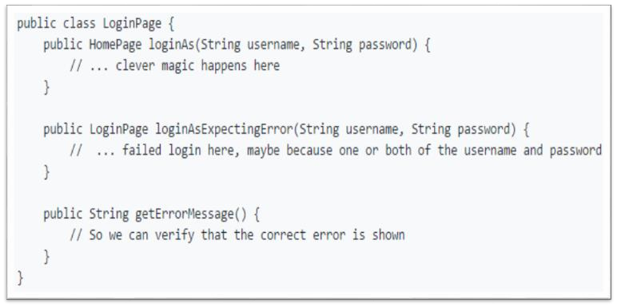
Page Objects
For the cases when application could have different outcome depending on the state of the app , create multiple
methods :

Slide 9
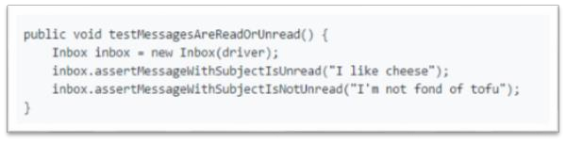
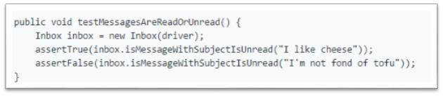
Page Objects
The code in the previous slide explains an important point: the tests, not the Objects, are responsible for assertions about the current state of a page. For example:
could be re-written as:

Slide 10
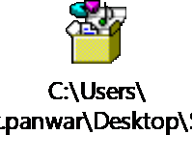
Summary – page objects
The public methods shows the facilities that the page offers.
Methods that return other Page-
Objects.
In page objects, there is no need to represent the entire page. Only present the required element.
Different methods should be created for different results of same functionality.

Slide 11
Page Factory
In Page-Factory, fields can be assumed to be initialized.
List<WebElement> fields are identified @FindBy or @FindBys annotation. "by name or id" search strategy us unsuitable for lists as several elements may have same name or id on a page.
WebElements are evaluated slowly. There will not be a call to findElement function if you don’t use the WebElement in a PageObject.

Slide 12
@FindBy and @FindBys Annotations
@FindBy :
Used to spot an element on a Page Object for indicating alternative mechanism for locating an
element or a list of the elements. You can use the annotation by specifying "how" and "using“.
For example, these two annotations point to the same element:
@FindBy(id = "foobar") WebElement foobar
@FindBy(how = How.ID, using = "foobar") WebElement foobar
@FindBys :
Used to spot a field on a Page Object which indicates lookup is using a series of @FindBy tags in a chain.
For example:
@FindBys({@FindBy(id = "foo"), @FindBy(className = "bar")})

Slide 13
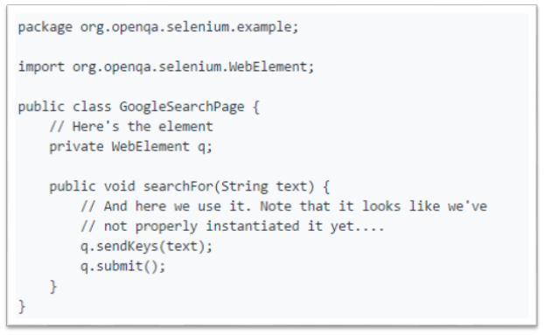
A Simple Example
Create some fields on a Page-Object class that are WebElements or List<WebElement> for example:
To avoid NullPointerException as the "q" field isn't instantiated, we have to initialize the Page-Object.

Slide 14
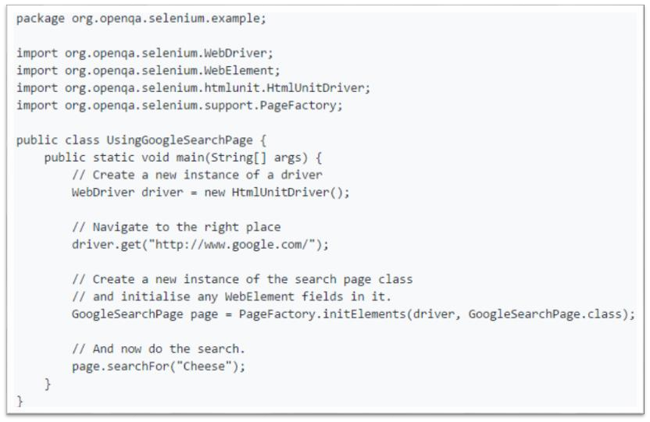
A Simple Example

Slide 15
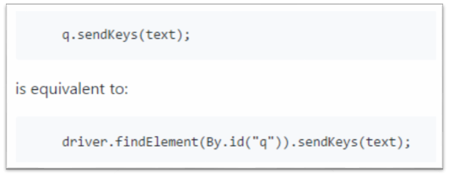
Explanation
The same driver instance is passed to the Page-Factory initElements method.
In the given example, we are relying on the Page-Factory to start the instance of the Page-Objects. It start doing this by looking for a constructor that has "WebDriver" as its sole argument (ex : public anyWebPage(WebDriver driver) {).
Otherwise, the default constructor will be called.

Slide 16
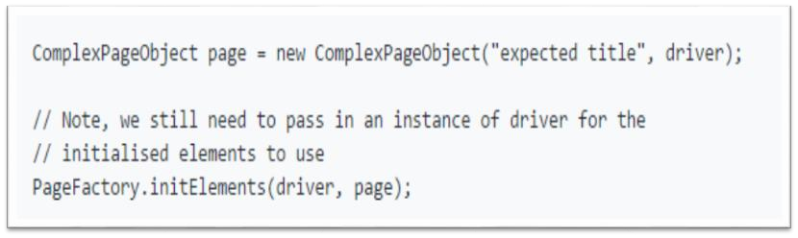
Explanation
In this case , Page-Factory has initialized the elements of an constructed object:

Slide 17
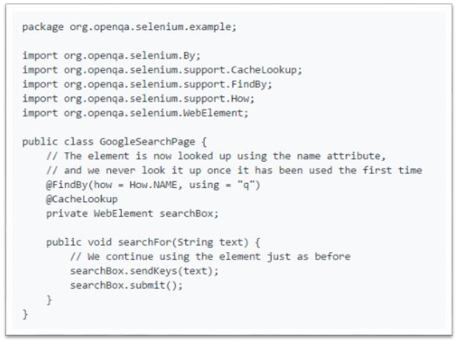
Cache the Element
- It would be good to "cache" the element after we have identified it.

Slide 18
Module Objectives
At the end of this module, you will be able to:
Explain Page Object Model.

Slide 19
Module Summary
Now, you should be able to:
Explain Page Object Model.

Slide 20
Course Summary
Now, you should be able to:
Explain Page Object Model.

Slide 21
Reference

Slide 22
Thank You

