Slide 1

SEARCH METHODS IN ROBOTIC PATH
Christopher Conti
Corey Hunnan
Laura Paulino

Slide 2

SEARCH AIM
Use Breadth-First and A* search methods to:
Find the optimal solution to determine a robot’s travel path from point A to point B within a controlled environment.
The controlled environment consists of built in obstacles representing stops interfering with the solution.
The robot’s aim is to navigate around the obstacles and avoid interference to find the best-cost solution.

Slide 3
Breadth-First Search
In BFS nodes are ordered as a queue in the FIFO (first-in-first-out) order.
The traversal process begins with a selected node or the starting node.
The traversal process happens horizontally therefore all nodes within the same layer must be visited before moving on to the next layer.
Visited nodes must be labeled as “visited” using Boolean values.

Slide 4
Why Breadth-First?
Pros:
Finds the shortest path between vertices
Searches level by level
Can find the closest goal in less time
Cons:
Consumes a lot of memory

Slide 5
Code:
def dfs(x,y,k):
global totalchecks
global goal
global grid
global pathfound
global distances
distances[x][y]=k
totalchecks+=1
if(x==goal[0] and y==goal[1]):
print('Goal reached')
pathfound=True
pass
for i in range(len(moves)):
newx=x+moves[i][0]
newy=y+moves[i][1]
if(validposition(newx,newy)):
if(distances[newx][newy]==0 and grid[newx][newy]==0):
print('pos=','(',newx,',',newy,')',' val=',distances[newx][newy],' k=',k,sep='')
dfs(newx,newy,k+1)
pass
def bfs(x,y):
global totalchecks
k=1
distances[x][y]=1
while(distances[goal[0]][goal[1]])==0 and k<len(grid)**2:
for i in range(len(grid)):
for j in range(len(grid[0])):
if(distances[i][j]==k):
totalchecks+=1
x=i
y=j
for m in range(len(moves)):
newx=x+moves[m][0]
newy=y+moves[m][1]
if(validposition(newx,newy)):
if(distances[newx][newy]==0 and grid[newx][newy]==0):
distances[newx][newy]=k+1
print(k)
k+=1

Slide 6
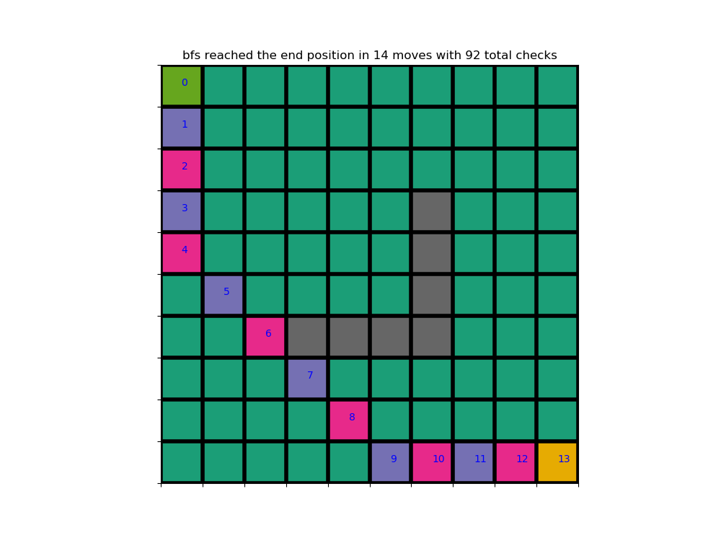

Slide 7
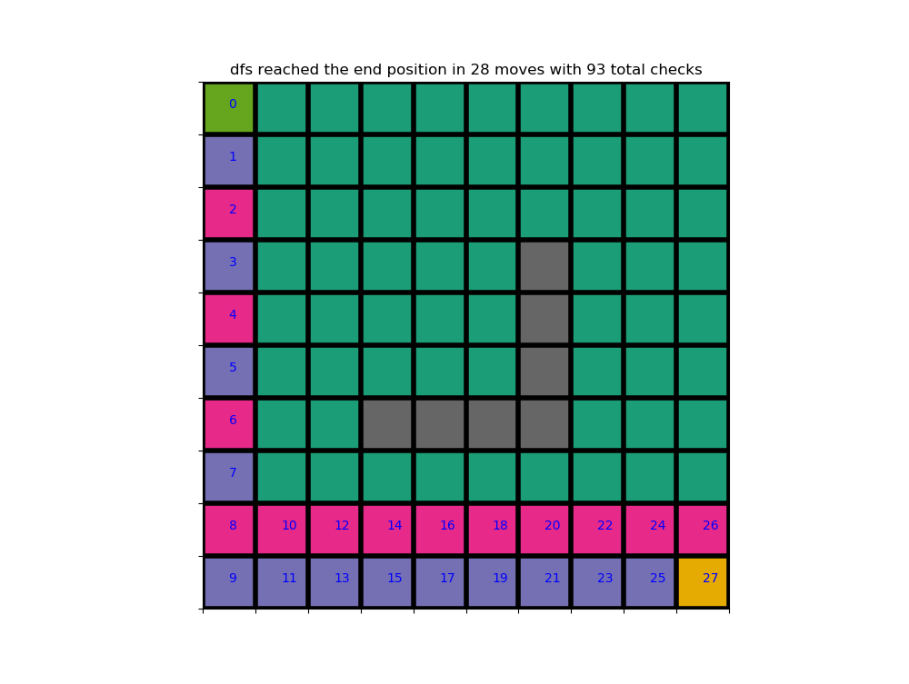

Slide 8
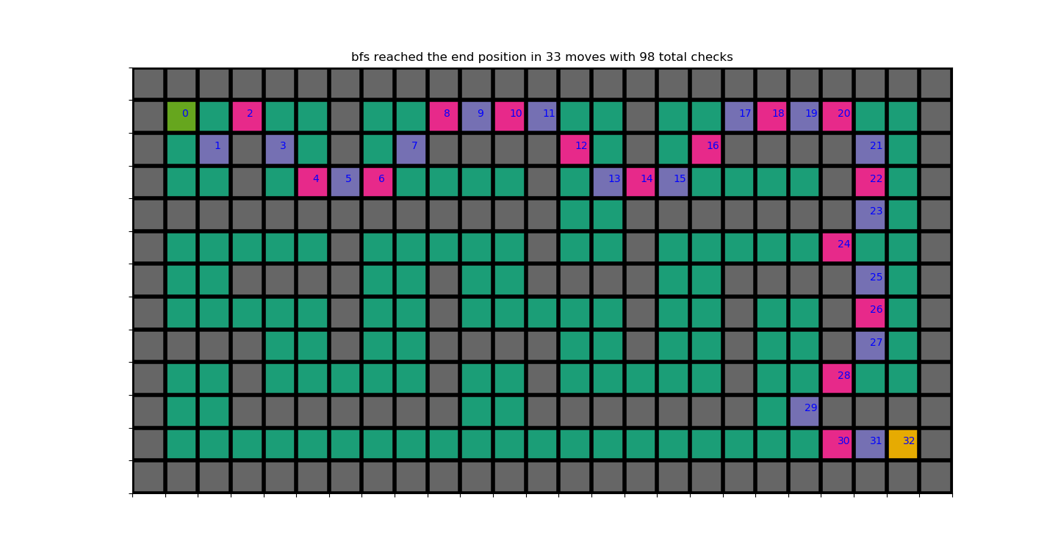

Slide 9
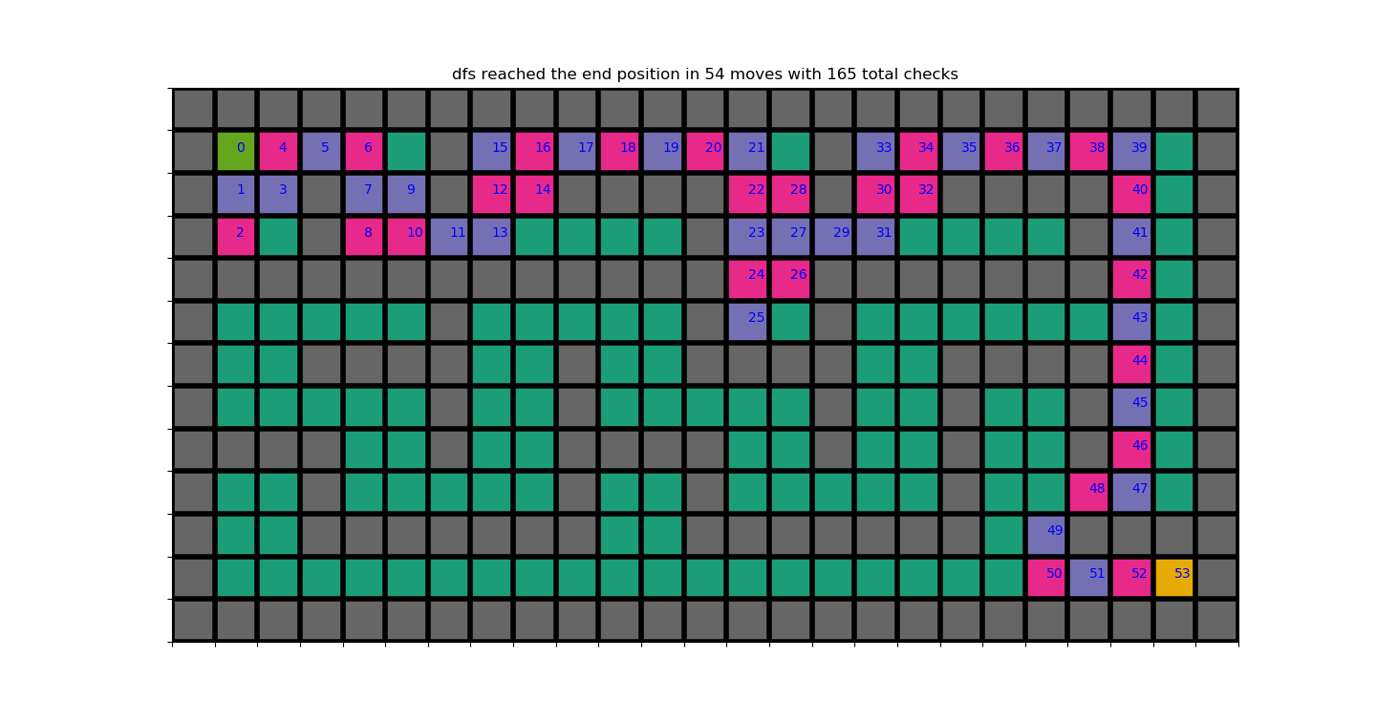

Slide 10
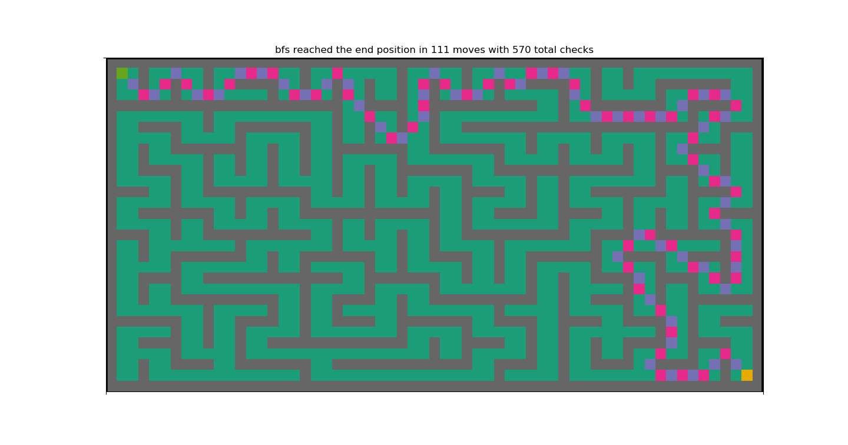

Slide 11
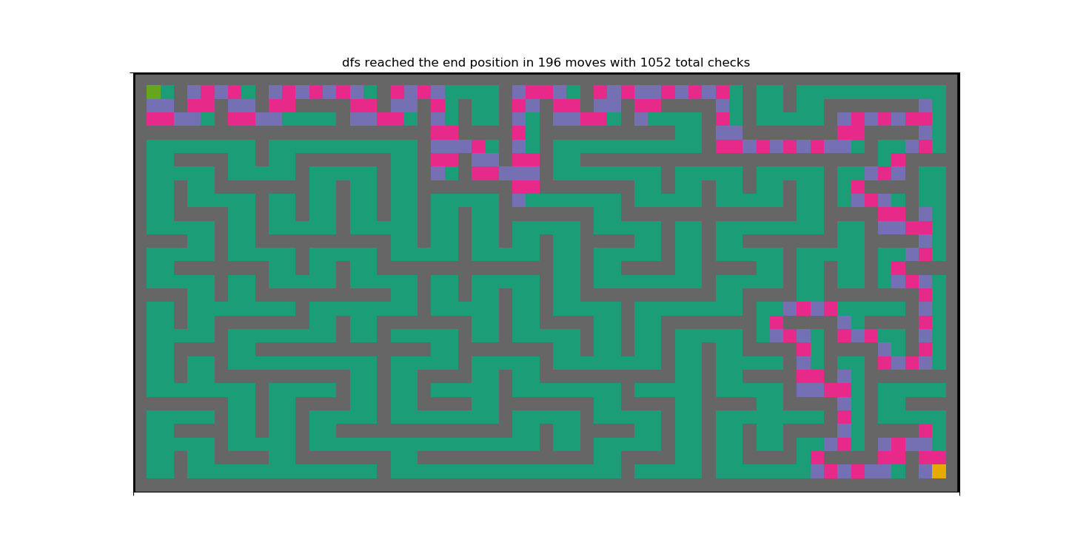

Slide 12
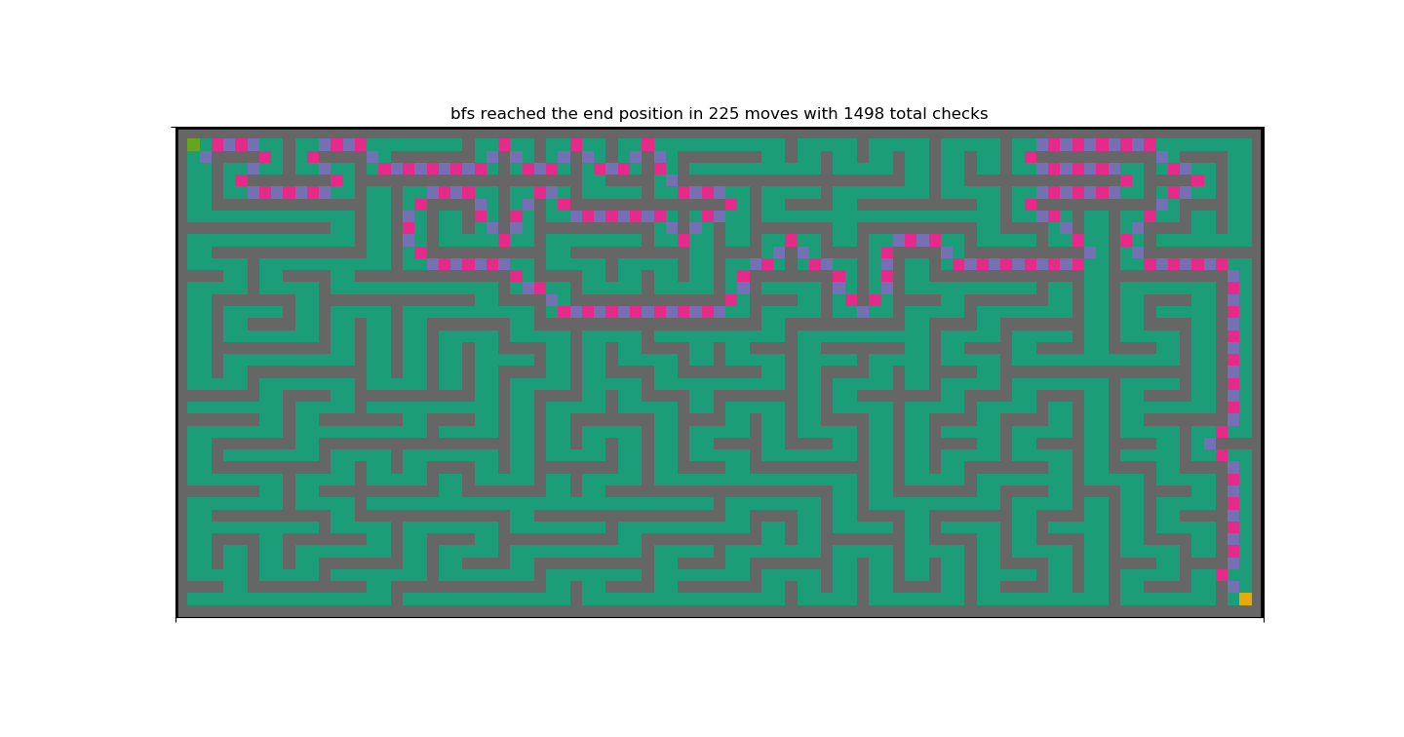

Slide 13
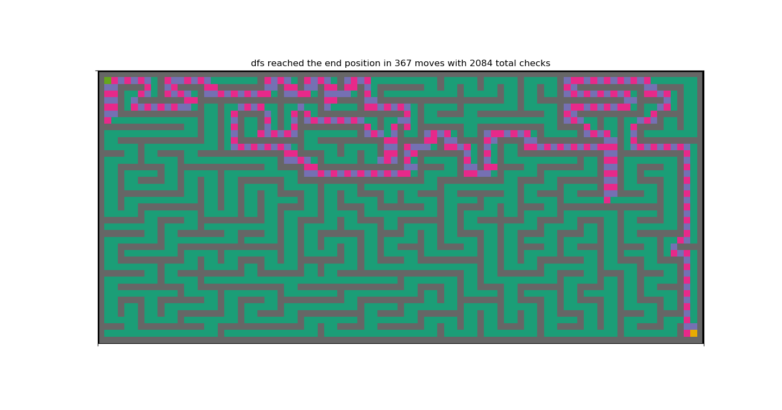

Slide 14
A* Search Method
Used to find the path to the goal with the least possible cost using a heuristic function.
Works well if the branches are finite and each action requires a fixed cost.
The cost of the path can be found using the following formula: f(n) = g(n) + h(n)

Slide 15
A* Continued…
f(n) = g(n) + h(n)
Where:
g(n) – cost path from start state to current state
h(n) – cost path from current state to goal state
f(n) – sum of g(n) and h(n)

Slide 16
A* Implementation
The implementation of this algorithm requires two arrays: one with the nodes that have not been visited and one with the nodes that have been visited.
Begin with the starting node
Check f(n) value of all nodes that have not already been visited within one step of the current node and return the one with the lowest value
Move the current node to the visited array
Set the node returned in step 2 to the current node and repeat until goal node is found

Slide 17





A* Search
Pros:
Optimal algorithm
Solves complex problems
Guaranteed to expand the fewer amount of nodes.
Cons:
Complexity problems
Strongly affected by heuristic algorithm that is used.

Slide 18
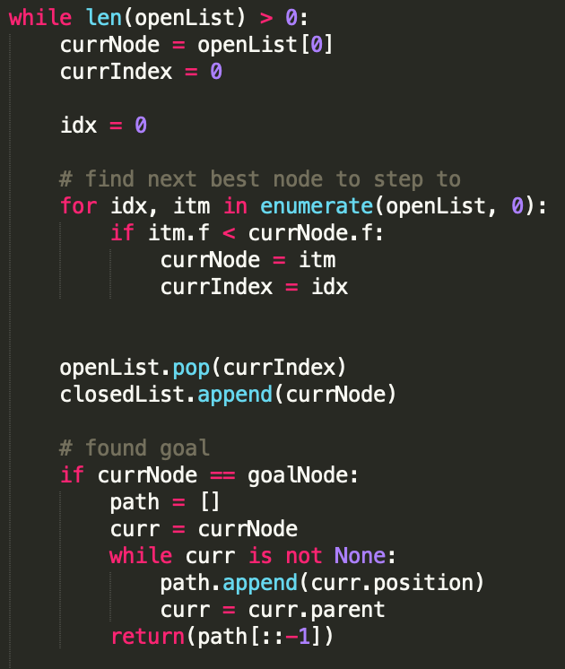
Code: Main Loop

Slide 19
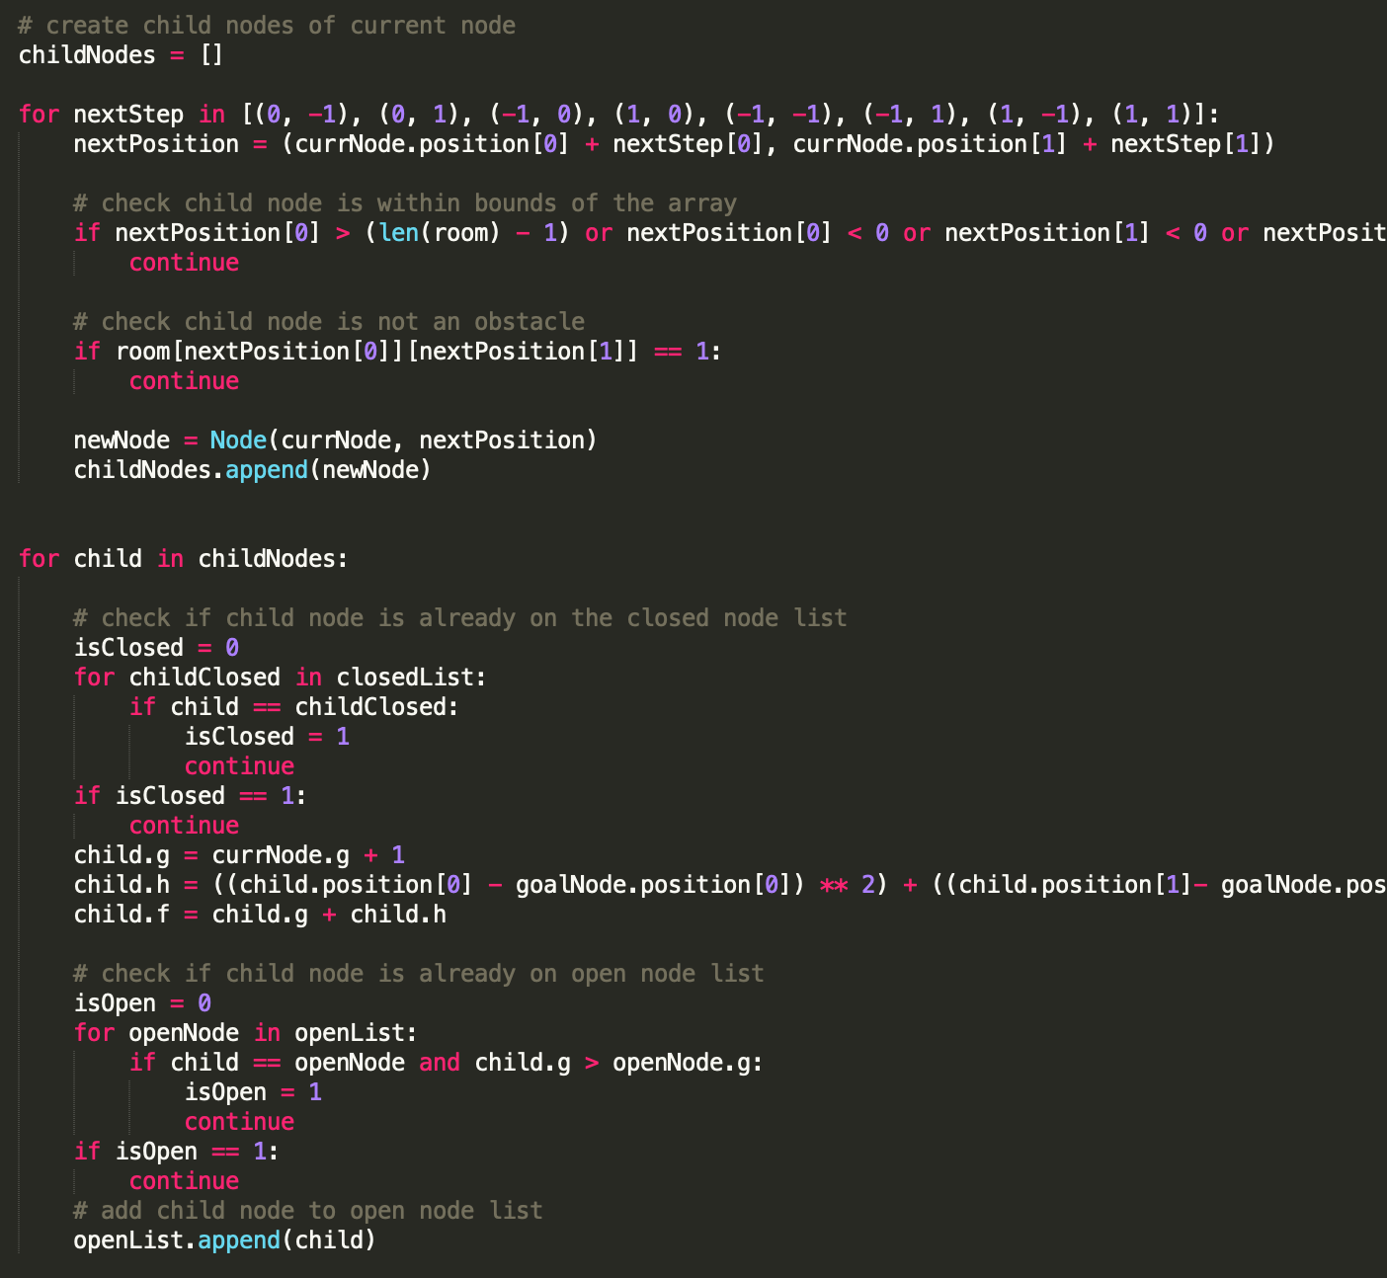
Code: Main Loop 2

Slide 20
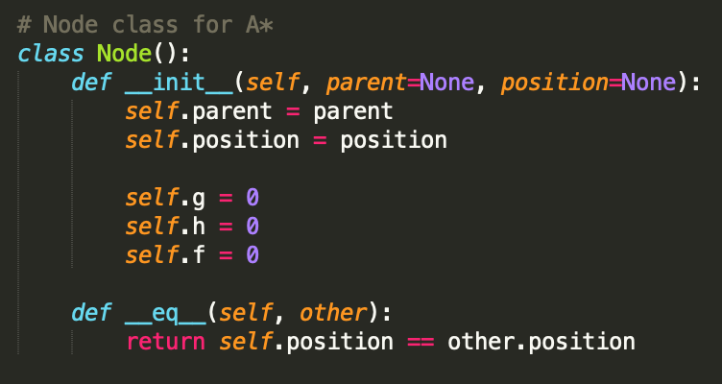
Code: Node Class

Slide 21
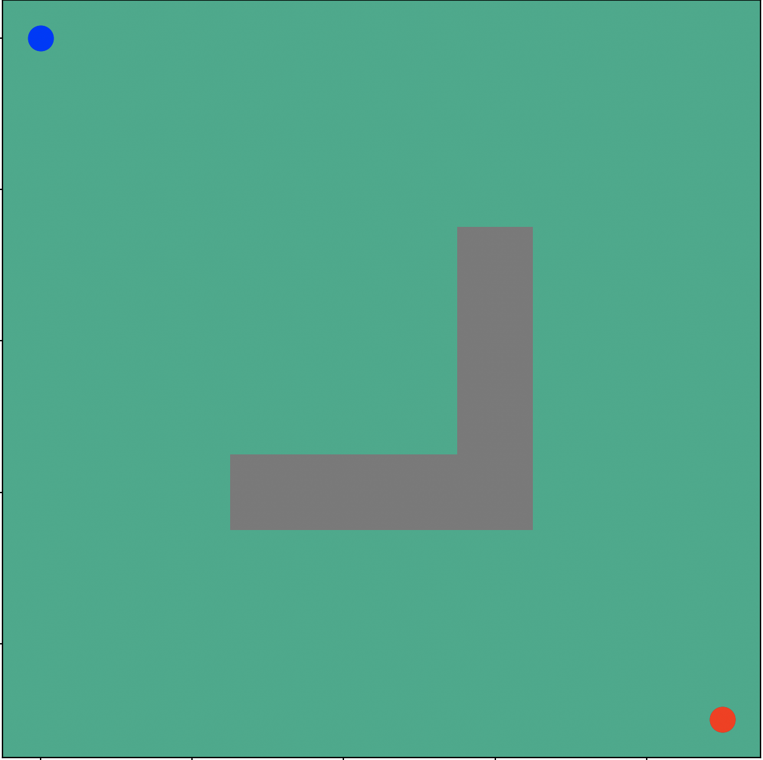
Heuristics
 | 146 | 132 | 120 | 110 | 102 | 96 | 92 | 90 | 90
146 | 129 | 115 | 103 | 93 | 85 | 79 | 75 | 73 | 73
132 | 115 | 100 | 88 | 78 | 70 | 64 | 60 | 58 | 58
120 | 103 | 88 | 76 | 66 | 57 |  | 47 | 45 | 45
110 | 93 | 78 | 66 | 55 | 47 |  | 37 | 34 | 34
102 | 85 | 70 | 57 | 47 | 39 |  | 28 | 26 | 26
96 | 79 | 64 |  |  |  |  | 22 | 20 | 19
92 | 75 | 60 | 47 | 37 | 28 | 22 | 17 | 15 | 15
90 | 73 | 58 | 45 | 34 | 26 | 20 | 15 | 13 | 13
90 | 73 | 58 | 45 | 34 | 26 | 19 | 15 | 13

Slide 22
Search Map

Slide 23
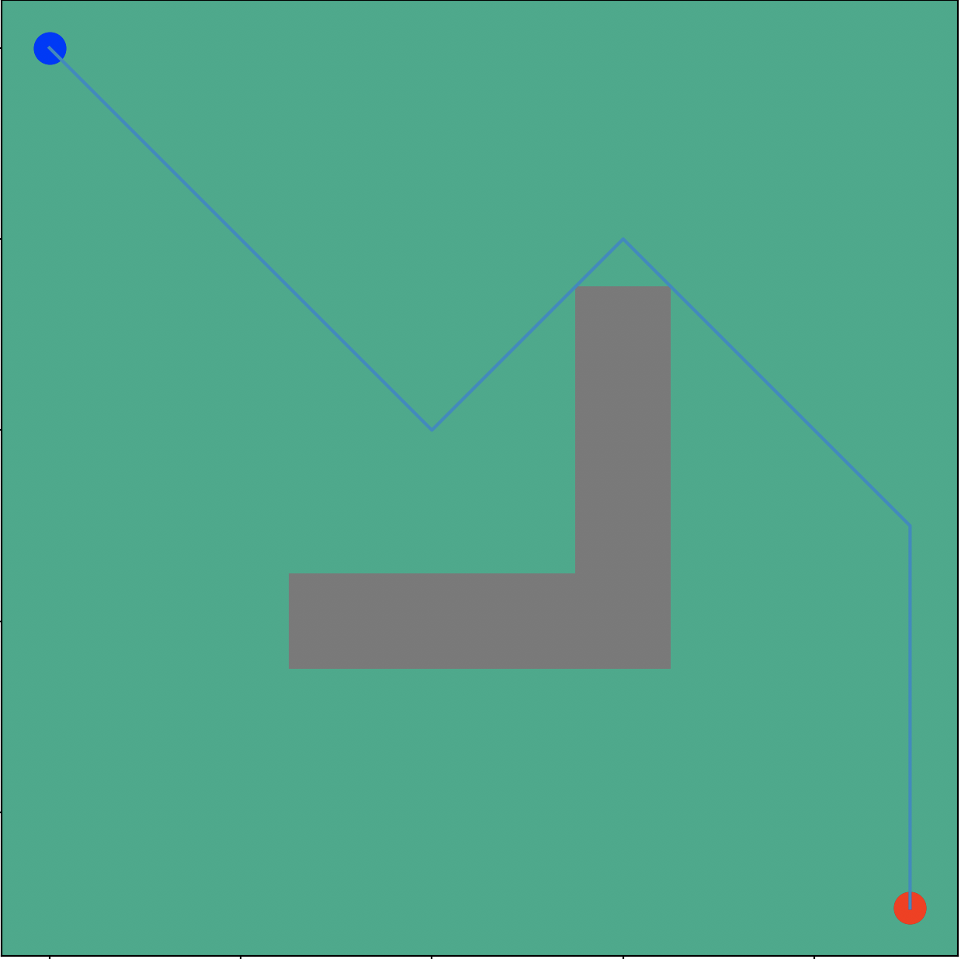
Search Tree

Slide 24
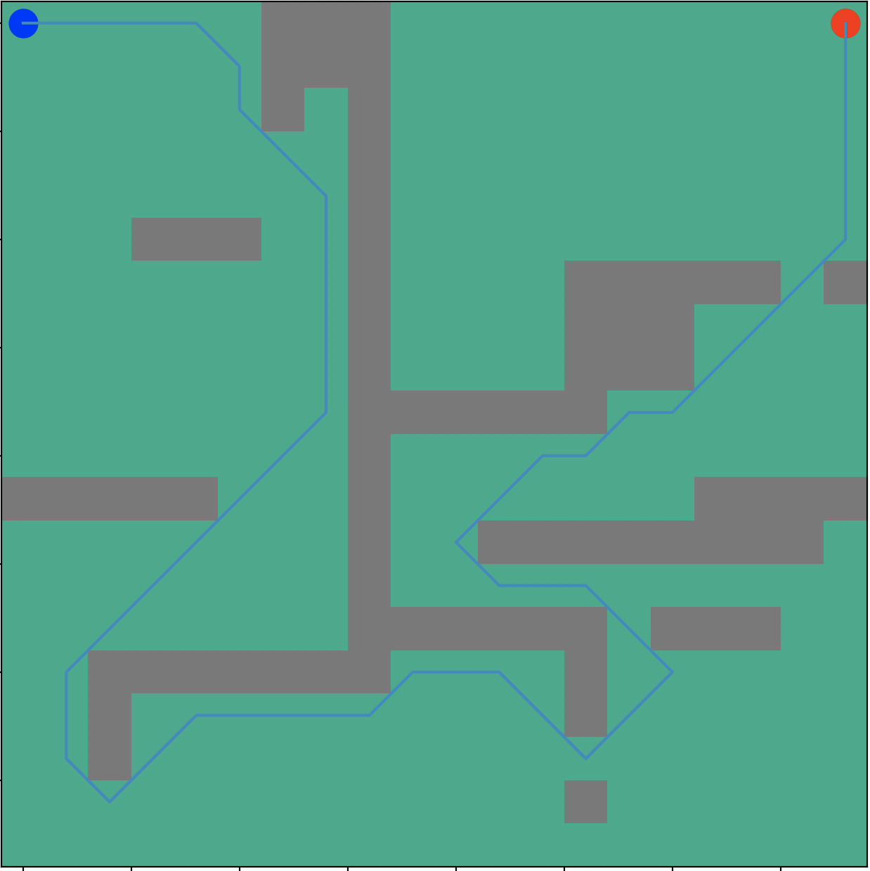
More Complex Search Tree

Slide 25
References:
HackerEarth, "Hackerearth.com," 2020. [Online]. Available: https://www.hackerearth.com/practice/algorithms/graphs/breadth-first-search/tutorial/. [Accessed 25 September 2020].
P. N. Stuart Russell, "Artificial Intelligence," in A Modern Approach, Hoboken, NJ, Pearson , 2021, pp. 64-92.
BrainKart.com, "BrainKart.com," 2018-2021. [Online]. Available: http://www.brainkart.com/article/A--Search--Concept,-Algorithm,-Implementation,-Advantages,-Disadvantages_8883/. [Accessed 25 September 2020].

