Slide 1

SEARCH METHODS IN ROBOTIC PATH
Christopher Conti
Corey Hunnan
Laura Paulino

Slide 2

SEARCH AIM
Use Breadth-First and A* search methods to:
Find the optimal solution to determine a robot’s travel path from point A to point B within a controlled environment.
The controlled environment consists of built in obstacles representing stops interfering with the solution.
The robot’s aim is to navigate around the obstacles and avoid interference to find the best-cost solution.

Slide 3
Breadth-First Search
In BFS nodes are ordered as a queue in the FIFO (first-in-first-out) order.
The traversal process begins with a selected node or the starting node.
The traversal process happens horizontally therefore all nodes within the same layer must be visited before moving on to the next layer.
Visited nodes must be labeled as “visited” using Boolean values.

Slide 4
Why Breadth-First?
Pros:
Finds the shortest path between vertices
Searches level by level
Can find the closest goal in less time
Cons:
Consumes a lot of memory

Slide 5
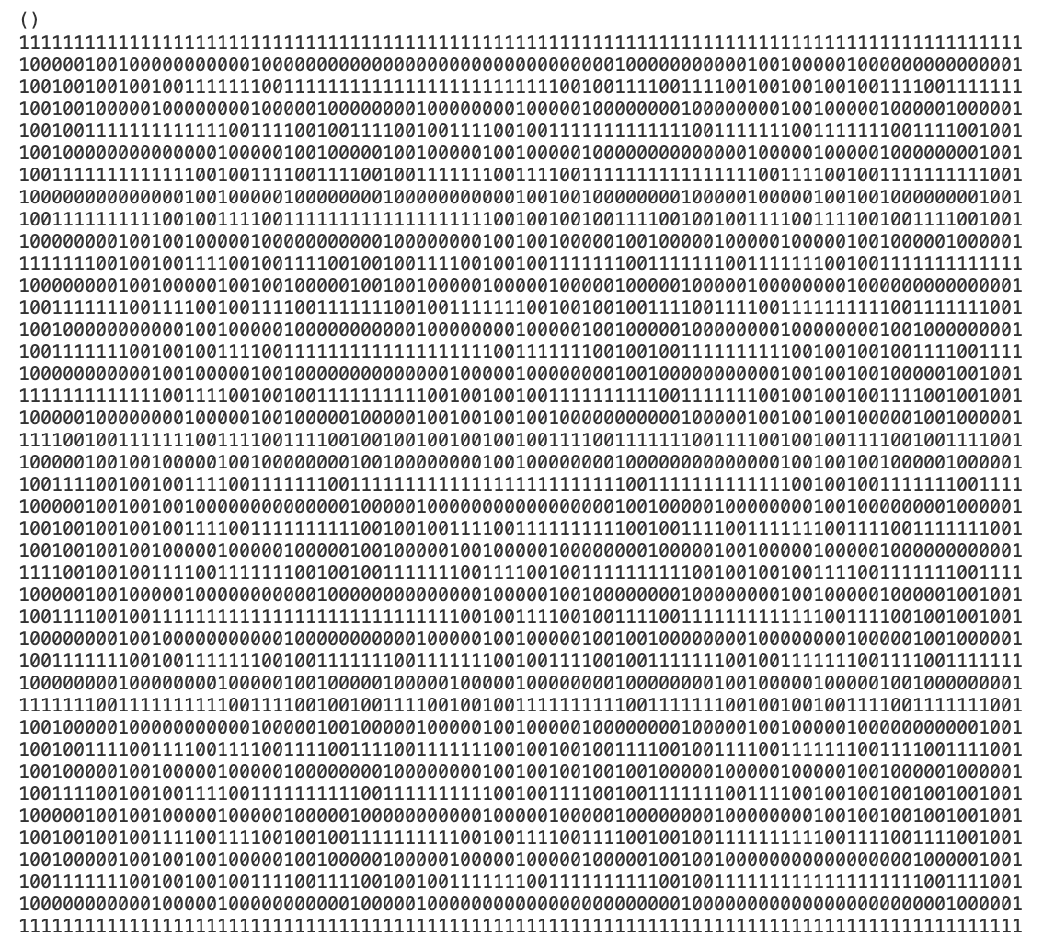
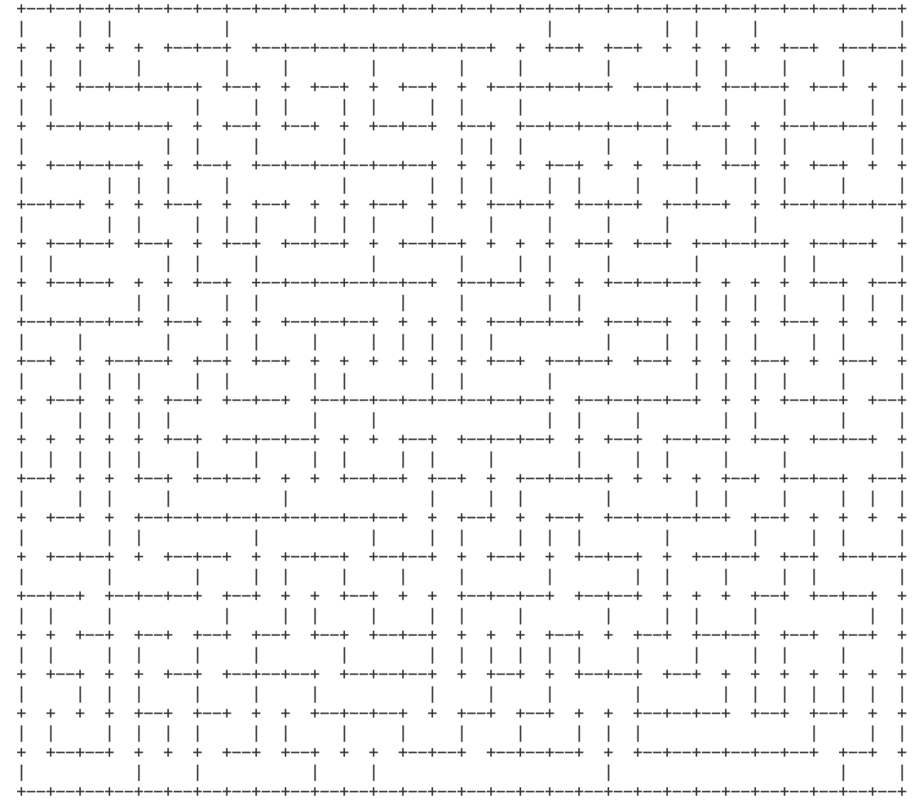
mazegenerator.py
mazegenerator.py

Slide 6
Search Map

Slide 7
Search Tree

Slide 8
A* Search Method
Used to find the path to the goal with the least possible cost.
The traversal process begins with a selected node or the starting node.
The traversal process happens horizontally therefore all nodes within the same layer must be visited before moving on to the next layer.
Visited nodes must be labeled as “visited” using Boolean values.

Slide 10
10 x 10 canvas

Slide 11
PATH COST

Slide 12
Links
Interferences between starting point and end point.
There is no limit to the number of obstacles that could interfere with the robot’s path.

Slide 13
Why Depth First Search?
Pros:
French Mathematician Charles Pierre Tremaux used it as a strategy for solving mazes which is comparative to our problem.
We can estimate how far the robot is from the goal.
Assuming that the end point is on a leaf-nod and trees are finite, depth first search could be a good candidate.
Cons:
Consumes a lot of time and space.

Slide 14
Depth-First Search
In depth-first search, a node is selected as the starting point.
All nodes are labeled as unvisited.
Once a node is visited, a “visited” label is added to that node.
The process continues onto all adjacent nodes until the searched node is found or until all nodes have been visited.

