Slide 1

SEARCH METHODS IN ROBOTIC PATH
Christopher Conti
Corey Hunnan
Laura Paulino

Slide 2

SEARCH AIM
Use Breadth-First and A* search methods to:
Find the optimal solution to determine a robot’s travel path from point A to point B within a controlled environment.
The controlled environment consists of built in obstacles representing stops interfering with the solution.
The robot’s aim is to navigate around the obstacles and avoid interference to find the best-cost solution.

Slide 3
Breadth-First Search
In BFS nodes are ordered as a queue in the FIFO (first-in-first-out) order.
The traversal process begins with a selected node or the starting node.
The traversal process happens horizontally therefore all nodes within the same layer must be visited before moving on to the next layer.
Visited nodes must be labeled as “visited” using Boolean values.

Slide 4
Why Breadth-First?
Pros:
Finds the shortest path between vertices
Searches level by level
Can find the closest goal in less time
Cons:
Consumes a lot of memory

Slide 5
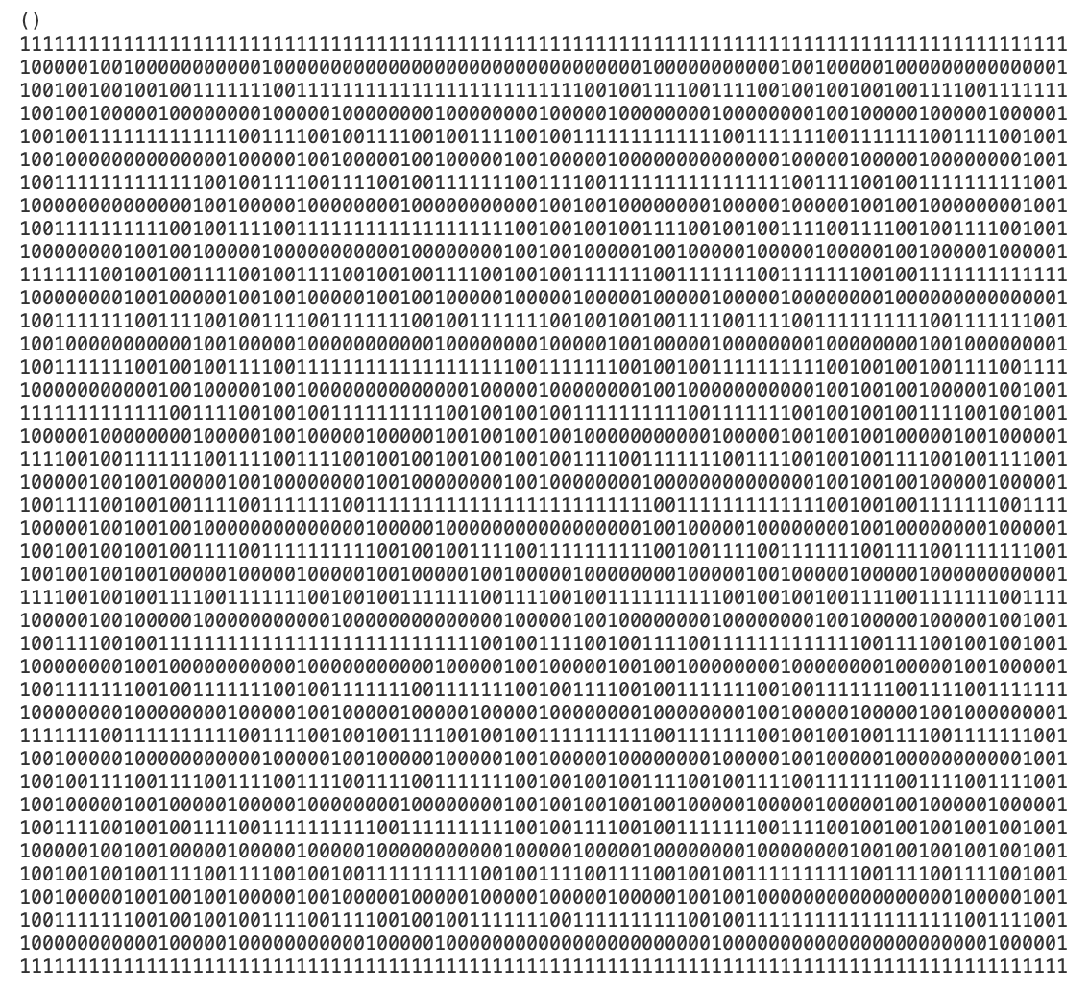
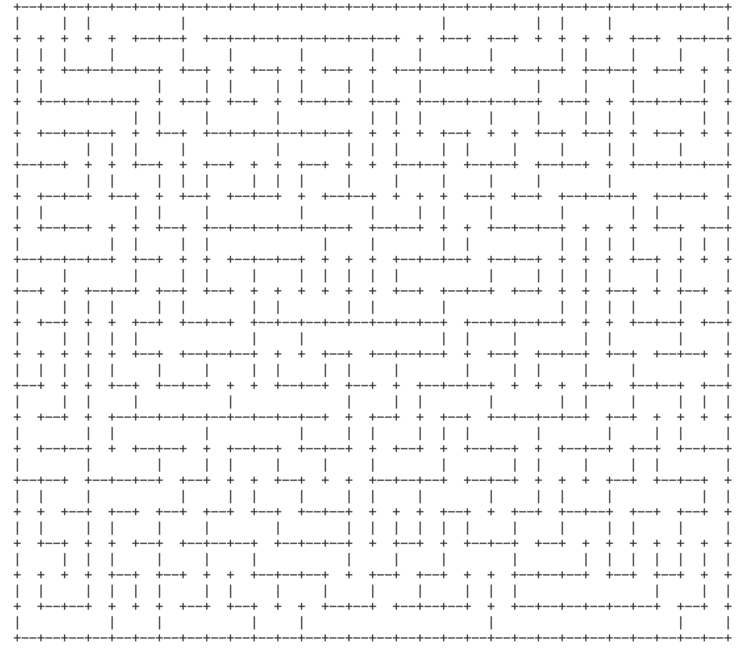
mazegenerator.py
mazegenerator.py

Slide 6
Search Map

Slide 7
Search Tree

Slide 8
A* Search Method
Used to find the path to the goal with the least possible cost using a heuristic function.
Works well if the branches are finite and each action requires a fixed cost.
The cost of the path can be found using the following formula: f(n) = g(n) + h(n)

Slide 9
A* Continued…
f(n) = g(n) + h(n)
Where:
g(n) – cost path from start state to current state
h(n) – cost path from current state to goal state
f(n) – cost path from start state to goal state

Slide 10
A* Implementation
The implementation of this algorithm requires two arrays: one of the with the nodes that have not been visited and one with the nodes that have been visited.
Begin with the starting node in the unvisited array and find its f(n) value.
Return the node with the smallest f(n) value.
If node not found, move node to visited array and continue and find f(n) value for next nodes.

Slide 11





A* Search
Pros:
Optimal algorithm
Solves complex problems
Guaranteed to expand the fewer amount of nodes.
Cons:
Complexity problems
Strongly affected by heuristic algorithm that is used.

Slide 12
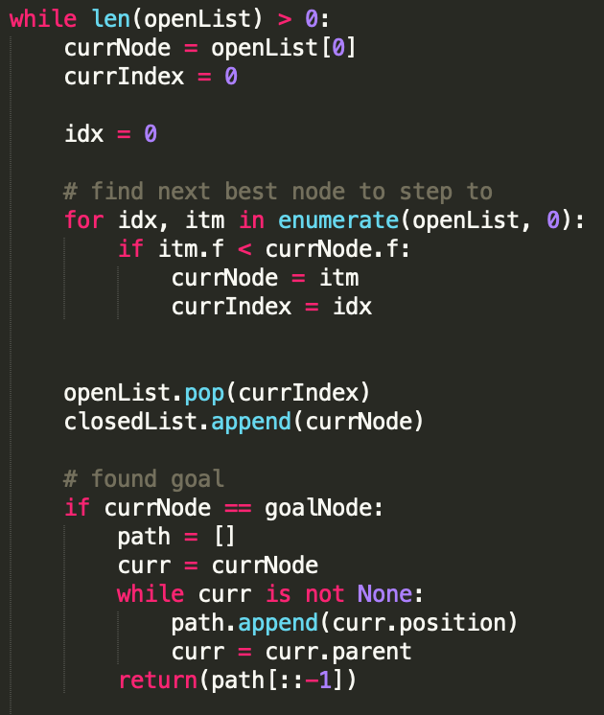
Code: Main Loop

Slide 13
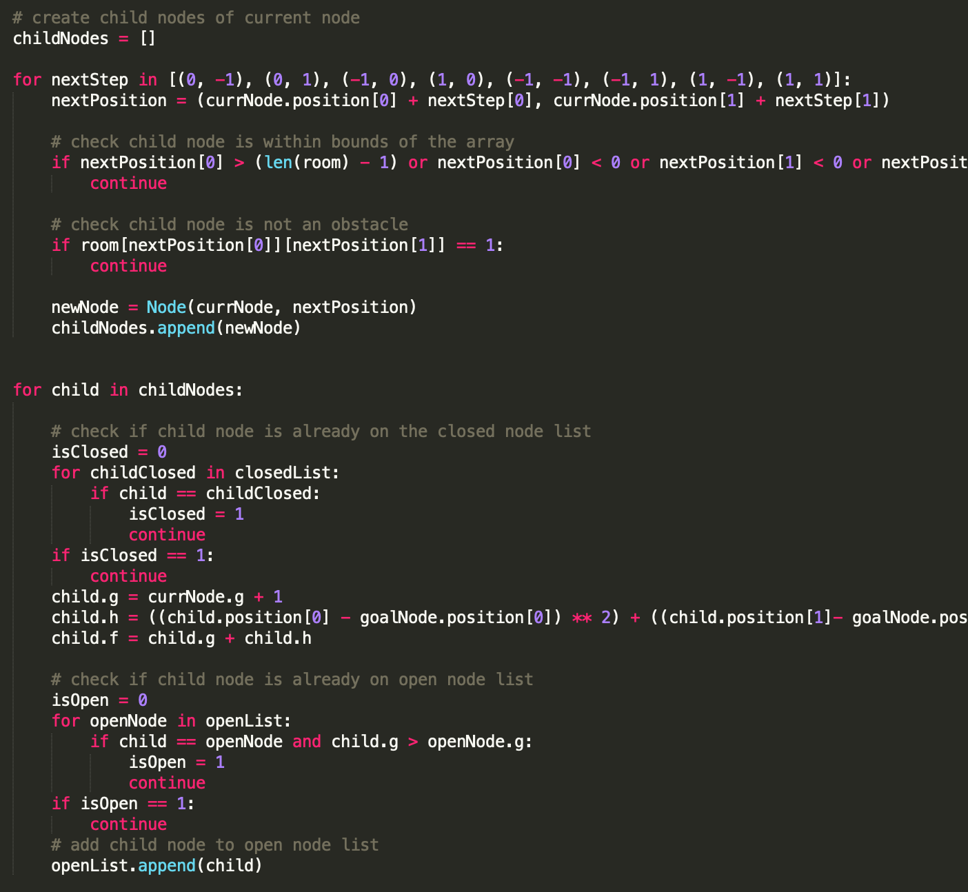
Code: Main Loop 2

Slide 14
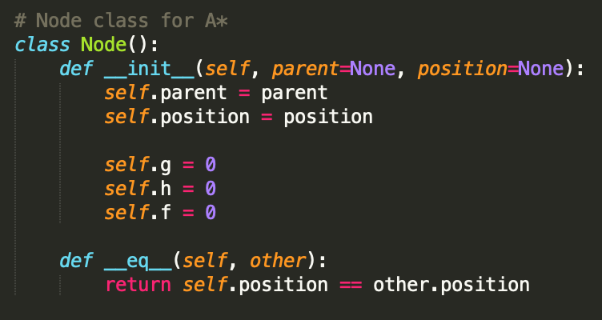
Code: Node Class

Slide 15
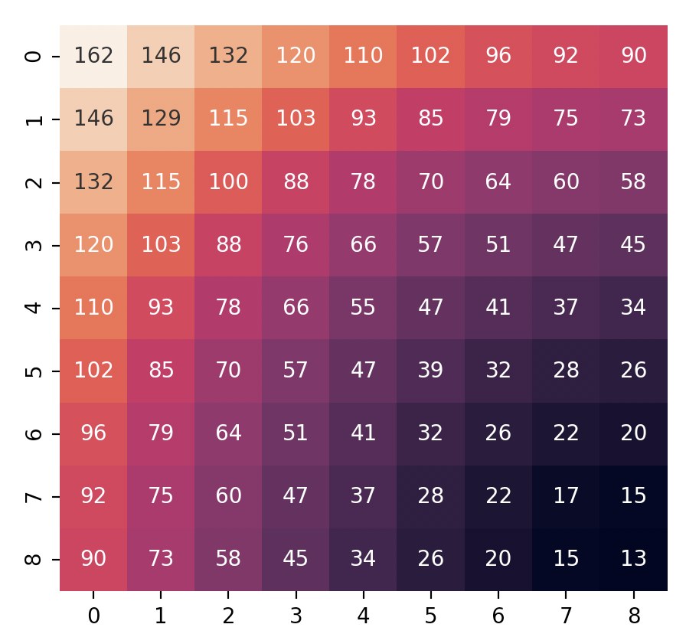
Heuristics

Slide 16
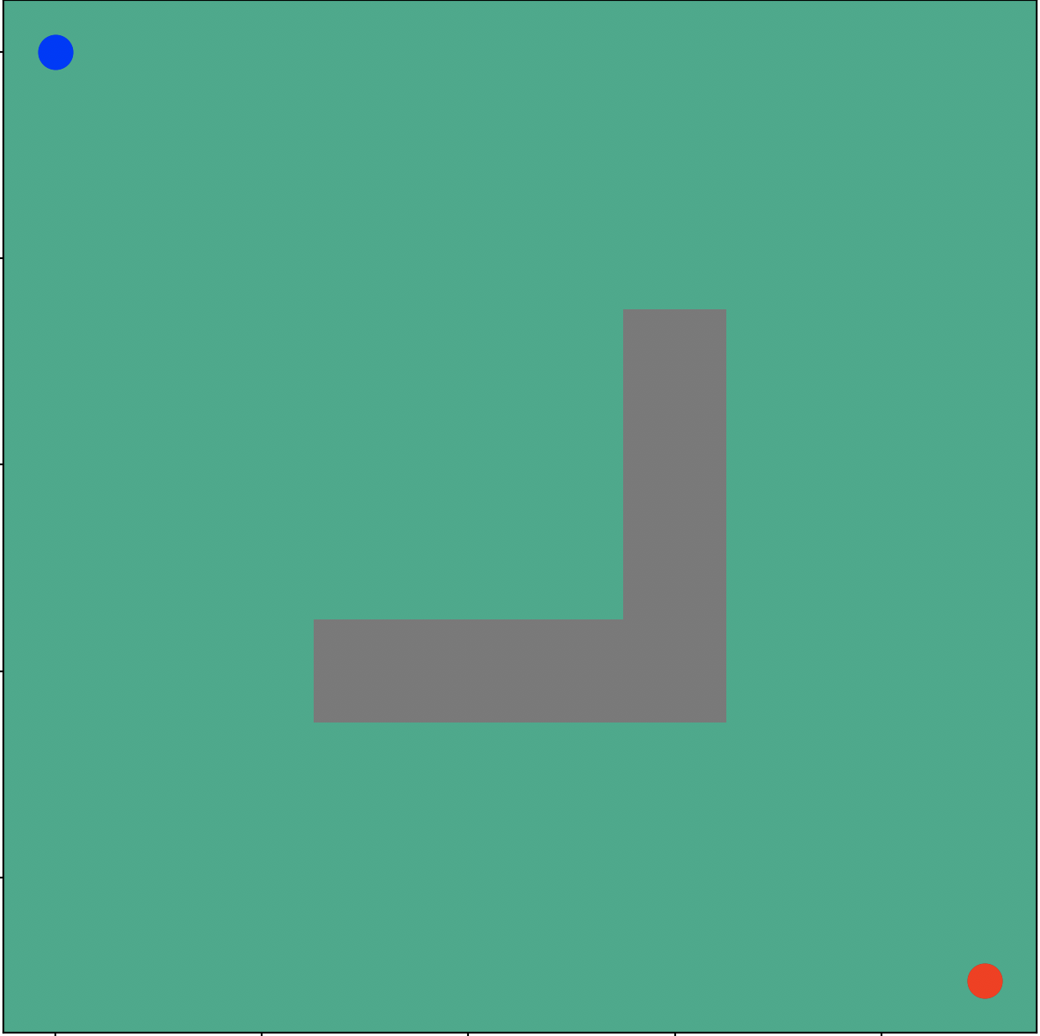
Search Map

Slide 17
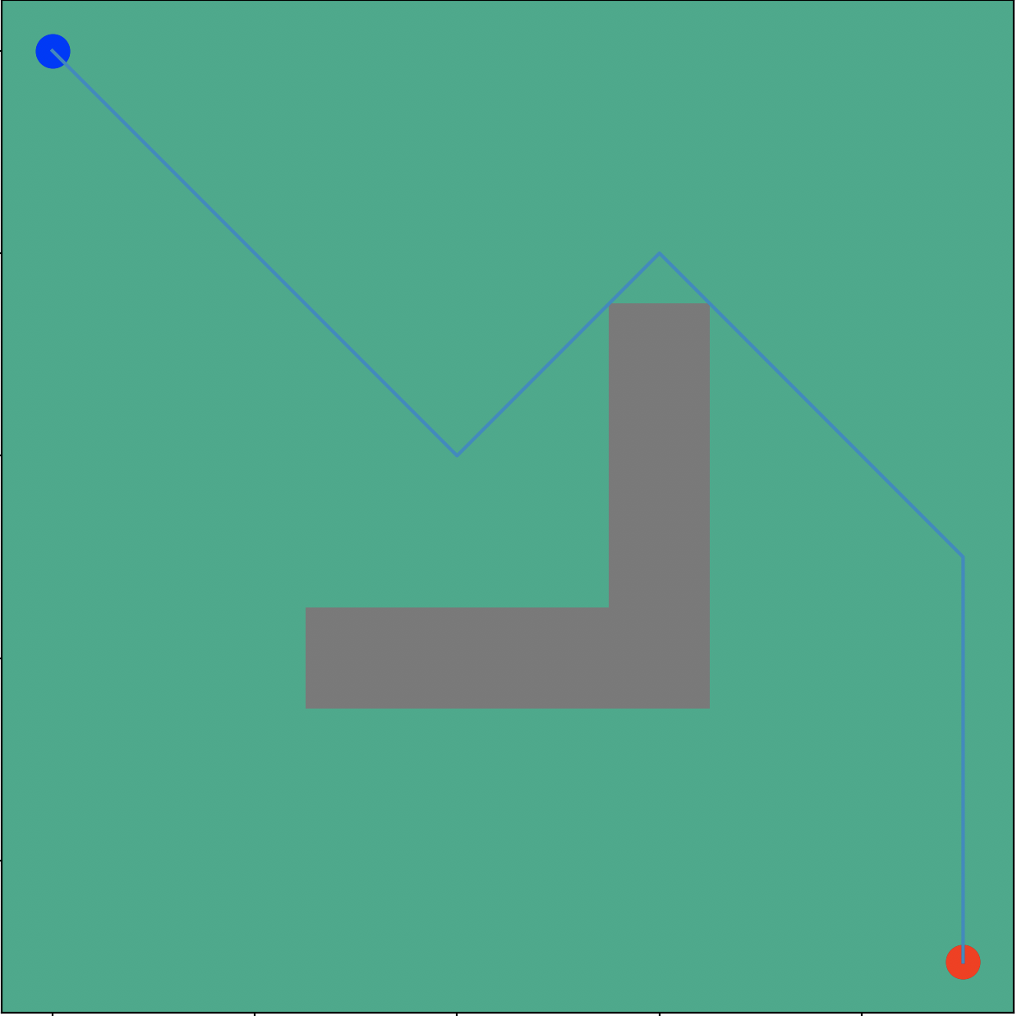
Search Tree

Slide 18
References:
HackerEarth, "Hackerearth.com," 2020. [Online]. Available: https://www.hackerearth.com/practice/algorithms/graphs/breadth-first-search/tutorial/. [Accessed 25 September 2020].
P. N. Stuart Russell, "Artificial Intelligence," in A Modern Approach, Hoboken, NJ, Pearson , 2021, pp. 64-92.
BrainKart.com, "BrainKart.com," 2018-2021. [Online]. Available: http://www.brainkart.com/article/A--Search--Concept,-Algorithm,-Implementation,-Advantages,-Disadvantages_8883/. [Accessed 25 September 2020].

