Slide 1


FusionArch: A Fusion-Based Accelerator for Point-Based Point Cloud Neural Networks
Xueyuan Liu¹ (Speaker)
Zhuoran Song¹*, Guohao Dai¹, Gang Li¹, Can Xiao², Yan Xiang²,
Dehui Kong², Ke Xu² and Xiaoyao Liang¹
¹Shanghai Jiao Tong University, ²Sanechips Technology Co., Ltd
* corresponding author
Notes:
Hello, everyone! My name is Xueyuan Liu, I come from Shanghai Jiao Tong University. It’s a great pleasure for me to report our research, namely FusionArch: A Fusion-Based Accelerator for Point-Based Point Cloud Neural Networks

Slide 2
Outline
Background and Challenge
Proposal (incl. Algorithm & Architecture)
Experiment Setup and Result
Conclusion
Notes:
This slide shows the outline of my talk

Slide 3
Point Cloud and PCNN
Point Cloud (PC) is a collection of unordered points scattered in 3D space, representing the geometry and attributes of the physical object.
Point Cloud Neural Network (PCNN)
Advantages of point-based PCNN? Lossless -> better accuracy!
Paradigm of the point-based PCNN
Notes:
Before delving into details, we should first learn about some conceptions. The point cloud is a collection of thousands and millions of unordered points in 3D space. And each point contains geometry information, like xyz coordinates and attributes like RGB colors. Then, the point cloud neural network, abbreviated as PCNN, applies deep learning on the point cloud data. Especially, the point-based PCNN preserves the most complete details of the point cloud rather than the other categories, like voxel-based or multi-view-based. Therefore, it usually achieves better accuracy and being widely utilized. We also focus on it in this work. The figure shows the flow of the point-based PCNN, which contains 4 main stages in the critical path: FPS, neighbor search, aggregation and feature computation.

Slide 4
Challenge
Performance issues caused by FPS
FPS is serially executed between layers due to data dependency
FPS introduces a heavy workload
FPS takes 96% of the execution time in PointNet++!
Notes:
Although point-based PCNNs exhibit outstanding accuracy, their performance remains a concern. We observe that each stage of the point-based PCNN may become a bottleneck across different models. In terms of FPS, it’s a leading stage that samples the point cloud in each layer. There’s data dependency between layers that results in serial execution. Additionally, repeated execution of FPS introduces heavy workload, which even takes 96% of the total time in PointNet2.

Slide 5
Challenge
Performance issues caused by FPS
FPS is serially executed between layers due to data dependency
FPS introduces a heavy workload
Performance issue caused by Feature Computation
“Filling Point” introduces considerable redundant feature computation
64.8% neighbor lists contain “Filling Points”,
86.3% of them experience re-computation over 5 times!
Notes:
In neighbor search, to fill the empty slot of a neighbor list when no enough neighbors has been found in a specific region, the nearest neighbor is replicated as the “Filling Point”. Therefore, these identical points introduce redundant feature computation. Our experiment shows that 64.8% neighbor lists contain “Filling Points”, and 86.3% of them undergo re-computation over 5 times.

Slide 6
Challenge
Performance issues caused by FPS
FPS is serially executed between layers due to data dependency
FPS introduces a heavy workload
Performance issue caused by Feature Computation
“Filling Point” introduces considerable redundant feature computation
Performance issue caused by Aggregation
Shared neighbors introduce redundant memory access to aggregation
73% features are accessed repeatedly over 4 times!
Notes:
For the aggregation, it is known that adjacent centroids are more likely to share neighbors. In PointNet2, 73% of features are accessed repeatedly more than 4 times, which introduces redundant memory access to the aggregation.

Slide 7
Proposal
CHALLENGES
FPS: serial dataflow, data dependency, heavy workload
Feature Computation: redundant computation introduced by “Filling Points”
Aggregation: redundant memory access caused by shared neighbors
SOLUTIONS
Fusion-FPS: change data dependency, improve parallelism
Fusion-Computation: Bypass redundant computations
Fusion-Aggregation: Coalesce redundant memory access
Notes:
To address these challenges, we accordingly propose 3 solutions, namely Fusion-FPS, Fusion-Computation and Fusion-Aggregation, which alter the data dependency between layers, improve the parallelism of stages, bypass the redundant computation introduced by “Filling Points”. And coalesce the redundant memory access caused by shared neighbors, respectively.

Slide 8
Algorithm --- Fusion-FPS
Motivation
Each layer’s centroid set is a subset of the preceding layer’s
Thus, each layer’s centroid set is a subset of the 1st layer’s
Fusion-FPS Algorithm
Only perform FPS in the 1st layer
The succeeding layers truncate the front n_{i} (i is layerid) centroids from the 1st layer’s centroid set
Reduce FPS to only once!
Notes:
If we analyze the FPS algorithm, we discover that each layer’s centroid set is a subset of the preceding layer’s. Extrapolating this conclusion, all layer’s centroid sets are subsets of the 1st layer’s. Following this principle, we construct our Fusion-FPS algorithm. We only perform FPS in the 1st layer, and for the succeeding layers, the centroids are directly truncated from the front of the 1st layer. So, we greatly alleviate the computational workload of the sampling stage.

Slide 9
Algorithm --- Fusion-FPS
Another benefit … Alter the execution flow
The succeeding layers’ centroid sets only depend on the 1st layer
The neighbor search across all layers can be launched in parallel
Notes:
This approach brings about another benefit, that is altering the execution flow. It breaks the original data dependency, allowing all the succeeding layers to start right after the 1st layer’s FPS is completed. Therefore, the neighbor search stages across all layers can be executed in parallel.

Slide 10
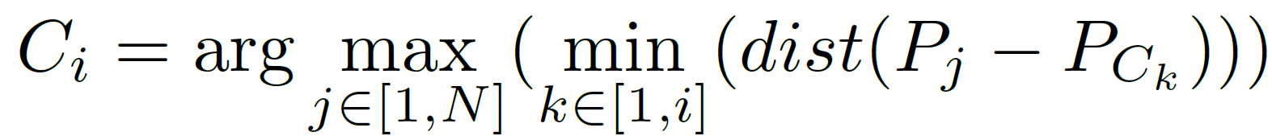
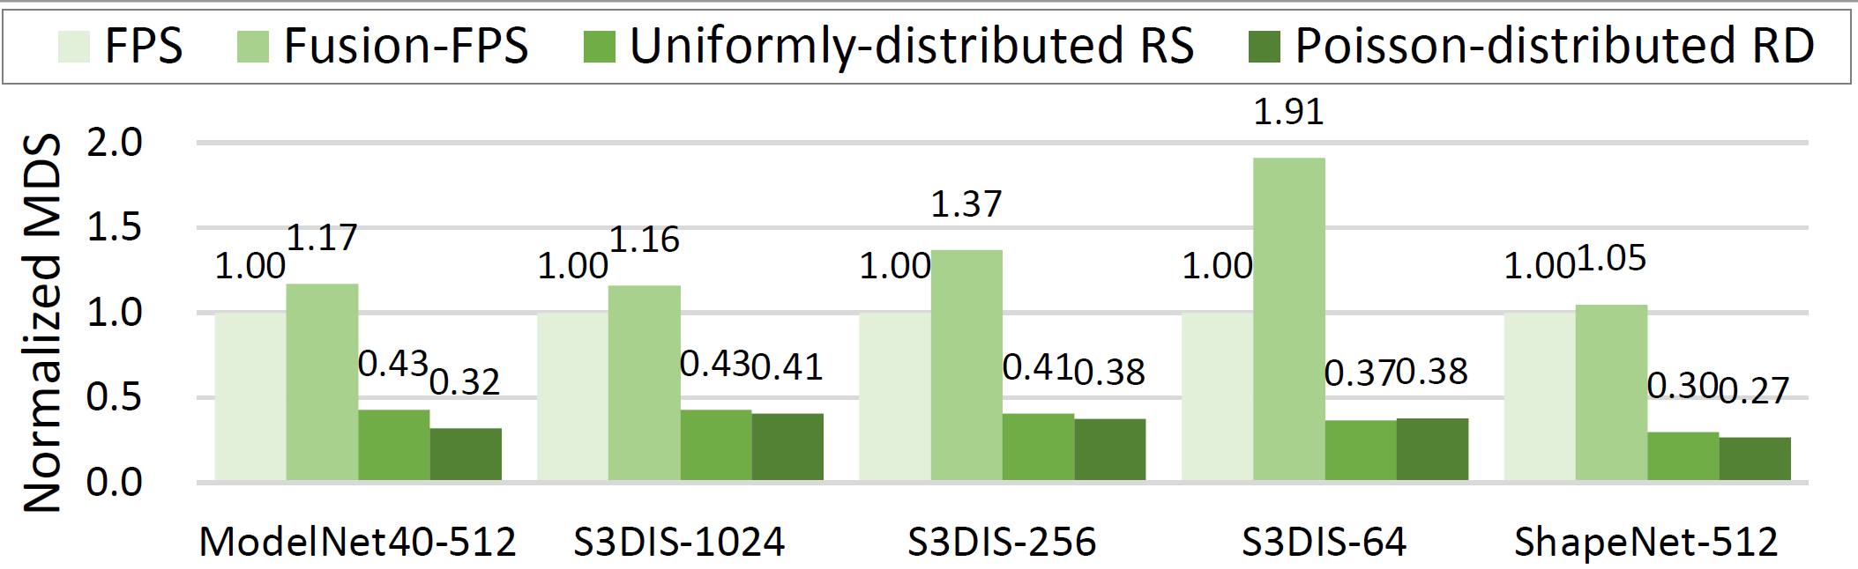
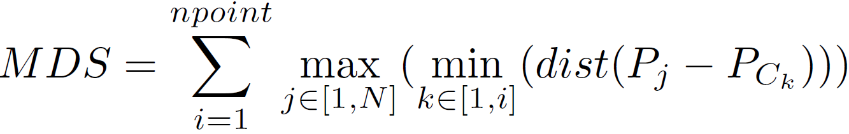
Algorithm --- Fusion-FPS
Validate rationality
Intuitively, Fusion-FPS is aligned with FPS, and avoids sampling shrinkage
Theoretically, we design a metric to quantify the sampling quality ---
Maximum Distance Sum (MDS), which is derived from FPS
Notes:
Someone may worry about the rationality of Fusion-FPS. To mitigate this concern, we analyze this algorithm from both intuitive and theoretical aspects. Intuitively, Fusion-FPS aligns with FPS, following the same rule to generate each layer’s centroid set. Moreover, it selects the front centroids from the 1st layer’s centroid set, ensuring that the selected centroids are farther from each other, exhibiting stronger shape representation capabilities than the rear centroids. In theory, we introduce a metric, named MDS, which is a sum of the maximum distances from the centroid set to the point in each iteration, aiming to quantify the sampling quality. This metric is derived from FPS by replacing the argmax with a sum operation. Its result shows in the right figure, indicating our Fusion-FPS outweighs the other sampling algorithms, and even performs better than the classic FPS. This is because our Fusion-FPS avoids the sampling shrinkage trend as the layer increases.

Slide 11
Algorithm --- Fusion-Computation
Identify the starting position of Filling Points in each neighbor list
Bypass the feature computation of “Filling Points”, and restore them by copy-ing the nearest neighbor’s features while writing back
baseline
Fusion-Computation
Notes:
To filter out redundant feature computations caused by Filling points, we design Fusion-Computation. It first identifies the presence and starting position of the Filling point. Then, it bypasses their feature computation and restores these absent features by a direct copy while writing back.

Slide 12
Algorithm --- Fusion-Aggregation
To maximize data reuse, employing the clustering to capture the spatial locality of centroids
Coalesce redundant memory access from a cluster for shared neighbors
balanced clusters
baseline
Fusion-Aggregation
Notes:
Additionally, we propose Fusion-Aggregation to coalesce redundant memory access for shared neighbors. Actually, the coalescing is well implemented in hardware, which we will discuss in the following slides. Before delving into those details, we apply a clustering method to capture the spatial locality of centroids, which helps maximize data reuse and promotes the effect of the memory coalescing scheme.

Slide 13
Algorithm --- Fusion-Aggregation
Balanced K-means clustering
Motivation: Although Fusion-Aggregation enables parallel execution among clusters, the unaligned cluster size results in workload imbalance.
Our goal: rebalance the clustering results produced by K-means
Algorithm Design:
Step 1: Calculate the expected (average) cluster size and deltas for each cluster
Step 2: Iteratively schedule the centroids from max(∆) to min(∆), update deltas
Step 3: When deltas of m (0 ≤ m ≤ C-1) clusters are +1, while the remaining C-m clusters are 0, terminate the algorithm
Notes:
Different from the classic K-means clustering, we add an extra prefix to its name. This is because in our design, different clusters are allowed to be processed in parallel, the unaligned size of clusters results in obvious workload imbalance. Therefore, we propose a greedy algorithm to rebalance the clustering results of K-means.

Slide 14
Algorithm --- Summary
The overall execution flow of our algorithms when compared to the baseline
Reduce FPS to only once
Parallel execution of the neighbor search and clustering stages
Reduce the latency of aggregation and feature computation
baseline
Speedup
Ours
Notes:
To sum up, this figure shows the overall execution flow of our algorithms. Comparing with the baseline, we reduce FPS to only once, parallel the execution of neighbor search and clustering stages across all layers and minimize the latency of both aggregation and feature computation. Our algorithms covers nearly all the primary stages in the critical path, which can easily handle various models with different bottlenecks. Therefore, they have great potential to achieve outstanding performance.

Slide 15
FusionArch Architecture
Processing Engine
Fusion-FPS Engine
Neighbor Search Engine
Fusion-Aggregation Engine
Fusion-Computation Engine
ON-CHIP BUFFER
Coordinate Buffer
Index Buffer
Feature Buffer
Notes:
To support our algorithms, we co-design an accelerator architecture, named FusionArch. Its composition is illustrated in both text and figure on this slide. Then, we will highlight 3 components corresponding to our algorithms in the following content.

Slide 16
Fusion-FPS Engine
A hardware implementation of the Fusion-FPS algorithm
Use a group of Distance Calculator (DC) to compute distances in parallel
Use a counter to identify the boundaries of each layer’s centroid set
The local controller truncates the front centroids based on specific positions and stores centroid sets to the index buffer
Notes:
Fusion-FPS engine is a hardware implementation of the Fusion-FPS algorithm. It incorporates a group of parallel distance calculators, whose structure is depicted in the right figure. It also employs a counter to record the generated centroids, identifying the boundaries of each layer’s centroid set. The extraction of centroids for the succeeding layers is handling by a local controller and the results are written back to the index buffer.

Slide 17
Fusion-Computation Engine
Hierarchical structure
Feature Processing Cluster (FPC): allocate each cluster to one FPC
Core: process one centroid at a time
MAC unit: perform matrix-vector multiplication on each neighbor list
The execution flow of the Fusion-Computation: transfer via tag
Notes:
Fusion-Computation Engine is designed as a hierarchical structure. At the top level, it contains several feature processing clusters, with each processing a cluster. Within the FPC, it embraces multiple cores and a cache, with each core handling a centroid at a time. Inside the core, there is a set of components. It utilizes a lightweight MAC unit to perform feature computation on each neighbor list. Then, we will explain how Fusion-Computation is performed in this engine. To identify the presence and locations of Filling points, we should trace back to the neighbor search engine, which assigns a tag once a neighbor list is produced. Then, the tag is transferred to the Fusion-Computation engine, where it is parsed by the core’s local controller to guide the feature computation and bypass the filling points. When writing features back, the tag is utilized to generate the corresponding address where the copied features are written.

Slide 18
Fusion-Aggregation Engine
Clustering Module: perform balanced K-means clustering
Reuse DC to compute deltas
The local controller handles rebalancing by swapping centroids among clusters in the cluster buffer
Notes:
The feature-aggregation engine mainly comprises 3 parts: the clustering module is employed to perform balanced K-means clustering. It reuses the distance calculator as a 3-way delta generator. The rebalancing process is conducted by a local controller, which swaps centroids among clusters in an internal buffer.

Slide 19
Fusion-Aggregation Engine
Local Fusion-Aggregation Table (LFT)
Enable parallel cores to access features in a non-blocking manner
Table entry consists of FPC index, neighbor index, core mask, valid bit
An example of LFT:
Notes:
Furthermore, we design a local fusion-aggregation table (abbreviated as LFT) to coalesce redundant memory access from each FPC. It enables parallel cores to access features in a non-blocking manner. The table entry contains 4 fields, and an example is provided here for better understanding. To be more generally, let’s assume there are 2 active entries in the LFT initially. In event 1, core 3 of FPC 0 accesses neighbor 87’s features. Since none of the existing entries is hit, a new entry is active, with FPCid set to 0, neighbor id set to 87 in binary, the 3rd bit of the core mask set to 1 and the valid bit toggle to 1. Then, In event 2, both core 2 and core 5 of FPC 0 request neighbor 38, and the corresponding entry is found in the LFT. Therefore, only core mask of the entry 2 is updated by setting the 2nd and 5th bits to 1. In the last event, neighbor 2’s features are returned from external memory. After matching the 1st entry, the data is forwarded to core 1, 2 and 4 of FPC 0. Then, the valid bit is set to 0, indicating the entry is released.

Slide 20
Experiment Setup
Benchmark: PointNet++(cls/s/ps), PointWeb, and F-PointNet++
Dataset: ModelNet40, ShapeNet, S3DIS, KITTI
Architecture Modeling
Cycle-accurate performance model with 25.6GB/s DDR4 bandwidth
DRAMSim3 -> DRAM; CACTI -> SRAM
2 implementations
FusionArch.Server: 4096 MACs and 334.6KB SRAM
FusionArch.Edge: 256 MACs and 83.8 KB SRAM
Notes:
Next, I’ll introduce our experiment setup. We evaluate our FusionArch using 5 benchmarks across 4 datasets, all these models and datasets are popular in this field. To model the behavior of our architecture, we developed a cycle-accurate performance model that integrates DRAMSIM3 to model DRAM and uses CACTI to model SRAM. Considering that different resource conditions may exhibit distinct properties, we developed 2 implementations to model the server-level and edge-level configurations, respectively.

Slide 21
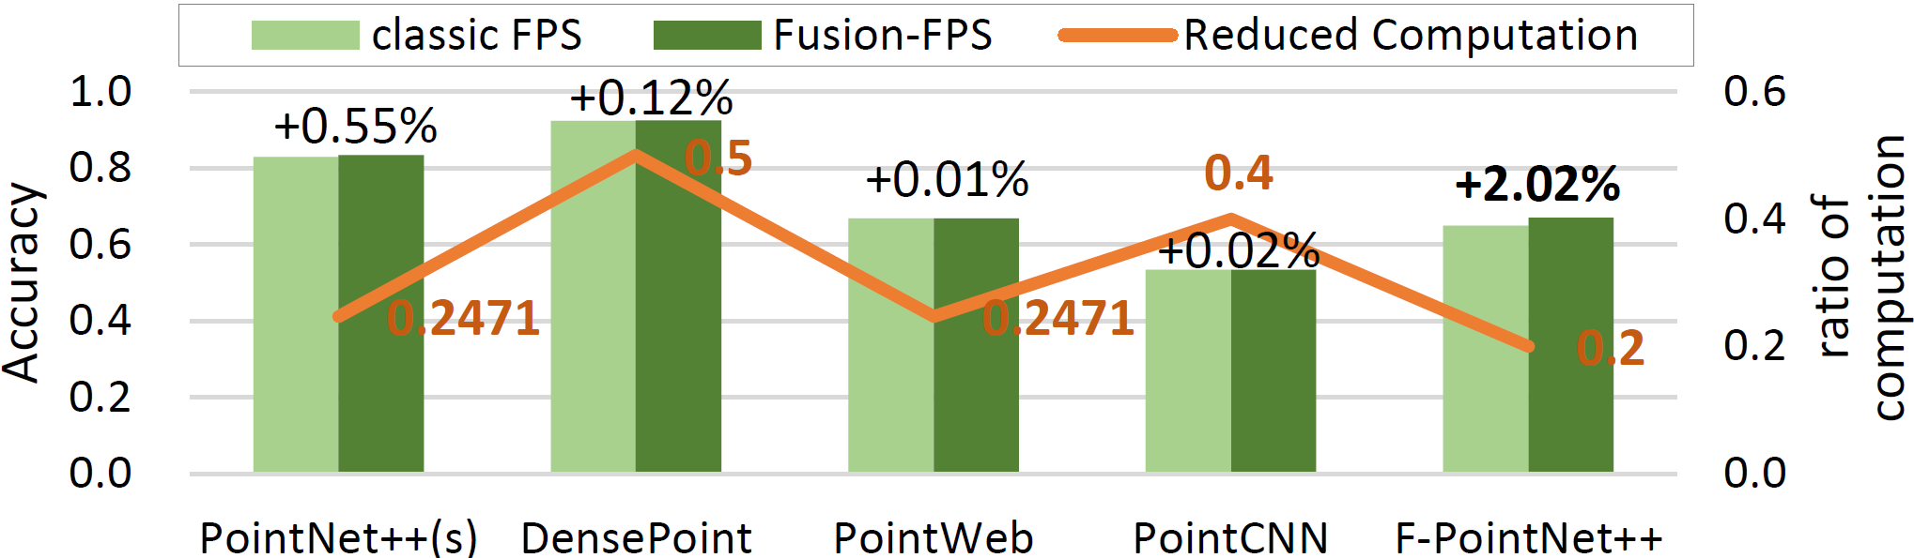

Experiment Result --- Accuracy
Fusion-FPS outperforms the classic FPS by up to 2.02%
Fusion-FPS avoids the sampling shrinkage trend across layers
Fusion-FPS reduces computations by 20%$\sim$50% compared to the classic FPS
Notes:
In terms of accuracy, we compare Fusion-FPS, the only algorithm that affects accuracy in our proposal, with the classic FPS. The figure shows our Fusion-FPS outperforms the baseline by up to 2.02%. This is because our Fusion-FPS avoids the sampling shrinkage trend across layers, as we have mentioned before. Regarding the reduced computation in the sampling stage, Fusion-FPS achieves a 20% to 50% reduction, thereby alleviating the workload of FPS.

Slide 22
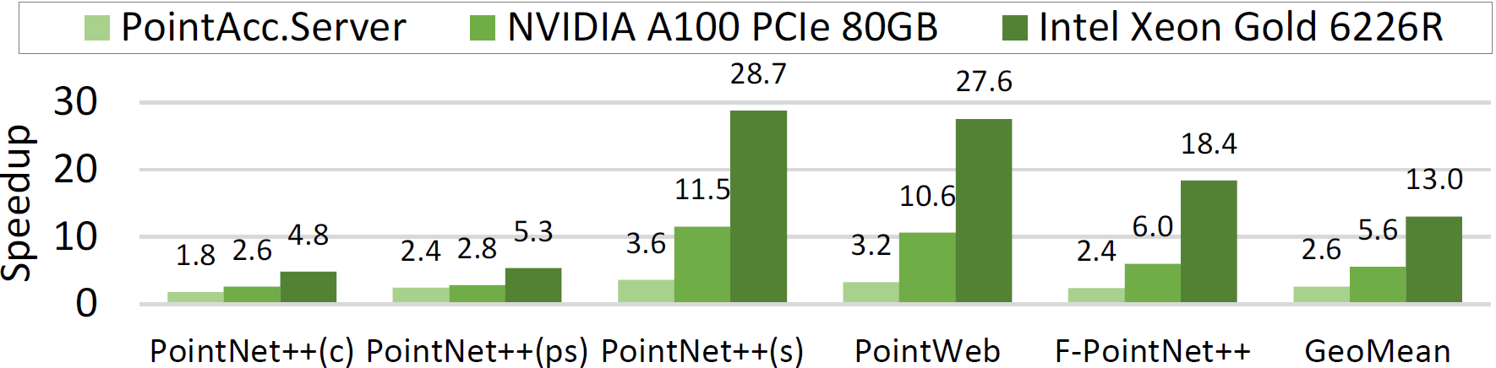
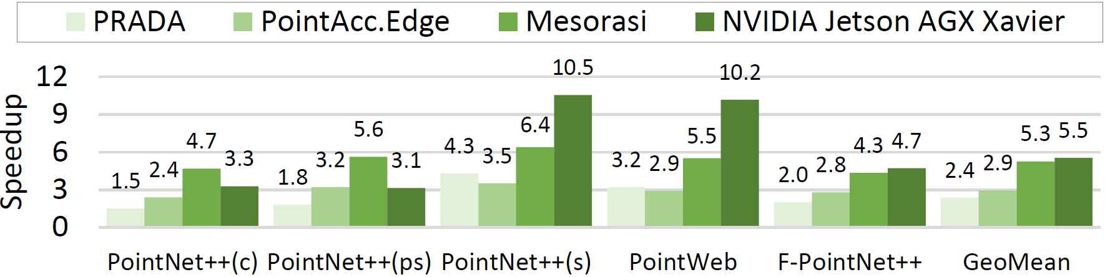

Experiment Result --- Performance
At the server-level, FusionArch.Server achieves 2.6$×$, 5.6$×$, 13$×$ speedup over PointAcc.Server, NVIDIA A100 GPU and Intel Xeon Gold 6226R
At the edge-level, FusionArch.Edge is 2.4×, 2.9×, 5.3×, 5.5× better than PRADA, PointAcc.Edge, Mesorasi and NVIDIA Jetson AGX Xavier
Notes:
As for performance, at the servel-level, FusionArch achieves an average speedup of 2.6x, 5.6x and 13x over PointAcc, A100 GPU and Xeon CPU. The most obvious improvement is observed in PointNet2(s), because the model is dominated by aggregation and feature computation due to its large-scale data and stacked layers of neural networks. This model is tested on S3DIS, an indoor dataset with points distributed more densely than the outdoor scenes. Therefore, the shared neighbors are more common, and it can take much benefits from our proposal. We choose 3 influential and the latest edge-level ASICs, including PRADA, PointAcc and Mesorasi as baselines. When compared with them, our FusionArch also achieves remarkable performance. This is because Mesoarsi only reduces the feature computation latency while increasing the cost of aggregation, which becomes more crucial in resource-limited edge-level platforms. PointAcc neglects the sequential execution flow and redundant feature access, resulting in less potential than our FusionArch.

Slide 23
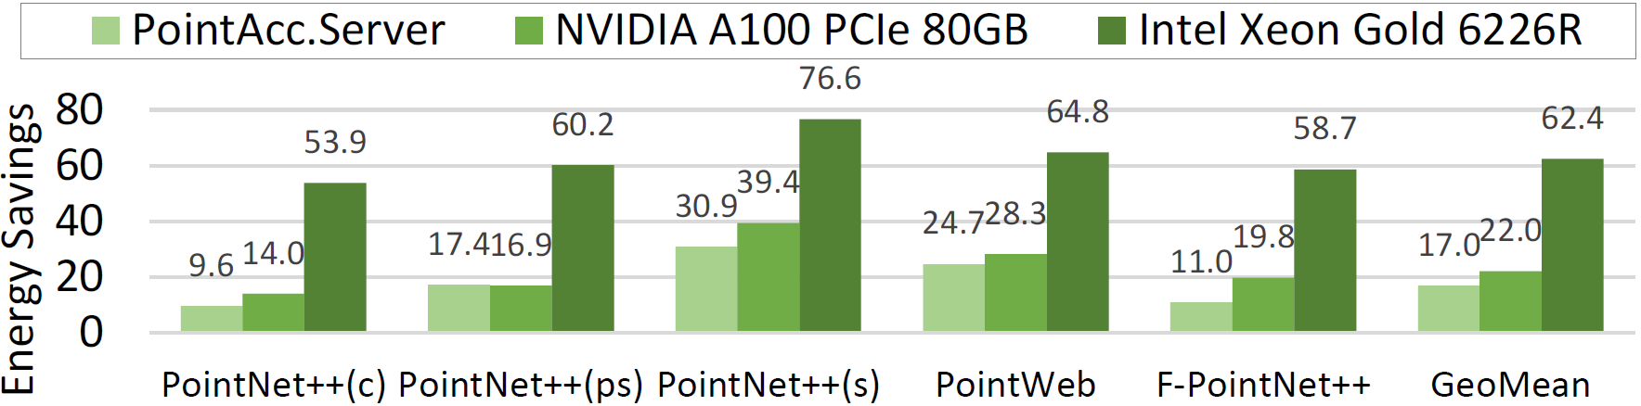
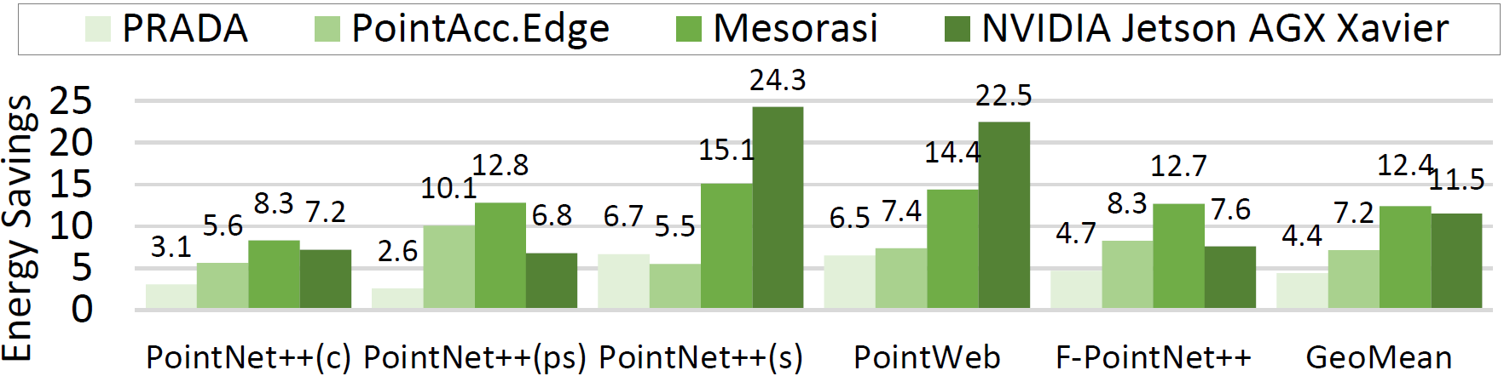

Experiment Result --- Energy Efficiency
At the server-level, FusionArch.Server achieves 17$×$, 22$×$, 62.4$×$ energy savings over PointAcc.Server, NVIDIA A100 GPU and Intel Xeon Gold 6226R
At the edge-level, FusionArch.Edge is 4.4×, 7.2×, 12.4×, 11.5× better than PRADA, PointAcc.Edge, Mesorasi and NVIDIA Jetson AGX Xavier
Notes:
The energy savings are shown in these figures. The benefits not only obtained from the reduced computation and memory access, but from the specialized architecture.

Slide 24
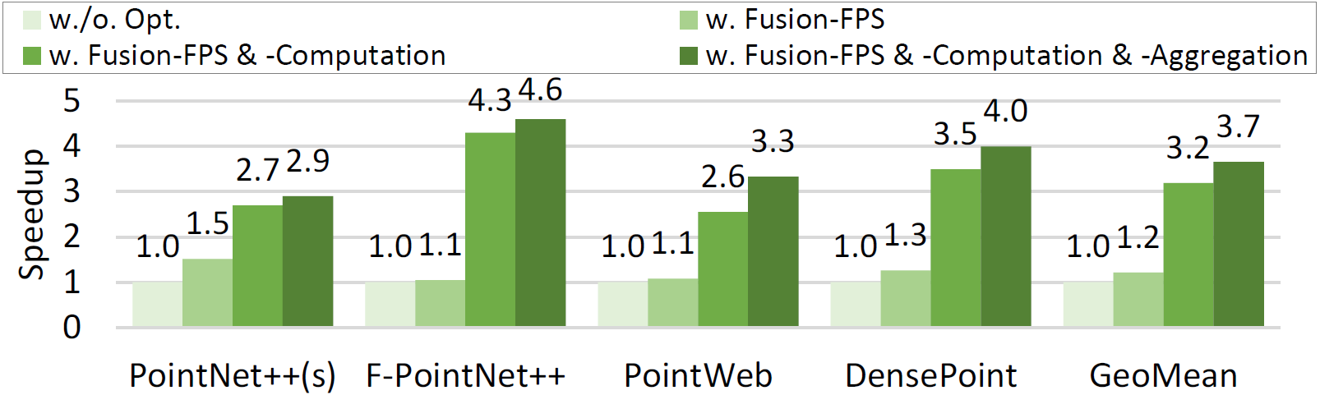
Experiment Result --- Ablation Study
At the edge-level, the performance is constrained by the limited computing power, therefore, the bottleneck alters to the feature computation
Xueyuan Liu / Shanghai Jiao Tong University
Notes:
We further conducted an ablation study under the edge-level configuration to evaluate the contributions of different schemes in our FusionArch. Due to limited resources, the bottlenecks commonly shift to aggregation and feature computation. This is why the average gain from Fusion-FPS is 1.2x, less than the expected. While the feature computation manifests a sharp speedup of 3.2x, attributed to the changed bottlenecks and intrinsic heavy workload of this stage.

Slide 25
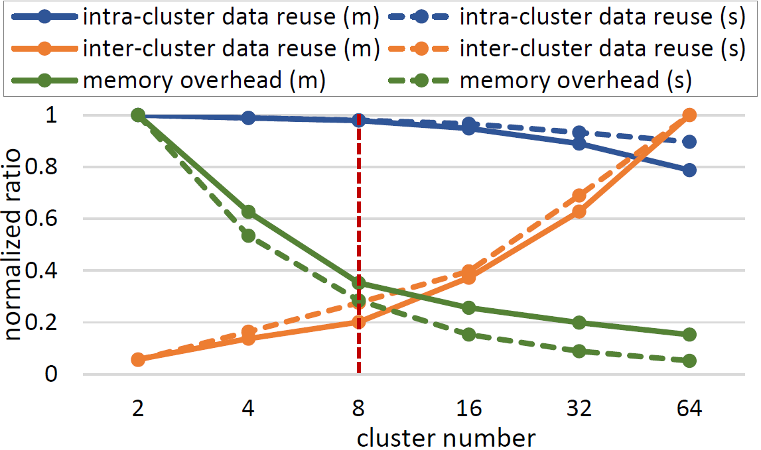
Experiment Result --- Exploration
Explore the number of clusters
The fewer the cluster count, resulting in better intra-cluster data reuse, but worse inter-cluster data reuse and lower memory overhead
Our goal: maximize intra-cluster data reuse, minimize inter-cluster data reuse, reduce memory overhead
Xueyuan Liu / Shanghai Jiao Tong University
Notes:
Then, we explore the number of clusters. A small number of clusters indicates a large cluster size, which can improve the intra-cluster data reuse, and reduce the intersection between clusters. This is also aligning with our goal. The experiment is conducted on 2 popular models, revealing that 8 clusters is a sweet spot between data reuse and memory overhead.

Slide 26
Conclusion
Fusion-FPS
Reduce FPS to only once, alleviate computational workload
Alter the execution flow, improve parallelism
Fusion-Computation
Identify the “Filling Point” and bypass the redundant computation for them
Fusion-Aggregation
Propose a balanced K-means clustering to capture the spatial locality of centroids while ensuring workload balance
Coalesce the redundant memory access for shared neighbors at the cluster level
FusionArch
A co-designed architecture, use LFT to coalesce redundant access
Xueyuan Liu / Shanghai Jiao Tong University
Notes:
In conclusion, this paper accelerate point-based PCNNs from multiple aspects. Specifically, we propose 3 fusion algorithms. Fusion-FPS not only reduces the sampling load but alter the execution flow, improving the parallelism of stages. Fusion-Computation bypasses the redundant feature computations of filling points. Fusion-Aggregation utilizes balanced K-means clustering to capture the spatial locality of centroids while ensuring workload balance among clusters. It further coalesces redundant access for shared neighbors at the cluster level. In support of these algorithms, we co-design the FusionArch architecture, which specially employs LFT to ease memory coalescing. Our evaluation shows that the proposed FusionArch outperforms the latest platforms in both server and edge-level, while achieving even better accuracy.

Slide 27
Thanks!
Q&A
WeChat: LiuXy_wx
E-mail: xueyuan_liu@sjtu.edu.cn
Personal Homepage: https://lauxy.github.io/
LinkedIn: https://www.linkedin.com/in/xueyuan-liu-2359042b2/
Xueyuan Liu / Shanghai Jiao Tong University
Notes:
Ok, that’s all. Thanks for your listening!

