Slide 1


Sava: A Spatial- and Value-Aware Accelerator for Point Cloud Transformer
Xueyuan Liu¹ (Speaker)
Zhuoran Song^{1∗}, Xiang Liao¹, Xing Li¹, Tao Yang², Fangxin Liu¹ and Xiaoyao Liang¹
¹Shanghai Jiao Tong University, ²Huawei Technology Co., Ltd.
* corresponding author
Notes:
Hello, everyone! My name is Xueyuan Liu, I come from Shanghai Jiao Tong University. It’s a great pleasure for me to report our research, namely Sava: A Spatial- and Value-Aware Accelerator for Point Cloud Transformer

Slide 2
Outline
Background and Challenge
Proposal (incl. Algorithm & Architecture)
Experiment Setup and Result
Conclusion
Notes:
This slide shows the outline of my talk

Slide 3
Point Cloud and Point Cloud Transformer
Point Cloud is a collection of unordered points scattered in 3D space, representing the geometry and attributes of the physical object.
Point Cloud Transformer is built upon the traditional point cloud neural network (PCNN), which primarily introduces transformer structures to replace feature extraction network or incorporate them as the back-end
Notes:
Firstly, let’s learn about some basic conceptions. The point cloud is a collection of thousands and millions of unordered points in 3D space, capturing the geometry and attributes of physical objects in the real world. The Point cloud neural network, abbreviated as PCNN, introduces deep learning into the point cloud to extract features. While the point cloud transformer is built upon this, it additionally introduces transformer structures to replace feature extraction network or incorporate them as the back-end. As shown in this figure, the paradigm of point cloud transformer can be divided into 2 parts, the front-end contains stages of traditional PCNNs, while the back-end is constructed on the transformer structure.

Slide 4
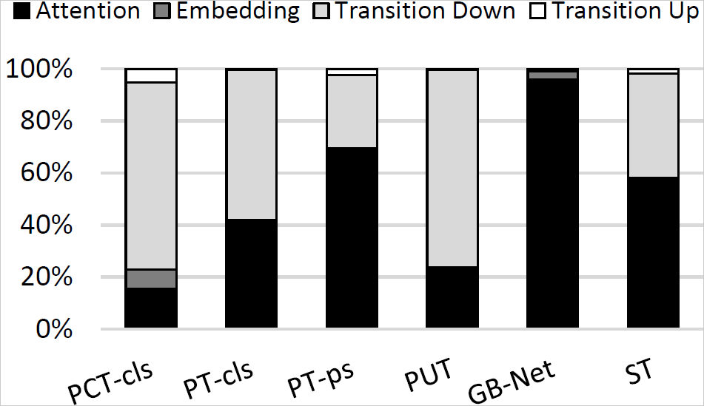
Challenge
Prior PCNN accelerators only focus on the front-end
The bottleneck of the point cloud transformer varies across different models
PT-ps, GB-Net, and ST are back-end dominant
Notes:
Despite the point cloud transformer achieving outstanding accuracy than traditional PCNNs, its performance remains to be improved. However, prior PCNN accelerators only focus on the front-end. For example, both Mesorasi and PRADA introduce approximation to accelerate the Multi-Layer Perceptron in the front-end. But the bottleneck of the point cloud transformer varies across different models, which is validated by experiments. As depicted in this figure, PT-ps, GB-Net and ST are back-end dominant.

Slide 5
Proposal
Goal: Consider both the front-end and the back-end together
Our Solution:
Use specialized hardware to accelerate the front-end
Use a hybrid pruning strategy to accelerate the back-end
Goal: Build a connection between the front-end and the back-end
Our Solution:
Leverage the spatial information obtained from the front-end to guide pruning in the back-end
Notes:
To tackle these challenges, we aim to consider both the front- and back-end of the point cloud transformer. Since existing PCNN accelerators have proposed several methods to accelerate the front-end, in this work, we simply use a specialized architecture to optimize the front-end, which is also orthogonal to the previous methods. For the back-end, we employ a hybrid pruning strategy to reduce the computational workload. Additionally, we tend to build a connection between the front- and the back-end, rather than leaving them as two independent parts. To be specific, we leverage the spatial information obtained from the front-end to guide pruning in the back-end.

Slide 6
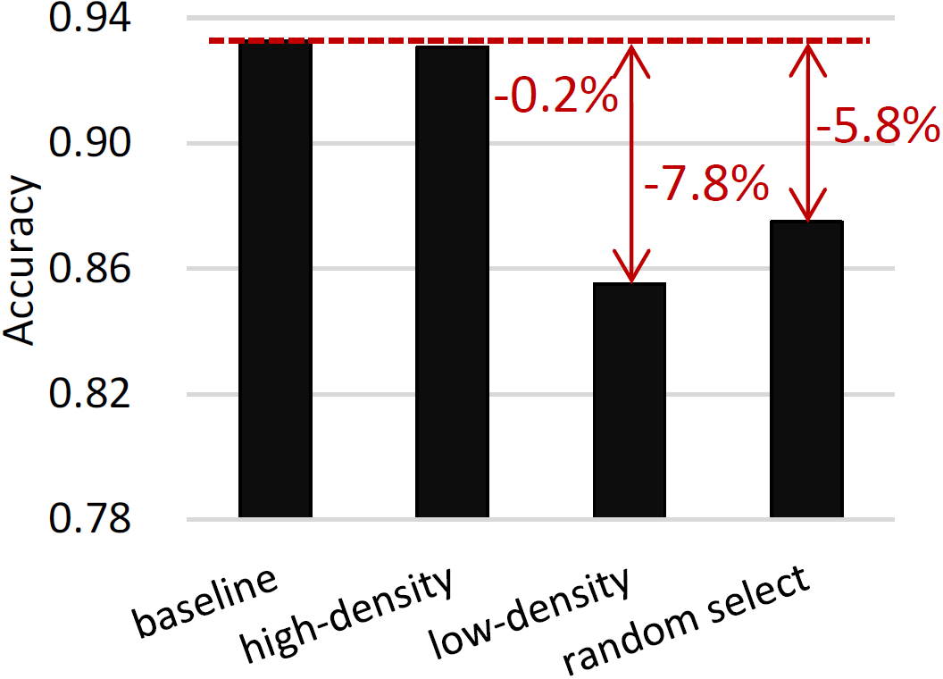
Spatial-Aware Pruning
Based on the non-uniform distribution of points, we assume the point within a high-density region exhibit less importance
Validate the assumption: prune 30% of points in high-density, low-density and randomly selected regions, observe their accuracy loss
The pruning should be spatial-aware
Notes:
Due to the non-uniform distribution of points, different regions exhibit various density. We suppose the high-density regions contain a lot of redundant information. The point within such region shows less importance, especially when we remove the point, the accuracy will not be significantly impacted. To validate this assumption, we conduct an experiment by pruning 30% of points in high-density, low-density and randomly selected regions, respectively. The result confirms that pruning the high-density regions only leads to a 0.2% accuracy loss compared to the baseline. Therefore, pruning should be aware of the spatial information.

Slide 7
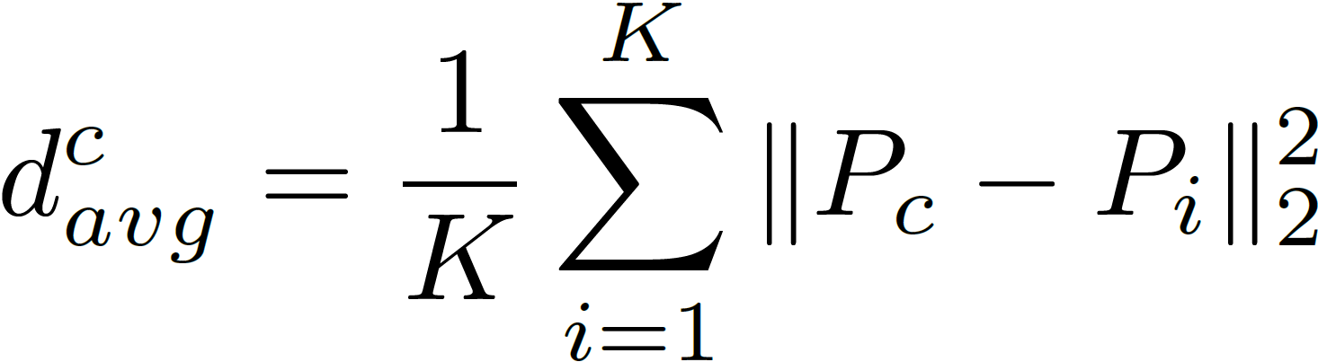
Spatial-Aware Pruning
Step 1: Use the average L2-distance between the centroid and its neighbors
Step 2: Rank the average distances to generate a Q-score vector
Step 3: Transpose the Q-score vector and obtain a K-score vector
Step 4: Multiply the Q-score and K-score vectors to form score matrix
Step 5: Binarize the score matrix based on the spatial pruning ratio
Notes:
Firstly, we should figure out how to measure point density of a region. We observe the denser the points are distributed, the average distance between the centroid and its neighbors becomes closer. Thus, we use the average L2-distance to quantify the density. To facilitate comparison across regions, we rank the distances and use orders to produce a Q-score vector. Since spatial information is utilized for the back-end pruning, we imitate the computing pattern of attention mechanism, transposing the Q-score to get a K-score vector, and multiplying them to form a score matrix. To guide pruning, we need to label the unimportant values and bypass their computations. Therefore, a binarization operation is performed and finally generating a spatial-aware pruning mask, named smask.

Slide 8
Value-Aware Pruning
Motivation: small values in the attention contribute less to the output
Step 1: Quantize Q and K into low precision
Step 2: Perform Softmax(GEMM(quant(Q), quant(K))
Step 3: Binarize the matrix to form a vmask
Notes:
Let’s proceed to the back-end. In value space, we notice that small values in the attention computation contribute less to the output features, which motivates us to prune small values. As shown in this figure, after the matrix Q and K generating within attention, we quantize them into low-precision, enabling a lightweight side path for pruning mask generation that does not significantly impact the performance of the critical path. The following step follows the computation pattern of attention, namely applying GEMM and softmax operations to the quantized matrices. Finally, another binarization is employed to create the value-aware pruning mask, termed as vmask.

Slide 9
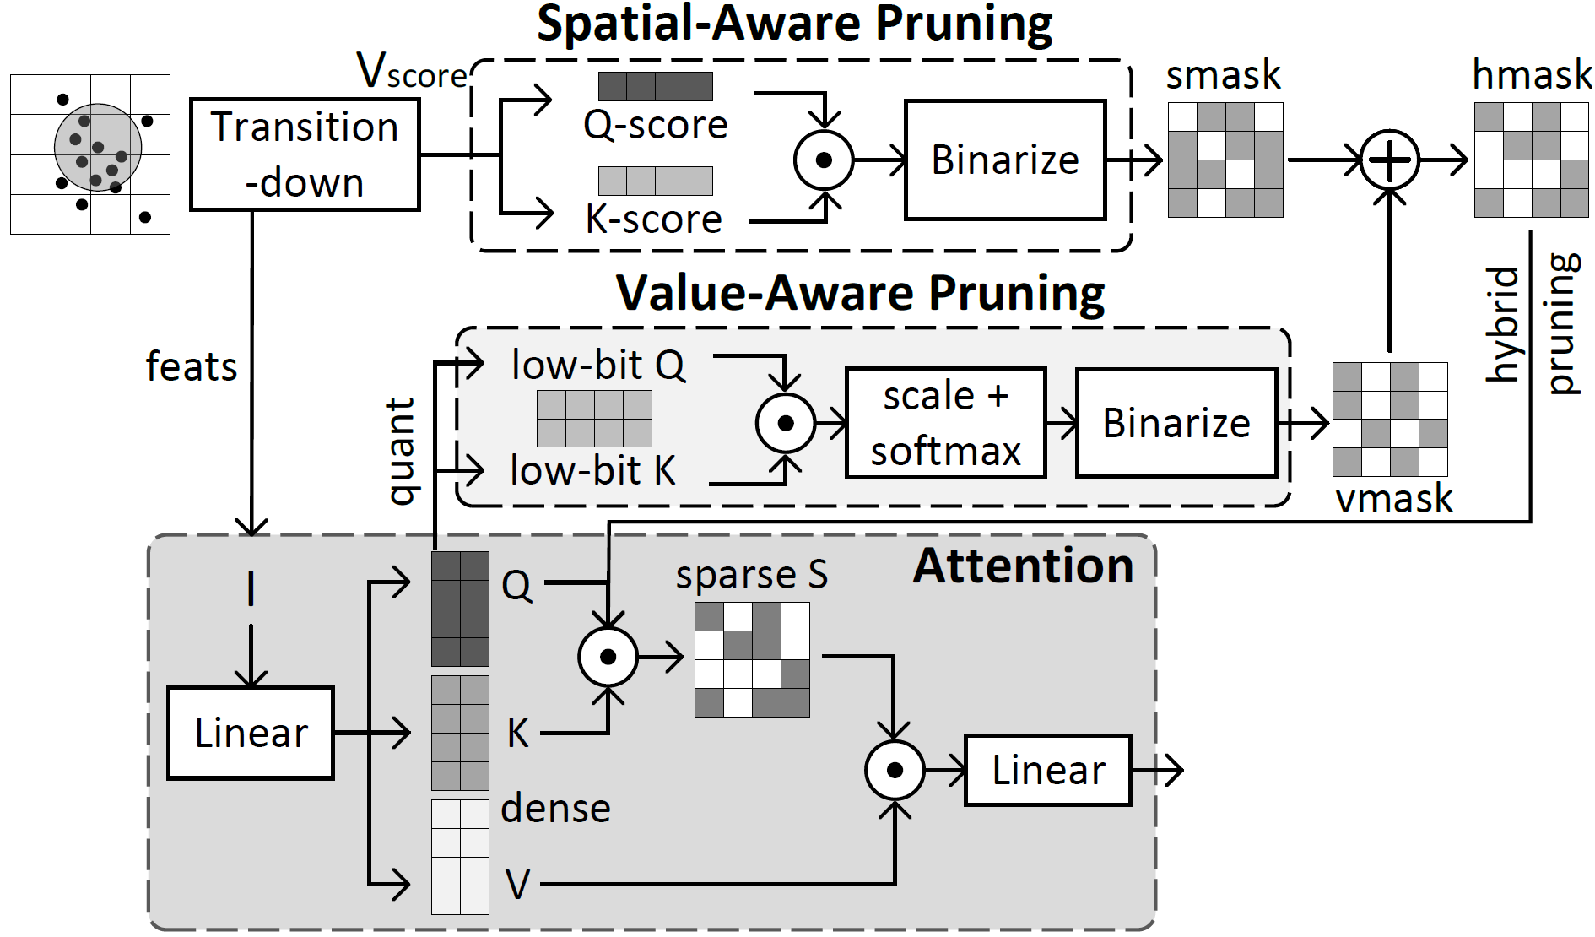
Hybrid Pruning
Hybridize the smask and vmask with corresponding weights to form a hybrid mask (hmask)
Use weights to adjust the contributions of smask and vmask to hmask as the number of layers increases
Notes:
Now, we have obtaind two masks based on different domains and pruning strategies, we can further fuse them together to create a hybrid mask, abbreviated as hmask. As the influence of smask declines with increasing layers, we use weights to adjust the contributions of smask and vmask to hmask at different layers. An overview of our pruning algorithm is illustrated in this figure.

Slide 10
Sava Architecture
Transition-Down Unit: Handle operations in the front-end
Tensor Unit: Used for feature computation and pruning mask generation
Mixed-precision systolic array for different quantization precisions
Notes:
In support of our spatial- and value-aware pruning algorithm, we co-design an accelerator architecture, named Sava. It primarily consists of 2 parts. Transition-down unit handles operations in the front-end, like FPS, KNN and grouping. It also takes responsibility for the score matrix generation. While the tensor unit is designed for feature computation and pruning mask generation. Considering that we incorporate different precisions in mask generation and feature computation, we specially introduce a mixed-precision systolic array.

Slide 11
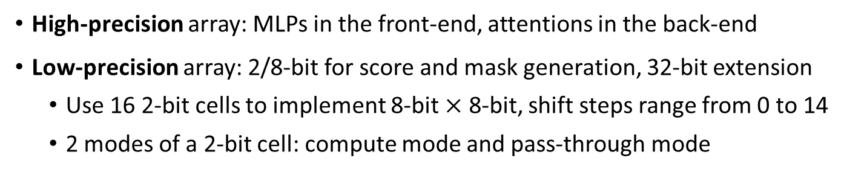
Sava Architecture --- Tensor Unit
High-precision array: MLPs in the front-end, attentions in the back-end
Low-precision array: 2/8-bit for score and mask generation, 32-bit extension
Use 16 2-bit cells to implement 8-bit $×$ 8-bit, shift steps range from 0 to 14
2 modes of a 2-bit cell: compute mode and pass-through mode
Notes:
The mixed-precision array is composed of a 2-bit array linked with a 32-bit array. The high-precision array is utilized for MLPs in the front-end and attentions in the back-end to ensure accuracy. The low-precision array supports GEMM operations with arbitrary precisions in power of 2, which can be implemented by combining multiple 2-bit cells and merging results using shift and add operations. For example, 8-bit multiplication can be implemented by merging 16 of 2-bit multiplications. In addition, the 2-bit cell possesses 2 mode, while the pass-through mode is designed to align data transfer latency with the 32-bit array. Notably, we connect the two arrays not only for a separate use, but join them as a whole, which means the 2-bit array can be treated as an extension for the 32-bit array. However, 32-bit multiplication consists of 256 2-bit multiplications. It’s not practical to use the same number of cells. Therefore, we pack 32 of the 2-bit cells and use them in a time-division multiplexing mode.

Slide 12
Sava Architecture --- Tensor Unit
How to skip computations based on hmask?
Decouple the register from the cell, allowing data to be routed to any cells
An example of QK --> S and SV, where S is in a sparse pattern
Notes:
There remains a critical question to be answered: How to skip less important values in the attention computation based on hmask? In both the 2-bit and 32-bit arrays, the register is decoupled from the cell, and fused as a register group, which holds both Q and K vectors. The register group is connected to all cells, allowing data to be routed to any of them. Let’s consider an example. Assume the position (i, j) in hmask is 1, the j-th cell of i-th row accesses the register group for j-th row of matrix K if the i-th row of Q has already been loaded. After the GEMM operation between Q and K, the result matrix S is in a sparse pattern. We keep S stationary and load dense vector V only for the cell with a non-zero value. In this way, all major computations in attention can be accelerated by skipping unimportant values guided by hmask.

Slide 13
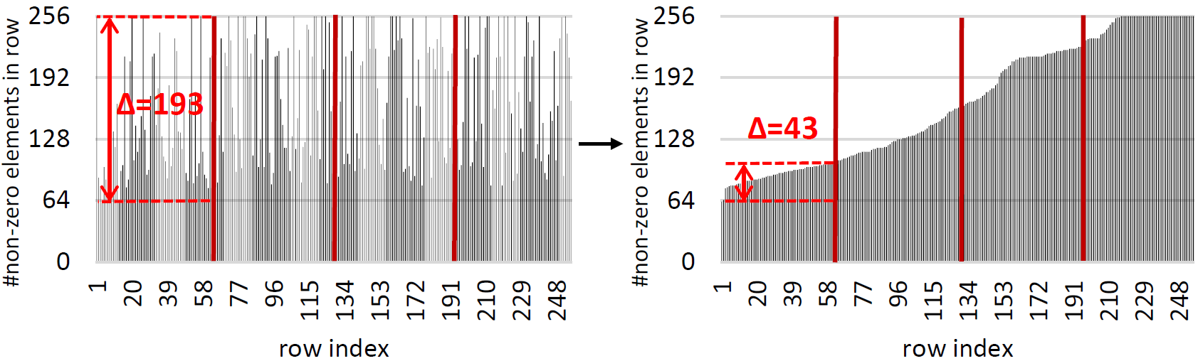
Sava Architecture --- Tensor Unit
Unstructured sparsity leads to workload imbalance
The rows with the most non-zero elements bottleneck the performance
Rearrange rows of hmask, packing the rows with similar sparsity for execution
Notes:
Inevitably, the unstructured sparsity introduces an uncertain number of zeros in each row. We conduct an experiment and observe a significant variation in the number of non-zero elements in each row. As shown in the left figure, the maximum difference in the 1st block reaches 193. When the block is scheduled to the array, the bottleneck occurs in the row with the most non-zero elements. Thus, the earliest row has to wait for the slowest one for a long time. To address this problem, we sort the rows of hmask based on the number of non-zero elements, and packs the rows with similar sparsity together for execution. After completing the feature computation, the results are written back in accordance with the sorting orders.

Slide 14
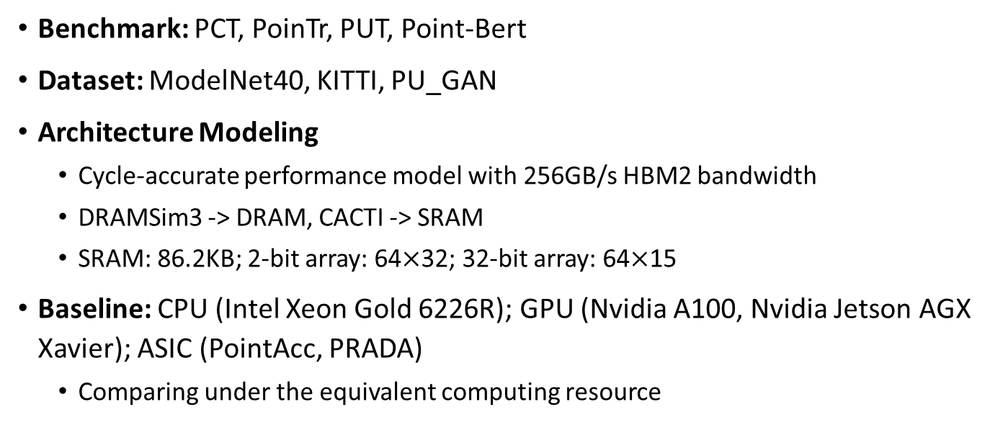
Experiment Setup
Benchmark: PCT, PoinTr, PUT, Point-Bert
Dataset: ModelNet40, KITTI, PU_GAN
Architecture Modeling
Cycle-accurate performance model with 256GB/s HBM2 bandwidth
DRAMSim3 -> DRAM, CACTI -> SRAM
SRAM: 86.2KB; 2-bit array: 64$×$32; 32-bit array: 64$×$15
Baseline: CPU (Intel Xeon Gold 6226R); GPU (Nvidia A100, Nvidia Jetson AGX Xavier); ASIC (PointAcc, PRADA)
Comparing under the equivalent computing resource
Notes:
Next, I’ll introduce our experiment setup. Our proposals are tested on 4 popular point cloud transformer models across 3 widely-used test set. To evaluate our Sava architecture, we develop a cycle-accurate performance model, incorporating DRAMSim3 as DRAM and using CACTI to model SRAM, ensuring a reliable simulation results. The hardware configurations are listed here, where the 2-bit array can be extended as a column of the 32-bit array, and our memory overhead is considerably lower than most prior works. We compare the Sava with CPU, GPUs and the latest ASICs under the equivalent computing resource for fairness.

Slide 15
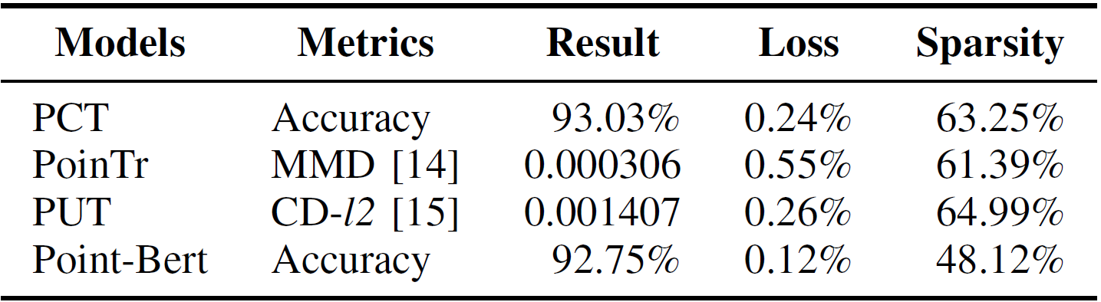
Experiment --- Accuracy
Our spatial- and value-aware pruning algorithm is implemented using PyTorch
Create significant sparsity in attention
Achieve negligible accuracy loss
Prune 59.03% values on average, substantially reduces computation
Notes:
This table illustrates the accuracy achieved by our hybrid pruning algorithm compared with the baseline of each model. It can be seen in the last column that our pruning algorithm creates significant sparsity in attention and achieves negligible accuracy loss. Our method prunes 59.03% values on average, indicating a substantial computational reduction.

Slide 16
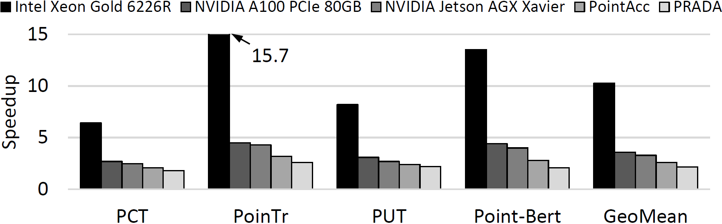
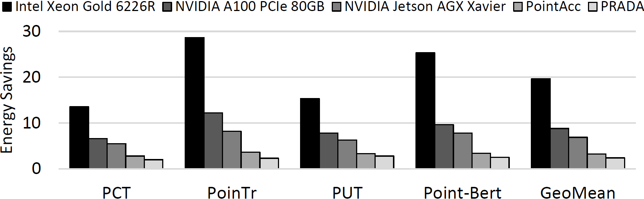

Experiment --- Performance
Performance: Sava achieves 10.3$×$, 3.6$×$, 3.3$×$, 2.6$×$, 2.2$×$ speedup over CPU, server GPU, edge GPU, PointAcc and PRADA
Energy Efficiency: Sava is 20$×$, 8.8$×$, 6.9$×$, 3.2$×$, 2.4$×$ better than CPU, server GPU, edge GPU, PointAcc and PRADA
Notes:
Sava achieves remarkable performance and energy efficiency compared with the baselines. As demonstrated in this figure, PoinTr and Point-Bert are the back-end dominant, especially PoinTr contains the most attention layers in both the encoder and decoder. Thus, these two models take fully benefit of our proposal.

Slide 17
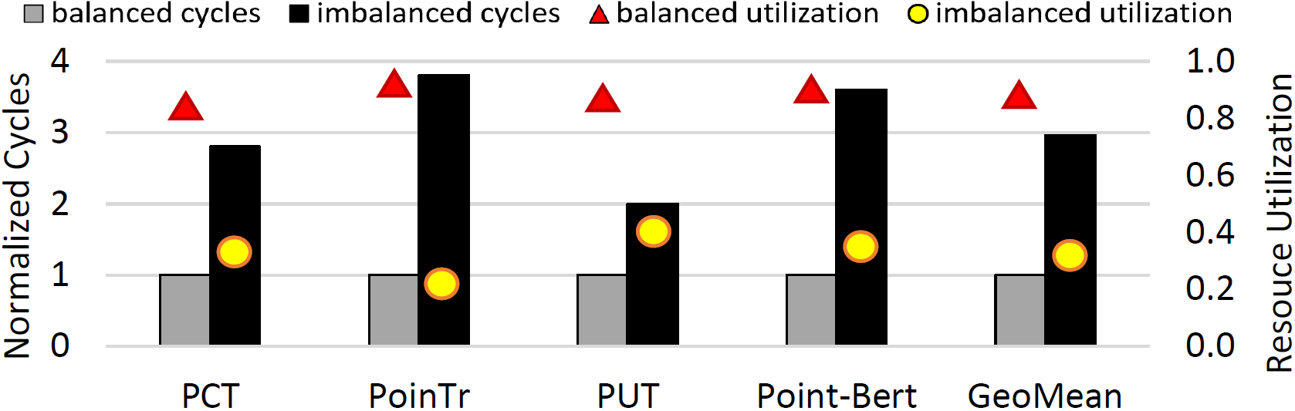

Experiment --- Exploration
Ablation Study of the Data Rearrangement Mechanism
The data rearrangement mechanism offers 2.9$×$ speedup and 57.45% improvement in resource utilization
Notes:
We further conduct an ablation study of the data rearrangement mechanism used to ensure workload balance. The results show that our method provides a 2.9x speedup and a 57.45% improvement in resource utilization, indicating the great potential of this mechanism.

Slide 18
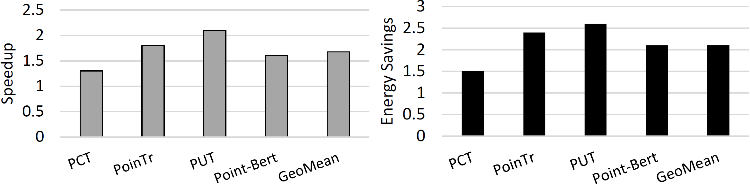
Experiment --- Exploration
The generality of Sava
Sava is orthogonal to several prior PCNN accelerators
Experiment to validate the effectiveness of Sava + PointAcc
Implementation: reserve MPU of PointAcc for the front-end, replace FoD dataflow with Gather-MatMul-Scatter dataflow, employ our mixed-precision systolic array for the back-end
Notes:
As mentioned before, Sava has potential to be orthogonal to several prior PCNN accelerators. To verify this claim, we designed experiments to validate the combination of Sava and PointAcc. The new system is implemented by reserving the mapping unit of PointAcc for the front-end, and utilizing our mixed-precision systolic array for the back-end. The results show that such a system achieves an average 1.7x speedup and 2.1x energy savings compared to individual Sava, indicating that Sava has good generality and can be seamlessly integrated with SOTA method.

Slide 19
Conclusion
A spatial- and value-aware hybrid pruning strategy
Spatial information derived from the front-end, guide pruning for the back-end
Value properties unveiled from the back-end, assist to prune in the back-end
Hybridize both pruning strategies to avoid over-pruning
Sava architecture
The first accelerator architecture for the point cloud transformer
Use a mixed-precision systolic array to support operations in different precision
Propose a data rearrangement mechanism to balance the workload
Notes:
In conclusion, this paper makes two major contributions. In aspect of the algorithm, we propose a spatial- and value-aware hybrid pruning strategy. It uses spatial information derived from the front-end to guide pruning for the back-end, which builds a connection between both ends of the point cloud transformer. Additionally, it considers value property from the back-end, which is utilized for the back-end pruning. We hybridize these two strategies to create a comprehensive and balanced pruning approach. To support our algorithm, we design the Sava architecture. As far as we know, Sava is the first work that accelerates the point cloud transformer. It employs a mixed-precision array to support various operations and skips unimportant computations based on the pruning algorithm. We further propose a data rearrangement mechanism to balance the workload under unstructured sparsity. The experiments show that our Sava outperforms the latest works while ensuring satisfactory accuracy and generality.

Slide 20
Thanks!
Q&A
E-mail: xueyuan_liu@sjtu.edu.cn
WeChat: LiuXy_wx
Personal Homepage: https://lauxy.github.io/
Xueyuan Liu / Shanghai Jiao Tong University
Notes:
Ok, that’s all. Thanks for your listening!

